Slide 1
Section 5: K Means Clustering

Slide 2
Principal Component Analysis
Section | Contents
5.1 | K Means Clustering Theory
5.2 | Code Walkthrough

Slide 3
Section 5.1: K Means Clustering - Theory

Slide 4
What is K Means Clustering?
K Means Clustering is a centroid based approach
User specifies the number of clusters K
User specifies initial guesses for the centres or means of each cluster
K Means Clustering employs an iterative approach (make a guess then improve) to determine the mean of each cluster and points associated with each cluster
Note: every data point is assigned to exactly one cluster
See Chapter 5 of Resources file for links for further information

Slide 5
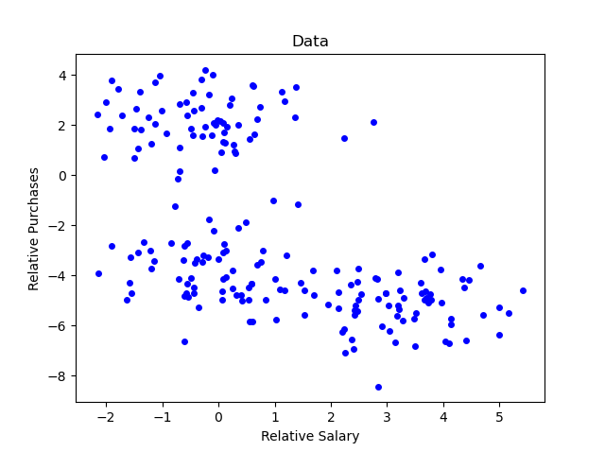
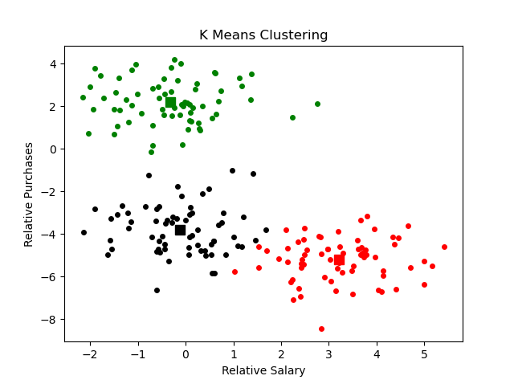
K Means Clustering
Example: Finding clusters in customer data

Slide 6
K Means Clustering: Basic Step
Start with dataset and current estimate for cluster means
For each point in dataset, determine closest cluster centre and assign point to that cluster
Recompute cluster means based on assignment of points in (A)
Go back to (A) and repeat process
A
B
C
A

Slide 7
K Means Algorithm
Assume N data points {X_{n}}
User specifies tolerance ε and number of clusters K and chooses cluster means {C_{k}} randomly
While change in cluster means is greater than ε
For X_{n} determine closest cluster centre C_{k} and assign that point to that cluster
Re-compute cluster means based on latest assignment of points
Compute change in cluster means
Typically, also specify a maximum number of iterations in while loop

Slide 8
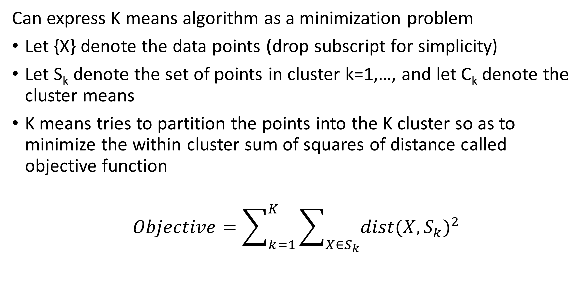
K Means Algorithm: Minimizing Objective Function
Can express K means algorithm as a minimization problem
Let {X} denote the data points (drop subscript for simplicity)
Let S_{k} denote the set of points in cluster k=1,…, and let C_{k} denote the cluster means
K means tries to partition the points into the K cluster so as to minimize the within cluster sum of squares of distance called objective function
$$Objective=\sum_{k=1}^{K}{\sum_{X∈S_{k}}{{dist(X,S_{k})}^{2}}}$$

Slide 9
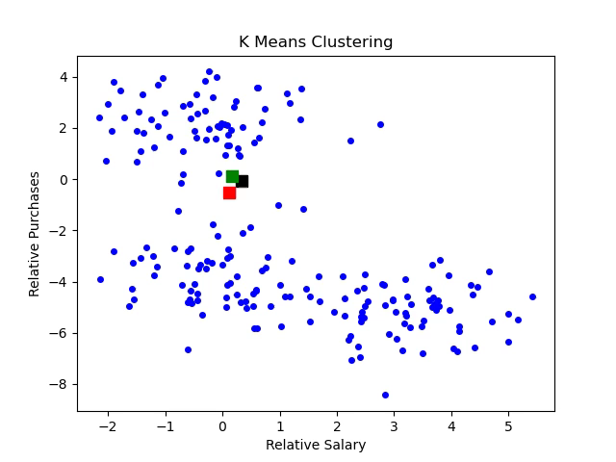
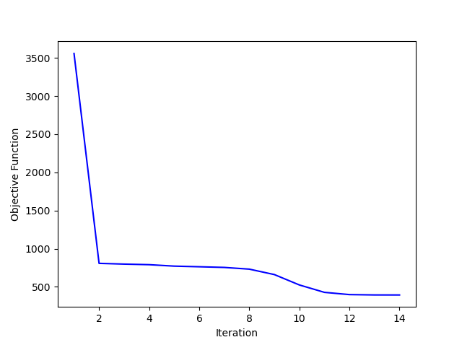
K Means Clustering: Results
Example: Finding clusters in customer data

Slide 10
K Means Clustering: Notes
Notes
Relatively straightforward to implement
User must specify number of clusters
User specifies distance measure
No guarantee that the objective function is minimized
Final cluster estimates depend on initial guesses
Cluster centre may get stuck between actual clusters
Despite issues, this is a good initial clustering algorithm to try

Slide 11
K Means ++ for Picking Initial Cluster Means
Pick point at random from dataset as first cluster mean
Loop for Cluster Means = 2, 3, …, K
For each point x not yet chosen, compute distance D(x) to nearest existing cluster mean
Among all distances, pick point at random using probability distribution proportional to [D(x)]²
After initial cluster mean, this approach tends to pick cluster means at the edges of the data set
Dataset
1st Mean
2nd Mean

Slide 12
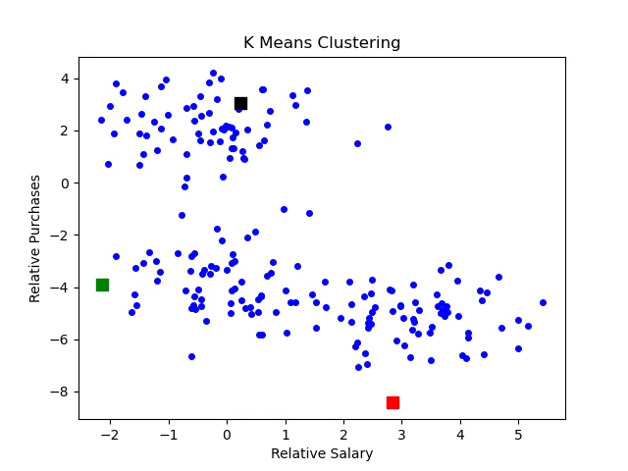
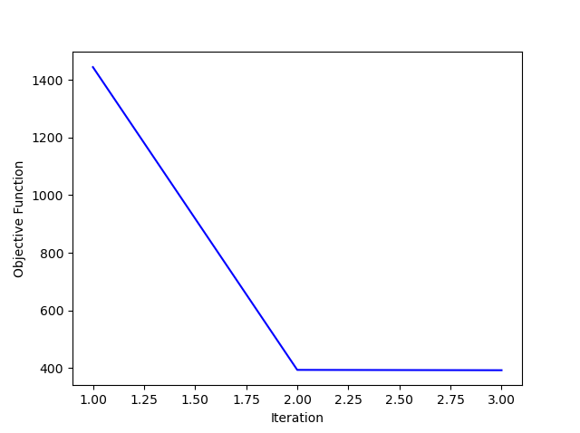
K Means Clustering: Results
Example: Finding clusters in customer data
Note: different initial cluster centres and rapid convergence
In this example, for simplicity, pick initial means 2 & 3 to be points with largest distances to nearest cluster mean

Slide 13
K Means Clustering: Notes
Notes:
Relatively straightforward to implement
Additional work to pick initial guesses is compensated by reduction in work in main K Means algorithm (fewer iterations required for convergence)

Slide 14
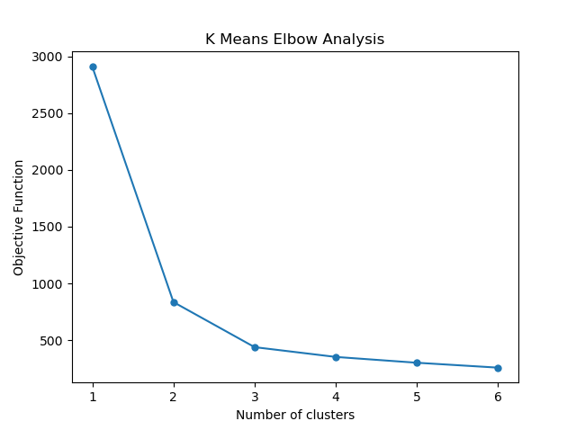
Determining Number of Clusters
In K means algorithms user specifies number of clusters
The K Means Elbow is a heuristic approach for determining number of clusters
Perform K Means for a range of number of clusters and plot final objective function value
Identify “Elbow” in plot to determine number of clusters
This is a heuristic approach so no precise rule about location of elbow
Choose number of clusters N so that if number is greater than N then, objective function does not decrease significantly
Elbow

Slide 15
Section 5.2: K Means Code Walkthrough

