Slide 1
Unsupervised Machine Learning

Slide 2
6.1 DBScan

Slide 3
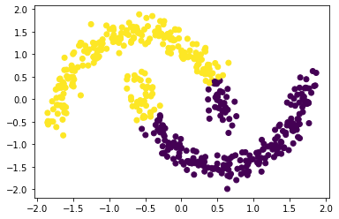
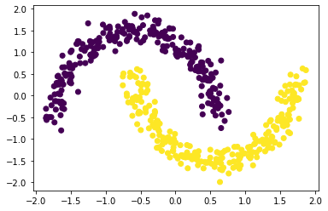
DBSCAN - Motivational Example
K Means with k=2 (left) vs DBSCAN with minPoints=3 and ε=0.3 (right)
Clusters obtained with DBSCAN make more sense

Slide 4
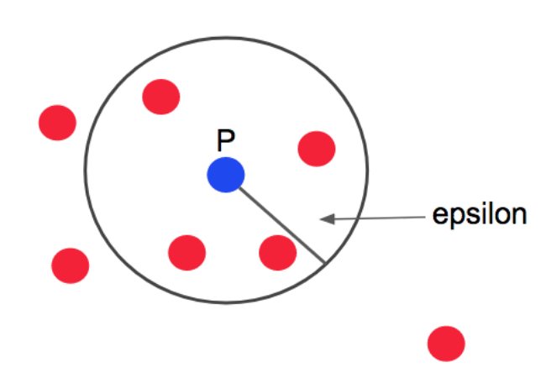
DBSCAN - Overview
Clusters are identified based on regions with high point density.
DBSCAN has 2 hyperparameters:
epsilon (ε): distance from a data point X_{i} used to locate its neighbours.
minPoints: minimum number of neighbours required to define a dense region.
X_{i} is a core point if it has at least minPoints neighbours
X_{i} is a border point if it has less than minPoints neighbours but it’s a core point’s neighbour
X_{i} is noise if it’s neither a core point or a border point
Example: if minPoints=4, P is a core point and the
red points in its neighbourhood are border points.
https://seongjuhong.com/2020-03-15pm-dbscan/

Slide 5
DBSCAN Algorithm
For each data point X_{i} not yet visited:
(1) mark X_{i} as visited
(2) find neighbours(X_{i}), all points that are <= ε away from X_{i}
(3) if X_{i} has at least minPoints neighbours, mark X_{i} as a core point and expandCluster(X_{i}), otherwise mark X_{i} as noise

Slide 6
expandCluster Algorithm
(1) remove X_{i} from neighbours(X_{i})
(2) for each neighbour X_{k} of X_{i}:
mark X_{k} as visited and add X_{k} to X_{i}’s cluster
find the neighbours(X_{k})
if X_{k} has at least minPoints neighbours, mark X_{k} as a core point and expandCluster(X_{k})

Slide 7

DBSCAN - Example
Movie shows the computation of clusters using DBSCAN with minPoints=3 and ε=0.3

Slide 8
DBSCAN - Advantages & Disadvantages
Advantages:
No need to specify number of clusters
Can find clusters of arbitrary shapes
Robust to outliers
Can be used to detect outliers
Disadvantages:
Can be difficult to choose appropriate ε and minPoints
Not entirely deterministic, assignment of border points depends on which order in which points are processed
Some points may not be assigned to any cluster (can be good or bad)

