Slide 1
Unsupervised Machine Learning

Slide 2
Section 8: Principal Component Analysis

Slide 3
Principal Component Analysis
Section | Contents
8.1 | PCA – Theory
8.2 | PCA Code Walkthrough
8.3 | Application to MNIST Dataset

Slide 4
Section 8.1: Principal Component Analysis - Theory

Slide 5
Principal Component Analysis (PCA)
Machine learning problems may deal with data in 1000s of dimensions
More dimensions generally means slower computation
PCA reduce dimensions by retaining information in directions of most relevant principal components
Typically choose # of principal components to capture specified amount of variance
Example 1: 4 data points in 2d. Since data points in all directions, both dimensions are relevant
Example 2: 4 data points in 2d. Data points nearly align with black line. In this case one can project data onto the black line and reduce to one dimension

Slide 6
PCA Algorithm
PCA Algorithm:
Start with data matrix X (number of features x number of samples)
Compute Singular Value Decomposition of X - Xmean
Variance is sum of squares of singular values
Choose first n singular values/components so partial variance captures specified percentage
Compute reduced X – Xmean using first n components
Add back Xmean

Slide 7
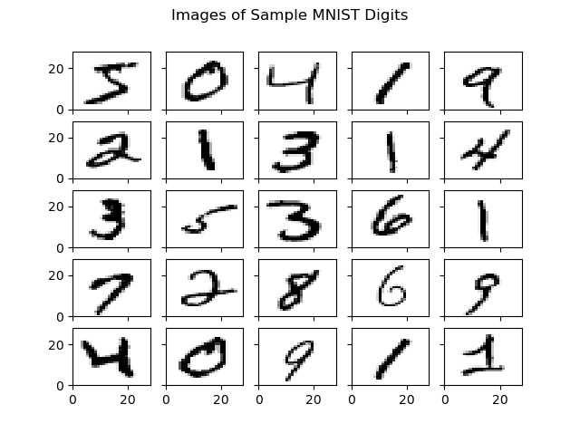
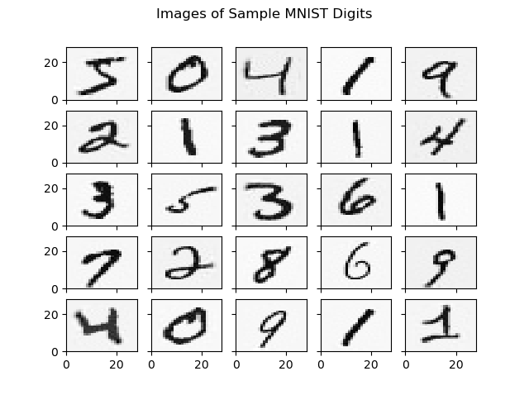
PCA for MNIST Data Set
% Variance to be Captured | Number of Components
100.0 | 784
99.9 | 476
99.0 | 323
90.0 | 84
Apply PCA to MNIST data set with 6000 images
Data matrix X: 784 entries for each sample
Original First 25 Images
First 25 Images Keeping Only 99% Variance

