Slide 1

Power BI Project
Columbia Asia Hospital Project

Slide 2

Agenda
Problem Statement
Data Description
Objective Key Metrics and Visualizations
Subjective Question for Insights

Slide 3
Problem Statement
The Columbia Asia Hospital is looking for key insights for the following objectives:
Assess the hospital's revenue generation
Insights about suitable departments for new hires
Strategies suggestions for patient discounts

Slide 4
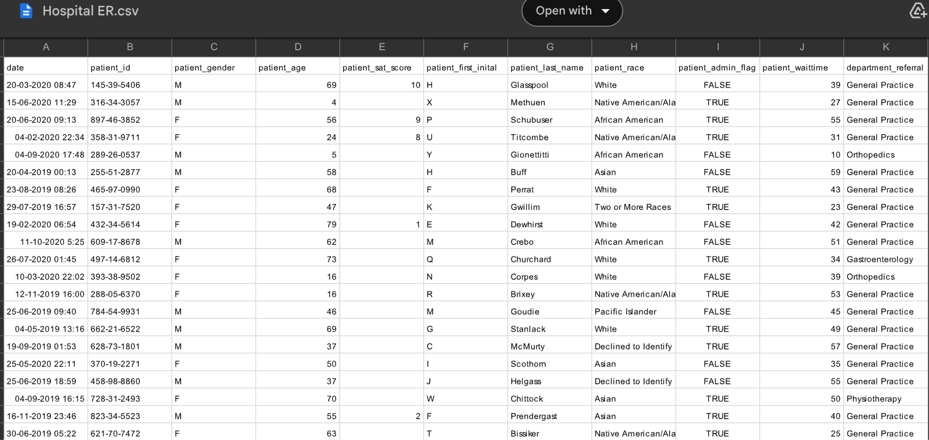

Slide 5
The image above displays details about Columbia Asia Hospital data, including:
Date :- This column contains date and time information without specifying AM or PM. The format is DD-MM-YYYY HH:MM.
Patient_id :- Each patient is assigned a unique identifier, which seems to be in the format 124-62-3289.
Patient_gender :- This column records the gender of the patient, denoted by 'M' for male and 'F' for female.
Patient_age :- The age of the patients is listed in years.
Patient_first_initial :- This column contains the first initial of the patient's first name.
Patient_last_name :- The surname of the patient is listed in this column.
Patient Sat Score: It seems to represent a satisfaction score given by or for the patient. However, the scores are single-digit, and it's not clear what the scale is.
Patient_race:- The racial or ethnic background of the patient is recorded here, with categories such as 'White', 'African American', 'Asian', 'Native American/Alaska Native', and 'Two or More Races'.
Patient_admin_flag:- This column contains boolean values ('TRUE' or 'FALSE') which might indicate whether the patient was admitted or some other administrative flag.
Patient_waittime:- Appears to indicate the time the patient waited, possibly in minutes, before being seen or processed.
Department_referral:- This column lists the department to which the patient was referred, with entries such as 'General Practice', 'Orthopedics', 'Gastroenterology', or 'None' indicating no referral.

Slide 6
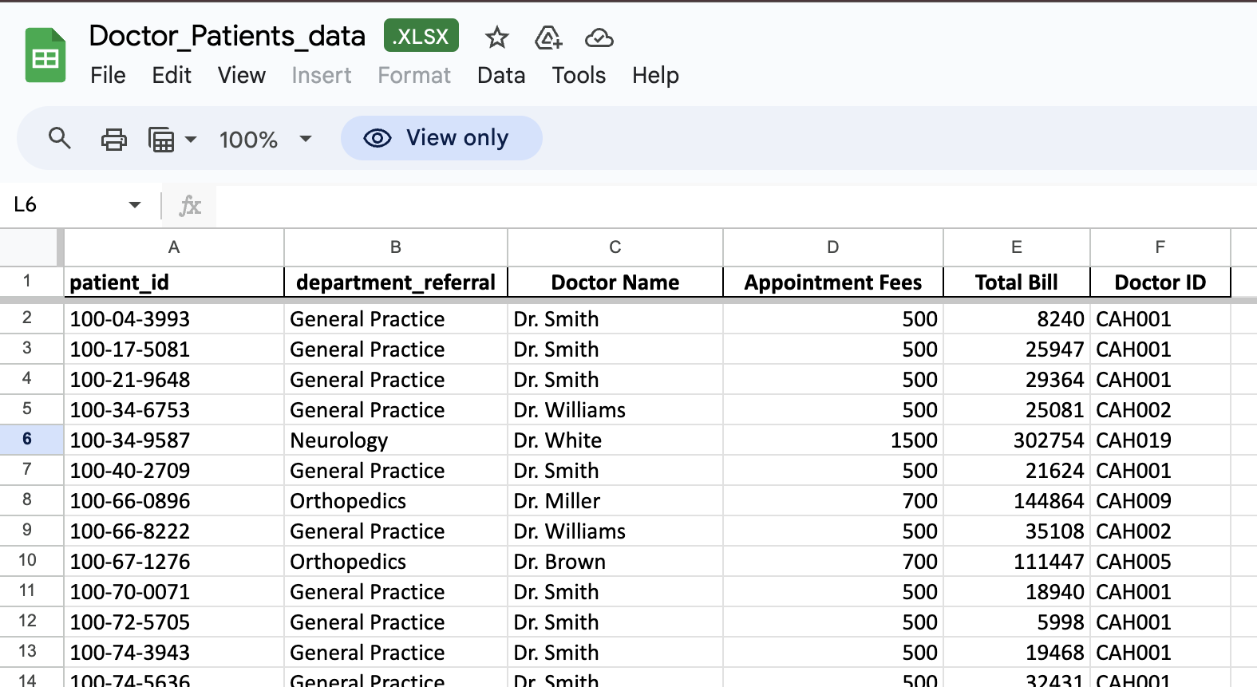

Slide 7
The image above displays details about Columbia Asia Hospital data, including:
Patient_id:- Each patient is assigned a unique identifier, which seems to be in the format 124-62-3289.
Department_referral:-This column lists the department to which the patient was referred, with entries such as 'General Practice', 'Orthopedics', 'Gastroenterology', or 'None' indicating no referral.
Doctor Name:-Identifies the doctor who attended each patient.
Appointment Fees:-The cost charged for a doctor's consultation.
Total Bill:- The overall amount billed to the patient, including all services and charges.
Doctor ID:- Each doctor is assigned a unique identifier, which seems to be in the format CAH001.

Slide 8
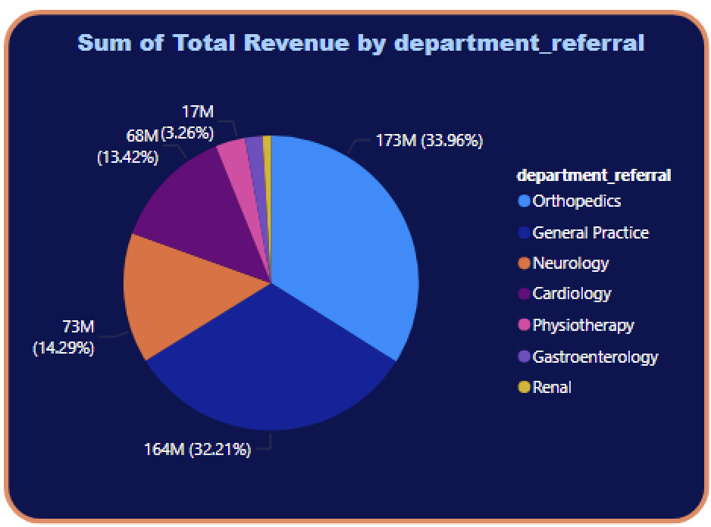
Revenue Generated by different Departments
The pie chart shows that revenue generated by Orthopedics department is highest i.e 173 M followed by General Practice i.e 164 M . And Revenue generated by Renal department is lowest.

Slide 9
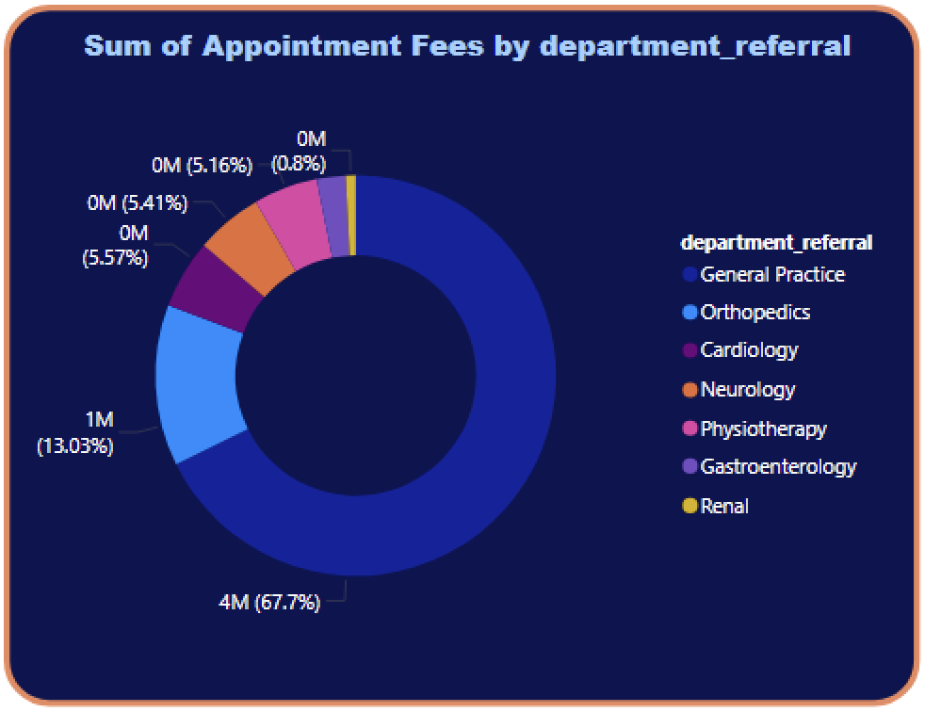
Appointment Fees of each department
From this chart we can clearly see that appointment fees charged by General Practice department is highest followed by Orthopedics department. And appointment fees charged by Renal department is lowest.

Slide 10
Strategies and Suggestions to provide discount to patients
To create effective discount strategies for patients, it's essential to consider various factors like patient demographics, treatment types, and frequency of visits. Here are several strategies that can be implemented:
1. Loyalty Program :- Reward frequent patients with discounts after a certain number of visits or treatments.
example: After every 5 visits, offer a 10% discount on the next appointment.
Benefit: Encourages repeat visits and enhances patient loyalty.
2. Referral Program :- Provide discounts to patients who refer others to the hospital or clinic. It will benefit by increasing new patient acquisition through word-of-mouth marketing.
example: Give a 15% discount on the next appointment when a patient successfully refers a new patient.

Slide 11

3. Early Payment Discounts :- Offer a discount for patients who pay their bills early.This will benefit the hospital by improving the cash flow and reducing accounts receivable.
example: Provide a 5% discount for payments made within
5 days of receiving the bill.
4. Seasonal Promotions :- Implement discounts during specific times of the year when patient visits might be lower (e.g., summer or holiday seasons).This will benefit by driving traffic during slower periods and helps manage patient volume.
Example: Offer a 20% discount on health checkups during winter
holidays.
5. Bundled Discounts:- Offer discounted packages for patients who need multiple treatments or services.This will benefit by encouraging patients to commit to lon
g-term treatment plans
and increase overall revenue per patient.

Slide 12
6. Group Discounts:- Provide discounts for families or groups who schedule appointments together.This will benefit the hospital by group visits and improves the clinic's utilization rates.
Benefit: Attracts group visits and improves the clinic's utilization rates.
7. Senior and Student Discounts:- Offer specific discounts to seniors, students, or other demographics.This will help by Building goodwill with specific demographics and fosters long-term relationships.
Example: Provide a 15% discount on appointments for patients over 60 or students with valid IDs.
8. First-Time Patient Discount:- Attract new patients by offering a discount on their first visit.This reduces the barrier to entry and attracts new patients.
Example: 20% off for first-time consultations or treatments.
10. Membership Program:- Introduce a subscription-based membership that provides patients with regular discounts or services. This benefits by ensuring recurring revenue while offering value to frequent patients.

Slide 13
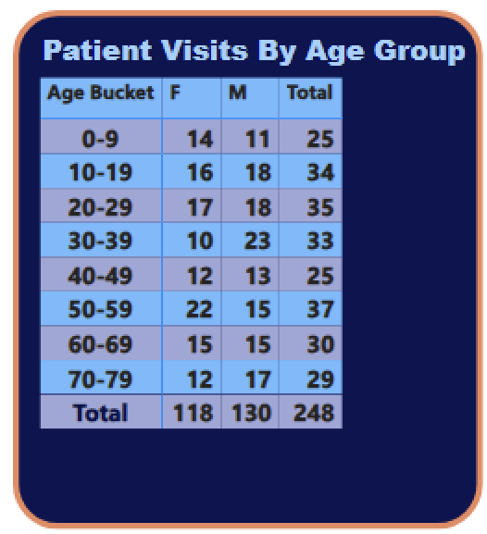
No. Of Visits by Age Groups
From this data it is clearly visits that number of visits of patients for age bucket of 50-59 is highest followed by patients in the age range of 20-20 .

Slide 14
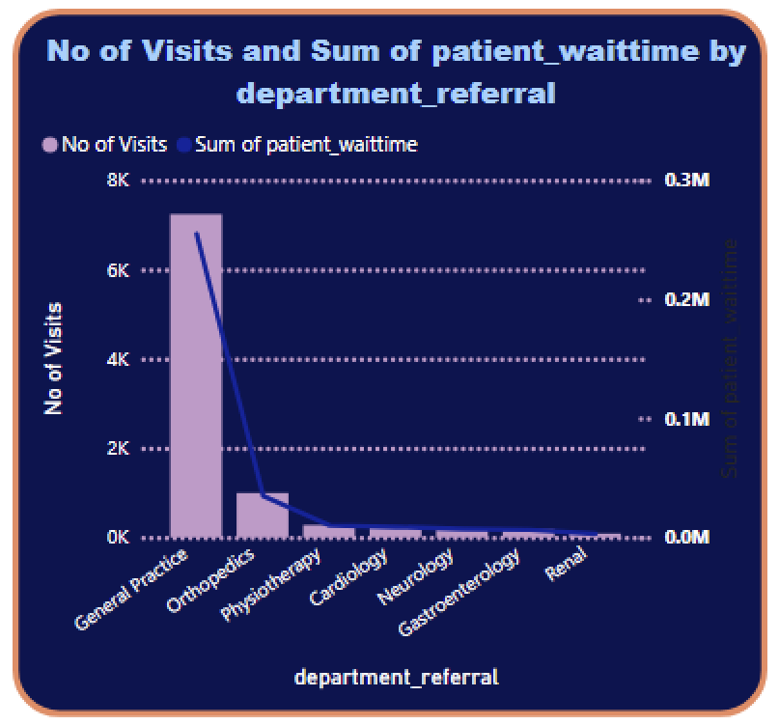
No. of visits by department
From this bar chart we can see that number of visits is greatest in General Practice department followed by Orthopedics Department. Also the Patient wait time is greatest in General Practice department followed by Orthopedics , which is justifiable.

Slide 15
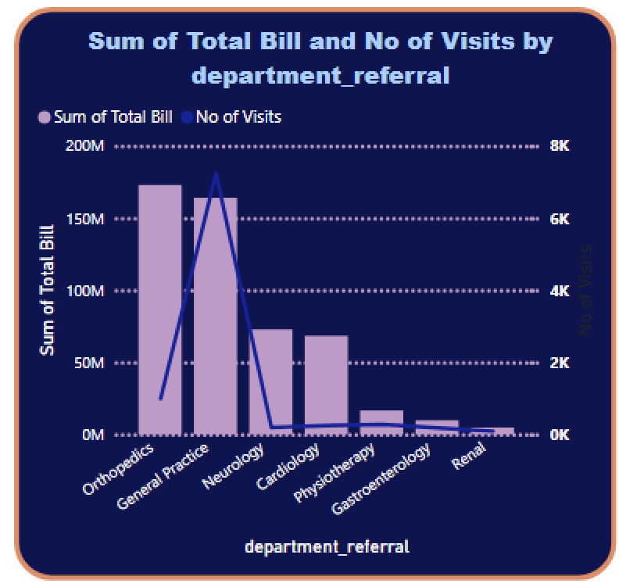
Revenue by Department
From this data we can clearly see that Revenue generated by Orthopedics department is greatest, followed by General Practice Department. Though number of visits in General Practice department is highest i.e 154 M followed by Orthopedics department .

Slide 16
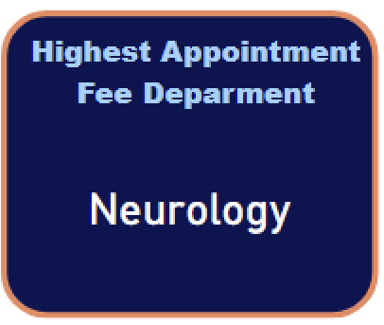
Department Having Highest Appointment Fees
From the data , we can see that Neurology department has the highest appointment fees i.e 1500 . Though the overall revenue generated and number of patients visits is very less.

Slide 17
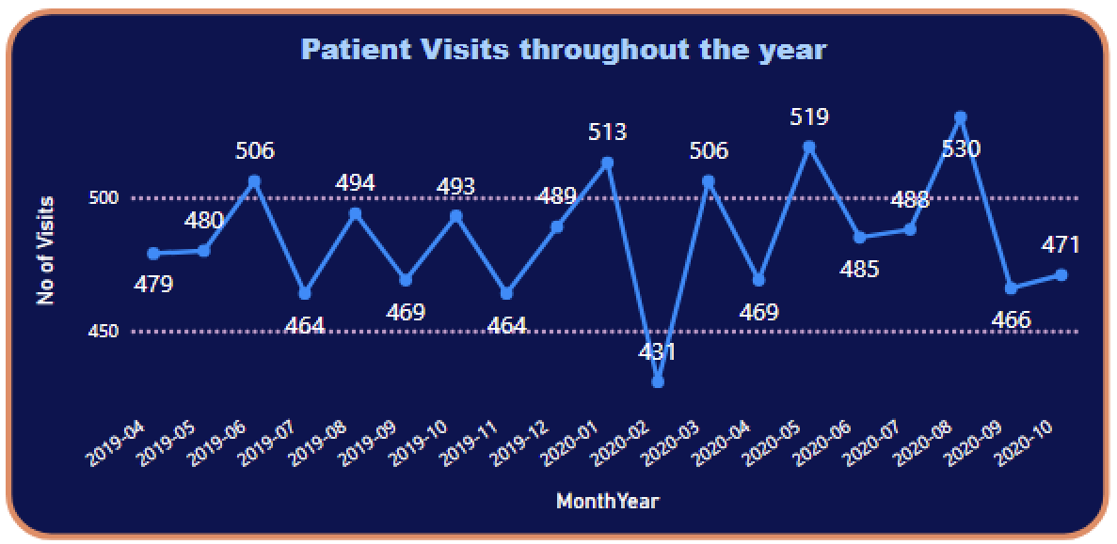

Slide 18
Patient trend throughout the year
From the above line chart we can see that number of patient visits throughout the year follows the zig-zag pattern, which first increases and then decreases in due time. Number of patients visits is greatest in August 2020 i.e 530 patients and lowest in March 2020 i.e 431 patients

Slide 19
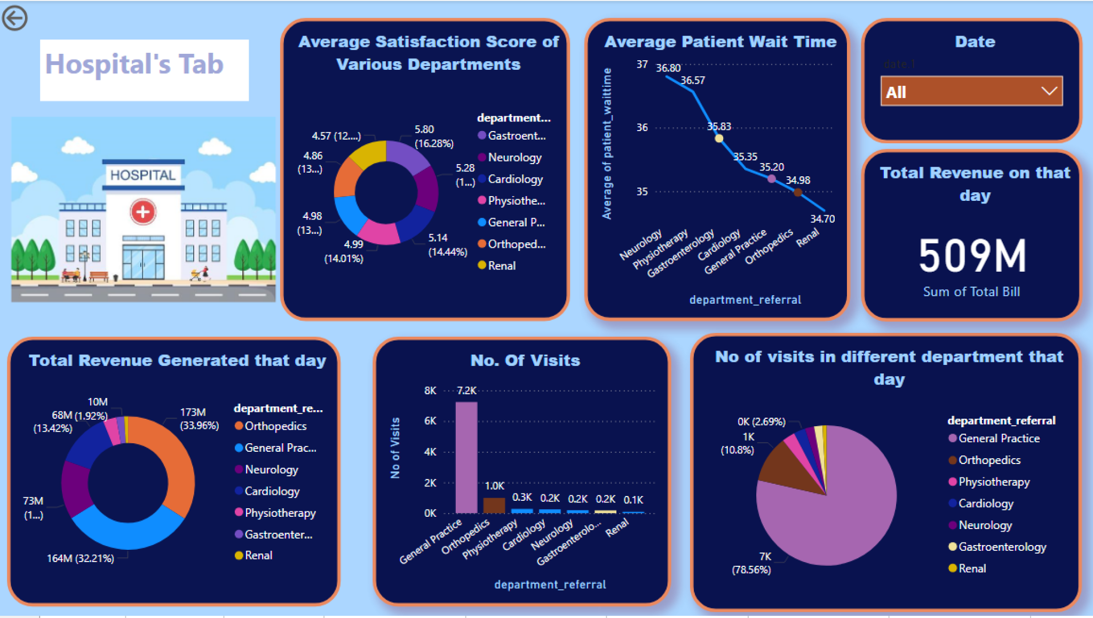
Hospital Tab

Slide 20
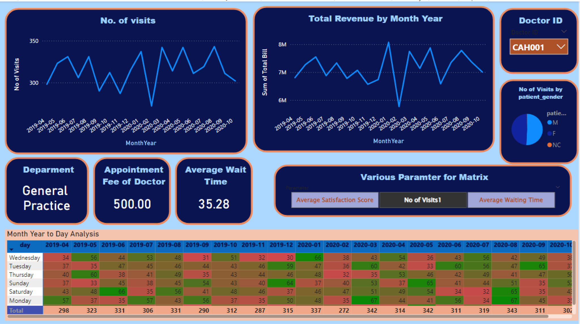
Patient’s Tab

Slide 21
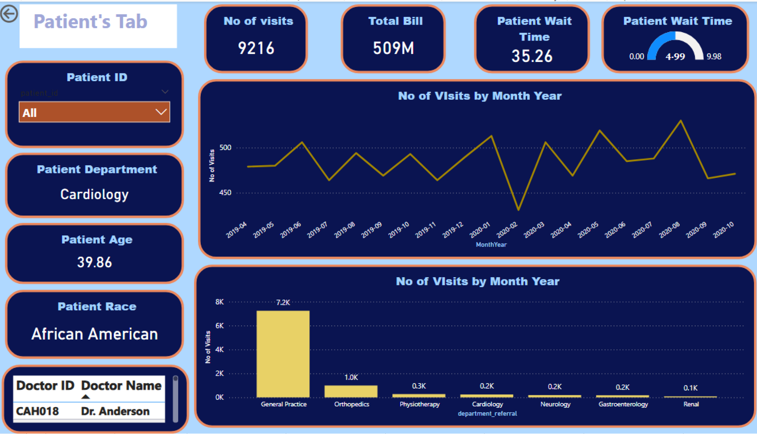
Doctor’s Tab

Slide 22


