Slide 1
Deep Reinforcement Learning for Computer Games
Sean Yin, Chung-En Yu
Dec 13, 2022
Notes:
4 mins for presentation & 1 min for Q&A session

Slide 2
Content
Project Motivation/Goal
Approach/Solution
DQN
A2C
Results/Demo
Q&A

Slide 3
Motivation / Goal
Motivation
Neural Networks + Reinforcement learning → DQN, A2C
The first deep reinforcement learning is to play Atari game.
Playing Atari with Deep Reinforcement Learning, Volodymyr Mnih, Koray Kavukcuoglu, David Silver, Alex Graves, Ioannis Antonoglou, Daan Wierstra, Martin Riedmiller
Goal
Implement the code from scratch : build and train DNN based on Atari game

Slide 4
Deep Reinforcement Learning
On-Policy | Off-Policy
Policy Gradient, Actor Critic (AC) | DQN, Double DQN Proximal Policy Gradient
Off-policy: can train NN based on data collected from different policy.

Slide 5
Double DQN

Slide 6
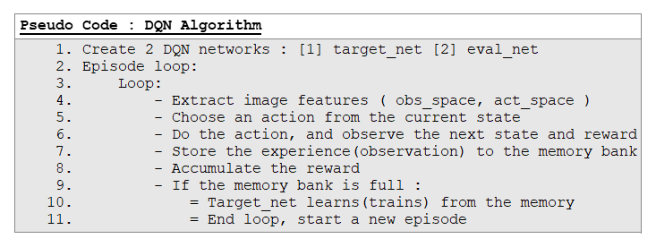
Approach/Solution

Slide 7
env
state
target_net
eval_net
choose random exp
state, action
mem
state, action
(train)
(train)
reward
store batch exp in mem
q_target
q_eval
reward
q_value after batch_state training
q_value after batch_state training
loss
* exp includes: state, action, reward

Slide 8
1 experience
(state, action, reward, next_state)
1 experience
(state, action, reward, next_state)
1 experience
(state, action, reward, next_state)
1 experience
(state, action, reward, next_state)
mem
…
a batch of experience
* experience = ‘transition’ variable in the code
1 experience is a 1D array

Slide 9
AC

Slide 10
Actor Critic
Critic:
Value Function served as a baseline to reduce the variance.
Shared Common features map between actor and critic to reduce the bias of the critic.

Slide 11
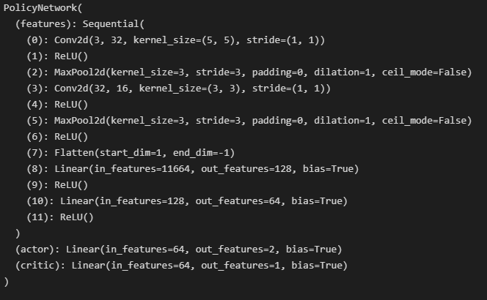

Slide 12
Simulation Setups

Slide 13
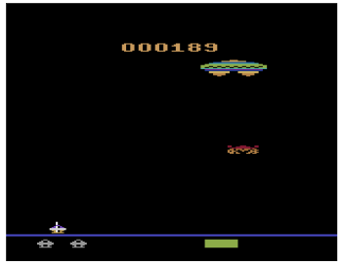
Atari - Assault v4
0: NOOP
1: FIRE,
2: UP
3: RIGHT
4: LEFT
5: RIGHTFIRE
6: LEFTFIRE
State | Image (210 x 160) x RGB (3)
Action | Discrete (7)
Reward | Score

Slide 14
Results

Slide 15
Results - Double DQN vs. A2C
Double-DQN
AC
Resources:
RTX 3080 10 G

Slide 16
Conclusion

Slide 17
Conclusion
Project novelty and difficulty:
We built and trained two of the most popular deep reinforcement learning algorithm from scratch.
Demo:
Two type of agents are trained to learn the optimal policy.

Slide 18
Q&A

Slide 19


