Slide 1
ManeFrame File Systems
Workshop Jan 12-15, 2015
Amit H. Kumar
Southern Methodist University

Slide 2
General use cases for different file systems
$HOME
  To store your programs, scripts etc.
  Compile your programs here.
  Please DO NOT RUN jobs from $HOME, use $SCRATCH instead
$SCRATCH/users/$USER (~750TB) & $SCRATCH/users/$USER/_small(~250TB)
  Primary storage for all your jobs.
  Volatile file system, backup your important files as soon as job completes.
$LOCAL_TEMP/users/$USER
  Auto mounted, storage limited.
  Available only on compute nodes
  Clean up after job completion.
$NFSSCRATCH
  Premium space for special application, needs approval before requesting access.

Slide 3
Lustre Overview
Lustre: $SCRATCH
  A parallel distributed file system mostly used on large scale clusters. It is primarily a object based storage as opposed to file based storage.
Key Features:
  Scalability to thousands of nodes
  Performance through put of single stream and parallel I/O.
  POSIX Compliant.
Components:
  Meta Data Server: MDS
  Object Storage Server: OSS
  Object Storage Target: OST

Slide 4
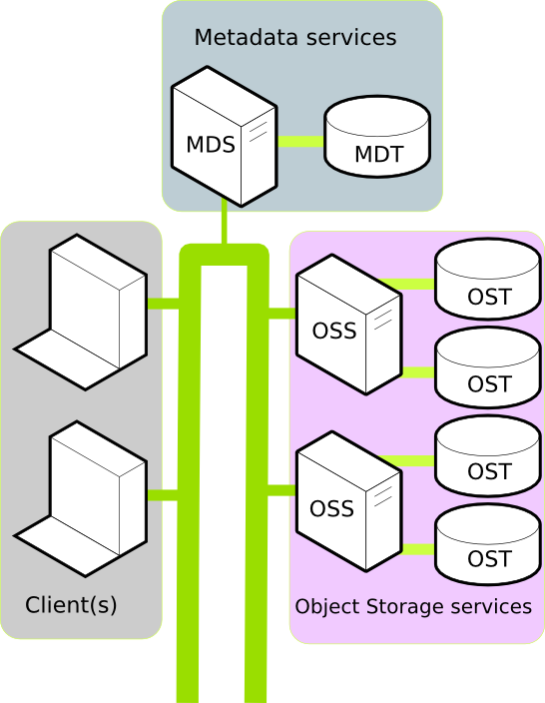
Lustre Components
ManeFrame
(836.889m files)
12 - OSS
77 - OST
2 MDS
Where 1 is in standby mode

Slide 5
Lustre File Operation
When a user requests, access to a file or a file creation on Lustre file system, it requests associated storage locations from the MDS.
And then all I/O operations occur directly between OSS’s and OST’s, without involving MDS.

Slide 6
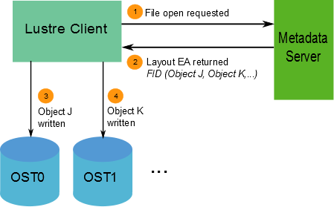
File create operation

Slide 7
Lustre File Striping
Files on Lustre can be striped such that, a file is split into stripes/segments and are stored on different OST’s, for example:
File-A
Stripe-1
Stripe-2
Stripe-3
Stripe-4
OST 0
OST 1
OST 2
OST 3

Slide 8
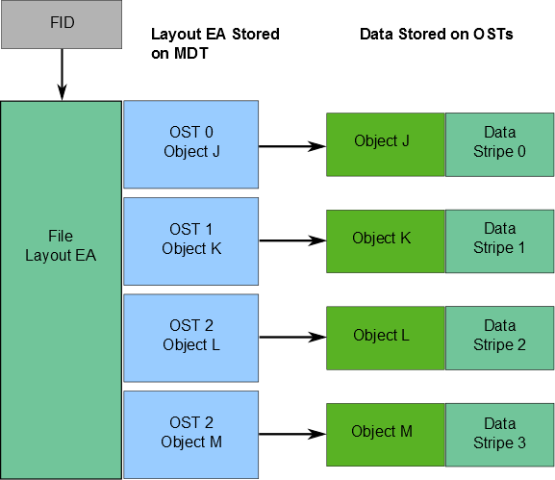
File Layout

Slide 9
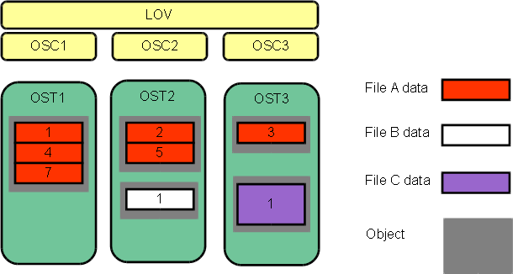
Example of layout of multiple files on OST’s

Slide 10
Lustre user command
Lustre provides a command or utility to list, copy, find, or create files on the lustre file system.
lfs help
lfs help ls
lfs help df
lfs help find
lfs help cp

Slide 11
Listing files and directories using lfs
List files
  lfs ls -l
  Works on regular file system and on /scratch
List directories
  lfs find --maxdepth=1 -type d ./
  Or
  lfs find -D 0 *
  Works only on /scratch file system.
List all files and direcotries in your lustre sub-directory
  lfs find ./sub-directory
Get a summary of Lustre file system usage
  lfs df -h | grep summary
Note: lfs find fails if the user does not own a directory and stops the command at that point.
filesystem summary: 1.0P 166.6T 874.1T 16% /scratch

Slide 12
Example ls vs lfs ls
time ls /scratch/data/files
time lfs ls /scratch/data/files
NOTE: ls -l is an expensive operation when you have large number of files, because it has to communicate with every OST for the objects of the file being listed to fetch the additional attributes. Instead if you just use ls it has to only communicate to MDS.
real 0m0.258s
user 0m0.028s
sys 0m0.231s
real 0m0.018s
user 0m0.014s
sys 0m0.002s

Slide 13
Lustre commands to avoid
tar *
rm *
tar and rm is very inefficient on large number(in millions) of files. Some of these commands can take days to complete when run with millions of files
Generates a lot of overhead on MDS
Alternatively generate a list of file using lfs find and then act on the list
# lfs find ./ -t f | xargs <action command>
# lfs find ./ -t f | xargs ls –l
Command “du” was a disaster when run on older version of Lustre currently on SMUHPC cluster. ManeFrame has a newer version of Lustre and “du” is much much better and responsive and fast. Alternatively you can use “lfs ls -sh filename” to find the size of a file

Slide 14
Lustre aware alternative utilities
Developed and maintained by: Paul Kolano paul.kolano@nasa.gov
Mtar: Lustre aware tar. Available at http://retools.sf.net
http://mutil.sf.net : Stripe-aware high performance multi-threaded versions of cp/md5sum called mcp/mssum.
Shiftc http://shiftc.sf.net a lightweight tool for automated file transfers that also includes high speed tar creation/extraction and automatic lustre striping among other things such as support for both local/remote transfers, file tracking, transfer stop/restart, synchronization, integrity verification, automatic DMF management (SGI's mass storage system), automatic many-to-many parallelization of both single and multi-file transfers, etc.
Please let us know if any of you would like to try these alternatives.

Slide 15
Lustre File Striping
A key feature of lustre file system is its ability to split and distribute segments/chunk/stripe of a file to multiple OST’s using a technique call file striping. In addition it allows a user to set/reset stripe count on a file or directory to gain benefits from striping.
Lustre file striping has both advantages and disadvantages
Advantages:
  Available Bandwidth.
  Maximum file size.
Disadvantages:
  Increased overhead: On OSS & OST on file IO
  Risk: If any OSS/OST crashes a small part of many files on the crashed entity is lost. On the other hand if striping is set to 1, you loose them in entirety.
Examples of striping to follow.
Notes:
Notes: Applying stipe sizes on: Workload operation type and file size: default let system handle it.

Slide 16
Types of I/O operation
Single Stream of I/O, alternatively serial I/O
  Single stream of I/O between the process on a client/compute node and the File representation on the storage
Single Stream I/O through a master process.
  Same as single stream I/O where a master process first collects all the data from other processes and then writes it out as a single stream of I/O.
  Still a serial I/O
Parallel I/O
  Multiple client/compute node process simultaneously writing to a single file. (mention MPI-IO(ROMIO), HDF5, netCDF, etc,..)

Slide 17
Single Stream IO
Single Stream master process on client node
Parallel I/O
Client process/node
Client
process/node
File
File
Master Process
on Client node
Client
process/node
File
Client process/node
…
Client process/node
File

Slide 18
Striping example
To create a new empty file named “filename” and set a stripe count to 1 type the following command:
  lfs setstripe -c 1 filename
To see the stripe count and size set on a file type the following
Similarly setting a stripe count on a directory will force new file created under that directory to inherit its stripe count other attributes set. Default stripe size is set to 1MB on ManeFrame based on the underlying hardware design.
$ lfs getstripe filename
filename
lmm_stripe_count: 1
lmm_stripe_size: 1048576
lmm_layout_gen: 0
lmm_stripe_offset: 37
obdidx objid objid group
37 445147 0x6cadb 0

Slide 19
Serial I/O example
Lets run the example in: /grid/software/examples/lustre/stripe_example.sbatch
Copy this file to your home directory or scratch directory and then run this by submitting it to the scheduler
  # sbatch stripe_example.sbatch
The above example when run basically creates a file in your /scratch/users/$USER/<hostname> directory, sets its stripe count to 1, and dumps dummy data to perform a serial I/O to a single file.

Slide 20
Sample output
$ cat exampleStripe.o74767
Job Begins
1024+0 records in
1024+0 records out
1073741824 bytes (1.1 GB) copied, 2.3798 s, 451 MB/s
Job Ends
Parallel I/O: An example showing direct parallel I/O is not that simple. It is much easier
Done by using higher level libraries such as MPI-IO etc.

Slide 21
General guidelines on striping.
Place small files on a single OST.
This causes the small files not to be spread out/fragmented across OSTs.
=====
Identify what type of I/O your application does.
Single shared files should have a stripe count equal to the number of processes which access the file.
Try to keep each process accessing as few OSTs as possible
On ManeFrame we have 77 OST’s and if you have hundreds of process accessing shared files then set the stripe count to -1 and let the system handle the distribution of stripe to all OST’s.
The stripe size should be set to allow as much stripe alignment as possible. Default stripe size on ManeFrame is set to 1MB to maximize the benefits gained from underlying storage.

