Slide 1
ENIAC E-COMMERCE
Are Discounts
Beneficial?
Data Analysis · Jan 2017 – Mar 2018
78,729
€20.2M
5,836
Orders Analysed
Total Revenue
Unique Products
Dana · Robert · Enayatul

Slide 2
HOW MANY PRODUCTS ARE DISCOUNTED?
1 – 10% off
28.80%
97.4%
of discounted order items
11 – 33% off
53.89%
of discounted order items
of products sold
34 – 50% off
9.73%
at a discount
of discounted order items
5,682 of 5,836 SKUs
51%+ off
7.58%
of discounted order items
Eniac is functionally a discount-first retailer — only 4.5% of orders are sold at full price.

Slide 3
DISCOUNT SIZE & REVENUE IMPACT
21.5%
96.6%
3.4%
Avg Discount
Revenue Discounted
Full-Price Revenue
across all discounted sales
€19.5M of €20.2M total
Only €678K at full price
Board's Concern
Aggressive discounting erodes margin. Orders rose but revenue per order fell.
Marketing's View
Discounts drive acquisition & retention, building long-term customer base.

Slide 4
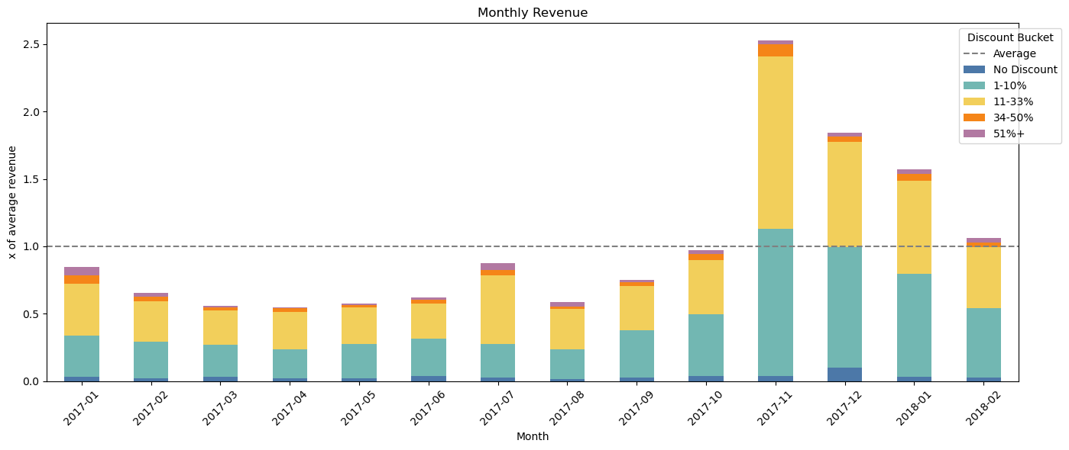
Monthly Revenue
Black Friday
Prime Day?

Slide 5
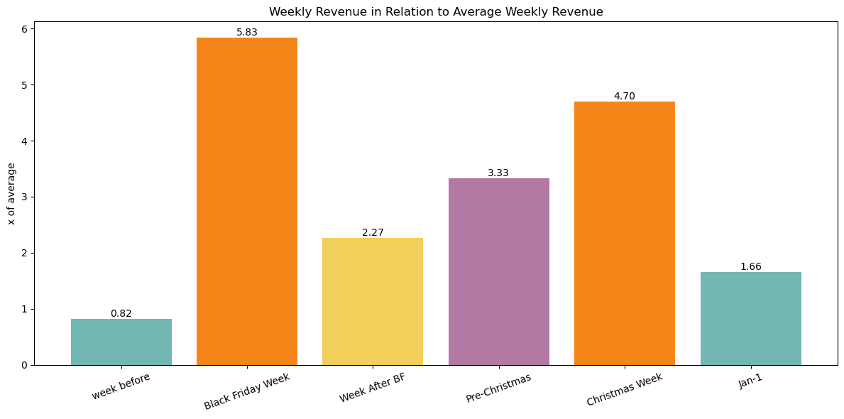
SEASONALITY: BLACK FRIDAY & CHRISTMAS
Black Friday Week
Christmas (Dec 18-31)
Post-Xmas (Jan 2018)
Orders: 5,444
Orders: 5,037
Orders: 7,460
Revenue: €1,775,453
Revenue: €1,431,025
Revenue: €2,187,735
6.73x vs prior week
1.57x vs Dec 1-17
Gift card redemptions

Slide 6
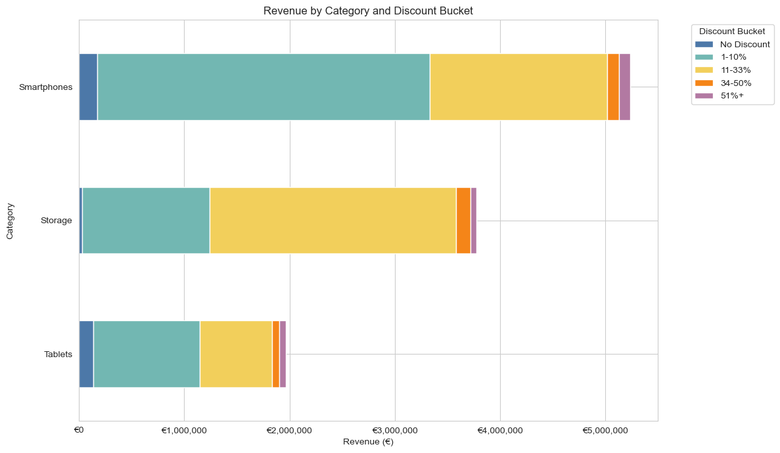
Revenue Driving Products
High amount of low discount sales

Slide 7
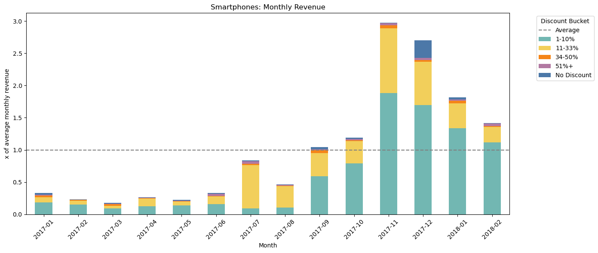
Smartphone Sales During the Year
We sold a lot of Smartphones during Black Friday Without discounting them further!

Slide 8
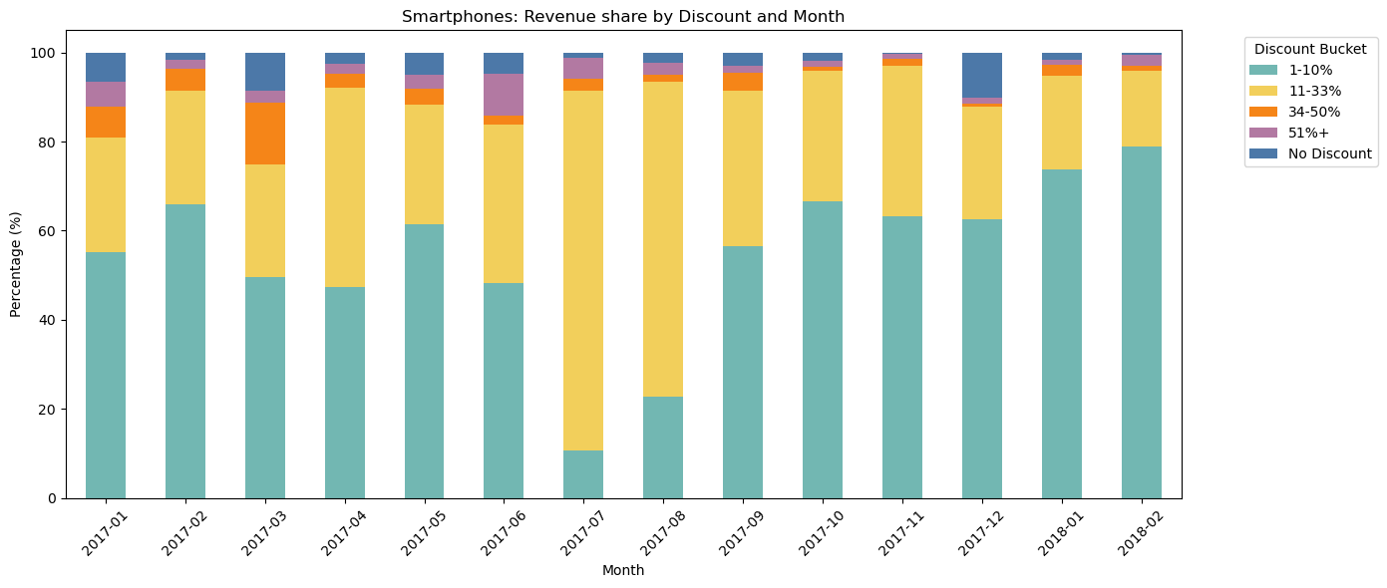
Smartphone Revenue Divided by Discount %

Slide 9
CONCLUSION & RECOMMENDATIONS
Should Eniac Keep Discounting?
VERDICT: Discount strategically — not universally
01 Events push sales irrespective of discounts
02 Create sales with Event Character
Black Friday and Christmas increase revenue by 3-6x without changing pricing structure.
There might be room for a second sale in the summer. Marketing should drive a potential sale as community event (vs. driven majorly by pricing).
03 Are permanent discounts a good idea?
04 Fix Data Collection
97.4% of products are discounted — this is the default, not a strategy. This should only be retained, if it serves a particular purpose.
Corrupted prices, duplicate SKUs, and missing brand data undermine analysis. Solid assertions can only be made under availability of profit margins.

Slide 10
Thank you for your attention!

