Slide 1
Classification and Regression Tree (CART) Implementation
Abubakar
HCIA-AI Trainer

Slide 2
Agenda
Datasets
CART Algorithm
Standard Deviation
Trees, Regression and Classifications
Data Science Libraries
CART Applications
Implemented CART Interpretation
Coding Marathon

Slide 3
Dataset and Subset
Feature | Dataset | Subset
Definition | The entire collection of data used for analysis/modeling. | A smaller portion of the dataset, selected based on conditions (e.g., filtering rows/columns).
Purpose | Serves as the complete input for training/testing models. | Used for specific analyses (e.g., splits in decision trees, train/test sets).
Size | Larger (contains all records). | Smaller (sampled or filtered from the dataset).
Example | A CSV file with 10,000 customer records. | Rows where Age > 30 or a 70% random sample for training.
In Decision Trees | Original data (df). | Temporary splits (subset1, subset2) during tree construction.

Slide 4
Types of Datasets
Dataset Type | Description | Common Uses
Structured Data | Tabular data with rows/columns (e.g., CSV, SQL tables). | Regression, classification, business analytics.
Unstructured Data | No predefined format (e.g., text, images, audio). | NLP, computer vision, speech recognition.
Time-Series Data | Data points indexed by time (e.g., stock prices, sensor logs). | Forecasting (ARIMA, LSTM), anomaly detection.
Geospatial Data | Data with geographic attributes (e.g., GPS coordinates, maps). | Route optimization, climate modeling, GIS applications.
Graph Data | Nodes and edges (e.g., social networks, recommendation systems). | Fraud detection, social network analysis (PageRank, GNNs).
Synthetic Data | Artificially generated data (e.g., GANs, simulations). | Privacy preservation, augmenting small datasets.
Labeled Data | Includes target/output values (e.g., "Spam" or "Not Spam"). | Supervised learning (classification/regression).
Unlabeled Data | No target values (e.g., raw text, images). | Clustering (k-means), dimensionality reduction (PCA), self-supervised learning.
Imbalanced Data | Uneven class distribution (e.g., 95% "Normal" vs. 5% "Fraud"). | Fraud detection, medical diagnosis (requires resampling/SMOTE).
Streaming Data | Continuously generated (e.g., live tweets, IoT sensor feeds). | Real-time analytics (Apache Kafka, Spark Streaming).

Slide 5
Common Dataset File Extensions
Extension | Format | Description | Common Uses
.csv | Comma-Separated Values | Plain text with data separated by commas (or other delimiters). | Tabular data analysis (Excel, Pandas).
.xlsx | Excel Workbook | Spreadsheet with multiple sheets, formulas, and formatting. | Business reports, financial data.
.json | JavaScript Object Notation | Lightweight key-value pair format, human-readable. | Web APIs, nested/hierarchical data.
.sqlite | SQLite Database | Lightweight relational database in a single file. | Mobile apps, local storage.
.xml | XML | Markup language for structured data. | Web data, document storage.
.db | Database File | Generic extension for databases (SQLite, Oracle, etc.). | Application data storage.
.txt | Plain Text | Unformatted text, often with line breaks or custom delimiters. | Log files, raw text data, simple datasets.

Slide 6
What is CART?
The CART algorithm is a foundational tool in machine learning due to its simplicity, interpretability, and versatility. By recursively splitting data based on optimized criteria (Gini impurity for classification, variance reduction for regression), CART builds decision trees that are effective for both classification and regression tasks. While it has limitations like overfitting and instability, techniques like pruning and ensemble methods mitigate these issues. Understanding CART provides a strong foundation for exploring more advanced tree-based models.

Slide 7
CART in Machine Learning
The term CART serves as a generic term for the following categories of decision trees:
Classification Trees: The tree is used to determine which "class" the target variable is most likely to fall into when it is continuous.
Regression trees: These are used to predict a continuous variable's value.

Slide 8
CART Algorithm (Cont.)
Classification and Regression Trees (CART) is a decision tree algorithm that is used for both classification and regression tasks. It is a supervised learning algorithm that learns from labelled data to predict unseen data.
Tree structure: CART builds a tree-like structure consisting of nodes and branches. The nodes represent different decision points, and the branches represent the possible outcomes of those decisions. The leaf nodes in the tree contain a predicted class label or value for the target variable.

Slide 9
CART Algorithm
Splitting criteria: CART uses a greedy approach to split the data at each node. It evaluates all possible splits and selects the one that best reduces the impurity of the resulting subsets. For classification tasks, CART uses Gini impurity as the splitting criterion. The lower the Gini impurity, the more-pure the subset is. For regression tasks, CART uses residual reduction as the splitting criterion. The lower the residual reduction, the better the fit of the model to the data.
Pruning: To prevent overfitting of the data, pruning is a technique used to remove the nodes that contribute little to the model accuracy. Cost complexity pruning and information gain pruning are two popular pruning techniques. Cost complexity pruning involves calculating the cost of each node and removing nodes that have a negative cost. Information gain pruning involves calculating the information gain of each node and removing nodes that have a low information gain.

Slide 10
How does CART algorithm work?
The CART algorithm works via the following process:
The best-split point of each input is obtained.
Based on the best-split points of each input in Step 1, the new “best” split point is identified.
Split the chosen input according to the “best” split point.
Continue splitting until a stopping rule is satisfied or no further desirable splitting is available.

Slide 11
Advantages of CART
Interpretability: Decision trees are easy to understand and visualize.
Handles Mixed Data: Works with both numerical and categorical features.
Non-parametric: No assumptions about data distribution.
Feature Importance: Provides insights into which features are most influential.
Versatile: Suitable for both classification and regression tasks.

Slide 12
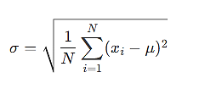
Standard Deviation
Standard Deviation (σ) is a statistical measure that quantifies how spread out or dispersed a set of data points is around their mean (average).
Measures Variability
A low standard deviation means data points are close to the mean.
A high standard deviation means data points are widely scattered.
Formula:
N = Number of data points
x_{i}​ = Each individual value
μ = Mean of all values

Slide 13
Why is it Used in Decision Trees (Regression)?
In regression trees, standard deviation helps decide splits by measuring how much variance exists in the target variable.
The algorithm tries to reduce standard deviation in child nodes compared to the parent node (similar to how Gini impurity works in classification).
A split is considered good if it maximizes standard deviation reduction (i.e., subsets become more homogeneous).

Slide 14
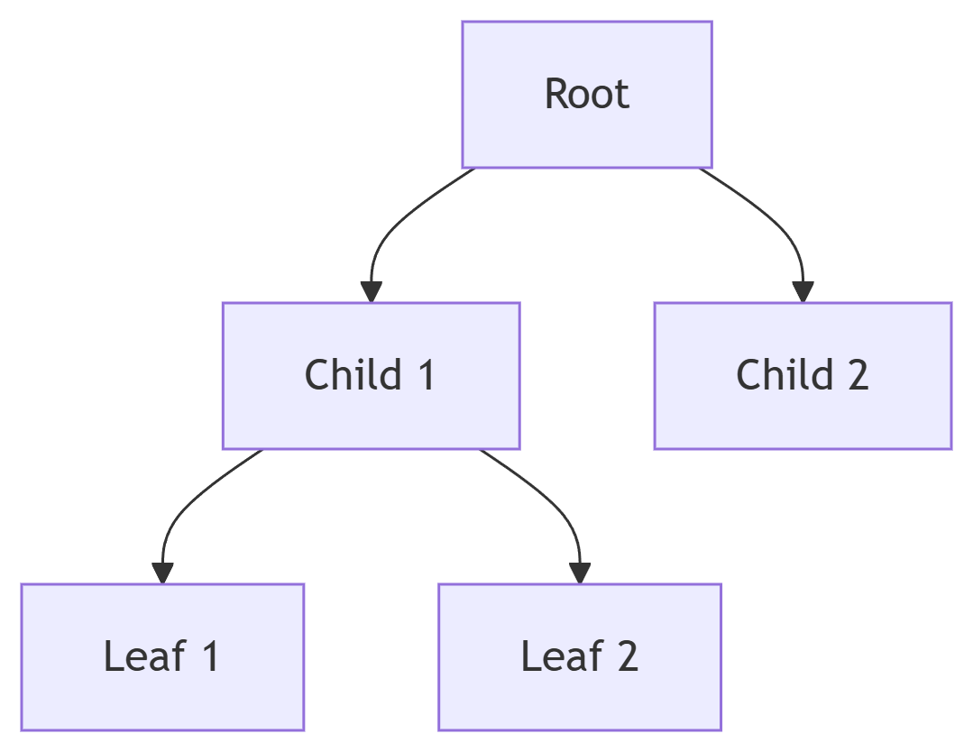
Trees
In computer science and mathematics, a tree is a hierarchical data structure consisting of nodes connected by edges. Key properties:
Root Node: The topmost node (starting point).
Parent/Child Nodes: Nodes branch out from parents to children.
Leaf Nodes: Terminal nodes with no children.
Non-linear Structure: Unlike arrays/lists, trees allow branching.

Slide 15
Use of Trees
Classification: Spam detection, medical diagnosis.
Regression: Sales forecasting, risk analysis.
Feature Selection: Identifies important features.
*Note:
Decision trees form the basis for advanced algorithms like Random Forests and Gradient Boosting Machines (GBM).

Slide 16
Regression
Definition:
A supervised learning method that predicts continuous numerical values (real numbers).
Examples:
Predicting house prices ($450,000, $520,000, etc.)
Forecasting temperature (28.5°C, 30.1°C)
Estimating stock market trends
Algorithms:
Linear Regression
Decision Tree Regression
Random Forest Regression

Slide 17
Classification
Definition: A supervised learning method that predicts discrete categorical labels (classes). Examples:
Spam detection ("Spam" or "Not Spam")
Disease diagnosis ("Positive" or "Negative")
Image recognition ("Cat", "Dog", "Bird")
Algorithms:
Logistic Regression
Decision Tree Classifier
Support Vector Machines (SVM)

Slide 18
Purpose of Pandas, Math, and NumPy Libraries
Pandas is used for data loading, manipulation, and preprocessing (like handling CSV files and Data Frames).
NumPy enables fast numerical operations and array manipulations (like threshold comparisons and binning numerical features).
Math provides basic mathematical functions (like logarithms and exponents) for entropy and Gini impurity calculations.

Slide 19
Key Differences
Feature | Regression | Classification
Output Type | Continuous (numbers) | Discrete (categories)
Goal | Predict a quantity | Assign a class label
Examples | Price, temperature, age | Yes/No, labels (A/B/C), binary outcomes
Evaluation | MSE, RMSE, R² | Accuracy, Precision, Recall

Slide 20
Limitations of CART
Overfitting: Deep trees can overfit noisy data unless pruned or constrained.
Instability: Small changes in the data can lead to different tree structures.
Bias Toward Dominant Classes: Can struggle with imbalanced datasets.
Greedy Algorithm: The splitting process is locally optimal, not globally optimal.
Limited Expressiveness: Single trees may not capture complex relationships as well as ensemble methods like Random Forests.

Slide 21
Practical Applications
CART is used in various domains, including:
Finance: Credit risk assessment, fraud detection.
Healthcare: Disease diagnosis, patient outcome prediction.
Marketing: Customer segmentation, churn prediction.
Environmental Science: Predicting weather patterns or species distribution.
Manufacturing: Quality control and fault detection.

Slide 22
Machine Learning Fundamentals
Machine Learning Fundamentals
Term | Explanation
Supervised Learning | ML paradigm where models learn from labeled training data
Classification | Predicting discrete categories (e.g., "Yes/No")
Regression | Predicting continuous values (e.g., temperature)
Target Variable | The output variable being predicted (called Decision in this code)
Features | Input variables used for prediction (columns in the dataset)

Slide 23
Decision Tree Concepts
Term | Explanation
Node | A point in the tree that contains a decision rule
Root Node | Topmost decision node (first split)
Leaf Node | Terminal node that provides final prediction
Splitting | Dividing data based on feature values
Pruning | Removing unnecessary branches to prevent overfitting

Slide 24
Splitting Criteria
Term | Explanation
Gini Impurity | Measure of node purity (0 = perfectly pure) used in classification
Entropy | Alternative impurity measure (not used in calculations here)
Standard Deviation Reduction | Regression equivalent of impurity reduction
Threshold | Value used to split continuous features (e.g., "≤25.4")

Slide 25
Data Handling Terms
Term | Explanation
Continuous Feature | Numeric values requiring binning (e.g., temperature)
Categorical Feature | Discrete values (e.g., "Sunny/Rainy")
DataFrame | Pandas 2D data structure (table-like)
dtype | Data type (object=string, float64=numeric)

Slide 26
Algorithm-Specific Terms
Term | Explanation
Global Stdev | Overall standard deviation of regression target
Weighted Impurity | Average impurity across child nodes after split
Value Counts | Frequency distribution of categories
Early Stopping | Termination condition (e.g., stddev < 40% of global)

Slide 27
Programming Concepts
Term | Explanation
Recursion | Function calling itself (used in tree building)
Vectorization | Using NumPy/Pandas for batch operations
Docstring | Function documentation (triple-quoted strings)
Error Handling | try/except blocks for file loading

Slide 28
Key Functions Explained
Function | Purpose
processContinousFeatures() | Converts numeric features to categorical bins
calculateEntropy() | Computes entropy (unused in splits but implemented)
findDecision() | Identifies best feature to split on
buildDecisionTree() | Recursively constructs and prints the tree

Slide 29
Critical Variables
Variable | Role
algorithm | Switches between classification/regression
target_column | Dynamically detected output variable
dataset_features | Dictionary storing feature data types
global_stdev | Reference value for regression stopping

Slide 30
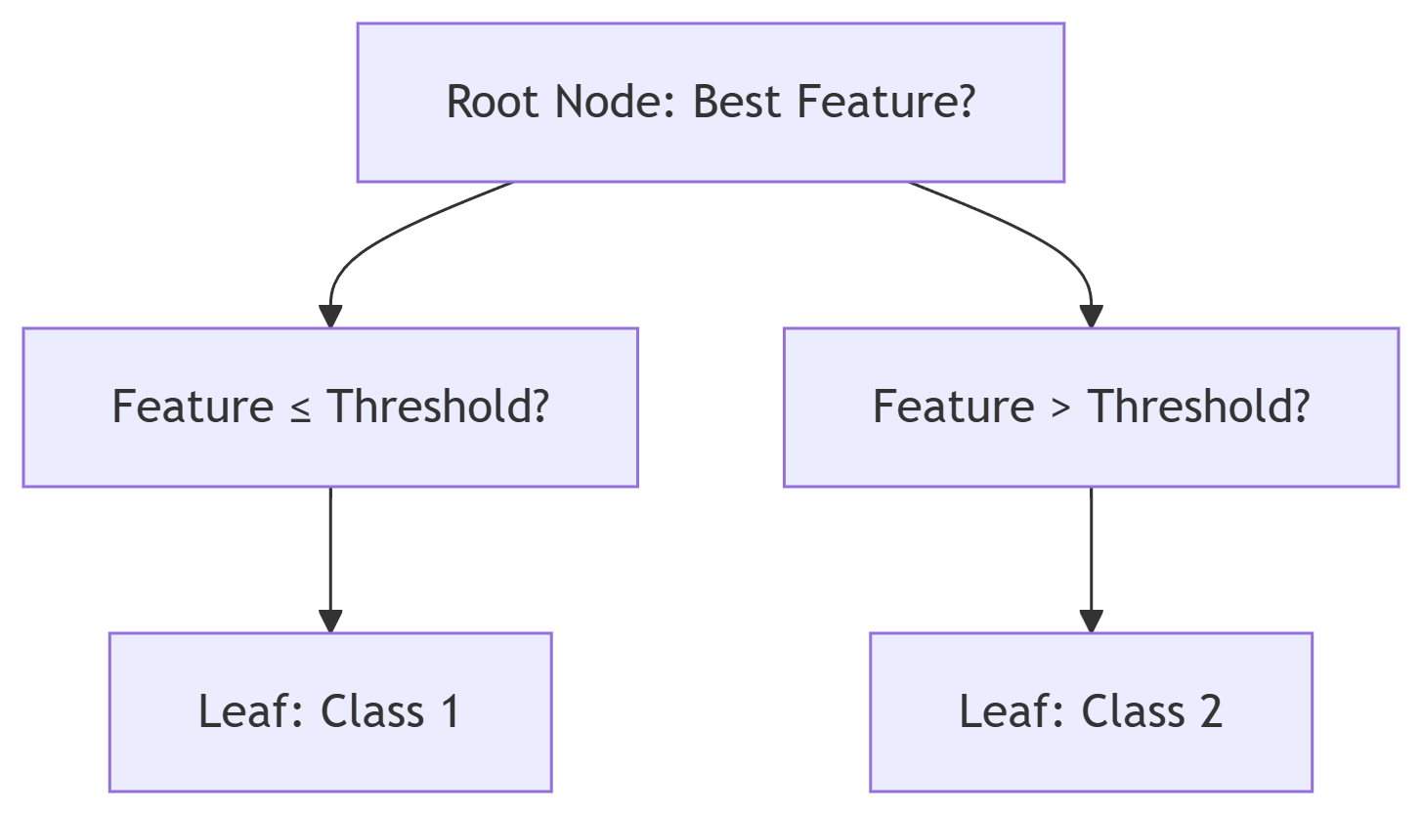
Visualization of Key Concepts

Slide 31
CART Dataflow:

Slide 32
Modularity in Machine Learning & Programming
Modularity is a design principle that breaks a system into independent, interchangeable components (modules), each responsible for a specific task. In machine learning (ML) and software development, it promotes readability, reusability, and maintainability.
Data Loading Module
Reads CSV/JSON files → Outputs a DataFrame.
Preprocessing Module
Handles missing values, scaling → Outputs clean data.
Model Training Module
Accepts cleaned data → Outputs a trained model.

Slide 33
What is a Threshold?
A threshold is a predefined cutoff value used to make decisions in ML models. It converts raw model outputs (probabilities, scores) into actionable predictions or classifications.
Applications of Thresholds in ML
Application | How Threshold is Used | Example
Binary Classification | Converts probabilities (0–1) to class labels (0/1). | Spam detection (≥0.5 = "Spam").
Medical Diagnosis | Balances sensitivity/specificity (e.g., lower threshold to catch more diseases). | Cancer screening (≥0.3 = "Positive").
Recommendation Systems | Filters items by relevance score (e.g., recommend if predicted rating ≥ 4/5). | Netflix movie suggestions.
Autonomous Vehicles | Object detection confidence threshold (e.g., ignore detections with <80% confidence). | Tesla’s pedestrian detection.
Natural Language Processing | Discards low-confidence intent classifications in chatbots. | Customer support bots.

Slide 34
CART Implementation Continue…
The data flow in this decision tree implementation follows a top-down recursive splitting approach, beginning with data loading and preprocessing before constructing the tree structure.
Initially, the script loads the dataset into a Pandas DataFrame (`df`) and identifies the target column through flexible name matching. It then analyzes feature types, storing them in dataset_features, and validates the algorithm choice (classification/regression).

Slide 35
CART Implementation Continue…
For numeric features, processContinousFeatures() dynamically determines optimal thresholds, converting them into categorical bins (e.g., "≤25.4" or ">25.4") using Gini impurity (classification) or standard deviation reduction (regression).
The findDecision() function evaluates all features to select the best split based on these metrics, while buildDecisionTree() recursively partitions the data, printing rules at each node.

Slide 36
CART Implementation
The recursion terminates when meeting leaf conditions: pure nodes (classification), sufficiently small standard deviation (regression), or exhausted features. Throughout this flow, temporary DataFrames (`subset1`, `subset2`, `temp_df`) handle data splits without modifying the original dataset, ensuring clean separation of training logic from data storage.
The process emphasizes modularity, with impurity calculations, threshold selection, and tree construction isolated in dedicated functions, making the workflow both interpretable and extensible.

Slide 37

Coding Marathon
Let's div deep into code

