Slide 1
Introduction to Dynamic Corporate Transformation
VOLUME I · CHAPTER 1 · WEEK 1
A company is a state and a transformation is the path that state travels: the path matters, and no single number can decide between the options
Graduate course companion · Lab seed 26101 · AXIOM Lab 1.1 (AXIOM-01)
Notes:
Volume I, Chapter 1. The chapter follows the Meridian Group as its board weighs a digital pivot, a restructuring and an operational turnaround, describes the company as a state and a transformation as a path, shows why no smooth single score can rank the options, and tours the DCT Map.

Slide 2
“The reasonable man adapts himself to the world: the unreasonable one persists in trying to adapt the world to himself. Therefore all progress depends on the unreasonable man.”
George Bernard Shaw
Nobel Prize in Literature 1925; Man and Superman, “Maxims for Revolutionists” (1903)
Notes:
Transformation is a deliberate change of the company's state (Definition 1.4): a company that adapts itself to the world drifts; one that sets out to change its position transforms. The epigraph and its source open Chapter 1.

Slide 3
After this chapter, you can
LEARNING OUTCOME STATEMENTS
1.1
Explain why boards struggle to compare transformation options such as a digital pivot, a restructuring, and a turnaround, and what a complete picture of the company would need to show.
1.2
Compare the main lenses used to analyze a company—finance, strategy, operations and control, systems thinking, and enterprise architecture—and say what each sees well and what it misses.
1.3
Describe a company as a state and a transformation as the path that state travels, and explain why the path matters as much as the destination.
1.4
Explain, using Meridian, why a single number such as enterprise value, ROIC, or a scorecard total cannot by itself decide between transformation options.
1.5
Use the DCT Map to explain the whole DCT framework—its moves, architectures, certificates, and methods—and how the two volumes, the course website, and the AXIOM laboratory take a company from description to decision, execution, and adaptation.
Notes:
The five learning outcome statements of Chapter 1; LOS Guidance at the end of the chapter explains what a strong answer to each looks like.

Slide 4
Six sections, a worked example and a lab
ROADMAP
§1.1
§1.2
§1.3
§1.4
The Transformation Question
How We Got Here: Six Ways of Looking at a Company
Why Existing Frameworks Fall Short
What DCT Is: Core Ideas and Two Key Results
Meridian · Equation 1.1
Figure 1.1
Table 1.1 · Limitations L1–L5
Definitions 1.1–1.5 · Propositions 1.1–1.2
§1.5
§1.6
Worked Example 1.1
AXIOM Lab 1.1
The DCT Map: How the Two Volumes Fit Together
Learning with This Book
Same Score, Different Company
Meridian at a Crossroads
Figure 1.4 · seven moves
Figure 1.5
Table 1.9 · Figure 1.3
AXIOM-01 · five steps
Notes:
Formal statements and proofs of Propositions 1.1 and 1.2 are in Appendix 1.A; the stronger form of Proposition 1.2, the linear-scorecard case and the Chapter 1 model are in Online Appendix 1.B.

Slide 5
Meridian at a moment of decision
§1.1 · THE MERIDIAN GROUP
$4.2bn
11.8%
3.4×
18,400
revenue; founded 1952, publicly listed
EBITDA margin
net leverage, net debt to EBITDA
employees in three divisions
Industrial Systems, the historic core: 61% of revenue, shrinking for five years in a row
Digital Solutions: 17% of revenue, growing 22% a year, consuming cash and talent faster than it replaces them
Advanced Materials: 22% of revenue, profitable, capital-intensive and strategically ambiguous
The board weighs a digital transformation, a restructuring and an operational turnaround
Notes:
Section 1.1. Digital moves capital and people from the core into Digital Solutions; restructuring sells part of Industrial Systems and pays down debt; the turnaround defends the core through cost and productivity programs. Meridian accompanies the reader through both volumes.

Slide 6
Eight readings say where Meridian stands
§1.1 · EQUATION 1.1
 | Reading | Today | Measured by (error band) | In Chapter 1's model
x₁ | Liquidity | $0.62bn (index 100) | treasury systems (±1%) | moves
x₂ | Net leverage | 3.4× | audited accounts (±2%) | held at today's value
x₃ | Workforce capability | 58 | skills survey (±5) | held at today's value
x₄ | Technology platform | 41 | architecture audit (±4) | moves
x₅ | Operational efficiency | 71 | cost benchmarking (±3) | moves
x₆ | ROIC | 8.3% | audited accounts (±0.4 pp) | held at today's value
x₇ | Strategic risk (lower is better) | 64 | risk committee (±6) | moves
x₈ | Market share | 19% | industry data (±0.8 pp) | held at today's value
Equation 1.1: x(t) = [x₁(t), …, x₈(t)]^{T}, the company's dashboard at time t
Notes:
Equation 1.1 and Worked Example 1.1, Step 1. Today's values are the state Chapter 3 declares (Table 3.1); sources and error bands are Chapter 5's (Table 5.2). The eight readings are a modeling choice, not a discovery (Chapter 4). Chapter 1's model moves four readings; Chapters 5-8 let all eight move.

Slide 7
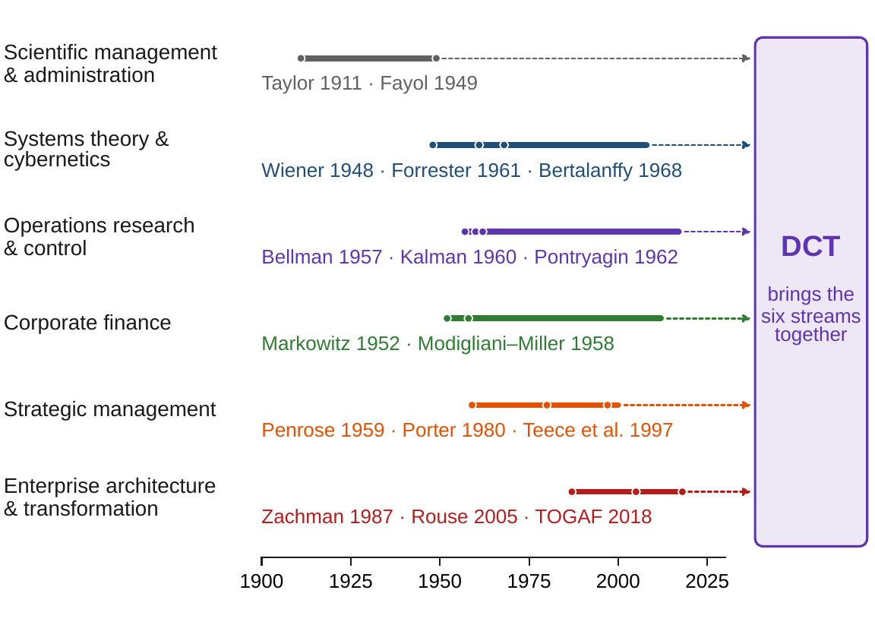
Six ways of looking at a company
§1.2 · FIGURE 1.1
Scientific management made the company measurable, one task at a time
Systems theory saw feedback and adaptation, but simulates rather than proves
Operations research and control steer systems over time, applied piece by piece
Corporate finance prices capital precisely by projecting the company onto cash flows
Strategy names the capacity to transform, but in words
Enterprise architecture describes structure, but not movement
Every ingredient exists; no single discipline combines them. That combination is DCT
Figure 1.1. How enterprise analysis evolved: six streams developed largely in parallel over the twentieth century; DCT brings them together for the transformation problem.
Notes:
Section 1.2. Control theory had the mathematics without the enterprise; systems theory had the enterprise without the mathematics. Joining the two for the transformation problem is the central gap the book addresses.

Slide 8
No discipline answers yes to all four
§1.3 · TABLE 1.1 · LIMITATIONS L1–L5
Discipline | What it analyzes | Form | Over time? | Whole company? | Ranks options?
Scientific management | tasks, processes | arithmetic, statistics | no | no | locally
Systems theory, system dynamics | feedback structures | simulation | yes | yes | no
Operations research, control | engineered subsystems | state models, optimization | yes | no | yes
Corporate finance | cash flows, claims | stochastic models | yes | no (projection) | yes (financial)
Strategic management | positioning, capabilities | largely verbal | implicitly | yes | no
Enterprise architecture | structure, components | diagrams, metamodels | no | yes | no
DCT | the company as a dynamic system | state, operators, optimization | yes | yes | yes (one declared problem)
L1 Fragmentation · L2 Snapshots · L3 One-number summaries · L4 No state · L5 No well-posed problem. Chapters 5–8 remove L4 and L2; 9–12 remove L3; 13 removes L1; 14–16 remove L5.
No discipline gives a dynamic, whole-company, optimizable description; DCT is built to do so
Notes:
Table 1.1 and Section 1.3. The four questions: does it describe the whole company, capture change over time, compute, and rank alternatives? The five limitations are the book's negative space: every later chapter removes one or more of them.

Slide 9
DCT describes a company as a dynamic system
§1.4 · DEFINITIONS 1.1–1.5
Six architectures organize the book
DEFINITIONS 1.1–1.5
Dynamic Corporate Transformation
ESA what is the company? (Chapter 9)
ETA how does it change? (Chapters 6–8)
ECA what makes change possible? Ten forms of capital (Chapter 10)
EPA how is change measured? Ten dimensions of performance (Chapter 11)
ERRA how does it withstand uncertainty? (Chapter 12)
UETA integrates the five into one model (Chapter 13)
Principles: describe before you analyze; declare, with owners; build in order; give every result a meaning
DCT describes a company as a dynamic system and treats transformation as analysis and optimization over it
Enterprise system: purposeful, open, adaptive, and able to change its own configuration
Enterprise state: a complete description, at a chosen level of detail, of the decision-relevant condition
Transformation: a deliberate change of state over time, by management's decisions, under uncertainty
Architecture: a structure that organizes one aspect of the company and plugs into a model that moves
Notes:
Definitions 1.1-1.5 and the four principles of Section 1.4. Principle 2, declare with owners: the state, the decisions, the commitments, the objective and the outside forces are declared, and every commitment has an owner and a consequence if it is broken. The framework's answers are answers about the declaration.

Slide 10
Three options, three paths from one start
§1.4 · TABLE 1.2 · PROPOSITION 1.1
Option | What improves | What suffers | Signature of the path
Digital transformation | technology platform and workforce capability; later, strategic risk falls | liquidity (deep dip in years 1–2); efficiency while old and new platforms run side by side | a mid-path liquidity trough, where programs are most exposed
Restructuring | leverage and liquidity, at the sale date | market share; workforce capability, if shared engineering leaves with the sold unit | a jump: the state moves at once when the sale closes
Operational turnaround | efficiency, ROIC, some liquidity | technology platform and market share keep eroding | improving locally, possibly worse overall: the digital window may close
Proposition 1.1: if a company's condition can be described by a state at every moment, every transformation traces a path of that state, and transformations that leave the company in different conditions at any moment trace different paths.
Read the options as paths: where along the way the company is weakest, and for how long
Notes:
Table 1.2 and Proposition 1.1; proof in Appendix 1.A. Once a state is declared, transformation is not merely like motion through a space, it is motion through a space, and everything known about steering moving systems becomes available to management.

Slide 11
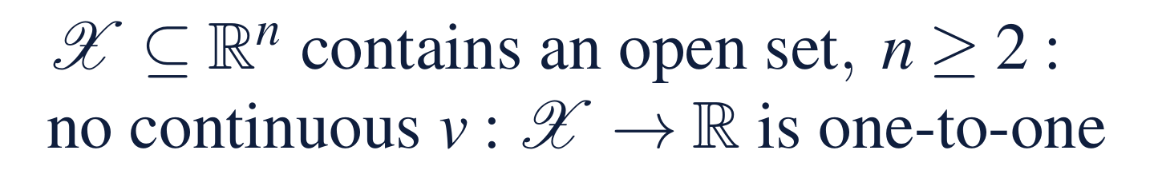
No smooth single score tells all states apart
§1.4 · PROPOSITION 1.2
What it means
PROPOSITION 1.2
Why one number is not enough
A law of conservation of information, not an attack on metrics
A good score is an excellent screening tool; the full state decides
The proof: a smooth score takes every value between two states along two routes that never meet
So the multidimensional architectures of Chapters 9–12 are required by the subject
Measures that vary independently: any score that moves smoothly with them ties some different states
Enterprise value, ROIC and a weighted scorecard are all such scores
Ties are everywhere: every reading strictly inside a score's range near a company is shared by infinitely many states
Notes:
Proposition 1.2; proof in Appendix 1.A. It makes Limitation L3 exact. Scores that jump erratically could avoid ties, but they say nothing reliable about nearby states and cannot be managed by (Online Appendix 1.B.3).

Slide 12
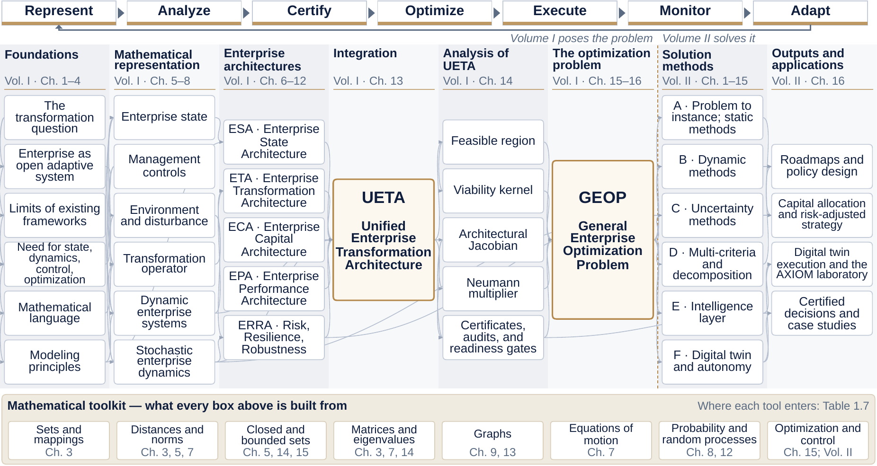
The DCT Map: the whole discipline on one page
§1.5 · FIGURE 1.4 · THE DCT MAP
Seven moves on top: a loop, Adapt back to Represent
Eight columns: each uses only what lies to its left
Dashed line: Volume I poses, Volume II solves
UETA and GEOP: the series turns on them
Toolkit band: the mathematics beneath every box
Notes:
Figure 1.4 and Section 1.5.1. The map is the book's table of contents redrawn as a system: DCT represents a company as an evolving state, changed by transformation operators, resourced by a capital architecture, measured by a performance architecture, exposed through a risk architecture, integrated into one unified architecture, and steered by the General Enterprise Optimization Problem. An interactive version is on the course website.

Slide 13
Seven moves, run as a loop
§1.5.2 · TABLE 1.3 · MERIDIAN'S DIGITAL PROGRAM
Each move answers one board question and hands its product to the next
1
Represent
2
Analyze
3
Certify
4
Optimize
What is the company? Meridian: eight readings with error bands, five owned commitments
What is it made of? A feedback core of four units; the same cash promised twice
Is the problem fit to optimize? Core ρ = 0.80; the trough $132m above the floor
Which program is best? A 5% appetite met for $10.4m; $12.50m once in lumps
5
Execute
6
Monitor
7
Adapt
1
Represent again
How does a policy become decisions? Sign the lumpy package
Is the company where the model says? A twin watches the armor and the core's ρ
What changes when the world does? Re-certify before phase two takes ρ above one
The loop returns to the first move: a company that has moved may need a different description
Notes:
Table 1.3 and Section 1.5.10. The order is not a convention: nothing can be analyzed before it is represented, an uncertified program can be optimal and still fail, and a policy that is never executed, monitored and revised is a report, not a transformation. Each Meridian number is derived in the chapters that follow (Worked Examples 13.1, 14.1, 15.1, 16.1; Volume II, Worked Example 1.1).

Slide 14
The board's question is not yet determined
§1.5.10 · WHAT THE FRAMEWORK TELLS MERIDIAN'S BOARD
Sequence · Chapters 3 and 6
The engineers · Volume II, Worked Examples 6.1 and 7.1
Sell keeping the engineers, then build
Worth $32.5m against a $20m discount
The only two-move route to a technology index of at least 50; it ends just $6 million above the liquidity floor.
Or $23.8 million if the digital build slows rather than stops below its capability floor.
Financing · Volume II, Worked Example 1.1
Automation · Volume II, Worked Example 5.1
One path in four breaches the floor
Self-funding only if savings are recycled
A $150 million standby line and one quarter's delay, $12.50 million in lumps, meet the 5 percent appetite.
At the board's 10 percent hurdle rate, three rounds are worth doing.
And any ranking of the three options rests on two undeclared choices: the score's scale and review window
Notes:
Section 1.5.10, What the framework tells Meridian's board. The options are moves that combine, and each worked example settles one piece under its chapter's declared model. The scorecard's scale reverses the ranking and its review window ranks digital last for two years (Worked Examples 11.1 and 16.1). Volume II, Chapter 16, puts the pieces into one declared model and one program.

Slide 15
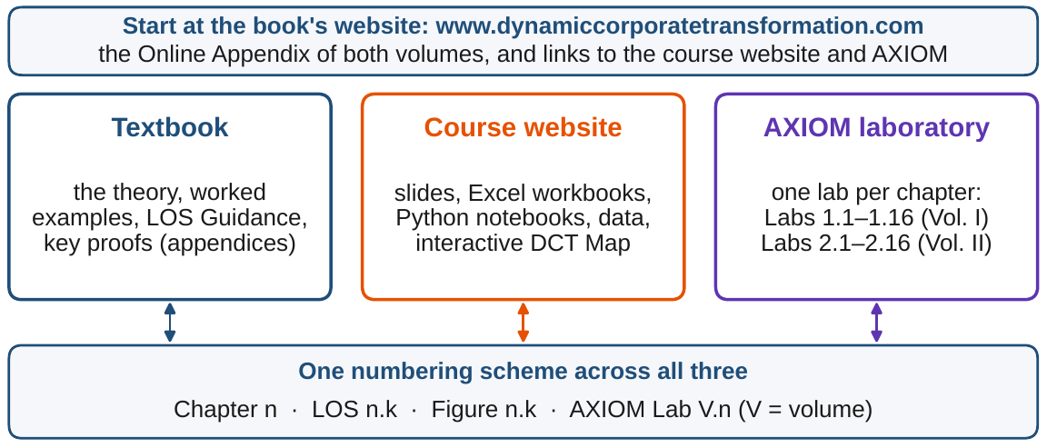
Three resources, one numbering scheme
§1.6 · FIGURE 1.5
The textbook: per chapter, five LOS, a Worked Example on Meridian and an AXIOM Lab
Two layers of rigor: proofs in each chapter's appendix; supporting results in the Online Appendix
The course website: slides, an Excel workbook, a Python notebook, data and the interactive DCT Map
AXIOM: one lab per chapter, sharing one computational core with the notebooks
Figure 1.5. The book's website, www.dynamiccorporatetransformation.com, is the entry point to all three and hosts the Online Appendix.
Notes:
Section 1.6. AXIOM Labs 1.1-1.16 accompany Volume I and Labs 2.1-2.16 Volume II. Every lab follows the same pattern: a business situation and your role in it, step-by-step work in AXIOM, what to look for, questions for discussion and a short deliverable.

Slide 16
One scorecard for three futures
WORKED EXAMPLE 1.1 · THE SITUATION AND STEP 1
the CFO's scorecard: three readings added with equal weights, strategic risk subtracted
The board has asked its strategy team for a recommendation; the CFO proposes this simple scorecard
The team projects each option five years ahead with the chapter's model (Online Appendix 1.B.4)
Four readings move; net leverage, workforce capability, ROIC and market share are held at today's values
Step 1: today's dashboard scores ¼ (100 + 41 + 71 − 64) = 37.0
Notes:
Worked Example 1.1, the situation and Step 1. The model is the one behind Figure 1.3 and AXIOM Lab 1.1; its equations and parameters are in Online Appendix 1.B.4. Liquidity is indexed to today = 100 ($0.62 billion).

Slide 17
One point apart, well inside any forecast error
WORKED EXAMPLE 1.1 · STEPS 2–3 · TABLE 1.9
Reading | Today | Digital | Restructuring | Turnaround
Liquidity (index, today = 100) | 100.0 | 94.3 | 121.1 | 105.4
Technology platform | 41.0 | 75.6 | 38.9 | 35.9
Operational efficiency | 71.0 | 73.6 | 73.7 | 78.6
Strategic risk (lower is better) | 64.0 | 55.2 | 49.4 | 66.3
Score | 37.0 | 47.1 | 46.1 | 38.4
Meridian today and in Year 5 under each option (Chapter 1 model). Indices run from 0 to 100, except liquidity, indexed to today = 100 ($0.62 billion). Lower strategic risk is better.
Step 3: $25 million more from the sale, 4.05 liquidity points, lifts restructuring to 47.1: a tie
Notes:
Table 1.9 and Worked Example 1.1, Steps 2-3. Digital scores 47.1 and restructuring 46.1, a one-point gap well inside any forecast error; the turnaround, at 38.4, is clearly behind. With four more points of liquidity the restructuring scores 1/4 (125.2 + 38.9 + 73.7 - 49.4) = 47.1, exactly matching the digital option (Online Appendix 1.B.2: 4.05 points at $6.2 million a point).

Slide 18
Same score, different company
WORKED EXAMPLE 1.1 · STEPS 4 AND 6
Digital Meridian, Year 5: score 47.1
Restructured, $25m more: score 47.1
75.6
38.9
=
technology platform: a modern platform
technology platform: slightly weaker than today's
94.3
125.2
liquidity index: thinner cash
liquidity index: cash-rich
Step 4: digital Meridian also carries more strategic risk (55.2 against 49.4); restructured Meridian is lower-risk
Step 6: restructured Meridian has the cash for a digital program later, but would start it from a platform of 38.9, and the window to catch up may have closed
From the digital state Meridian can grow on its new platform, but has less cushion for the next shock
Notes:
Worked Example 1.1, Steps 4 and 6. The two equal futures are very different companies: the same score hides different futures. Online Appendix 1.B.2: any further change along a direction that leaves the score unchanged keeps the tie, so the board faces a three-dimensional family of equal Year-5 companies.

Slide 19
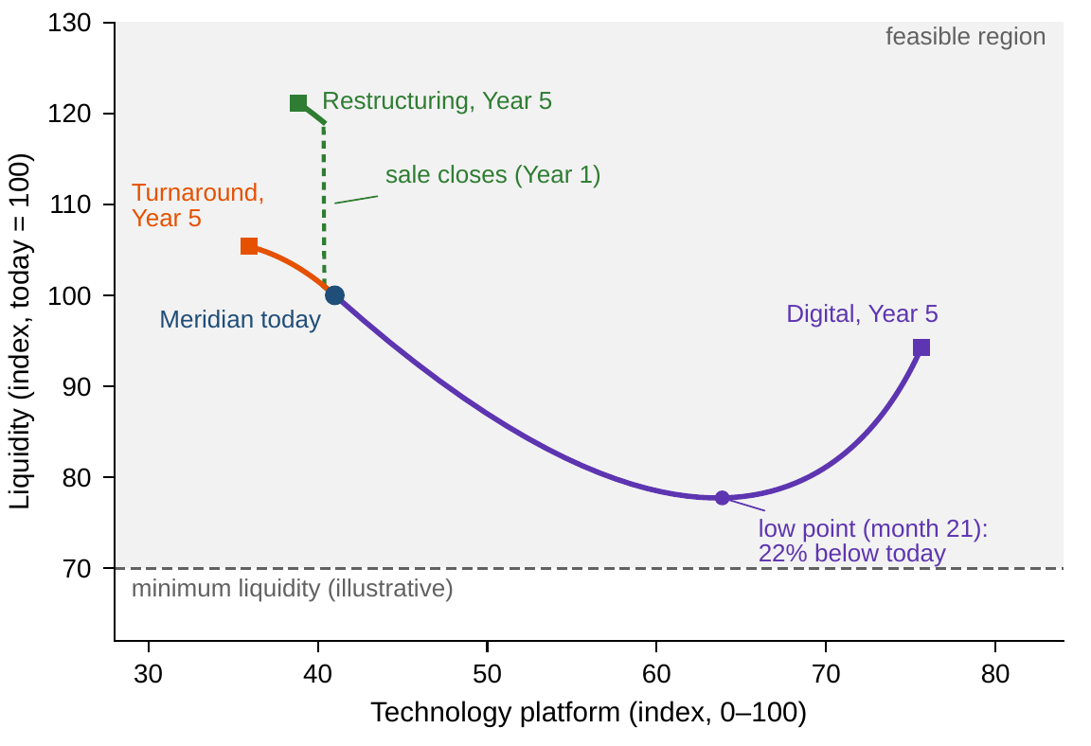
The path shows what the endpoint hides
WORKED EXAMPLE 1.1 · STEP 5 · FIGURE 1.3
Step 5: digital liquidity bottoms at 77.7 around month 21, 22% below today: about $138m
That trough is when the program is most exposed: a downturn or a delay could force the board to stop
The restructuring moves the other way: liquidity jumps about $112m when the sale closes in Year 1
On the way, digital's strategic risk peaks 1.4 points under its ceiling
And its score stays below today's 37.0 until month 29: annual reviews rank digital last for two years
Figure 1.3. Meridian's three options over five years in two of its eight dimensions, from the chapter's model. The dashed line is an illustrative minimum-liquidity requirement.
Notes:
Worked Example 1.1, Step 5, and Figure 1.3. A downturn or a delay at the trough could leave Meridian with the costs of the program but not its benefits. The risk peak and the score's path are in Section 1.5 (Tables 1.4 and 1.5; Worked Examples 11.1 and 16.1).

Slide 20
Use the score to screen, the state to decide
WORKED EXAMPLE 1.1 · WHAT THE BOARD SHOULD TAKE AWAY
38.4
47.1
Month 21
the turnaround: the scorecard correctly flags the weakest option
digital and a restructured Meridian with $25m more: one score, two companies
the liquidity trough that no endpoint score shows
The decision turns on what the score cannot see: how deep a trough the board can survive, how fast the technology window is closing, and which Year-5 company has the better next moves
Proposition 1.2 guarantees it is no quirk of this scorecard: every smooth single score produces ties like this one
For discussion: which Year-5 Meridian would you rather run, and what would you have to believe to be right?
Notes:
Worked Example 1.1, what the board should take away, and the discussion question: what would you have to believe about markets, technology and financing for your answer to be right?

Slide 21

Meridian at a crossroads, in AXIOM
AXIOM LAB 1.1 · MODULE AXIOM-01
Meridian's board meets in three weeks to choose among the digital pivot, the restructuring and the turnaround. You are on the corporate strategy team: the CFO wants a single scorecard, the head of Digital Solutions wants the board to see the full picture. Open AXIOM, choose Lab 1.1 and load the Meridian Group.
1
2
3
4
5
Read the dashboard
Play the three options
Compare paths, not just endpoints
Add uncertainty
Build your own score
For each of the eight readings: what it measures, and where the data would come from.
Run five years; pause around month 21 and at the sale date; record the Year-5 readings.
Technology against liquidity: find the digital low point and the restructuring's jump.
Turn on the fan for digital liquidity: how wide is the spread around month 21?
Choose weights; find two clearly different Meridians with the same score. Does any weighting avoid ties?
Deliverable: a one-page memo to the board stating which option deserves full analysis, the numbers that support your view, and what the scorecard cannot tell the board. About 45–60 minutes.
Notes:
AXIOM Lab 1.1. What to look for: the digital path's liquidity trough around month 21; the restructuring's jump at the sale date; and every scorecard producing ties between genuinely different companies, Proposition 1.2 at work. Discussion: which path would worry a lender most, and when; which reading would break the tie, and would a new tie appear; what would make the turnaround right?

Slide 22
What to carry forward
KEY TAKEAWAYS
1
Transformation decisions need a complete picture: the company's state, a compact set of measurable readings across finance, people, technology, operations, and strategy.
2
Each established lens—finance, strategy, operations and control, systems thinking, enterprise architecture—sees part of the company. None combines change over time, whole-company scope, precision, and the ability to rank options.
3
A transformation is a path, not a before-and-after pair. The path is where cash runs short, talent leaves, and options close.
4
No smooth single score can tell all genuinely different companies apart (Proposition 1.2). Use scores to screen and the full state to decide.
5
The DCT Map shows the whole discipline as seven moves and sixteen propositions (Section 1.5.9). Volume I poses the General Enterprise Optimization Problem and certifies when it can be solved, Volume II solves it with a certificate or a gap, and the course website and AXIOM put each chapter to work.
Notes:
Key Takeaways, Chapter 1.

Slide 23
Notebook and workbook reproduce the book
THIS WEEK'S LABORATORY
36
48
26101
AXIOM-01
notebook checkpoints, every one PASS
workbook checks against the engine, ALL PASS
the lab's seed
AXIOM Lab 1.1
Notebook DCT_V1_Ch01_Lab.ipynb: Worked Example 1.1 and the lab's five steps, ready for Colab; its fan reproduces the book's 24.6% and 3.0% with seed 8
Workbook DCT_V1_Ch01_Lab.xlsx: Table 1.9, the low point, the uncertainty's closed forms and every weighting's tie, in formulas
Every number on these slides is the book's; the companions check every one that this chapter computes
Notes:
The notebook and workbook are on the course website, www.dynamiccorporatetransformation.com. The notebook's fan uses Chapter 8's declared uncertainty, drawn as in the book with seed 8 (Volume II, Online Appendix 1.B.4); the lab's seed 26101 is used only for a fresh stream, labelled as such.

Slide 24
Chapter 2 asks what is being transformed
NEXT · CHAPTER 2
Companies are open: no model fed only this period's state reproduces every path (Proposition 2.1)
The state is a sufficient statistic: two histories that reach the same state have the same future (Theorem 2.1)
Where Meridian ends is a declaration: a boundary relabels flows but never changes them (Theorem 2.2)
Worked Example 2.1 asks where Meridian ends: is its independent dealer network inside the boundary?
Notes:
Chapter 2, Enterprise Systems and Transformation: the enterprise system as a septuple with a transition and an output function (Equation 2.2); Worked Example 2.1 asks where Meridian ends, with its dealer network inside or outside the boundary.

