Slide 1
Enterprise Systems and Transformation
VOLUME I · CHAPTER 2 · WEEK 1
Describe the company as an open system with a declared boundary and its rules as part of its state; transformation is designed system change
Graduate course companion · Lab seed 26102 · AXIOM Lab 1.2 (AXIOM-02)
Notes:
Volume I, Chapter 2. Chapter 1 described the company as an evolving state; this chapter makes it a system: a state, decisions, an environment, outputs and a declared boundary.

Slide 2
“I keep six honest serving-men (They taught me all I knew); Their names are What and Why and When And How and Where and Who.”
Rudyard Kipling
Nobel Prize in Literature 1907; Just So Stories (1902)
Notes:
Every transformation debate begins with the first of Kipling's questions: what, exactly, is being transformed? (the chapter's abstract; Section 2.1).

Slide 3
After this chapter, you can
LEARNING OUTCOME STATEMENTS
2.1
Explain what it means to treat a company as an open system—state, decisions, environment, and outputs—and why planning models that project the future from the present alone cannot represent a real company.
2.2
Describe a company's boundary as a declared modeling choice, and use Meridian's dealer network to show what moving the boundary changes and what it cannot change.
2.3
Distinguish the levels of a company—group, division, and unit—and explain why each level's environment includes its sibling units.
2.4
Distinguish feedback (changing decisions under a fixed rule) from adaptation (changing the rule itself), and explain why a company's rules are a form of capital.
2.5
Interpret transformation as designed system change—of state, rules, structure, or boundary—and apply the four-stage lifecycle to one of Meridian's options.
Notes:
The five learning outcome statements; LOS Guidance at the end of the chapter.

Slide 4
Six sections, a worked example and a lab
ROADMAP
§2.1
§2.2
§2.3
§2.4
Systems Thinking and Enterprise Analysis
The Enterprise as an Open System
Enterprise Boundaries and Environment
Hierarchy and Subsystems
Table 2.1
Definition 2.1 · Theorem 2.1
Definition 2.3 · Theorem 2.2
Definition 2.4 · Figure 2.3
§2.5
§2.6
Worked Example 2.1
AXIOM Lab 1.2
Feedback, Adaptation, and Control
Enterprise Transformation
Where Does Meridian End?
Drawing Meridian's Boundary
Proposition 2.3 · Figure 2.4
Definition 2.7 · Figure 2.5
Table 2.6 · Figure 2.2
AXIOM-02 · five steps
Notes:
Proofs of Theorems 2.1-2.2 and Proposition 2.3 are in Appendix 2.A; Propositions 2.1-2.2 in Online Appendix 2.B, with a corollary on free perimeter additions and a remark on algebraic loops.

Slide 5
Declare which Meridian you mean
§2.1 · SYSTEMS THINKING AND ENTERPRISE ANALYSIS
Legal perimeter
Operating perimeter
Economic perimeter
The consolidated entities
Plus the independent dealer network
Plus the co-development partners of Digital Solutions
The company as its accounts define it.
Meridian does not own the dealers but cannot function without them.
Each answer gives a different analysis of the same decision.
Holism with mechanism
Openness
Regulation and adaptation
The whole is explained by its parts but is not a list of them
Companies exist by exchanging with an environment
Companies steer by feedback and rewrite their own rules
Which part depends on which is where divisions interact.
Capital, goods, services, information and people cross the line.
Chapter 6 deepens this into transformation operators.
From here on, “the enterprise” means a declared boundary drawn in a declared map of entities and flows.
Notes:
Section 2.1. Which Meridian is the board discussing: its legal, operating or economic perimeter? The word 'enterprise' silently selects an answer, and different silent selections produce incompatible analyses of the same decision. Systems thinking adds three commitments (second row); Table 2.1 fixes the vocabulary.

Slide 6
Seven parts describe a company as a system
§2.2 · DEFINITION 2.1
states, decisions, environmental inputs, outputs, the transition, the output map, and the start
Transition f: the company's mechanism, how this period's condition, choices and circumstances produce the next
Decisions u: what management chooses—allocations, prices, hires, divestitures, programs
Environmental inputs w: what the world imposes—demand, input costs, regulation, competitors, technology
Outputs y: what crosses outward and what observers read—products, financial statements, signals
The system is open when it has inputs or outputs; capital markets bring structure of their own
Notes:
Definition 2.1, Equations 2.1-2.2; discrete time, decision periods such as quarters. The transition f is the company's mechanism. Investors' constraints and mandates shape which financing a company can raise (Section 2.2).

Slide 7
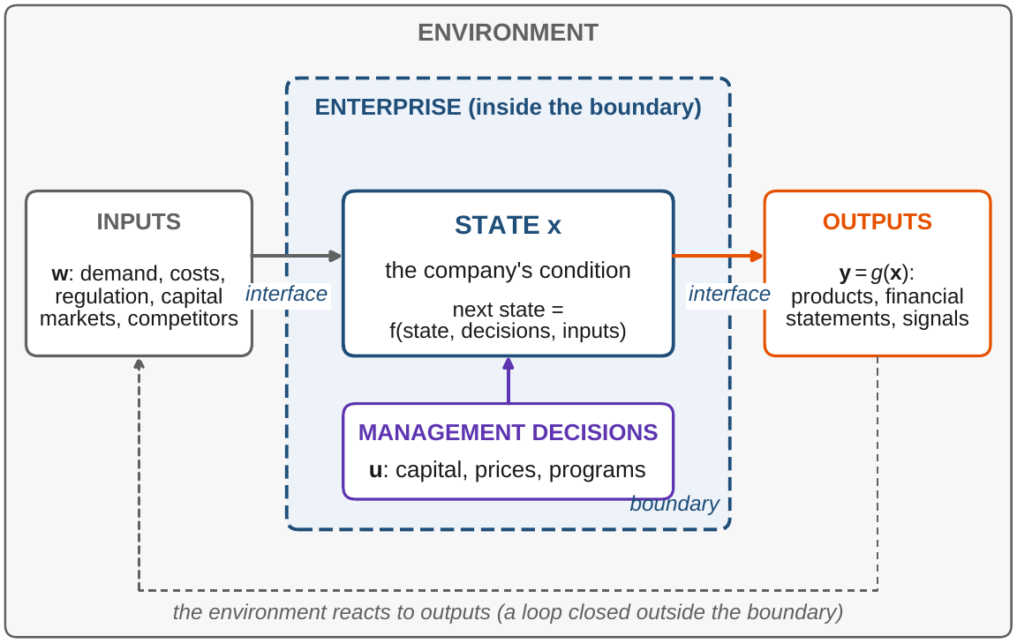
Momentum models cannot represent a company
§2.2 · PROPOSITION 2.1 · TABLE 2.2
Proposition 2.1: if the environment matters, today's state alone cannot generate every path
Trend extrapolation, ratio roll-forwards, momentum planning: some situations they cannot represent
The remedy is not more history but more inputs to the mechanism
Closed systems run down; open ones maintain themselves through throughput (Table 2.2)
Figure 2.1. The state evolves under management's decisions and the environment's inputs; the flows that cross the dashed boundary form the interface.
Notes:
Proposition 2.1; formal statement and proof in Online Appendix 2.B. Such models do not merely lose accuracy: the open form x' = f(x, u, w) is the minimum honest signature of a company model.

Slide 8
The current state is all the history that matters
§2.2 · THEOREM 2.1
What it means for Meridian
THEOREM 2.1
Enterprise System Representation Theorem
The state is a sufficient statistic for the company's future
If Meridian's eight readings are well chosen, the current dashboard is enough
The force is in the demand: next period must be determined by the three inputs
Too coarse a state hides variables (Chapter 4); uncertainty belongs in the inputs (Chapter 8)
Suppose next period's state is fully determined by this period's state, decisions and environmental inputs
(i) Every plan of decisions, under every path of the environment, produces exactly one path for the company and its outputs
(ii) Two histories that arrive at the same state have the same future under the same decisions and environment
Notes:
Theorem 2.1 (Enterprise System Representation Theorem); formal statement and proof in Appendix 2.A. It turns a philosophical dispute, can companies be described as states?, into a checkable modeling condition.

Slide 9
A boundary relabels flows; it never changes them
§2.3 · DEFINITION 2.3 · THEOREM 2.2
How to settle a boundary dispute
THEOREM 2.2
Enterprise Boundary Consistency Theorem
No conclusion about the total system can depend on the boundary: if one does, it is an error
Debates matter only for entities in the flows analyzed (Corollary 2.B.2)
A declared boundary leaves no flow ambiguous
The choice is one of purpose: what it makes controllable, observable, decision-relevant
A boundary is a set of entities; each typed flow is interior, an input, an output or environmental by where its two ends lie
(i) Every flow is classified as exactly one of the four
(ii) The full set of flows is the same under every boundary
(iii) Two boundaries classify identically exactly when they agree on every entity that takes part in some flow
Notes:
Definitions 2.2-2.3 and Theorem 2.2 (Enterprise Boundary Consistency Theorem); proof in Appendix 2.A; the corollary on free perimeter additions is in Online Appendix 2.B. A declared boundary cures the failure in which an analysis treats a joint venture's revenue as internal and its risk as external.

Slide 10
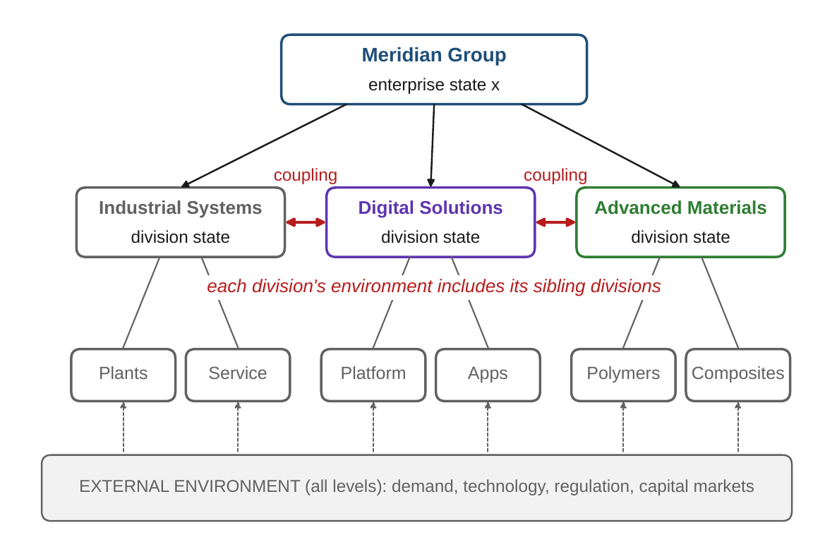
Each division's environment includes its siblings
§2.4 · DEFINITION 2.4 · FIGURE 2.3
Definition 2.4: a subsystem's environment is the company's environment plus its sibling subsystems
The coupling of two divisions is interior to the group, but environment to each division
Whole-company behavior lives in the coupling, absent from every division studied alone
Weak coupling: analyze divisions separately and add. Strong: only the group-level state will do
Figure 2.3. Meridian's group, its three divisions and their units. Each division's environment includes the external environment and its sibling divisions.
Notes:
Section 2.4, Definition 2.4 and Figure 2.3. Near-decomposability (Simon) is a property of the mechanism f, which blocks depend on which, and Chapter 9 measures it.

Slide 11
Every part of the system, at Meridian
§2.4 · TABLE 2.3
Part | Company content | Meridian instances
States | capital stocks, capabilities, structures, positions | the eight readings of Equation 1.1
Decisions | allocations, prices, programs, perimeter changes | capital-spending mix; divestiture; hiring plan
Environment | demand, input costs, regulation, competition, technology | industrial demand cycle; software disruption
Outputs | deliveries, statements, signals, externalities | shipments; reported earnings
Transition f | operating, financial, and organizational mechanisms | how spending and attrition move workforce capability and the technology platform
Output map g | accounting, disclosure, and delivery processes | consolidation and reporting
Definition 2.1 is the container into which all later structure is poured.
Notes:
Table 2.3 maps the components of an operating company into the septuple (2.1), at group-level resolution. The architectures of Chapters 9-12 organize the state; the operators of Chapter 6 come from f and the decisions; the program of Chapter 15 chooses the decisions.

Slide 12
Feedback comes in kinds, and they matter
§2.5 · TABLE 2.4
Type | Mechanism | Company instances
Negative (balancing) | opposes deviation from a target | inventory control; budget variance response; capacity balancing
Positive (reinforcing) | amplifies deviation | network effects; talent clustering; runs on funding
Feedforward | acts on a forecast disturbance, not on an error | building ahead of announced demand; hedging
First-order (single loop) | adjusts decisions under a fixed rule | quarterly reforecast within policy
Second-order (double loop) | revises the decision rule itself | changing the pricing policy, not the price (Argyris and Schön)
A company that revises its rule is adapting: what strategy calls dynamic capability.
Notes:
Table 2.4. Negative feedback is the mechanism of stability; positive feedback of both growth and collapse. The stability theory that separates the benign from the dangerous cases arrives in Chapter 7.

Slide 13
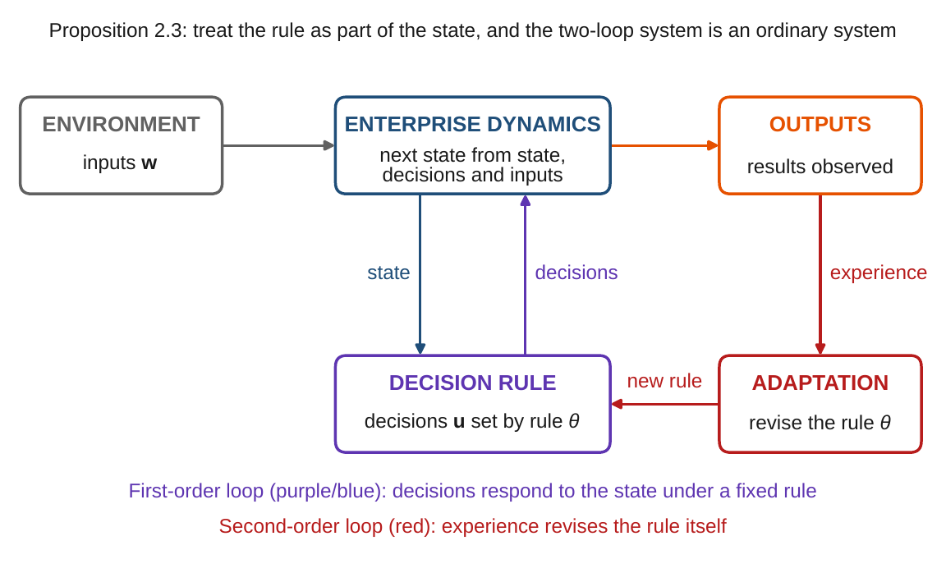
Adaptation changes the rule; count it as state
§2.5 · DEFINITIONS 2.5–2.6 · PROPOSITION 2.3
Feedback (Definition 2.5): a fixed rule sets the decision from the state, u = φ(x)
Adaptation (Definition 2.6): a second-order law revises the rule, θ′ = a(θ, x, y)
Proposition 2.3: with the rule in the state, (x, θ), the adaptive company is an ordinary system
Rules are capital: dynamic capability is the range of rules a company can reach
A model that freezes the rule while the company learns forecasts well, then badly
Figure 2.4. The inner loop sets decisions from the state under the current rule; the outer loop revises the rule from experience.
Notes:
Definitions 2.5-2.6 and Propositions 2.2-2.3; Proposition 2.3's proof is in Appendix 2.A, Proposition 2.2's in Online Appendix 2.B. Changing how a company learns needs a further enlargement; the regress ends with the modeling judgment of Chapter 4.

Slide 14
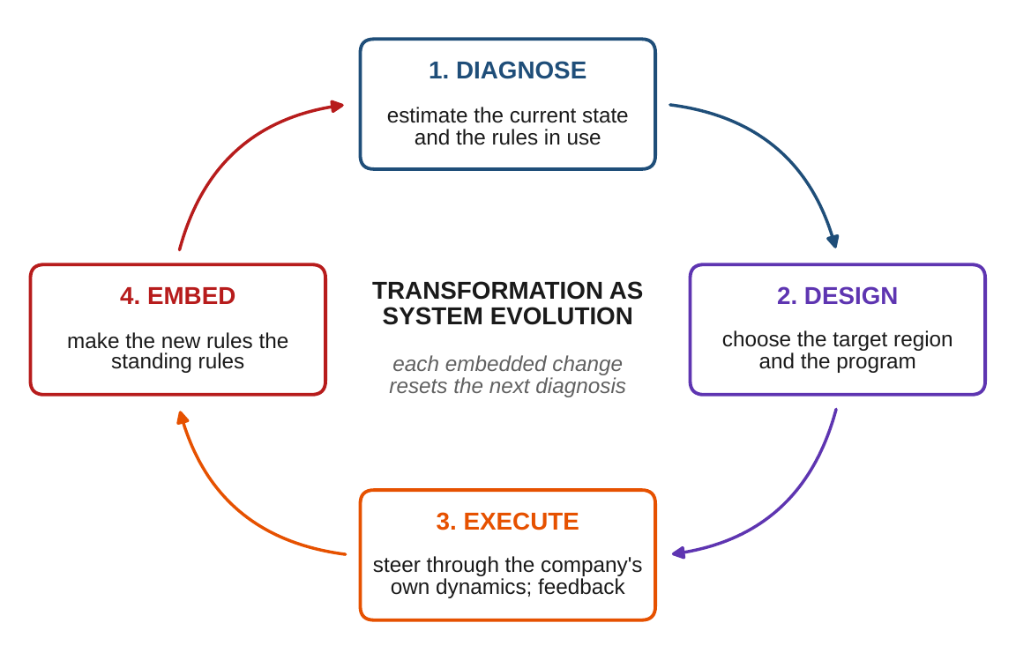
Transformation is designed system change
§2.6 · DEFINITION 2.7 · FIGURE 2.5
Definition 2.7: a designed sequence of decisions, with any revision of rules, structure or boundary
It steers the company into a target region through its own dynamics
It acts under the environment that unfolds: a design must anticipate its variety
Four layers: state, rules, structure, boundary; it aims at a region, not a point
Diagnose, design, execute, embed: each embedded change resets the next diagnosis
Figure 2.5. The transformation lifecycle as system evolution.
Notes:
Section 2.6 and Definition 2.7. LOS Guidance 2.5 applies the four stages to the restructuring: diagnose Meridian's state and rules, design the divestiture and target region, execute through the sale and the quarters after it, and embed new capital-allocation rules.

Slide 15
One lens, four kinds of company
§2.6 · TABLE 2.5
Meridian Industrial Systems
Digital platform
Hospital system
Commercial bank
A slow reinforcing loop: customer migration cuts volume, which raises unit cost, which speeds migration
Cross-side network effects that tip rather than settle
Discharge planning against a workload–fatigue–attrition loop
Withdrawals that beget withdrawals, a loop closed through depositors
The boundary bites at the dealer network and at siblings competing for capital and engineers. Diagnose the loop as structural, not cyclical.
Third-party developers sit outside the boundary but inside the dynamics: the interface carries the growth mechanism.
The boundary bites at referral flows and payer rules; capacity and staffing limits must hold along the whole path.
Regulation is a binding constraint, not a disturbance; the decisions allowed shrink after a shock.
What varies is which couplings are strong, which loops dominate, and where the boundary bites.
Notes:
Table 2.5 reads four kinds of company through the chapter's vocabulary. Industrial Systems' migration loop is the one AXIOM Lab 1.2 maps.

Slide 16
Where does Meridian end?
WORKED EXAMPLE 2.1 · THE SITUATION
$2.56bn
$1.54bn
+20%
Industrial Systems' sales, 61 percent of Meridian's $4.2 billion
shipped to independent dealers: about 60 percent of those sales
the dealers' resale price to end customers, above Meridian's price
The turnaround team treats the dealers as outside the company: its baseline “sales” are $1,540 million
The digital team, planning connected services sold directly to end customers, treats them as inside: $1,848 million
The two baselines for the same products disagree by $308 million; each team suspects the other of an error
Step 1 lists six entities and nine flows (Table 2.6): boundary A has the dealers outside, boundary B inside
Notes:
Worked Example 2.1, the situation. Two teams are preparing Meridian's board materials; the gap between their figures is the subject of Steps 1-6.

Slide 17
Nine flows, two declarations
WORKED EXAMPLE 2.1 · TABLE 2.6
 | From → to | What flows | Boundary A | Boundary B
F1 | suppliers → Meridian | components | input | input
F2 | Meridian → suppliers | payments | output | output
F3 | Meridian → dealers | shipments, $1,540m | output | interior
F4 | dealers → Meridian | payments, $1,540m | input | interior
F5 | dealers → customers | sales, $1,848m | environmental | output
F6 | customers → dealers | payments, $1,848m | environmental | input
F7 | dealers → Meridian | market intelligence | input | interior
F8 | capital markets → Meridian | funding | input | input
F9 | regulator → Meridian | rules | input | input
Values per year. Boundary A: only Meridian inside; boundary B: Meridian and the dealer network. Shaded rows change class.
Interior / input / output / environmental: A 0 / 5 / 2 / 2; B 3 / 4 / 2 / 0. The same nine flows.
Notes:
Table 2.6 (Worked Example 2.1, Steps 1-3): six entities and nine flows. Each class follows from where the flow's two ends lie (Definition 2.3).

Slide 18
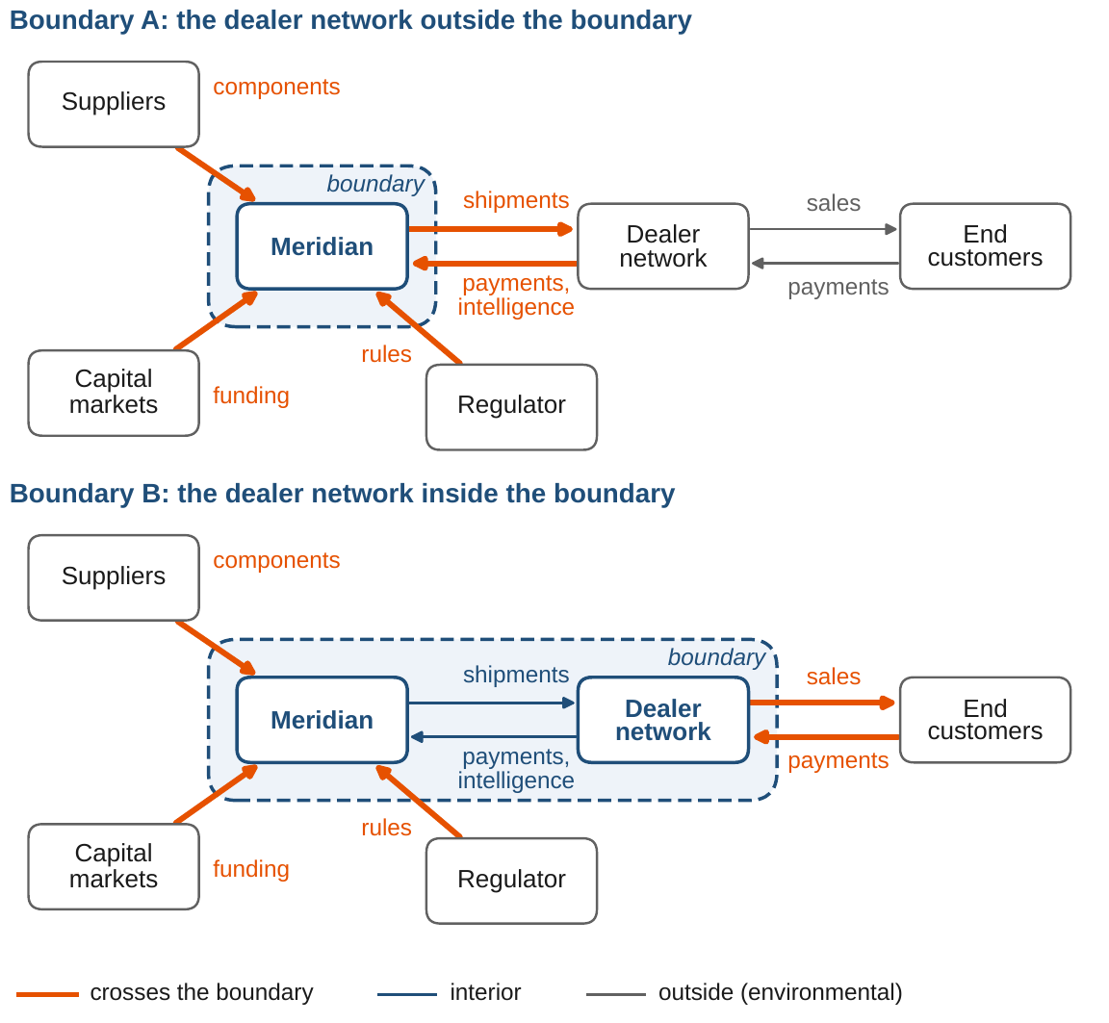
The same money, labeled twice
WORKED EXAMPLE 2.1 · STEPS 2–4
Step 2, boundary A: the goods output is the shipments to dealers, $1,540 million
Dealers' sales never touch the boundary; end demand arrives only as market intelligence
Step 3, boundary B: the goods output is the dealers' sales, $1,540m × 1.20 = $1,848m
Shipments, dealer payments and intelligence turn interior; customers' payments become an input
Step 4: the same nine flows, each in exactly one class; no dollar created or destroyed
Figure 2.2. Top: the dealer network outside the boundary. Bottom: inside. The flows are identical; only their classification changes.
Notes:
Worked Example 2.1, Steps 2-4, and Theorem 2.2, parts (i) and (ii). The two teams agree on the facts.

Slide 19
A boundary difference, not a performance gap
WORKED EXAMPLE 2.1 · STEPS 5–6
$308m
9 flows
5 of 9
the gap, 20 percent of shipments: exactly the dealers' gross margin
the same nine under both boundaries, each in exactly one class
flows relabeled by the move: shipments, payments, sales, intelligence
End-customer demand moves from environmental to the interface: seen directly, if Meridian gets the data
Control does not move with the line: the dealers remain independent businesses
The rule for the board: compare options under one declared boundary, B for the digital option's question, A for the turnaround's
For discussion: which boundary would you use to compare all three options, and what would it hide?
Notes:
Worked Example 2.1, Steps 5-6, what the board should take away, and the discussion question. Theorem 2.2 guarantees the total system is the same under every declaration; what changes is what each team's numbers mean.

Slide 20

Drawing Meridian's boundary, in AXIOM
AXIOM LAB 1.2 · MODULE AXIOM-02
Meridian's CFO wants one definition of “the enterprise” for all board materials on the three options; you are on the finance team. Open AXIOM, choose Lab 1.2 (module AXIOM-02) and load the Meridian entity–flow world.
1
2
3
4
5
Draw boundary A
Move the dealers inside
Change levels
Close the loop
Map a loop
Only Meridian inside: record the inputs, outputs, interior and environmental flows.
Read the conservation panel; repeat with another entity and note which moves change nothing.
Zoom from group to unit; note which parts of Meridian become Digital Solutions' environment.
Run the efficiency example, feedback off and on; vary the gain; switch on adaptation; shift the environment.
Build Industrial Systems' migration loop: volume, unit cost, customer migration; sign each link.
Deliverable: a one-page memo to the CFO recommending a boundary for the board materials: which analyses it supports, which it makes harder, and what it cannot affect. About 45–60 minutes.
Notes:
AXIOM Lab 1.2. What to look for: moving the boundary relabels flows but never changes the total (Theorem 2.2); each division's environment includes its siblings (Definition 2.4); feedback holds a target against the environment's pull, while adaptation trades predictability for flexibility (Proposition 2.3). Supports LOS 2.2, 2.3 and 2.4.

Slide 21
What to carry forward
KEY TAKEAWAYS
1
A company is an open system: its state evolves under management's decisions and the environment's inputs, and no model that projects the future from the present alone can represent it.
2
When next period's state is determined by state, decisions, and environment, the current state is all the history that matters.
3
The boundary is a declaration: it relabels flows as inputs, outputs, or interior, but never changes them, so options must be compared under one declared boundary.
4
Environments are level-relative: each division's environment includes its sibling divisions, and whole-company behavior lives in the coupling between them.
5
Feedback changes decisions; adaptation changes the rule. Counting rules as part of the state keeps adaptive companies analyzable and makes rules a form of capital (Proposition 2.3); transformation is designed change of state, rules, structure, or boundary.
Notes:
Key Takeaways, Chapter 2.

Slide 22
Notebook and workbook reproduce the book
THIS WEEK'S LABORATORY
39
44
26102
AXIOM-02
notebook checkpoints, every one PASS
workbook checks against the engine, ALL PASS
the lab's seed
AXIOM Lab 1.2
Notebook DCT_V1_Ch02_Lab.ipynb: Worked Example 2.1 and the lab's five steps in eight panels, ready for Colab
Workbook DCT_V1_Ch02_Lab.xlsx: Table 2.6 by formula under any boundary you draw, all 64 boundaries, the levels, the feedback bench and the migration loop
Every number on these slides is the book's, and both companions check it
Notes:
The notebook and workbook are on the course website, www.dynamiccorporatetransformation.com.

Slide 23
Chapter 3 gives the state its numbers
NEXT · CHAPTER 3
A company's state is a vector of readings, each with a unit: totals across units need declared weights
Every reasonable distance agrees on what converges and what is stable; measures differ only in the numbers
A program is feasible only if each step delivers the company into the next one's domain, and order matters
Meridian's sequencing of its restructuring and its digital program makes each idea concrete
Notes:
Chapter 3, Mathematical Foundations: Proposition 3.2 (units), Theorem 3.1 (equivalent distances), Proposition 3.1 and Equation 3.4 (feasibility chaining), Theorem 3.2 (order matters). Meridian's sequencing of its restructuring and its digital program makes each idea concrete.

