Slide 1
Enterprise Modeling Principles
VOLUME I · CHAPTER 4 · WEEK 2
A model can be exactly right today and wrong about tomorrow: declare what it represents, test its roll-ups, and trust it only where its record has been
Graduate course companion · Lab seed 26104 · AXIOM Lab 1.4 (AXIOM-04)
Notes:
Volume I, Chapter 4. Three chapters of tools stand ready; this chapter supplies the principles by which company models are built, related across levels, tested, trusted and retired (Section 4.1). Meridian's engineering workforce and its digital program show what is at stake.

Slide 2
“The first principle is that you must not fool yourself—and you are the easiest person to fool.”
Richard P. Feynman
Nobel Prize in Physics 1965; Caltech commencement address (1974)
Notes:
Feynman's first principle opens the chapter. A model that fits history flawlessly is the easiest thing to be fooled by: validation earns trust where the record has been and provably nowhere else (Theorem 4.3).

Slide 3
After this chapter, you can
LEARNING OUTCOME STATEMENTS
4.1
Explain why company models are instruments for answering questions, and state what a modeling contract must declare.
4.2
Distinguish conceptual, logical, mathematical, and computational models, and explain why no analysis can answer a question that a model's representation leaves out.
4.3
Explain when a summary such as a roll-up supports a forecast, and diagnose a broken roll-up using Meridian's engineering workforce.
4.4
Distinguish verification from validation, and explain why validation against history cannot certify a model for a transformation that takes the company somewhere new.
4.5
Apply the modeling contract and the model lifecycle to a Meridian model, including when it must be revalidated.
Notes:
The five learning outcome statements of Chapter 4; LOS Guidance at the end of the chapter explains what a strong answer to each looks like.

Slide 4
Six sections, a worked example and a lab
ROADMAP
§4.1
§4.2
§4.3
§4.4
Enterprise Modeling Philosophy
Model Types and the Representation Bound
Abstraction and Decomposition
Aggregation and Hierarchies
The modeling contract
Table 4.1 · Theorem 4.1
Definitions 4.2–4.3 · Table 4.2
Theorem 4.2 · Table 4.3
§4.5
§4.6
Worked Example 4.1
AXIOM Lab 1.4
Measurement, Validation, and Verification
The Model Lifecycle
When the Roll-Up Breaks
Can We Trust the Model?
Theorem 4.3 · Table 4.4
Figure 4.4
Table 4.5 · Figure 4.2
AXIOM-04 · five steps
Notes:
Section 4.2: Definition 4.1, Theorem 4.1, Proposition 4.1 and Table 4.1. Section 4.3: Definitions 4.2-4.3, Proposition 4.2 and Table 4.2. Section 4.4: Definitions 4.4-4.5, Theorem 4.2, Proposition 4.3 and Table 4.3. Section 4.5: Equation 4.2, Definition 4.6, Theorem 4.3 and Table 4.4. Proofs of Theorems 4.1-4.3 are in Appendix 4.A; those of Propositions 4.1-4.3, with a bound for approximate aggregation, in Online Appendix 4.B.

Slide 5
Every model travels with a contract
§4.1 · ENTERPRISE MODELING PHILOSOPHY
(i) Readings
(ii) Assumptions
(iii) Validated domain
(iv) Lifecycle plan
Readings, with units and measurement conventions
Every assumption, by the classes of Table 4.3
Where the model was validated, and to what tolerance
How the model is monitored, revalidated and retired
Meridian: the eight readings of Table 3.1.
An undeclared assumption is a defect regardless of its truth.
Definition 4.6: the record and its excited domain.
Section 4.6: revalidation follows transformation.
Models are instruments, not portraits: a metro map that distorts every distance is a superb instrument for its question.
Notes:
Section 4.1. Three commitments: models are instruments, not portraits; every modeling choice is a commitment with conditions; trust in a model is bounded by evidence and structure. The modeling contract is not bureaucracy; it is the written form of the chapter's theorems.

Slide 6
A model is a chain of four translations
§4.2 · TABLE 4.1 · DEFINITION 4.1
Type | Medium | Question it settles | Typical failure
Conceptual | diagrams, prose | what matters and how it connects | omitted mechanism; wrong boundary
Logical | structured schema | which readings, links, constraints | hidden variable; category error
Mathematical | spaces, mappings | exact form of dynamics and constraints | unearned assumption (linearity, independence)
Computational | code, data | numbers, paths, optima | implementation bug; discretization artifact
Each type translates its predecessor into a stricter medium; an error introduced at one link travels silently through all later links, which is why every link is verified, not only the last.
Definition 4.1: the completed chain is a model M = (X, μ, f̂, ĝ); the hats mark its claims as claims.
Notes:
Table 4.1 and Definition 4.1 (Equation 4.1): a state space, a measurement convention that turns the company's condition into a represented state, a posited transition and a posited output map. The transition is the modeler's mechanism, to be verified and validated, not the company's own.

Slide 7
No analysis extracts what the model lacks
§4.2 · THEOREM 4.1 · PROPOSITION 4.1
For Meridian
THEOREM 4.1
Enterprise Model Representation Theorem
No reading of talent concentration: no dashboard can judge the program's key-person risk
Stage balances say where working capital is trapped, not why export receivables age
The remedy is never cleverer analysis but a richer representation
Box's aphorism made exact: every model is wrong, and useful for the questions it represents
For every enterprise question there is a model that can answer it
Conversely, a model can answer a question only if the question depends on nothing but the readings it represents
A question that depends on a reading outside the model cannot be answered there by any analysis
Proposition 4.1: completeness is always relative to a declared class of questions
Notes:
Theorem 4.1; formal statement and proof in Appendix 4.A; Proposition 4.1 in Online Appendix 4.B. An enterprise question is any quantity computed from the company's readings over a horizon. A question the model cannot express is not hard in that model: any number produced under its name answers a different question.

Slide 8
Each step down the ladder is an abstraction
§4.3 · DEFINITIONS 4.2–4.3 · TABLE 4.2
Level | Description | Typical readings | Typical questions
L3 | group | the eight readings of Table 3.1 | board strategy
L2 | divisions | capital, performance, and risk by division | portfolio allocation
L1 | business units, plants | backlog, capacity, skill mix by unit | operations design
L0 | transactions, individuals | orders, postings, employees | process forensics
Abstraction (Definition 4.2) discards detail by lumping fine states into fibers; decomposition (Definition 4.3) splits the state into blocks and keeps everything: its content is the coupling structure.
Proposition 4.2: no abstraction is automatically safe for forecasting; it depends on the dynamics too.
Notes:
Table 4.2, the Meridian abstraction ladder, and Proposition 4.2 (formal statement and proof in Online Appendix 4.B). What goes wrong is simple to state: the fine dynamics can split a fiber, sending states the abstraction lumped together to places it tells apart. Sparse coupling is Simon's near-decomposability.

Slide 9
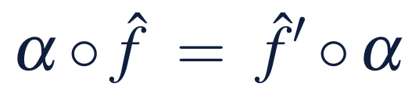
A roll-up forecasts only if dynamics respect it
§4.4 · THEOREM 4.2 · PROPOSITION 4.3
What it means
THEOREM 4.2
Hierarchical Consistency Theorem
A divisional summary forecasts only if units with the same totals have the same future
Summarize along directions the dynamics do not split, or carry the mix up into the summary
Consolidated statements are exact as accounting and conditional as dynamics
Proposition 4.3: consistency between adjacent levels composes up the hierarchy
A summary supports its own forecasting model exactly when the detailed dynamics never split what it lumps together
Then the summary model is unique and agrees with the rolled-up detailed model at every horizon
For linear dynamics the test is a calculation: A ker P ⊆ ker P (Appendix 4.A)
Notes:
Definition 4.4 and Theorem 4.2; formal statement and proof in Appendix 4.A; Proposition 4.3 in Online Appendix 4.B. Approximate aggregation is sound engineering when its error is measured and budgeted, and silent malpractice when it is not (the Scope and Limits note; Online Appendix 4.B bounds the error).

Slide 10
Declare every assumption, by its class
§4.4 · TABLE 4.3 · DEFINITION 4.5
Class | Content | Meridian instances
Structural | which mechanisms exist; coupling; functional forms | modernization affects efficiency with a one-period lag
Parametric | values and ranges of named parameters | talent attrition between 6 and 11 percent a year
Domain | the region where the model is asserted | leverage at most 4.5×; no acquisitions
Measurement | proxies, error sizes, and delays for each reading | capability index: survey proxy, ±5 points, twice a year
Horizon | periods over which conclusions are claimed | 12 quarters
An undeclared assumption is a defect regardless of its truth.
Definition 4.5: internally consistent means the model's own transition never leaves its admissible region.
Notes:
Table 4.3 and Definition 4.5. Internal consistency is the humbler condition and the more often violated: a model whose simulated leverage goes negative, or whose capability index leaves 0-100, asserts states its own description declares impossible.

Slide 11
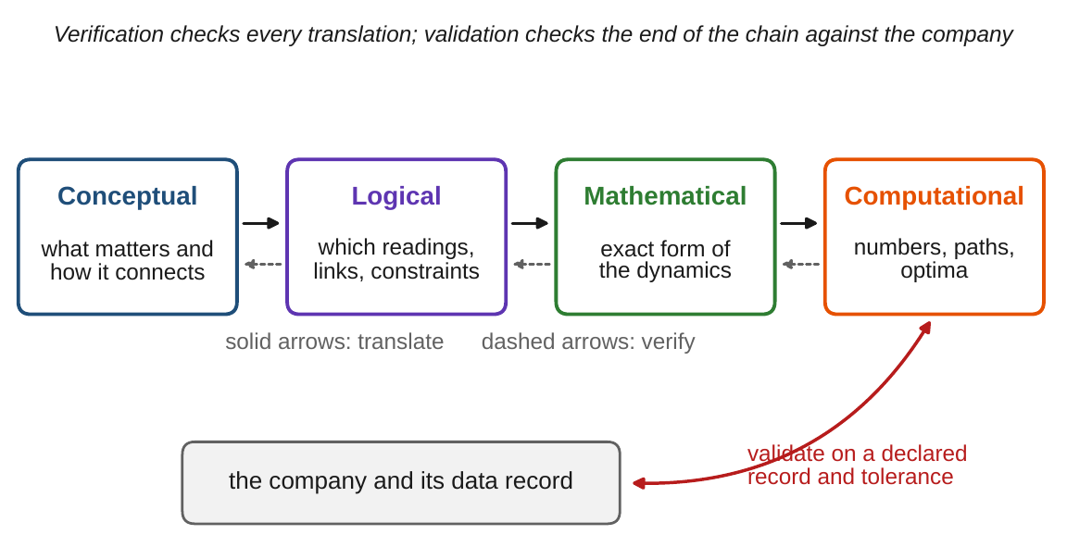
Verification and validation are different tests
§4.5 · EQUATION 4.2 · FIGURE 4.1
Measurement: a recorded reading is its proxy plus an error, m = μ(x) + η (Equation 4.2)
Some readings are observed directly, some are index proxies with material error, some are latent
Verification: is each translation faithful? Internal: settled by proof, test, inspection
Validation: does the end of the chain track the company? Empirical: against measured outputs
A perfectly verified chain can faithfully implement a wrong idea
Figure 4.1. Verification checks each translation link; validation checks the end of the chain against the company, on a declared record and tolerance.
Notes:
Section 4.5, Equation 4.2 and Figure 4.1. Meridian's capability index is a survey proxy with an error of ±5 points, read twice a year (Table 4.3); organizational cohesion is latent, with no declared proxy. Measurement can be least precise exactly when stress makes it most important. Whether outputs determine states is the observability question, Chapter 7.

Slide 12
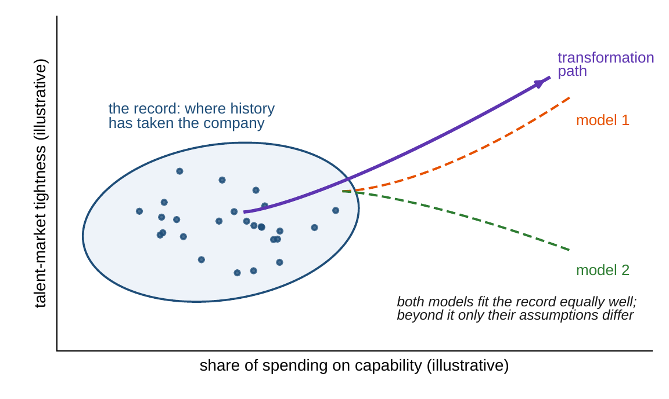
A fit certifies only where the record has been
§4.5 · DEFINITION 4.6 · THEOREM 4.3
Theorem 4.3: another model can fit the same record exactly as well, yet differ off it by any amount
No test computed from the record can tell the two apart
Transformation is, by design, an excursion beyond the record
Fitted curves say nothing off the record; mechanisms credentialed elsewhere earn reach
Extrapolation is bought with assumptions: name the one that carries each number
Figure 4.3. The record covers the shaded region; Meridian's transformation path leaves it by design, and two models that fit the record equally well fan apart.
Notes:
Definition 4.6 and Theorem 4.3 (Model Validation Theorem); formal statement and proof in Appendix 4.A. This is an allocation of burden, not counsel of despair: an attrition mechanism validated across other companies' transformations travels; a fitted revenue curve does not. Volume II's robust methods optimize against every model the evidence cannot separate.

Slide 13
Audit the domain before trusting a projection
§4.5 · TABLE 4.4
Stage | Items
Verification | mathematics renders the logic; code implements the mathematics (tests on known solutions); constraints preserved (internal consistency, Definition 4.5)
Validation | data record declared; distance and tolerance declared; discrepancy reported against tolerance; measurement error of each output stated
Domain | excited domain described (ranges visited, couplings exercised); intended use compared with it; conclusions beyond it annotated with the assumptions that carry them
Monitoring | drift indicators and revalidation triggers defined (Section 4.6)
Meridian's digital-program model, validated on seven years of history: leverage and liquidity stay in range; history has no year with capability spending above 40 percent of capital spending.
Every projection through those regions is carried by structural assumptions; the report should say so.
Notes:
Table 4.4 and Section 4.5's domain audit. The record also has no period of running two platforms side by side and no talent market like the one the hiring plan assumes. The projections there rest on an attrition mechanism credentialed elsewhere and an adoption mechanism declared as an assumption rather than fitted.

Slide 14
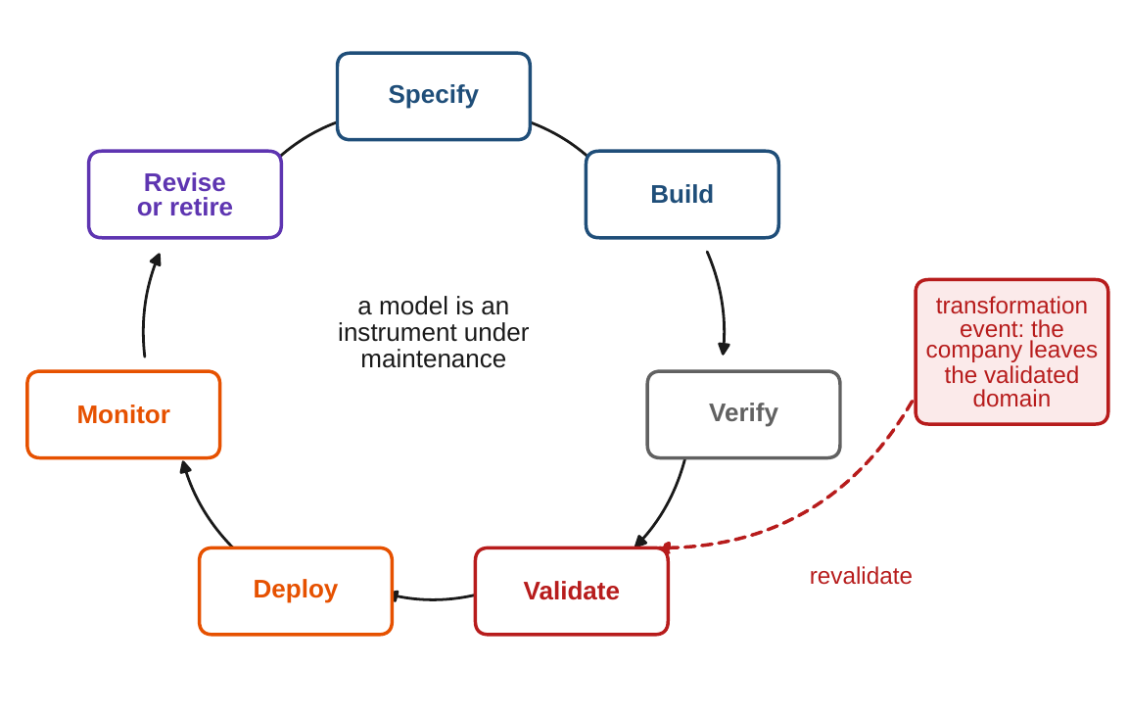
Revalidation follows transformation
§4.6 · FIGURE 4.4
Specify, build, verify, validate, deploy, monitor, revise or retire: an instrument under maintenance
Deploy within the validated domain, and annotate any use beyond it
A completed transformation leaves the domain the models were validated on
Programs must budget for remodeling as they budget for retraining
Retirement is a success mode: the failure is the model kept past its domain
Figure 4.4. The DCT model lifecycle. A transformation event takes the company outside the validated domain and forces revalidation.
Notes:
Section 4.6 and Figure 4.4. Models drift out of date unless they are managed: parameters wander, mechanisms appear and retire, and the change is often the company's own learning (Chapter 2's adaptation).

Slide 15
Two units, the same headcount, two futures
WORKED EXAMPLE 4.1 · THE SITUATION
Unit A
Unit B
The planning model
400 legacy and 100 software engineers
100 legacy and 400 software engineers
One attrition rate for each unit's total
500 in all: one software engineer in five.
500 in all: four software engineers in five.
The HR dashboard tracks engineers by unit.
The legacy pool
The software pool
The board's question
8% leave it each year
4% leave each year
Can a total forecast each unit?
5% leave the company; 3% are retrained into software skills.
It gains the legacy engineers retrained into software.
The digital program needs software engineers.
Meridian's HR dashboard tracks the number of engineers in each unit of Industrial Systems.
Notes:
Worked Example 4.1, When the Roll-Up Breaks: the situation. The dashboard tracks the number of engineers in each unit; the planning model projects each unit's total with one attrition rate.

Slide 16
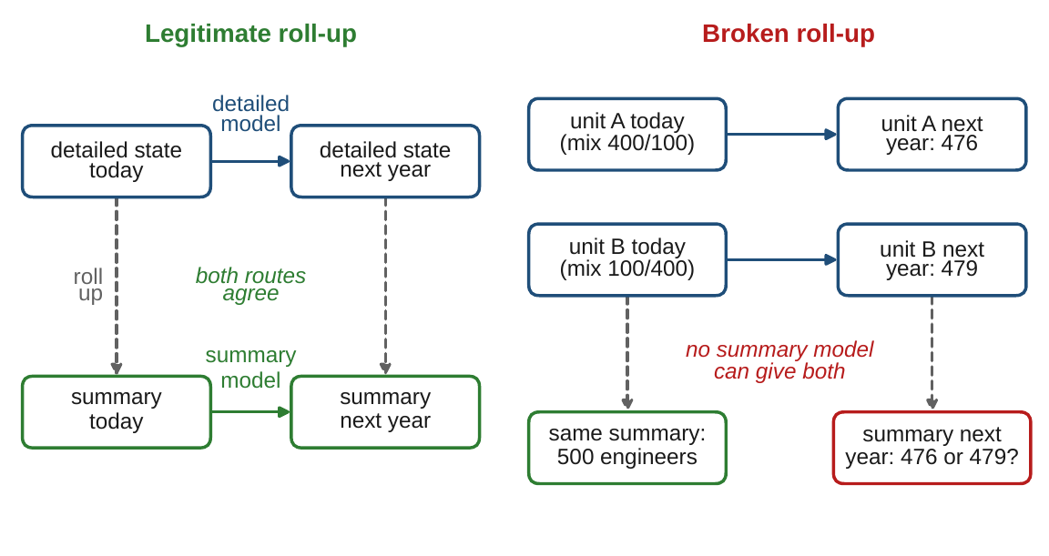
The total alone is not a state
WORKED EXAMPLE 4.1 · STEPS 1–2 · FIGURE 4.2
Step 1: Unit A next year: 0.92 × 400 = 368 legacy, 0.96 × 100 + 0.03 × 400 = 108 software: 476
Unit B: 0.92 × 100 = 92 legacy, 0.96 × 400 + 0.03 × 100 = 387 software: 479
Step 2: the same total today, 500; different totals next year
By Theorem 4.2 no model that forecasts from the total alone can be right for both units
Appendix 4.A: A(1, −1) = (0.92, −0.93) lies outside ker P
Figure 4.2. Left: a legitimate roll-up, both routes agree. Right: the same total today, 476 or 479 next year, so no summary model can serve both.
Notes:
Worked Example 4.1, Steps 1-2, Figure 4.2 and Appendix 4.A: with A = [[0.92, 0], [0.03, 0.96]] and P = [1 1], ker P is spanned by (1, -1). The headcount roll-up is exact as arithmetic and broken as a forecast.

Slide 17
A total-only model drifts as the mix shifts
WORKED EXAMPLE 4.1 · STEP 3 · TABLE 4.5
Year | 0 | 1 | 2 | 3 | 4 | 5
Unit A, detailed model | 500 | 476.0 | 453.3 | 431.8 | 411.4 | 392.1
Unit B, detailed model | 500 | 479.0 | 458.9 | 439.7 | 421.3 | 403.8
Total-only model (× 0.952 a year) | 500 | 476.0 | 453.2 | 431.4 | 410.7 | 391.0
Error for Unit B | 0 | −3.0 | −5.8 | −8.3 | −10.7 | −12.8
Total engineers, by unit, under the detailed model and under a total-only model calibrated on Unit A's first year: total next year = total today × 0.952.
The model under-forecasts Unit B by 3 engineers in year one and by about 13 by year five.
Notes:
Table 4.5 and Step 3. The error grows because the mix keeps shifting. Online Appendix 4.B: a summary model with a small error each period is acceptable only if the error is budgeted over the horizon; with L near one it grows roughly in proportion to the number of periods.

Slide 18

Carry the mix, and the roll-up holds
WORKED EXAMPLE 4.1 · STEPS 4–5
next year's total from this year's total H and software share s: exact for every unit
Step 4: by year five the totals are close, 392.1 and 403.8; the software engineers are not, 128.4 and 337.9
The digital program needs software engineers: the dashboard misstates the capacity the board most needs to see
Step 5: 500 × (0.95 + 0.01 × 0.2) = 476 for Unit A and 500 × (0.95 + 0.01 × 0.8) = 479 for Unit B
The enlarged summary satisfies the condition of Theorem 4.2
Notes:
Worked Example 4.1, Steps 4-5. Totals and software engineers in year five from the detailed model (Table 4.5). Today the two units are the same dashboard state and differ by 300 software engineers: the representation bound of Theorem 4.1. Carrying the share repairs the summary.

Slide 19
Exact today, wrong about tomorrow
WORKED EXAMPLE 4.1 · WHAT THE BOARD SHOULD TAKE AWAY
500 = 500
12.8
476, 479
the same total today: the dashboard cannot tell the two units apart
engineers by which the total-only model under-forecasts Unit B by year five
next year's totals from the total and the software share, matching Step 1
A summary can be exactly right today and still mislead about tomorrow
Before using a roll-up to forecast, check that units with the same summary have the same future
If they do not, carry the missing mix into the summary
For discussion: which Meridian roll-ups—revenue by division, capital spending, customer counts—break this way?
Notes:
Worked Example 4.1, what the board should take away, and the discussion question: which other Meridian roll-ups might break the same way, and what mix would you carry to repair each?

Slide 20

Testing the planning model, in AXIOM
AXIOM LAB 1.4 · MODULE AXIOM-04
The board is about to approve Meridian's digital program on the strength of a planning model that fits seven years of history well. How far can it be trusted somewhere Meridian has never been? Open AXIOM, choose Lab 1.4 (module AXIOM-04) and load the Meridian modeling bench.
1
2
3
4
5
Walk the chain
Test a roll-up
Fit and extrapolate
Leave the record
Set triggers
Follow the working-capital question from diagram to code; note what each verification checkpoint tests.
Roll Industrial Systems' engineers up to one total; add the skill mix and test again.
Fit a simple and a rich model to one adoption history; compare history and later quarters.
Fit two models equally well, run both through the digital program, watch them separate.
Replay five years of use with drift; set the triggers that send the model back.
Deliverable: a one-page modeling contract for the digital-program model: the readings and units, the assumption classes of Table 4.3, the validated domain, and the revalidation triggers. About 45–60 minutes.
Notes:
AXIOM Lab 1.4. What to look for: the total-only summary drifts while the mix-aware summary holds (Theorem 4.2); the better fit on history can be the worse forecast; two models indistinguishable on the record can disagree sharply beyond it (Theorem 4.3). Supports LOS 4.3, 4.4 and 4.5.

Slide 21
What to carry forward
KEY TAKEAWAYS
1
Models are instruments for questions; every DCT model carries a modeling contract declaring readings, assumptions, validated domain, and lifecycle plan.
2
No analysis extracts what the representation lacks: a question that depends on a missing reading is unanswerable in that model.
3
A summary supports a forecast only if units with the same summary have the same future; a roll-up can be exact today and wrong tomorrow.
4
Verification checks the chain; validation checks the end against evidence, and certifies the model only where the record has been.
5
Transformation leaves the record by design, so its forecasts rest on mechanisms, and transformation programs must schedule revalidation.
Notes:
Key Takeaways, Chapter 4: the modeling contract (Section 4.1), Theorem 4.1, Theorem 4.2 with Worked Example 4.1, Theorem 4.3, and the lifecycle of Section 4.6.

Slide 22
Notebook and workbook reproduce the book
THIS WEEK'S LABORATORY
54
66
26104
AXIOM-04
notebook checkpoints, every one PASS
workbook checks against the engine, ALL PASS
the lab's seed
AXIOM Lab 1.4
Notebook DCT_V1_Ch04_Lab.ipynb: Worked Example 4.1 and the lab's five steps in eight panels, ready for Colab
Workbook DCT_V1_Ch04_Lab.xlsx: Table 4.5, the roll-up test for any summary, the repair, the bench, the record and the triggers, in formulas
Every number on these slides is the book's, and both companions check it
Notes:
The notebook and workbook are on the course website, www.dynamiccorporatetransformation.com. The lab's seed 26104 is used only for the bench's new draws, labelled as such.

Slide 23

Chapter 5 asks what the state must remember
NEXT · CHAPTER 5
The minimal state is the memory the future requires: possible pasts sorted by their consequences (Theorem 5.1)
Worked Example 4.1 was a first instance: the total merges two units with different futures; the total with the mix does not
Balance sheets, capabilities and order books belong in the state; sunk costs do not
From a single observed step, how long a turnaround takes to settle (Equation 5.1), and why stability is not success
Notes:
Chapter 5, Enterprise State Representation: Definition 5.1 and Theorem 5.1 (Enterprise State Representation Theorem); feasible regions walled in by covenants, liquidity floors and capacity; Theorem 5.4 and its contraction bound, Equation 5.1; Meridian's turnaround delivers the lesson that stability is not success.

