Slide 1
Enterprise State Architecture
VOLUME I · CHAPTER 9 · WEEK 5
A company is drawn as an org chart but behaves as a wiring diagram: its arrows are testable claims, and the wiring sets a speed limit on every shock
Graduate course companion · Lab seed 26109 · AXIOM Lab 1.9 (AXIOM-09)
Notes:
Volume I, Chapter 9. Part II built the mathematics of the company in general: any state, any transformation, any dynamics, any noise. Part III builds it around what companies are made of, and this chapter builds the first and foundational architecture, the Enterprise State Architecture (Section 9.1).

Slide 2
“We shape our buildings and afterwards our buildings shape us.”
Winston S. Churchill
Nobel Prize in Literature 1953; House of Commons (1943)
Notes:
Winston Churchill to the House of Commons, 28 October 1943, on rebuilding the bombed Commons chamber. The structure a company draws shapes what it can do; this chapter makes that structure an object with theorems (Section 9.1).

Slide 3
After this chapter, you can
LEARNING OUTCOME STATEMENTS
9.1
Explain what an enterprise state architecture adds to a description of a company's state—components, typed wiring, and scoped constraints—and why both its arrows and its missing arrows are testable claims.
9.2
Use a dependency graph to determine which parts of a company a shock can reach, how soon at the earliest, and what it would take to insulate one part from another.
9.3
Identify a company's feedback cores and causal layers, compare them with its org chart, and explain why a summary dependency map can prove separations but not connections.
9.4
Explain why policies that are compatible pair by pair can be impossible to meet together, and decide where bilateral sign-off suffices and where a joint review is required.
9.5
Judge whether an architecture can answer the questions put to it, audit it with the validation checklist, and read its complexity measures for what they show and what they cannot see.
Notes:
The five learning outcome statements; LOS Guidance at the end of the chapter.

Slide 4
Eight sections, a worked example and a lab
ROADMAP
§9.1
§9.2
§9.3
§9.4
§9.5
From Org Chart to Wiring Diagram
Architecture versus Representation
Enterprise Topology and State Dependencies
Structural Dependency and Propagation
Hierarchical Enterprise States
four questions, made computable
Definition 9.1 · Theorem 9.1
Table 9.2 · Figure 9.1
Theorem 9.2 · Proposition 9.3
Theorem 9.3 · Figure 9.2
§9.6
§9.7
§9.8
Worked Example 9.1
AXIOM Lab 1.9
Architectural Constraints and Consistency
Architectural Completeness and Validation
Architecture Metrics and Complexity
How Fast Can a Demand Shock Reach the Covenant?
Wiring Meridian
Theorem 9.4 · Figure 9.3
Theorem 9.5 · Table 9.4
Definition 9.10 · Table 9.5
Table 9.7 · Figures 9.1–9.3
AXIOM-09 · five steps
Notes:
Section 9.2: Definitions 9.1-9.2, Proposition 9.1, Theorem 9.1 and Table 9.1. Section 9.3: Definitions 9.3-9.5, Proposition 9.2, Table 9.2 and Figure 9.1. Section 9.4: Theorem 9.2 and Proposition 9.3. Section 9.5: Definition 9.6, Proposition 9.4, Theorem 9.3 and Figure 9.2. Section 9.6: Definitions 9.7-9.8, Proposition 9.5, Theorem 9.4, Table 9.3 and Figure 9.3. Section 9.7: Definition 9.9, Theorem 9.5 and Table 9.4. Section 9.8: Definition 9.10, Proposition 9.6 and Tables 9.5-9.6. Worked Example 9.1: Table 9.7. AXIOM Lab 1.9: module AXIOM-09, five steps. Proofs of Theorems 9.2-9.4 are in Appendix 9.A; Theorems 9.1 and 9.5 and Propositions 9.1-9.6 in Online Appendix 9.B.

Slide 5
Arguments become computations
§9.1 · FROM ORG CHART TO WIRING DIAGRAM
Contagion
Summary maps
How fast can a fall in demand reach the loan covenant?
Is the divisional dependency map trustworthy?
No faster than the number of arrows between them (Theorem 9.2).
In one direction only (Theorem 9.3).
Policies
Hierarchy
Can rules agreed pair by pair be impossible to meet together?
Is there a natural hierarchy beneath the org chart?
Exactly when the constraints form a cycle (Theorem 9.4).
Yes, and it can be computed (Proposition 9.3).
The architecture is the state space with its organization: components, wiring and constraints as one object.
Notes:
Section 9.1. No executive meets a company as one vector in one space; one meets divisions, functions, subsidiaries and platforms, wired by flows of cash, capability, demand and obligation, and bound by constraints that reach across the wiring. The chapter's mathematical spine is the theory of directed graphs; it uses only elementary graph theory, and network optimization belongs to Volume II.

Slide 6

An architecture is a triple
§9.2 · DEFINITIONS 9.1–9.2 · TABLE 9.1
a structured state space, a relationship structure, and a constraint family with scopes
Components V, each with its own state: Meridian's divisions IND, DIG and MAT, engineering ENG, treasury TRS, the market MKT and governance GOV
Wiring: a typed dependency graph D = (V, E), Meridian's demand, cash, funding, capability and policy arrows
Constraints, each with a scope: local (covenant, liquidity floor, plant capacity) or coupling (risk ceiling, capability floor)
Interfaces (Definition 9.2): treasury exposes funding capacity; engineering, the workforce-capability index
Notes:
Definitions 9.1-9.2 and Table 9.1, with Meridian's instance. A representation (Chapter 4) says what is measured; an architecture says how what is measured is organized. Interfaces matter more than they look: what a component can read of the others shapes its behavior as much as its own state does.

Slide 7
Arrows are dependences; missing arrows, claims
§9.2 · THEOREM 9.1
What it means
THEOREM 9.1
Enterprise State Architecture Representation Theorem
An arrow asserts a dependence; a missing arrow, an independence
“Materials does not depend on treasury” is a strong claim of the second kind
Wiring diagrams compute: an interfaced architecture is the company model
Proposition 9.1: every declared decomposition gives an architecture
(i) Systems induce architectures. Draw u → v exactly when v's next state changes with u's: the canonical graph is the minimal sufficient wiring
(ii) Architectures assemble into systems. Interface-backed components assemble into one company model with a unique path from every start
(iii) The two constructions agree. Assembling the canonical architecture of a model gives back the model
Notes:
Theorem 9.1; formal statement and proof in Online Appendix 9.B. Part (ii) is the assembled system of Appendix 9.A (Equation 9.1): each component's next state is computed from its own state, the states of the components with arrows into it, and the common decisions and environment. Interface discipline is not documentation hygiene: an arrow that needs a reading its source does not expose leaves the company's own dynamics undefined (Proposition 9.5).

Slide 8
Every arrow carries a declared type
§9.3 · DEFINITION 9.3 · TABLE 9.2
Type | What the arrow asserts | Meridian instance
Dynamic | v's next state changes with u's state | demand: MKT to each division
Resource flow | a conserved quantity (cash, people, materials) crosses the arrow | cash: divisions to TRS; funding: TRS to IND, DIG; capability: ENG to and from IND, DIG
Informational | v reads u's signals or decisions; nothing is conserved | policy: GOV to TRS, DIG
Constraint coupling | u and v appear in one constraint | strategic-risk ceiling across the divisions; capability floor, ENG–DIG
Table 9.2. One arrow may carry several types (every resource flow is also a dynamic dependence); each analysis declares which layer it reads.
Proposition 9.2. The canonical graph is minimal and sufficient: it misses no channel and reports no vacuous one.
Notes:
Definitions 9.3-9.4, Table 9.2 and Proposition 9.2 (formal statement and proof in Online Appendix 9.B). Enterprise topology is meant in the network sense, connections, routes and loops, not the mathematician's sense of nearness between states.

Slide 9
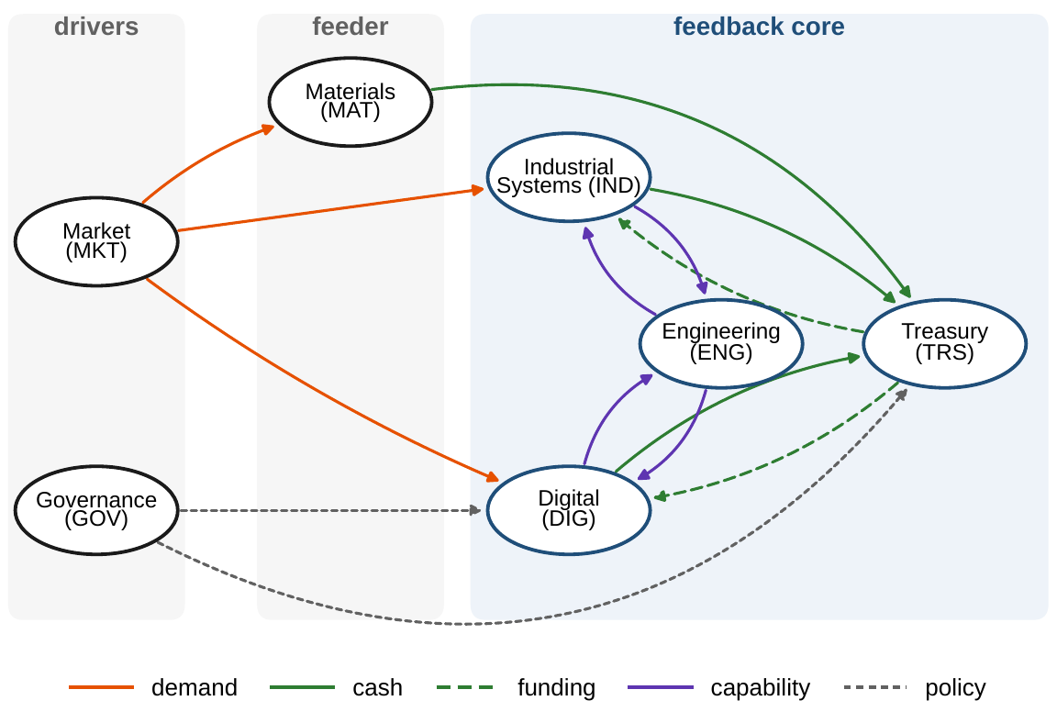
One feedback core, three causal layers
§9.3 · DEFINITION 9.5 · FIGURE 9.1
Definition 9.5. A feedback core is a strongly connected component of several members
Meridian: seven components, fourteen arrows, one core, {IND, DIG, ENG, TRS}, with six loops
Layers: drivers (market, governance), a feeder (Materials), the core
Distances by breadth-first search, cores by Tarjan's algorithm: a fraction of a second
Figure 9.1. Meridian's state architecture: seven components joined by fourteen typed arrows; the shaded bands are the causal layers.
Notes:
Definition 9.5 and Figure 9.1. The six loops are the four two-way relationships, cash and funding between treasury and each of Industrial Systems and Digital and capability between engineering and each of them, and two loops through all four members. The condensation, one node per strongly connected component, is the company's one-way causal skeleton.

Slide 10
The wiring is a speed limit
§9.4 · THEOREM 9.2 · PROPOSITION 9.3
What it means
THEOREM 9.2
Structural Dependency Theorem
Contagion: a demand shock reaches the covenant no sooner than two quarters: a floor, not a forecast
Quarantine: every path must be cut; a component reached by three separate routes needs three cuts
Feedback geography: Meridian's core concentrates its leverage and its instability risk
Proposition 9.3: every company owns a causal hierarchy that no one drew
(i) Influence travels only along paths. With no path from u to v, a shock to u never changes v
(ii) Propagation is no faster than distance. Graph distance is a floor on arrival time
(iii) Feedback lives in the cores. Between the components of the condensation, influence runs one way
Scope. It bounds whether and how soon, not how much: that is a route sum (Online Appendix 9.B.2)
Notes:
Theorem 9.2 (proof in Appendix 9.A) and Proposition 9.3 (Online Appendix 9.B). The theorem bounds whether and how soon at the earliest, not how much: how much arrives is bounded by the sum over all routes of the products of their sensitivities (Online Appendix 9.B.2). Influence is not co-movement: components can move together because they share a driver, as the operating divisions share the market.

Slide 11
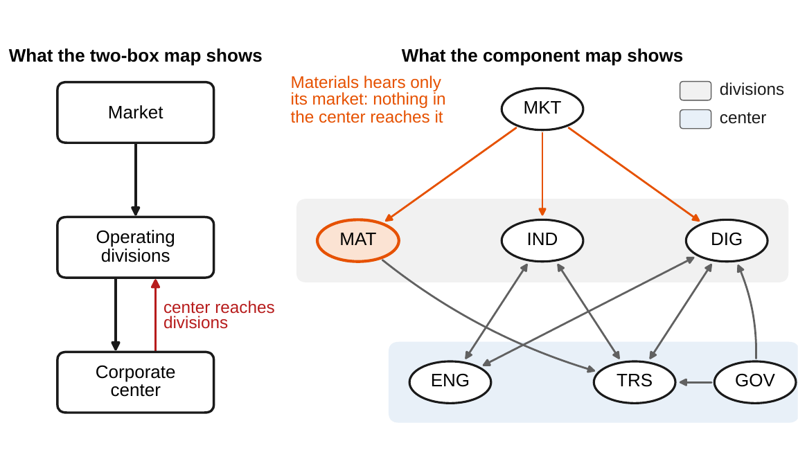
Trust summary maps one way
§9.5 · THEOREM 9.3 · FIGURE 9.2
Theorem 9.3. Aggregation keeps every real path and never lengthens one; it can invent paths
On the two-box map, the corporate center reaches the operating divisions
True for Industrial Systems and Digital; false for Materials, which nothing in the center reaches
Clear with the summary map; drill down to confirm a connection
Boxes that are feedback cores invent no path (Online Appendix 9.B.3)
Figure 9.2. Left: Meridian's two-box map. Right: the component map; double-headed arrows mark two-way dependencies.
Notes:
Theorem 9.3 (proof in Appendix 9.A), Definition 9.6 and Proposition 9.4. Aggregation overstates coupling: the absence of a path on a summary map proves the absence of every underlying path, while its presence proves nothing. The divisions box is not strongly connected, since no arrow runs between two divisions. Aggregating by Meridian's causal structure, into the market, governance, Materials and the core, invents no connection.

Slide 12
Compatible pair by pair, impossible together
§9.6 · THEOREM 9.4
The audit rule
THEOREM 9.4
Architectural Consistency Theorem
Count the cycles of the constraint graph: the cycle measure β
Sign off bilaterally on the tree-shaped parts; hold one joint review per cycle, of exactly its members
Each sign-off must cover everything that binds the pair
A group rule links every pair in its scope and closes a cycle (Online Appendix 9.B.6)
(i) Cycles defeat local checks. Constraints can pass every bilateral check, any two can be met, and all together cannot
Three planning rules, each acceptable to the two units it binds, would put the budget three months after itself
(ii) Trees are safe. With no cycle, bilateral arc-consistency guarantees a plan meeting every constraint
Notes:
Theorem 9.4 (proof in Appendix 9.A) and Definitions 9.7-9.8. The three rules: the budget at least a month after the capacity plan, the capacity plan at least a month after the hiring plan, and the hiring plan at least a month after the budget; any two can be met. The plan under part (ii) is built by fixing an acceptable setting for one component and extending outward, one link at a time. Bilateral sign-off is the only way distributed institutions can check compatibility; part (ii) certifies that practice on hub-and-spoke structures and part (i) locates its failure in a cycle of mutual accommodation. Proposition 9.5: an inconsistent architecture describes no company. Online Appendix 9.B.4: dates under such rules are feasible exactly when no cycle has negative weight.

Slide 13
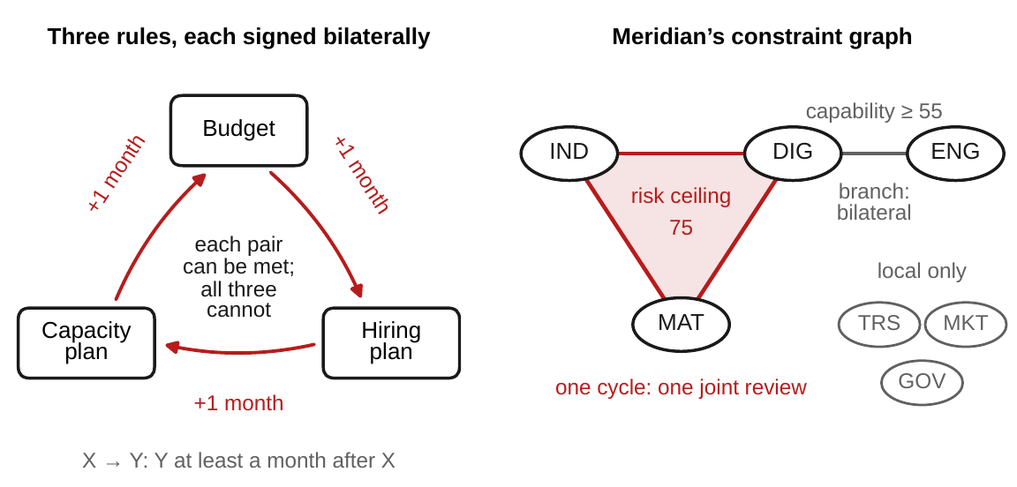
Cycles, not counts, decide joint review
§9.6 · TABLE 9.3 · FIGURE 9.3
Covenant and liquidity floor at treasury, plant capacity at Industrial Systems: local
The risk ceiling of 75 couples the three divisions: a triangle, one cycle
The capability floor of 55 couples engineering and Digital: a branch
β = 4 − 7 + 4 = 1: one joint review, of the three division heads
Treasury, the market and governance carry local constraints only
Figure 9.3. Left: three planning rules, each acceptable to the two units it binds, that cannot all hold. Right: Meridian's constraint graph.
Notes:
Table 9.3 and Figure 9.3. The liquidity floor and the risk ceiling are board policies the company can revise; the covenant only the lenders can change. The constraint graph has four links, seven components and four separate pieces, so its cycle measure is 4 - 7 + 4 = 1 (Worked Example 9.1, Step 4).

Slide 14
Every architectural claim has an audit row
§9.7 · THEOREM 9.5 · TABLE 9.4
Stage | Checks
Interfaces | every arrow interface-backed, so the components assemble (Proposition 9.5); exposed readings versioned
Wiring | each arrow witnessed by a situation in which it is active (Theorem 9.1(i)); missing arrows tested as claims of independence; cores and layers computed and reviewed
Constraints | scopes declared; cycles listed; bilateral sign-off on the tree-shaped parts and one joint review per cycle (Theorem 9.4)
Hierarchy | aggregations tested (Theorem 4.2); summary maps used one way only (Theorem 9.3)
Completeness | question class declared; supports covered (Theorem 9.5); unanswerable questions listed with the enrichment that would admit them
Table 9.4, extending Table 4.4. AXIOM automates every row that can be computed.
Theorem 9.5. An architecture answers exactly the questions whose support it covers.
Notes:
Theorem 9.5 (Online Appendix 9.B) and Table 9.4. Meridian's architecture can bound how soon a demand shock reaches the covenant, because the question's support, the market, the divisions, treasury and the arrows among them, is declared. It cannot say which customers' orders will fall first: no component holds customer-level readings. Adding structure never shrinks the answerable set; aggregation spends completeness.

Slide 15
Read the panel, not a single score
§9.8 · DEFINITION 9.10 · TABLE 9.5
14
0.33
8
4
2
arrows on 7 components
density: 14 of the 42 possible arrows
cycle measure: 14 − 7 + 1
members of the one core, with 6 loops
depth of the condensation
Definition 9.10. Size, density, the cycle measure β = |E| − |V| + p, feedback mass, condensation depth, hierarchy depth
Each measure has a reading and a blindness (Table 9.5): none says how strong the loops are
Routes multiply: 3 routes of two steps from the market to treasury, 10 of four, 40 of six
Proposition 9.6. An added arrow never lowers density, β, a route count or a core
Notes:
Definition 9.10, Table 9.5, Proposition 9.6 and Section 9.8's Meridian numbers. Each two-way relationship counts as a loop in the cycle measure: the four two-way relationships contribute four, and the graph with directions ignored the other four (Online Appendix 9.B.7). The constraint graph is much sparser, with β = 1. Metrics read the wiring and are blind to the dynamics; pricing what they find is the work of Part II.

Slide 16
Architectures differ in where loops sit
§9.8 · TABLE 9.6
Company | Architectural signature | What it means for management
Commercial bank | nearly everything in one core; capital and liquidity rules are wide couplings on it | stability is a feedback question; bilateral compliance checks are insufficient: consolidated supervision is a necessity
Hospital network | nearly a one-way chain, intake to discharge, with readmission a thin return loop; hub and spoke constraints | surge planning is a distance computation; checks against the center suffice
Technology platform | a star: complementors wired to the hub, few links among them | the hub's interface is the architecture; its stability is what the ecosystem relies on
Government agency | dominated by constraints imposed from outside, often cyclic | every bilateral memo signed, the annual plan infeasible: one joint review per cycle
Table 9.6, abridged.
Architectures differ less in size than in where the loops sit and how the constraints are wired.
Notes:
Table 9.6. The hospital network is the rare case in which local consistency provably implies global; the government agency, the case in which every bilateral memo can be signed while the plan is infeasible.

Slide 17
How fast can a demand shock reach the covenant?
WORKED EXAMPLE 9.1 · THE SITUATION
The board's first question
The board's second question
Today
How soon could a sharp fall in demand show up in the covenant?
Which limits must be reviewed jointly, not unit by unit?
Both are answered from experience
The loan covenant caps net leverage at 4.5 times EBITDA (Table 5.4).
To be sure that they can all be met at once.
The architecture answers them by computation, with the model running in quarters.
Before it commits to the digital program, Meridian's board puts two questions to the chief financial officer.
Notes:
Worked Example 9.1, the situation. The covenant is Table 5.4's: net leverage at most 4.5 times EBITDA.

Slide 18
From the declared map to the answers
WORKED EXAMPLE 9.1 · STEPS 1–5
1
Declare the wiring
2
Find the core
3
Floor the arrivals
Seven components, fourteen typed arrows. Covenant and $350m floor local to treasury; the risk ceiling couples the divisions, the capability floor ENG and DIG.
One core, {IND, DIG, ENG, TRS}, with six loops. Layers: drivers, feeder, core; the core cuts across the org chart.
The covenant cannot move before the second quarter-end. Five paths reach treasury; three share no arrow: three cuts.
4
Audit the constraints
5
Test the map's claims
?
For discussion
β = 4 − 7 + 4 = 1: one joint review, of the division heads. Risk peaks at 73.6, 1.4 under the ceiling of 75.
The center reaches Industrial Systems and Digital, not Materials. No arrow points into the market.
If treasury funds Materials' next expansion, which arrow is added, and what happens to the core, the layers and the joint reviews?
Notes:
Worked Example 9.1, Steps 1-5 and the discussion question. Treasury keeps the group's books, cash, debt and the EBITDA the divisions report along the cash arrows, so the covenant is a reading of treasury. Online Appendix 9.B.7 answers the discussion question: the funding arrow TRS -> MAT puts Materials in the core, which grows to five members; the layers collapse to drivers and core, with depth 1; the two-box map's connection to Materials becomes real; and the single joint review is unchanged.

Slide 19
The covenant cannot move before quarter two
WORKED EXAMPLE 9.1 · STEP 3 · TABLE 9.7
Component | Earliest quarter | A shortest route
Industrial Systems (IND) | 1 | MKT → IND
Digital (DIG) | 1 | MKT → DIG
Materials (MAT) | 1 | MKT → MAT
Shared engineering (ENG) | 2 | MKT → IND → ENG (also via DIG)
Treasury (TRS), covenant | 2 | MKT → IND → TRS (also via DIG, MAT)
Governance (GOV) | never | no path
Table 9.7: the earliest quarter-end at which a demand shock can change each component, its graph distance from the market (Theorem 9.2(ii)).
Five paths reach treasury; three share no arrow, so insulating it takes three cuts.
Notes:
Worked Example 9.1, Step 3, and Table 9.7. Five distinct paths lead from the market to treasury: three of two steps, one through each division, and two of four steps, through engineering. At least three arrows must be cut to separate treasury from the market, for instance the three cash arrows into treasury or the three demand arrows out of the market.

Slide 20
Headroom, not insulation, defends the covenant
WORKED EXAMPLE 9.1 · WHAT THE BOARD SHOULD TAKE AWAY
1 quarter
3 routes
1 review
the covenant's reaction window: no change before the second quarter-end
reach it then, sharing no arrow: insulation would take three cuts
of all the group's limits, only the risk ceiling needs a joint review
On the digital plan, strategic risk peaks at 73.6 about eleven months in: 1.4 points under the ceiling, well inside the ±6 measurement error, so that review decides the matter
The two-box map should be used to clear connections, never to assert them
For discussion: which missing arrow in Meridian's architecture are you least confident about, and how would you test it?
Notes:
Worked Example 9.1, what the board should take away. The risk peak is Chapter 1's digital plan (Online Appendix 1.B, Equation 1.B.1); the measurement error is the risk committee's (Table 5.2).

Slide 21

Wiring Meridian, in AXIOM
AXIOM LAB 1.9 · MODULE AXIOM-09
Meridian is preparing a reorganization and a board review of its limits. The chief operating officer wants to know which units really depend on which; treasury wants the reaction window for a demand shock; the risk committee wants to know which reviews must be held jointly. Open AXIOM, choose Lab 1.9 and load the Meridian architecture.
1
2
3
4
5
Declare the architecture
Find the core
Send a shock
Test the summary map
Audit the constraints
Inspect the components, typed arrows and scoped constraints; check each arrow's reading against its source's interface.
Run the topology analyzer: components, condensation and layers, against the org chart.
Watch the wavefront for three quarters; weaken a dependence; count the routes to treasury.
Build the two-box map, find the connections it invents and drill down; then aggregate by cores.
Enter the three planning rules; load Meridian's constraints, count the cycles, run the checklist.
Deliverable: a one-page architecture memo to the chief operating officer: the declared map, the feedback core and layers, the arrival floors for a demand shock, the joint-review calendar, and the one missing arrow to test first. About 75 minutes.
Notes:
AXIOM Lab 1.9. What to look for: no component moves before its distance from the shock (Theorem 9.2); summary maps add connections but never remove them (Theorem 9.3); the joint-review burden is set by the number of cycles, not by the number of constraints (Theorem 9.4). Discussion: which missing arrow are you least confident about, and how would you test it? Why might a company prefer a hub-and-spoke policy structure even when it costs flexibility?

Slide 22
What to carry forward
KEY TAKEAWAYS
1
An architecture is a state description organized into components, typed wiring, and scoped constraints; its arrows are testable dependences and its missing arrows testable claims of independence.
2
The wiring is a speed limit: influence travels only along arrows and never faster than graph distance, so arrival floors and quarantine proofs are reachability computations.
3
Feedback lives in strongly connected cores; the one-way layers between them are the company's causal hierarchy, which rarely matches its org chart.
4
Trust summary dependency maps one way only: they prove separations, never connections, because aggregation overstates coupling.
5
Bilateral sign-off suffices when the constraint graph is a tree and never on a cycle: count the cycles and hold one joint review per cycle; completeness and complexity are audits of the same object.
Notes:
Key Takeaways, Chapter 9.

Slide 23
Notebook and workbook reproduce the book
THIS WEEK'S LABORATORY
76
75
26109
AXIOM-09
notebook checkpoints, every one PASS
workbook checks against the engine, ALL PASS
the lab's seed
AXIOM Lab 1.9
Notebook DCT_V1_Ch09_Lab.ipynb: Worked Example 9.1 and the lab's five steps in eight panels, every graph algorithm in plain Python, ready for Colab
Workbook DCT_V1_Ch09_Lab.xlsx: the arrow list drives reach, cores, layers, Table 9.7, the cuts, the summary maps and the joint review, in formulas
Every number on these slides is the book's, and both companions check it
Notes:
The notebook and workbook are on the course website, www.dynamiccorporatetransformation.com. None of the chapter's numbers is random; the lab's seed 26109 is used only for fresh draws, labelled as such.

Slide 24

Chapter 10 adds the stocks
NEXT · CHAPTER 10
The balance of Equation 10.2: each stock decays, grows by investment, is drawn down by use, and converts into other forms, with some loss
The capital architecture equips the components through which capital enters, resides and leaves with conservation laws along the arrows
Its carriers are this chapter's components and its conversions run along this chapter's arrows: structure on the state architecture, not a parallel construction
Notes:
Section 9.8's bridge to Chapter 10, and Chapter 10's stock-and-flow balance (Equation 10.2). The performance and risk architectures of Chapters 11 and 12 are built on this one too, and Chapter 13 integrates the four.

