Slide 1
Enterprise Performance Architecture
VOLUME I · CHAPTER 11 · WEEK 5
Between options that do not dominate each other, a scorecard's weights, yardstick and review window choose the winner: declare them
Graduate course companion · Lab seed 26111 · AXIOM Lab 1.11 (AXIOM-11)
Notes:
Volume I, Chapter 11. Chapter 10 built the company's stocks; this chapter builds its flows: performance, the readings a company's state and decisions produce each period, and the Enterprise Performance Architecture that measures and combines them (Section 11.1).

Slide 2
“If you torture the data long enough, nature will confess.”
Ronald H. Coase
Nobel Memorial Prize in Economic Sciences 1991; “How Should Economists Choose?” (1982)
Notes:
Coase's remark (1982), the chapter's epigraph. A scorecard can make data confess to more than one ranking: between options that do not dominate each other, its weights, its normalization and its rule decide (Theorem 11.2). The chapter's remedy is declaration.

Slide 3
After this chapter, you can
LEARNING OUTCOME STATEMENTS
11.1
Explain enterprise performance as the flows that a company's state and decisions produce each period, distinguish it from the capital stocks that produce it, and tell what is measured apart from the indicators that measure it.
11.2
Explain what a weighted scorecard decides: why its weights choose between options that do not dominate each other, how normalization reweights silently, and how the aggregation rule sets how far strength in one dimension may offset weakness in another.
11.3
Trace how performance dimensions influence one another through the company's architecture, and use the J-curve to compute a transformation's dip and the evaluation window it needs.
11.4
Distinguish effectiveness, efficiency, and productivity; identify the performance frontier; and explain why weighted indices reach the frontier but can miss balanced options, and what the frontier's slope prices.
11.5
Audit a measurement system: roll up ratio measures correctly, check cascaded targets for joint feasibility, and report performance with its uncertainty, its sustainable level, and its resilience.
Notes:
The five learning outcome statements; LOS Guidance at the end of the chapter.

Slide 4
Nine sections, a worked example and a lab
ROADMAP
§11.1
§11.2
§11.3
§11.4
§11.5
Why Performance Needs an Architecture
Performance Beyond Financial Metrics
Dimensions of Enterprise Performance
Indicators, Metrics, and Measurement Systems
Aggregation and Weighting
§11.6
§11.7
§11.8
§11.9
Worked Example 11.1
Performance Dependencies
Trade-offs and the Performance Frontier
Performance Dynamics
Consistency of Measurement Systems
Who Really Chose Digital?
AXIOM Lab 1.11
Auditing Meridian's Scorecard
Notes:
Section 11.2: Definitions 11.1-11.2, Proposition 11.1 and Table 11.1. Section 11.3: Definitions 11.3-11.4, Theorem 11.1 and Table 11.2. Section 11.4: Definitions 11.5-11.6. Section 11.5: Theorem 11.2, Table 11.3 and Figure 11.1. Section 11.6: Theorem 11.3 and Table 11.4. Section 11.7: Definitions 11.7-11.10, Theorem 11.4, Proposition 11.2 and Figure 11.2. Section 11.8: Proposition 11.3 and Definitions 11.11-11.12. Section 11.9: Theorem 11.5 and Table 11.5. Worked Example 11.1: Table 11.6 and Figure 11.3. AXIOM Lab 1.11: module AXIOM-11, five steps. Proofs of Theorems 11.2, 11.3 and 11.5 are in Appendix 11.A; those of Theorems 11.1 and 11.4 and Propositions 11.1-11.3 in Online Appendix 11.B.

Slide 5
Measurement hazards are mathematical properties
§11.1 · WHY PERFORMANCE NEEDS AN ARCHITECTURE
“One metric crowds out the rest”
“The scorecard ratified the decision”
“The new peer group reversed the ranks”
A merged indicator loses information before any gaming
Between undominated options, the weights choose
Normalization is a second set of weights
Theorem 11.1(iii)
Theorem 11.2(ii)
Theorem 11.2(iii)
“The dashboard punished the program”
“The targets were agreed pair by pair”
“Every division improved its margin”
Transformation is measured as underperformance first
Around a cycle, pairwise agreement is not joint feasibility
Ratios do not average: the group can still fall
Theorem 11.3(iii)
Theorem 11.5(ii)
Theorem 11.5(i)
Here they are properties of the measurement apparatus: they can be proved, and therefore designed around.
Notes:
Section 11.1. The hazards of performance measurement are usually discussed as management pathologies; here they are mathematical properties of the apparatus. The Enterprise Performance Architecture is the triple (P, M, W): performance dimensions, measurement mappings, and the apparatus of weights, normalizations, aggregation rules and target cascades (Definition 11.2).

Slide 6

Performance is a flow, capital the stock behind it
§11.2 · DEFINITION 11.1 · PROPOSITION 11.1
For Meridian
DEFINITION 11.1
Enterprise Performance
Table 5.2: efficiency, ROIC and market share are performance; liquidity and capability are capital
Meridian: EBITDA about $496m, liquidity $0.62bn; a twin: the same EBITDA, $0.45bn
A $0.15bn shock leaves Meridian at $0.47bn, above the $0.35bn floor, and the twin at $0.30bn, below it
Same financial performance, different resilience
Flows, not stocks. Readings defined per period, as functions of the state and the decisions
Consumed by the period that produces it; what it leaves behind, it leaves as changes in state and capital
Proposition 11.1. No single financial measure is complete for the questions a board must answer
Definition 11.2. The EPA declares dimensions, measurement mappings, and the weights and rules that combine them
Notes:
Definitions 11.1-11.2 and Proposition 11.1; formal statement and proof in Online Appendix 11.B, with the twin example. Table 11.1 contrasts financial and non-financial measures by their mathematical character: verifiability, timing, aggregation, gaming exposure, horizon and comparability. Financial measures are the best-behaved coordinates of the performance vector, not the vector.

Slide 7
Ten dimensions, each read off its support
§11.3 · TABLE 11.2
Dimension | What it measures per period | Sample indicators
Financial | earnings, cash, returns on capital | margin, ROIC, free cash flow
Operational | throughput, quality, delivery, cost | equipment effectiveness, defects
Strategic | position gained: share, options | share change, win rate
Human | capability applied and grown | output per employee, retention
Technological | platform uptime and speed of change | availability, cycle time
Innovation | validated novelty shipped | new-product revenue share
Governance | quality of decisions and controls | audit findings, incidents
Environmental | footprint per unit of output | intensity metrics
Resilience | shock absorption, shown or ready | recovery half-life, buffer days
Sustainability | the above, without depleting capital | Definition 11.11
The ten working dimensions of Equation 11.2 (Definition 11.3), each subject to the proxy contract of Chapter 4. As with capital, the list is a modeling choice.
Notes:
Table 11.2 and Definitions 11.3-11.4. Each coordinate carries declared units and scale, its support (the components whose readings it uses) and its measurement mapping; a performance function reads exactly the readings of its dimension's support, the attachment Theorem 11.3 exploits.

Slide 8
Information is lost before anyone games it
§11.4 · DEFINITIONS 11.5–11.6 · THEOREM 11.1
Two design rules
THEOREM 11.1
Enterprise Performance Representation Theorem
Cover the supports: every dimension needs an indicator that reads its support
Mind the merging: one indicator per dimension is an information bottleneck
Gaming comes second: targets move the operation where validation never went
When a measure becomes a target, it stops measuring what it measured
(i) Well defined. Once its performance function is declared, performance is defined along every path, planned or uncertain
(ii) Read off the state. A dimension that reads more than financial flows cannot be reproduced from them
(iii) What is measured versus what measures it. An indicator that merges levels the company ranks differently can choose the worse
Definitions 11.5–11.6. An indicator estimates a dimension with a declared error; a metric adds a declared scale
Notes:
Theorem 11.1 (Section 11.3; formal statement and proof in Online Appendix 11.B) and Definitions 11.5-11.6 (Section 11.4). Part (iii) is the result that comes before Goodhart's law: the first failure is a collapse of information, not its manipulation. The design responses: several indicators per dimension, declared error models with periodic revalidation, and aggregation that is owned rather than inherited.

Slide 9
Between undominated options, the weights choose
§11.5 · THEOREM 11.2 · TABLE 11.3
Table 11.3: may finance excuse weak safety?
THEOREM 11.2
Performance Aggregation Theorem
Weighted average: yes, at a fixed rate
Geometric mean: less and less; a zero on any dimension zeroes the index
Minimum: never; the weakest link governs
Lexicographic gate: not until the safety tier passes, the mathematics of “non-negotiable”
Declare the weights, the normalization and its reference group, the rule and the gates
(i) Additive indices are weighted sums with nonnegative weights: additivity is not a style of index
(ii) The weights choose. Between options that do not dominate each other, some positive weights favor each
(iii) Normalization is a second set of weights: rescaling a dimension multiplies its effective weight
(iv) The rule sets compensability: how far strength in one dimension may offset weakness in another
Notes:
Theorem 11.2; formal statement and proof in Appendix 11.A. Part (ii) is the sentence for every scorecard review: between options that do not dominate each other, the index is the decision, and whoever set the weights made the choice. Table 11.3 is part (iv)'s compensability spectrum: the rule is a policy choice, to be declared in W.

Slide 10
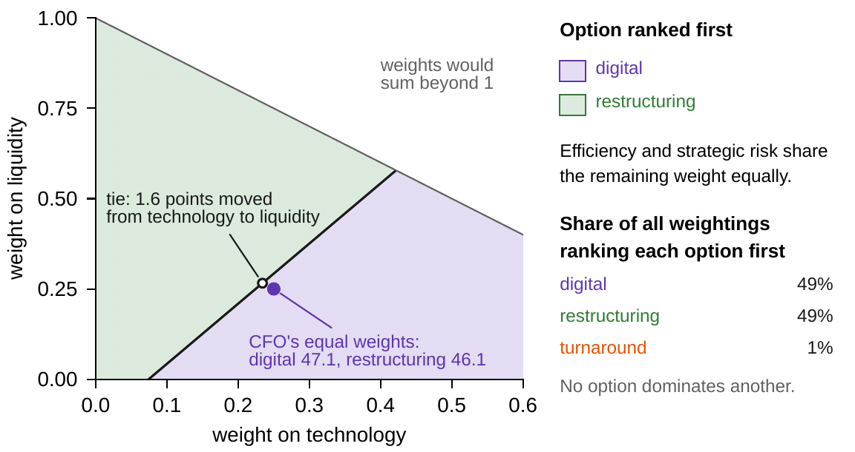
Meridian's ranking sits 1.6 points from a tie
§11.5 · FIGURE 11.1
At equal weights digital leads restructuring by one point, 47.1 to 46.1
Each point of weight moved from technology to liquidity cuts the lead by 0.64
After 1.6 points the two tie; after 2, restructuring leads, 47.7 to 47.5
Over all weightings each leader wins about half; the turnaround about 1 percent
The turnaround wins only where efficiency carries most of the weight
Figure 11.1. Who ranks first on a slice of the weights: efficiency and strategic risk share what technology and liquidity leave.
Notes:
Figure 11.1, Worked Example 11.1 Step 2 and Online Appendix 11.B.2. Drawing 200,000 weightings uniformly from the simplex (seed 26111), digital ranks first under 49.4 percent, restructuring under 49.3 and the turnaround under 1.3; the count measures how much of the space of weights each option wins, not a probability that either option is better.

Slide 11

Transformation shows underperformance first
§11.6 · THEOREM 11.3 · EQUATION 11.3
a program that spends ū once shows a net gain over H periods exactly when its later gains exceed its cost
(i) Influence obeys the architecture. A shock to one dimension's support reaches another no sooner than the distance between the supports
(ii) Transformation couples dimensions: a program moves the dimensions it touches together
(iii) The J-curve. Costs hit financial performance at once, by cū; benefits arrive only through the state, Δ a period
Any window shorter than 1 + cū/Δ periods reports a sound program as a loss: correctly for the window, wrongly for the program
Notes:
Theorem 11.3; formal statement and proof in Appendix 11.A. The two managerial numbers are the depth of the dip, cū, known in advance, and the payback window, 1 + cū/Δ periods. When the built state decays the window lengthens: a program that costs 10 and adds 3 pays back over 4.3 periods if the benefit lasts, 4.8 at 10 percent decay a period, 5.9 at 20 percent, and never at 30 percent or more (Online Appendix 11.B.1).

Slide 12
No effect arrives faster than the wiring allows
§11.6 · TABLE 11.4
Improving | Financial | Operational | Strategic | Technological | Innovation | Resilience
Financial (funds) | — | + / 1 | + / 1 | + / 1 | + / 1 | + / 0
Operational | + / 1 | — | + / 0 |  |  | + / 1
Strategic | + / 1 |  | — |  | + / 0
Technological | + / 1 | + / 2 | + / 0 | — | + / 0 | + / 1
Innovation | + / 1 |  | + / 0 | + / 0 | —
Resilience (buffers) | − / 0 | − / 1 |  |  |  | —
Sign of the medium-run effect of improving the row on the column, and the floor on the lag in quarters: the distance between the two supports in Chapter 9's architecture. Actual lags can be longer, never shorter. A blank means no material effect is declared.
Nothing done in Digital reaches Industrial Systems' operations in under two quarters; no path leads to Materials.
Notes:
Table 11.4 and Theorem 11.3(i). Supports: financial and resilience performance at treasury; operational at Industrial Systems and Materials; strategic at the three divisions; technological at Digital; innovation at Digital and engineering. The notebook and workbook recompute all 20 declared lag floors from Chapter 9's fourteen arrows. Crediting this year's Materials efficiency to the digital program is refuted by the wiring: no path leads from Digital to Materials.

Slide 13
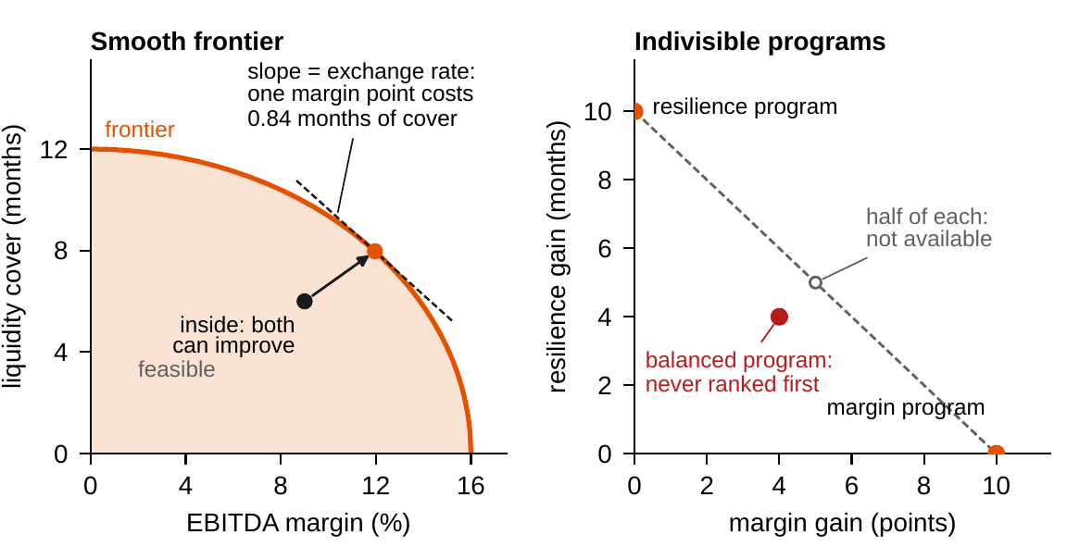
Weighted indices reach the frontier, not all of it
§11.7 · THEOREM 11.4 · FIGURE 11.2
Effectiveness is attainment of a target; efficiency, distance to the frontier
Productivity is flow per unit of capital (Definitions 11.7–11.9)
Theorem 11.4: every positively weighted index picks a Pareto-optimal point
Of (0, 10), (4, 4) and (10, 0), the balanced program is never ranked first
The slope is an exchange rate: a margin point costs 0.84 months of cover
Proposition 11.2: inside the frontier, improve before trading off
Figure 11.2. Left: a smooth frontier of margin against liquidity cover. Right: three indivisible programs; half of each end program is not available.
Notes:
Definitions 11.7-11.10, Theorem 11.4 and Proposition 11.2; formal statements and proofs in Online Appendix 11.B. A weighted index is a legitimate vehicle to the frontier and a biased explorer of it: when programs are lumpy, walk the frontier by hand. Online Appendix 11.B.4: three programs (0, m), (a, a), (m, 0) leave the balanced one visible exactly when 2a ≥ m. Most organizations debate weights while standing inside their frontier.

Slide 14
Skipping the rent is borrowed performance
§11.8 · DEFINITIONS 11.11–11.12
$23m
3 quarters
ln 2/|ln ρ|
a year: Meridian's capability rent, which skipping would add to reported EBITDA
until capability, decaying 2.5 percent a quarter, falls below the floor of 55
periods: the recovery half-life that resilience performance reports
Proposition 11.3. Performance inherits the state's dynamics: a forecast has a fan, a mean and quantiles
Definition 11.11. A level is sustainable if it can be delivered while every stock receives its rent δC
Definition 11.12. Resilience: the recovery half-life, with the buffer margins to binding constraints
Meridian with no rent: capability 58, then 56.55, 55.14 and 53.76, below the floor of 55 in quarter 3
A dashboard without a sustainability line will reliably prefer the program that eats the base
Notes:
Section 11.8's three disciplines: report flows with their fans; match windows to lags (Theorem 11.3(iii)); charge borrowed level. Meridian's capability rent is about $23 million a year (Worked Example 10.1); without it capability falls from 58 to 56.55, 55.14 and 53.76, below 55 in the third quarter. Chapter 12 gives resilience its full treatment.

Slide 15
Ratios do not average: pool them, then bridge
§11.9 · THEOREM 11.5 · TABLE 11.5
The bank of Table 11.5
THEOREM 11.5
Performance Consistency Theorem
Retail shrinks on purpose: cost–income 80 to 78 percent
Markets grows: 85 to 84 percent
The group worsens, 81.7 to 82.0 percent: rate effect −1.3 points, mix effect +1.7
The unweighted average falls 82.5 to 81.0 and reports an improvement
Discuss the mix decision, which was the strategy, not two ratios
(i) Ratios do not average. The group ratio weights divisional ratios by their shares of the denominator
Two margins rise, 20.0 to 22.0 and 15.0 to 16.0 percent, while the group's falls from 18.3 to 18.0
(ii) Target cascades are constraint families: around a cycle, pairwise agreement is not joint feasibility
(iii) Roll-ups need certificates: totals pass; a ratio rolls up only with its denominators
Notes:
Theorem 11.5; formal statement and proof in Appendix 11.A; the bank's bridge in Online Appendix 11.B.5. The safe rule: add numerators and denominators separately, then divide, and show the mix as its own exhibit. For Meridian the trap is not hypothetical: the digital option shifts revenue toward a growing division whose margins are still being built. Table 11.5 also reads a hospital network, a start-up and a government agency through the architecture.

Slide 16
Who really chose digital?
WORKED EXAMPLE 11.1 · THE SITUATION
The CFO's scorecard
The head of Digital Solutions
The chair
Digital 47.1, restructuring 46.1, turnaround 38.4
Presents the ranking as the case for digital
Did the data choose digital, or the design of the scorecard?
Liquidity, technology and efficiency, less strategic risk, equally weighted, at Year 5.
One point ahead of restructuring, well ahead of the turnaround.
A sharper question than Chapter 1 could ask, before the board votes.
No option dominates another: digital leads on technology, restructuring on liquidity, risk and efficiency.
Notes:
Worked Example 11.1, the situation and Step 1. The scorecard is Worked Example 1.1's, on the Chapter 1 model (Table 1.9). At Year 5 digital leads restructuring by 36.8 points on technology; restructuring leads by 26.8 on liquidity, 5.8 on strategic risk and 0.1 on efficiency; the turnaround has the best efficiency of the three.

Slide 17
The weights and the yardstick pick the winner
WORKED EXAMPLE 11.1 · STEPS 1–3
1.6 points
52.3 to 41.4
24.0 to 10.6
of weight moved from technology to liquidity tie the leaders; 2 points put restructuring first, 47.7 to 47.5
restructuring first when each reading is rescaled, best option 100 and worst 0
digital first when the readings are scored by percentage improvement on today
Step 1: no option dominates another, so positive weights exist that put either leader first (Theorem 11.2(ii))
Step 2: each leader ranks first under 49 percent of all weightings, the turnaround under about 1 percent
Step 3: rescaling divides by each reading's spread: strategic risk's 5.8 points become 34, technology's 36.8-point lead 93
Notes:
Worked Example 11.1, Steps 1-3; Online Appendix 11.B.2-11.B.3. The best-to-worst scale's effective weights, as shares, are 12, 8, 62 and 18 percent; the percentage scale's 16, 38, 22 and 24. The 'equal' weights are equal on neither scale: the first all but ignores technology, the second leans on it. Same data, same weights, opposite rankings.

Slide 18
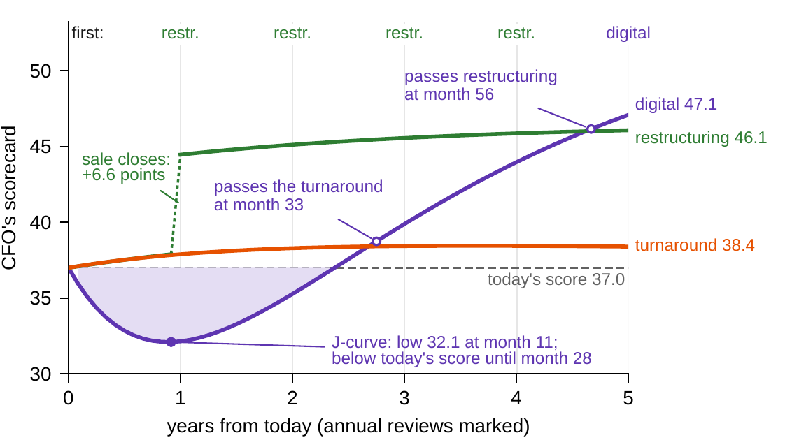
Digital trails at four annual reviews
WORKED EXAMPLE 11.1 · STEP 4
Digital falls to 32.1 at month 11 and regains today's 37.0 at month 29
It passes the turnaround at month 33 and restructuring only at month 56
Annual reviews rank it last in Years 1–2 and second in Years 3–4
Only a five-year window ranks it first
The J-curve of Theorem 11.3(iii): the liquidity trough and the efficiency dip
Figure 11.3. The CFO's scorecard for Meridian's three options, month by month, with the annual reviews marked.
Notes:
Worked Example 11.1, Step 4, Figure 11.3 and Online Appendix 11.B.6. Restructuring's score jumps by 6.57 points when the sale closes at Year 1; before that, restructuring and the turnaround differ by less than 0.1 point. A board that compares the options at its annual reviews will see digital trail for four years.

Slide 19
Same data, opposite rankings
WORKED EXAMPLE 11.1 · TABLE 11.6
Declaration | Digital | Restructuring | Turnaround | First
The CFO's scorecard | 47.1 | 46.1 | 38.4 | digital
2 points of weight moved from technology to liquidity | 47.5 | 47.7 | 39.8 | restructuring
Best option 100, worst 0 | 41.4 | 52.3 | 35.3 | restructuring
Percentage improvement on today | 24.0 | 10.6 | 0.0 | digital
Review at Year 1 | 32.2 | 44.5 | 37.9 | restructuring
Review at Year 3 | 39.9 | 45.6 | 38.4 | restructuring
Meridian's three options under alternative scorecard declarations (Chapter 1 model). Equal weights, index points, and Year 5 unless stated.
Each is a legitimate choice. None is a fact about the options.
Notes:
Table 11.6 and Worked Example 11.1, Step 5. The strategy team's recommendation is not 'digital scores 47.1' but a declaration the board can own: the weights, with their 1.6-point margin from a tie; the yardstick and the options or peers it rescales against; the aggregation rule and any gates; and the review window, at least five years for the digital program.

Slide 20
The data did not choose digital
WORKED EXAMPLE 11.1 · WHAT THE BOARD SHOULD TAKE AWAY
1.6 points
5 years
24.6%
the weights' margin from a tie, to be declared with the weights
the review window the digital program needs before it ranks first
chance the planned program breaches the liquidity floor, against a 5 percent appetite
The data narrowed the choice to two options that no scorecard can separate without a declared view
The 47.1 is the board's own judgment returned to it as arithmetic (Theorem 11.2)
For discussion: the appetite as a weight or as a gate? A standby line and a phased build bring the chance to 3.0 percent
Notes:
Worked Example 11.1, what the board should take away, and the discussion question. The 24.6 and 3.0 percent are Worked Example 8.1's, drawn with random seed 8; as a lexicographic gate (Table 11.3) the program as planned fails its tier, and passes once both levers are in place.

Slide 21

Auditing Meridian's scorecard, in AXIOM
AXIOM LAB 1.11 · MODULE AXIOM-11
Meridian's board wants a performance dashboard it can trust through five years of transformation, whichever option it chooses. The CFO wants one number, the transformation office the full profile, the divisions their own margins. Open AXIOM, choose Lab 1.11 and load the Meridian performance model.
1
2
3
4
5
Build the dashboard
Sweep the weights
Change the yardstick
Roll up a ratio
Walk the frontier, move the window
Declare six or more dimensions with supports, one indicator each with its error, and a band.
Score the three options, sweep the weights and find the tie nearest the CFO's equal weights.
Switch among index points, best-to-worst and percentage scales, and between two reference groups.
Shift revenue between divisions; rebuild the report as a pooled ratio with a rate-and-mix bridge.
Find any balanced option no weighting selects; slide the window until digital turns to a gain.
Deliverable: a one-page performance declaration: dimensions with supports and indicators; weights and their margin from a tie; the yardstick and its reference group; the rule and any gates; pooled ratios with a mix bridge; each program's evaluation window. About 75–90 minutes.
Notes:
AXIOM Lab 1.11. What to look for: between options that do not dominate each other, the ranking moves with the weights and with the normalization (Theorem 11.2); divisional ratios can all improve while the pooled ratio worsens (Theorem 11.5(i)); and a program's verdict flips at the payback window (Theorem 11.3(iii)). Supports LOS 11.2-11.5.

Slide 22
What to carry forward
KEY TAKEAWAYS
1
Performance is the family of flows read off the company's state and decisions, distinct from the stocks that produce it and multidimensional by necessity; indicators estimate it, and an indicator that merges levels the company would rank differently loses information before anyone games it.
2
Between options that do not dominate each other, the scorecard's weights choose; normalization is a second set of weights; and the aggregation rule sets how far strength may excuse weakness. Declare all three.
3
Costs arrive at once and benefits only through the state, no sooner than the architecture allows: transformation is measured as underperformance first, and a review window shorter than 1 + cū/Δ periods condemns a sound program.
4
Weighted indices reach the frontier but cannot explore it: balanced options can be invisible to every weighting, and the frontier's slope is the exchange rate the company has chosen. Inside the frontier, improve before trading off.
5
Ratios do not average: pool numerators and denominators and bridge the mix; audit target cascades as Chapter 9 audits constraints; and report performance with its fan, its sustainable level, and its resilience.
Notes:
Key Takeaways, Chapter 11.

Slide 23
Notebook and workbook reproduce the book
THIS WEEK'S LABORATORY
112
125
26111
AXIOM-11
notebook checkpoints, every one PASS
workbook checks against the engine, ALL PASS
the lab's seed
AXIOM Lab 1.11
Notebook DCT_V1_Ch11_Lab.ipynb: Worked Example 11.1 and the lab's five steps in eight panels, ready for Colab
Workbook DCT_V1_Ch11_Lab.xlsx: the Chapter 1 paths, Table 11.4's lag floors, the weights, the yardsticks, the ratio bridge and Table 11.6, in formulas
Every number on these slides is the book's, and both companions check it
Notes:
The notebook and workbook are on the course website, www.dynamiccorporatetransformation.com.

Slide 24

Chapter 12 turns targets into risk
NEXT · CHAPTER 12
Risk is the exposure of declared objectives, this chapter's targets, floors and frontiers, to the distribution of the state (Definition 12.1)
Four questions kept apart: risk, vulnerability, robustness, and resilience, the spring-back
The habit to carry forward: a target without a distribution is not yet a statement about risk
Notes:
Section 11.9's bridge to Chapter 12. The performance architecture hands the risk architecture four finished parts: the performance vector with its supports, the targets and constraints, the fans of Proposition 11.3, and the resilience dimension of Definition 11.12.

