Slide 1
Unified Enterprise Transformation Architecture
VOLUME I · CHAPTER 13 · WEEK 6
Five layers on one skeleton, read from one state, with a declared register of the couplings: a verdict reached in any one ledger can be wrong in sign
Graduate course companion · Lab seed 26113 · AXIOM Lab 1.13 (AXIOM-13)
Notes:
Volume I, Chapter 13. Part II built the transformation layer and Part III four architectures on it, each answering its own questions. A transformation program ignores these jurisdictions; this chapter assembles the five architectures into one object (Section 13.1 and the abstract).

Slide 2
“Adam Smith's invisible hand—the idea that free markets lead to efficiency as if guided by unseen forces—is invisible, at least in part, because it is not there.”
Joseph E. Stiglitz
Nobel Memorial Prize in Economic Sciences 2001; The Guardian (2002)
Notes:
Joseph Stiglitz in The Guardian (2002). The chapter's counterpart: coordination among a company's ledgers does not happen by itself. Whatever crosses a layer boundary must be declared, and an undeclared coupling is a modeling error for the audit to find (Section 13.3, the declared-coupling principle).

Slide 3
After this chapter, you can
LEARNING OUTCOME STATEMENTS
13.1
Explain why a transformation program cannot be judged in any single ledger, and what a unified architecture adds: one state, five layers, and a declared register of the couplings between them.
13.2
Assemble a unified architecture for a company—skeleton, layers, compatibility checks, coupling register—and explain why unification costs the existing models nothing and why no layer can be dropped.
13.3
Use the layered network and the interaction matrix to trace and time cross-ledger effects, and explain why every layer can pass its own stress test while the whole company is unstable.
13.4
Audit a unified declaration: find the capital–performance–risk cycle that a funded program creates, explain why bilateral sign-offs cannot certify it, and locate errors with invariants.
13.5
Read one program in synchronized ledgers on their own clocks, and explain why integrated decisions dominate separated ones and what that implies for the optimization problem of Chapter 15.
Notes:
The five learning outcome statements; LOS Guidance at the end of the chapter.

Slide 4
Eight sections, a worked example and a lab
ROADMAP
§13.1
§13.2
§13.3
§13.4
§13.5
Why Transformation Needs One Architecture
The Five Architectures as Interfaces
Integration Principles
The Unified Enterprise Representation
Enterprise Architecture Interactions
Figure 13.1
Table 13.1
Proposition 13.1
Theorems 13.1–13.2
Theorem 13.3 · Table 13.2
§13.6
§13.7
§13.8
Worked Example 13.1
AXIOM Lab 1.13
Integrated Enterprise Dynamics
Architectural Consistency
The Enterprise Transformation Framework
Is the Same Cash Promised Twice?
One Company, Five Ledgers
Theorem 13.4
Theorem 13.5 · Table 13.3
Proposition 13.5
Table 13.6 · Figure 13.3
AXIOM-13 · five steps
Notes:
Section 13.1: Figure 13.1. Section 13.2: Table 13.1. Section 13.3: Proposition 13.1. Section 13.4: Definitions 13.1-13.4 and Theorems 13.1-13.2. Section 13.5: Proposition 13.2, Definition 13.5, Table 13.2, Theorem 13.3, Propositions 13.3-13.4 and Figure 13.2. Section 13.6: Definitions 13.6-13.8 and Theorem 13.4. Section 13.7: Definition 13.9, Tables 13.3-13.4 and Theorem 13.5. Section 13.8: Definition 13.10, Proposition 13.5 and Table 13.5. Worked Example 13.1: Table 13.6 and Figure 13.3. AXIOM Lab 1.13: module AXIOM-13, five steps. Proofs of Theorems 13.1, 13.3 and 13.5 and Proposition 13.5 are in Appendix 13.A; Theorems 13.2 and 13.4 and Propositions 13.1-13.4 in Online Appendix 13.B.

Slide 5
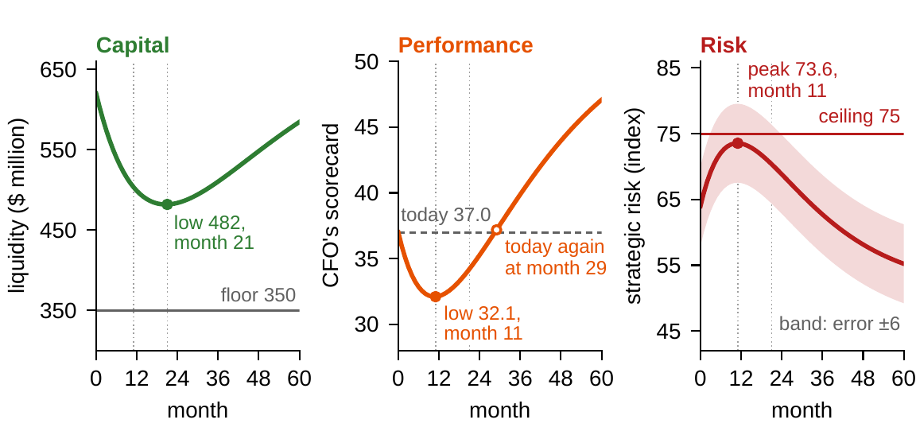
One program, three ledgers, three clocks
§13.1 · FIGURE 13.1
Meridian's digital program, month by month, in the capital, performance and risk ledgers
The CFO's scorecard and strategic risk are at their worst in month 11, liquidity in month 21
The scorecard regains today's 37.0 only in month 29
At month 11, three reviews: a failing program, a falling but ample cushion, a ceiling 1.4 points away
Each verdict is correct in its ledger and unsafe as a verdict on the program
Figure 13.1. The Chapter 1 model, month by month: liquidity against the $350m floor, the CFO's scorecard against today's 37.0, strategic risk against its ceiling of 75 with the risk committee's band of ±6.
Notes:
Section 13.1 and Figure 13.1. Costs and benefits land in different ledgers at different times. Chapter 1 promised that transformation would be treated as the evolution of one multidimensional state; this chapter keeps the promise. Two facts make the assembly cheap: every architecture is structure on the same skeleton, and every architecture reads one state.

Slide 6
Five architectures as interfaces, one new object
§13.2 · TABLE 13.1
Layer | Question it answers | Key results | Meridian instance
State (Chapter 9) | what is connected; how fast influence travels | Theorems 9.1, 9.2, 9.4 | seven components; a feedback core of four
Transformation (Chapters 6–8) | what can be done, in what order, with what odds | Theorems 6.1, 6.3, 8.2 | digital build, sale, automation rounds
Capital (Chapter 10) | what the company has; how stocks build and wear | Theorems 10.1, 10.3, 10.4 | ten forms; a capability rent of $23m a year
Performance (Chapter 11) | what it delivers, at what trade-offs | Theorems 11.1, 11.2, 11.4 | ten dimensions; the CFO's scorecard
Risk (Chapter 12) | what it can lose, absorb, and recover from | Theorems 12.1, 12.3, 12.5 | $270m of armor; 24.6% breach odds
Couplings (this chapter) | what crosses between layers | Definition 13.1 | funding, buffer and target links
Table 13.1. Four of the five layers are declared on the first: capital carriers, performance supports, risk supports and operator domains are components of the state architecture.
The only new object is the coupling register: the handoffs with which each chapter of Part III closed.
Notes:
Table 13.1 and Section 13.2. The layers already exchange objects: capital's rent to performance, performance's targets to risk, risk's buffers back to capital. These handoffs are the couplings that Section 13.5 registers. Every layer travels with a declaration under Chapter 4's contract, so the compatibility of layers is a checkable property of declarations, not a hope.

Slide 7
Three principles make the assembly cheap
§13.3 · INTEGRATION PRINCIPLES · PROPOSITION 13.1
Shared skeleton
Single state
Declared coupling
Proposition 13.1
All content attaches to one state architecture
All layers read one state process
Whatever crosses a layer boundary is declared
Every company has a unified architecture
One set of components, one dependency graph, one constraint discipline: every propagation question runs on Chapter 9's machinery.
No layer carries dynamics of its own: one state equation, and the layers' paths are readouts of the state's path.
Which stocks feed which flows, which buffers are which stocks: an undeclared coupling is a modeling error.
The trivial one, with no declared couplings, always exists. What is substantive is which couplings it registers.
Offices that manage capital, performance and risk with separate models claim an empty coupling register: a falsifiable claim.
Notes:
Section 13.3 and Proposition 13.1 (formal statement and proof in Online Appendix 13.B). Every observed J-curve, every program funded by running down a stock, every buffer that turned out to be someone else's working capital is a coupling that the empty coupling register suppressed.

Slide 8
One object: five layers and their couplings
§13.4 · DEFINITIONS 13.1–13.4
state, transformation, capital, performance and risk architectures on one skeleton, plus the declared channels between them
Definition 13.2. Every layer is a readout of one state: capital κ(x), performance Φ(x, u), risk measures of the loss channels under the state's distribution
Definition 13.3. Integration attaches a layer whose every reference resolves to the skeleton
Definition 13.4. Compatible: (C1) every carrier is a component; (C2) one contract per shared indicator; (C3) every buffer named to a capital stock; (C4) a joint feasible region; (C5) operator domains recomputed against it
Notes:
Definitions 13.1-13.4 and Equations 13.1-13.2. Each readout travels with its measurement contract. Compatibility is a property of declarations, and it is checkable (Section 13.7). In Meridian's declaration, (C3) names the closure buffer as treasury cash, and (C4) is the joint check of Worked Example 13.1.

Slide 9
Unification costs the existing models nothing
§13.4 · THEOREMS 13.1–13.2
What it means
THEOREM 13.1
Unified Enterprise Representation Theorem
Two panels that disagree reveal a declaration defect, not a fact about the world
The treasurer's, the COO's and the CRO's models survive as restrictions; they lose only the pretense of self-sufficiency
A four-layer governance model is not leaner but blind in a declared direction
Theorem 13.2. Order does not matter; divisional models glue exactly when they agree on what they share
(i) Existence. The quintuple built on the skeleton, each layer attached by its own construction, is determined by the declarations
(ii) One state. Every layer quantity is a declared function of the state, the decisions and the distribution
(iii) Faithful restriction. Dropping all but one layer returns that layer exactly
(iv) Non-redundancy. No layer is determined by the other four: declared with value at risk or with expected shortfall, one risk channel answers “does consolidating two loans raise measured risk?” differently
Notes:
Theorems 13.1 (proof in Appendix 13.A) and 13.2 (Online Appendix 13.B). Part (ii) keeps the unified dashboard from becoming five dashboards stapled together. Theorem 13.2(iii) is the board-pack theorem at full strength: couplings seen only in the aggregate must be audited below before anyone acts on them.

Slide 10
The interaction matrix as a governance document
§13.5 · DEFINITION 13.5 · TABLE 13.2
Receives | from transformation | from capital | from performance | from risk
capital | conversion bills, write-offs | (within: conversions) | retained flows build stocks | shocks deplete stocks
performance | the J-curve | stocks produce flows | (within: Table 11.4) | dents and recoveries
risk | exposure during the program | buffers are stocks (C3) | shortfalls are loss channels | (within: propagation gains)
transformation | (within: composition) | stocks enlarge the menu | review windows trigger action | thin armor shrinks domains
Table 13.2. The row layer receives, the column layer sends; diagonal blocks are the layers' own structures, and a zero block is a declaration that nothing passes directly.
Proposition 13.2. A program changes, in general, every layer supported where it writes: one ledger sees a projection.
Notes:
Definition 13.5, Table 13.2 and Proposition 13.2 (Online Appendix 13.B). The results that price each block: conversion bills and write-offs (Proposition 10.5), conversions (Theorem 10.2), retained flows (Theorem 10.1), depletion (Definition 10.12); the J-curve (Equation 11.3), stocks produce flows (Theorem 10.4), dents and recoveries (Theorem 12.3); buffers (C3), shortfalls as loss channels (Definition 12.1), propagation (Theorem 12.5); composition (Theorem 6.3), the menu (Proposition 10.3), shrinking domains (Theorem 12.2).

Slide 11
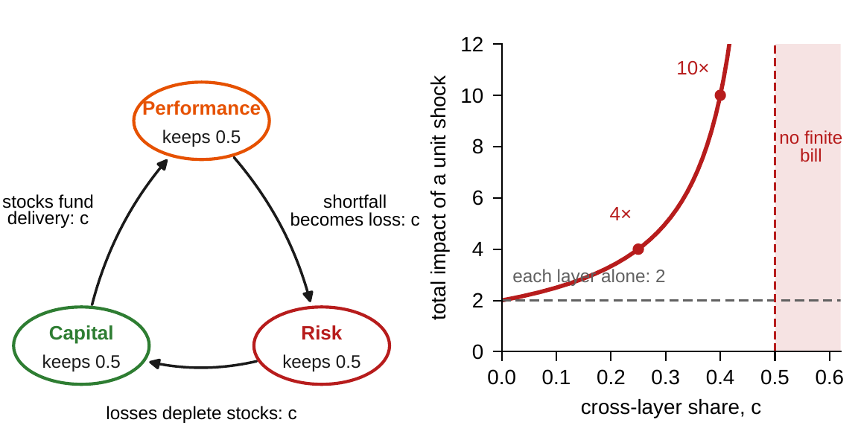
Every layer can pass while the whole fails
§13.5 · THEOREM 13.3 · FIGURE 13.2
Theorem 13.3. The layered graph is one network: influence travels only along its paths
Containment needs ρ(M) < 1 for the whole matrix; each layer passing its own test is necessary, not sufficient
Three layers that each book a shock twice over book it 4 times over when a quarter crosses, 10 at 0.40, without limit from 0.5
Cross-layer feedback lives where strongly connected components span layers; Meridian has one by construction
Figure 13.2. Left: three layers in a cycle, each keeping half of a quarter's loss (a = 0.5). Right: the total impact of a unit shock, 1/(1 − a − c), while every layer alone still reports 2.
Notes:
Theorem 13.3 (proof in Appendix 13.A), Propositions 13.3-13.4 and Online Appendix 13.B.1. Every column of the cycle matrix sums to a + c, so rho(M) = a + c while each layer's radius is a. Meridian's loop: stocks fund delivery, shortfalls trip the risk appetite, and the appetite freezes funding. The fire-sale spiral of 2008 was such a loop, invisible to each diagonal block.

Slide 12
One state equation drives every ledger
§13.6 · DEFINITION 13.8 · THEOREM 13.4
the integrated state is a presentation of the state, not an enlargement: the ledgers move because they read it
The two dashboards agree: scenario paths for planning and distributions for risk differ only where an implementation departs from the declaration
Confinement: the program writes to Digital and engineering; treasury and Industrial Systems can respond after one quarter, Materials never
The flaw of averages in every ledger: a planned low of $482m, an average simulated low of $384m
Invariants as tripwires: a computed violation points to a declaration or implementation error
Notes:
Definitions 13.6-13.8, Equation 13.5 and Theorem 13.4 (Online Appendix 13.B), parts (ii)-(v). The ledger clocks are Online Appendix 13.B.3: treasury is one arrow from Digital and Industrial Systems one arrow from engineering; Advanced Materials, the market and governance cannot be reached, so crediting Materials' results to the program is refuted by the wiring. The $384 million is Worked Example 8.1's average low.

Slide 13
Cycles defeat bilateral sign-offs
§13.7 · THEOREM 13.5
What it means
THEOREM 13.5
Unified Consistency Theorem
The CFO–COO, COO–CRO and CRO–CFO checks can all pass while the three books are jointly infeasible
The same liquidity is promised twice: once as program funding, once as risk buffer
Walk the cycle as one constraint; keep the constraint topology as close to a tree as the real couplings allow
Meridian: a $138m draw and a $187m buffer each fit in $270m of cash; together they need $325m
(i) Inconsistent declarations admit no state: no analysis of them is about any company
(ii) Trees are safe: bilateral checks certify the whole. On a cycle they cannot
(iii) Cross-layer cycles are the norm: a buffer identity, a funding coupling and a target link close one
(iv) Divisions assemble exactly when some setting of the shared components works for both
(v) A failed invariant points to its ancestors; every other node is cleared
Notes:
Theorem 13.5; formal statement and proof in Appendix 13.A. The chapter's governance theorem: the anatomy of every funding squeeze in which 'fully funded' and 'fully buffered' were both true until the quarter in which they were jointly false. Every cycle added is audit cost compounded.

Slide 14
Unified constraints, with Meridian's instances
§13.7 · TABLE 13.3
Class | Form | Meridian instance
Single-layer | a layer's own scoped constraints | covenant at treasury; plant capacity (Table 9.3)
Buffer identities (C3) | buffer = a named capital stock | the closure buffer is treasury cash
Funding couplings | program draw within available stocks | the digital build's draw within cash above the floor
Target–exposure links | a shortfall wired to a loss channel | the plan corridor and the 5% appetite
Domain restrictions | risk responses shrink operator domains | thin armor freezes the next build phase
Unified feasibility (C4) | a nonempty joint feasible region | the joint check of Worked Example 13.1
Table 13.3. Highlighted: the buffer identity, the funding coupling and the target link that close Meridian's capital–performance–risk cycle.
The unified audit (Table 13.4) walks the cycle as one constraint and reports ρ(M) block by block.
Notes:
Table 13.3, and Table 13.4, the unified validation checklist: carriers (C1), contracts (C2), buffer identities (C3), joint feasibility (C4), domains (C5), the coupling register, the cycle walk, the spectral report with the share owed to each block, invariant tripwires, and the hierarchy gate.

Slide 15
Integrated decisions dominate separated ones
§13.8 · PROPOSITION 13.5
What it means
PROPOSITION 13.5
Unified Representation Enables Integrated Optimization
A J-curve rejected by performance, a program funded blind by capital, a trough priced without its recovery by risk
The formulation must be unified even where execution is delegated: the shape of Chapter 15's problem
Dashboards: every layer on one skeleton, the couplings shown, the ledgers on one clock
Table 13.5: a bank's regulatory capital sits in three ledgers; a hospital's quality floors keep its network a tree
(i) Objectives and constraints that mix ledgers are well defined on the unified object, and on no single layer
(ii) A separated procedure is the unified problem with extra constraints: never better, strictly worse exactly when they exclude every integrated optimum
(iii) When the problem truly separates, separation costs nothing: what it loses is what the couplings carry
Meridian (Worked Example 13.1): each repair alone fails a ledger; only both levers, chosen in one place, pass every one
Notes:
Definition 13.10 (the unified enterprise system), Proposition 13.5 (proof in Appendix 13.A) and Table 13.5. The proposition does not say that central optimization should replace divisional judgment. The reader carries three objects forward: the quintuple with its coupling register, the interaction matrix with its spectral reading, and the integrated state.

Slide 16
Is the same cash promised twice?
WORKED EXAMPLE 13.1 · THE SITUATION
CFO and transformation office
CFO and CRO
Transformation office and CRO
The program is fully funded
The risk buffer is fully funded
The unphased schedule is within appetite
On Chapter 8's plan its deepest draw is $138m, at quarter 7: it fits in the $270m above the floor, with $132m to spare.
The risk office holds the 90th-percentile closure of a funding window, $187m: it fits in the same $270m, with $83m to spare.
The risk office accepts the plan as scheduled because the buffer is held.
Before approving the program's second phase, the chair asks whether the three are true together.
Notes:
Worked Example 13.1, the situation and Step 1. Liquidity today is $620 million against the board's floor of $350 million. The plan is Chapter 8's; the closure law is Chapter 12's (gamma, mean $120 million and standard deviation $50 million: median $113 million, 90th percentile $187 million). Each check is correct.

Slide 17
Put both claims on one skeleton
WORKED EXAMPLE 13.1 · STEPS 1–3
the program's deepest draw plus the closure buffer, against the cash above the floor ($ million)
Step 1: each check is correct: the draw fits with $132m to spare, the buffer with $83m
Step 2: the draw flows through Digital's cash arrow to treasury; the buffer is a claim on that cash (C3); the schedule links the plan to the appetite
One constraint binds three ledgers: a triangle, a cycle, so no bilateral sign-off can certify it (Theorem 13.5(iii))
Step 3: infeasible by $55m; from quarter 3 on, the plan runs inside the buffer line of $537m, 55 deep at quarter 7
Notes:
Worked Example 13.1, Steps 1-3; Online Appendix 13.B.2 (the joint check as a constraint network) and 13.B.4 (the numbers). The program, as planned, spends the cash that the buffer is counting on.

Slide 18
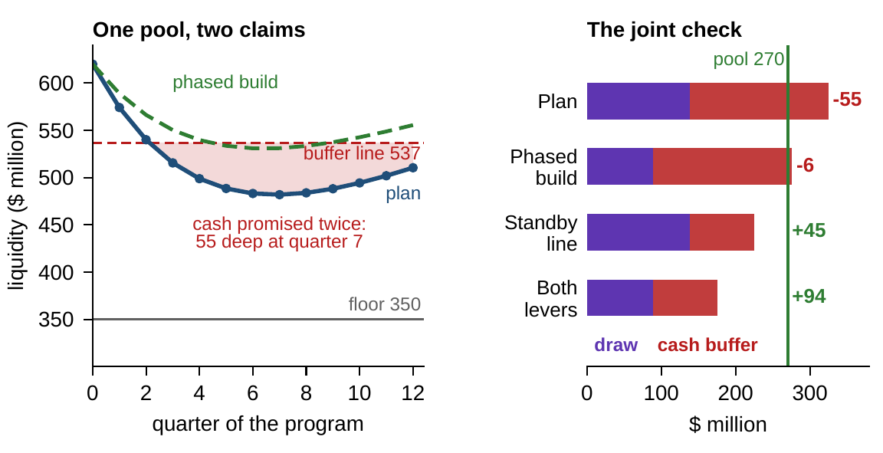
Four repairs, each in its own ledger
WORKED EXAMPLE 13.1 · STEP 4 · FIGURE 13.3
Risk: a buffer at the median closure, $113m, passes with $19m to spare, but only by lowering the bar
Transformation: the phased build cuts the draw to $89m, and alone still fails by $6m
Capital: the standby line covers $100m of any closure, cuts the cash buffer to $87m, passes with $45m
Both levers pass with $94m to spare
Figure 13.3. Left: planned liquidity and the phased build against the $350m floor and the buffer line at $537m. Right: the joint check, draw plus cash buffer against the $270m above the floor.
Notes:
Worked Example 13.1, Step 4, Figure 13.3 and Online Appendix 13.B.4. Half of all closures would exceed the median buffer, and the breach odds stay at 24.6 percent, since the declaration does not change the cash. The phased build runs inside the buffer line only in quarters 5-8, by at most $6 million.

Slide 19
The joint check, declaration by declaration
WORKED EXAMPLE 13.1 · TABLE 13.6
Declaration | Draw | Cash buffer | Total claims | Spare cash
As signed off | 138 | 187 | 325 | −55
Buffer at the median closure | 138 | 113 | 251 | +19
Phased build | 89 | 187 | 276 | −6
Standby line | 138 | 87 | 225 | +45
Both levers | 89 | 87 | 176 | +94
Table 13.6, $ million. The draw is the program's deepest cash draw; the cash buffer is the closure the risk office declares, less the standby line's cover.
Claims on Meridian's $270m of cash above the floor: as signed off, the books are $55m short.
Notes:
Table 13.6 and Online Appendix 13.B.4. The notebook and the workbook recompute every entry from the declarations: closures gamma with mean $120 million and standard deviation $50 million, the plan and the phased build from Chapter 8.

Slide 20
Only the unified choice passes every ledger
WORKED EXAMPLE 13.1 · STEP 5 · WHAT THE BOARD SHOULD TAKE AWAY
Risk ledger
Transformation
Capital
Both, in one place
+$19m
−$6m
+$45m
+$94m
median buffer: passes the joint check
phased build: fails the joint check
standby line: passes the joint check
both levers: pass the joint check
24.6%
13.1%
12.4%
3.0%
breach odds: above the appetite
breach odds: above the appetite
breach odds: above the appetite
breach odds: within the 5% appetite
“Fully funded” and “fully buffered” were both true, and jointly false: the error is in the architecture of the sign-offs, not in any office's arithmetic
For discussion: the line alone passes the joint check with $45m to spare, yet its breach odds are 12.4%. Which uncertainty does the joint check leave out?
Notes:
Worked Example 13.1, Step 5, what the board should take away and the discussion question; Proposition 13.5. Each repair alone is a separated choice: the unified problem with the other ledgers' repairs ruled out; deciding alone, each office guards its own ledger. The breach odds are Worked Example 12.1's, over Chapter 8's 100,000 paths (seed 8): 24.6 percent for the plan with either buffer declaration, 13.1 for the phased build, 12.4 for the standby line, 3.0 for both. The coupling register that names the buffer's funding stock makes the line of joint arithmetic impossible to skip.

Slide 21

One company, five ledgers, in AXIOM
AXIOM LAB 1.13 · MODULE AXIOM-13
Meridian's board wants one integrated view of the digital program before it approves the second phase. Treasury, the transformation office and the risk office each bring a model and a sign-off. Open AXIOM, choose Lab 1.13 and load the Meridian model.
1
2
3
4
5
Assemble
Wire the couplings
Follow the wavefront
Audit the cycle
Decide in one place
Attach the layers in two orders and confirm the result is the same; read (C1) to (C5) at each step.
Enter coupling gains, watch ρ(M) and each block's share; make every layer stable and the whole not.
Seed the program at Digital and a demand shock at the market; record when each ledger can respond.
Load the three sign-offs: each bilateral check passes, the joint check fails. Repair it three ways.
Run the program through every ledger on one clock; compare the separated and unified verdicts.
Deliverable: a one-page unified declaration: the coupling register, the zero blocks and spectral report, the ledger-clock table, the audit with the cycle walked as one constraint, and the integrated recommendation with the cost of deciding separately. About 75–90 minutes.
Notes:
AXIOM Lab 1.13. What to look for: the layers are returned unchanged by the assembly (Theorem 13.1(iii)); the whole can be unstable while every layer is stable (Theorem 13.3(ii)); no ledger responds before its layered distance allows (Theorem 13.4(iii)); bilateral checks pass on a cycle that the joint check fails (Theorem 13.5(iii)); separated decisions lose exactly what the couplings carry (Proposition 13.5). Discussion: which coupling would you audit first? What do you reply to a divisional CFO who says unification will override her capital model? Which zero block are you least willing to certify, and who should be accountable for it?

Slide 22
What to carry forward
KEY TAKEAWAYS
1
Unification is declaration, not construction: five layers on one skeleton, reading one state; the only new object is the register of couplings.
2
Unification costs the existing models nothing—each layer survives unchanged—and no layer can be dropped without losing questions only it answers.
3
Cross-ledger questions are network questions: influence travels only along layered paths, no ledger responds before its distance allows, and every layer can pass its own stress test while the whole is unstable.
4
Every funded program creates a capital–performance–risk cycle on which bilateral sign-offs can all pass while the books are jointly impossible; walk the cycle as one constraint, and read a failed invariant back to its ancestors.
5
Integrated decisions dominate separated ones by exactly what the couplings carry: the formulation must be unified even where execution is delegated, the shape of Chapter 15's optimization problem.
Notes:
Key Takeaways, Chapter 13.

Slide 23
Notebook and workbook reproduce the book
THIS WEEK'S LABORATORY
64
72
26113
AXIOM-13
notebook checkpoints, every one PASS
workbook checks against the engine, ALL PASS
the lab's seed
AXIOM Lab 1.13
Notebook DCT_V1_Ch13_Lab.ipynb: Worked Example 13.1 and the lab's five steps in eight panels, ready for Colab; its breach odds are the book's paths
Workbook DCT_V1_Ch13_Lab.xlsx: the assembly checks, the cascade gap, the ledger clocks, the three ledgers, the joint check and Table 13.6, in formulas
Every number on these slides is the book's, and both companions check it
Notes:
The notebook and workbook are on the course website, www.dynamiccorporatetransformation.com. The breach odds are drawn, as in the book, with random seed 8 (Volume II, Online Appendix 1.B.4); the lab's seed 26113 is used only for fresh draws, labelled as such.

Slide 24
Chapter 14 asks what the object does
NEXT · CHAPTER 14
Well-posedness, equilibria, stability (opening with the interaction matrix's spectral reading), sensitivity and viability
The coupling register becomes a stability budget: while every true gain stays within its declared ceiling, the company is certified to settle
Feasible this quarter and next can still mean doomed: only the viability kernel certifies the horizon
Chapter 15 then formulates the General Enterprise Optimization Problem on the analyzed object
Notes:
Section 13.8's bridge to Chapters 14 and 15, and Chapter 14's abstract and Equation 14.1.

