Slide 1
Synthesis, Future Directions, and Transition to Volume II
VOLUME I · CHAPTER 16 · WEEK 7
One structure, consistent and complete relative to its declarations: four gates tell a board whether it is ready to optimize, and Volume II solves what Volume I has posed
Graduate course companion · Lab seed 26116 · AXIOM Lab 1.16 (AXIOM-16)
Notes:
Volume I, Chapter 16. Fifteen chapters have built one object: a company declared as a state, moved by programs, resourced by capital, read by performance measures, exposed to risk, and unified into a single system on which the board's question becomes the General Enterprise Optimization Problem. This closing chapter looks back, then forward (the chapter's abstract).

Slide 2
“Now this is not the end. It is not even the beginning of the end. But it is, perhaps, the end of the beginning.”
Winston S. Churchill
Nobel Prize in Literature 1953; Mansion House, London (1942)
Notes:
Section 16.7 closes the volume with the epigraph: in the words at the head of this chapter, this is not the end, nor even the beginning of the end; it is the end of the beginning. What has been established, and what has not, are both on the record.

Slide 3
After this chapter, you can
LEARNING OUTCOME STATEMENTS
16.1
Explain the DCT framework as one structure—how the volume removed the five limitations of Chapter 1 and what holds its architectures together—and what it guarantees: consistency, shown on one company, and completeness relative to what is declared.
16.2
Run the four readiness gates on a company—declaration completeness, unified consistency, the analytical panel, and feasibility with horizon honesty—and read every failure as a work order with an owner.
16.3
Describe the transformation lifecycle as the seven moves run as a loop, and explain why declared contracts let models, layers, and solution methods change without redoing the theory.
16.4
Assess artificial intelligence, digital twins, and autonomous optimization from the framework's position, and distinguish adaptation within a declaration from evolution of the declaration itself.
16.5
Explain the division of labor between Volumes I and II, route a question to the right volume, and state the framework's open problems.
Notes:
The five learning outcome statements; LOS Guidance at the end of the chapter.

Slide 4
Seven sections, a worked example and a lab
ROADMAP
§16.1
§16.2
§16.3
§16.4
§16.5
The Arc of Volume I
What the Framework Guarantees
Transformation, Stated Once
Are We Ready to Optimize?
Modularity: How the Framework Grows
Table 16.1
Theorems 16.1–16.2
Theorem 16.3
Theorem 16.4 · Figure 16.1
Theorem 16.5 · Figure 16.2
§16.6
§16.7
Worked Example 16.1
AXIOM Lab 1.16
Computation, Artificial Intelligence, Twins, and Autonomy
Open Problems and the Road to Volume II
Is Meridian Ready to Optimize?
Certifying Meridian for Volume II
Proposition 16.1
Tables 16.2–16.3
Table 16.4
AXIOM-16 · five steps
Notes:
Section 16.2: Definition 16.1, Theorems 16.1-16.2. Section 16.3: Theorem 16.3. Section 16.4: Theorem 16.4, Definition 16.2, Figure 16.1. Section 16.5: Theorem 16.5, Figure 16.2. Section 16.6: Definitions 16.3-16.5, Proposition 16.1. Section 16.7: Definition 16.6, Tables 16.2-16.3. Proofs of Theorems 16.4 and 16.5 are in Appendix 16.A; Theorems 16.1-16.3 and Proposition 16.1 in Online Appendix 16.B.

Slide 5
Five limitations, removed on Meridian's evidence
§16.1 · TABLE 16.1
Limitation | Removed by | Meridian's evidence | What remains true
L1 Fragmentation | five architectures on one skeleton, one coupling register (Chs. 9–13) | the same cash promised twice: a $138 million draw and a $187 million buffer on $270 million (Ch. 13) | couplings are only as good as their ceilings
L2 Snapshots | paths: operators, dynamics, uncertainty (Chs. 5–8) | the floor breached on 24.6% of paths, though the average path never breaches it (Ch. 8) | the flaw of averages
L3 One-number summaries | warranted readouts; the scorecard audit (Ch. 11) | digital and restructuring tie 1.6 weight points away; the scale flips the ranking (Ch. 11) | a measure targeted hard stops measuring
L4 No state | an eight-reading state with equilibria and stability (Chs. 3, 5, 7, 14) | a shock in the core halves in 3.1 quarters; one more link would make it grow (Ch. 14) | every reading has an error band
L5 No well-posed problem | the GEOP, with audits, prices, and a frontier (Ch. 15) | the 5% appetite met for $10.4 million; it prices a breach at $180 million (Ch. 15) | feasible this quarter is not viable for the horizon
Two disciplines held the ascent together: declaration, and inheritance through stated contracts.
Notes:
Table 16.1, abridged in its first column: the gain audit is the check behind the first row's honesty clause. Removing a limitation does not remove every danger. Three structural facts follow from the two disciplines: one skeleton, declared coupling, and symmetric honesty (Section 16.1).

Slide 6
Consistent, and complete relative to declarations
§16.2 · DEFINITION 16.1 · THEOREMS 16.1–16.2
Theorem 16.2: Relative Completeness
THEOREM 16.1
Unified DCT Consistency Theorem
A question the declaration determines can be posed: on one architecture, on the unified system, or as a GEOP
A question it does not determine cannot be answered by any analysis of it, human or machine
Two units of 500 engineers with different skill mixes end five years later 12 apart; a model of totals predicts 391 for both
The remedy is a richer declaration, or the admission that none can be made
(i) Declarations. Commitments can hold together exactly when the consistency audit passes; if not, it names a minimal set
(ii) Analysis. Honest layer contracts satisfy the panel A1–A5, which survives assembly and projection
(iii) Optimization. Every ingredient of the GEOP is a certified output of an earlier chapter
(iv) All at once. One declared company meets every requirement: Meridian, with the repairs of Chapters 13–15
Notes:
Definition 16.1 and Theorems 16.1-16.2; formal statements and proofs in Online Appendix 16.B. Consistency is shown the way a practitioner should read it, by running one company through every demand. The instance of Theorem 16.2 is Worked Example 4.1: the units reach 392 and 404 engineers by year 5.

Slide 7
“Should we transform?” now has a meaning
§16.3 · THEOREM 16.3
(i) Realizable
(ii) Effect
(iii) Worth
(iv) Choice
A policy of the declared class
The trajectory and its ledgers
A declared value functional
The GEOP of the declaration
Its decisions stay in their admissible sets, its trajectory in the feasible region.
Unique for each policy and each path of the environment; uncertainty as declared laws.
Conflicts among worths are frontier structure, not paradox (Theorem 15.5).
With existence, characterization, prices and stability as Theorem 15.7 certifies.
Optimization depends on unification: until the books close, there is no problem to solve.
Notes:
Theorem 16.3 (General Enterprise Transformation Theorem); formal statement and proof in Online Appendix 16.B. A ledger-by-ledger optimization solves the GEOP with extra constraints, so it can never do better (Proposition 15.1; Theorem 15.6(iii)). The translation is only as good as the declaration: the gate between ambition and optimization is a test of the declaration, the readiness chain.

Slide 8
Four gates stand between ambition and optimizer
§16.4 · THEOREM 16.4
What it means
THEOREM 16.4
Enterprise Optimization Readiness Theorem
Readiness is equivalent to passing the four gates, in order; a ready company's GEOP has an optimal policy
No gate implies the next, and none can be dropped: without (R3) there can be feasible plans but no best one
Every failure returns its artifact, which names the owners who must act: a work order, not a verdict
Readiness, not tooling, is the adoption milestone
(R1) Declaration completeness: every element of the GEOP declared, with an owner. Artifact: the inventory
(R2) Unified consistency: the commitments can hold together. Artifact: the certificate, or a minimal set
(R3) Analytical panel: A1–A5 with the gain audit current; compact decisions, continuous data
(R4) Feasibility with horizon honesty: some policy keeps every commitment over the whole horizon
Notes:
Theorem 16.4; formal statement and proof in Appendix 16.A, with counterexamples for each gate: a floor of 350 beside a payout cap of 300 fails (R2); a strict inequality fails (R3); Chapter 14's runway fails (R4), cash four quarters on at most 120 - (50 + 40 + 30 + 20) = -20. The theorem converts 'should we bring in optimization?' from a procurement question into an audit question.

Slide 9
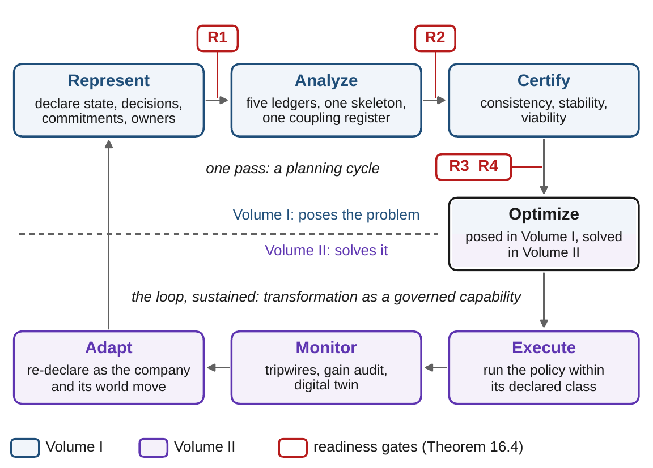
Readiness runs as a loop, not an examination
§16.4 · DEFINITION 16.2 · FIGURE 16.1
Definition 16.2. The seven moves of the DCT Map run as a loop: represent, analyze, certify, optimize, execute, monitor, adapt
The gates sit where representation is handed to analysis (R1), the unified system to certification (R2), and before anything is optimized (R3, R4)
One pass is a planning cycle; a certificate earned last year need not hold this year
Volume I builds the upper half and poses the optimization; Volume II solves it
Figure 16.1. The transformation lifecycle and the readiness gates.
Notes:
Definition 16.2 and Figure 16.1. For the analyst, the lifecycle sequences the volume's mathematics into an operating cadence; for the executive, it replaces the transformation program as a one-time event with transformation as a governed capability (Section 16.4).

Slide 10
Results depend on models only through contracts
§16.5 · THEOREM 16.5
For Meridian
THEOREM 16.5
Disciplinary Integration Theorem
Four core links at ceilings of 0.40 certify a spectral radius of 0.80, a half-life of 3.1 quarters and a multiplier of 5
A $10m shock at Digital echoes by at most $8m next quarter, $6.4m the quarter after, $50m in all
Whatever the true model is: the risk office needs the ceilings to hold, and the gain audit checks exactly that
(i) Well founded. No result rests on a later chapter's, and the citations contain no loop
(ii) Modular at its contracts. A model that honors a layer's contract keeps every result that refers to the layer only through it
Within the register's ceilings the true dynamics are at least as stable as the register: ρ(A) ≤ ρ(M)
(iii) Extensible at three points: models behind contracts, new layers, new solution methods
Notes:
Theorem 16.5; formal statement and proof in Appendix 16.A. Example 16.B.2 draws 10,000 models within the ceilings: every spectral radius is below 0.80, and no echo exceeds the register's; the register is the worst case among the models it certifies. Clause (ii) answers 'your model is not mine': correct, and immaterial, provided the substitute honors the contract.

Slide 11
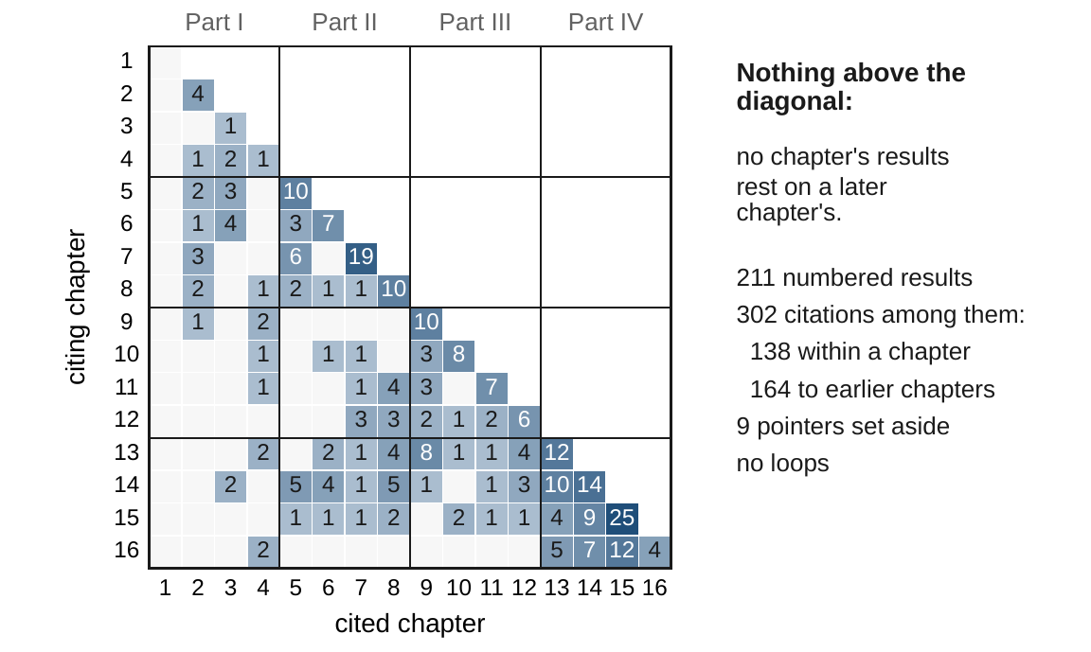
No result rests on a later chapter's
§16.5 · THEOREM 16.5(I) · FIGURE 16.2
Checked mechanically on the volume's source: 211 numbered results and 302 citations among them
138 within a chapter, 164 to earlier chapters, none to a later one
Nine pointers to illustrations the citing proofs do not use are set aside; then there is no loop
The longest chains run 15 steps, from Theorem 16.1 down to the embedding theorem, Theorem 3.3
Figure 16.2. Who cites whom: every count lies on or below the diagonal.
Notes:
Theorem 16.5(i), Figure 16.2 and Example 16.B.1. Sixty-two results cite no other result of the volume; there are eight chains of 15 citations, starting at Theorem 16.1 or Example 16.B.2 and ending at Theorem 3.3 or Proposition 5.1. Part IV leans on all of Parts II and III; Chapter 1's results cite none.

Slide 12
AI proposes; certificates dispose
§16.6 · PROPOSITION 16.1 · DEFINITIONS 16.3–16.5
The framework's position
PROPOSITION 16.1
AI Complements Optimization Theory
To the enthusiast: a learned system that cannot say which GEOP it solves, under which audits, is an unaccountable recommender
To the skeptic: rules that read rich, fast data are in practice searchable only by learning
A digital twin is a live declaration under continuous audit (Definition 16.4)
Autonomy is an envelope of commitments, with owners and a price (Definition 16.5)
(i) A target needs a declaration: with an undeclared normalization, the same scorecard ranks Meridian's options in opposite orders
(ii) Tests are not certificates: a model that passes every test can fail on an untested case
(iii) Learning searches; it does not redefine: no policy beats its class's optimum
Notes:
Proposition 16.1 (formal statement and proof in Online Appendix 16.B) and Definitions 16.3-16.5: enterprise intelligence is any capability, however implemented, that improves the lifecycle using information. The governance version fits in one line: AI proposes within contracts; certificates dispose. Automated re-declaration of objectives and commitments is where autonomy meets governance itself, and it remains an open problem.

Slide 13
Eight open problems, each at a declared point
§16.7 · DEFINITION 16.6 · TABLE 16.2
 | Open problem | Extension point; what it inherits
O1 | richer capital: intangibles, data, networks, assets valued by model | a model behind the capital contract; every downstream result
O2 | performance for many stakeholders under the Goodhart limit | a model behind the performance contract; the GEOP's objectives
O3 | dependent, heavy-tailed, and regime-switching uncertainty | a model behind the uncertainty contract; the risk calculus
O4 | ecosystems: several companies' declarations coupled | a new layer; compatibility, the register calculus
O5 | safe evolution: optimizing over declarations | new structure; the lifecycle and the readiness gates
O6 | estimating registers, gains, and laws with audit-grade guarantees | new structure; the gain audit and the certificates
O7 | methods at enterprise scale for nonconvex, mixed, dynamic GEOPs | a method for the canonical form; Volume II
O8 | certificates for learned components and policies | a method for the canonical form; the admission contract
Table 16.2, abridged. O1–O3 replace models behind existing contracts, O4–O6 add structure, O7–O8 are methods; O5 is the summit.
Adaptation changes within the declaration; evolution changes the declaration itself (Definition 16.6).
Notes:
Definition 16.6 and Table 16.2. Evolution is governed procedurally, through re-declaration and the readiness gates, but not yet optimized, because the space of declarations lacks the structure the GEOP requires of its feasible sets. The boundary between the two is the framework's current frontier.

Slide 14
Volume I poses the problem; Volume II solves it
§16.7 · TABLE 16.3
Volume I delivers | Volume II develops
the unified system and its certificates (Chs. 13–14) | methods that consume the certificates
the GEOP and its audits (Ch. 15) | algorithms for each method family (Table 15.4)
multipliers, costates, and frontiers, with their meaning | their computation at enterprise scale
policy classes with priced information | policy search and learning under certificates
decomposition with coordination prices | distributed and hierarchical computation
the honesty clauses and the readiness gates | the same clauses and gates, enforced in every application
Travel light: the canonical form from memory; no computed claim without its grade; consistency, then viability, then optimization; the honesty clauses as standing objections.
Volume I: what the company is, and whether its declarations hold together. Volume II: how to compute.
Notes:
Table 16.3 and Section 16.7's four habits for the reader crossing into Volume II. Volume II will not re-pose the problem, re-derive the theory, or renegotiate the honesty clauses; it will solve, at scale and under contract, what this volume has posed.

Slide 15
Is Meridian ready to optimize?
WORKED EXAMPLE 16.1 · THE SITUATION
The board
The next step
The chair
The digital program is approved
An optimization platform, and learning tools
First, a readiness certificate
With the risk package of Chapter 15: a $170m standby line and a delay of two months.
For the whole transformation, and to monitor it.
Run the four gates as the declaration stood after Chapter 8, and as it stands now.
Report what failed, what was repaired, at what cost, and what is still weak.
Notes:
Worked Example 16.1, the situation. The transformation office runs the gates of Theorem 16.4 on the declaration for the digital program's GEOP, Worked Example 15.1.

Slide 16
Two gaps, a double claim, and a link
WORKED EXAMPLE 16.1 · STEPS 1–3
(R1) Declaration completeness
(R2) Unified consistency
(R3) Analytical panel
$19.0m
$325m
0.80
Chapter 8's package, chosen on safety alone; $14.7m buys the same 3.0 percent odds
draw 138 and buffer 187 claimed on $270m of cash: the same cash twice
the core certified: a half-life of 3.1 quarters, a multiplier of 5
52.3 · 24.0
$131m
1.02
the scale decides who leads: restructuring, or digital
unclaimed after the repair: 122 + 17 = 139
the phase-two link at 0.40: past the board's rule
(R1) The levers' prices are now declared; the scorecard's scale is the board's to declare before any optimizer ranks the options
(R2) A minimal set of three commitments with three owners, the draw, the buffer and the floor; any two can hold
(R3) For phase two: run the new link below 0.08, ring-fence treasury below 0.16, or trim all four links to 0.30
Notes:
Worked Example 16.1, Steps 1-3. Step 1: eight readings, seven components and fourteen arrows, five standing commitments, the register, the six elements of the GEOP. On a best-to-worst scale restructuring leads digital 52.3 to 41.4; on percentage improvement digital leads 24.0 to 10.6. Step 2: $55 million more than there is. Step 3: the undeclared link has a ceiling of zero, so the gain audit would flag it at once.

Slide 17
Every gate passes now, after priced repairs
WORKED EXAMPLE 16.1 · TABLE 16.4
Gate | After Chapter 8 | Now | Owners
(R1) declaration | lever prices and the scorecard's scale undeclared | prices declared; the scale is the board's to declare | CFO, transformation office, board
(R2) consistency | draw 138 + buffer 187 = 325 on 270 of cash | 122 + 17 = 139; 131 unclaimed | transformation office, treasury, board
(R3) panel | fails with (R2), though the core alone is certified (0.80) | passes; a phase-two link at 0.40 would fail (1.02) | risk office, Digital, Industrial Systems
(R4) horizon | breach odds 24.6% against 5% | 5.0% with the $10.4 million package | board, CFO, transformation office
Table 16.4, top ($ million). The repairs were priced in Chapters 13–15.
Readiness is a property of declarations: Meridian won it by declaring prices, a scale, a link.
Notes:
Table 16.4, top. Meridian's first failures were at (R1), not for lack of data but for lack of owned declarations. As first declared, the plan had no levers among its decisions, so no policy in the declared class kept the 5 percent appetite: (R4) failed.

Slide 18
Two passes are thinner than their readings
WORKED EXAMPLE 16.1 · STEP 4 · TABLE 16.4
Commitment | Margin | Error of the reading | Grade
leverage ≤ 4.5× | 0.76 | ± 0.075 | strong
breach odds ≤ 5% | 0 (binds) | ± 0.07 points (simulation) | statistical; $1.8 million a point
capability ≥ 55 | 3 | ± 5 | weaker than the reading
strategic risk ≤ 75 | 1.4 | ± 6 | weaker than the reading
Table 16.4, bottom. With the line fully drawn leverage reaches only 3.74×; strategic risk peaks at 73.6 in month 11.
The covenant passes with ten times its band; the appetite binds, as a binding commitment must.
Notes:
Worked Example 16.1, Step 4, and Table 16.4, bottom: each margin against the error band of the reading behind it (Table 5.2). The appetite's certificate is statistical, and its price says what more safety would cost. The capability floor holds by 3 points against a survey error of 5; strategic risk is 1.4 points under its ceiling against a band of 6.

Slide 19
Readiness is won by declaring things
WORKED EXAMPLE 16.1 · WHAT THE BOARD SHOULD TAKE AWAY
4 of 4
2
(R3)
gates pass for the program as approved, after repairs earlier chapters priced
passes thinner than the errors in the readings behind them, and the board knows which two
where phase two must return before it is optimized
Work orders: tighten the capability survey or protect five points of margin; narrow the risk reading's band, or buy margin at the month-11 peak
For discussion: repair which thin pass first? Is precision in the reading cheaper than margin in the plan?
Phase two will fail (R3) as designed: against which of the three repairs should the board price the new link?
The repaired declaration is Theorem 16.1(iv)'s company, meeting all of the volume's requirements at once
Notes:
Worked Example 16.1, Step 5, what the board should take away, and the discussion questions. The repaired declaration is the company of Theorem 16.1(iv): one company that meets all of the volume's requirements at once (Example 16.B.3).

Slide 20

Certifying Meridian for Volume II, in AXIOM
AXIOM LAB 1.16 · MODULE AXIOM-16
Meridian's board will decide whether to commission an optimization platform and learning tools for its transformation. You prepare the readiness pack: the four gates, their artifacts, and the work orders. Open AXIOM, choose Lab 1.16 and load the Meridian model.
1
2
3
4
5
Framework visualizer
GEOP formulation assistant
Digital-twin demonstration
Dependency navigator
Volume II transition
Walk the map and the five ledgers' contracts; open the register and the commitments.
Run (R1)–(R4): reproduce the gaps and the joint check; apply the package.
Inject a drift into one gain; then declare the phase-two link at 0.40.
Trace Theorem 16.4 to its foundations; find the longest chain.
Export the certified instance in the canonical form.
Deliverable: a two-page readiness pack for the board: the four gates with their artifacts and grades; the work orders with their owners; the certified instance; and the conditions under which the certificate lapses. About 90 minutes.
Notes:
AXIOM Lab 1.16. What to look for: readiness is won mostly by declarations (Theorem 16.4); the register's certificates hold for every model within its ceilings (Theorem 16.5(ii)); and a pass is only as strong as its margin against the error of the reading behind it.

Slide 21
What to carry forward
KEY TAKEAWAYS
1
Volume I is one structure: it removed the five limitations of Chapter 1, and it is built from the ground up—no result rests on a later chapter's, and its citations contain no loop.
2
The framework's demands are consistent, because one company meets all of them at once, and its completeness is relative: no analysis, human or machine, answers a question that the declaration does not determine.
3
Readiness is checkable: four gates in order, each with an artifact; none implies the next, none can be dropped, and every failure is a work order with an owner.
4
Contracts are the framework's interfaces: models behind them can be replaced, layers added, and solvers attached, and the register's certificates hold for every model within its ceilings.
5
AI is admitted, not enthroned: it proposes within contracts and certificates dispose; a twin is a live declaration under audit; autonomy is a priced envelope; and the evolution of declarations is the named frontier.
Notes:
Key Takeaways, Chapter 16.

Slide 22
Notebook and workbook reproduce the book
THIS WEEK'S LABORATORY
73
77
26116
AXIOM-16
notebook checkpoints, every one PASS
workbook checks against the engine, ALL PASS
the lab's seed
AXIOM Lab 1.16
Notebook DCT_V1_Ch16_Lab.ipynb: Worked Example 16.1 and the lab's five steps in ten panels, ready for Colab
Workbook DCT_V1_Ch16_Lab.xlsx: the four gates, Table 16.4, the twin's gain audit and Volume I's citation graph, in formulas
Every number on these slides is the book's, and both companions check it
Notes:
The notebook and workbook are on the course website, www.dynamiccorporatetransformation.com. The worked example's paths are Chapter 8's, drawn with random seed 8; the lab's seed is used only for fresh draws.

Slide 23

Volume II begins with this instance
NEXT · VOLUME II, CHAPTER 1
Introduction to Enterprise Optimization: every well-posed transformation decision in one canonical form
Analysis runs forward from a plan; optimization runs backward, from what the company wants and must respect
Worked Example 1.1, “Can Meridian Sign Volume I's Answer?”, tests whether the cheapest way to meet the appetite survives lines in tranches and delays in whole quarters
Notes:
Volume II, Chapter 1, Equation 1.1, and its Worked Example 1.1. The Meridian Group enters with the answers Volume I gave it, certified by the gates of this chapter.

