Slide 1
Hamilton–Jacobi–Bellman Enterprise Framework
VOLUME II · CHAPTER 8 · WEEK 11
As the periods shrink, Bellman's equation becomes the HJB equation: the hurdle return on a position equals the best the next moment can earn
Graduate course companion · Lab seed 26208 · AXIOM Lab 2.8 (AXIOM-08)
Notes:
Volume II, Chapter 8. Chapter 7 valued every position on a calendar of quarters; this chapter lets the periods shrink and reads the value as prices of stocks and a rule for every position.

Slide 2
“It is a mistake to look too far ahead. Only one link in the chain of destiny can be handled at a time.”
Winston S. Churchill
Nobel Prize in Literature 1953; House of Commons, after Yalta (1945)
Notes:
Churchill's advice to the Commons is Bellman's principle: handle one link at a time, valued by where it leaves you (Section 8.1).

Slide 3
After this chapter, you can
LEARNING OUTCOME STATEMENTS
8.1
Explain how the Hamilton–Jacobi–Bellman equation arises from Bellman's equation as the periods shrink, and read it as an asset-pricing statement about positions.
8.2
Formulate a continuous-time dynamic program—states, decision rates and their limits, dynamics, the value earned each moment, the hurdle rate, and the horizon—write its HJB equation, and read the best rule from the Hamiltonian at the value's slope.
8.3
Certify a value and a rule with the verification theorem, including its limit condition and residual bound, and recognize the corners of a value function and the sense in which it still solves the equation.
8.4
Solve linear–quadratic problems with the Riccati equation, read the rule's gain and the prices of the stocks, test the rule's robustness, and handle delays by predicting the state.
8.5
Compute values and rules with upwind schemes and policy iteration, judge their convergence, and explain the curse of dimensionality and why linear–quadratic problems escape it.
Notes:
The five learning outcome statements; LOS Guidance at the end of the chapter.

Slide 4
Six sections, a worked example, a case and a lab
ROADMAP
§8.1
§8.2
§8.3
§8.4
§8.5
From the Bellman Equation to a Differential Equation
Prices and Rules from the HJB Equation
Certifying a Rule
Corners in the Value
Linear–Quadratic Rules
Definition 8.1 · Theorem 8.1 · Table 8.1
Proposition 8.1
Theorem 8.2
Proposition 8.2 · Figure 8.1
Theorem 8.3 · Proposition 8.3
§8.6
Worked Example 8.1
In Practice
AXIOM Lab 2.8
Computing Values and Rules
How Fast Should Meridian Close Its Engineering Gap?
Brokers Pace a Large Sale
Steering by the Value: Meridian's Hiring Rule and Capability Floor
Proposition 8.4 · Table 8.2
Table 8.3 · Figures 8.2–8.3
At a Glance · board questions
AXIOM-08 · five steps
Notes:
Formal statements and proofs of Theorems 8.1–8.3 are in Appendix 8.A; Propositions 8.1–8.4 and the numbers behind Worked Example 8.1 in Online Appendix 8.B.

Slide 5

The hurdle return on a position, moment by moment
§8.1 · DEFINITION 8.1
the hurdle return on a position equals the best of what the next moment earns plus the change in its value
A continuous-time dynamic program declares states, decision rates and their limits, dynamics, the value earned each moment, the hurdle rate ρ = ln(1 + r) and a horizon
The Hamiltonian H = ℓ + mᵀf is Chapter 6's, with the costate replaced by the slope of the value
Decisions are rates, so a rule can respond at every moment rather than once a quarter
Over a finite horizon the value also changes as time passes: ρV − ∂V/∂t = max H, with V = Φ at the horizon
Notes:
Definition 8.1 and Equations 8.2–8.3. The definition adds nothing to Chapter 6's declarations; it changes the question from the best plan from one start to a value and a decision for every position.

Slide 6
From a calendar of periods to continuous time
§8.1 · TABLE 8.1
 | On a calendar (Chapter 7) | In continuous time (this chapter)
The equation | the best of a period's value plus the discounted value of where it leads (Theorem 7.1) | the hurdle return equals the best the next moment earns plus the change in value (Theorem 8.1)
Prices of stocks | slopes of the value; the price recursion (Proposition 7.1) | slopes of the value; along a best plan, Chapter 6's costate (Theorem 8.1(iii))
The best rule | greedy for the value function | maximizes the Hamiltonian at the value's slope (Proposition 8.1)
Certificate | the contraction; a residual bounds the error by 1/(1 − β) periods' worth (Theorem 7.3) | verification, with a limit condition; a residual bounds the error by 1/ρ years' worth (Theorem 8.2)
Where the value has no slope | differences still value lumps | corners: viscosity solutions with continuous data; for one stock, a direct certificate (Proposition 8.2)
Closed forms | targets and thresholds (Theorem 7.2) | linear rules from a Riccati equation (Theorem 8.3)
Notes:
Table 8.1. Read it row by row: the equation, the prices of stocks, the best rule, the certificate, what happens where the value has no slope, and the closed forms, on a calendar and in continuous time.

Slide 7
Bellman's principle in continuous time
§8.1 · THEOREM 8.1
What it means
THEOREM 8.1
Hamilton–Jacobi–Bellman Theorem
Asset pricing for positions: the hurdle return is the best dividend plus capital gain
Each unit of change in the stocks is priced at the value's slope
A decision needs the current position and the value of where it leads, not the history or a forecast
The maximum principle is the HJB equation read along one path; dynamic programming adds the rule
(i) Dynamic programming principle. A value is the best over any stretch of time plus the discounted value of where it ends
The rest of a best plan is best from wherever it stands
(ii) The HJB equation. The value is continuous, and wherever it has a slope it solves the equation
(iii) Prices and rules. Along a best plan the decision maximizes the Hamiltonian at the value's slope: Chapter 6's costate
Notes:
Theorem 8.1; formal statement and proof in Appendix 8.A. Part (iii) closes the loop with Chapter 6: along a best plan the price of a stock is the slope of the value.

Slide 8
Read the rule from the Hamiltonian
§8.2 · PROPOSITION 8.1
$10.13m
$4m
$3.61m
a capability point at 53, more than its $4m cost: hire at the cap
a point on the floor, exactly its cost: hold it there, paying the rent
a point at 58, less than its cost: hire nothing
Proposition 8.1. Linear decisions sit at a limit or hold; smooth decisions set marginal cost equal to the value of what they build; a concave value prices a stock lower as it grows
At 58, ρV(58) = −δ · 58 · V′(58): carrying the $222.36m liability costs $21.19m a year, exactly the drift of 5.87 points a year at $3.61m a point
In the hiring problem the premium grows with its square, so approvals are smooth: HR approves until the premium on one more equals 60 percent of the price of an engineer of gap
Notes:
Proposition 8.1 and the Enterprise Interpretation of Section 8.2, on Chapter 6's capability problem (Worked Example 6.1): hiring at $4 million a point up to 10.13 points a year, decay at 0.101 a year, the build waiting at $32 million a year until capability first reaches 55.

Slide 9
A solution and a limit condition certify a rule
§8.3 · THEOREM 8.2
An audit
THEOREM 8.2
Verification Theorem
The effective horizon 1/ρ is 10.5 years: values with a residual of at most $0.1m a year are within $1.05m
The theorem certifies; it does not find. Candidates come from guesses, plans or computation
The limit condition matters: the second root solves the equation, but its rule releases engineers
(i) A bound. A function that satisfies the HJB equation as an inequality is worth no less than any plan
Over an open horizon this needs a limit condition at the far end of time
(ii) A certificate. If it solves the equation, a rule attains it, and its discounted value tends to zero, the rule is best
(iii) A near-certificate. A residual of ε a year: within ε/ρ of the value; its rule within 2ε/ρ
Notes:
Theorem 8.2; formal statement and proof in Appendix 8.A. The Scope and Limits box of Section 8.3: the second root's rule makes the gap grow without limit, its cost is infinite, and part (ii) certifies nothing.

Slide 10
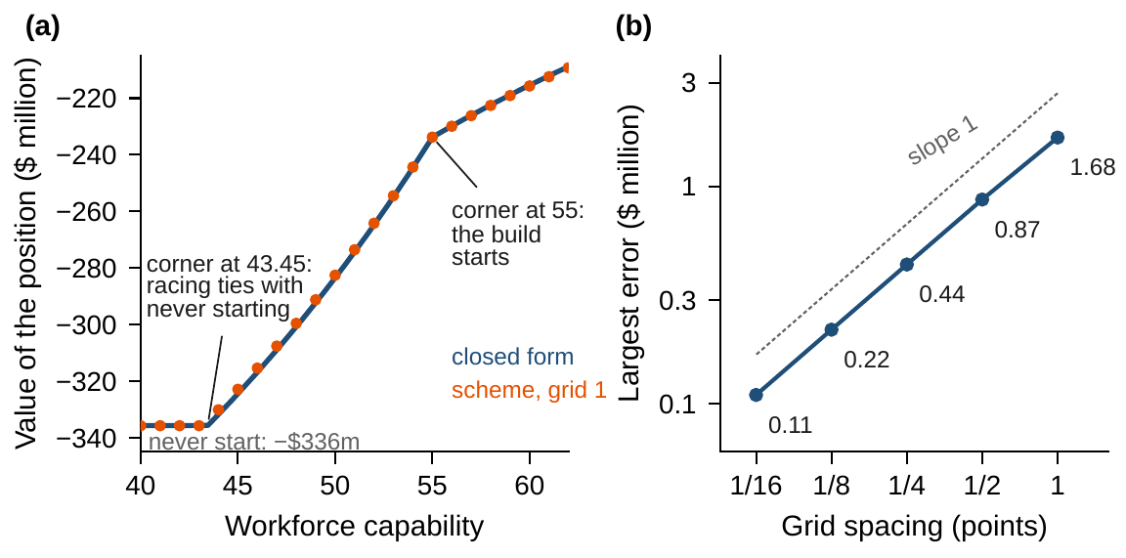
Corners: where a declared switch moves the price
§8.4 · PROPOSITION 8.2
Proposition 8.2. For one stock, a direct test at each corner extends verification
With continuous data the value is the only viscosity solution; almost everywhere is not enough
At 43.45 racing to the floor ties with never starting the build: the price jumps from zero to $7.07m
At 55 the build starts: a point's price falls from $11.02m, its cost plus the delay it saves, to $4m
On the floor the rent, $22.28m a year, is 9.5 percent of $233.76m: exactly the hurdle return
Figure 8.1. (a) The value of each capability level: closed form and the upwind scheme on a grid of one point. (b) The scheme's largest error halves with the spacing, from $1.68m to $0.11m.
Notes:
Proposition 8.2; formal statement and proof in Online Appendix 8.B. Holding capability at 43.45 would cost $49.6 million a year, more than the $32 million a year that never starting costs at the hurdle rate; so part (i) certifies Chapter 6's plans across both corners.

Slide 11
Quadratic costs give linear rules
§8.5 · THEOREM 8.3
For Meridian's hiring loop
THEOREM 8.3
Linear–Quadratic Rules
One stock: (b²/r)p² + (2a + ρ)p − q = 0, and the gain is K = bp/r
A gap of d engineers costs 0.0032d² a year; approving v a year costs a premium of 0.000125v²
If approvals landed at once: approve 4.34 times the gap a year
The gain depends only on q/r: doubling the cost of a gap calls for the same rule as halving the premium
(i) The Riccati equation has one positive semidefinite solution P; the least cost from x is xᵀPx
(ii) The best rule is u = −Kx with K = R⁻¹BᵀP: the marginal cost of the pace equals the value of what it builds
(iii) Policy iteration from any stabilizing rule never raises the cost and converges to P
(iv) Over a finite horizon, P(t) solves the Riccati differential equation backward
Notes:
Theorem 8.3 and Equation 8.5; formal statement and proof in Appendix 8.A. Quadratic costs are declarations: small deviations are nearly free and large ones expensive.

Slide 12
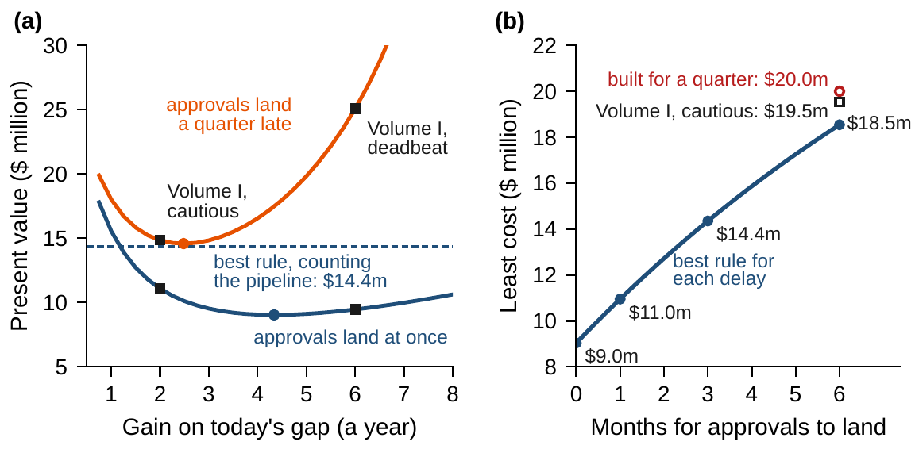
With a delay, steer by the predicted state
§8.5 · PROPOSITION 8.3
(i) Without a delay, any stronger gain, or one weaker by less than half, stays stable
(ii) With a delay, steer by the position a delay ahead, which counts the decisions in flight
Meridian: approve 4.28 times the gap a quarter ahead a year, instead of 4.34; the bench never overshoots
A rule on today's gap must be gentle: best at 2.48 a year, swinging ever wider above 10.92
Least cost: $9.0m at once, $11.0m a month late, $14.4m a quarter, $18.5m half a year
Figure 8.3. (a) Cost of rules on today's gap against their gain, at once and a quarter late; dashed, the best rule. (b) The least cost against the months approvals take to land.
Notes:
Proposition 8.3; formal statement and proof in Online Appendix 8.B. The critical gain of 10.92 a year, 2.73 a quarter, is in Online Appendix 8.B.1. Smith's predictor and Artstein's reduction are the origins of steering by the predicted state.

Slide 13
Four ways to compute values and rules
§8.6 · TABLE 8.2
Method | Computes | Guarantee | Watch for
Guess and verify | a value and a rule of a known shape | exact, by verification (Theorem 8.2) | a guess that misses a corner (Proposition 8.2)
Riccati equation | linear–quadratic problems, any number of stocks | exact; policy iteration from any stabilizing rule (Theorem 8.3) | limits on the decisions, which it ignores
Upwind scheme with policy iteration | values and rules for one or a few stocks | converges with continuous data, corners included; finitely many steps on each grid (Proposition 8.4) | Gⁿ positions; a linear solve per step
Fitted values | values and rules for many stocks | a residual of ε a year costs at most 2ε/ρ (Theorem 8.2(iii)) | a shape that cannot fit the value
With n stocks and G levels each, a grid has G^{n} positions; the Riccati equation has n(n + 1)/2 unknowns, whatever the grid.
Notes:
Table 8.2 and Proposition 8.4(iii). All methods rest on Theorems 8.1 and 8.2; they differ in what they compute and in what they promise.

Slide 14
Upwind schemes converge, corners included
§8.6 · PROPOSITION 8.4
$1.68m
$0.11m
$9.037m
largest error on a grid of one point, 51 levels: 15 policy-iteration steps
on a sixteenth of a point, 801 levels: the error halves with the spacing
the hiring problem needs no grid: three Riccati steps from the cautious gain come within a dollar
Proposition 8.4. An upwind scheme is a monotone dynamic program on a grid, solved by policy iteration in finitely many steps; with continuous data it converges to the value
The finest grid prices a point at $10.99m just below the floor and $3.99m above it (exactly $11.02m and $4m), and starts the race from 43.44 (exactly 43.45)
Two stocks on grids of 801 levels need 641,601 positions; Meridian's eight coordinates about 1.7 × 10²³; a linear–quadratic model of them, 36 unknowns
Notes:
Proposition 8.4 and the Computational Implications box of Section 8.6; Online Appendix 8.B.2. Policy iteration from Volume I's cautious gain of 2 a year ($11.08 million) reaches gains of 5.32, 4.42 and 4.338 a year, at $9.20, $9.04 and $9.037 million (Kleinman).

Slide 15
How fast should Meridian close its gap?
WORKED EXAMPLE 8.1 · THE SITUATION
Chief operating officer
Chief financial officer
The new declarations
What rule should HR run?
What do the gap and the delay cost?
A price on the gap and on speed
Volume I recommended the cautious rule, half the gap a quarter, on speed and stability alone.
Approvals take a quarter to land, and 60 percent of approved hires become productive engineers.
Program office: a gap costs 0.0032d² a year, $32m at 100 short. Human resources: approving costs 0.000125v² a year.
The digital program's bench is 100 engineers short. Nothing priced a gap or speed, so Volume I could not say how fast is fast enough.
Notes:
Worked Example 8.1, the situation. Each quarter retraining and internal moves close 10 percent of any gap on their own; with the quarter's delay, Volume I's deadbeat rule made the bench boom and bust for years.

Slide 16
Price the gap and the pace, then solve
WORKED EXAMPLE 8.1 · STEPS 1–3
the gap closes a tenth a quarter on its own; 60 percent of approvals become engineers a quarter later
Step 2, as if approvals landed at once: p = 0.000904; approve 4.34 times the gap a year; least cost $9.04m
At 100 short an engineer of gap is priced at $181,000; the premium on the last approval, $108,000, equals 60 percent of that price
Step 3, with the delay: steer by the predicted gap, 90 short today, at 4.28 times it a year
The rule starts at 385 a year and approves 68 in the first quarter; the gap closes without overshoot
Least cost $14.35m: $7.13m for the first quarter, fixed whatever the rule, plus $7.22m; the delay costs $5.31m
Notes:
Worked Example 8.1, Steps 1–3, and Online Appendix 8.B.1. The other root of the quadratic fails the limit condition (Section 8.3). With the delay the price of an engineer on the bench rises from $181,000 to $287,000.

Slide 17
Rules for closing a gap of 100 engineers
WORKED EXAMPLE 8.1 · TABLE 8.3
Rule | Gain | First quarter | Peak | At a year | Cost | Extra | At once
Best rule: steer by the predicted gap | 1.07* | 68 | 0 | −10 | 14.35 | – | 9.04
Step 2's gain on today's gap | 1.08 | 103 | 16 | 12 | 17.47 | 3.12 | 9.04
Best gain on today's gap | 0.62 | 59 | 0 | −6 | 14.58 | 0.23 | 10.14
Volume I's cautious gain | 0.50 | 47 | 0 | −14 | 14.84 | 0.49 | 11.08
Volume I's deadbeat gain | 1.50 | 142 | 37 | 11 | 25.07 | 10.72 | 9.46
Present values at 10 percent over an open horizon, $ million. Gain: approvals a quarter as a multiple of the gap. First quarter: approved in it. Peak: largest surplus (engineers). At a year: bench minus target. At once: the rule's cost if approvals landed at once. *On the predicted gap, counting approvals in flight.
Steer by the predicted gap; a rule that cannot see the pipeline must be gentle.
Notes:
Table 8.3. Rules on today's gap are proportional and run continuously; costs from simulations of the delay equation (Online Appendix 8.B.1). Step 2's gain on today's gap approves about 400 a year while nothing lands, overshoots to 16 too many and must release them.

Slide 18
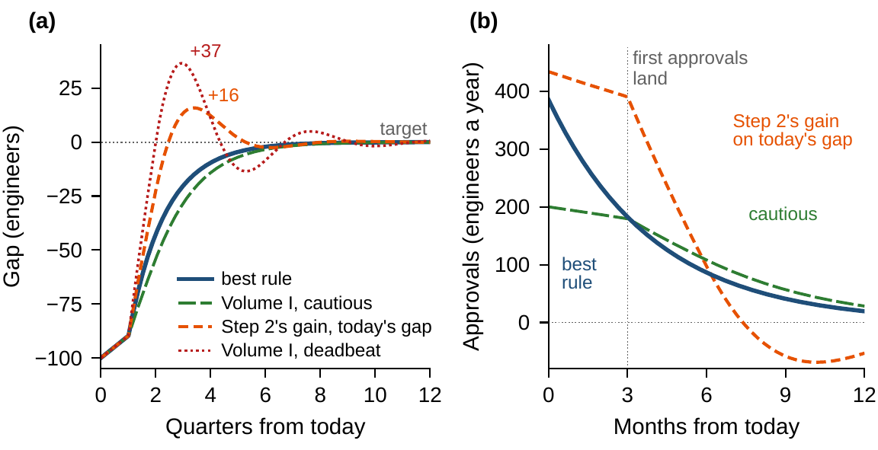
Count the pipeline, or steer gently
WORKED EXAMPLE 8.1 · STEPS 4–5
Step 2's gain on today's gap overshoots to 16 ($3.12m more); Volume I's deadbeat gain to 37 ($10.72m)
The best gain on today's gap is gentle, 0.62 a quarter: within $0.23m; Volume I's cautious gain: $0.49m
If approvals landed at once, the cautious gain would be the worst of these, $2.05m above the best
Step 5: half a year's delay, steered for a quarter, costs $19.99m against $18.54m for the right rule
A month instead of a quarter is worth $3.40m; at 30 percent productivity the rule is within $0.08m
Figure 8.2. (a) The gap under the best rule and under rules on today's gap. (b) Approvals: the best rule starts at 385 a year and eases as the pipeline fills.
Notes:
Worked Example 8.1, Steps 4 and 5. Doubling the cost of a gap, or halving the premium, raises the gain to 6.33 a year (least costs $24.95 and $12.47 million); the reverse lowers it to 2.84 ($8.36 and $16.71 million).

Slide 19
Approve by the gap a quarter ahead
WORKED EXAMPLE 8.1 · WHAT THE BOARD SHOULD TAKE AWAY
4.28
$14.35m
$3.4m
times the predicted gap a year, about 1.07 a quarter: 385 a year at first, 68 approvals in the first quarter
gap and premium from 100 short; within 10 engineers in a year, without overshoot
saved by cutting the delay to a month: the case for faster onboarding
A rule that cannot see the pipeline must be gentle: Volume I's cautious gain comes within $0.5m; steering hard on today's gap costs up to $10.7m more
Three owners: the program office keeps the cost of a gap; human resources the premium and the record of approvals in flight; the board the hurdle rate
For discussion: what would HR have to track, and who should audit it? If the delay is sometimes half a year, which rule would you run?
Notes:
Worked Example 8.1, what the board should take away, and the discussion questions. The delay itself costs $5.3 million from 100 short.

Slide 20
Brokers pace a large sale with a rule
IN PRACTICE · OPTIMAL EXECUTION
The decision
The method
The result
How fast to sell a block
Linear–quadratic, with a deadline
A standard of execution
Sell fast and push the price down; sell slowly and bear the risk that the price moves.
Almgren–Chriss: sell in proportion to what remains, with a gain that rises as the deadline nears.
Many brokers offer shortfall-minimizing algorithms; Citigroup estimated impact from 29,509 orders.
Making it work
What Meridian takes
For the board
Assumptions met the data
Worked Example 8.1 with a deadline
What does speed cost us?
Impact followed a 3/5 power law, not a straight line, and rules that read prices beat the static schedule.
A stock that costs its square, closed at a pace that costs its square, gives a linear rule.
When we must exit a position, what does waiting risk, and who decides the trade-off?
Notes:
In Practice, Chapter 8: Brokers Pace a Large Sale. A real organization's decision of this chapter's kind, told from its published record; every figure is cited in the book. The lesson for Meridian: Quadratic declarations give linear rules; measure the costs, as Citigroup did when impact followed a 3/5 power law. Sources: Almgren and Chriss (2000/01), Journal of Risk; Almgren et al. (2005), Risk; SEC staff (2020); Lorenz and Almgren (2011); Risk.net (2017).

Slide 21

Steering by the value, in AXIOM
AXIOM LAB 2.8 · MODULE AXIOM-08
Human resources must propose a standing rule for approving hires against the engineering gap, and the board wants a certificate that no other rule does better. Open AXIOM, choose Lab 2.8 and load the Meridian hiring instance and Chapter 6's capability instance.
1
2
3
4
5
Assemble the equation
Read the Hamiltonian
Generate and simulate rules
Compare prices
Solve on a grid
Try quadratic values; map the residual and its bound; find both roots.
Plot it against the approval rate; find where the premium meets the value.
With and without the delay, beside Volume I's rules and the predicted gap.
Check that the value's slope along the best path is Chapter 6's costate.
Upwind scheme and policy iteration, one point to a sixteenth; corners, errors.
Deliverable: a one-page note to the board: the approval rule and its cost, the comparison with Volume I's rules, the value of faster onboarding, the certificate, and the declarations the rule rests on. About 75 minutes.
Notes:
AXIOM Lab 2.8. What to look for: a Riccati coefficient that makes the residual vanish and a second root that fails the limit condition; approvals where the marginal premium equals the value of an approval; a rule on the predicted gap that never overshoots; corners at 43.45 and 55; errors that halve with the grid.

Slide 22
What to carry forward
KEY TAKEAWAYS
1
The HJB equation is Bellman's equation in continuous time: the hurdle return on a position equals the best of what the next moment earns plus the change in the position's value. Wherever the value has a slope it solves the equation, and along a best plan its slope is Chapter 6's costate.
2
The best rule maximizes the Hamiltonian at the value's slope: at every position, compare a decision's cost with the value of what it builds—at a limit or holding when decisions enter linearly, marginal cost equal to marginal value when they enter smoothly.
3
A function that satisfies the HJB equation, a rule that attains it, and a limit condition at the far end of time certify the rule as best; a residual of ε a year bounds the error by ε/ρ. Value functions have corners; with continuous data the equation holds there in the viscosity sense, and only the value function satisfies it; for one stock, a direct certificate covers an abrupt declaration.
4
Linear dynamics with quadratic costs give linear rules from a Riccati equation, found by policy iteration and stable under any stronger gain when decisions act at once. A delay breaks that, and is handled by steering on the predicted state, which counts the decisions in flight.
5
Upwind schemes are dynamic programs on a grid, solved by policy iteration; with continuous data they converge to the value function, corners included. Grids grow as Gⁿ with the number of stocks, a curse that linear–quadratic problems escape.
Notes:
Key Takeaways, Chapter 8.

Slide 23
Notebook and workbook reproduce the book
THIS WEEK'S LABORATORY
65
67
26208
AXIOM-08
notebook checkpoints, every one PASS
workbook checks against the engine, ALL PASS
the lab's seed
AXIOM Lab 2.8
Notebook DCT_V2_Ch08_Lab.ipynb: Worked Example 8.1 and the lab's five steps in nine panels, ready for Colab
Workbook DCT_V2_Ch08_Lab.xlsx: the Riccati roots, the predicted-gap rule, policy iteration, the critical gain, Chapter 6's closed forms and the upwind scheme, in formulas
Every number on these slides is the book's, and both companions check it
Notes:
The notebook and workbook are on the course website, www.dynamiccorporatetransformation.com.

Slide 24
Part III adds outside events at random
NEXT · CHAPTER 9
Chapter 9 opens Part III: outside events that push the stocks at random
The HJB equation gains a term for their spread; verification, viscosity solutions and monotone schemes carry over
For linear–quadratic problems whose events add to the stocks regardless of their level, the best rule is unchanged and only the cost rises: certainty equivalence
Notes:
The Scope and Limits box of Section 8.5 and the Further Reading point ahead to Part III, Enterprise Optimization Under Uncertainty, which Chapter 9, Stochastic Enterprise Optimization, opens.

