Slide 1
Neuro-Fuzzy Robust Enterprise Optimization
VOLUME II · CHAPTER 10 · WEEK 12
Part III's second declaration: a bounded set of futures with no odds, and decisions that keep their commitments on every future in it
Graduate course companion · Lab seed 26210 · AXIOM Lab 2.10 (AXIOM-10)
Notes:
Volume II, Chapter 10. Chapter 9 kept Meridian's appetite with a declared probability law; this chapter declares a bounded set of futures, with no odds, grades it in the offices' words, and learns its price as neuro-fuzzy rules (abstract).

Slide 2
“If history repeats itself, and the unexpected always happens, how incapable must Man be of learning from experience!”
George Bernard Shaw
Nobel Prize in Literature 1925; Man and Superman (1903), “Maxims for Revolutionists”
Notes:
Shaw's maxim frames the chapter: the unexpected happens, so a board that cannot vouch for the odds declares what could happen instead, and audits that declaration (Section 10.1).

Slide 3
After this chapter, you can
LEARNING OUTCOME STATEMENTS
10.1
Explain what declaring a bounded set of futures guarantees, what it costs, and how it differs from declaring a law.
10.2
Formulate the robust counterpart of a commitment over a box, a budget, or a ball, and find a robust decision and its binding worst case.
10.3
Turn linguistic declarations into graded sets, read possibility and necessity guarantees from their cuts, and choose by max-min against a graded goal.
10.4
Build a neuro-fuzzy rule system in the declarations' language, train it by hybrid learning, and certify what it proposes.
10.5
Compare a guarantee on a set with a chance under a law, and judge when rules that read the past help under a set.
Notes:
The five learning outcome statements; LOS Guidance at the end of the chapter.

Slide 4
Five sections, a worked example, a case and a lab
ROADMAP
§10.1
§10.2
§10.3
§10.4
From a Law to a Set
Robust Counterparts
Graded Declarations
Neuro-Fuzzy Rules
Definition 10.1 · Table 10.1
Theorem 10.1 · Proposition 10.1
Theorem 10.2 · Proposition 10.2 · Figure 10.1
Theorem 10.3 · Figure 10.2
§10.5
Worked Example 10.1
In Practice
AXIOM Lab 2.10
Guarantees, Odds, and Rules
What Can Meridian Guarantee Without Odds?
Ford Maps Its Supply Risk Without Odds
Guarantees Without Odds: Sets, Grades, and Rules
Proposition 10.3 · Table 10.2
Table 10.3 · Figure 10.3
At a Glance · board questions
AXIOM-10 · five steps
Notes:
Formal statements and proofs of Theorems 10.1–10.3 are in Appendix 10.A; Propositions 10.1–10.3 and the numbers behind Worked Example 10.1 and Figures 10.1–10.3 in Online Appendix 10.B.

Slide 5
Three declarations of uncertainty
§10.1 · DEFINITION 10.1 · TABLE 10.1
 | A law (Chapter 9) | A set (this chapter) | A graded set (this chapter)
Declares | the odds of every event | what can happen | how possible each event is
Promise | a chance, an expected value | on every event in the set | on every event of possibility at least α
Owner's evidence | a record | bounds | words: usual, possible, unthinkable
Computation | samples (Theorem 9.3) | robust counterparts (Theorem 10.1) | one robust problem per cut (Theorem 10.2)
Fails when | the odds are wrong | the set leaves out what matters | the words are miscalibrated
Definition 10.1: a robust decision keeps every commitment for every event in a declared bounded set; it promises more than a chance, and assumes less.
Notes:
Definition 10.1 and Table 10.1. A graded (fuzzy) declaration gives each event a possibility, its membership; its α-cut holds the events of possibility at least α. The possibility of a set of events is the largest membership in it, and the necessity of its complement is one minus that.

Slide 6
A set must say everything that matters
§10.1 · VOLUME I'S JOINT CHECK, READ AS ROBUST
$55m
17.4%
8.4%
a line that keeps the floor against one closure of $187m: $1.65m, robust on its set
its chance of a breach under Chapter 9's law
the chance from execution and market deviations alone, which its set left out
Volume I, Worked Example 13.1 guarded the floor against the 90th-percentile closure at the deepest draw
A guarantee is exactly as good as its set: the set is a declaration, with owners and an audit
The engineering office owns the bound on deviations; the treasury, the bound on a closure
Notes:
Section 10.1. The joint check's package passes its set and breaches on 17.4 percent of paths under Chapter 9's law, because the set left out deviations (Volume I, Worked Example 15.1). Online Appendix Example 10.B.2: law 17.39 percent (fresh 17.12), set coverage 1.5 percent.

Slide 7
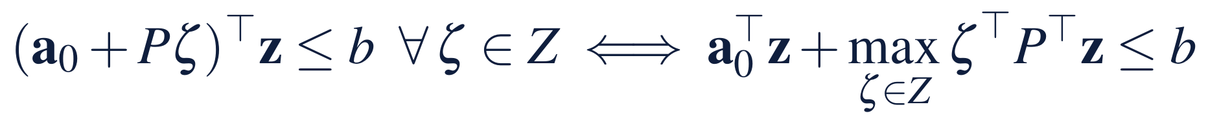
A commitment on a whole set is one constraint
§10.2 · THEOREM 10.1
For Meridian's floor
THEOREM 10.1
Robust Counterparts
The floor is linear in the deviations and in the closure beyond the line
Worst case: deviations at their bound, the closure early enough to be felt in the deepest quarter
There, quarter 7, the plan stands $132m above the floor
A line covers a dollar of closure for 3 cents; delay lifts quarter 7 by $24.6m for $8m, about 33 cents a dollar
(i) Counterparts. A box gives ‖y‖₁, a ball ‖y‖₂, a budget min over t of Γt + Σ(|yᵢ| − t)⁺: linear, cone, linear
(ii) Price of robustness. Robust decisions form a convex set that shrinks as the set grows
(iii) Sets and odds. A set of probability 1 − α under a law promises the chance 1 − α
(iv) Budgets. With independent symmetric events, a breach has probability at most exp(−Γ²/(2n))
Notes:
Theorem 10.1; formal statement and proof in Appendix 10.A. A box lets every coefficient reach its worst at once; a budget lets at most Γ of them do so (Bertsimas and Sim). Part (iii) is the bridge to Chapter 9: a set that holds 95 percent of the law's futures promises a 5 percent appetite, conservatively.

Slide 8
The cheapest robust package in closed form
§10.2 · PROPOSITION 10.1(II)
the least delay the deviations need; the margin absorbs what it can of a closure; the line covers the rest
Joint check (D 0, S 187): the margin absorbs $132m; a $55m line, $1.65m
Crisp set (D 125, S 210): deviations use $125m of the $132m margin; the first $7m of a closure fits; a $203m line, no delay, $6.09m
A bank's cap of $100m on the line: the delay carries the rest, 4.3 quarters and $37.23m
Notes:
Proposition 10.1(ii); formal statement and proof in Online Appendix 10.B. The closed form holds because a line is cheaper than delay per dollar of cover, 0.03 against 8 / 24.8. For nested sets the least cost never falls as the set grows (part (iii)). Crisp set under the law: 8.64 percent (fresh 8.43).

Slide 9
Words become nested sets
§10.3 · THEOREM 10.2
The offices' words
THEOREM 10.2
Graded Declarations
Deviations: usually within $50m of plan, never beyond $200m
A closure: most plausibly about $120m, never above $300m
The cut at α: deviations within 200 − 150α, a closure within 300 − 180α
The board: a guarantee should cost about $5m or less, surely no more than $20m
(i) Cuts. Nested crisp sets that determine the declaration; declarations combined by the minimum have the products of their cuts
(ii) Possibility guarantee. Robust on the α-cut: a breach has possibility at most α, safety necessity at least 1 − α; the cost C(α) never rises with α
(iii) Max-min choice. Maximize λ with the goal for cost at least λ and robustness on the (1 − λ)-cut: bisection, one robust problem per step
(iv) Calibration. Grades read from a law's record: a cut at α holds probability at least 1 − α
Notes:
Theorem 10.2; formal statement and proof in Appendix 10.A. The max-min choice is the decision of Bellman and Zadeh, computed as Zimmermann's crisp program. A common mistake is to read a possibility as a probability: without a record, the grades are the offices' words (LOS 10.3).

Slide 10
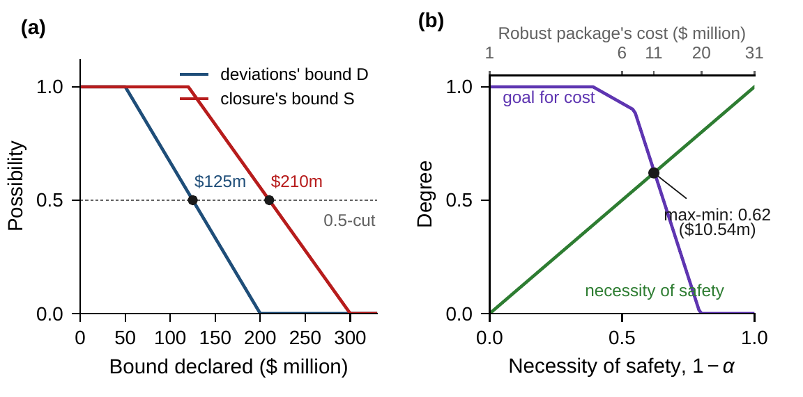
Max-min: necessity 0.62 at $10.54m
§10.3 · PROPOSITION 10.2 · FIGURE 10.1
The graded price runs from $1.14m at possibility 1 to $31.37m at 0
Computed cut by cut: its 0.5-cut is the crisp answer, $6.09m (Proposition 10.2(i))
As the necessity of safety rises, the cost rises and the board's goal falls
The cut at 0.38: a $232m line and 0.45 quarter, $10.54m
It fails only in futures the offices graded below 0.38
Figure 10.1. (a) The offices' graded declarations; the 0.5-cut is $125m and $210m. (b) Necessity of safety against the board's goal for cost; the max-min choice is the crossing.
Notes:
Proposition 10.2 and Figure 10.1; formal statement and proof in Online Appendix 10.B. The cuts are solved on a grid of α in steps of 0.01; the max-min choice has safety 0.62 and goal 0.630, deviations within $143.0m and a closure within $231.6m. Strengthening the goal ('very cheap') can only lower the level (Proposition 10.2(iii)).

Slide 11
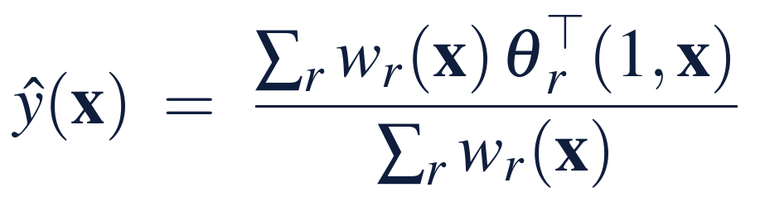
Rules in the offices' words, learned
§10.4 · THEOREM 10.3 · EQUATION 10.2
Meridian's price surface
THEOREM 10.3
Neuro-Fuzzy Rules
Eight rules: deviations mild, moderate, severe or extreme; closures small or large
Learned rule by rule from 150 exact robust solutions
Within $0.25m on 93.5% of 3,266 declarations
Largest error $0.95m, at the corner where deviations use up the $132m margin
(i) Reading. A weighted average of the rules' conclusions
(ii) Learning. Conclusions by least squares, overall or rule by rule; Armijo steps on the widths never raise the error
(iii) Reach. Gaussian systems approximate any continuous function
(iv) Certificate. Error at most e + (L + L̂)h/2 from a grid check; adopt only after the exact check
Notes:
Theorem 10.3 and Equation 10.2; formal statement and proof in Appendix 10.A. A first-order Sugeno system (Takagi and Sugeno), learned as an ANFIS by hybrid learning (Jang). Online Appendix Example 10.B.2: 300 projected Armijo steps, mean squared error from 0.0802 to 0.00806; root-mean-square error 0.158 on the certification grid.

Slide 12
Eight rules rediscover the economics
§10.4 · ONLINE APPENDIX EXAMPLE 10.B.2
Rule: deviations – closures | Anchor D, S | Conclusion there | Exact cost | Per $ of D | Per $ of S
mild – small | 25, 0 | −0.04 | 0.00 | 0.0014 | 0.0015
mild – large | 25, 350 | 7.23 | 7.29 | 0.0295 | 0.0289
moderate – small | 100, 0 | −0.12 | 0.00 | 0.0122 | 0.0156
moderate – large | 100, 350 | 9.54 | 9.54 | 0.0315 | 0.0299
severe – small | 175, 0 | 14.05 | 14.01 | 0.3288 | 0.0300
severe – large | 175, 350 | 24.55 | 24.51 | 0.3288 | 0.0300
extreme – small | 250, 0 | 39.58 | 39.58 | 0.3531 | 0.0300
extreme – large | 250, 350 | 50.08 | 50.08 | 0.3531 | 0.0300
$ million at each rule's anchor; slopes per $ of the declared bound. Learned rule by rule, each with its own firing as weights, so each rule describes its own region and can be read alone.
Where the line is needed: about 3 cents a dollar of closure. Severe and extreme deviations: 33 and 35 cents, the price of delay.
Notes:
Section 10.4 and Online Appendix Example 10.B.2. Inputs normalized, u = (D − 25)/225, v = S/350; terms centred at the anchors the offices named, widths learned within 0.03 to 0.6 (Yen, Wang, and Gillespie on readable fuzzy models).

Slide 13
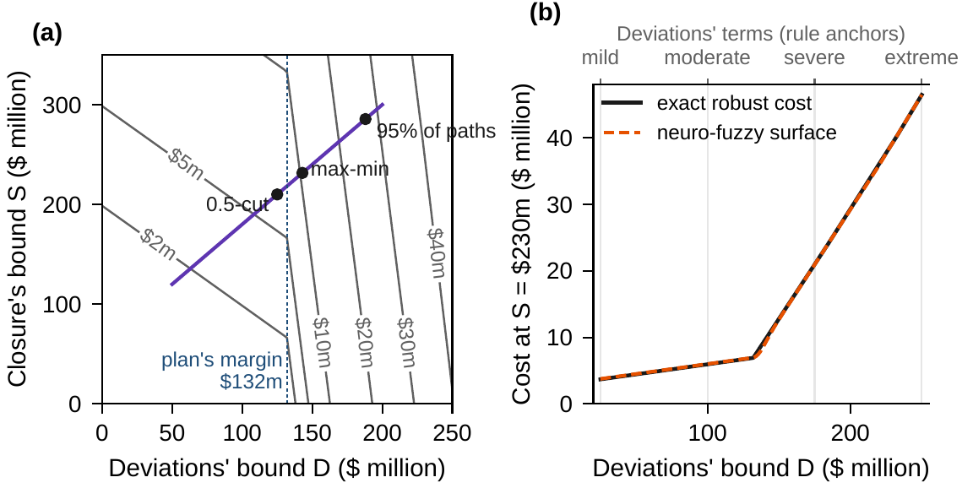
Explore with rules, decide with the exact solve
§10.4 · FIGURE 10.2
(a) The least cost of a guarantee over the two bounds, with the graded cuts' path
A corner where deviations exhaust the $132m margin: 3 cents a dollar becomes 33
(b) At S = $230m the eight-rule surface runs smoothly through the corner
Six rules trained for accuracy alone fit about as well, but conclude anything from −$19m to $62m
Figure 10.2. (a) The price of a guarantee over D and S, the cuts' path marked. (b) The cost against D at S = $230m: exact, and the eight-rule surface.
Notes:
Figure 10.2 and Theorem 10.3(iv). The six rules trained for accuracy alone reach a root-mean-square error of 0.183, but their conclusions cancel: −0.03, 6.71, 58.64, −9.56, −19.49 and 61.58 at their centres (Online Appendix Example 10.B.2).

Slide 14
Under a set, a rule must read early
§10.5 · PROPOSITION 10.3
On Meridian's sets
PROPOSITION 10.3
Rules under a Bounded Set
A future quiet through quarter 6, then deviations at −D and the closure in quarter 7
Cash read in quarters 1–6 sees nothing; quarter 7 lands exactly at the floor
A slowdown decided after quarter 6 cannot lift quarter 7: reading cash saves nothing
Under Chapter 9's law it saved at most $0.25m
(i) A rule that reads what has happened never has a worse worst case than a decision fixed today
(ii) Affine commitments and rules: a robust rule from Theorem 10.1, its coefficients as decisions
(iii) If the set allows the whole damage in one period, after the last reading that could act, the best rule does no better than the best fixed decision
Notes:
Proposition 10.3; formal statement and proof in Online Appendix 10.B. Adjustable rules are due to Ben-Tal, Goryashko, Guslitzer, and Nemirovski. Under a law a rule gains the value of the information it reads (Proposition 9.3); under a set, only if the reading comes before the damage.

Slide 15
Methods for decisions on a declared set
§10.5 · TABLE 10.2
Method | Computes | Guarantee | Watch for
Robust counterpart | decisions robust on a box, budget, or ball | exact on the set (Theorem 10.1) | a set that leaves out what matters
Cut by cut | a graded price; the max-min choice | possibility of a breach at most α (Theorem 10.2) | words that are not calibrated
Neuro-fuzzy surface | prices and decisions for any declaration, as rules | error bounded by grid checks (Theorem 10.3) | corners; rules that cancel
Affine rules | rules robust on the set | exact for affine data (Proposition 10.3) | damage that outruns the reading
Check against a law | the chance of a breach of a robust decision | sampling errors (Theorem 9.3) | a law the set does not trust
Notes:
Table 10.2. Meridian's cuts are solved exactly in microseconds because Proposition 10.1(ii) gives the package in closed form; larger models need one linear or cone program per cut, which is where a neuro-fuzzy surface earns its keep, provided its proposals are checked exactly.

Slide 16
What can Meridian guarantee without odds?
WORKED EXAMPLE 10.1 · THE SITUATION
Chapter 9's answer
The audit committee
The offices and the board
A chance, if the law is right
Nobody can vouch for the odds
Bounds in words, a goal for cost
A $170m line and two-thirds of a quarter of delay, $10.44m: a 5% chance of a breach under the law.
In a crisis, what could Meridian guarantee without odds, what would it cost, and how would it fare?
The engineering office bounds deviations, the treasury a closure; the board grades what a guarantee may cost.
The floor: $350m in every quarter of the program, on every future in the declared set.
Notes:
Worked Example 10.1, the situation. The levers and their prices are Chapter 9's: a standby line at 3 percent, a quarter of committed delay at $8 million.

Slide 17
From the offices' words to a guarantee
WORKED EXAMPLE 10.1 · STEPS 1–5
1
Write the problem
2
Solve on a crisp set
3
Grade and choose
Worst case: deviations at −D, the closure in quarter 1. Quarter 7's $132m margin binds.
$125m and $210m: a $203m line, no delay, $6.09m. Under the law 8.6%; the set holds 79% of paths.
Cuts from $1.14m to $31.37m. Max-min at 0.38: a $232m line, 0.45 quarter, $10.54m.
4
Judge against the law
5
Price any declaration
5.6% at $10.54m, against 5.0% at $10.44m. Meeting 5% takes the 0.35-cut, $12.17m.
(140, 230): the rules say $8.99m; the exact solve $9.52m, a $230m line and 0.33 quarter.
Notes:
Worked Example 10.1, Steps 1–5. Step 5's difference of $0.53m sits at the corner where deviations exhaust the margin: the board explores with the rules and decides with the exact solve (Theorem 10.3(iv)).

Slide 18
Packages robust on declared sets
WORKED EXAMPLE 10.1 · TABLE 10.3
Set | D | S | Line | Delay | Cost | Paths | Breach
Volume I's joint check | 0 | 187 | 55 | 0 | 1.65 | 1.5 | 17.4
Crisp set (the 0.5-cut) | 125 | 210 | 203 | 0 | 6.09 | 78.9 | 8.6
Max-min choice (0.38-cut) | 143 | 232 | 232 | 0.45 | 10.54 | 87.0 | 5.6
Meeting 5% (0.35-cut) | 148 | 237 | 237 | 0.63 | 12.17 | 88.5 | 4.7
95% of paths (0.08-cut) | 188 | 286 | 286 | 2.29 | 26.92 | 95.0 | 0.8
The whole support (0-cut) | 200 | 300 | 300 | 2.80 | 31.37 | 95.6 | 0.4
Volume I's package (law) |  |  | 170 | 0.67 | 10.44 |  | 5.0
$ million; delays in quarters; percent. D, S: the bounds on deviations and on a closure. Paths: the share of Chapter 9's 100,000 paths inside the set. Breach: the chance under Chapter 9's law (fresh paths within 0.3 points).
Notes:
Table 10.3; Online Appendix Example 10.B.2. Every package is robust on its set: no path inside a set breaches. The max-min package breaches on 5.64 percent of the book's paths (fresh 5.51).

Slide 19
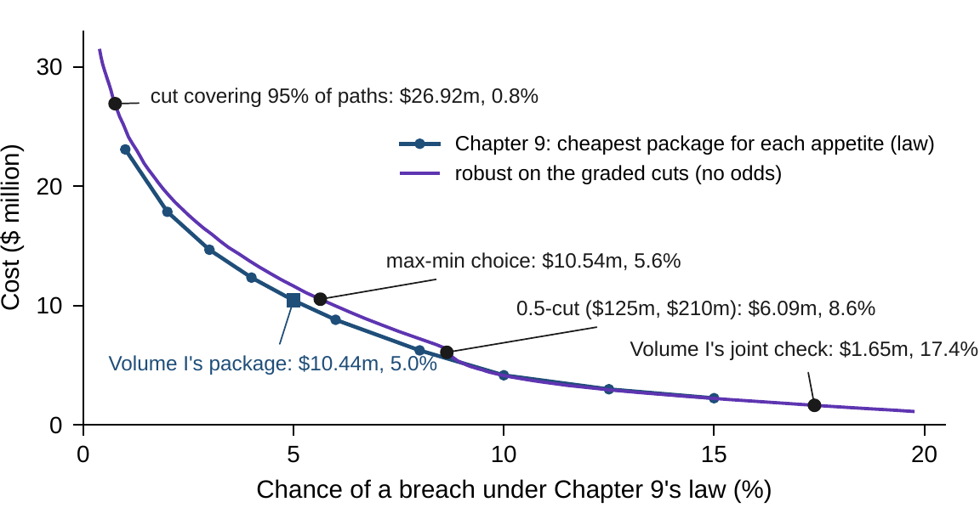
A guarantee costs a little more than a chance
WORKED EXAMPLE 10.1 · STEP 4 · FIGURE 10.3
Graded packages lie just above Chapter 9's frontier, the cheapest package for each appetite
Max-min: 5.6% at $10.54m; Volume I's package: 5.0% at $10.44m
Meeting 5% with a cut takes the 0.35-cut and $12.17m
A set holding 95% of paths: $26.92m, breaching on 0.8%: Theorem 10.1(iii) is conservative
Figure 10.3. Cost against the chance of a breach under Chapter 9's law: the frontier and the packages robust on the graded cuts.
Notes:
Worked Example 10.1, Step 4, and Figure 10.3. Robust packages are designed for the set, not for the law: when the law is right they cost a little more than the cheapest package for the same chance; when it is wrong, the guarantee still holds on the set.

Slide 20
Audit the set: it prices the guarantee
WORKED EXAMPLE 10.1 · WHAT THE BOARD SHOULD TAKE AWAY
$10.54m
5.6%
$37m
the most satisfying guarantee: a $232m line and 0.45 quarter, safe on every future graded above 0.38
its chance of a breach if Chapter 9's law were right, against 5.0%
the same guarantee if the bank capped the line at $100m
If the board trusts the law, Volume I's package is the cheapest way to keep its appetite
The offices own the words; the board owns the goal and the level; the bank's cap is worth negotiating
For discussion: how would you test the offices' words, and who should keep the record that calibrates them?
Notes:
Worked Example 10.1, what the board should take away, and the discussion questions. When would you rather have a guarantee on a set than a chance under a law?

Slide 21
Ford maps its supply risk without odds
IN PRACTICE · FORD
The decision
The method
The result
Where to spend risk effort
Every node down, one at a time
Exposure, not spend
Across thousands of supplier sites, without reliable probabilities of rare disruptions.
Each site disrupted for its time to recover; the best response by linear program; time to survive.
Some of the largest exposures in low-cost parts; about 1,500 more sites slated for more attention.
Making it work
What Meridian takes
For the board
Data, systems, and use
A guarantee priced by its set
What would stop us longest?
A decision support system on purchasing and planning data, used strategically, daily, and after disruptions.
Worked Example 10.1's declared set is the declaration the board should audit first.
Is our risk effort allocated by exposure, or by spend?
Notes:
In Practice, Chapter 10: Ford Maps Its Supply Risk Without Odds. A real organization's decision of this chapter's kind, told from its published record; every figure is cited in the book. The lesson for Meridian: Judge a decision by the worst declared event, and let the guarantee choose which estimates to audit. Sources: Simchi-Levi et al. (2015), Interfaces; Simchi-Levi, Wang and Wei (2018); MIT News (2014).

Slide 22

Guarantees without odds, in AXIOM
AXIOM LAB 2.10 · MODULE AXIOM-10
The audit committee doubts the law behind Chapter 9's package and asks for a guarantee that does not depend on odds. Open AXIOM, choose Lab 2.10 and load the Meridian robust instance: Chapter 9's levers and floor, the offices' bounds and their words.
1
2
3
4
5
Declare and solve
Grade
Judge against the law
Learn rules
Certify
Bounds on deviations and a closure; the binding quarter and worst case.
The offices' words as cuts, the cost of each, the max-min choice.
Chapter 9's paths and fresh ones, beside the frontier.
The price surface rule by rule and overall; read the rules.
The surface against exact solutions on a grid; one revision exactly.
Deliverable: a one-page note to the board: the guarantee, its set and price, its chance of a breach if the law is right, the max-min choice, and the declarations it rests on. About 75 minutes.
Notes:
AXIOM Lab 2.10. What to look for: a binding quarter where the plan's margin is smallest; a set's guarantee that fails often under the law when the set leaves out deviations; a graded price and a max-min choice near Chapter 9's cost; rules that rediscover the line's fee and the price of delay, and an error that peaks at the corner.

Slide 23
What to carry forward
KEY TAKEAWAYS
1
A bounded set of futures is a declaration without odds. A robust decision keeps its commitments on every future in the set, and its guarantee is exactly as good as the set.
2
Linear commitments over a box, a budget, or a ball have linear or cone counterparts; the price of robustness rises with the set; a set with probability 1 - α under a law promises the chance 1 - α.
3
Graded declarations turn offices' words into nested sets. A decision robust on the α-cut fails only where the offices graded futures below α, and the max-min choice balances a graded goal for cost against the necessity of safety.
4
Neuro-fuzzy rules write decision surfaces in the declarations' language and learn them by least squares and gradient steps; trained rule by rule they stay readable. Their proposals are adopted only after the exact check.
5
Robust packages, judged by a law, cost a little more than the cheapest package for the same chance, but do not need the law. Under a set, a rule helps only if its reading comes before the damage.
Notes:
Key Takeaways, Chapter 10.

Slide 24
Notebook and workbook reproduce the book
THIS WEEK'S LABORATORY
247
133
26210
AXIOM-10
notebook checkpoints, every one PASS
workbook checks against the engine, ALL PASS
the lab's seed
AXIOM Lab 2.10
Notebook DCT_V2_Ch10_Lab.ipynb: Worked Example 10.1 and the lab's five steps in five panels, on the book's paths and the fresh ones
Workbook DCT_V2_Ch10_Lab.xlsx: margins, robust packages, the graded cuts and the max-min choice, the frontier's costs, and the rules, in formulas
Notes:
The notebook and workbook are on the course website, www.dynamiccorporatetransformation.com.

Slide 25
Next, a family of laws
NEXT · CHAPTER 11
Chapter 9 trusted one law; this chapter guaranteed on a set, with no odds
Chapter 11 declares a family of laws, between a law and a set: trust the record enough to name the laws that fit it, not enough to pick one
The guarantee and the chance are its two ends
Notes:
The Scope and Limits box of Section 10.1: Chapter 11 declares a family of laws, which sits between a law and a set. Part III, Enterprise Optimization Under Uncertainty.

