Slide 1
Distributionally Robust Enterprise Optimization
VOLUME II · CHAPTER 11 · WEEK 12
Part III's third declaration: a family of laws, for when the law itself is in doubt, and decisions that keep their commitments under every law in it
Graduate course companion · Lab seed 26211 · AXIOM Lab 2.11 (AXIOM-11)
Notes:
Volume II, Chapter 11. Chapter 9 kept Meridian's appetite under one declared law and Chapter 10 on a bounded set; this chapter declares a family of laws, from the records behind the law, and asks what the doubt costs (abstract).

Slide 2
“Wall Street indexes predicted nine out of the last five recessions! And its mistakes were beauties.”
Paul A. Samuelson
Nobel Memorial Prize in Economic Sciences 1970; “Science and Stocks: Sense and Nonsense,” Newsweek (1966)
Notes:
Samuelson's quip frames the chapter: a model's odds are an estimate with a record behind it, not a fact. The audit committee asks where the declared law came from and how far to trust it (Section 11.1).

Slide 3
After this chapter, you can
LEARNING OUTCOME STATEMENTS
11.1
Explain what declaring a family of laws adds to a law and to a set, and place Chapters 9 and 10 as its end cases.
11.2
Work with divergence families: their dual form, the worst chance of a breach, and the radius a doubt about a parameter requires.
11.3
Work with Wasserstein families on a record: their dual form, the Lipschitz premium, the chance constraint as a margin of the paths nearest a breach, and a radius set by the record's size.
11.4
Judge what a moment family fears, and bound its worst chance of a breach with Cantelli's inequality.
11.5
Declare a family from a record with stated confidence, price the doubt, and judge promises and plans as time passes.
Notes:
The five learning outcome statements; LOS Guidance at the end of the chapter.

Slide 4
Five sections, a worked example, a case and a lab
ROADMAP
§11.1
§11.2
§11.3
§11.4
From a Law and a Set to a Family
Divergence Families
Wasserstein Families on a Record
Moment Families
Definition 11.1 · Table 11.1 · Theorem 11.1
Theorem 11.2 · Figure 11.1
Theorem 11.3 · Figure 11.2
Proposition 11.1
§11.5
Worked Example 11.1
In Practice
AXIOM Lab 2.11
Records, Confidence, and Time
How Much Should Meridian Trust Its Law?
Seven States Plan for Four Colorado Rivers
Which Law Do We Trust? Records, Families, and Balls
Propositions 11.2–11.3 · Table 11.2
Table 11.3 · Figure 11.3
At a Glance · board questions
AXIOM-11 · five steps
Notes:
Formal statements and proofs of Theorems 11.1–11.3 are in Appendix 11.A; Propositions 11.1–11.3, how the records' laws are simulated (Remark 11.B.1) and every number of the Worked Example (Example 11.B.2) are in Online Appendix 11.B.

Slide 5
Three declarations of uncertainty
§11.1 · DEFINITION 11.1 · TABLE 11.1
 | A law (Chapter 9) | A set (Chapter 10) | A family (this chapter)
Declares | the odds of every event | what can happen | which laws are possible
Promise | a chance, an expected value | on every event in the set | a chance or a value under every law in the family
Evidence | a record, trusted | bounds | a record, with its confidence
Computation | samples (Theorem 9.3) | robust counterparts (Theorem 10.1) | dual forms (Theorems 11.2–11.3)
Fails when | the odds are wrong | the set leaves out what matters | the family leaves out the true law or holds laws nobody fears
Definition 11.1: a distributionally robust decision keeps its commitments under every law in a declared family, its worst expected value maximized.
Notes:
Definition 11.1 and Table 11.1. A family is declared by parameters a record allows, by distance from a declared law (a ball of radius r), or by moments. Knight separated risk, odds that are known, from uncertainty, odds that are not; Ellsberg's urns showed that people pay to avoid the second.

Slide 6
A family sits between a law and a set
§11.1 · THEOREM 11.1
Meridian's records
THEOREM 11.1
Families Between a Law and a Set
Two closures in twenty years allow a rate up to 0.315 a year; forty quarters, a spread up to $61.6m
95 percent each, so the family holds the true law with at least 90 percent confidence
Under the law with both, Volume I's package breaches on 15.8% of paths, not 5
More closures only remove liquidity and a wider spread raises the chance: the worst law is the corner
(i) End cases. One law gives Chapter 9's problem; every law on a set, Chapter 10's
(ii) Monotone. A larger family never raises the best value it allows
(iii) A worst law. For expected values, the robust decision is optimal for a worst law in the family
(iv) Honest promises. A family that holds the true law with confidence 1 − β keeps the promise with that confidence
Notes:
Theorem 11.1; formal statement and proof in Appendix 11.A. Part (iii) needs no new machinery for expected values: the answer is Chapter 9's for a law chosen by an adversary inside the family, as Hansen and Sargent read robustness. Part (iv) is why the record matters (Proposition 11.2).

Slide 7
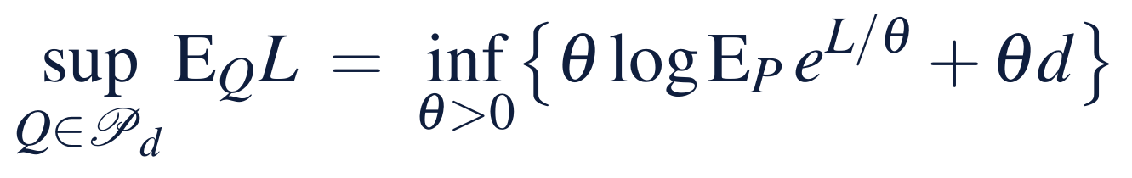
A divergence ball reweights the law's futures
§11.2 · THEOREM 11.2
For Meridian's appetite
THEOREM 11.2
Divergence Families
d = 0.01: keep 2.5% under the law, a $175m line and 1.35 quarters, $16.08m
Volume I's package breaches on up to 8.4% of paths in that ball
The doubts lie far away: closures 0.44, spread 0.60, both 1.04
At 0.44 the law must keep 3 in a million; no package gets below 1 path in 100,000
(i) Dual form. Chapter 9's entropic criterion with a tuned multiplier; the worst law tilts P
(ii) Worst chance. The q ≥ p with kl(q ‖ p) = d: the ball keeps α exactly when the law keeps the smaller α′ with kl(α ‖ α′) = d
(iii) Radii. Divergences add; a rate λ′ for λ: H(λ′ log(λ′/λ) − λ′ + λ); a spread × c: n(log(1/c) + (c² − 1)/2)
Notes:
Theorem 11.2 and Equation 11.2; formal statement and proof in Appendix 11.A. A law in the ball can only reweight the declared law's futures; it cannot invent new ones. Online Appendix Example 11.B.2: radii 0.439, 0.603 and 1.042; appetites 2.93 × 10^-6, 1.09 × 10^-7 and 1.69 × 10^-11.

Slide 8
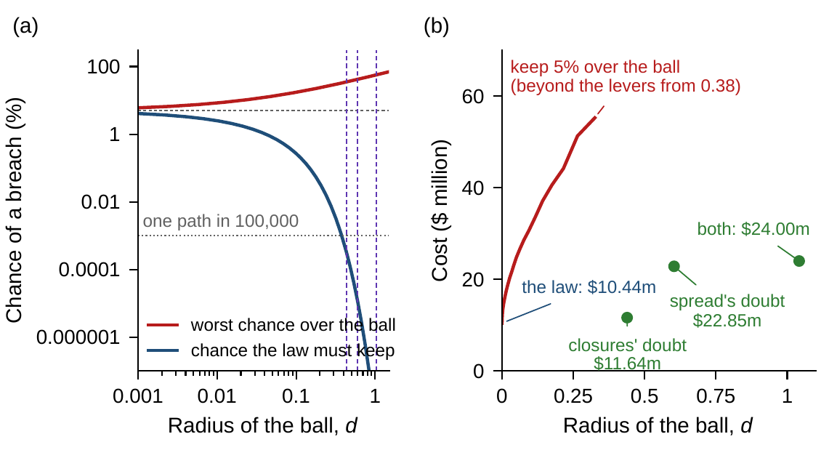
Balls that hold the doubts are out of reach
§11.2 · FIGURE 11.1
(a) As d grows, the package's worst chance rises and the law's appetite falls
Below one path in 100,000 nothing suffices: beyond the levers from about 0.38
(b) Keeping 5% over the ball: $16.08m at d = 0.01, then steeply more
The same doubts as a family cost $24.00m: a ball also holds laws nobody fears
Figure 11.1. (a) Worst chance over the ball and the chance the law must keep; dashed, the doubts' radii. (b) The cost of keeping 5 percent over the ball, and the records' doubts at their radii.
Notes:
Figure 11.1 and Section 11.2. A ball holds every reweighting as near as the feared law, including the one that piles its weight on the paths that breach. Worst chance of Volume I's package: 6.00 percent at d = 0.001, 8.36 at 0.01, 17.29 at 0.1, 55.55 at 1 (Online Appendix Example 11.B.2).

Slide 9
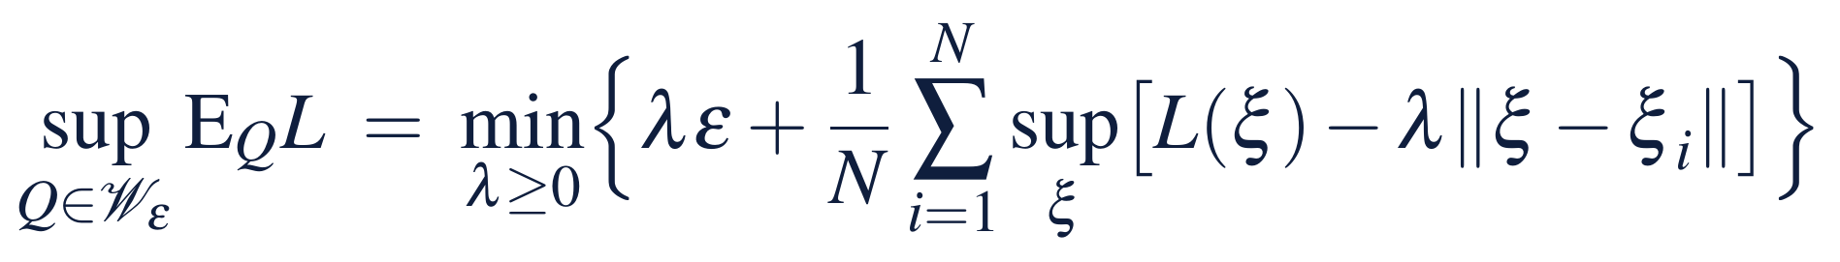
A Wasserstein ball moves the nearest futures
§11.3 · THEOREM 11.3
On Meridian's 100,000 paths
THEOREM 11.3
Wasserstein Families
A path's distance from a breach is its thinnest margin above the floor
A ball of $0.1m pushes Volume I's package from 5% to 7.1%
Keeping 5%: the thinnest 5% must average $2m, 1.15 quarters, $14.13m
The spread's doubt lies at $26.3m: it would ask $525m; the levers reach $122m
(ii) Lipschitz premium. The worst expected loss exceeds the record's average by at most εℓ
(iii) Worst chance. Nearest futures move first: keeping α needs the αN nearest at least ε/α away on average
(iv) Finite records. A radius shrinking as N^{−1/max(m, 2)} holds the true law with confidence 1 − β
Notes:
Theorem 11.3 and Equation 11.3; formal statement and proof in Appendix 11.A. A move shifts a path's deviations, its closures fixed, at a cost equal to the largest shift in any quarter. Online Appendix Example 11.B.2: the spread's doubt lies at 0.232 × 113.2 = 26.3.

Slide 10
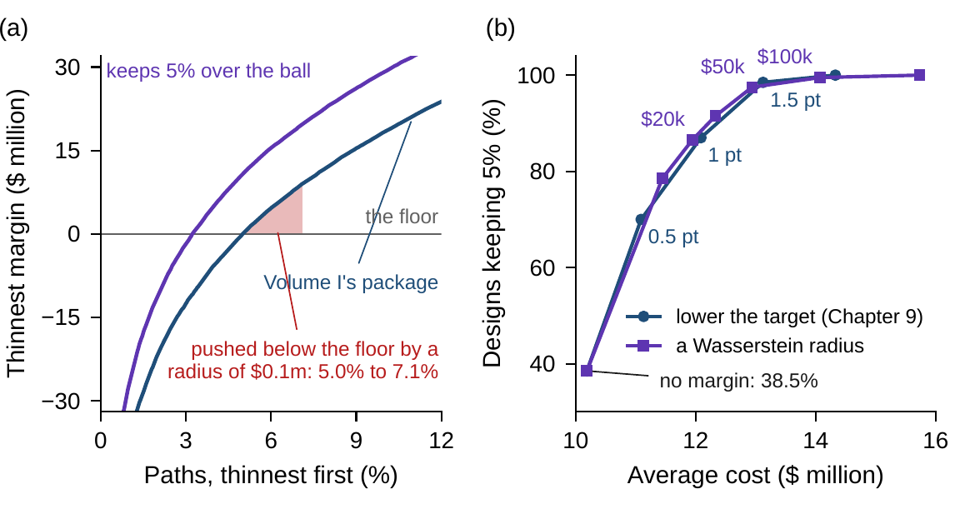
On small records, a radius buys reliability
§11.3 · FIGURE 11.2
Designed on 1,000 paths, packages keep 5% only 38.5% of the time
A radius of $20,000: 86.5%, $11.94m on average; of $50,000: 97.5%, $12.94m
Lowering the target buys about the same: one point gives 87% at $12.09m
A radius is a margin that says what it protects against
Figure 11.2. (a) The thinnest 12 percent of paths by thinnest margin; shaded, the paths a ball of $0.1m pushes across the floor. (b) Designs on 200 records of 1,000 paths, checked on fresh paths.
Notes:
Figure 11.2 and Section 11.3. Part (iv)'s radius shrinks only as N^(-1/12) for twelve quarters, so in practice the radius is set by holdout or by checking designs on fresh paths (Chapter 9's sample-size study: seeds 900000-900199).

Slide 11
A record of averages fears a lump
§11.4 · PROPOSITION 11.1
Cantelli: the worst chance a mean and a spread allow, attained by a two-point law
Proposition 11.1. Dual form over moment functions; worst cases on at most k + 1 points; with several margins, between the largest bound and their sum
Volume I's package: quarter 7's margin averages $147.5m with a spread of $62.9m: some law breaches there with chance 15.4%
Every quarter at 5% takes six quarters of delay and $53.29m, and still cannot promise the program's appetite
Notes:
Proposition 11.1; formal statement and proof in Online Appendix 11.B. The two-point law is exactly at the floor or comfortably above it, the lump a closure produces. The twelve bounds sum to 148.6 percent, so the union bound says nothing. A moment family is the right declaration when shape is truly unknown; Meridian's records know more than averages.

Slide 12
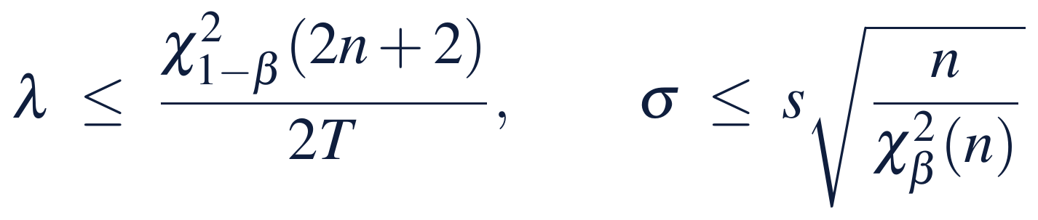
Records declare the family, with confidence
§11.5 · PROPOSITIONS 11.2–11.3
Families over time (Proposition 11.3)
PROPOSITION 11.2
Records and Confidence
A family declared stage by stage obeys a robust Bellman equation: plans stay optimal
Divergences add along the stages
A ball on the whole path is not rectangular: today's plan need not be next quarter's
Rules that read cash, or Chapter 15's twin, need families declared quarter by quarter
(i) Counts. n events in T years bound the rate, with confidence 1 − β
(ii) Spreads. n Gaussian innovations of root-mean-square s bound the spread
(iii) Several bounds hold together with confidence at least one less the sum of their β; an ordered family's worst law is its corner
(iv) Optimism. A design looks better on its own record; a family with confidence 1 − β keeps its promise
Notes:
Propositions 11.2 and 11.3; formal statements and proofs in Online Appendix 11.B. The Worked Example builds its family from the treasury's count and the engineering office's spreads, 95 percent each, 90 percent together. Volume I's package is decided once, so time does not bite (Iyengar; Nilim and El Ghaoui).

Slide 13
Families of laws, and how to use them
§11.5 · TABLE 11.2
Family | Declared by | Worst case | Computation | Watch for
Parameters | confidence bounds from records | the corner, if ordered | Chapter 9's design at the worst law | doubts left out
Divergence ball | a radius around a law | a reweighting | a closed-form chance; the entropic dual | radii that hold a doubt are huge
Wasserstein ball | a radius around a record | moved futures | the nearest futures first; the dual | radii that shrink slowly in many dimensions
Moments | means and covariances | a few points | Cantelli; semidefinite programs | lumps the record rules out
Over time | a set for each stage | stage by stage | a robust Bellman equation | balls on whole paths
Notes:
Table 11.2. Every family in the chapter is evaluated on Chapter 9's 100,000 paths and checked on 100,000 fresh ones; larger models replace these shortcuts with the dual forms, which are linear, cone or semidefinite programs (the Computational box of Section 11.5).

Slide 14
How much should Meridian trust its law?
WORKED EXAMPLE 11.1 · THE SITUATION
Chapter 9's answer
The audit committee
The records
A chance, if the law is right
The law came from records
Two closures, forty quarters
A $170m line and two-thirds of a quarter of delay, $10.44m: a 5% chance of a breach under the law.
How much should the board trust it, and what does the doubt cost?
The treasury's two closures in twenty years; the engineering office's forty quarters of deviations.
Chapter 10 priced a guarantee without odds. The question in between: a family of the laws the records allow.
Notes:
Worked Example 11.1, the situation. The appetite: at most a 5 percent chance that liquidity falls below the $350 million floor in some quarter of the digital program. The levers and their prices are Chapter 9's.

Slide 15
From records to the price of the doubt
WORKED EXAMPLE 11.1 · STEPS 1–5
1
Read the records
2
Declare the family
3
Try a ball instead
Rate at most 0.315, spread $42.3m to $61.6m. Volume I's package: 4.5–6.2% by rate, 1.6–14.4% by spread, 15.8% at both bounds.
Its worst law is the corner: a $200m line and 2.25 quarters, $24.00m; never above 5.0% on 49 laws.
Holding the doubts needs 2 in 100 billion, or $525m of margin. $16.08m and $14.13m balls breach 10.2% and 12.2% at the corner.
4
Size the ball to the record
5
Price the doubt
On 1,000 paths, 38.5% of designs keep 5%; a radius of $50,000 makes it 97.5%, at $12.94m.
$24.00m against $10.44m: a price of ambiguity of $13.56m, mostly the spread's. A longer record is worth $4.63m.
Notes:
Worked Example 11.1, Steps 1–5. Step 2: on fresh paths at the corner the family's package breaches on 4.9 percent; under the declared law on 0.9 percent; the closures' doubt alone takes $11.64 million, the spread's alone $22.85 million. Step 3's corner chances are 10,248 and 12,153 paths of 100,000 (Online Appendix Example 11.B.2: 10.25 and 12.15).

Slide 16
Every declaration's package, side by side
WORKED EXAMPLE 11.1 · TABLE 11.3
Declaration | Line | Delay | Cost | Law | Worst law
One law (Chapter 9) | 170 | 0.67 | 10.44 | 5.0 | 15.8
A set, max-min (Chapter 10) | 232 | 0.45 | 10.54 | 5.6 | 16.2
Wasserstein ball, $0.1m | 165 | 1.15 | 14.13 | 3.2 | 12.2
Divergence ball, d = 0.01 | 175 | 1.35 | 16.08 | 2.5 | 10.2
Closures' doubt (rate ≤ 0.315) | 210 | 0.67 | 11.64 | 4.6 | 14.4
Spread's doubt (spread ≤ 61.6) | 170 | 2.22 | 22.85 | 1.1 | 5.9
The records' family (both) | 200 | 2.25 | 24.00 | 0.9 | 5.0
Records twice as long | 195 | 1.69 | 19.37 | 1.7 | 7.7
Moments only (every quarter) | 160 | 6.06 | 53.29 | 0.03 | 0.4
$ million; delays in quarters; percent. The chance of a breach under Chapter 9's law and under the records' worst law (closures 0.315 a year, spread $61.6m), on 100,000 paths; fresh paths within 0.3 points.
Notes:
Table 11.3; Online Appendix Example 11.B.2. Rows: one law, a set, two balls, then the records' doubts one at a time and together, a record twice as long, and moments only. Every chance has a standard error below 0.12 points. The divergence ball's package breaches at the worst law on 10,248 paths of 100,000.

Slide 17
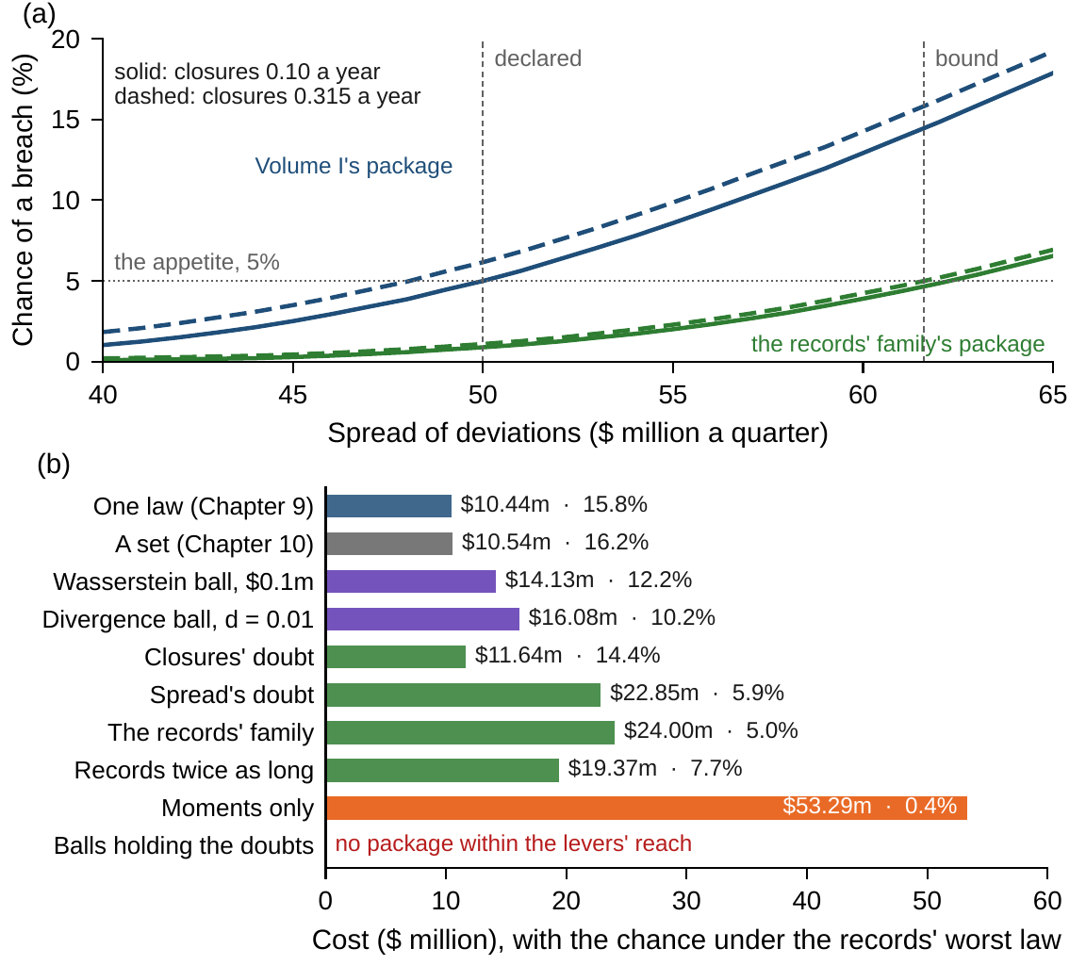
The spread of deviations is what costs
WORKED EXAMPLE 11.1 · FIGURE 11.3
(a) Volume I's package moves little with the rate of closures and much with the spread
The records' family's package stays at or below 5% across the family, 0.9% under the declared law
(b) The closures' doubt alone costs $11.64m, the spread's alone $22.85m
Moments only: $53.29m, and still no promise of the appetite
Figure 11.3. (a) The chance of a breach across the spread's range, closures at 0.10 and 0.315. (b) Each declaration's cost, with its chance under the records' worst law.
Notes:
Worked Example 11.1, Step 5, and Figure 11.3. Of the $13.56 million price of ambiguity, the spread's doubt alone accounts for $12.41 million: the cheapest protection may be measurement.

Slide 18
Pay for the doubt, then measure it
WORKED EXAMPLE 11.1 · WHAT THE BOARD SHOULD TAKE AWAY
$24.00m
$13.56m
$4.63m
keeps the appetite under every law the records allow, at 90 percent confidence: a $200m line and 2.25 quarters
the price of ambiguity over trusting the law, mostly the spread of execution deviations
what records twice as long would save on this program alone
Volume I's package is right if the law is right; the records allow a law under which it breaches on 15.8%
Balls around the law are no substitute: those that hold the doubts are beyond any package
For discussion: what confidence should the board ask of its records, and who should own them?
Notes:
Worked Example 11.1, what the board should take away, and the discussion questions. When is a ball around a law the right declaration, and when a family of parameters?

Slide 19
Seven states plan for four Colorado Rivers
IN PRACTICE · COLORADO RIVER BASIN STUDY
The decision
The method
The result
Close the supply–demand gap
A family of four laws
The price of doubt, explicit
Through 2060, without knowing which description of the river's flows is right.
Observed, paleo, blended, and climate-projected supply; over 20,000 simulations for every portfolio.
2060 portfolio costs of $2.5–3.5bn at the observed-flow median, $3.6–5.8bn under the climate projections.
Making it work
What Meridian takes
For the board
Options only when needed
The family the records allow
What does our doubt cost?
Portfolios triggered options against specific vulnerabilities; the study itself chose no portfolio.
Worked Example 11.1: Meridian's records allow laws under which the package breaches far more often.
How far does the bill move from the kindest law our records allow to the harshest?
Notes:
In Practice, Chapter 11: Seven States Plan for Four Colorado Rivers. A real organization's decision of this chapter's kind, told from its published record; every figure is cited in the book. The lesson for Meridian: Declare the family of laws the records allow, and judge every option under every law in it. Sources: U.S. Bureau of Reclamation (2012), Colorado River Basin Study, Executive Summary; Groves et al. (2013), RAND.

Slide 20

Records, families and balls, in AXIOM
AXIOM LAB 2.11 · MODULE AXIOM-11
The audit committee accepts Chapter 9's law as the offices' best estimate, but not as a fact. Open AXIOM, choose Lab 2.11 and load the Meridian ambiguity instance: Chapter 9's law and levers, the treasury's count of closures and the engineering office's record of deviations.
1
2
3
4
5
Read the records
Price the family
Try balls
Set a radius
Moments only
Confidence bounds for the rate and the spread; sweep each across its range.
Its worst law, the cheapest package there, checked on fresh paths.
Divergence and transport balls of growing radius; the radii of the doubts.
Records of 1,000 paths, radii against margins, reliability per dollar.
Each quarter's Cantelli bound and the cost of keeping all at 5%.
Deliverable: a one-page note to the board: the records' doubts, the family's worst law and its package, the price of ambiguity, and the record worth improving. About 75 minutes.
Notes:
AXIOM Lab 2.11. What to look for: a chance that moves little with the rate of closures and much with the spread; balls whose radii hold the doubts but whose appetites no package can meet; radii that buy reliability on small records at about the price of a margin; a moment bound that fears a lump.

Slide 21
What to carry forward
KEY TAKEAWAYS
1
A family of laws declares that the law itself is in doubt. A distributionally robust decision keeps its commitments under every law in it: one law gives Chapter 9, every law on a set gives Chapter 10, and a family that holds the true law with known confidence makes the promise honest.
2
Divergence balls reweight the law's futures. Their dual form is the entropic criterion with a tuned multiplier, and their worst chance is a formula, so a ball's appetite is a smaller appetite under the law.
3
Wasserstein balls move futures. Their dual form adds a Lipschitz premium, and keeping a chance means the futures nearest a breach must keep an average margin; their radius suits a record's sampling error.
4
Moment families fear lumps: a two-point law attains Cantelli's bound, so averages alone ask for 4.36 spreads of margin at 5 percent.
5
Records declare the family: confidence bounds for counts and spreads, their corner, and families over time declared stage by stage (Propositions 11.2–11.3; Table 11.2). For Meridian, the doubt costs $13.56 million, mostly the spread's.
Notes:
Key Takeaways, Chapter 11.

Slide 22
Notebook and workbook reproduce the book
THIS WEEK'S LABORATORY
358
105
26211
AXIOM-11
notebook checkpoints, every one PASS
workbook checks against the engine, ALL PASS
the lab's seed
AXIOM Lab 2.11
Notebook DCT_V2_Ch11_Lab.ipynb: Worked Example 11.1 and the lab's five steps in seven panels, on the book's paths and the fresh ones
Workbook DCT_V2_Ch11_Lab.xlsx: the records' bounds, the radii, the law's appetite by bisection, Cantelli's bounds, the price of ambiguity and Table 11.3, in formulas
Notes:
The notebook and workbook are on the course website, www.dynamiccorporatetransformation.com.

Slide 23
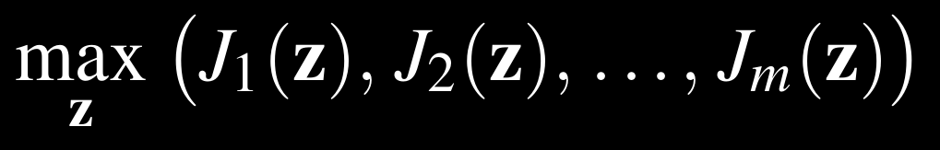
Next, several objectives at once
NEXT · CHAPTER 12
Part III asked what to trust: a law (Chapter 9), a set (Chapter 10), a family of laws (this chapter)
Table 11.3 already sets two objectives side by side: a package's cost and its protection under the records' worst law
Chapter 12, Multi-Objective Enterprise Optimization, opens Part IV: Pareto frontiers and the trade-offs along them
Notes:
Chapter 12 opens Part IV, Multi-Objective and Intelligent Enterprise Optimization: Pareto optimality, frontiers, scalarizations, and trade-offs read as frontier slopes and shadow prices.

