Slide 1
Machine Learning for Enterprise Transformation
VOLUME II · CHAPTER 13 · WEEK 13
Part IV's second chapter: let data supply a declared part of the model. Learning proposes, fresh data checks, and the optimizer keeps the commitments
Graduate course companion · Lab seed 26213 · AXIOM Lab 2.13 (AXIOM-13)
Notes:
Volume II, Chapter 13. Parts I-III declared every part of their models; this chapter lets data supply a part, on the framework's terms. The Worked Example prices a learned warning of funding-window closures: a perfect warning would be worth $4.12 million, the desk's five readings allow at most $1.44 million, and the warning certified on the desk's record is worth $1.06 million (abstract).

Slide 2
“I remember my friend Johnny von Neumann used to say, with four parameters I can fit an elephant, and with five I can make him wiggle his trunk.”
Enrico Fermi
Nobel Prize in Physics 1938; as recalled by Freeman Dyson, “A Meeting with Enrico Fermi,” Nature (2004)
Notes:
Fermi's elephant, as Freeman Dyson recalled it: a model with enough parameters can fit any record. Theorem 13.1(iii) is the elephant with the parameters counted (Section 13.2).

Slide 3
After this chapter, you can
LEARNING OUTCOME STATEMENTS
13.1
Explain how a learned model enters a declared enterprise model, and what a record can and cannot tell.
13.2
Judge what a record's performance says about new cases: generalization, complexity, bias and variance, and ensembles.
13.3
Value a prediction by the decision it changes: regret, thresholds set by costs, and the ceiling set by the information.
13.4
Check a model honestly: fresh data, confidence bounds, many candidates, and conformal guarantees and their limits.
13.5
Read a model responsibly: what principal components keep and lose, and what attributions show and do not.
Notes:
The five learning outcome statements; LOS Guidance at the end of the chapter.

Slide 4
Five sections, a worked example, a case and a lab
ROADMAP
§13.1
§13.2
§13.3
§13.4
Learning Inside a Declared Model
Learning from a Record
From Predictions to Decisions
Honest Checks
Definition 13.1 · Proposition 13.1
Theorem 13.1 · Proposition 13.2 · Table 13.1
Definition 13.2 · Theorem 13.2 · Figure 13.1
Theorem 13.3 · Table 13.2 · Figure 13.2
§13.5
Worked Example 13.1
In Practice
AXIOM Lab 2.13
Reading a Model
Is the Market Desk's Warning Worth Paying For?
Netflix Pays a Million Dollars for Ten Percent
Pricing a Learned Warning: Records, Thresholds, and Fresh Paths
Definition 13.3 · Proposition 13.3
Table 13.3 · Figure 13.3
At a Glance · board questions
AXIOM-13 · five steps
Notes:
Formal statements and proofs of Theorems 13.1-13.3 are in Appendix 13.A; Propositions 13.1-13.3, how the warning is designed and checked (Remark 13.B.1) and every number of the Worked Example and the figures (Example 13.B.2) are in Online Appendix 13.B.

Slide 5
Learning supplies one declared part, no more
§13.1 · DEFINITION 13.1 · PROPOSITION 13.1
Three conditions, and Meridian's desk
PROPOSITION 13.1
What the Data Can Tell
Learning supplies a declared part of the model and nothing else, is judged on data it has not seen, and leaves the commitments to the optimizer
The desk's warning supplies one part: whether a funding window will close in the program's three years
Its five readings are known when the board signs; given closure or not they say nothing more, so Chapter 9's law stands
Every field in a record must be one the board would know at the moment it decides
(i) The floor. The conditional mean attains it under squared loss; predicting 1 when the chance is at least ½ attains it under 0–1 loss
(ii) Computed features. A feature computed from the readings never lowers the floor; only new information can
(iii) Association is not intervention. A record's conditional mean need not be the effect of setting the feature by decision
(iv) Leakage. A field recorded after the outcome can make a record's error zero, and the model useless when the decision is made
Notes:
Definition 13.1 (a record, a class, a loss; empirical risk minimization; the floor) and Proposition 13.1; formal statement and proof in Online Appendix 13.B. Part (iii) is why a learned demand curve, fitted to a record in which prices responded to demand, is not the price response the board would get by setting prices. The chapter treats learning from a record the decision does not change.

Slide 6
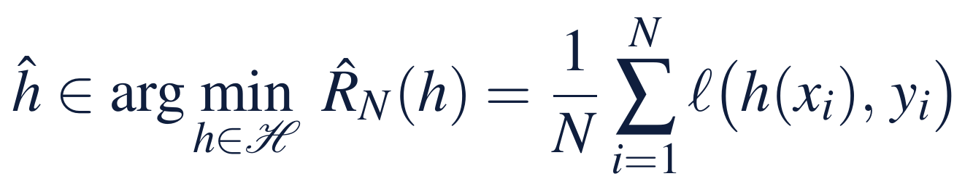
A record's score is not evidence
§13.2 · THEOREM 13.1
Meridian's desk: 1,000 windows
THEOREM 13.1
Learning from a Record
Empirical risk minimization is Chapter 9's sample average approximation, with predictors in place of packages
Boosting, 500 stages of trees, fits every window: AUC 1.00 on the record, 0.89 on fresh programs
A logistic model with six parameters is a small class: AUC 0.94 on the record, 0.92 fresh
Fermi's elephant is part (iii) with the parameters counted
(i) Two gaps. The record's best predictor is within twice the largest record-to-risk gap of the class's best
(ii) Finite classes. That gap is at most √(ln(2|H|/δ)/(2N)) with probability 1 − δ
(iii) Rich classes. Risk ≤ record risk + 2 × Rademacher complexity + √(ln(1/δ)/(2N)); with VC dimension d, the complexity is at most √(2d ln(eN/d)/N)
(iv) Growing classes. The risk tends to the floor if the class reaches it slowly enough that d ln N/N → 0
Notes:
Theorem 13.1; formal statement and proof in Appendix 13.A. The record's best predictor inherits the optimism of a sample's optimum (Theorem 9.3(iii)). LOS Guidance 13.2: a strong answer explains why boosting scores 1.00 on the desk's record and 0.89 on fresh programs while the logistic model scores 0.94 and 0.92.

Slide 7
Richer classes fit more and promise less
§13.2 · TABLE 13.1 · PROPOSITION 13.2
Class | Richness set by | What it promises | Watch for
Linear and logistic models | number of features | small gap between record and fresh error (Theorem 13.1(ii)–(iii)) | features that miss the signal
Trees and forests | depth, leaves, members | averages cut variance (Proposition 13.2(ii)) | correlated members
Boosting | stages, depth, learning rate | record loss falls at every stage (Proposition 13.2(iv)) | a perfect record score
Neural networks | layers and width | can approximate any continuous rule | approximation is not learning
Principal components, clusters | components, clusters | summaries of the features, not of the outcome (Proposition 13.3) | variance mistaken for relevance
Proposition 13.2. Error = floor + bias² + variance; B members with correlation ρ leave ρσ² + (1 − ρ)σ²/B.
Notes:
Table 13.1 and Proposition 13.2; formal statement and proof in Online Appendix 13.B. The Online Appendix's majority vote: three classifiers, each right on 60 percent of cases, whose majority is right on 40 percent. Boosting lowers the record's loss at every stage while the fresh error can rise; stopping early is a form of regularization.

Slide 8
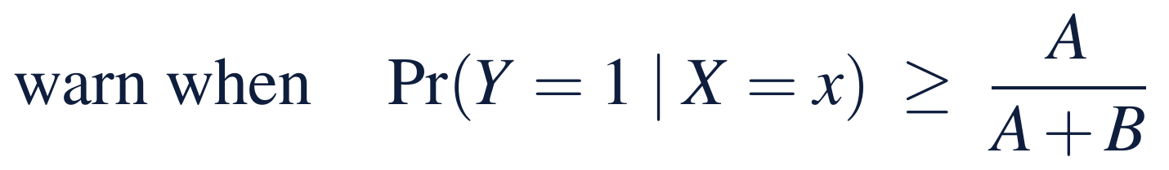
A prediction is worth the decision it changes
§13.3 · DEFINITION 13.2 · THEOREM 13.2
Meridian's warning, priced by its packages
THEOREM 13.2
From Predictions to Decisions
At accuracy's threshold, 0.5: right 87.3% of the time, worth $0.53m
Where the packages are cheapest, a 4.1% chance: right 65.9%, less than never warning (74.0%), worth $1.44m
The desk's five readings allow at most $1.44m, against $4.12m for a perfect warning
(i) Regret. If costs move by at most L per unit of error, the plug-in decision's regret is at most 2L times the error; the 2 is sharp
(ii) Costs set thresholds. A: a false alarm's cost, B: a miss's; accuracy's ½ is best only when they are equal; an appetite is priced into the costs
(iii) The information ceiling. No rule on a function of the features beats the best rule on the features, nor that a clairvoyant
(iv) Plug-in. Plugging in the conditional mean is optimal when the cost is affine in the outcome; otherwise it need not be
Notes:
Definition 13.2 (regret; the value of a reading) and Theorem 13.2; formal statement and proof in Appendix 13.A. Part (ii) is the board's answer to 'the model is 87 percent accurate': accuracy counts a false alarm and a miss as equal; the board's packages do not. Elmachtoub and Grigas, and Bertsimas and Kallus, build part (iv) into the learning itself.

Slide 9
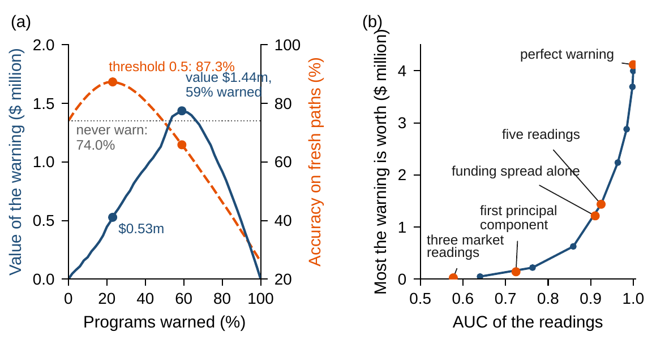
The valuable warning is the less accurate one
§13.3 · FIGURE 13.1
(a) At 0.5 the warning is right 87.3% of the time and worth $0.53m: its all-clear group still sees closures 10.2% of the time and needs a $125m line
At a 4.1% chance it warns 59% of programs, is right 65.9% of the time, and is worth $1.44m, with no line for the all-clear group
(b) Value rises steeply with separation: $0.63m at an AUC of 0.86, $2.24m at 0.96
Figure 13.1. (a) The desk's logistic warning at every threshold: the value of its two packages and its accuracy on fresh paths. (b) The most a warning can be worth against its readings' AUC.
Notes:
Figure 13.1 and Worked Example 13.1, Steps 1-2. In panel (a) each group's closure share is the law's; the dots mark the threshold 0.5 and the packages' own threshold. Panel (b) scales the signal in all five readings: AUC 0.640 to 1.000, value $0.05 million to $4.12 million (Online Appendix Example 13.B.2).

Slide 10
Certify a design on bounds, not estimates
§13.4 · THEOREM 13.3
The audit committee's rule
THEOREM 13.3
Honest Checks
Score a model on cases held out from its fitting, and certify a design on bounds, not point estimates
Designed from held-out estimates, the warning promises $1.73m and breaches 5.02% on fresh paths
Over 200 records such designs keep the appetite only half the time; designed on one-sided 95% bounds, in 98%
(i) Fresh data. For a predictor fixed before m fresh cases, the fresh average is unbiased; Hoeffding bounds it, Clopper–Pearson bounds a chance
(ii) Many candidates. With K fixed in advance, every estimate is within √(ln(2K/δ)/(2m)); one chosen by its fresh score is not covered
(iii) Conformal sets. Coverage between 1 − α and 1 − α + 1/(n + 1), whatever the law, when cases are exchangeable
(iv) Limits. Averages over cases, not promises for each; they assume new cases come from the record's law
Notes:
Theorem 13.3; formal statement and proof in Appendix 13.A. Dwork and coauthors show how a reused holdout stops being fresh; Angelopoulos and Bates introduce conformal methods. LOS Guidance 13.4: a common mistake is to tune and judge a model on the same held-out cases.

Slide 11
Each measure says one thing and misses another
§13.4 · TABLE 13.2
Measure | Says | Misses | Desk's warning
RMSE, MAE, MAPE | size of a numerical error | which errors cost money | –
Accuracy | share of cases right | costs of misses and false alarms | 87.3% at 0.5, 65.9% where cheapest
AUC | ranking of cases | the threshold, and calibration | 0.924
Calibration | stated chances match frequencies | ranking | –
Decision value | saving in the board's own costs | nothing the costs omit | $1.44m at most
Fresh breach | whether the appetite holds | whether the record was typical | 4.73% certified
Table 13.2: what each measure says, and what it misses (Worked Example 13.1, fresh paths).
Notes:
Table 13.2. The board reads the decision value and the fresh breach; accuracy and AUC describe the model, not what it is worth. Decision value misses only what the costs omit.

Slide 12
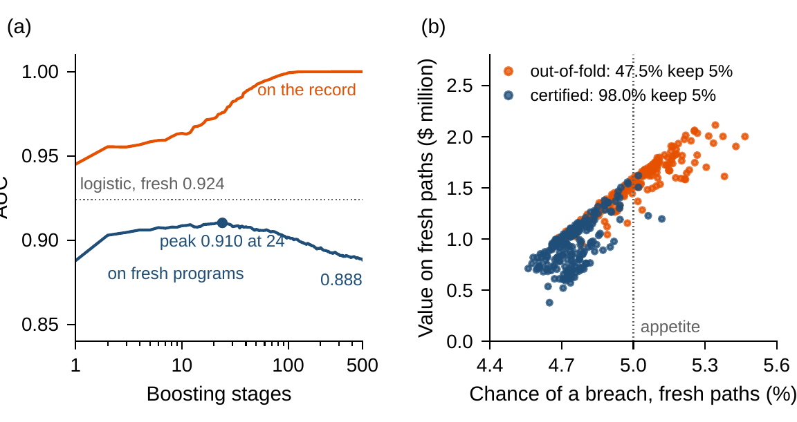
A perfect record score breaks the appetite
§13.4 · FIGURE 13.2
(a) Boosting's AUC on the record climbs to 1.00; on fresh programs it peaks at 0.910 after 24 stages and falls to 0.888
Trusted, its packages promise $4.04m, nearly a perfect warning; on fresh paths they breach 7.68%
(b) Over 200 records, designs from held-out shares keep 5% in 47.5%; certified designs in 98.0%, worth $0.95m on average
Figure 13.2. (a) Boosting on the desk's record: AUC on the record and on fresh programs by number of stages. (b) 200 records of 1,000 windows: held-out and certified designs, checked on fresh paths.
Notes:
Figure 13.2; Theorems 13.1 and 13.3; Worked Example 13.1, Steps 3-4. Online Appendix Example 13.B.2: held-out designs have a mean true chance of 5.02 percent (90th percentile 5.21) and a mean value of $1.53 million; certified designs 4.75 percent (4.89) and $0.95 million. The stage curve uses 20,000 fresh programs.

Slide 13
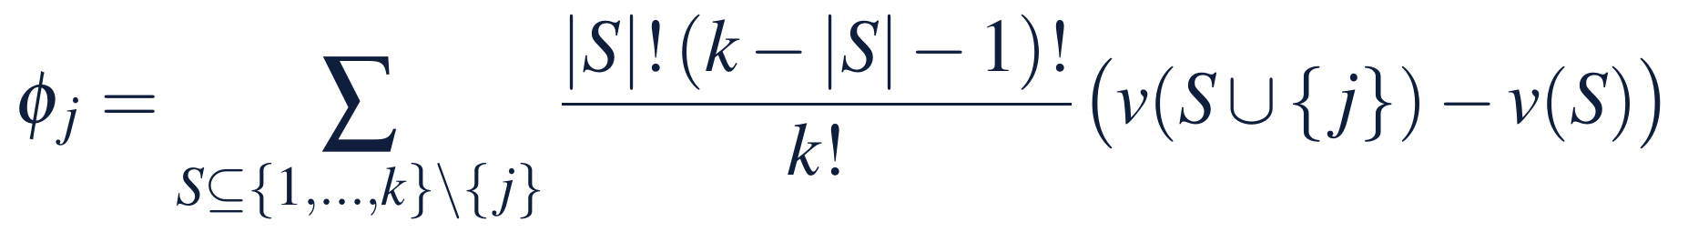
Components keep variance; attributions need a game
§13.5 · DEFINITION 13.3 · PROPOSITION 13.3
Meridian's five readings
PROPOSITION 13.3
Reading a Model
The record's first component, an equal-weighted index, keeps 56% of the variance and allows at most $0.14m
The funding spread alone keeps 30% and allows $1.21m
Attributions describe a model under a declared game, not causes: before reading one, ask which game it plays
(i) Components. The top r principal components keep more variance than any other r directions
(ii) Variance is not relevance. The top component can carry none of the information about the outcome; a discarded one, all of it
(iii) Shapley values. The only efficient, symmetric, null and additive attribution; for a linear model under the interventional game, each coefficient times the reading's distance from its mean
(iv) The game decides. Conditional: an ignored feature can get credit; interventional: a proxy carries what it stands for
Notes:
Definition 13.3 and Proposition 13.3; formal statement and proof in Online Appendix 13.B. Part (ii) is the risk in a one-number financial-conditions index: the common factor that moves every spread together holds most of the variance and little of the warning. The author's papers find the same loss of information when latent factors summarize financial conditions.

Slide 14
Is the market desk's warning worth paying for?
WORKED EXAMPLE 13.1 · THE SITUATION
Chapter 9
The treasury's market desk
The board's terms
A perfect warning is worth $4.12m
Five readings and a record
Two packages, one appetite
No line and 0.61 quarter of delay without a closure ahead; a $215m line and half a quarter with one: $6.32m against Volume I's $10.44m.
Meridian's bond spread, the high-yield spread, equity volatility, lending standards, the bank-funding spread; 1,000 windows, 268 with a closure.
One package for warning, one for all clear, 5% counted over both; the audit committee certifies at one-sided 95%.
Chapter 9 asked how to test a warning before paying for it. The desk now offers one, learned from data.
Notes:
Worked Example 13.1, the situation and Step 1. A common financial-conditions factor drives the readings (loadings 0.9, 0.85, 0.8, 0.6, 0.3); programs that will see a closure start higher by 0.25, 0.25, 0.15, 0.7 and 1.9 units; given closure or not the readings say nothing more about the path, so Chapter 9's law is unchanged (Proposition 9.3(ii); Worked Example 9.1).

Slide 15
Five steps from a ceiling to a certified price
WORKED EXAMPLE 13.1 · STEPS 1–5
1
Declare and price the ceiling
2
Accuracy is not value
3
A perfect record, a broken appetite
Read by the declared law, the readings separate closures with an AUC of 0.924; the best warning is worth $1.44m.
At 0.5: 23% warned, 87.3% right, $0.53m. At a 4.1% chance: 59% warned, 65.9% right, $1.44m, the ceiling.
Boosting is right on every window; trusted, it promises $4.04m and breaches 7.68% on fresh paths.
4
Certify before paying
5
One number or five
Held-out shares: $1.73m, 5.02%, 47.5% of records keep 5%. Certified: 98.0%; $1.06m on the desk's record.
The first component keeps 56% of the variance, worth $0.14m; the funding spread alone 30%, worth $1.21m.
Notes:
Worked Example 13.1, Steps 1-5; Online Appendix Example 13.B.2. Step 4: held-out shares of closures, 44.7 percent in the warned group and 1.0 percent in the all-clear group; their one-sided 95 percent upper bounds, 48.2 and 2.2 percent. Step 5: the interventional game credits the funding spread with 2.13 of the log-odds and the market readings with -0.83; the conditional game gives every reading positive credit, 1.47 to the funding spread.

Slide 16
Every promise is checked on fresh paths
WORKED EXAMPLE 13.1 · TABLE 13.3
Warning | Warned (%) | All clear: line, delay | Warned: line, delay | Promised value | Fresh breach (%) | Fresh value
None (Volume I) | 0 | 170, 0.67 | -- | 0 | 4.91 | 0
Perfect (Chapter 9) | 26.0 | 0, 0.61 | 215, 0.50 | 4.12 | 4.91 | 4.12
Declared law (ceiling) | 58.9 | 0, 0.67 | 190, 0.73 | 1.44 | 4.90 | 1.43
Logistic, at 0.5 (law) | 22.9 | 125, 0.71 | 205, 0.67 | 0.53 | 4.90 | 0.53
Logistic, cheapest (law) | 58.6 | 0, 0.67 | 190, 0.73 | 1.44 | 4.93 | 1.46
Logistic, held-out | 60.9 | 0, 0.68 | 185, 0.68 | 1.73 | 5.02 | 1.63
Logistic, certified | 60.9 | 0, 0.73 | 190, 0.74 | 1.17 | 4.73 | 1.06
Boosting, trusted | 35.7 | 0, 0.61 | 215, 0.51 | 4.04 | 7.68 | --
Boosting, held-out | 68.3 | 0, 0.76 | 190, 0.74 | 1.16 | 4.96 | 0.59
(law): each group's closure share as the law gives it; the other logistic and boosting rows estimate it from the desk's record. $ million; delays in quarters. A fresh value is shown only where the fresh breach is near the appetite.
Notes:
Table 13.3. Warned: share of the 100,000 fresh programs warned; promised value: Volume I's $10.44 million less the expected cost the design expects; fresh: the true chance of a breach and the value on the fresh paths, each with its own readings. The certified warning is the one the audit committee can sign.

Slide 17
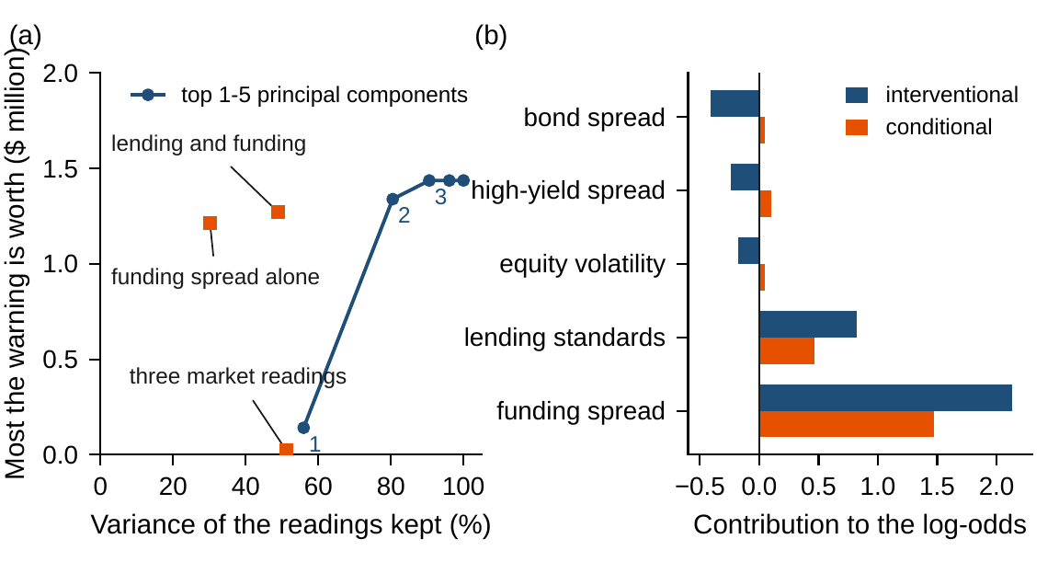
The index keeps the variance, not the warning
WORKED EXAMPLE 13.1 · FIGURE 13.3
(a) The first principal component keeps 56% of the readings' variance and allows at most $0.14m
The three market readings hold 51% and allow $0.02m; the funding spread alone 30% and $1.21m
(b) The model weighs the funding spread at 2.18, lending at 0.97, the market readings negatively: they net out the common factor
Interventional credit: 2.13 to funding, −0.83 to the market readings; conditional: all positive
Figure 13.3. (a) Variance kept against the most the warning is worth: top 1–5 principal components and subsets. (b) Attributions of one warned reading under the interventional and the conditional game.
Notes:
Figure 13.3 and Worked Example 13.1, Step 5; Proposition 13.3(ii) and (iv). The reading is one standard unit high on every indicator and 1.5 on the funding spread: fitted log-odds -0.071, a chance of 48.2 percent, warned at the best threshold but not at 0.5 (Online Appendix Example 13.B.2).

Slide 18
Pay for the warning, but certify it first
WORKED EXAMPLE 13.1 · WHAT THE BOARD SHOULD TAKE AWAY
$1.44m
4.1%
$1.06m
the most the desk's warning can be worth: a third of a perfect warning
the threshold the packages set, not accuracy's 0.5: wrong more often than never warning
the certified warning on the desk's record: about $1 million
A model that is perfect on its record promises nearly $4 million and breaks the appetite
The information sits in the funding spread; the credit a reading receives depends on the declared game
For discussion: who should own the threshold, the desk or the board? How large a record before the certified warning is worth most of its ceiling?
Notes:
Worked Example 13.1, what the board should take away, and the discussion questions: who should own the warning's threshold, the desk or the board? How large must the desk's record be before the certified warning is worth most of its ceiling?

Slide 19
Netflix paid $1m for ten percent
IN PRACTICE · NETFLIX PRIZE
The decision
The method
The result
Is better accuracy worth $1m?
A hidden test set
Won in 2009, not deployed
A 10 percent cut in rating-prediction error over Cinematch, judged on data the teams never saw.
A public leaderboard on half the withheld ratings; the prize decided on the other half.
Two 2007 methods went into production; the final blend's gains did not justify the engineering.
Making it work
What Meridian takes
For the board
The objective moved
Value a warning by decisions
Judged on what data?
Streaming changed what mattered; engagement and retention, tested in experiments, decide.
Worked Example 13.1 values the desk's warning by what it does to the liquidity packages.
And what could our data reveal about individuals before we share it?
Notes:
In Practice, Chapter 13: Netflix Pays a Million Dollars for Ten Percent. A real organization's decision of this chapter's kind, told from its published record; every figure is cited in the book. The lesson for Meridian: Judge a model on data it has not seen, and value it by the decisions it changes. Sources: Bennett and Lanning (2007); Feuerverger, He and Khatri (2012); Koren, Bell and Volinsky (2009); Netflix Tech Blog (2012); Gomez-Uribe and Hunt (2015); FTC (2010).

Slide 20

Pricing a learned warning, in AXIOM
AXIOM LAB 2.13 · MODULE AXIOM-13
The audit committee will not pay for the desk's warning until it knows what the warning can be worth, at which threshold to read it, and whether its promise survives fresh data. Open AXIOM, choose Lab 2.13 and load the Meridian warning instance.
1
2
3
4
5
Read the record
Train and validate
Price the warning
Check and certify
Compress and explain
Compare readings with and without a closure; compute the ceiling.
Fit a logistic and a boosted model; score them on the record, held-out folds and fresh programs.
Sweep the threshold; mark best accuracy and best value.
Trusted, held-out and certified designs on fresh paths; repeat on 200 records.
Price one index and subsets; compare two games of attribution.
Deliverable: a one-page note to the board: what the warning can be worth, the threshold and packages it should use, its certified value and fresh check, and what the desk should record next. About 75 minutes.
Notes:
AXIOM Lab 2.13. What to look for: a ceiling well below a perfect warning (Theorem 13.2(iii)); a valuable threshold that is less accurate than never warning (Theorem 13.2(ii)); a perfect record score that breaks the appetite (Theorem 13.1); certified designs that keep it (Theorem 13.3); and an index that keeps the variance and loses the warning (Proposition 13.3(ii)).

Slide 21
What to carry forward
KEY TAKEAWAYS
1
Learning supplies a declared part of the model, is judged on data it has not seen, and leaves the commitments to the optimizer; computed features never lower the floor, and leaked fields fake it.
2
Learning from a record is sample average approximation over predictors: a rich class can fit any record, so its record score is not evidence.
3
A prediction is worth the decisions it changes. Its threshold comes from the decision's costs, and its value is capped by the information in its inputs.
4
Fresh data, confidence bounds, and conformal sets give guarantees while the future resembles the record; certify designs on bounds, not point estimates.
5
Principal components keep variance, not relevance, and attributions describe a model under a declared game. The desk's warning is worth at most $1.44 million and, certified, about $1 million.
Notes:
Key Takeaways, Chapter 13.

Slide 22
Notebook and workbook reproduce the book
THIS WEEK'S LABORATORY
376
203
26213
AXIOM-13
notebook checkpoints, every one PASS
workbook checks against the engine, ALL PASS
the lab's seed
AXIOM Lab 2.13
Notebook DCT_V2_Ch13_Lab.ipynb: Worked Example 13.1 and the lab's five steps in eight panels, on Chapter 9's paths and the book's seeds
Workbook DCT_V2_Ch13_Lab.xlsx: the declared law, the shares and bounds, the two-package arithmetic and Table 13.3, in formulas
Notes:
The notebook and workbook are on the course website, www.dynamiccorporatetransformation.com.

Slide 23
Next, Chapter 14 continues Part IV
NEXT · CHAPTER 14
Parts I–III declared every part of their models; this chapter let data supply one part, on the framework's terms
Learning proposes, fresh data checks, and the optimizer keeps the commitments; no rule that reads less does better than the best rule that reads more (Theorem 13.2(iii))
Chapter 14, Artificial Intelligence for Enterprise Optimization, continues Part IV, Multi-Objective and Intelligent Enterprise Optimization
Notes:
The inequality is Theorem 13.2(iii), the information ceiling: a rule that reads a function g(X) of the features does no better than the best rule that reads X, and none does better than a clairvoyant who reads the outcome. Chapter 14, Artificial Intelligence for Enterprise Optimization, is the next chapter of Part IV, Multi-Objective and Intelligent Enterprise Optimization.

