Slide 1
Enterprise Digital Twins and Autonomous Enterprise Transformation
VOLUME II · CHAPTER 15 · WEEK 14
Keep a declared model in step with the company: filter its readings into a belief, size margins to its error, watch its surprises, and act alone only inside an envelope
Graduate course companion · Lab seed 26215 · AXIOM Lab 2.15 (AXIOM-15)
Notes:
Volume II, Chapter 15. Every chapter so far solved a model once, from a state the board took as known. A digital twin is the model kept running: it reads the company, keeps what the readings imply about the state, re-decides as they arrive, and says when its own model has stopped fitting. The Worked Example asks whether a twin fed by the skills survey can replace the engineering office's count of capability: it costs $11.1 million more than the count, $4.8 million less than reading the survey as exact, and finds a tighter labor market in a median of 12 quarters (abstract).

Slide 2
“For a successful technology, reality must take precedence over public relations, for nature cannot be fooled.”
Richard P. Feynman
Nobel Prize in Physics 1965; “Personal Observations on the Reliability of the Shuttle,” Rogers Commission Report, Appendix F (1986)
Notes:
Feynman's observations on the reliability of the Shuttle, in the Rogers Commission report. A twin is only as good as its law, and laws change: a twin that never questions its law keeps deciding with growing confidence on a world that has gone, and its readings are its only witness (Section 15.4).

Slide 3
After this chapter, you can
LEARNING OUTCOME STATEMENTS
15.1
Explain what a digital twin declares and how it differs from a model solved once: state, law, readings, belief, rule, and envelope.
15.2
Synchronize a twin: filter readings into a belief, and judge the error at which it settles.
15.3
Decide on a twin: value its readings, and size margins to its error.
15.4
Monitor a twin: test its innovations, and detect a changed law.
15.5
Govern a twin's autonomy: envelopes, escalation, and stability.
Notes:
The five learning outcome statements; LOS Guidance at the end of the chapter.

Slide 4
Five sections, a worked example, a case and a lab
ROADMAP
§15.1
§15.2
§15.3
§15.4
The Twin as a Declared Model
Synchronizing the Twin
Deciding on the Twin
Monitoring the Twin
Definition 15.1 · Table 15.1
Theorem 15.1 · Proposition 15.1 · Figure 15.1
Theorem 15.2 · Proposition 15.2 · Figure 15.2
Theorem 15.3 · Figure 15.3
§15.5
Worked Example 15.1
In Practice
AXIOM Lab 2.15
Autonomy and Governance
Can a Digital Twin Replace the Engineering Office's Count?
Rolls-Royce Watches Every Engine in Flight
A Twin for Capability: Synchronize, Decide, Monitor
Definition 15.3 · Proposition 15.3
Table 15.3 · Figures 15.1–15.3
At a Glance · board questions
AXIOM-15 · five steps
Notes:
Formal statements and proofs of Theorems 15.1-15.3 are in Appendix 15.A; Propositions 15.1-15.3, how the Worked Example is computed (Remark 15.B.1) and every number of the Worked Example and the figures (Example 15.B.2) are in Online Appendix 15.B. Table 15.2 lists the methods for running a twin.

Slide 5
A twin is a declared model kept running
§15.1 · DEFINITION 15.1
Meridian's capability twin
DEFINITION 15.1
Digital Twin
c′ = 0.975c + h − w: Chapter 7's law for capability, the state
Readings: the skills survey, good to ±5 points (Volume I, Table 5.2)
Rule: Chapter 7's target rule, run on the twin's estimate
Envelope: inside Chapter 14's guardrail
Not a new kind of model, but a discipline for running a declared one
A digital twin of an enterprise declares a state and its law, the decisions, and the readings with the laws of their errors
It keeps a belief, the law of the state given the readings and decisions so far, and acts by a rule on it
Its envelope declares the decisions it may take alone and the triggers on which it refers a decision to an owner
It is synchronized when its belief is the one its readings imply under its law
Notes:
Definition 15.1. A company does not stand still while its model is solved: the state moves, the readings arrive late and with error, and the law itself can change (Section 15.1). Volume I asked for this discipline (Volume I, Theorem 15.4(iv)): a plan re-solved each period keeps the company feasible only if each re-solve ends where the company can still be kept feasible.

Slide 6
Every block of a twin has an owner
§15.1 · TABLE 15.1
Block | Declares | Supplied by | Meridian's owner
State and law | what moves and how | Chapter 7; Part III | engineering office
Readings | what is read, how often, with what error | Volume I, Table 5.2 | survey's owner
Belief | what the readings imply | Theorem 15.1 | the twin
Rule | the decision for each belief | Chapter 7; Theorem 15.2 | human resources
Envelope | what the twin may do alone; when it escalates | Chapter 14; Definition 15.3 | the board
Monitor | when the law has stopped fitting | Theorem 15.3 | audit committee
Definition 15.1 turns a slogan into a list of declarations, each with an owner.
Notes:
Table 15.1. Scope and limits: the chapter treats a twin of one company whose readings and decisions it declares. A twin of a market, whose state is a population of agents each reacting to the others, keeps a belief about a distribution; its law is a McKean–Vlasov equation (Section 15.1).

Slide 7
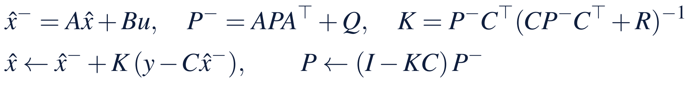
The twin's error settles between surveys
§15.2 · DEFINITION 15.2 · THEOREM 15.1
Meridian's twin
THEOREM 15.1
Synchronizing a Twin
Capability keeps 97.5% of itself and swings by 0.67 points a quarter
With no readings after the audit the error settles at 3.0 points; the survey read as exact is good to 2.5
The twin settles at 1.33 just after a survey and 1.58 just before the next, with a gain of 0.28
The exact belief's mean is within 0.012 points of the filter's in all 5,700 surveys
(i) The belief is enough. A problem read with error is a dynamic program whose state is the belief
(ii) The Kalman filter computes the belief for linear laws with Gaussian noises; with any noises of those means and covariances, and decisions linear in the readings, the best linear estimate
(iii) The twin settles. With readings every k periods, the variance just after a reading converges to one positive fixed point
(iv) Feedback bounds the error. Without readings the variance tends to q/(1 − a²); every reading lowers it
Notes:
Definition 15.2 and Theorem 15.1; formal statement and proof in Appendix 15.A. Equation 15.1 is the Kalman filter: predict through the law and the decisions, then correct by the reading; the innovation y − Cx̂⁻ is the part of a reading the twin did not expect, and K the gain that weighs it. Part (i) is Chapter 7's promise kept: a rule that acts on what the readings say is a rule on the belief. For the swings' discrete law the best linear estimate is, here, as good as the best estimate (Section 15.2).

Slide 8
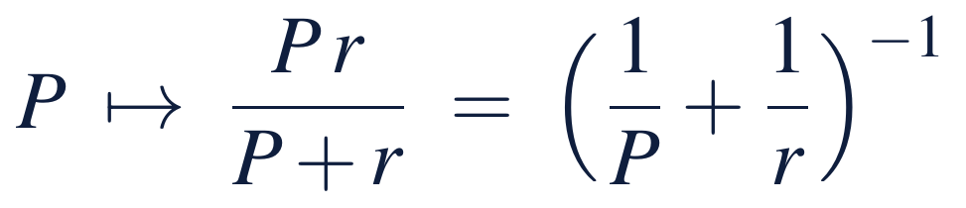
Precisions add; bias survives fusion
§15.2 · PROPOSITION 15.1
At Meridian's survey
PROPOSITION 15.1
Fusing Readings
Just before a survey the law knows capability to 1.58 points, the survey to 2.5
Their precisions add to an error of 1.33: the twin weighs the survey by 0.28
The survey read as exact throws away what the law and earlier surveys say
Finding a bias in the survey takes an independent reading, an audit
(i) Precisions add. Independent unbiased readings, weighted by their precisions 1/r, give the least-variance unbiased linear estimate
(ii) A reading's worth depends on what the twin knows: by a lot when it knows little, by little when it knows much
(iii) Bias survives fusion. A biased reading leaves a bias no averaging removes, and the innovations show only part of it
Notes:
Proposition 15.1; formal statement and proof in Online Appendix 15.B. The twin's innovations show only part of a reading's bias, and none when the stock keeps all of itself. LOS Guidance 15.2: a common mistake is to read each new reading as the truth and discard what the law and earlier readings say.

Slide 9
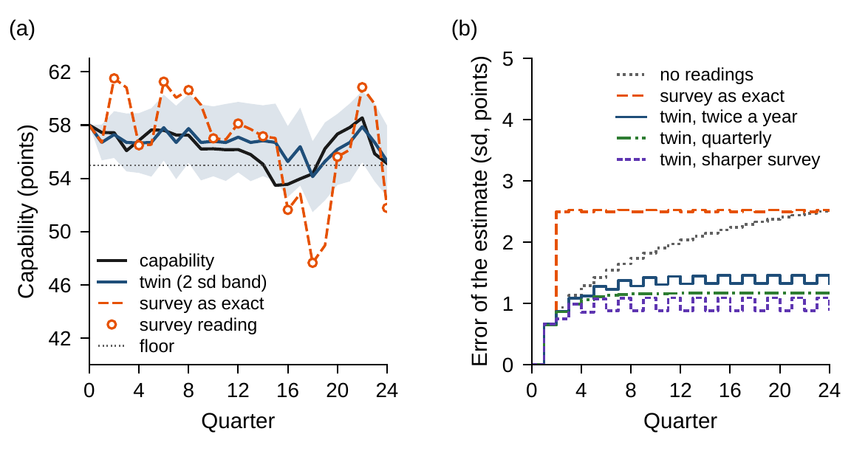
The twin settles at 1.33 to 1.58 points
§15.2 · FIGURE 15.1
(a) One program from an audited 58: the twin's estimate stays near capability; the survey read as exact jumps with every reading
(b) The twin settles at 1.33 to 1.58 points; the survey read as exact at 2.50 to 2.53; with no readings the error climbs toward 3.02
A quarterly survey settles at 1.17 to 1.32, one twice as sharp at 0.89 to 1.26, both at 0.79 to 1.02
Figure 15.1. (a) One simulated program from an audited 58: capability, the survey's readings, the twin's estimate with a band of two standard deviations, and the survey read as exact. (b) The estimate's error by quarter.
Notes:
Figure 15.1 and Worked Example 15.1, Step 2; the error column of Table 15.3. Reading the survey as exact and carrying it forward by hires and decay, as the count would without its team leads, leaves an error of 2.50 to 2.53 points; with no readings it would reach 3.0 (Theorem 15.1(iv)).

Slide 10
Margins must grow with the twin's error
§15.3 · THEOREM 15.2
Meridian's rule on the twin
THEOREM 15.2
Deciding on a Twin
On the count, Chapter 7's rule costs $230.8m from 58; on the twin, $241.9m
The count is worth $11.1m in present value, about $1.0m a year
The twin's best target is 56.70: a margin of 1.70 points where the count needs 0.75
Chapter 7's target on the twin costs $16.3m more and leaves capability short in 31% of quarters
(i) Readings never cost. The least cost on the true state is at most that on the twin's readings, on coarser readings, or on none; each gap is a value of information
(ii) Certainty equivalence. For linear laws, quadratic costs and Gaussian noises, the best rule applies the true-state rule to the twin's mean
(iii) Margins grow with the twin's error. With shortfalls at b > 2k a unit, plan to the floor plus the (1 − k/b)-quantile of the swing less the twin's error; as if exact, the margin covers the swing alone
Notes:
Theorem 15.2; formal statement and proof in Appendix 15.A. Keeping Chapter 7's target on the twin is certainty equivalence outside its quadratic world (Section 15.3). Volume I's theorem on the value of information and authority is part (i) in general (Volume I, Theorem 15.4(iii)).

Slide 11
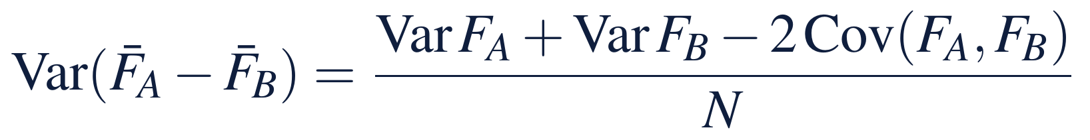
Choose on design paths, value on fresh ones
§15.3 · PROPOSITION 15.2 · TABLE 15.2
Methods for running a twin
PROPOSITION 15.2
Simulation Inside the Twin
Kalman filter: exact for linear Gaussian laws; watch a law that is not linear
Grid and particle filters: any belief; watch the curse of dimensionality
Simulation on the belief: unbiased on fresh paths; watch the optimism of design paths
Re-solving each period: the best rule, given a terminal value; watch a window that ends nowhere safe
Innovation tests (CUSUM): fastest detection; watch thresholds set by habit
(i) Choose on design paths, value on fresh ones. The least of several averages is biased toward optimism; the chosen candidate's average on fresh paths is unbiased again
(ii) Common random numbers. On the same paths, candidates whose costs move together are told apart with far fewer paths
(iii) The twin's simulator is its law. A simulation inside the twin inherits every error of its law and belief
Notes:
Proposition 15.2; formal statement and proof in Online Appendix 15.B; Table 15.2 lists the methods. In the Worked Example each design's target is chosen on 20,000 design paths and valued on 100,000 fresh ones, all on common random numbers: the twin's target costs $241.85 million on the design paths and $241.94 million on the fresh ones, within the simulation's error (Step 6).

Slide 12
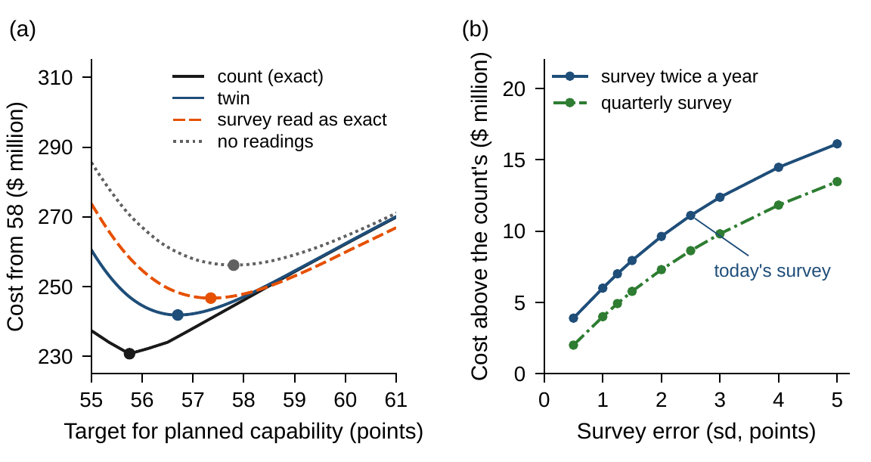
The count is worth $11.1m, about $1.0m a year
§15.3 · FIGURE 15.2
(a) Best targets: 55.75 on the count, 56.70 on the twin, 57.35 for the survey read as exact, 57.80 with no readings
Above the count: the twin $11.10m, the survey read as exact $15.95m, no readings $25.43m
(b) A quarterly survey cuts the twin's cost above the count to $8.6m, one twice as sharp to $7.0m, both to $4.9m
A year: up to $0.23m, $0.39m and $0.58m
Figure 15.2. (a) Expected cost from 58 against the target for planned capability, on common design paths; dots mark each design's best target. (b) The twin's cost above the count's, at its best target, against the survey's error.
Notes:
Figure 15.2 and Worked Example 15.1, Steps 3 and 4; Table 15.3. Guarding against the survey's whole error, the five planned points Chapter 7 priced, with a target of 60.75 costs $34.4 million more than the count; the survey read as exact at Chapter 7's 55.75, $27.5 million. With no readings after the audit the best target is 57.80, close to Chapter 7's best committed plan.

Slide 13
A correct twin is unpredictable to itself
§15.4 · THEOREM 15.3
A tighter labor market
THEOREM 15.3
Monitoring a Twin
From year 3 each quarter loses an extra half point; a twin that keeps its law overestimates capability by 2.2 to 3.1 points
Its rule leaves capability below the floor in 80% of quarters
A cumulative sum of the surveys' surprises, reference 0.5, threshold 2.25: a false alarm about once in 26 years
It finds the change in a median of 12 quarters
(i) Innovations. A correct twin's have mean zero, are uncorrelated, and have the variances the filter computes; a shifted law leaves a bias that settles
(ii) Cumulative sums detect fastest. With κ = δ/2 and H = ln γ/δ, at most one false alarm in γ readings on average, and no test with as few is faster
(iii) Re-planning on the twin. Re-solving each period with the declared value function as terminal value applies the best rule on beliefs
Notes:
Theorem 15.3; formal statement and proof in Appendix 15.A. Page proposed the test, Lorden bounded its delay, and Moustakides proved that no test does better (Section 15.4). Unmonitored, the twin's innovations' mean settles at −1.045 standard deviations (Online Appendix Example 15.B.2). A rolling window without a terminal condition can keep every window feasible while the company runs out of room (Volume I, Theorem 15.4(iv)).

Slide 14
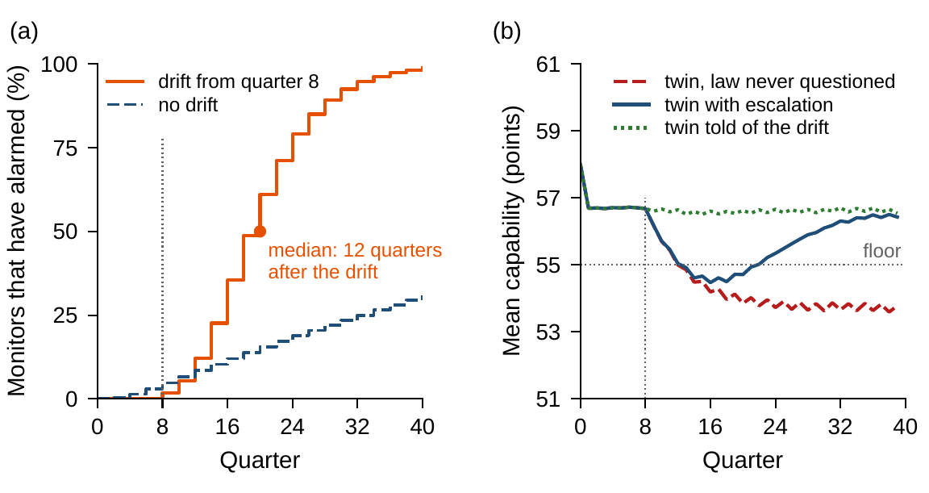
The monitor finds the drift in 12 quarters
§15.4 · FIGURE 15.3
(a) The monitor detects the drift on every program, after 12 quarters in the median, 4 to 22 from the 10th to the 90th percentile
(b) A twin that never questions its law costs $56.5m more than the count and spends 80% of quarters below 55
Escalating on the alarm to the engineering office's audit: $18.2m; told of the drift when it begins: $10.3m
Figure 15.3. (a) The share of programs whose monitor has raised an alarm, by quarter, with the drift from quarter 8 and, as false alarms, without it. (b) Mean capability under the drift.
Notes:
Figure 15.3 and Worked Example 15.1, Step 5. With the count, and the law re-estimated at once, the program costs $302.0 million from 58. On an alarm the engineering office audits capability, the estimate is set to it, and once the drift has begun the law's mean is re-estimated and the target raised by it (Online Appendix Remark 15.B.1).

Slide 15
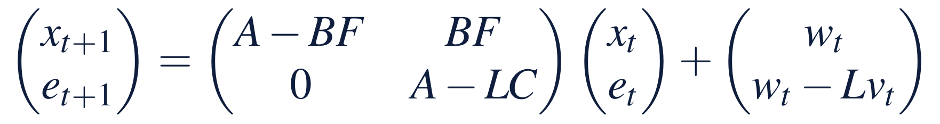
Escalate on surprises, not on uncertainty
§15.5 · DEFINITION 15.3 · PROPOSITION 15.3
Meridian's envelope
PROPOSITION 15.3
Autonomy within an Envelope
An envelope (Definition 15.3): the decisions the twin may take alone, and when it escalates
Hire alone inside Chapter 14's guardrail, which every target here keeps
The twin is least sure just before each survey, 1.58 points, most sure just after, 1.33: a calendar
Escalate on the monitor's alarm: the engineering office audits, the law is re-estimated, the twin resumes
(i) Separation and stability. The loop's modes are the rule's and the estimation error's: stable exactly when both are
(ii) Envelopes cost nothing at the best rule. A guardrail holding a best decision for every belief loses nothing, and caps the damage
(iii) Uncertainty runs on a calendar. The error variances do not depend on the readings; only triggers on the readings catch a change in the law
Notes:
Definition 15.3 and Proposition 15.3; formal statement and proof in Online Appendix 15.B. An audit reads the state exactly, at a cost, and resets the belief. LOS Guidance 15.5: a common mistake is to escalate on the twin's uncertainty instead of on its surprises. A twin of a market faces the same tasks with a harder state: the author's papers model many investors who each react to the distribution of the others, a McKean–Vlasov law with prices that clear (Section 15.5).

Slide 16
Can a twin replace the engineering office's count?
WORKED EXAMPLE 15.1 · THE SITUATION
Chief operating officer
The benchmark
The audit committee
Retire the count and run the rule on a twin
Chapter 7's rule on the count
What would the twin cost, and how would it know?
The count is a manual assessment by team leads; the twin would read the skills survey.
Plan capability to 55.75 each quarter: $230.8m of cost from 58.
What are better readings worth, and how would the twin notice a change in the world?
The program starts from an audited 58; the survey runs twice a year, good to ±5 points.
Notes:
Worked Example 15.1, the situation. Chapter 7's rule acts on capability as the engineering office counts it each quarter, a count the board took as exact, and asked what the rule would need if capability were known only through the skills survey (Worked Example 7.1, Step 6). The twin knows the law and its own hires but not the swings; it keeps its estimate by the Kalman filter and runs Chapter 7's rule as a target for planned capability on its estimate.

Slide 17
Six steps from the survey to an envelope
WORKED EXAMPLE 15.1 · STEPS 1–6
1
Declare the twin
2
Synchronize
3
Decide on the twin
Chapter 7's law and costs; the survey twice a year, error 2.5 points; targets chosen on 20,000 design paths, valued on 100,000 fresh ones.
The twin settles at 1.33 points just after a survey and 1.58 just before; read as exact, 2.50 to 2.53; no readings, 3.0.
Best target 56.70, $11.1m above the count. Chapter 7's 55.75 costs $16.3m and leaves 31% of quarters short.
4
Price better readings
5
Monitor the law
6
Set the envelope
Above the count: quarterly $8.6m, twice as sharp $7.0m, both $4.9m; worth up to $0.23m, $0.39m and $0.58m a year.
Threshold 2.25: a false alarm once in 26 years. A tighter market: never questioned $56.5m, monitored $18.2m, told $10.3m.
Hire inside Chapter 14's guardrail; escalate on the alarm. The target costs $241.85m on design paths, $241.94m on fresh.
Notes:
Worked Example 15.1, Steps 1-6; Online Appendix Remark 15.B.1 and Example 15.B.2. Step 3: the survey read as exact costs $15.95 million more than the count at its best target, 57.35 (Table 15.3), and $27.5 million at Chapter 7's; with no readings after the audit the best target is 57.80, $25.4 million more. Step 5: the monitor detects the change in a median of 12 quarters (10th to 90th percentile, 4 to 22), escalates, and after the engineering office's audit resumes with the law re-estimated.

Slide 18
Designs for knowing capability, priced
WORKED EXAMPLE 15.1 · TABLE 15.3
Design | Survey | Target | Error (sd) | Cost above the count | Below floor (%)
Count (Chapter 7) | – | 55.75 | 0 | 0 | 6.0
No readings after the audit | none | 57.80 | 3.02 | 25.43 | 17.6
Survey read as exact | twice a year | 55.75 | 2.50–2.53 | 27.51 | 38.6
whole error guarded | twice a year | 60.75 | 2.50–2.53 | 34.40 | 0.2
best target | twice a year | 57.35 | 2.50–2.53 | 15.95 | 13.3
Twin, Chapter 7's target | twice a year | 55.75 | 1.33–1.58 | 16.31 | 31.3
Twin, best target | twice a year | 56.70 | 1.33–1.58 | 11.10 | 13.4
Twin | quarterly | 56.50 | 1.17–1.32 | 8.63 | 13.0
Twin | twice as sharp | 56.40 | 0.89–1.26 | 7.01 | 12.1
Twin | both | 56.20 | 0.79–1.02 | 4.92 | 12.2
Twin, law never questioned* | twice a year | 56.70 | – | 56.47 | 79.9
Twin with monitor* | twice a year | 56.70 | – | 18.18 | 14.4
Twin told of the drift* | twice a year | 56.70 | – | 10.29 | 14.6
Target: planned capability (points). Error: the estimate's standard deviation just after and just before a survey. Cost above the count: present value at 10%, $ million, on 100,000 fresh paths. Below floor: long-run share of quarters below 55. * An extra half point lost each quarter from quarter 8: cost above the count with the drift.
Notes:
Table 15.3. The twin is $4.8 million cheaper than the survey read as exact on the same surveys, because it weighs each survey against the law and the earlier surveys. A survey twice as sharp, a quarterly one, or both buy back part of the count's value; a twin without a monitor turns a tighter labor market into years below the floor.

Slide 19
Keep a monitor; size the margin to the error
WORKED EXAMPLE 15.1 · WHAT THE BOARD SHOULD TAKE AWAY
$1.0m
1.70
12
a year: what the count is worth against the twin; retire it only if it costs more
points of margin for the twin, against Chapter 7's 0.75 on the count
quarters, in the median, for the monitor to find a tighter labor market
Run the rule on a twin, not on the survey read as exact; a sharper or more frequent survey buys back part of the count's value
Above all, give the twin a monitor: one that never questions its law turns a tighter labor market into years below the floor
For discussion: who should own the twin's law, the engineering office or the team that runs the twin? What should an alarm cost before the board raises the threshold?
Notes:
Worked Example 15.1, what the board should take away, and the discussion questions. The twin knows capability to about a point and a half, and its margin must cover that as well as the swings; a twin that escalates on its surprises finds the change in about three years.

Slide 20
Rolls-Royce watches every engine in flight
IN PRACTICE · ROLLS-ROYCE
The decision
The method
The result
Act on an engine, or not
Trend the readings, escalate change
By the company's account
Paid by the flying hour, the company decides when an engine's readings call for action.
Snapshots of 20–30 parameters a flight, trended; an analyst confirms a change before the airline is told.
75 percent of potential in-flight events mitigated in 2008; some maintenance intervals up to 50 percent longer.
Making it work
What Meridian takes
For the board
People, and limits
A twin with a monitor
What do we read, and how soon?
Analysts confirm what the algorithms flag; the Trent 1000 and 2020 showed the risks of selling hours.
Worked Example 15.1: give the twin a margin, and a monitor that questions its law.
Which decisions may our systems take alone, and which must go to a named owner?
Notes:
In Practice, Chapter 15: Rolls-Royce Watches Every Engine in Flight. A real organization's decision of this chapter's kind, told from its published record; every figure is cited in the book. The lesson for Meridian: Monitoring detects change; it did not make the Trent 1000 durable, and selling outcomes means owning their risks. Sources: Rolls-Royce (2012, 2018, 2020, 2021, c. 2024); Waters (2009), Ingenia; Hayton et al. (2007); CIO.com (2021); McGee and Schmidt (1985), NASA.

Slide 21

A twin for capability, in AXIOM
AXIOM LAB 2.15 · MODULE AXIOM-15
The chief operating officer proposes to retire the engineering office's count and run Chapter 7's hiring rule on a digital twin fed by the skills survey. The audit committee wants to know what the twin would cost, which readings are worth buying, and how it would notice a change. Open AXIOM, choose Lab 2.15 and load the Meridian capability twin.
1
2
3
4
5
Synchronize
Decide
Price readings
Monitor
Set the envelope
Run the Kalman filter on simulated surveys; compare its error with the survey read as exact and with no readings.
Sweep the target for the count, the twin and the survey read as exact; mark each best target and its cost on fresh paths.
Vary the survey's frequency and error, and price each design against the count.
Set the cumulative sum's threshold for a false-alarm rate, and test it on a drift in the law.
Decide what the twin may do alone and when it escalates.
Deliverable: a one-page note to the board: whether to retire the count, the twin's rule and margin, the readings worth buying, and the monitor and envelope the twin should run under. About 75 minutes.
Notes:
AXIOM Lab 2.15. What to look for: an error that settles between surveys (Theorem 15.1); a margin that must grow with the twin's error (Theorem 15.2(iii)); readings priced by what they save (Theorem 15.2(i)); a monitor that trades false alarms for speed (Theorem 15.3(ii)); and an uncertainty that runs on a calendar (Proposition 15.3(iii)).

Slide 22
What to carry forward
KEY TAKEAWAYS
1
A digital twin is a declared model kept running: state, law, readings, belief, rule, and envelope, each with an owner.
2
The belief holds all the readings say; for linear laws the Kalman filter computes it, and its error settles where the law and the readings balance.
3
Deciding on a twin costs the value of the information it lacks, and its margins must grow with its error; certainty equivalence holds only in the quadratic world.
4
A correct twin is never surprised on average; a cumulative sum of its surprises finds a changed law as fast as any test with as few false alarms.
5
Autonomy is a declared envelope: a guardrail, escalation on the monitor's alarm, and stability when both loops are stable. Meridian's twin costs $11.1 million more than the count, and its monitor is what keeps it honest.
Notes:
Key Takeaways, Chapter 15 (Definition 15.1 and Table 15.1; Theorem 15.1 and Proposition 15.1; Theorem 15.2; Theorem 15.3; Proposition 15.3).

Slide 23
Notebook and workbook reproduce the book
THIS WEEK'S LABORATORY
202
95
26215
AXIOM-15
notebook checkpoints, every one PASS
workbook checks against the engine, ALL PASS
the lab's seed
AXIOM Lab 2.15
Notebook DCT_V2_Ch15_Lab.ipynb: Worked Example 15.1 and the lab's five steps in six panels, with the book's seeds, ready for Colab
Workbook DCT_V2_Ch15_Lab.xlsx: the filter's variances, one program, Table 15.3, the margins, the bias and the cumulative sum, in formulas
Notes:
The notebook and workbook are on the course website, www.dynamiccorporatetransformation.com.

Slide 24
Next, Meridian runs its whole program
NEXT · CHAPTER 16
This chapter kept a declared model running: a belief from the readings, margins sized to its error, a monitor, and an envelope
Chapter 16, Enterprise Applications and Integrated Transformation Case Studies, opens Part V, Applications and Synthesis
Its Worked Example 16.1 asks: Can Meridian Run Its Whole Program?
Notes:
The inequality is Theorem 15.2(i): readings never cost, and each gap is the value of the information it adds. Chapter 16, Enterprise Applications and Integrated Transformation Case Studies, opens Part V, Applications and Synthesis; its Worked Example 16.1 puts Volume II's pieces, the twin among them, into one program.

