Slide 1
Artificial Intelligence for Enterprise Optimization
VOLUME II · CHAPTER 14 · WEEK 14
Learn rules by acting, on the framework's terms: the learner proposes, a declared model or fresh trials judge, and guardrails and certificates keep the commitments
Graduate course companion · Lab seed 26214 · AXIOM Lab 2.14 (AXIOM-14)
Notes:
Volume II, Chapter 14. Chapter 7 computed the best rule from a declared law, and Chapter 13 learned a part of a model from a record that decisions do not change. This chapter learns rules by acting, where each decision changes the data that follow. The Worked Example lets an agent learn Meridian's hiring rule: in a simulator it needs a million quarters to come within $1.26 million of the best rule; learning on the company would cost $545.5 million, and $1.2 million inside the board's guardrail (abstract).

Slide 2
“[W]ithin ten years a digital computer will be the world's chess champion, unless the rules bar it from competition.”
Herbert A. Simon
Nobel Memorial Prize in Economic Sciences 1978; with Allen Newell, “Heuristic Problem Solving,” Operations Research (1958)
Notes:
Simon and Newell's forecast for game-playing computers. Many systems now sold as artificial intelligence learn a rule by acting, as a game-playing program learns from the games it plays against itself; this chapter treats such learning on the framework's terms (Section 14.1).

Slide 3
After this chapter, you can
LEARNING OUTCOME STATEMENTS
14.1
Explain how learning from acting differs from learning from a record, and write an enterprise decision as a decision process with decision values.
14.2
Judge when learning a rule by trial converges, how fast, and how it fails.
14.3
Price exploration: regret, the failure of greedy learning, and the optimism that bounds the loss.
14.4
Learn with a simulator: what a learned law costs, and what a record kept under one rule cannot tell.
14.5
Keep the commitments when AI proposes: guardrails, certificates, and coordination among many agents.
Notes:
The five learning outcome statements; LOS Guidance at the end of the chapter.

Slide 4
Five sections, a worked example and a lab
ROADMAP
§14.1
§14.2
§14.3
§14.4
Learning from Acting
Learning a Rule by Trial
The Price of Exploration
Learning with a Simulator
Definition 14.1 · Table 14.1
Theorem 14.1 · Proposition 14.1 · Figure 14.1
Theorem 14.2 · Figure 14.2
Theorem 14.3 · Figure 14.3
§14.5
Worked Example 14.1
AXIOM Lab 2.14
Keeping the Commitments
Should Meridian Let an Agent Learn Its Hiring Rule?
Learning a Rule by Trial: Simulators, Exploration, and Guardrails
Definitions 14.2–14.3 · Propositions 14.2–14.3
Table 14.3 · Figures 14.1–14.3
AXIOM-14 · five steps
Notes:
Formal statements and proofs of Theorems 14.1-14.3 are in Appendix 14.A; Propositions 14.1-14.3, how the Worked Example is computed (Remark 14.B.1) and every number of the Worked Example and the figures (Example 14.B.2) are in Online Appendix 14.B. Table 14.2 lists the methods of learning by acting.

Slide 5
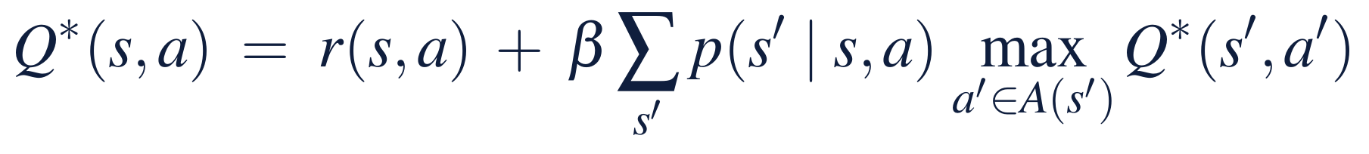
Learning from acting writes a decision process
§14.1 · DEFINITION 14.1
Meridian's hiring program
DEFINITION 14.1
Decision Process, Decision Values, and Regret
State: capability c; decision: the points h hired; a quarter's value −4h − 1.6(55 − c)⁺
Law: c′ = 0.975c + h − w, with the engineering office's swings w
Dynamic programming needs the law; learning by trial only tries decisions
Each decision changes the data that follow, so the learner must choose what to try
A decision process declares states s, decisions a ∈ A(s), a period's expected value r(s, a), a law p(s′ | s, a) of the next state, and a discount β < 1
A rule chooses a decision in each state; its values are the expected discounted sum of the periods' values, and the best rules' decision values solve Equation 14.1
Learning by trial (Q-learning) tries a in s, sees the value R and the next state s′, and moves Q(s, a) toward R + β max Q(s′, a′) by a step set by the pair's trials
A learner's regret over T trials is the expected value its decisions lose against the best rule's
Notes:
Definition 14.1. Equation 14.1 is Chapter 7's Bellman equation (Definition 7.2) written for decisions instead of states: Q*(s, a) is the value of deciding a in s and acting best afterwards. Learning by trial needs only the ability to try decisions and see what follows, in a simulator or on the company itself.

Slide 6
Every source of a rule needs its own judge
§14.1 · TABLE 14.1
Source | Needs | Guarantee | Watch for
Dynamic programming (Chapter 7) | the declared law | the best rule, exactly (Theorem 7.3) | a law nobody can declare
A record of practice (Chapter 13) | decisions and outcomes kept under one rule | associations under that rule | decisions it never tried (Theorem 14.3(iii))
Trials in a simulator | a simulator | the simulator's best rule, in the limit (Theorem 14.1) | a wrong simulator (Theorem 14.3(i))
Trials on the company | the company | regret that grows slowly (Theorem 14.2) | losses paid in money
Proposals from AI systems | an agent, a language model, rules | none of their own | a certificate (Proposition 14.2)
The learner proposes; a declared model or fresh trials judge; guardrails and certificates keep the commitments.
Notes:
Table 14.1: where a rule comes from, and what judges it. The chapter treats decision processes with finitely many states and decisions, observed exactly, and one learner at a time until the last section (Scope and limits).

Slide 7
Learning by trial works, slowly, and can fail
§14.2 · THEOREM 14.1
Meridian's agent, in a simulator
THEOREM 14.1
Learning a Rule by Trial
A million simulated quarters to come within $1.26m of the best rule; two million for $0.55m
Its values are wrong by up to $615.6m where Meridian never goes: a uniform bound of $52 billion
At 58 the error is $0.79m: the rule is good where the company goes
After a million quarters, steps of 1/n leave $21.7m and a constant step of 0.1 leaves $11.9m
(i) Convergence. If every pair is tried infinitely often and its steps sum to infinity while their squares do not, the decision values converge to Q*
(ii) Where the error matters. A rule greedy for values within ε of Q* loses at most 2ε/(1 − β); more sharply, twice the discounted errors where the rule goes
(iii) Failures. A pair never tried keeps its starting value; a constant step never settles; fitted values updated off the rule's path can grow without bound
Notes:
Theorem 14.1; formal statement and proof in Appendix 14.A. Watkins and Dayan proved that Q-learning converges. The uniform bound multiplies the largest error by the effective horizon, 1/(1 − β) = 42 quarters at Meridian's discount (Section 14.2). Steps of 1/n^0.7 leave $31.9 million after a million quarters (Online Appendix Example 14.B.2).

Slide 8
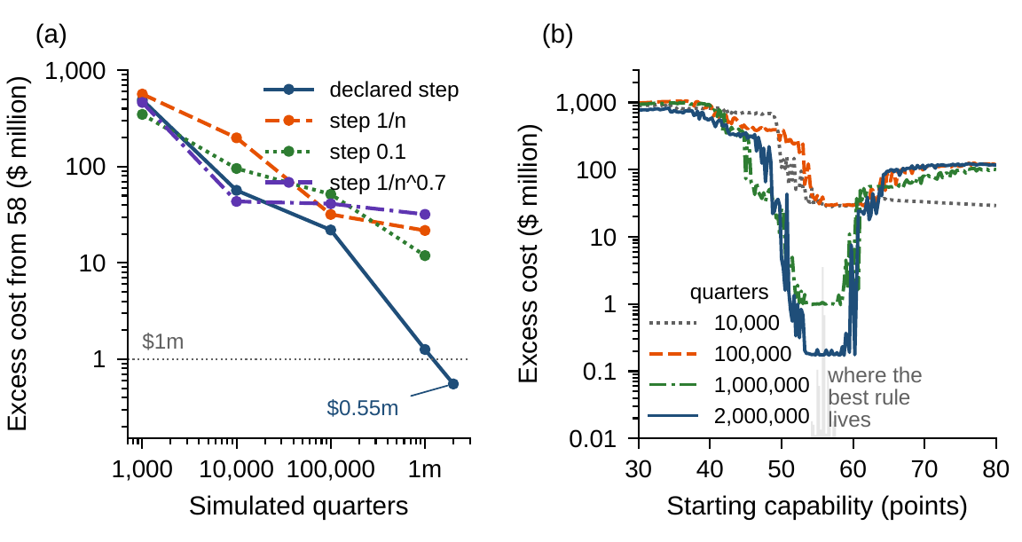
The agent's rule is good where the company goes
§14.2 · FIGURE 14.1
(a) Ten agents' rules cost $493.4m, $56.7m, $22.0m, $1.26m and $0.55m more than the best after 1,000 to two million quarters
Nine of ten end within $1m; after a million quarters other step sizes leave $11.9m to $31.9m
(b) One agent's rule, by starting capability: poor where Meridian never goes, close to the best where the best rule lives
Two million quarters is half a million years; with the law, policy iteration needs three evaluations
Figure 14.1. (a) Q-learning in a simulator of Chapter 7's law: excess cost from 58 against simulated quarters, by step size. (b) One agent's excess by starting capability; shaded, where the best rule lives.
Notes:
Figure 14.1 and Worked Example 14.1, Step 2. By 100,000 quarters the agents have tried 2,104 of the 2,113 decisions; their decision values are still wrong by $615.6 million at low capabilities, where they seldom went (Online Appendix Example 14.B.2).

Slide 9
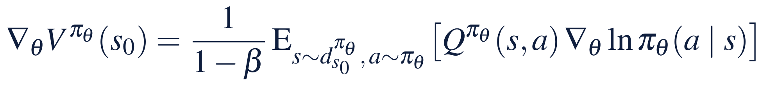
Gradients improve a rule where it goes
§14.2 · PROPOSITION 14.1 · TABLE 14.2
Methods of learning by acting
PROPOSITION 14.1
Improving a Rule
Q-learning with a table: the best rule in the limit; watch untried pairs
Fitted and deep Q-learning: scale; watch divergence
Policy gradient, actor–critic: ascent on the value; watch local maxima
Bandit rules: regret like ln T; watch many options and drifting payoffs
Learn a simulator, then plan: watch records kept under one rule
(i) Performance difference. One rule's value less another's is 1/(1 − β) times its discounted advantage where it goes: changing a rule where it never goes changes nothing
(ii) Policy gradient. For smooth randomized rules the gradient averages Q times the gradient of the rule's log-chances; a baseline leaves it unchanged
(iii) Local maxima. When rules cannot tell states apart, gradient steps can stop at a rule that only its neighbours cannot beat
Notes:
Proposition 14.1; formal statement and proof in Online Appendix 14.B. Table 14.2 lists the methods and what they promise. Part (i) is why the AI team's rule can be poor where Meridian never goes and still cost little from 58. Part (ii) drives actor–critic methods, proximal policy optimization, and the fine-tuning of language models from human preferences. Part (iii) is a caution for a board told that a learned rule 'has converged'.

Slide 10
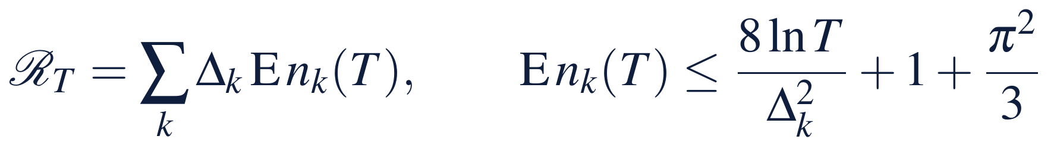
Exploration has a price no learner escapes
§14.3 · THEOREM 14.2
Meridian's thirteen target rules
THEOREM 14.2
The Price of Exploration
Tried a decade at a time from 58, the best target, 55.75, beats its neighbours by $0.16m and $1.01m
A decade's cost has a standard deviation of about $12m
Over 20,000 decades optimism ends on the best target in 84% of runs, greedy choice in 20%
Twenty thousand decades is 200,000 years; on the company the price is paid in money
(i) Regret. Every trial of a worse option costs its shortfall
(ii) Greed fails. Always taking the best average can stop trying the best option after one unlucky trial: regret grows in proportion to T
(iii) Optimism works. The largest average plus √(2 ln t/n), n an option's trials so far, tries each worse option at most 8 ln T/Δ² + 1 + π²/3 times on average
(iv) No learner does better. Regret grows at least like ln T
Notes:
Theorem 14.2; formal statement and proof in Appendix 14.A. Part (iv) is a law of learning, not a weakness of a method: whoever learns by trying pays at least a logarithm of the trials. Lai and Robbins proved the lower bound; Auer, Cesa-Bianchi and Fischer the optimistic rule's bound. The optimistic rule's bonus is scaled to the decades' spread.

Slide 11
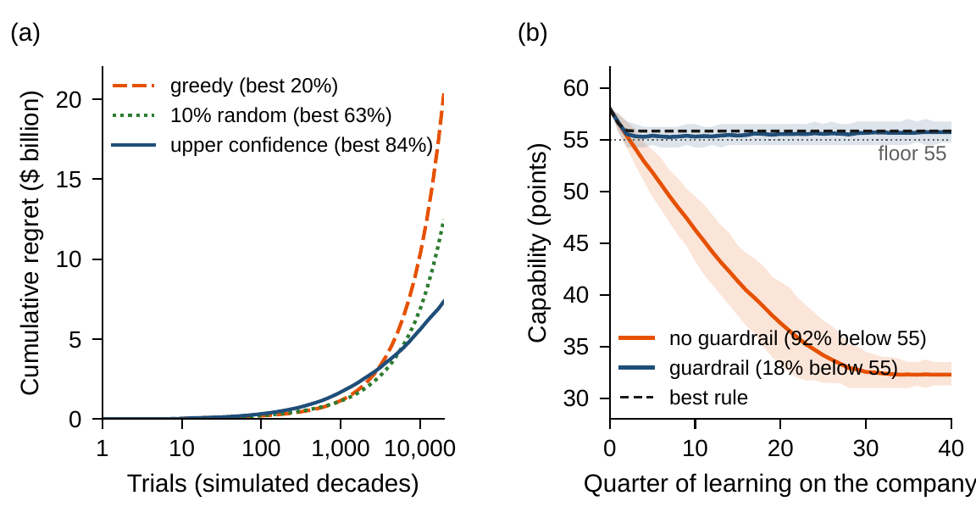
On the company, exploration is paid in money
§14.3 · FIGURE 14.2
(a) Over the last 2,000 decades greedy choice still loses $1.01m a decade, one random target in ten $0.55m, optimism $0.15m
(b) Learning on Meridian from its software's defaults, the agent hires nothing in every capability it has not yet seen
Capability falls to 32 points in ten years; inside the guardrail it ends at 55.7
Figure 14.2. (a) Choosing among thirteen target rules a decade at a time: cumulative regret, the mean of 100 runs. (b) Learning on the company for 40 quarters from 58, without and with the guardrail.
Notes:
Figure 14.2 and Worked Example 14.1, Steps 3 and 5. Starting untried decisions at zero makes every untried decision look best, and ties go to hiring nothing. Optimism that pays in a bandit is ruinous when every new state invites a new trial.

Slide 12
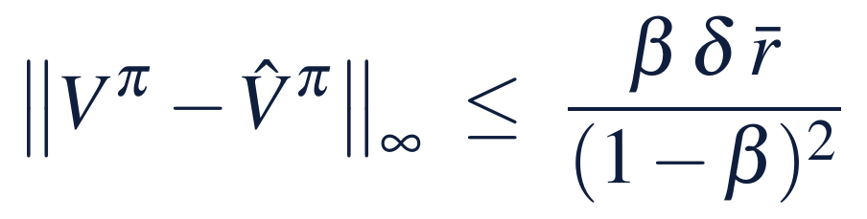
Learn the outside events, not the decisions
§14.4 · THEOREM 14.3
Meridian's simulators
THEOREM 14.3
Learning with a Simulator
Part (i)'s bound is about $88 billion times δ: consistency, not a forecast
Learned from 40 quarters of swings, the simulator's rule costs $0.30m more than the best on average
Fitted to records kept under Volume I's rule, a point hired moves capability by −4.5 to 5.4 points (truth 1)
In 66 of 200 such records the simulator recommends the worst rule there is
(i) What a wrong simulator costs. A law within δ moves every rule's values by at most βδr̄/(1 − β)²; the simulator's best rule loses at most twice that
(ii) Learning the law of the outside events. Frequencies from n independent periods are within δ with probability at least 1 − (2^{k} − 2)e^{−2nδ²}
(iii) A record kept under one rule. Laws that agree on the decisions it took give the record the same law: no method learns what other decisions do
Notes:
Theorem 14.3; formal statement and proof in Appendix 14.A. Kearns and Singh gave the simulation lemma, Weissman and coauthors the deviation of a learned law. Part (ii) is the cheap route, because the engineering office's record of swings is a record of an outside event, not of the board's decisions.

Slide 13
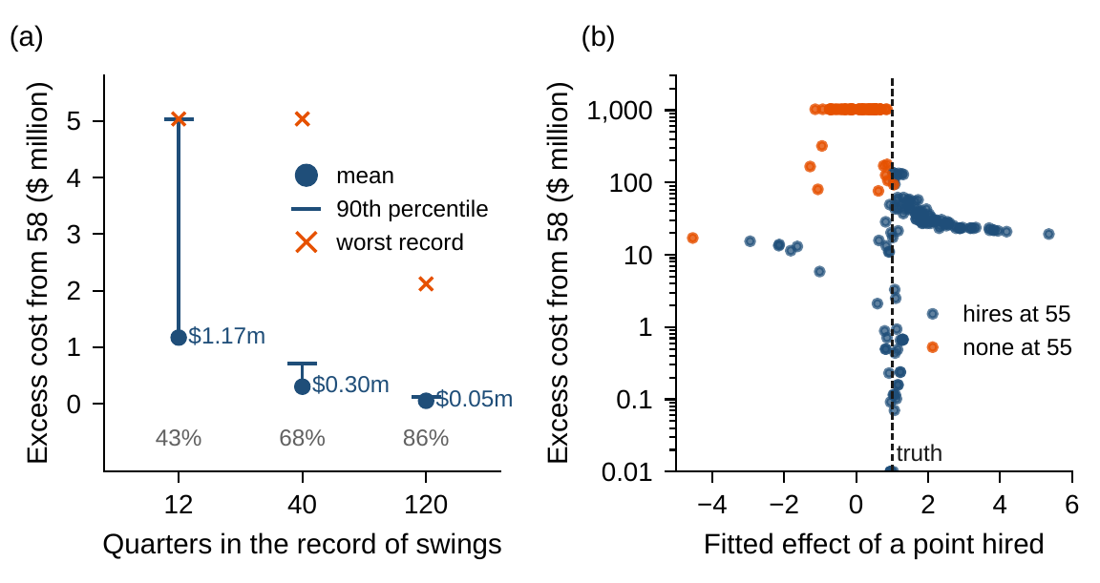
A record kept under one rule misleads
§14.4 · FIGURE 14.3
(a) From 12, 40 and 120 quarters of swings: $1.17m, $0.30m and $0.05m on average; the best rule in 86, 137 and 171 of 200 records
(b) Under Volume I's rule hiring moved with capability, so a regression cannot tell their effects apart
Its rule costs a median $42.7m more, within $1m in only 28 records, and $1,029.7m in 66
Figure 14.3. (a) Simulators that learn the law of the swings from 12, 40 or 120 quarters. (b) Simulators fitted to 40 quarters kept under Volume I's rule: the effect of a point hired against excess cost.
Notes:
Figure 14.3 and Worked Example 14.1, Step 4. Offline learning from logged decisions meets the same wall; the repair is a record that tried other decisions, or a declaration (Section 14.4).

Slide 14
Guardrails and certificates keep the commitments
§14.5 · DEFINITION 14.2 · PROPOSITION 14.2
Meridian's guardrail
PROPOSITION 14.2
Guardrails and Certificates
Never plan below 55 unless hiring at the cap: 1,152 of 2,113 decisions, the best rule among them
The worst rule inside it costs $142.8m more than the best; outside it, $1,029.7m
The agent that loses $545.5m learning on the company loses $1.2m inside it
A language model's plan or an expert system's rules is a declaration to be checked
(i) Guardrails. One that holds a best decision in every state costs nothing at the optimum; whatever a learner does inside it, it does no worse than the worst rule there
(ii) Certificates. A proposed rule's value is one linear solve; values whose Bellman residual is e lie within e/(1 − β), and their greedy rule loses at most 2βe/(1 − β)
(iii) The optimizer's curse. The best of K noisy estimates overstates the adopted proposal's value; a fresh estimate does not
A certificate is a computation the board can check without trusting the source: the exact value, every commitment checked, and a bound on what any other rule could add
Notes:
Definition 14.2 and Proposition 14.2; formal statement and proof in Online Appendix 14.B. A fluent proposal can be wrong. For a convex program, a proposed plan comes with its own proof when it comes with prices whose dual value matches its value (Theorem 3.4(iii)). Part (iii) is Chapter 13's warning about many candidates, now for rules.

Slide 15
Coordinate many agents by a price
§14.5 · DEFINITION 14.3 · PROPOSITION 14.3
The Online Appendix's examples
PROPOSITION 14.3
Many Agents
Two agents paid only for differing agree in every round, earning 0, as their frequencies approach ½
Two units that share or hoard: both hoard, worth 2 to the company against 6
Shapley's example cycles forever: agents trained against one another need not settle
Coordinate units by a price the center computes and certifies
(i) Equilibria exist, in randomized decisions; for discounted stochastic games, in stationary randomized rules
(ii) Learning need not settle. In fictitious play the frequencies approach equilibrium in zero-sum and common-value games, yet the play can miscoordinate every round; elsewhere they can cycle
(iii) Prices coordinate; selfish agents need not. The price that clears a shared resource makes the units' choices the company's best plan; without it, selfish units can do worse
Notes:
Definition 14.3 and Proposition 14.3; formal statement and proof in Online Appendix 14.B. Part (iii) is the framework's answer, the one Part I gave for capital. The author's papers study equilibria of many agents who watch one another: institutions that track their peers and guard against tail risk allocate in a mean-field equilibrium.

Slide 16
Should an agent learn Meridian's hiring rule?
WORKED EXAMPLE 14.1 · THE SITUATION
Digital Solutions' AI team
Chief human resources officer
The audit committee
An agent that learns the rule by itself
Should we let it?
What must it show before adoption?
Without being told the law of the swings, and learning on as the company changes.
Chapter 7's rule plans capability to 55.75 each quarter, at $230.8m of cost from 58.
An exact price under the declared model, and the guardrail checked at every capability.
The board adds a guardrail: never plan below 55 unless hiring at the cap.
Notes:
Worked Example 14.1, the situation. The agent reads capability in quarter-points and hires in quarter-point steps; it knows the costs, $4 million a point hired and $1.6 million a point-quarter short, and the discount, but not the law of the swings. It takes a random decision one time in ten, uses the step size 1/(1 + (1 − β)n), and starts untried decisions at zero, its software's default.

Slide 17
Six steps from a simulator to a certificate
WORKED EXAMPLE 14.1 · STEPS 1–6
1
Declare the agent and its world
2
Learn by trial in a simulator
3
The price of exploration
201 levels, 2,113 decisions. The best rule on this grid costs $231.18m from 58; the guardrail keeps 1,152.
$493.4m above the best after 1,000 quarters, $1.26m after a million, $0.55m after two million.
Greedy learners stall at $121.2m. Optimism ends on the best target in 84% of runs, greedy choice in 20%.
4
Learn the simulator instead
5
Learn inside a guardrail
6
Certify before adopting
From 40 quarters of swings: $0.30m. Fitted to practice: $42.7m in the median, the worst rule in 66 records.
On the company: $545.5m lost, 92% of quarters below 55. Inside the guardrail: $1.2m, at most $142.8m.
Ten rules cost $0.17m to $1.40m more; each breaks the guardrail at 74 to 84 levels. Three or four evaluations.
Notes:
Worked Example 14.1, Steps 1-6; Online Appendix Example 14.B.2. Step 1: the best rule on the quarter-point grid costs $0.42 million more than Chapter 7's, targets planned capability of about 55.85, and starts 5.8 percent of quarters below the floor. Step 6: the breaches all lie below 54.5, where the best rule spends at most 2.8 percent of its quarters; policy iteration from any learned rule reaches the best rule.

Slide 18
What each learner learned, priced exactly
WORKED EXAMPLE 14.1 · TABLE 14.3
Learner | Experience | Excess (mean) | 90th pct | Below floor (%)
Best rule (declared law) | none | 0 | 0 | 5.8
Volume I's rule (hold 58) | none | 15.37 | – | 0.0
Q-learning, simulator | 10,000 quarters | 56.69 | 86.11 | 50.9*
 | 100,000 quarters | 21.97 | 31.63 | 7.9*
 | 1,000,000 quarters | 1.26 | 1.75 | 7.6*
 | 2,000,000 quarters | 0.55 | 0.73 | 7.8*
Greedy, pessimistic start | 100,000 quarters | 121.19* | 133.51† | 99.5*
Simulator from swings | 12 quarters | 1.17 | 5.04 | 5.8*
 | 40 quarters | 0.30 | 0.71 | 5.8*
 | 120 quarters | 0.05 | 0.12 | 5.8*
Simulator from practice | 40 quarters | 42.70* | 1,029.74 | 8.3*
On the company | 40 quarters | 545.54 | 622.59 | 92.2
On the company, guardrail | 40 quarters | 1.18 | 19.04 | 17.8
Excess: cost from 58 above the best rule's $231.18m, $ million; the mean (* median) and 90th percentile over agents, records or companies († the largest of 20). Below floor: long-run share of quarters below 55, or over the 40 quarters on the company.
Notes:
Table 14.3. Ten agents learn in the simulator, 200 records feed each simulator, and 400 companies learn on the company. Inside the guardrail the agent spends 18 percent of quarters below the floor, against 5.8 percent for the best rule, and ends at 55.7.

Slide 19
Learn the law, guard the company, certify
WORKED EXAMPLE 14.1 · WHAT THE BOARD SHOULD TAKE AWAY
$545.5m
$1.2m
1,000,000
lost over ten years by an agent learning on the company from its software's defaults
lost by the same agent inside the guardrail, which costs nothing at the best rule
simulated quarters to approach a rule dynamic programming computes at once from the same law
Learn the law of the swings from the engineering office's record, never the effect of hiring from a record kept under one rule
Let any agent act only inside the guardrail, and adopt its rule only after exact evaluation
For discussion: who should own the agent's defaults, the AI team or the board? What should the guardrail be if the floor itself were uncertain?
Notes:
Worked Example 14.1, what the board should take away, and the discussion questions. With the law declared, the agent adds nothing that Chapter 7's recursion does not compute at once; its use is where no law is declared, and there it is the agent's simulator that must be certified.

Slide 20

Learning a rule by trial, in AXIOM
AXIOM LAB 2.14 · MODULE AXIOM-14
Digital Solutions' AI team proposes an agent that learns Meridian's hiring rule by acting. The chief human resources officer and the audit committee must decide whether, where, and within what limits it may learn. Open AXIOM, choose Lab 2.14 and load the Meridian hiring instance.
1
2
3
4
5
Benchmark
Train by trial
Price exploration
Learn a simulator
Learn on the company
Solve the declared program by policy iteration: the best rule, its cost, the guardrail.
Q-learning in the simulator to a million quarters with several step sizes; price each rule.
Greedy, randomized and optimistic choice among the target rules.
Learn the swings from 12, 40 and 120 quarters; fit the dynamics to practice.
Forty quarters with and without the guardrail, against the worst rule inside it.
Deliverable: a one-page note to the board: whether and where the agent may learn, the guardrail and what it costs, the certificate the audit committee requires, and the records the engineering office should keep. About 75 minutes.
Notes:
AXIOM Lab 2.14. What to look for: slow convergence, and a rule good where the company goes while its values are wrong elsewhere (Theorem 14.1); greedy learners that stop exploring (Theorem 14.2(ii)); regret that grows like a logarithm for the optimistic rule (Theorem 14.2(iii)); a cheap simulator from the swings and a misleading one from practice (Theorem 14.3); and the guardrail's bound (Proposition 14.2(i)).

Slide 21
What to carry forward
KEY TAKEAWAYS
1
Learning from acting writes the decision as a decision process; each decision changes the data that follow, so the learner must choose what to try.
2
Learning by trial finds the best rule if every decision keeps being tried and the steps shrink at the right pace, but slowly; errors count where the rule goes, and untried decisions, constant steps, and fitted values off the rule's path break it.
3
Exploration has a price: greed can lose in proportion to the trials, optimism only in their logarithm, and no learner does better. On the company the price is paid in money.
4
A simulator learned from records of the outside events makes trials cheap and improves as the record grows; a record kept under one rule cannot reveal what other decisions do.
5
A guardrail that holds a best rule costs nothing and caps the damage; every proposal is certified under the declared model, and many agents are coordinated by a price. Meridian's agent would lose $545.5 million learning on the company, and $1.2 million inside the guardrail.
Notes:
Key Takeaways, Chapter 14.

Slide 22
Notebook and workbook reproduce the book
THIS WEEK'S LABORATORY
211
115
26214
AXIOM-14
notebook checkpoints, every one PASS
workbook checks against the engine, ALL PASS
the lab's seed
AXIOM Lab 2.14
Notebook DCT_V2_Ch14_Lab.ipynb: Worked Example 14.1 and the lab's five steps in eight panels, with the book's seeds, ready for Colab
Workbook DCT_V2_Ch14_Lab.xlsx: the grid and the guardrail, one Bellman step at 201 levels, the learners' summaries, the regret decomposition and Table 14.3, in formulas
Notes:
The notebook and workbook are on the course website, www.dynamiccorporatetransformation.com.

Slide 23

Next, the enterprise's digital twin
NEXT · CHAPTER 15
This chapter learned rules by acting and judged every learned rule exactly under the declared model
Whoever proposes a rule, an agent, a language model or an expert system, the board checks it with a certificate and keeps it inside a guardrail
Chapter 15, Enterprise Digital Twins and Autonomous Enterprise Transformation, continues Part IV
Notes:
The inequality is the certificate of Proposition 14.2(ii): values whose largest Bellman residual is e lie within e/(1 − β) of the best values (Theorem 7.3(ii)). Chapter 15, Enterprise Digital Twins and Autonomous Enterprise Transformation, is the next chapter of Part IV, Multi-Objective and Intelligent Enterprise Optimization.

