Slide 1
Multi-Objective Enterprise Optimization
VOLUME II · CHAPTER 12 · WEEK 13
Part IV opens: when a program has several owners, compute the frontier first, read its prices, and make the choice second
Graduate course companion · Lab seed 26212 · AXIOM Lab 2.12 (AXIOM-12)
Notes:
Volume II, Chapter 12. Parts I-III optimized one objective at a time; boards rarely have one. A chief financial officer counts payouts, a chief operating officer savings, a treasury the cash it keeps in reserve. The chapter computes the frontier first and makes the choice second (abstract).

Slide 2
“Nothing in life is as important as you think it is, while you are thinking about it.”
Daniel Kahneman
Nobel Memorial Prize in Economic Sciences 2002; “Focusing Illusion,” Edge (2011)
Notes:
Kahneman's focusing illusion: whichever objective an owner is thinking about looks like the one that matters. The chapter declares all three owners' objectives before any weighting (Section 12.1).

Slide 3
After this chapter, you can
LEARNING OUTCOME STATEMENTS
12.1
Explain why a transformation program is a vector problem, and tell efficient plans from dominated ones.
12.2
Compute a Pareto frontier: its existence, its characterization by bounds on all objectives but one, and the ideal and nadir points.
12.3
Read prices on a frontier: what weighted sums reach and miss, and multipliers as rates at which owners trade.
12.4
Choose on a frontier with preferences, goals, and reference points, and avoid the dominated answers goals can return.
12.5
Compute frontiers in practice, and read Part III's appetites as frontiers between cost and safety.
Notes:
The five learning outcome statements; LOS Guidance at the end of the chapter.

Slide 4
Five sections, a worked example and a lab
ROADMAP
§12.1
§12.2
§12.3
§12.4
One Program, Several Owners
Prices on a Frontier
Choosing on the Frontier
Computing Frontiers
Definition 12.1 · Table 12.1 · Theorem 12.1
Definition 12.2 · Theorem 12.2 · Figure 12.1
Theorem 12.3 · Proposition 12.1
Proposition 12.2 · Table 12.2
§12.5
Worked Example 12.1
AXIOM Lab 2.12
Frontiers under Uncertainty
Whose Objective Runs the Automation Program?
Frontier First: Payouts, Savings, and the Reserve
Proposition 12.3
Table 12.3 · Figures 12.2–12.3
AXIOM-12 · five steps
Notes:
Formal statements and proofs of Theorems 12.1-12.3 are in Appendix 12.A; Propositions 12.1-12.3, how Meridian's frontier is computed (Remark 12.B.1) and every number of the Worked Example and the figures (Example 12.B.2) are in Online Appendix 12.B.

Slide 5
A single value hides an agreement nobody made
§12.1 · DEFINITION 12.1 · TABLE 12.1
 | One objective (Chapters 2–11) | A vector of objectives (this chapter)
Declares | one criterion, others as commitments | each owner's criterion
Answer | a best plan | the efficient plans, then a choice
Prices | multipliers of the commitments | rates of trade between owners
Who chooses | whoever wrote the objective | the board, after seeing the frontier
Fails when | the weights inside the objective are wrong | the frontier is skipped and a weighting assumed
Definition 12.1: a plan is efficient when no plan is at least as good for every owner and better for one; the efficient vectors form the Pareto frontier.
Notes:
Definition 12.1 and Table 12.1. Chapter 5's value added the payouts and the year-6 savings at a fixed rate and ignored the treasury's reserve; a vector problem keeps the three owners' objectives apart. The ideal point holds each objective's best value; the nadir, each one's worst over the efficient plans.

Slide 6
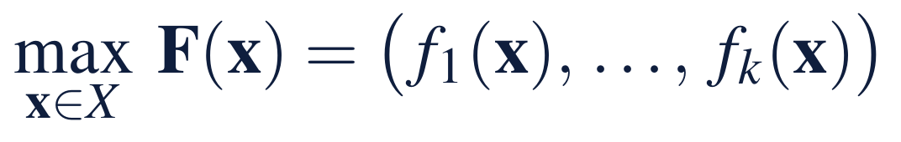
Efficient plans exist, and bounds trace them all
§12.1 · THEOREM 12.1
Meridian's three owners
THEOREM 12.1
Pareto Frontiers
CFO: the payouts' present value; COO: year-6 savings; treasury: a reserve on every commitment
No reserve: all 64 schedules keep the commitments; 59 are dominated, 5 efficient
One round is dominated by two, which pays more and saves more
The ideal, $384.17m of payouts with $137.81m a year, is out of reach
(i) Existence. On a closed bounded set efficient plans exist, and every plan is efficient or dominated by one
(ii) Bounds on all but one. A plan is efficient exactly when it maximizes each objective given the others; no convexity needed
(iii) The ideal point. Reached only when the frontier is that single point; otherwise every efficient plan gives something up
Notes:
Theorem 12.1; formal statement and proof in Appendix 12.A. Part (ii) is how boards already speak: maximize payouts, provided savings reach $122.5 million a year and the reserve $50 million. Jensen's single objective, with the other owners' claims as constraints, is one point of a frontier, picked by the bounds.

Slide 7
Weighted sums reveal prices but miss the dents
§12.2 · DEFINITION 12.2 · THEOREM 12.2
Meridian's prices
THEOREM 12.2
Weighted Sums and Trade-Off Prices
Chapter 5's value is a weighted sum: a dollar a year of savings at 1.1⁻⁶/0.10 = $5.645
Its answer, three rounds, is efficient; a board valuing savings more would run more rounds
The reserve's multiplier: $0.909 of payouts per dollar
Whole rounds and the reserve make dents that weights skip
(i) Weighted sums with positive weights find efficient plans
(ii) The convex case. Every weakly efficient plan maximizes some weighted sum
(iii) Dents. If an average of plans beats a plan in every objective, no weights pick it
(iv) Prices. The bounds' multipliers are the slopes of the trade-off surface: the rates at which owners trade
Notes:
Theorem 12.2 and Definition 12.2; formal statement and proof in Appendix 12.A. The price is a declaration like any other. Plans just past a jump in cost are efficient, yet a weighted sum skips them for the plans on either side (Figure 12.2); only bounds and reference points reach them.

Slide 8
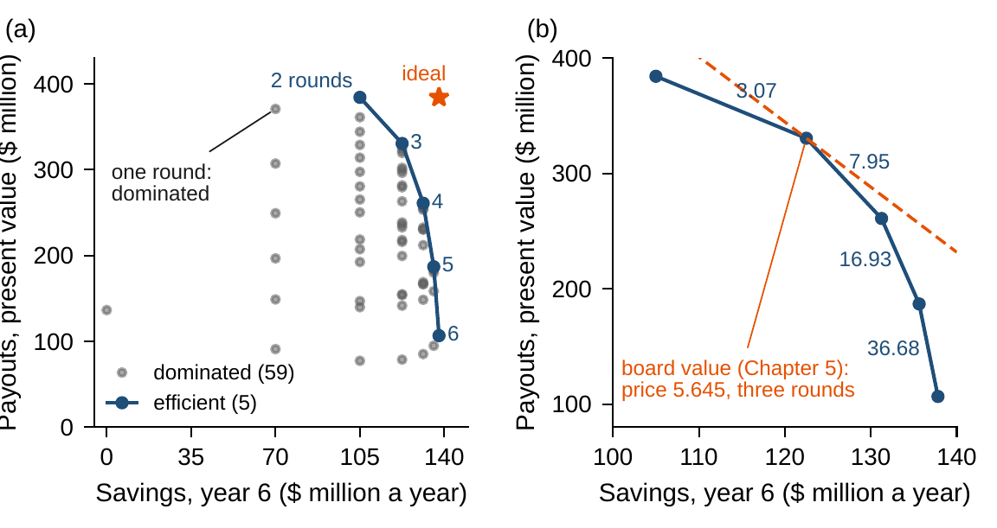
Five efficient plans, four prices between them
§12.2 · FIGURE 12.1
(a) Of 64 schedules of whole rounds, 59 are dominated; two to six rounds are efficient
(b) A dollar a year of savings costs $3.07, $7.95, $16.93 and $36.68 of payouts
The board's $5.645 touches the frontier at three rounds: $1,021.93m
Below $3.07 a board would pick two rounds; above $7.95, four
Figure 12.1. (a) The 64 schedules with no reserve: savings in year 6 against the payouts' present value. (b) Prices between neighbouring efficient plans, and Chapter 5's board value at $5.645.
Notes:
Figure 12.1 and Worked Example 12.1, Steps 2-3. Online Appendix Example 12.B.2: two to three rounds give up 53.72 for 17.5 a year; three to four 69.57 for 8.75; four to five 74.06 for 4.375; five to six 80.23 for 2.1875. Board values: 976.87, 1,021.93, 1,001.75, 952.39 and 884.51.

Slide 9

A reference point reaches every efficient plan
§12.3 · THEOREM 12.3
The augmented Chebyshev program: the least largest weighted shortfall from an aspiration
Theorem 12.3. Its solutions are efficient; with the reference above the ideal, every efficient plan is chosen for some weights, the plans in dents included
Equal weights, shortfalls as shares of the ranges: years 1, 2 and 4 with a $92m reserve, $242.80m, a plan no prices reach
The CFO weighted twice: two rounds with a $96m reserve, $296.90m
Notes:
Theorem 12.3; formal statement and proof in Appendix 12.A. Bowman showed that Chebyshev programs reach every efficient plan; Wierzbicki built decisions on reference points. Online Appendix Example 12.B.2: shortfalls 0.390, 0.226 and 0.387 with equal weights; 0.482, 0.484 and 0.360 with the CFO's weight doubled; rho = 0.0001.

Slide 10
Targets that can all be met need a second stage
§12.3 · PROPOSITION 12.1
Goals alone: years 1, 2, 5
A second stage: years 1–3
$300.00m
$307.72m
paid: just the goal, of $300.05m available
<
the most payouts among plans meeting every goal
991.48
999.21
board value: a dominated plan
board value: $7.72m more paid out
Proposition 12.1(ii). When goals can all be met, every plan meeting them is a solution, dominated ones too
Goals: payouts of $300m, savings of $122.5m a year, a $25m reserve; three schedules meet them
A second stage that maximizes a strictly increasing preference returns an efficient plan
Notes:
Proposition 12.1; formal statement and proof in Online Appendix 12.B. Hannan showed goal programming's dominated solutions and their remedy, a second stage; Simon's satisficing is goal programming without it. Worked Example 12.1, Step 5; LOS Guidance 12.4: the first answer leaves $7.72 million unpaid.

Slide 11
Sweeping weights finds only the supported plans
§12.4 · PROPOSITION 12.2
Meridian's frontier, computed
PROPOSITION 12.2
Computing Frontiers
9,664 payout programs, each solved by HiGHS in under two milliseconds
740 efficient plans, one small program each to test support: about 20 seconds
453 supported; 287 in dents, with reserves from $86m to $149m
Evolutionary archives are galleries: check them by bounds
(i) Bracketing. With two objectives, bounds at rising levels box the frontier
(ii) Hypervolume. On a finite set, the m points that dominate the most hold only efficient points
(iii) Weights are not enough. Sweeps find supported plans; dents need bounds or reference points
(iv) Evolutionary search. An archive that keeps every undominated plan ends with the efficient set
Notes:
Proposition 12.2 and the Computational box of Section 12.4; formal statement and proof in Online Appendix 12.B. The previous edition claimed that a bounded hypervolume archive converges to the whole frontier; it cannot, and the V56 statement is for an unbounded archive on a finite set. The course notebook illustrates parts (iii) and (iv) with the lab's own seed, 26212.

Slide 12
Five methods: what each finds, what to watch
§12.4 · TABLE 12.2
Method | Finds | Guarantee | Watch for
Weighted sums | supported plans; prices | efficient for positive weights (Theorem 12.2) | dents
Bounds (ε-constraints) | every efficient plan; the trade-off surface | exact characterization (Theorem 12.1) | ties: solutions only weakly efficient
Reference points | every efficient plan, by aspiration | complete, with no convexity (Theorem 12.3) | reference points below the ideal
Goal programming | a plan that meets targets | efficient after a second stage (Proposition 12.1) | targets that can all be met
Evolutionary search | a gallery of plans | statistical, not certified (Proposition 12.2) | archives that forget
Notes:
Table 12.2. Evolutionary methods, NSGA-II and MOEA/D among them, earn their keep when plans cannot be enumerated and each evaluation is a simulation; their archives are galleries, to be checked by bounds before the board relies on them (Section 12.4).

Slide 13
An appetite is a point on a cost–safety frontier
§12.5 · PROPOSITION 12.3 · FIGURE 10.3
Proposition 12.3(i). The least cost never rises with the appetite; its slope is the appetite's price
$12.35m at 4%, $10.44m at 5%, $8.82m at 6%: a point is worth about $1.6–1.9m
(ii) A family of laws never lowers it: Chapter 11's records' family, $24.00m at 5%
(iii) With CVaR the frontier is convex; the chance itself can have dents
Notes:
Proposition 12.3; formal statement and proof in Online Appendix 12.B. Chapter 9's frontier is printed in Online Appendix Example 10.B.2 and drawn in Figure 10.3; the records' family is Worked Example 11.1's. LOS Guidance 12.5 reads $12.35 million at 4 percent and $10.44 million at 5 as about $1.9 million a point.

Slide 14
Whose objective runs the automation program?
WORKED EXAMPLE 12.1 · THE SITUATION
The chief financial officer
The chief operating officer
The treasury
Pay more, sooner
Run all six rounds
Keep a reserve
Judges a plan by the present value of its payouts at the 10 percent hurdle rate.
Judges a plan by the run-rate savings it leaves in year 6.
Judges a plan by the cash it keeps above every one of the board's commitments.
Chapter 5's one value chose three rounds in years 1–3, $1,021.93m. The board asks to see the choices.
Notes:
Worked Example 12.1, the situation. The program is Chapter 5's: a round costs $120 million and halves the gap to 85 points of efficiency; savings are $10 million a year per point above 71; cash must stay above $350 million, reach $470 million before a round, and end at $470 million. Three rounds paid $455 million.

Slide 15
Frontier first, then prices, reserve and choice
WORKED EXAMPLE 12.1 · STEPS 1–5
1
Write the vector problem
2
The frontier first
3
Prices, and the choice
Chapter 5's program; three objectives: the payouts' value, year-6 savings, and the reserve b on every commitment.
All 64 schedules feasible, 59 dominated. Five efficient, from $384.17m with $105m a year to $106.59m with $137.81m.
$3.07, $7.95, $16.93 and $36.68 per dollar a year; the board's $5.645 picks three rounds.
4
The treasury's reserve
5
Choice second
$0.909 a dollar. Above $85m and $100m the rounds move later, at $4.02m and $24.38m more; 287 plans sit in dents.
Equal aspirations: years 1, 2, 4 with $92m, $242.80m. Goals pay $300.00m; a second stage, $307.72m.
Notes:
Worked Example 12.1, Steps 1-5; Online Appendix Example 12.B.2. Step 3: a price below $3.07 would choose two rounds, and one above $7.95 four. Step 4: on a $1 million grid of reserves, 740 plans are efficient; 287 of them maximize no weighted sum with positive weights.

Slide 16
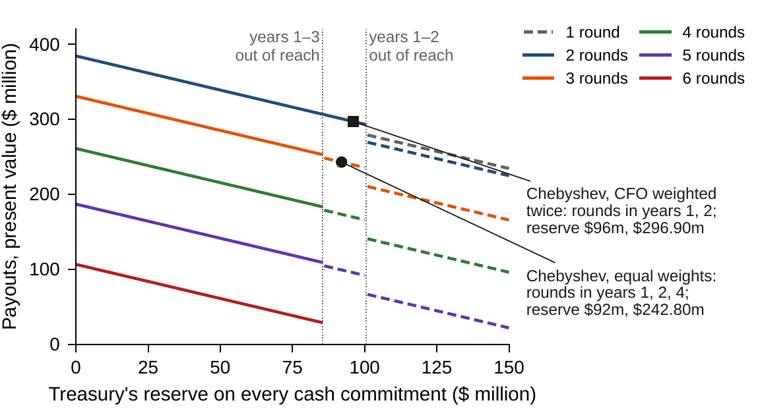
A reserve costs $0.909 until the rounds move
WORKED EXAMPLE 12.1 · FIGURE 12.2
Each dollar of reserve is a year-1 payout held back: $0.909
Above $85m, rounds in years 1–3 no longer fit; above $100m, rounds in years 1 and 2
The rounds move later, at $4.02m and $24.38m beyond the price
Dashed: plans in dents, efficient yet picked by no weights
Figure 12.2. Best present value of the payouts against the reserve, by number of rounds: solid where some positive weights pick the plan, dashed where none do; the two Chebyshev choices marked.
Notes:
Figure 12.2 and Worked Example 12.1, Step 4. Online Appendix Example 12.B.2: the best three-round plans are years 1-3 to $85 million (307.72 at 25, 285.00 at 50, 253.18 at 85), years 1, 2, 4 from 86 to 100 (248.25 at 86), and years 1, 3, 4 from 101 to 150 (210.23 at 101, 165.69 at 150). The figure's axis calls the reserve the treasury's buffer.

Slide 17
Plans by owner and by method of choice
WORKED EXAMPLE 12.1 · TABLE 12.3
Plan | Rounds (years) | Reserve | Payouts | Savings | Board value
CFO's best | 1, 2 | 0 | 384.17 | 105.00 | 976.87
COO's best | 1–6 | 0 | 106.59 | 137.81 | 884.51
Treasury's best | 1 | 150 | 234.31 | 70.00 | 629.44
Board value (Chapter 5) | 1–3 | 0 | 330.45 | 122.50 | 1,021.93
Chebyshev, equal weights | 1, 2, 4 | 92 | 242.80 | 122.50 | 934.28
Chebyshev, CFO twice | 1, 2 | 96 | 296.90 | 105.00 | 889.60
Goals, first answer | 1, 2, 5 | 25 | 300.00 | 122.50 | 991.48
Goals, second stage | 1–3 | 25 | 307.72 | 122.50 | 999.21
$ million; savings in $ million a year. Reserve: the amount by which every cash commitment is kept; payouts at their present value at 10 percent; board value: payouts plus savings at Chapter 5's price, $5.645.
Notes:
Table 12.3; Online Appendix Example 12.B.2. Each owner's own best optimizes that owner's objective first and the others after; the board's weighted sum is Chapter 5's value; the goals' first answer is dominated by the second stage's plan, the same savings and reserve with $7.72 million more paid out.

Slide 18
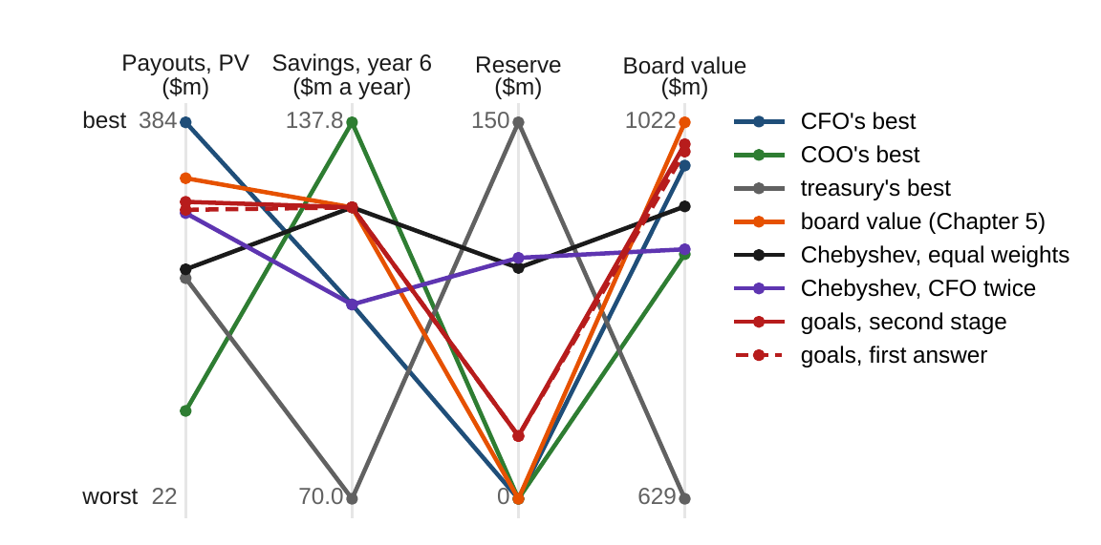
Aspirations reach a balanced plan in a dent
WORKED EXAMPLE 12.1 · FIGURE 12.3
Axes run from worst to best efficient value; board value 629.44 to 1,021.93
The owners' bests are extreme: the treasury's keeps $150m, saves $70m a year
Equal weights balance all three: shortfalls 0.39, 0.23, 0.39 of the ranges
The goals' first answer, dashed, is dominated by the second stage
Figure 12.3. Each plan's payouts, savings, reserve and board value: the owners' own bests, the board's weighted sum, the two Chebyshev choices and goal programming's two answers.
Notes:
Figure 12.3 and Worked Example 12.1, Step 5. The treasury's own best is one round in year 1 with a $150 million reserve, payouts 70, 70, 70, 70, 20 and 0, worth 234.31. The figure's axis calls the reserve the buffer.

Slide 19
The price, not the program, picks the rounds
WORKED EXAMPLE 12.1 · WHAT THE BOARD SHOULD TAKE AWAY
$5.645
$0.909
$7.72m
the board's price of a dollar a year of savings: three rounds; below $3.07 two, above $7.95 four
the price of a dollar of reserve, until the rounds move at $85m and $100m
left unpaid by goals that can all be met, without a second stage
No plan is best for all three owners, and five of the 64 schedules are worth discussing at all
Balanced plans beyond an $85m reserve are reachable only by stating aspirations
For discussion: which price of savings would you defend to the shareholders, and to the operating teams?
Notes:
Worked Example 12.1, what the board should take away, and the discussion questions: which price of savings would you defend to the shareholders, and to the operating teams? When should a board state aspirations rather than prices?

Slide 20

Payouts, savings and the reserve, in AXIOM
AXIOM LAB 2.12 · MODULE AXIOM-12
The board will not adopt a single measure until it has seen what each owner gives up. Open AXIOM, choose Lab 2.12 and load the Meridian automation instance: Chapter 5's program and the three owners' objectives.
1
2
3
4
5
Enumerate
Price the frontier
Bound the reserve
Choose
Add uncertainty
Solve the payouts for every schedule; plot payouts against savings; mark the dominated.
The price between neighbouring efficient plans, and the prices each wins.
Raise the reserve, read its multiplier, find where the rounds move.
Aspirations and weights for a Chebyshev choice; goals with and without a second stage.
Load Chapter 9's packages; read the price of the board's appetite.
Deliverable: a one-page note to the board: the efficient plans, the prices between them, the recommended plan with the prices or aspirations that select it, and what each owner gives up. About 75 minutes.
Notes:
AXIOM Lab 2.12. What to look for: dominated plans that nobody should propose; prices that decide between neighbouring plans; a reserve that costs $0.909 a dollar until a round moves; plans in dents that only aspirations reach; and goals that leave money on the table.

Slide 21
What to carry forward
KEY TAKEAWAYS
1
A transformation program has several owners and several objectives. Compute the frontier first: efficient plans exist, dominated plans can be discarded, and bounds on all objectives but one trace the frontier exactly.
2
Weighted sums find efficient plans and reveal prices, but reach only the frontier's supported part; bounds' multipliers are the rates at which owners trade.
3
Reference points reach every efficient plan, dents included; preferences strictly increasing in every objective choose efficient plans; goals need a second stage.
4
Frontiers are bracketed by bounds, summarized by hypervolume, and approximated by evolutionary search, which is statistical, not certified.
5
Part III's appetites are bounds on a cost–safety frontier, and their prices are its slopes (Proposition 12.3). For Meridian's program, the board's price of savings, $5.645 a dollar, decides between two, three, and four rounds.
Notes:
Key Takeaways, Chapter 12.

Slide 22
Notebook and workbook reproduce the book
THIS WEEK'S LABORATORY
260
206
26212
AXIOM-12
notebook checkpoints, every one PASS
workbook checks against the engine, ALL PASS
the lab's seed
AXIOM Lab 2.12
Notebook DCT_V2_Ch12_Lab.ipynb: Worked Example 12.1 and the lab's five steps in seven panels, every payout program solved
Workbook DCT_V2_Ch12_Lab.xlsx: the war chest raised by the reserve, the prices, every dent certified, the choices and Table 12.3, in formulas
Notes:
The notebook and workbook are on the course website, www.dynamiccorporatetransformation.com.

Slide 23

Next, models learned from the enterprise's data
NEXT · CHAPTER 13
Chapters 1–12 optimized declared models: dynamics, laws, families of laws, and owners' objectives
This chapter declared the objectives and chose on a frontier; the next learns models from data
Chapter 13, Machine Learning for Enterprise Transformation, continues Part IV
Notes:
Chapter 13 continues Part IV, Multi-Objective and Intelligent Enterprise Optimization: predictive models learned from the enterprise's data by regularized empirical risk minimization, and their place inside the optimization.

