Slide 1
Stochastic Enterprise Optimization
VOLUME II · CHAPTER 9 · WEEK 11
With a declared law, the objective becomes an expectation, a commitment a probability, and a decision a rule that reads what has happened
Graduate course companion · Lab seed 26209 · AXIOM Lab 2.9 (AXIOM-09)
Notes:
Volume II, Chapter 9, opens Part III. Part II steered with one declared future, or with outside events drawn from a short list; Part III declares the uncertainty itself, and this chapter takes the first declaration: a probability law (abstract).

Slide 2
“Probability is the most important concept in modern science, especially as nobody has the slightest notion what it means.”
Bertrand Russell
Nobel Prize in Literature 1950; lecture, 1929, as quoted by E. T. Bell (1945)
Notes:
Russell's remark frames the chapter: a probability law is a declaration, with an owner, like the floor and the hurdle rate (Section 9.1).

Slide 3
After this chapter, you can
LEARNING OUTCOME STATEMENTS
9.1
Explain what declaring a probability law adds to an enterprise optimization problem—expectations, probabilities, and information—and why the average path misleads.
9.2
Formulate a stochastic control problem, write its Hamilton–Jacobi–Bellman equation with the spread term, and certify a rule with the verification theorem.
9.3
Explain what outside events change in a linear–quadratic rule: certainty equivalence and its cost, gentler steering when the effect of decisions is uncertain, and harder steering when risk grows with the stocks or the law itself is in doubt.
9.4
Formulate commitments kept with a stated probability and decisions with recourse, and measure the value of information and of the rules that use it.
9.5
Compute with samples: estimate expectations and probabilities with their errors, solve by sample average approximation, and judge an answer on fresh draws with a margin.
Notes:
The five learning outcome statements; LOS Guidance at the end of the chapter.

Slide 4
Six sections, a worked example and a lab
ROADMAP
§9.1
§9.2
§9.3
§9.4
From One Future to a Declared Law
The Stochastic HJB Equation
What Outside Events Change in a Rule
Commitments Kept with a Stated Probability
Definition 9.1 · Table 9.1
Theorem 9.1
Theorem 9.2 · Proposition 9.1
Proposition 9.2 · Figure 9.1
§9.5
§9.6
Worked Example 9.1
AXIOM Lab 2.9
Rules, Recourse, and the Value of Information
Computing with Samples
Can a Rule Replace the Committed Delay?
Keeping Meridian's Appetite: Odds, Rules, and Samples
Proposition 9.3
Theorem 9.3 · Table 9.2 · Figure 9.2
Table 9.3 · Figure 9.3
AXIOM-09 · five steps
Notes:
Formal statements and proofs of Theorems 9.1–9.3 are in Appendix 9.A; Propositions 9.1–9.3, the numbers behind Worked Example 9.1 and the hiring loop with outside events in Online Appendix 9.B.

Slide 5
What a declared law changes
§9.1 · DEFINITION 9.1 · TABLE 9.1
 | One future (Chapters 5–8) | A declared law (this chapter)
Objective | the value of the path | its expected value; the average path is not a plan
Commitments | on the path | on every path, on average, or with a stated probability (Proposition 9.2)
Decisions | a plan, or a rule that reads the stocks | a rule that reads what has been revealed; information has a value (Proposition 9.3)
Value of a position | HJB equation (Theorem 8.1) | the same, plus half the spread priced at the value's curvature (Theorem 9.1)
Certificate | verification, limit condition | the same in expectation; no drift in the value ledger (Theorem 9.1(iii))
Computation | transcription, grids | samples: Monte Carlo, sample average approximation, fresh draws (Theorem 9.3)
Definition 9.1: a law and the information it reveals; stocks, rules, an expected objective, and commitments of three grades.
Notes:
Definition 9.1 and Table 9.1. A chance constraint requires a commitment to hold, at every review it covers, with probability at least 1 − α. The law is a declaration with an owner: for the digital program it was made in Volume I from the engineering office's and the treasury's records.

Slide 6
The average path is not a plan
§9.1 · VOLUME I, CHAPTER 8'S LAW
$460m
24.6%
5%
the average path's trough: it clears the $350m floor with room to spare
of the program's paths breach the floor with no levers
the board's appetite: the most it accepts, in some quarter of the program
Execution and market surprises: sd $50m a quarter, 60 percent carried into the next; funding-window closures about once a decade, removing $120m on average
The average of the outcomes is not the outcome of the average (Volume I, Theorem 8.5(ii))
Part III declares uncertainty three ways: a law (Chapter 9), a bounded set (Chapter 10), a family of laws (Chapter 11)
Notes:
Section 9.1. Volume I, Chapter 8 declared the law for Meridian's digital program (Volume I, Theorems 8.3 and 8.4). The three declarations of Part III pose different problems, with different answers (Volume I, Proposition 15.7).

Slide 7
Uncertainty is priced at the curvature
§9.2 · THEOREM 9.1
In Chapter 8's hiring loop
THEOREM 9.1
Stochastic HJB Theorem
The value −pd² is concave, p = 0.000904: spread lowers its average
HR's record: departures and early or late starts move the bench by 15 engineers a year
They cost σ²p = $0.20m a year, $2.13m in present value, whatever HR decides
The audit: along the best rule the ledger stays at $11.171m; under Volume I's cautious gain it drifts toward $13.70m
(i) Expected change. A smooth function of the stocks drifts at its slope times their drift plus half their spread times its curvature
(ii) The equation. Where the value is twice differentiable, it solves the equation above
(iii) Verification. A function satisfying it as an inequality bounds every rule; along the best rule, value earned plus the position's value has no drift
Notes:
Theorem 9.1, Equations 9.2–9.3; formal statement and proof in Appendix 9.A. A convex value gains from spread, which is why options are worth more when the future is more uncertain. The ledger numbers are in Online Appendix 9.B.3.

Slide 8
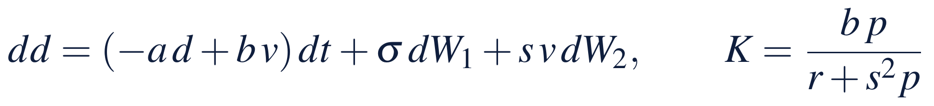
Three ways outside events enter a rule
§9.3 · THEOREM 9.2
The hiring loop, gain a year
THEOREM 9.2
Linear–Quadratic Rules under Uncertainty
Departures: the gain stays at 4.34; they cost $2.13m
A cohort's yield varies by 20 points (s = 0.10): 4.16; twice as uncertain: 3.68
Ignoring the yield's uncertainty costs only $0.01m, or $0.16m at twice it: the cost is flat near its best
Noise that grows with the gap (c = 0.5): 4.52
(i) The best rule is linear; the least cost is xᵀPx + tr(ΣᵀPΣ)/ρ
(ii) Certainty equivalence. Events that only add to the stocks change the cost, not the rule
(iii) Caution. If they make the effect of decisions uncertain, each decision costs more at the margin: steer more gently
(iv) Vigilance. If they grow with the stocks, deviations cost more: steer harder
Notes:
Theorem 9.2 and Equation 9.4; formal statement and proof in Appendix 9.A. Part (iii) is Brainard's principle: when the effect of a lever is uncertain, pull it less hard. The vigilance gain of 4.52 is in Online Appendix 9.B.3.

Slide 9
Distrust of the law also steers harder
§9.3 · PROPOSITION 9.1
4.66
5.07
6.55
the hiring gain a year at θ = 1, up from 4.34: guarding against a misjudged drift
at θ = 2: the gain rises with the penalty's weight
the breakdown point: past it no linear rule has a finite worst case
Proposition 9.1(i). Judging a cost by its entropic certainty equivalent is judging it by the worst expected cost over other laws, each charged its relative entropy at the rate 1/θ
Risk aversion and distrust of the declared law are two readings of one penalty (Hansen and Sargent)
At θ = 1 a distortion of one standard deviation a year is charged $0.5m a year; Chapter 11 builds on this
Notes:
Proposition 9.1; formal statement and proof in Online Appendix 9.B. The coefficient b²/r − 2θσ² turns negative at θ = 6.4, but the robust rule continues to the breakdown point 6.553, where p tends to 2q/β = 0.006822 and the gain to 32.7 (Remark 9.B.1; Online Appendix 9.B.3).

Slide 10
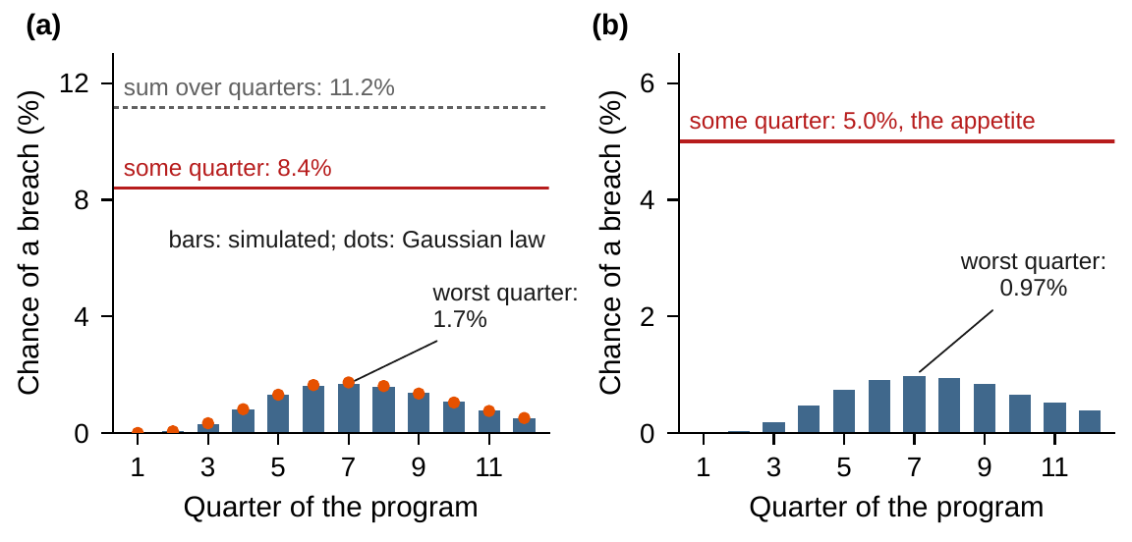
An appetite over 12 quarters is joint
§9.4 · PROPOSITION 9.2 · FIGURE 9.1
(i) A joint chance lies between the worst review's and the sum; α at each review does not keep it
(ii) Quantile form: the decision must reach the (1 − α)-quantile, its value at risk
(iii) CVaR of the largest shortfall at most zero: convex and safe
Surprises alone breach in some quarter on 8.4% of paths, in no single quarter on more than 1.7%; the sum is 11.2%
Volume I's package keeps 5.0% with no quarter above 0.97%
Figure 9.1. (a) Surprises only, no levers: each quarter's chance (bars simulated, dots Gaussian). (b) The full law under Volume I's package.
Notes:
Proposition 9.2 and Figure 9.1; formal statement and proof in Online Appendix 9.B. Each quarter's chance follows from the Gaussian law of Volume I, Theorem 8.3, as Theorem 3.6(v) would compute it; the joint chance needs the whole path. 100,000 paths of Volume I, Chapter 8's law.

Slide 11
Three readings of one appetite
§9.4 · PROPOSITION 9.2(II)–(III)
Quarter by quarter
Quantile (Volume I)
CVaR (convex, safe)
$1.86m
$10.44m
$18.31m
a $60m line and almost no delay
<
a $170m line, 0.67 quarter of delay
<
a $185m line, 1.6 quarters of delay
16.7%
5.0%
1.9%
chance of a breach in some quarter
the appetite, exactly
safe, at a price
Read quarter by quarter, the appetite is met in each quarter and missed over the program
Volume I's package sets the delay at the 95th percentile of the delays the paths need: exact, not convex
The convex safe version buys tractability and gives up $7.9m
Notes:
Section 9.4, Enterprise Interpretation; Online Appendix 9.B.2: quarter by quarter, l = 60, φ = 0.008, $1.86m, 16.69% (fresh 16.39%); CVaR, l = 185, φ = 1.596, $18.31m, 1.88% (fresh 1.85%).

Slide 12
Information is worth at most the gap
§9.5 · PROPOSITION 9.3
For Meridian's appetite
PROPOSITION 9.3
Recourse and the Value of Information
Volume I's package, decided today: $10.44m
A clairvoyant: $0.44m. Four paths in five need no lever; one in six needs some of the line
Perfect information is worth $10.0m: a bound, not a promise
A rule reads only what has happened; Worked Example 9.1 finds how little of it reading cash captures
(i) Ordering. Clairvoyant ≤ recourse ≤ here and now; revealing more never raises the least cost
The expected value of perfect information bounds what any information can be worth
(ii) Signals. Choose a package signal by signal, allotting the chance of a breach among the signals
(iii) The clairvoyant's bound. Each path its cheapest safe decision; the ⌊αN⌋ costliest paths breach
Notes:
Proposition 9.3; formal statement and proof in Online Appendix 9.B. Recourse is the stochastic programming name for decisions that respond to what has been revealed (Proposition 7.2(ii); Volume I, Theorem 15.4(iii)). Clairvoyant over lines $0–400m: $0.437m (Online Appendix 9.B.2).

Slide 13
Methods for computing with a declared law
§9.6 · TABLE 9.2
Method | Computes | Guarantee | Watch for
Closed form and verification | values and rules of a known shape | exact (Theorems 9.1 and 9.2) | a shape that misses a corner or a limit
Grids for the stochastic HJB | values and rules for one or a few stocks | monotone schemes converge | Gⁿ positions
Monte Carlo | expected values and chances of any rule | standard error falls as 1/√N (Theorem 9.3(i)) | rare events; paths needed
Sample average approximation | the best decision of a class, on sampled paths | consistent; optimistic; judged on fresh paths (Theorem 9.3) | a design fitted to its own sample
Quantile and CVaR forms | commitments kept with a stated probability | exact; convex and safe (Proposition 9.2) | nonconvexity; conservatism
Scenario approach | decisions that keep a convex commitment on N paths | a small, computable chance of exceeding a stated breach rate | conservatism
Notes:
Table 9.2. Grids converge by Kushner and Dupuis; the scenario approach is Campi and Garatti's. Every Meridian number in the chapter comes from samples.

Slide 14
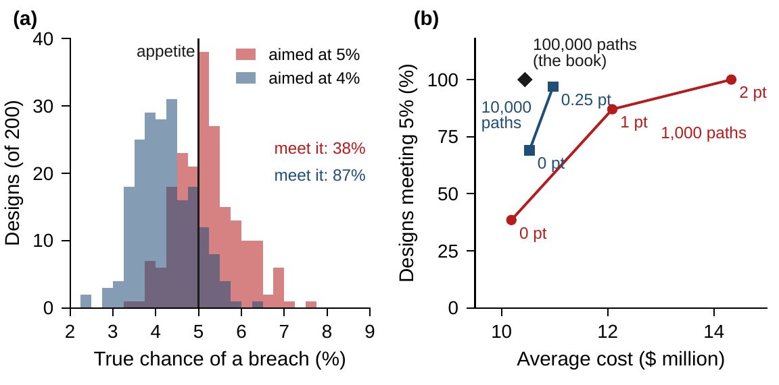
The sample is part of the answer
§9.6 · THEOREM 9.3 · FIGURE 9.2
Theorem 9.3. Sample averages are unbiased; the design is consistent but optimistic; judge it on fresh paths
On 100,000 paths a 5% chance has a standard error of 0.07 points
Designed on 1,000 paths, packages meet 5% only 38% of the time, at $10.19m: they buy too little
A one-point margin: 87%, at $12.09m; on 10,000 paths a quarter point: 97%, at $10.97m
Margins priced in advance: 0.12% on 100,000 paths at 4.75%; up to 32% on 1,000 at 4%
Figure 9.2. (a) True chances of 200 packages, each designed on its own 1,000 paths. (b) Share meeting 5% against average cost, by sample size and margin.
Notes:
Theorem 9.3 and Equation 9.5; formal statement and proof in Appendix 9.A. The bound is conservative, so the board's test of record is the check on fresh paths. Online Appendix 9.B.2: designs on 200 samples of 1,000 paths (seeds 900000–900199) and 100 of 10,000.

Slide 15
Can a rule replace the committed delay?
WORKED EXAMPLE 9.1 · THE SITUATION
Volume I's answer
Transformation office
Chief financial officer
A line and a committed delay
Slow the build when cash runs low
Answer before the line is signed
A $170m standby line and two-thirds of a quarter of delay: $5.10m of fees and $5.34m of delay, $10.44m.
A slowdown decided at a quarter's end cuts the rest of the draw, at $8m a quarter times the share still ahead.
Could a rule keep the appetite more cheaply, and what would the office need to see, and how soon?
The appetite: at most a 5 percent chance that liquidity falls below $350m in some quarter of the program.
Notes:
Worked Example 9.1, the situation. Volume I, Worked Example 15.1 priced the board's appetite and left this question open. A quarter of committed delay lifts liquidity by up to $25 million, at the deepest point of the draw.

Slide 16
Write the problem, check the benchmark
WORKED EXAMPLE 9.1 · STEPS 1–2
liquidity in quarter k: the plan, the draw cut by the delay, surprises, and closures the line does not cover
Step 1: the law on the same 100,000 paths; a slowdown decided at a quarter's end cuts the rest of the draw
Every rule is designed on the book's paths by sample average approximation and judged on 100,000 fresh paths
Step 2: the package's delay is the 95th percentile of the delays the paths need; on fresh paths 4.91%
Designed on the fresh paths: a $165m line, the same delay, $10.28m; gaps under $0.2m cannot be told apart
Notes:
Worked Example 9.1, Steps 1 and 2; Online Appendix 9.B.2. On the fresh paths the package breaches 4.907 percent of the time, within 1.3 standard errors of 5 percent: the appetite holds (Theorem 9.3(iv)).

Slide 17
Ways of keeping Meridian's appetite
WORKED EXAMPLE 9.1 · TABLE 9.3
Way | Line | Committed | Slowdown | Paths | Cost | Fresh odds | Fresh cost
Volume I's package | 170 | 0.67 | – | – | 10.44 | 4.91 | 10.44
Slow only, reading quarter 1 | 170 | 0 | 1.00 | 99% | 10.62 | 4.90 | 10.62
Slow only, reading quarter 3 | 175 | 0 | 4.00 | 64% | 11.41 | 4.95 | 11.41
Commit and slow, quarter 3 | 165 | 0.55 | 2.50 | 15% | 10.23 | 4.96 | 10.24
Commit and slow, every quarter | 165 | 0.50 | 1.25 | 33% | 10.20 | 4.95 | 10.21
Early warning of closures (a) | 0, 215 | 0.61, 0.50 | – | – | 6.32
Every path's future (b) |  |  |  |  | 0.44
$ million; delays in quarters. Slowdown: its length; Paths: the share it slows. Fresh: chance of a breach (%) and cost on 100,000 fresh paths. (a) A hypothetical signal at the start: no closure ahead (74% of paths) or one ahead. (b) Line and delay chosen path by path, knowing each path's future.
Notes:
Table 9.3. Designed on the book's 100,000 paths by sample average approximation; every answer checked on 100,000 fresh paths (seed 26209).

Slide 18
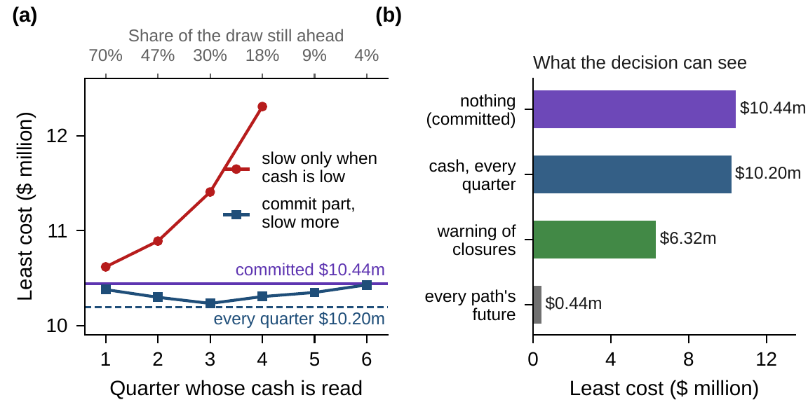
Cash reveals trouble too late
WORKED EXAMPLE 9.1 · STEPS 3–5 · FIGURE 9.3
Step 3: slowing only costs more than the package whichever quarter's cash it reads
Commit 0.55, a $165m line, and slow by 2.5 quarters the 15% below $461m at quarter 3: $10.23m
Step 4: reading every quarter: slow by 1.25 at $73m below plan, $10.20m, 2% less
Step 5: a warning of closures at the start would be worth $4.1m
If 85% of a surprise persisted, reading cash every quarter would save $2.3m of $28.2m
Figure 9.3. (a) Least cost with one reading of cash, by the quarter read. (b) Least cost by what the decision can see.
Notes:
Worked Example 9.1, Steps 3–5; Online Appendix 9.B.2. Reading quarter 1, slowing only slows 99 percent of paths by a quarter, a committed delay in disguise; after quarter 3 only 30 percent of the draw is still ahead. With the warning: no line and 0.61 quarter when no closure is coming; a $215m line and half a quarter when one is, at 5.7 percent there and 4.8 elsewhere.

Slide 19
Sign the line and commit the delay
WORKED EXAMPLE 9.1 · WHAT THE BOARD SHOULD TAKE AWAY
$0.25m
$4.1m
$10.0m
the most a rule that reads cash saves, of $10.44m: within the noise of the design
what a credible early warning of funding-window closures would be worth
the most any information could be worth with these levers
Information is worth paying for when it comes before the trouble: watch the funding markets, not the cash
The treasury would own the warning, the transformation office the slowdown, the board the appetite
For discussion: what would a credible warning look like, and how would you test it before paying for it?
Notes:
Worked Example 9.1, what the board should take away, and the discussion questions. If execution surprises persisted longer, as in Step 5's test, who would have to read cash, and how fast would they have to act?

Slide 20

Keeping Meridian's appetite, in AXIOM
AXIOM LAB 2.9 · MODULE AXIOM-09
The board wants the cheapest way to keep its appetite, checked on paths the design has not seen. Open AXIOM, choose Lab 2.9 and load the Meridian liquidity instance (Volume I, Chapter 8's law) and the hiring instance with HR's record.
1
2
3
4
5
Estimate and check
Design on a sample
Compare rules
Price information
Steer with outside events
Chances by quarter and over the program, with standard errors.
The cheapest package on the book's paths; then on 1,000 and 10,000.
Under common random numbers: the package against reading cash.
The clairvoyant's bound and an early warning of closures.
Departures and an uncertain yield; the martingale audit.
Deliverable: a one-page note to the board: the package or rule, its cost and its chance of a breach on fresh paths with their errors, the value of information, and the declarations the answer rests on. About 75 minutes.
Notes:
AXIOM Lab 2.9. What to look for: chances under 1 percent in every quarter when the program-wide chance is 5 percent; designs that look safe on their own 1,000 paths and fail on fresh ones; a rule that saves little because cash reveals trouble late, and a warning worth $4.1 million; a gain that stays at 4.34 a year with departures and falls to 4.16 with an uncertain yield; a value ledger with no drift.

Slide 21
What to carry forward
KEY TAKEAWAYS
1
Declaring a probability law turns the objective into an expected value, a commitment into one kept on every path, on average, or with a stated probability, and a decision into a rule that reads only what has been revealed. The average path is not a plan.
2
With outside events, the HJB equation gains half their spread priced at the value's curvature. Verification carries over in expectation, and along the best rule the value ledger has no drift.
3
Events that only add to the stocks leave a linear–quadratic rule unchanged and cost money. Uncertainty about what a decision achieves calls for gentler steering; risk that grows with the stocks, or doubt about the law, for harder steering. Risk aversion and distrust of the law are one penalty.
4
A commitment over many reviews is a joint chance constraint, whose chance lies between the worst review's and the sum. Quantile forms are exact and CVaR is convex and safe. Information never hurts, and the clairvoyant bounds what any of it is worth.
5
Answers computed from samples carry two errors, the estimate's and the design's. Sample average approximation is consistent but optimistic: judge an answer on fresh paths, with a margin priced by the sample's size.
Notes:
Key Takeaways, Chapter 9.

Slide 22
Notebook and workbook reproduce the book
THIS WEEK'S LABORATORY
169
87
26209
AXIOM-09
notebook checkpoints, every one PASS
workbook checks against the engine, ALL PASS
the lab's seed
AXIOM Lab 2.9
Notebook DCT_V2_Ch09_Lab.ipynb: Worked Example 9.1 and the lab's five steps in nine panels, on the book's paths and the fresh ones
Workbook DCT_V2_Ch09_Lab.xlsx: the plan and Gaussian chances, every package's and rule's cost, the margin bounds, the warning's allotment, and the hiring loop, in formulas
Notes:
The notebook and workbook are on the course website, www.dynamiccorporatetransformation.com.

Slide 23
Next, a bounded set of possible futures
NEXT · CHAPTER 10
Chapter 9 trusted the declared law; Chapter 10 asks what can be guaranteed when only a set of futures is declared
Chapter 11 asks what to do when several laws fit the record: a family around the declared one
Proposition 9.1 is the bridge: risk aversion read as robustness to a misjudged law
Notes:
The Scope and Limits box of Section 9.1 and Proposition 9.1's Enterprise Interpretation point ahead to Chapters 10 and 11, the other two declarations of Part III, Enterprise Optimization Under Uncertainty.

