Slide 1
Enterprise State Representation
VOLUME I · CHAPTER 5 · WEEK 3
Where a company stands is a point, an option is a path, the walls make a region, and where it settles is an equilibrium: a stable state need not be a good one
Graduate course companion · Lab seed 26105 · AXIOM Lab 1.5 (AXIOM-05)
Notes:
Volume I, Chapter 5, the first chapter of Part II. Part I asserted that a company has a state; this chapter shows that beneath every adequate description lies one canonical object, and builds the vocabulary the rest of the book uses: point, path, region, equilibrium (Section 5.1).

Slide 2
“Englishmen never will be slaves: they are free to do whatever the Government and public opinion allows them to do.”
George Bernard Shaw
Nobel Prize in Literature 1925; the Devil, in Man and Superman (1903)
Notes:
Shaw's Devil (Man and Superman, 1903): freedom is whatever the walls allow. Section 5.7 makes it literal: the feasible region is the set of states every constraint permits, and some walls, like the board's liquidity floor, are self-imposed and revisable (Table 5.4).

Slide 3
After this chapter, you can
LEARNING OUTCOME STATEMENTS
5.1
Explain what a company's state is—the memory its future requires—and use that test to decide what belongs in a state description.
5.2
Build a declared state for a company, with readings, units, types, and measurement sources, and distinguish state variables from parameters, explaining why the line between them moves with the planning horizon.
5.3
Read a company's position in its state space: configurations as points, constraints as walls, the feasible region and its binding constraints, and when a blended operating model is feasible.
5.4
Interpret transformation paths in continuous and discrete time, explain how program phases join, and explain why some models carry a built-in validity horizon.
5.5
Explain equilibrium and its stability, estimate how long a company takes to settle using the contraction rule, and explain why a stable state need not be a good one.
Notes:
The five learning outcome statements; LOS Guidance at the end of the chapter.

Slide 4
Eight sections, a worked example and a lab
ROADMAP
§5.1
§5.2
§5.3
§5.4
§5.5
Why the State Needs a Foundation
The Minimal State: The Memory the Future Requires
State Variables and Parameters
State Spaces and Configurations
Trajectories and Transitions
Part II's foundation
Theorem 5.1
Tables 5.1–5.2
Theorem 5.2
Theorem 5.3
§5.6
§5.7
§5.8
Worked Example 5.1
AXIOM Lab 1.5
Equilibrium States
Feasible Regions
Dimension and Visualization
Where Does the Turnaround Settle?
Meridian's Room to Maneuver
Theorem 5.4
Theorem 5.5
Figure 5.5
Table 5.5
AXIOM-05
Notes:
Section 5.2: Definition 5.1, Proposition 5.1, Theorem 5.1. Section 5.3: Definitions 5.2-5.3, Tables 5.1-5.2. Section 5.4: Definitions 5.4-5.5, Proposition 5.2, Theorem 5.2, Figure 5.1. Section 5.5: Definition 5.6, Propositions 5.3-5.4, Theorem 5.3, Figure 5.2. Section 5.6: Definition 5.7, Table 5.3, Theorem 5.4, Figure 5.3. Section 5.7: Definitions 5.8-5.9, Table 5.4, Proposition 5.5, Theorem 5.5, Figure 5.4. Section 5.8: Definition 5.10, Figure 5.5. Worked Example 5.1: Table 5.5. AXIOM Lab 1.5: module AXIOM-05, five steps. Proofs of Theorems 5.1, 5.2, 5.4 and 5.5 are in Appendix 5.A; those of Propositions 5.1-5.5 and Theorem 5.3 in Online Appendix 5.B.

Slide 5
Four board phrases become four objects
§5.1 · WHY THE STATE NEEDS A FOUNDATION
“Where the company is”
“Where an option takes it”
“What the company can be”
“What it would settle into”
A point
A trajectory
A feasible region
An equilibrium
A configuration is a point of the state space; constraints are walls (§5.4, Theorem 5.2)
A path through time, of which a report shows only the samples (§5.5, Theorem 5.3)
The states that meet every constraint at once, walls included (§5.7, Theorem 5.5)
The state the dynamics leave unchanged, if it stopped transforming (§5.6, Theorem 5.4)
Two modeling teams, two lists of readings: is one of them wrong? Theorem 5.1 answers the skeptic.
Notes:
Section 5.1. If two teams, each following every rule of Chapter 4, describe Meridian with different lists of readings, is one of them wrong, or is the state of the company a convention all the way down? Everything in this chapter is deterministic by declaration; uncertainty enters in Chapter 8.

Slide 6
The state is the memory the future requires
§5.2 · THEOREM 5.1
What it means
THEOREM 5.1
Enterprise State Representation Theorem
What the state is, is not a convention once observable behavior is declared
A reading earns its place by carrying information the future needs, not by being true or important
Balance sheets, capabilities and order books belong; sunk costs do not
The money spent on the legacy platform is gone; the platform's condition today remains
Fix what counts as observable behavior. Two histories are future-equivalent if no future can tell them apart by their outputs
(i) The future-equivalence classes form a state description that reproduces behavior exactly
(ii) Every adequate description carries at least this much information: none has fewer states
(iii) Any two smallest descriptions are the same up to relabeling
Different pasts with identical balance sheets, capabilities, contracts and positions are future-equivalent
Notes:
Definition 5.1, Proposition 5.1 and Theorem 5.1; proof in Appendix 5.A. The construction is Nerode's, carried into system theory as realization theory. Scope: the theorem removes arbitrariness after the behavioral declaration, not before, and the minimal state may be very large, so working vectors are approximations whose adequacy is tested by the state property.

Slide 7
Meridian's eight readings, declared
§5.3 · TABLE 5.2
 | Reading | Unit | Type | Measurement source (error) | Tag
x₁ | liquidity | US$ billion | stock | treasury systems (±1%) | ECA
x₂ | net leverage | ND/EBITDA | ratio | audited accounts (±2%) | ECA
x₃ | workforce capability | 0–100 | index | skills survey (±5) | ECA
x₄ | technology platform | 0–100 | index | architecture audit (±4) | ECA
x₅ | operational efficiency | 0–100 | index | cost benchmarking (±3) | EPA
x₆ | ROIC | ratio | ratio | audited accounts (±0.4 pp) | EPA
x₇ | strategic risk | 0–100 | index | risk committee (±6) | ERRA
x₈ | market share | ratio | ratio | industry data (±0.8 pp) | EPA
Errors for indices are in index points. Tags anticipate Part III's architectures: capital (ECA), performance (EPA), and risk, resilience and robustness (ERRA).
One vector carries cash, ratios and survey indices: the declaration, not the notation, does the carrying.
Notes:
Table 5.2 and Definition 5.3: the readings of Table 3.1 with the measurement discipline of Chapter 4. On Chapter 3's scale the widest error bars belong to strategic risk (±6) and workforce capability (±5).

Slide 8
Yesterday's parameter is tomorrow's state variable
§5.3 · DEFINITION 5.2
The line moves with the horizon
DEFINITION 5.2
Enterprise State Variable
Tax rate: a parameter in a four-quarter cash model, a variable in a ten-year model
The decision rule: a parameter in Chapter 2's loop, a state variable once adaptation entered
A private firm's liquidity premium responds to its own financing and payout decisions
The modeling contract records on which side each quantity sits, and why
A declared reading admitted to the state vector, with a declared range, units and a measurement convention
Treated as evolving within the horizon: its future values are outputs of the dynamics, not inputs
A declared quantity held fixed over the horizon is an enterprise parameter, θ
Table 5.1: stocks carry memory; ratios and indices enter with their constructions declared
Definition 5.3. The state vector lists the variables in a fixed order; reordering or rescaling gives an equivalent description
Notes:
Definition 5.2, Section 5.3 and Table 5.1, which lists the attrition rate among the parameters. AXIOM Lab 1.5, step 1, switches it to a state variable: Chapter 1's model never reads it, so the digital program reruns unchanged and the new coordinate stays put over five years (notebook, Panel 1).

Slide 9
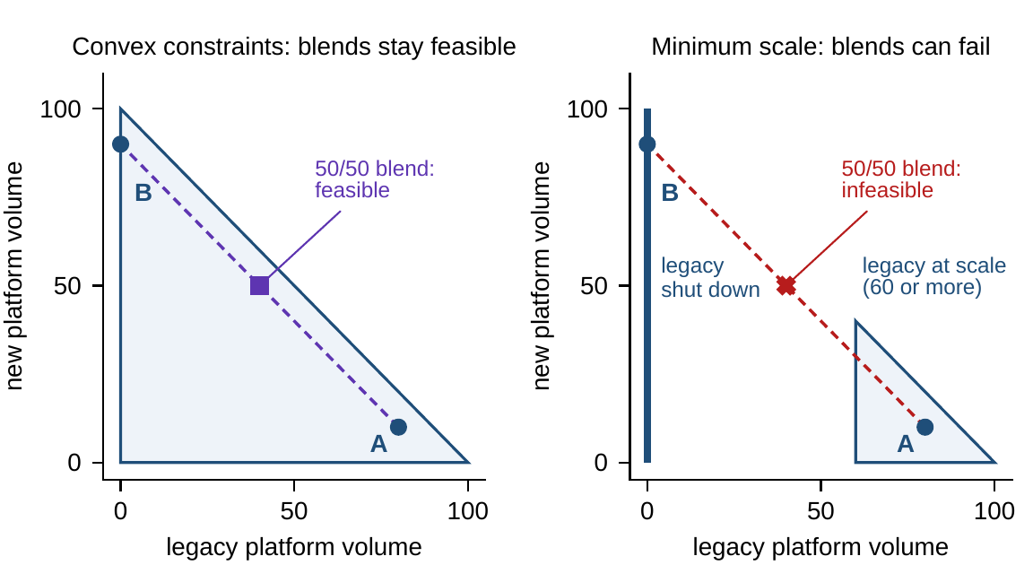
A blend of two workable models can be unworkable
§5.4 · THEOREM 5.2
Theorem 5.2. Constraints are walls; questions about a few readings are projections
Blends of admissible configurations are admissible when every constraint is convex
A budget of 100: A runs legacy 80 and new 10; B shuts legacy and runs new 90
A minimum efficient scale, legacy at 60 or more or not at all, rules out the 50/50 blend
Many troubled transitions are blends of this kind
Figure 5.1. Left: under a capacity budget alone, every blend of A and B is feasible. Right: a minimum efficient scale leaves two separate pieces, and the 50/50 blend falls between them.
Notes:
Definitions 5.4-5.5, Proposition 5.2 and Theorem 5.2; proof in Appendix 5.A, where the blend's minimum-scale reading is g = min{40, 20} = 20 > 0. Legacy at 40 is too small to run economically and too large to have been shut. Convexity will separate problems that can be solved reliably from those that can only be searched (Chapter 15).

Slide 10
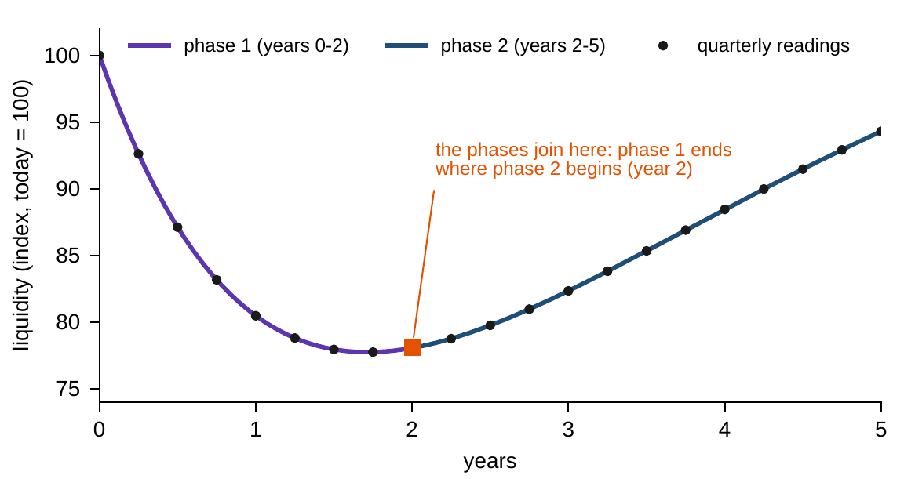
Readings sample a path; phases must join
§5.5 · PROPOSITION 5.3
A trajectory is the state over time; a report shows only its samples (Definition 5.6)
Proposition 5.3. Phases join exactly when the first ends where the second begins
Digital: the build (years 0–2) hands over to the scale-up at a liquidity index of 78
Half-yearly readings equal two quarterly steps: the flow map composes
Theorem 5.3. Lipschitz dynamics give one path, locally; explosive growth can end in finite time
Figure 5.2. Meridian's liquidity under the digital program (Chapter 1 model): the continuous path, its quarterly readings, and two phases that join at year 2.
Notes:
Definition 5.6, Propositions 5.3-5.4 and Theorem 5.3; proofs in Online Appendix 5.B. A plan whose second phase assumes a starting state the first does not deliver is two disconnected stories. Models of self-reinforcing growth, viral platforms and bank runs, carry a validity horizon: x' = x^2 from 1 reaches infinity at t = 1 (Online Appendix 5.B.1); without the Lipschitz condition a path need not be unique (5.B.2).

Slide 11

A contraction settles on a computable schedule
§5.6 · THEOREM 5.4
Equation 5.1: after k periods, the distance left is bounded by the size of the first step
(i) Contraction. If the space is closed and each period shrinks every distance by a factor L < 1, there is exactly one equilibrium and every path converges to it
(ii) Compact and convex. A continuous map on a bounded, closed, convex space has at least one equilibrium, possibly several
The convergence budget: from a single observed step, the periods needed to come within any tolerance, before any simulation
Notes:
Definition 5.7 and Theorem 5.4; proof in Appendix 5.A (Banach for part i, Brouwer for part ii). Part (i) is the world of dampened response, the signature of dominant balancing feedback; part (ii) the world of coexistence: industries sustain several viable business models, and history decides which one a company settles into.

Slide 12
Stable, unstable, saddle: equilibria in business
§5.6 · TABLE 5.3
Class | Behavior nearby | Business instance
Stable, attracting | trajectories converge to it | a mature operating model under balancing control
Stable, not attracting | trajectories neither converge nor flee | a market share drifting neutrally in a static duopoly
Unstable | some trajectories flee | a cost position eroding under reinforcing customer migration (Industrial Systems)
Saddle | attracting in some directions, repelling in others | a highly levered company at its target: cost shocks die out, confidence shocks feed on themselves
For a linear company the equilibrium attracts exactly when every eigenvalue has modulus below one (Chapter 7).
The third world is growth: near zero a start-up's user base grows 22.5 percent a quarter, and it runs to the market wall.
Notes:
Table 5.3 and Section 5.6. Online Appendix 5.B.6: f(x) = 3x^2 - 2x^3 has three equilibria, the pure positions attracting and the middle unstable (slope 1.5), the strategist's 'stuck in the middle'. Online Appendix 5.B.7: the start-up's slope is 1.225 at zero and 0.775 at the wall; it contracts only above 60, which it passes in year 5.25.

Slide 13
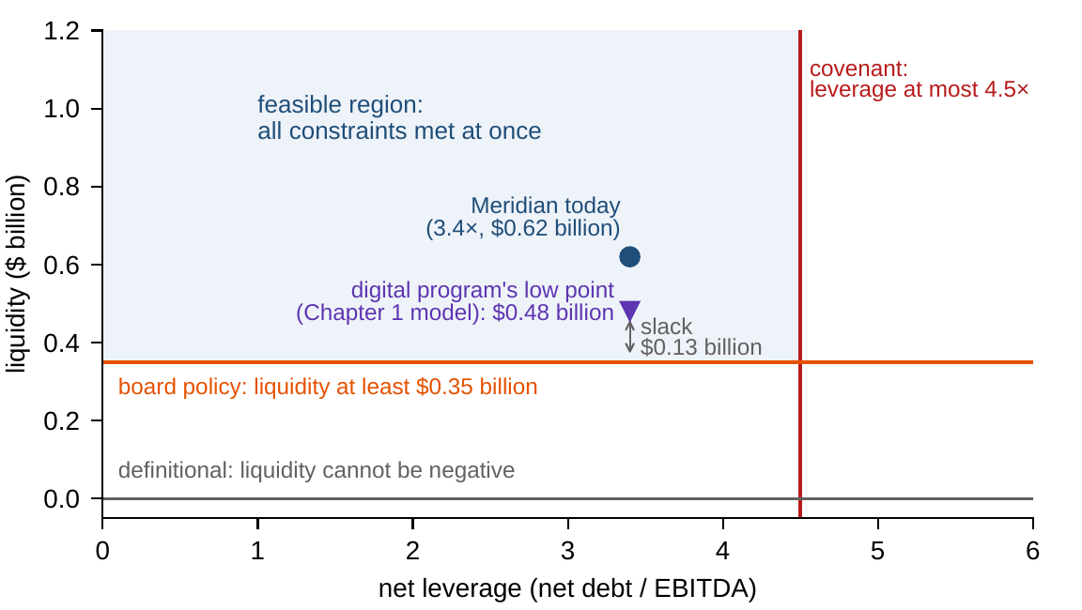
No wall binds today; the digital path draws near
§5.7 · PROPOSITION 5.5
Proposition 5.5. The feasible region is the overlap of what each wall permits; failing one wall is failing
Today, 3.4× leverage and $0.62bn: the binding set is empty, with 1.1 turns and $0.27bn of slack
Digital low point, around month 21: $0.48bn, $0.13bn above the floor
A floor above $0.48bn makes the program, as modeled, infeasible
Off this projection, strategic risk peaks 1.4 points under its ceiling of 75, in month 11 (Chapters 1, 16)
Figure 5.4. Meridian's feasible region projected on net leverage and liquidity: the covenant and the board's floor cut it out of the definitional bounds.
Notes:
Definitions 5.8-5.9, Table 5.4 (definitional, structural, contractual, physical and policy walls), Proposition 5.5 and Figure 5.4. A plan that respects every covenant but breaches the liquidity floor in one quarter is infeasible, not mostly feasible. Table 1.5 and Worked Example 16.1 report the strategic-risk margin on the digital path: a peak of 73.6 in month 11, 1.4 points under the ceiling, inside the risk committee's ±6 reading error. The notebook's Panel 2 probes every wall.

Slide 14
Weak inequalities keep the walls in the region
§5.7 · THEOREM 5.5
What it means
THEOREM 5.5
State Space Completeness Theorem
Companies live at their walls: covenants touched, capacity full, buffers at their floor
Written strictly, a model cannot even say “the covenant binds”
Banks operate at their capital and liquidity requirements deliberately: capital is expensive
Part (ii) is the book's first optimization result; Chapter 15 will need it
(i) With continuous constraints and weak inequalities the region is closed: feasible states cannot converge to an infeasible one
(ii) If it is also bounded, every continuous objective attains its best and worst values on it
(iii) With strict inequalities these guarantees fail, and the boundary states are excluded
DCT's convention: every wall is written with continuous functions and weak inequalities, ≤ and =
Notes:
Theorem 5.5; proof in Appendix 5.A. Part (i) also underwrites the analysis of equilibria: the limit of a feasible path is feasible, so the steady state of a contraction, approached through a closed region, is a legitimate configuration of the company. Policy walls are self-imposed and revisable; revising one is itself a transformation act (Chapter 6).

Slide 15
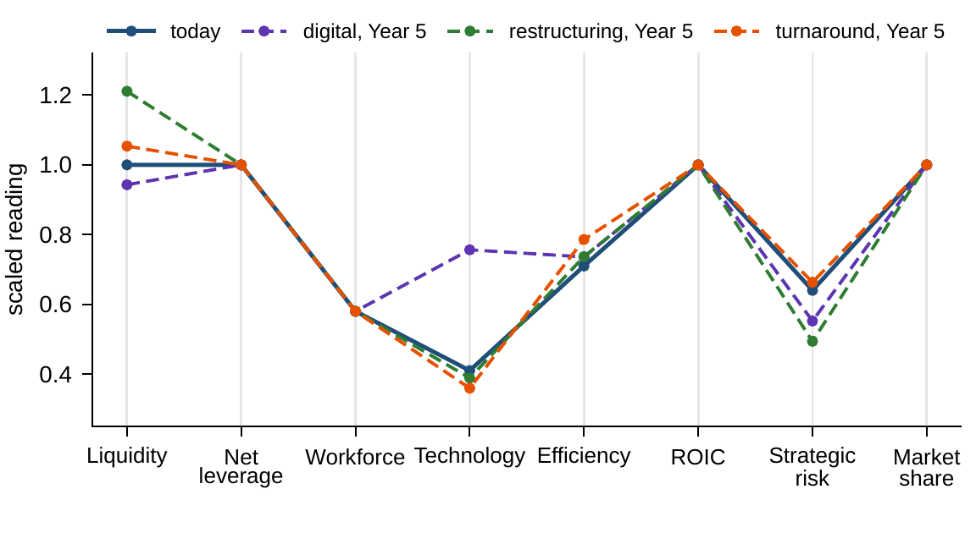
Profiles show every reading and distort distance
§5.8 · FIGURE 5.5
Projections show two or three readings exactly and hide the rest; profiles show all of them
Digital departs on technology, restructuring on liquidity and risk, the turnaround hardly at all
Declared distance from today: turnaround 0.11, restructuring 0.26, digital 0.36
A ball fills 79 percent of its cube in two dimensions, 1.6 percent in eight, Meridian's
Figure 5.5. Meridian today and in Year 5 under each option, in parallel coordinates of the scaled readings (indices divided by 100, other readings by today's value).
Notes:
Definition 5.10 and Section 5.8. Online Appendix 5.B: more than half of an eight-dimensional ball lies within 10 percent of its surface, so the typical state of a rich representation is near some wall, and the binding set deserves regular attention. Rankings of similar states are computed with the declared distance (Proposition 3.3), never read off the page.

Slide 16
Where does the turnaround settle?
WORKED EXAMPLE 5.1 · THE SITUATION
A director asks
Then
And
If the turnaround runs indefinitely, where does Meridian end up?
How long does it take to get there?
Is the destination a good one?
Each of four readings closes a fixed share of its gap to a target every year.
About 36 percent of the gap a year for liquidity, 18 for technology, 45 for efficiency, 26 for strategic risk.
The targets: a liquidity index of 106, technology 33, efficiency 79, strategic risk 67.
The third of Meridian's options defends the core with cost and productivity programs (Chapter 1's model).
Notes:
Worked Example 5.1, the situation. The turnaround's annual map is Chapter 1's model sampled once a year; the notebook's Panel 5 checks that the two agree.

Slide 17

One year of data budgets the whole journey
WORKED EXAMPLE 5.1 · STEPS 1–3
the largest gap after k years, budgeted from the first year's largest move: efficiency, 71.0 to 74.6
Step 1: next year's gap is this year's times 0.638, 0.819, 0.549 and 0.741; from (100, 41, 71, 64), year 1 is (102.2, 39.5, 74.6, 64.8)
Step 2: gaps between any two starting states shrink by at least L = 0.819, set by technology: one steady state, (106, 33, 79, 67)
Step 3: the bound falls below one point by year 15: a guarantee available on day one, from one year of data
Notes:
Worked Example 5.1, Steps 1-3; Theorem 5.4(i) and Equation 5.1. The contraction is in the largest-gap norm: each reading's gap is multiplied by its own factor, so the largest gap shrinks by at least the largest factor.

Slide 18
Within a point of the steady state by year 11
WORKED EXAMPLE 5.1 · TABLE 5.5
Year | 0 | 1 | 3 | 5 | 11 | Steady state
Liquidity (index) | 100.0 | 102.2 | 104.4 | 105.4 | 106.0 | 106
Technology | 41.0 | 39.5 | 37.4 | 35.9 | 33.9 | 33
Efficiency | 71.0 | 74.6 | 77.7 | 78.6 | 79.0 | 79
Strategic risk | 64.0 | 64.8 | 65.8 | 66.3 | 66.9 | 67
Largest gap to steady state | 8.0 | 6.5 | 4.4 | 2.9 | 0.9 | 0
Day-one bound | 19.9 | 16.3 | 10.9 | 7.3 | 2.2 | 0
Scorecard | 37.0 | 37.9 | 38.4 | 38.4 | 38.0 | 37.8
The bound is the day-one guarantee of Equation 5.1; the scorecard is Chapter 1's, (liquidity + technology + efficiency − strategic risk)/4.
The largest gap falls from 8.0 to 2.9 by year 5 and below one point by year 11, comfortably inside the bound.
Notes:
Table 5.5 and Step 4. The bound is conservative because it assumes the worst case at every step; its value is that it is guaranteed. From the digital program's Year-5 state the same map attains its bound: technology makes the largest first move and is the slowest reading (notebook, Panel 6).

Slide 19
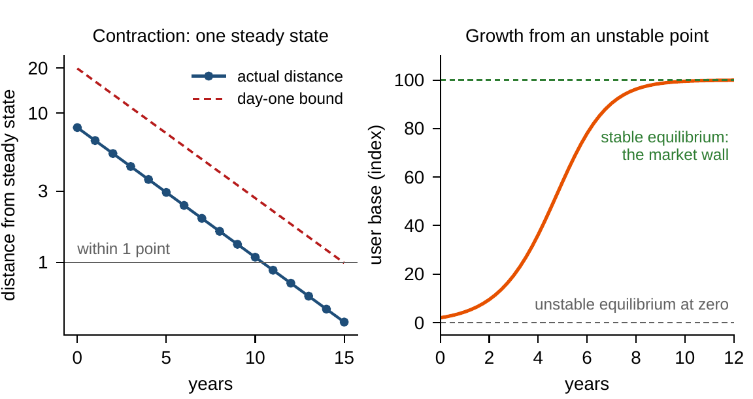
The turnaround settles inside its bound
WORKED EXAMPLE 5.1 · STEPS 4–5
Step 4: the distance to the steady state falls every year and stays below the day-one bound
From any starting point, the map reaches the same steady state
Step 5: stronger liquidity and efficiency, but a weaker platform (33 vs 41) and more risk (67 vs 64)
The scorecard rises from 37.0 to about 38.4 by year 3, holds through year 5, then slides toward 37.8
Figure 5.3. Left: the turnaround's distance to its steady state (log scale) stays below the day-one bound. Right: a start-up leaves its unstable equilibrium at zero for the market wall.
Notes:
Worked Example 5.1, Steps 4-5, and Figure 5.3. The right panel is Section 5.6's third world: an expanding map near zero, 22.5 percent a quarter, that hands over to a contracting one once the user base passes 60, in year 5.25 (Online Appendix 5.B.7).

Slide 20
Stability is not success
WORKED EXAMPLE 5.1 · WHAT THE BOARD SHOULD TAKE AWAY
Year 11
33 vs 41
37.8
within one point of the steady state; the day-one bound guarantees year 15
technology at the destination against today; the digital program reaches 75.6 by year 5
where the scorecard comes to rest, below its 38.4 of years 3–5
The turnaround settles, reliably and on a computable schedule, in about a decade
A contraction guarantees arrival, not a good destination: choosing a transformation means choosing a destination as well as a path
For discussion: what would have to change for the steady state to include a stronger platform, and would the result still be a turnaround?
Notes:
Worked Example 5.1, what the board should take away, and the discussion question.

Slide 21

Meridian's room to maneuver, in AXIOM
AXIOM LAB 1.5 · MODULE AXIOM-05
Before choosing among its three options, Meridian's board has asked the strategy office for a one-page “state of the company”: where Meridian stands, which walls are closest, how much room each option leaves, and where each would settle. Open AXIOM, choose Lab 1.5 and load the Meridian state.
1
2
3
4
5
Declare the state
Build the walls
Sample a path
Find the steady state
Compare profiles
Review Table 5.2's declaration; switch the attrition rate from parameter to state variable and rerun the digital program.
Add Table 5.4's constraints one at a time; probe today and the digital low point for the binding set and each slack.
Run the digital program in continuous time, take quarterly readings, join the two phases, check half-yearly readings.
Run the turnaround's annual map from three starting states with the day-one bound; then the start-up map.
Show today and the three Year-5 states in parallel coordinates, with the distance readout alongside.
Deliverable: a one-page note to the CFO: Meridian's binding and near-binding constraints today and along each option's path, the slack at the tightest point, and where and when the turnaround settles. About 45–60 minutes.
Notes:
AXIOM Lab 1.5. What to look for: every starting point of the turnaround converges to the same steady state, inside the day-one bound (Theorem 5.4); the binding set is empty today, but the liquidity floor comes close on the digital path; and profiles that look alike on the page can be far apart in the declared distance. Discussion question 1: the digital program, as modeled, stays feasible for any floor up to its low point, $0.48 billion.

Slide 22
What to carry forward
KEY TAKEAWAYS
1
A company's state is the memory its future requires: the smallest record of the past that, with future decisions and conditions, determines what happens next. It is unique up to relabeling once observable behavior is declared.
2
A reading earns its place in the state by carrying information the future needs; parameters are quantities held fixed over the horizon, and the line between the two moves as the horizon lengthens.
3
Configurations are points and constraints are walls. Feasibility means meeting every constraint at once; blended operating models are feasible only when the constraints allow it; and weak inequalities keep the boundary states where companies actually operate.
4
Well-behaved dynamics give exactly one path from each starting state, but models of self-reinforcing growth carry built-in validity horizons.
5
A contracting company settles into a unique steady state on a schedule computable from one year of data; a stable state is not necessarily a good one.
Notes:
Key Takeaways, Chapter 5.

Slide 23
Notebook and workbook reproduce the book
THIS WEEK'S LABORATORY
91
118
26105
AXIOM-05
notebook checkpoints, every one PASS
workbook checks against the engine, ALL PASS
the lab's seed
AXIOM Lab 1.5
Notebook DCT_V1_Ch05_Lab.ipynb: Worked Example 5.1 and the lab's five steps in nine panels, ready for Colab
Workbook DCT_V1_Ch05_Lab.xlsx: the declared state, every wall's slack, the sampled path, the turnaround's budget and Table 5.5, the profiles, in formulas
Every number on these slides is the book's, and both companions check it
Notes:
The notebook and workbook are on the course website, www.dynamiccorporatetransformation.com.

Slide 24
Chapter 6 gives the state its verb
NEXT · CHAPTER 6
A transformation operator is a declared action: its preconditions are its domain, its effect is where it takes the company (Definition 6.1)
This chapter's walls become preconditions: an automation round costs $120m, so it needs $470m of liquidity for the $350m floor to hold after it
Programs compose; order can decide whether a plan runs at all; a repeatable playbook has an exact test
Notes:
Section 6.1: Chapter 5 gave Dynamic Corporate Transformation its noun, the state; Chapter 6 supplies its verb. The automation round is Worked Example 6.1's (Figure 6.1).

