Slide 1
Enterprise Transformation Operators
VOLUME I · CHAPTER 6 · WEEK 3
Every action is an operator with preconditions and an effect: programs run only if every seam holds, and a playbook is a strategy only if it renews its own preconditions
Graduate course companion · Lab seed 26106 · AXIOM Lab 1.6 (AXIOM-06)
Notes:
Volume I, Chapter 6. Chapter 5 gave Dynamic Corporate Transformation its noun, the state; this chapter supplies its verb. Actions become Enterprise Transformation Operators, and their structure is the Enterprise Transformation Architecture (ETA), the second of the six DCT architectures and the bridge between the states of Chapter 5 and the dynamics of Chapter 7 (Section 6.1).

Slide 2
“Work is of two kinds: first, altering the position of matter at or near the earth's surface relatively to other such matter; second, telling other people to do so.”
Bertrand Russell
Nobel Prize in Literature 1950; “In Praise of Idleness” (1932)
Notes:
Bertrand Russell, 'In Praise of Idleness' (1932). Transformation is work of the second kind: decisions that move the company from one state to another. This chapter makes each such action precise, with its preconditions and its effect.

Slide 3
After this chapter, you can
LEARNING OUTCOME STATEMENTS
6.1
Explain what a transformation operator is—a declared action with preconditions (its domain) and an effect—and why domains turn feasibility questions into checks.
6.2
Explain why applying operators and running the company as a system are the same thing, and distinguish effects the company commits to from effects that depend on the environment.
6.3
Analyze how operators combine into programs: when a sequence can run, why order can decide whether it runs at all, and why most transformation steps cannot be undone.
6.4
Use the sustainable core and the reachable set to decide whether a playbook can be repeated and whether a target can be reached, and explain why “complete” goals need tolerances.
6.5
Explain how execution error accumulates through a program, and match the execution tolerance to whether the program consolidates or amplifies.
Notes:
The five learning outcome statements of Chapter 6; LOS Guidance at the end of the chapter explains what a strong answer to each looks like.

Slide 4
Seven sections, a worked example and a lab
ROADMAP
§6.1
§6.2
§6.3
§6.4
§6.5
From States to Actions
Transformation as Mapping
Composition and the Operator Algebra
Repeated Programs and the Sustainable Core
Feasible Transformations and Constraints
The verb of DCT
Definitions 6.1–6.4 · Theorem 6.1
Theorem 6.2 · Table 6.2
Theorem 6.3 · Equation 6.3
Proposition 6.5 · Table 6.3
§6.6
§6.7
Worked Example 6.1
AXIOM Lab 1.6
Transformation Paths and Reachability
Transformation Stability
Strategy or Trade? Meridian's Automation Playbook
Sequencing Meridian's Moves
Theorem 6.4 · Figure 6.3
Theorem 6.5 · Figure 6.4
Table 6.4 · Figure 6.2
AXIOM-06 · five steps
Notes:
Section 6.2 also holds Figure 6.1 and Table 6.1. Proofs of Theorems 6.1, 6.3, 6.4 and 6.5 are in Appendix 6.A; those of Propositions 6.1-6.5 and Theorem 6.2 in Online Appendix 6.B, with the bank's policy (Example 6.B.1) and two remarks on the drift bound and on tolerance targets.

Slide 5
Board questions become checks
§6.1 · FROM STATES TO ACTIONS
Can this program start from here?
Is the order of steps a matter of taste?
Strategy or trade?
Is today's state in the operator's domain?
Order can decide whether a program runs
Is today's state in the playbook's sustainable core?
Definition 6.3
Theorem 6.2(iii)
Theorem 6.3
Can the target be reached?
How much slippage can it absorb?
Meridian's board
Search the reachable set; give complete goals a tolerance
Consolidating programs forgive it; amplifying ones compound it
Is choosing a word in its repertoire's alphabet
Theorem 6.4
Theorem 6.5
Section 6.1
Actions become operators: preconditions as domains, effects as mappings, programs as an algebra.
Notes:
Section 6.1. Two shifts of viewpoint from Chapter 3's operator algebra: grounding, because operators are declared business actions and the declaration is part of the object; and repertoire, because a company owns a family of transformations, the alphabet from which programs are spelled.

Slide 6
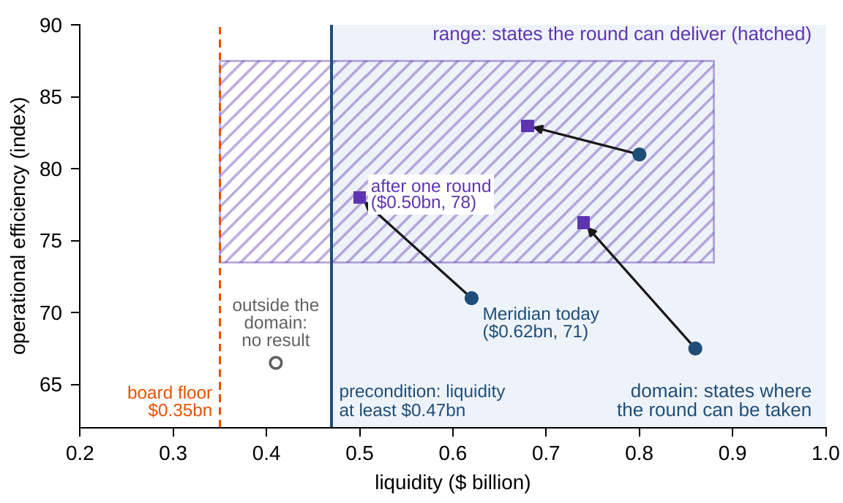
An operator: a domain and an effect
§6.2 · DEFINITIONS 6.1–6.4 · FIGURE 6.1
Operator: a declared action, defined on its domain, that sends each state there to a result
Domain: where the action can be taken; outside it there is no result, not merely a poor one
Range: what the action can deliver; 'it can deliver any target' claims the range is everything
Meridian's automation round costs $120m, closes half the gap to 85, and needs $470m so the $350m floor holds after it
From today, $620m and efficiency 71, one round leads to $500m and 78
Figure 6.1. Meridian's automation round: the domain (shaded) holds the precondition, the arrows are the effect, the range (hatched) is what the round can deliver.
Notes:
Definitions 6.1-6.4 and Figure 6.1. 'Can we do this from here?' becomes a membership check (LOS Guidance 6.1). A feasible state with too little liquidity, $0.41 billion in the figure, is outside the domain: the round has no result there. A common mistake is to treat preconditions as advice rather than as limits on where the action exists.

Slide 7
Operators and system steps are one subject
§6.2 · THEOREM 6.1
What it means
THEOREM 6.1
Transformation Representation Theorem
Effects that rest on decisions are commitments; effects that need the environment are assumptions
Meridian's sale delivers its cash only if a buyer pays the assumed price
A bank that invests half its liquidity above a $300m floor each year goes from $900m to $600m, $450m, $375m: never below the floor
(i) Each one-period step of the company, for given decisions and environment, is the application of an operator
(ii) A declared operator can be carried out exactly when, at every state in its domain, some decision and some environment produce its effect
(iii) A policy, a rule that chooses the decision from the current state, turns a family of operators into a closed-loop system
Notes:
Theorem 6.1, the Enterprise Transformation Representation Theorem; formal statement and proof in Appendix 6.A. Online Appendix Example 6.B.1 works the bank: technology rises from 41 toward 71 (56 after one year, 63.5 after two), and a board that wants faster progress must change the rule, not hope for a different path.

Slide 8
Readiness is a domain condition
§6.2 · TABLE 6.1
Type | Typical form | Typical domain condition
Efficiency program | affine, close to 'do nothing': x ↦ Ax + b with A near I | funding available; capacity slack
Capacity investment | changes the capacity readings only | liquidity at least the capital spending; leverage headroom
Divestiture | removes a block of the state, credits the proceeds | asset still owned; a buyer at the assumed price (environmental)
Acquisition or merger | combines two companies' states into one | financing; regulatory clearance
Technology migration | saturating gain on platform readings | talent threshold; old and new platforms able to coexist
Reorganization | regroups the structural readings | governance approval; integration capacity
Deleveraging | targets a ratio of liquidity and leverage | covenant headroom along the way
Table 6.1: recurring operator types. Forms are local models; domains carry the preconditions that practice calls readiness.
A divestiture's cash rests on a buyer at the assumed price: an assumption, not a commitment
Notes:
Table 6.1. Each type's typical domain condition is what practice calls readiness. Where the condition is environmental, as with the divestiture's buyer, the declared effect is an assumption about the world (Theorem 6.1(ii)).

Slide 9
Order can decide whether a program runs
§6.3 · THEOREM 6.2
What it means
THEOREM 6.2
Transformation Composition Theorem
Transformation lives in the monoid: the inverse is almost never in the repertoire
Each step's reversibility premium is a risk number; an infinite premium is a commitment
A merger is a three-step word, diligence, closing and integration; closing is the point of no return
Selling with the engineers kept enables Meridian's build; built first, the build has no result
(i) Algebra. Programs and 'do nothing' chain and group freely, a monoid; programs that can be undone form a far smaller set, which a repertoire typically meets only at 'do nothing'
(ii) Sensitivity. If each step amplifies differences by at most its own factor, the program amplifies them by at most the product of the factors
(iii) Order. Some pairs can run in one order from many states and in the other order from none
Notes:
Definitions 6.5-6.7, Propositions 6.2-6.4 and Theorem 6.2; proofs in Online Appendix 6.B. Part (iii) sharpens Chapter 3's sequencing lesson from 'order changes the outcome' to 'order decides whether the program runs'. The broken deal is a program that leaves the next step's domain at one of its seams.

Slide 10
Operator properties, read as business
§6.3 · TABLE 6.2
Property | Mathematics | Business reading
Total or partial | domain is all of X, or not | unconditional action, or one with preconditions
One-to-one | distinct states, distinct results | no information destroyed; an undo is well defined in principle
Onto the codomain | range equals codomain | the program can deliver any declared target
Invertible and available | an undo exists and is in the repertoire | a genuinely reversible step (rare)
Idempotent | T ∘ T = T | one-and-done: repeating it adds nothing
Contractive (L < 1) | differences shrink | consolidating step: forgives error
Expansive (L > 1) | differences grow | amplifying step: compounds error
Table 6.2. Sensitivity factors are measured with a declared distance and scaling (Proposition 3.3).
The sensitivity factor belongs on the operator's declaration
Notes:
Table 6.2. Inverses exist on paper for many operators; in practice the inverse is almost never in the repertoire: a divested division cannot be bought back at the sale price, and a retired platform cannot be revived with its expertise intact (Section 6.3).

Slide 11
A playbook repeats forever only from its core
§6.4 · EQUATIONS 6.2–6.3 · THEOREM 6.3
each repetition adds a precondition on today's state; the core is where the playbook can run forever
Theorem 6.3. The core is self-sustaining, the largest such set, and closed when the domain is closed and the effect continuous
'Is this a strategy or a trade?' asks whether today's state lies in the sustainable core
A roll-up that uses up its integration capacity has an empty core; a serial acquirer that rebuilds its bench holds one
Meridian's automation playbook is a trade with its savings paid out and a strategy with them recycled
Notes:
Section 6.4 and Theorem 6.3; proof in Appendix 6.A. The core concerns whether a playbook can run forever, not whether it is worth running: value questions await the performance architecture (Chapter 11) and the optimization problem of Chapter 15. For a whole repertoire the analogous object belongs to the viability theory that Volume II takes up.

Slide 12
Feasible at every seam, not only at the end
§6.5 · PROPOSITION 6.5 · TABLE 6.3
Constraint type | Domain condition | Meridian instance
Resource | the resource reading covers the cost | liquidity at least the program's spending
Regulatory | the clearance condition holds | merger control; sector approvals
Precedence | an earlier step has been completed | integration only after closing
Capacity | change capacity covers the load | one major program per division and year
Integrity | the result stays in the feasible region | the board's floor and the covenant hold after the step
Proposition 6.5: programs of feasible operators stay feasible along the way; a single step that is not can pass through an infeasible state between feasible end points.
Worked Example 3.1's digital-then-restructure ends at $422m but passes through $310m, below the $350m floor
Notes:
Definition 6.8, Proposition 6.5 (proof in Online Appendix 6.B) and Table 6.3. Practice knows the defect as 'the plan works on an annual view'; the mathematics locates it in the step and not in the plan's end points. On the floor of Table 5.4 the digital build is not a feasible operator from today's state.

Slide 13
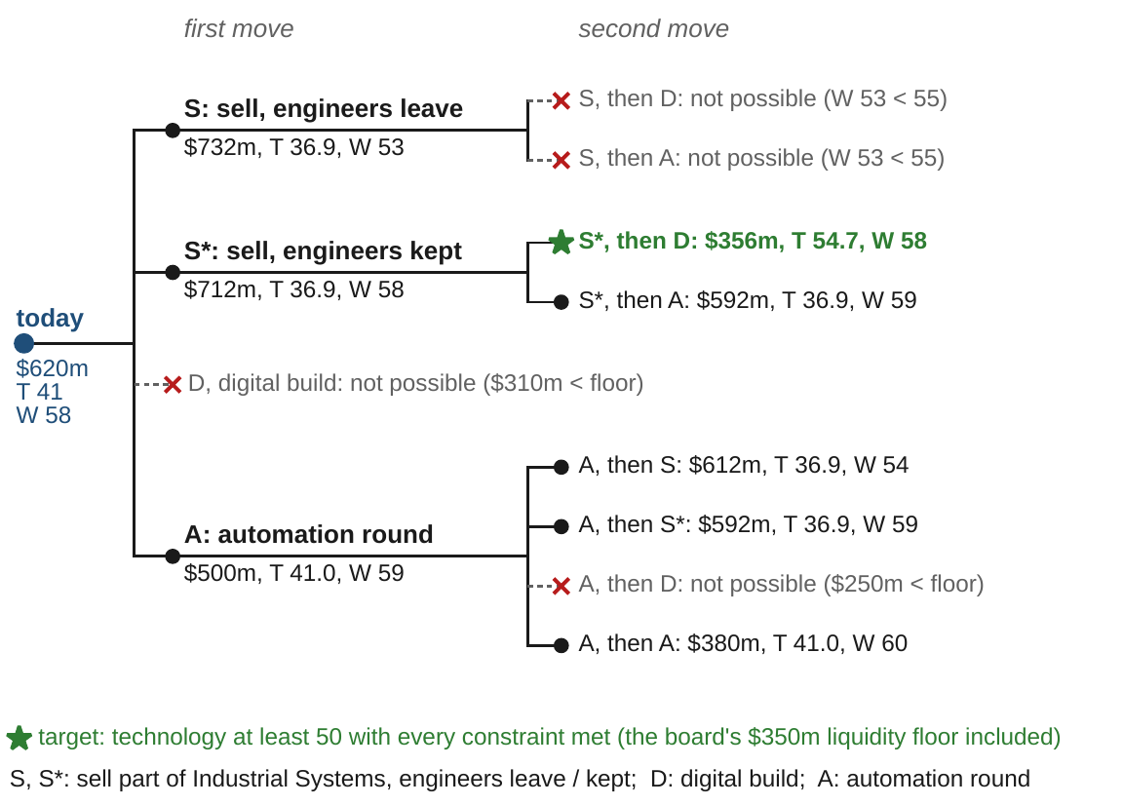
One path reaches the technology target
§6.6 · THEOREM 6.4 · FIGURE 6.3
Theorem 6.4. A target is reachable exactly when it holds a reachable state; breadth-first search finds a shortest path
Three of four first moves are possible; the build alone would leave $310m, below the floor
Selling as designed is a dead end: with capability at 53, neither the build nor automation can follow
Only selling with the engineers kept, then building, reaches technology 50: $356m, technology 54.7
Complete goals such as 'zero defects' are limits: give them a tolerance
Figure 6.3. Every sequence of up to two moves from today, pruned where a precondition fails; the one path to the target is found at depth two.
Notes:
Definition 6.9, Theorem 6.4 (proof in Appendix 6.A) and Figure 6.3. The target path ends $6 million above the floor. Part (iii): some targets can be approached as closely as desired yet reached by no finite path; 'within 1 percent of full digitization' rejoins the reachable world. The companions grow the repertoire to closure: 12 reachable states, no program longer than 4 moves.

Slide 14
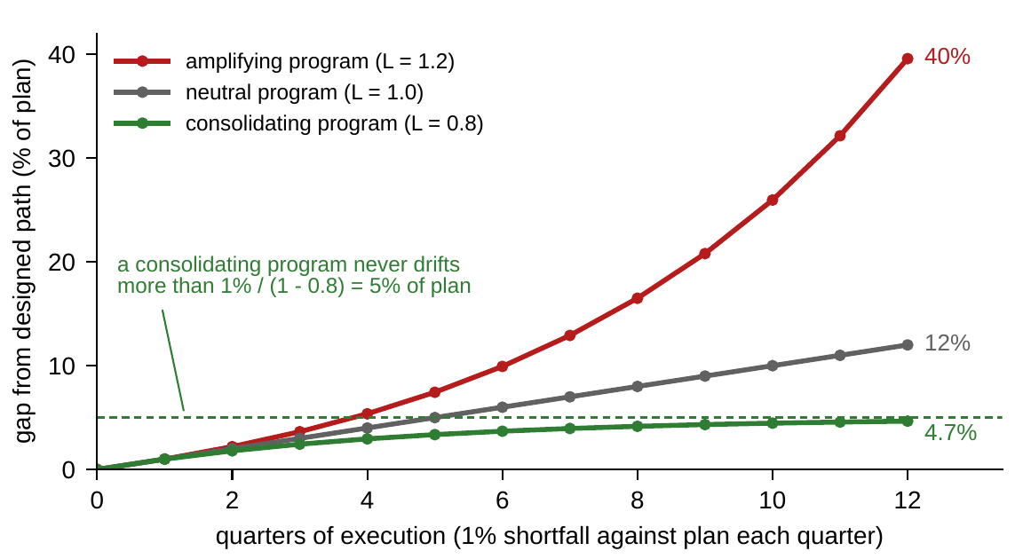
Set execution tolerance by the factor L
§6.7 · THEOREM 6.5 · FIGURE 6.4
Theorem 6.5. A starting error grows at most by the factor L^{k}; a shortfall ε at each step drifts at most ε(1 + L + ⋯ + L^{k−1})
Under contraction the drift never exceeds ε/(1 − L), and the steady state moves no more than that
A 1% shortfall a quarter: at most 5% at L = 0.8, 12% in three years at L = 1, about 40% at L = 1.2
Amplifying programs need precise execution and frequent re-anchoring; consolidating ones can economize
Figure 6.4. The gap between executed and designed paths when each quarter falls 1 percent short of plan. The bound is attained, so the curves are the worst case itself.
Notes:
Definition 6.10, Theorem 6.5 (proof in Appendix 6.A), Equation 6.4 and Remark 6.B.2: T x = Lx + c executed as Lx + c - ε attains the bound. The notebook draws shortfalls between 0 and 1 percent a quarter with the lab's seed 26106: every path stays inside the bound.

Slide 15
Strategy or trade? The automation playbook
WORKED EXAMPLE 6.1 · THE SITUATION
Industrial Systems
The value
The chief financial officer
An automation round every year
$10m a year for every efficiency point gained
A strategy Meridian can repeat, or a trade that runs out?
$120m a round; it closes half the gap from efficiency 71 to the plants' ceiling of 85 and adds a point of workforce capability.
One round from today is worth $70m a year in lower costs.
Assume the rest of Meridian's cash flows leave liquidity unchanged.
A round needs $470m of liquidity, so the $350m floor holds after it, and capability of at least 55.
Notes:
Worked Example 6.1, the situation and Step 1. The round is Figure 6.1's operator: liquidity falls by $120 million, efficiency e becomes e + (85 - e)/2, workforce capability rises by one point; its domain is liquidity of at least $470 million and workforce capability of at least 55, so that the automated lines can be staffed.

Slide 16
Paid out, the playbook ends after two rounds
WORKED EXAMPLE 6.1 · STEPS 1–2
liquidity q in $ million, efficiency e, workforce capability w: Step 1 declares the effect and the domain
Step 2: with the savings paid out, each round spends $120m: $620m, $500m, $380m, and the third round's precondition fails
The k-th round needs today's liquidity of at least 470 + 120(k − 1): no start supports every round
The sustainable core is empty (Theorem 6.3): on these terms automation is a trade
The workforce precondition is not the problem: each round renews it
Notes:
Worked Example 6.1, Steps 1-2, and Equation 6.2: the nested domains shrink to nothing, since round k needs $470 million, $590 million, $710 million and so on of today's liquidity. LOS Guidance 6.4: the round runs twice and stops.

Slide 17
Recycled savings fund the rounds from year 3
WORKED EXAMPLE 6.1 · STEP 3 · TABLE 6.4
Year | 0 | 1 | 2 | 3 | 4 | 5 | 6
Efficiency (index) | 71.00 | 78.00 | 81.50 | 83.25 | 84.13 | 84.56 | 84.78
Savings this year | – | 70.0 | 105.0 | 122.5 | 131.3 | 135.6 | 137.8
Savings less the round's cost | – | −50.0 | −15.0 | 2.5 | 11.3 | 15.6 | 17.8
Liquidity at year end | 620.0 | 570.0 | 555.0 | 557.5 | 568.8 | 584.4 | 602.2
Table 6.4: the automation playbook with the savings recycled, as designed; $ million, one round at the start of each year.
Liquidity bottoms at $555m; the playbook runs indefinitely from $535m, and Meridian, at $620m, is $85m inside the core
Notes:
Table 6.4 and Worked Example 6.1, Step 3. Each year's composite operator is 'run a round, then bank the year's savings'. The savings grow from $70 million to $122.5 million in year 3, when they first exceed the round's cost; liquidity then rises by up to $20 million a year. The tightest moment is the start of year 3.

Slide 18
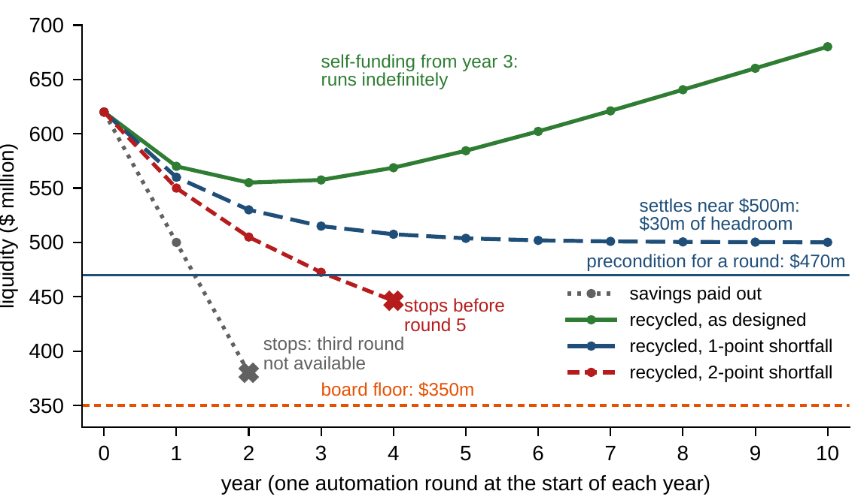
Two points of slippage make it a trade again
WORKED EXAMPLE 6.1 · STEP 4 · FIGURE 6.2
Each round halves the gap to 85: the efficiency step is a contraction with L = 0.5
One point short a round: the steady state moves at most 1/(1 − 0.5) = 2 points, to 83
Savings top out at $120m, exactly a round's cost; liquidity sinks toward $500m: $30m of headroom
Two points short: savings top out at $100m; liquidity falls below $470m before round 5
Figure 6.2. Meridian's liquidity under one automation round a year: savings paid out, recycled as designed, and recycled with shortfalls of one and two efficiency points a round.
Notes:
Worked Example 6.1, Step 4, Theorem 6.5(iii) and Figure 6.2. With two points short, liquidity is $550 million, $505 million, $472.5 million and $446.25 million after rounds 1-4 (the companions compute them), so the fifth round's precondition fails.

Slide 19
Two board choices decide strategy or trade
WORKED EXAMPLE 6.1 · WHAT THE BOARD SHOULD TAKE AWAY
Year 3
$535m
2 points
from which the ring-fenced program funds itself and can run indefinitely
the core's threshold: Meridian, at $620m, is $85m inside
of slippage a round, or paid-out savings, and it exhausts its own precondition
Strategy or trade is not a property of the technology: the board sets it by what happens to the savings and how closely execution tracks the design
For discussion: which of Meridian's other playbooks, bolt-on acquisitions, annual price increases, capital recycling in Advanced Materials, renew their own preconditions?
Notes:
Worked Example 6.1, what the board should take away, and the discussion question. Ring-fence the savings and execute to plan, and the program funds itself from year 3; pay them out, or let execution slip by two points a round, and the same program exhausts its own precondition within a few years.

Slide 20

Sequencing Meridian's moves, in AXIOM
AXIOM LAB 1.6 · MODULE AXIOM-06
The board wants a two-year program built from four moves, the sale of part of Industrial Systems with or without the shared engineering team, the digital build and the automation round, and a view on whether automation should become an annual playbook. Open AXIOM, choose Lab 1.6 and load Meridian's repertoire.
1
2
3
4
5
Forge the operators
Compose programs
Test the playbook
Explore reachability
Stress the execution
Declare the four moves with their effects and preconditions, the floor included; inspect each domain and range.
Chain the moves two at a time; record which pass every seam and find the one that reaches technology 50.
Repeat the round with the savings paid out and recycled; find the smallest starting liquidity of the core.
Grow the reachable sets one step at a time against the target; tighten or loosen its tolerance.
Set the shortfall per round and the factor L; compare the drift with the bound of Equation 6.4.
Deliverable: a one-page memo recommending a two-year sequence with its seam conditions, the automation playbook's status (strategy or trade, with the core threshold), and the execution tolerance for each step. About 45–60 minutes.
Notes:
AXIOM Lab 1.6. What to look for: only one two-move sequence reaches the technology target within the floor (Theorem 6.4); the recycled playbook is tightest early, at the start of year 3 (Theorem 6.3); consolidating steps forgive shortfalls and amplifying steps compound them (Theorem 6.5). Discussion: the only sequence that reaches the target leaves Meridian $6 million above its floor; should the board ring-fence the savings, and how would it explain that to investors who expect dividends; which of the four moves can be undone, and at what cost?

Slide 21
What to carry forward
KEY TAKEAWAYS
1
Operators are declared actions: domains hold the preconditions, mappings the effects, and feasibility questions become membership checks.
2
Applying operators and running the company as a system are one subject in two notations; effects that rest on the environment are assumptions, not commitments.
3
Programs are operators. Transformation lives in the monoid, not among reversible steps, and order can decide whether a program runs at all.
4
A playbook is a strategy rather than a trade exactly when today's state lies in its sustainable core; whether targets are reachable is a membership question, and complete goals need tolerances.
5
Execution error is forgiven by consolidating programs and compounded by amplifying ones; set execution tolerance by the program's sensitivity factor.
Notes:
Key Takeaways, Chapter 6.

Slide 22
Notebook and workbook reproduce the book
THIS WEEK'S LABORATORY
73
86
26106
AXIOM-06
notebook checkpoints, every one PASS
workbook checks against the engine, ALL PASS
the lab's seed
AXIOM Lab 1.6
Notebook DCT_V1_Ch06_Lab.ipynb: Worked Example 6.1 and the lab's five steps in eight panels, ready for Colab
Workbook DCT_V1_Ch06_Lab.xlsx: the operators, every two-move program, the playbook and its core, the reachable sets and the drift bound, in formulas
Every number on these slides is the book's, and both companions check it
Notes:
The notebook and workbook are on the course website, www.dynamiccorporatetransformation.com. The chapter's numbers involve no randomness; the lab's seed 26106 drives only the notebook's new draws of execution shortfalls, labelled as such.

Slide 23
Chapter 7 turns acts into behavior
NEXT · CHAPTER 7
The bridge is Theorem 6.1(iii): a policy turns a family of operators into a closed-loop system
Chapter 7 assembles the machine: momentum, decisions and environment, in continuous and quarterly time
Under a held policy steady states are chosen, and exact tests decide whether a company settles or spirals
Worked Example 7.1: steering Meridian's hiring harder can cause the swings it means to damp
Notes:
Section 6.2's bridge and Chapter 7, Dynamic Enterprise Systems: the linear time-invariant forms of Equation 7.1, free and forced response, what outsiders can infer from reports, steady states and stability, and management as feedback (Worked Example 7.1, How Hard Should Meridian Steer Its Hiring?).

