Slide 1
Mathematical Formulation of Enterprise Optimization
VOLUME I · CHAPTER 15 · WEEK 7
Pose the board's question once, as one problem it can audit: feasibility first, a price on everything that binds, and a frontier the board chooses from
Graduate course companion · Lab seed 26115 · AXIOM Lab 1.15 (AXIOM-15)
Notes:
Volume I, Chapter 15. Fourteen chapters described what a company is and how it moves; this chapter asks the question every board asks first: of the futures the company can reach, which should it choose? The answer is one problem, the General Enterprise Optimization Problem (the chapter's abstract).

Slide 2
“My intention was to minimize my future regret. So I split my contributions 50/50 between bonds and equities.”
Harry M. Markowitz
Nobel Memorial Prize in Economic Sciences 1990; the founder of portfolio theory, on his own retirement savings, Money (1998)
Notes:
Harry Markowitz on his own retirement savings (Money, 1998). The chapter's subject is formulation, not computation: enterprise optimization almost never fails in the algorithm; it fails in the problem statement (Section 15.1).

Slide 3
After this chapter, you can
LEARNING OUTCOME STATEMENTS
15.1
Formulate a transformation decision as the General Enterprise Optimization Problem—decisions, objective, commitments, horizon, uncertainty, and the rules the company can implement, each with an owner—and explain why it must be posed on the unified company.
15.2
Explain why feasibility comes before optimality, and read the binding commitments and their multipliers as the priced list of what the company has promised.
15.3
Handle several objectives: recognize conflict, trace the efficiency frontier with constraint-based methods, and read its slopes as exchange rates that the board chooses.
15.4
Choose among static, dynamic, stochastic, robust, and adaptive formulations, and explain rules versus plans, rolling plans and their terminal conditions, the flaw of averages, and the value of information.
15.5
Explain how architecture shapes the optimum—decentralization with prices, the value of coordination, holdable optima—and what Volume II inherits: a solver-neutral problem with certificates.
Notes:
The five learning outcome statements; LOS Guidance at the end of the chapter.

Slide 4
Eight sections, a worked example and a lab
ROADMAP
§15.1
§15.2
§15.3
§15.4
§15.5
Why Enterprise Optimization?
The Problem, Stated
Decisions, Objectives, and Commitments
Feasibility Before Optimality
Optimality Conditions and Shadow Prices
Three failures
Definition 15.1 · Theorem 15.1
Table 15.2
Theorem 15.2
Theorem 15.3
§15.6
§15.7
§15.8
Worked Example 15.1
AXIOM Lab 1.15
Time, Uncertainty, and Rules
Multiple Objectives and the Efficiency Frontier
Architecture, Holdability, and the Unified Theorem
What Does the Board's Appetite Cost?
Pricing Meridian's Commitments
Theorem 15.4 · Figure 15.1
Theorem 15.5
Theorems 15.6–15.7
Table 15.5 · Figure 15.2
AXIOM-15 · five steps
Notes:
Section 15.2: Definition 15.1, Proposition 15.1, Theorem 15.1 and Table 15.1. Section 15.3: Definitions 15.2-15.5, Propositions 15.2-15.3 and Tables 15.2-15.3. Section 15.4: Definition 15.6, Proposition 15.4 and Theorem 15.2. Section 15.5: Theorem 15.3 and Proposition 15.5. Section 15.6: Theorem 15.4, Figure 15.1 and Propositions 15.6-15.7. Section 15.7: Proposition 15.8, Definitions 15.7-15.8 and Theorem 15.5. Section 15.8: Proposition 15.9, Theorem 15.6, Definition 15.9, Table 15.4 and Theorem 15.7. Worked Example 15.1: Figure 15.2 and Table 15.5. Proofs of Theorems 15.3, 15.5 and 15.6 are in Appendix 15.A; all other results in Online Appendix 15.B.

Slide 5
Optimization fails in the problem statement
§15.1 · WHY ENTERPRISE OPTIMIZATION?
Failure: fragmentation
Failure: feasibility naïveté
Failure: objective monoculture
Each method optimizes a projection of the company
Constraints taken as given, and per period
One scalar hides what companies pursue
Rigorous on its slice, silent on the couplings that carry the company's behavior.
Admissibility belongs to the whole path; per-period checks certify nothing.
Value, resilience, sustainability and adaptability conflict, structurally.
The GEOP's answer
The GEOP's answer
The GEOP's answer
Posed on the unified company
Its feasible set is the audited region
Its objective is declared, single or plural
Every objective and commitment reads the same state (Chapters 13–14).
With the viability kernel as its honest core (Theorem 14.5).
A functional of the ledgers, with units, weights and owners.
And it is free of any algorithm: Volume I formulates, Volume II solves.
Notes:
Section 15.1. Optimizing a projection while the couplings move the whole is how companies maximize a KPI into a crisis. Volume I formulates and Volume II solves: a formulation owned by no algorithm can be audited by every office.

Slide 6

One problem, every component declared
§15.2 · DEFINITION 15.1
subject to the unified dynamics, a rule the company can implement, and its declared commitments
Six declarations, each with an owner: horizon, decisions, policy class, environment, objective, commitments
Proposition 15.1. It reads several ledgers of one state: posed on separate layers, it can count the same cash twice
Theorem 15.1. Well-posed data; the familiar optimization families are instances with blocks frozen; nothing hidden
Under uncertainty each commitment holds on every path or in a declared probabilistic form; with several objectives, max means Pareto optimal
Notes:
Definition 15.1 (Equations 15.1-15.3), Proposition 15.1 and Theorem 15.1; formal statements and proofs in Online Appendix 15.B. The commitments are capital floors, performance targets, risk ceilings, governance identities and sustainability floors, held on every path or in a declared probabilistic form.

Slide 7
Every component is supplied by a chapter
§15.2 · THEOREM 15.1 · TABLE 15.1
Component | Supplied by
State | Chapters 3 and 5; the integrated state (Definition 13.7)
Decisions; rules | operators and programs (Chapters 6–7); Definitions 15.2–15.3
Dynamics; environment | Chapters 7, 8 and 13
Objective | the capital, performance and risk ledgers (Chapters 10–12)
Commitments | Chapters 9–13; Table 13.3
Honest planning set | the viability kernel: Theorems 13.5 and 14.5
Regularity | the analytical panel A1–A5 (Table 14.1)
Derivatives; prices | sensitivities and multipliers: Theorems 14.4 and 15.3
Holdability | stability certificates: Theorem 14.3
Honesty clauses | Goodhart, the flaw of averages, viability: Theorems 11.1, 8.5 and 14.5
The problem adds only the frame: every objection lands on a declared component and its owner.
Notes:
Table 15.1 (abridged: the symbols are left out) and Theorem 15.1(iii): every component is a declared object of Chapters 1-14, inherited with its warranty. The company's existing optimization estates, the portfolio model, the capacity plan, the business case, are not rivals to replace but instances to reconcile: each is the GEOP with blocks frozen (Section 15.2's enterprise box).

Slide 8
Nine classes of commitment, each with an owner
§15.3 · DEFINITION 15.5 · TABLE 15.2
Class | Meridian instance | Owner
Structural, architectural | every core link at most 0.40; the board's half-life rule | risk office
Financial, budget | liquidity floor $350 million; covenant at most 4.5× | CFO
Operational, resource | plant capacity in Industrial Systems | COO
Performance, strategic | scorecard and service floors | division heads
Risk | strategic-risk ceiling 75; breach odds at most 5 percent | CRO, board
Governance | the buffer's funding identity (C3) | board
Legal, regulatory | licenses; disclosure duties | general counsel
Sustainability, ESG | emissions ceilings | sustainability office
Human capital, technology | capability at least 55 for the digital build | HR, CTO
Table 15.2, without its canonical forms. A commitment carries a scope, a predicate, an owner and a consequence of violation.
A commitment is never free: if it binds, it costs its multiplier; if it never binds, it was decoration.
Notes:
Definitions 15.2-15.5, Table 15.2 and Proposition 15.3: tightening a commitment never raises the attainable value, relaxing one never lowers it. Most companies hold every row, in nine documents owned by nine offices, with the meetings between them undeclared (Section 15.3's enterprise box).

Slide 9
Feasibility comes before optimality
§15.4 · THEOREM 15.2
What it means
THEOREM 15.2
Feasible Enterprise Solution Theorem
Proposition 15.4 fixes the order: joint consistency, then viability, then optimization
A minimal infeasible set is the next meeting's agenda: Worked Example 13.1's sign-offs were one
“The plan feels tight” becomes “these commitments exhaust each other in so many quarters”
Lab 1.15: cap the line at $100m and the delay at two quarters, then ask for under 3 percent
(i) Feasible plans. A plan exists exactly when the start lies in the viability set; the construction builds one or proves there is none
(ii) Optima exist. If a feasible plan exists, a best one is attained
(iii) Failures are named: a minimal set of commitments that cannot hold together, or an emptying date
(iv) Proposed commitments are priced before adoption by rerunning the two audits
(v) Room to spare. A Slater plan, which the multiplier theory needs
Notes:
Definition 15.6, Proposition 15.4 and Theorem 15.2; formal statements and proofs in Online Appendix 15.B. Chance constraints are not path-wise and are checked by simulation (Example 15.B.4). With both levers capped, the best package is Chapter 8's, at 3.0 percent.

Slide 10

Everything that binds has a price
§15.5 · THEOREM 15.3 · EQUATION 15.4
at the optimum you are held only by what binds; slack commitments carry zero multipliers
(ii) Sufficient under declared convexity: concave objective, convex commitments, affine identities
(iii) Multipliers are prices: loosening a commitment by b gains at most λb; tightening it loses at least λb
(iv) Without convexity a point that meets it is a candidate, not a verdict: say which certificate it carries
Proposition 15.5: values are stable, decisions twitchy: near the stability edge, at ρ = 0.95, a 1% recalibration moves the best decision 19%
Notes:
Theorem 15.3 (proof in Appendix 15.A) and Proposition 15.5 with Example 15.B.1. The multiplier vector is the chapter's premier governance export: a priced list of the binding commitments. Worked Example 15.1 prices Meridian's risk appetite this way.

Slide 11
One rule book from every state
§15.6 · THEOREM 15.4
Three declarations, three promises
THEOREM 15.4
Dynamic Enterprise Optimization Theorem
Stochastic: commitments on every path, or as a chance constraint: on average
Robust: the guaranteed floor over a declared set: whatever happens within it
Adaptive: decisions that respond to what is learned: as we learn
Proposition 15.7: certainty equivalence is the exception, and Meridian's digital program is not one
(i) One rule book. The backward recursion gives one rule, optimal from every feasible start
(ii) Costates are sensitivities: the price of every stock at every date
(iii) Information and authority have a computable value: a larger policy class never lowers the optimum
(iv) Rolling plans need a terminal condition: every window must end inside the viability kernel
(v) Long horizons. With a discount, a contraction and one time-invariant rule
Notes:
Theorem 15.4 and Propositions 15.6-15.7; formal statements and proofs in Online Appendix 15.B. Part (ii): the sensitivity machinery Chapter 14 built for audit is the engine of dynamic optimization. Part (iii): the value of a better dashboard or a delegated authority is a difference of two GEOP values.

Slide 12
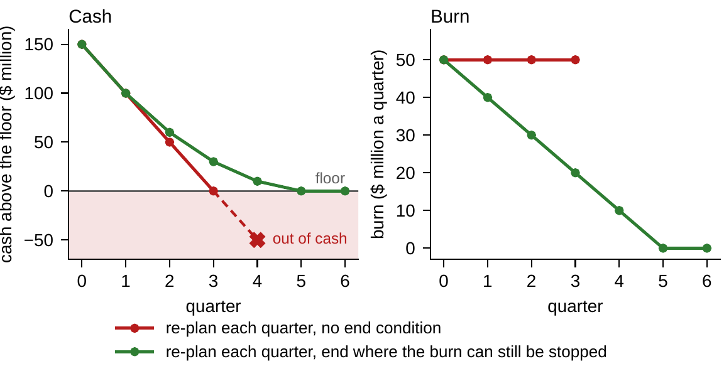
Rolling plans need a terminal condition
§15.6 · THEOREM 15.4(IV) · FIGURE 15.1
$150m above the floor, a burn of $50m a quarter, cuts of at most $10m a quarter
Re-plan each quarter to maximize spending: the burn is never cut, and cash runs out in quarter 4
End each window where the burn can still be stopped: the cuts start in the first quarter
Every window was feasible and optimal; the sequence was doomed once it left the kernel
Annual plans re-solved annually are only as good as their terminal condition
Figure 15.1. Chapter 14's runway after its $30m repair, re-planned each quarter without and with a terminal condition.
Notes:
Theorem 15.4(iv), Figure 15.1 and Example 15.B.2. Stopping a burn r needs N(r) = Σ max(r − 10i, 0) of cash, and N(50) = 150: the start is on the kernel's edge. With the terminal condition the path is 150/50, 100/40, 60/30, 30/20, 10/10, 0/0.

Slide 13
The board chooses on the frontier
§15.7 · THEOREM 15.5
For Meridian
THEOREM 15.5
Enterprise Pareto Frontier Theorem
Proposition 15.8: the levers' cost and the breach odds conflict
At the board's 5 percent the frontier's slope is $1.8m per percentage point
Chapter 8's package is inside it: its 3.0 percent costs $14.7m on the frontier, not $19.0m
Nothing here chooses the point: that choice is the board's, among efficient points with prices attached
(i) Existence. The frontier is not empty, and it matches or beats every attainable combination
(ii) Weighted sums land on the frontier, but cannot see the points in a dent
(iii) The constraint method is complete: every frontier point maximizes one objective subject to floors
(iv) Frontier slopes are multipliers: the floors' prices are its exchange rates
(v) The inefficiency gauge: how far every objective can rise together
Notes:
Definitions 15.7-15.8, Proposition 15.8 and Theorem 15.5 (proof in Appendix 15.A). Weight sweeping, the default practice, cannot see frontier segments in a dent, often where lumpy transformation options live; the constrained form is the audit-grade method (Section 15.7's enterprise box).

Slide 14
Prices coordinate; silos have a cost
§15.8 · THEOREM 15.6 · PROPOSITION 15.9
For Meridian
THEOREM 15.6
Enterprise Architecture Optimality Theorem
Under the half-life rule, every 0.01 trimmed from both engineering links frees 0.019 of the new link
Its multiplier is the price at which each office buys down its own couplings
Charged λ = α/r* for the budget it uses, each office chooses what the company would
Priced together, the two levers of Worked Example 15.1 save $30m: the value of coordination
Boards that read the paper optimum beside the holdable one stop buying paper
(i) No couplings, no center: with no shared commitments, decentralization is exact
(ii) Prices coordinate: under convexity, each block maximizes its objective less the prices of what it uses
(iii) The value of coordination: fixed shares never do better than prices
(iv) Holdability: a stability certificate turns the paper optimum into one the company can keep
Notes:
Theorem 15.6 (proof in Appendix 15.A), Proposition 15.9 and Example 15.B.3: with every existing link at 0.40, the new link can carry at most 0.080, and dh/de = −4e/r* = −1.903. Transfer prices are multipliers, not negotiations; boards that see the paper optimum and the holdable one side by side stop buying paper.

Slide 15
Solver-neutral, certificate-strict
§15.8 · TABLE 15.4 · THEOREM 15.7
Method family (Volume II) | Natural regime | Certificate returned
Linear and convex programming | convexity declared | global optimum; exact multipliers
Nonlinear programming | smooth, nonconvex | a point meeting Equation 15.4; local grade
Dynamic programming, optimal control | the recursion of Equation 15.5 | value function; policy
Stochastic programming | scenarios or kernel | expected optimum; bounds
Robust optimization | a declared set of environments | guaranteed floor
Multi-objective methods | plural mandates | frontier points; exchange rates
Integer and combinatorial | lumpy or sequencing decisions | bounds and gaps
Learning-based, approximate DP | rich policy classes; scale | statistical guarantees
Admission contract: the instance consumed as declared; a feasibility report; an optimality certificate; prices; sensitivity handles; seeds, tolerances and versions logged; a holdability check.
Theorem 15.7: the problem is posed, on one certified object; what remains is to solve it well.
Notes:
Definition 15.9, Table 15.4 and Theorem 15.7 (formal statement and proof in Online Appendix 15.B). AI assistance enters at three declared points and never dissolves the problem statement: the GEOP remains the contract between the company and every optimizer, human or learned.

Slide 16
What does the board's appetite cost?
WORKED EXAMPLE 15.1 · THE SITUATION
Chief financial officer
Transformation office
The chair
The standby line costs its fees
Phasing costs its delay
The cheapest package that meets the appetite, and what the appetite costs
About 1 percent of the line a year: $3m per $100m over the three-year program.
Chapter 8's phasing cuts the deepest draw by $49m and delays the platform two quarters, at $8m each.
Together the two levers bring the odds of breaching the $350m floor within 5 percent; alone, neither does.
Notes:
Worked Example 15.1, the situation. Chapter 8 left open how much of each lever; Chapter 13 noted that each office would resist the lever in its own ledger.

Slide 17
Write it down, then compare the promises
WORKED EXAMPLE 15.1 · STEPS 1–2
the line ℓ (CFO) and the delay φ in quarters (transformation office); the covenant and capability floor too
Certainty equivalent: the average path bottoms out at $460m: it buys nothing; the true odds are 24.6 percent
Robust, Chapter 13's joint check: a $55m line passes it for $1.6m, but the odds stay at 17.4 percent
That set leaves out the execution and market deviation, which alone breaches the floor on 8.4 percent of paths
Only the stochastic formulation states the board's actual promise (Proposition 15.7)
Notes:
Worked Example 15.1, Steps 1-2. The horizon is the program's 12 quarters, and the environment is Chapter 8's: the same 100,000 simulated paths. The appetite is a chance constraint owned by the board; the covenant (net leverage at most 4.5×) and the capability floor of 55 complete the commitments.

Slide 18
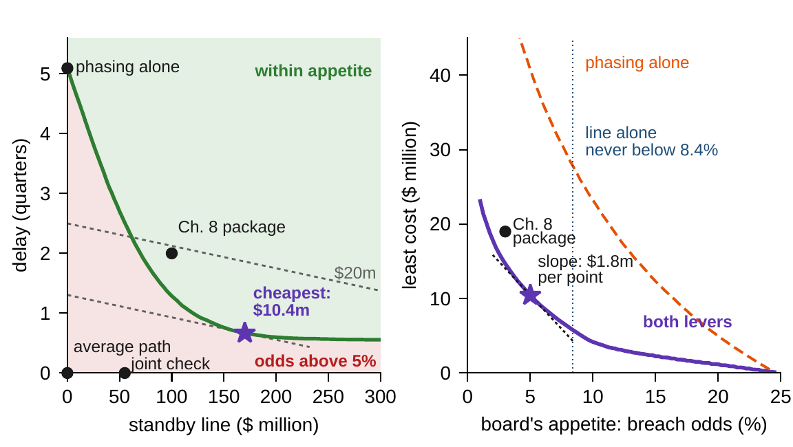
A large line and a short delay
WORKED EXAMPLE 15.1 · STEPS 3 AND 5
Step 3: a line of about $170m and a two-month delay, for $10.4m
$5.1m of fees and $5.3m of delay; any line from $140m to $205m is within $0.5m
The appetite binds, the covenant does not; the last $1m on either lever buys half a point
Step 5: a line alone stops at 8.4 percent; phasing alone costs $40.8m
Priced together, the two levers save $30m: the value of coordination
Figure 15.2. Left: the decisions and the 5 percent contour. Right: the least cost of each appetite; the slope at 5 percent is $1.8m a point.
Notes:
Worked Example 15.1, Steps 3 and 5, Figure 15.2 and Example 15.B.4. The deepest draw is $16m smaller. The capability floor is slack too, so both it and the covenant carry zero multipliers (Theorem 15.3(i)). At the optimum a point of safety costs $1.80m by the line and $1.77m by the delay.

Slide 19
The natural package is not the cheapest
WORKED EXAMPLE 15.1 · TABLE 15.5
Package | Line ($m) | Delay (quarters) | Cost ($m) | Odds (%)
Average path (certainty equivalent) | 0 | 0 | 0 | 24.6
Joint check of Chapter 13 (robust) | 55 | 0 | 1.6 | 17.4
Line alone, any size | any | 0 | – | ≥ 8.4
Phasing alone | 0 | 5.1 | 40.8 | 5.0
Chapter 8 package | 100 | 2.0 | 19.0 | 3.0
Cheapest at 6 percent | 160 | 0.50 | 8.8 | 6.0
Cheapest at the board's 5 percent | 170 | 0.67 | 10.4 | 5.0
Cheapest at 4 percent | 165 | 0.93 | 12.4 | 4.0
Cheapest at 3 percent | 180 | 1.16 | 14.7 | 3.0
Fees at 3 percent of the line over the program, $8 million a quarter of delay; odds that liquidity falls below the floor in some quarter (100,000 paths, as in Chapter 8).
Chapter 8's package is safe but inefficient: the frontier buys its 3.0 percent for $14.7m, not $19.0m.
Notes:
Table 15.5 and Step 5 (Theorem 15.5(v)). The cheapest way to honor the appetite is a large line and a short delay, not the package that looked natural.

Slide 20
The appetite is a price in disguise
WORKED EXAMPLE 15.1 · WHAT THE BOARD SHOULD TAKE AWAY
$10.4m
$1.8m
$180m
the cheapest way to honor the 5 percent appetite
per percentage point: the appetite's multiplier
the cost of a breach that a 5 percent appetite implies: a third of a year's EBITDA
Step 4: 4 percent costs $12.4m, 6 percent $8.8m. At $4m or $16m a quarter of delay the price is $0.9m or $3.4m; the line hardly moves
The board should set the value of avoiding a breach deliberately, not leave it implicit in a round number
For discussion: the bank's $100m cap adds $2.9m. Could a rule that slows the build when cash runs low do better?
Notes:
Worked Example 15.1, Step 4, what the board should take away, and the discussion questions (Theorem 15.3(iii); Theorem 15.4(iii)). If the directors believe a breach would cost more, they should tighten the appetite; if less, loosen it.

Slide 21

Pricing Meridian's commitments, in AXIOM
AXIOM LAB 1.15 · MODULE AXIOM-15
Meridian's board wants every major transformation decision brought to it as a problem it can audit: decisions with owners, objectives with declared weights, commitments with prices. You prepare the first such pack, on the digital program's risk levers. Open AXIOM, choose Lab 1.15 and load the Meridian model.
1
2
3
4
5
GEOP builder
Constraint manager
A small allocation
Multi-objective explorer
Scenario generator
Assemble the instance from the declared inventories; run the well-posedness checks.
Audit consistency and viability; cap both levers, ask for less than 3 percent, read the infeasible set.
Watch the first-order point demand a negative investment; read the corner's multipliers.
Trace the frontier by floors and by weight sweeps; read the exchange rate at 5 percent.
Run the three formulations side by side; test a cash rule against the committed delay.
Deliverable: a one-page priced-commitments exhibit: the declared instance with its owners, the binding commitments and their prices, the frontier with the chosen point and its exchange rate, the formulation's promise, and the numbers' certificate. About 90 minutes.
Notes:
AXIOM Lab 1.15. What to look for: feasibility comes before optimality (Theorem 15.2); everything that binds has a price, and slack commitments have none (Theorem 15.3); the frontier's slope is the multiplier (Theorem 15.5(iv)); and the formulation's promise changes the answer (Proposition 15.7).

Slide 22
What to carry forward
KEY TAKEAWAYS
1
The GEOP is the volume in one problem: every chapter supplies a component, the problem adds only the frame, and every objection lands on a declared owner.
2
Feasibility precedes optimality, and the audits name what fails: a minimal set of incompatible commitments, or the date on which the room runs out.
3
At the optimum, everything that binds has a price: a multiplier caps what relaxing a commitment can gain and floors what tightening it will cost.
4
Time, uncertainty, and conflict change what “optimal” means: one rule book from every state, rolling plans that are honest only with a terminal condition, formulations that make different promises, and a frontier whose slopes are exchange rates the board chooses.
5
Decentralization is exact with prices, silos have a computable cost, optima must be holdable, and the problem is solver-neutral and certificate-strict.
Notes:
Key Takeaways, Chapter 15.

Slide 23
Notebook and workbook reproduce the book
THIS WEEK'S LABORATORY
84
92
26115
AXIOM-15
notebook checkpoints, every one PASS
workbook checks against the engine, ALL PASS
the lab's seed
AXIOM Lab 1.15
Notebook DCT_V1_Ch15_Lab.ipynb: Worked Example 15.1 and the lab's five steps in ten panels, ready for Colab
Workbook DCT_V1_Ch15_Lab.xlsx: the cheapest package, the price of the appetite, the frontier by floors and by weights, and the audit, in formulas
Every number on these slides is the book's, and both companions check it
Notes:
The notebook and workbook are on the course website, www.dynamiccorporatetransformation.com. The worked example's paths are Chapter 8's, drawn with random seed 8; the lab's seed is used only for fresh draws.

Slide 24
Chapter 16 asks: is Meridian ready?
NEXT · CHAPTER 16
Theorem 16.4 turns this chapter's hypotheses into four gates, checked in order, each failure a work order:
(R1) Declaration completeness: every element of the GEOP declared, with an owner
(R2) Unified consistency: the ledgers agree, and the commitments can hold together
(R3) Analytical panel: A1–A5 hold, decision sets compact, commitments continuous
(R4) Feasibility with horizon honesty: some policy keeps every commitment over the whole horizon
Worked Example 16.1 runs them on this chapter's GEOP; then Volume II solves it, method by method
Notes:
Chapter 16: Theorem 16.4 (Enterprise Optimization Readiness Theorem) and Worked Example 16.1, which runs the gates on the digital program's GEOP with the $170 million line and the two-month delay; Meridian passes all four after repairs earlier chapters priced. Section 15.8's handoff: Volume I ends holding one canonical problem on one certified object; Volume II begins holding the method families of Table 15.4.

