Slide 1
Optimal Control of Enterprise Systems
VOLUME II · CHAPTER 6 · WEEK 10
Price every stock, and at every moment choose the decision that maximizes the value earned now plus the value banked in the stocks
Graduate course companion · Lab seed 26206 · AXIOM Lab 2.6 (AXIOM-06, AXIOM-04)
Notes:
Volume II, Chapter 6. Chapter 5 priced every stock at every review date; this chapter lets the reviews come continuously, so the prices become costates and one condition, the maximum principle, replaces a whole program.

Slide 2
“The golden rule is that there are no golden rules.”
George Bernard Shaw
Nobel Prize in Literature 1925; Man and Superman, “Maxims for Revolutionists” (1903)
Notes:
Shaw's maxim returns in Section 6.4: the level at which a maintained stock is held, the modified golden rule, is no fixed number; it moves whenever the hurdle rate, the decay, or the price does.

Slide 3
After this chapter, you can
LEARNING OUTCOME STATEMENTS
6.1
Explain how the maximum principle extends Chapter 5's prices to continuous time, and read the Hamiltonian as the value earned now plus the value banked in the stocks.
6.2
Formulate an optimal control problem—state, decisions, dynamics, discounting, running and terminal value, end and path conditions—and write its Hamiltonian and costate equation.
6.3
Read costates as prices of stocks: the marginal value of a unit, the present value of what it earns net of decay, its user cost, and the ratio of its price to its replacement cost.
6.4
Apply the maximum principle to derive candidate plans, recognize their shapes—smooth, bang-bang, singular, the race to a level—and close them with end conditions and floors.
6.5
Certify a candidate by concavity, recognize when the necessary conditions are not enough, and choose and audit an indirect or a direct method of computation.
Notes:
The five learning outcome statements; LOS Guidance at the end of the chapter.

Slide 4
Six sections, a worked example and a lab
ROADMAP
§6.1
§6.2
§6.3
§6.4
From Prices at Review Dates to Optimal Control
The Hamiltonian and the Prices of Stocks
The Maximum Principle
Shapes of Optimal Plans
Definition 6.1 · Table 6.1
Definition 6.2 · Theorem 6.1
Theorem 6.2 · Proposition 6.1
Proposition 6.2 · Figure 6.2
§6.5
§6.6
Worked Example 6.1
AXIOM Lab 2.6
Ends, Floors, and Certificates
Computing Optimal Plans
What Is Meridian's Engineering Team Worth?
Steering a Stock: Prices, Switches, and Floors
Proposition 6.3 · Theorem 6.3
Table 6.2
Table 6.3 · Figure 6.3
AXIOM-06 · five steps
Notes:
Formal statements and proofs of Theorems 6.1-6.3 are in Appendix 6.A; Propositions 6.1-6.3 in Online Appendix 6.B, with the numbers behind Worked Example 6.1 (Example 6.B.3).

Slide 5
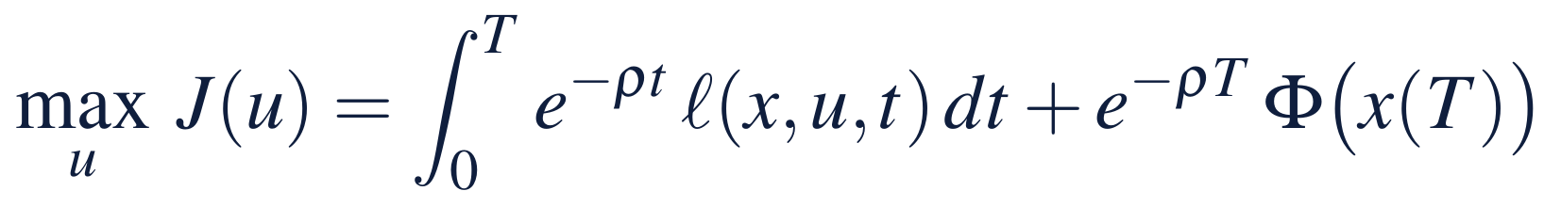
Prices at review dates become paths
§6.1 · DEFINITION 6.1
What continuous time changes
DEFINITION 6.1
Optimal Control Problem
Let Chapter 5's review dates come continuously, and its prices become paths: the costates
Stocks move only through rates: capability cannot be set, only built or lost
Volume I's cap of 2.5 capability points a quarter is a bound on a rate, not on a level
Each plan produces one path, and a rule the same path as its plan: conditions on paths bind both
A state x that collects the stocks, and decisions u(t), rates in a set U that carries the limits of authority
Dynamics ẋ = f(x, u, t) from a declared start, with the end and path commitments of Definition 5.1
Discounting at ρ = ln(1 + r): 9.5 percent for a hurdle rate of 10 percent a year
With T = ∞ there is no terminal value and ρ > 0; a plan is feasible if its path keeps every commitment
Notes:
Definition 6.1 and Section 6.1. An optimal control problem is Chapter 5's dynamic instance in continuous time with its discounting explicit. The prices become paths, the period-by-period judgment one condition at every moment, and the answers take shapes a coarse calendar can blur.

Slide 6
Chapter 5's prices, in continuous time
§6.1 · TABLE 6.1
 | On a calendar (Chapter 5) | In continuous time (this chapter)
Price of a stock | multiplier of the dynamics at each date, in today's dollars | costate m(t), in dollars of date t (Theorem 6.1)
How prices move | a backward recursion (Theorem 5.1(iii)) | the costate equation, backward from the end
Judging a decision | the period's value plus the priced change in the stocks | the Hamiltonian, maximized at every moment (Theorem 6.2)
End of the horizon | discounted gradient of the terminal value | m(T) = ∇Φ, plus the price of any end condition
Floors on the path | a multiplier for each period | a price per unit of time on the arcs where the floor binds
What can go wrong | a lumpy or local answer reported as best | a candidate that meets every condition and is not best
Notes:
Table 6.1. Read it row by row: the price of a stock, how prices move, how a decision is judged, the end of the horizon, floors on the path, and what can go wrong.

Slide 7
The Hamiltonian: value earned plus value banked
§6.2 · DEFINITION 6.2
the value a decision earns now plus the value it banks in the stocks, each unit of change priced at m
The costate m(t) prices one more unit of each stock at date t, in dollars of that date; in today's dollars, e^{−ρt}m(t), it is Chapter 5's multiplier
The costate equation is an asset-pricing condition: a stock's price earns the hurdle rate, through what a unit earns now, its effect on the stocks and the change in its price
For one stock that decays at δ, with decisions that add to it one for one: ṁ = (ρ + δ)m − ∂ℓ/∂x
Notes:
Definition 6.2, Equations 6.2 and 6.3. The current-value Hamiltonian; the costate equation runs backward from the end.

Slide 8
A stock's price: what one more unit will earn
§6.2 · THEOREM 6.1
For Meridian
THEOREM 6.1
Prices of Stocks Theorem
A point costs $4m and decays at 10.1 percent a year: a user cost of about $0.79m a year
Above the floor a point earns nothing until capability drifts to 55: at 58 it is worth $3.6m
Below the floor a point brings the build forward: at 53 it is worth $10.1m, 2.5 times its cost
Tobin's q, price over replacement cost: above one, build the stock; below one, let it run down
(i) Along any plan, the costate is the marginal value of the state, the plan's decisions held fixed
(ii) It is the present value of what one more unit earns, net of decay: at ρ + δ, a binding floor's price included
(iii) Along a best plan it is the slope of the best value: a unit priced to the best plan, not only the plan in hand
Notes:
Theorem 6.1; formal statement and proof in Appendix 6.A. The theorem gives a price to every stock that never reaches the balance sheet; Meridian's workforce capability is the case in point.

Slide 9
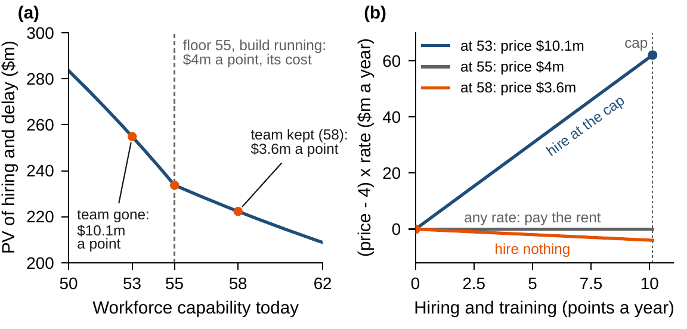
Maximize the Hamiltonian at every moment
§6.3 · THEOREM 6.2
(i) A best plan's decision maximizes the Hamiltonian at almost every moment: myopia repaired
(ii) With a free end date, stop when the value rate of continuing falls to ρ × the terminal value
Meridian's hiring enters H only through (m − 4)u: the cap when a point is worth more than $4m
Nothing when it is worth less; at exactly $4m any rate, the rent among them
Volume I's time to build is part (i) at work; part (ii) is the stopping rule of an asset with a sale value
Figure 6.1. (a) The PV of hiring and delay from each capability level; the price is minus the slope: $11.0m just below 55, $4m once the build runs. (b) (m − 4)u at three prices: the cap, any rate, or zero.
Notes:
Theorem 6.2; formal statement and proof (a needle variation) in Appendix 6.A. Part (ii) needs data that do not change with time: the plan ends when the maximized Hamiltonian, the value rate of continuing, falls to the hurdle return on the terminal value. Maximizing the running value moment by moment fails because it ignores the stocks (Proposition 5.1); maximizing the Hamiltonian adds their change at their prices.

Slide 10
Five audits every computed plan must pass
§6.3 · PROPOSITION 6.1
Proposition 6.1: maximizing the Hamiltonian is Chapter 5's period-by-period rule, value banked included.
1
State forward
2
Costate backward
3
Maximum condition
Run the state equation forward from the starting stocks, under the plan's decisions.
Run the costate equation backward from the end condition: the prices of the stocks along the plan.
Check, moment by moment and on a grid of decision values, that the plan's decision maximizes the Hamiltonian.
4
End conditions
5
Hamiltonian's drift
The end state, and the price at the end: the terminal value's gradient plus the price of any end condition.
Along a best plan the maximized Hamiltonian grows at ρ times the value banked; with no discounting it is constant.
Notes:
Proposition 6.1 (Hamiltonian Accounting) and the computational box of Section 6.3: (i) the value equals the discounted terminal value plus the discounted Hamiltonian less the priced change in the stocks; (ii) maximizing the Hamiltonian is Chapter 5's period-by-period rule with the running value replaced by the value earned now plus the value banked; (iii) the drift of the maximized Hamiltonian. The gradient of the value with respect to every decision costs one forward and one backward pass: the adjoint method.

Slide 11
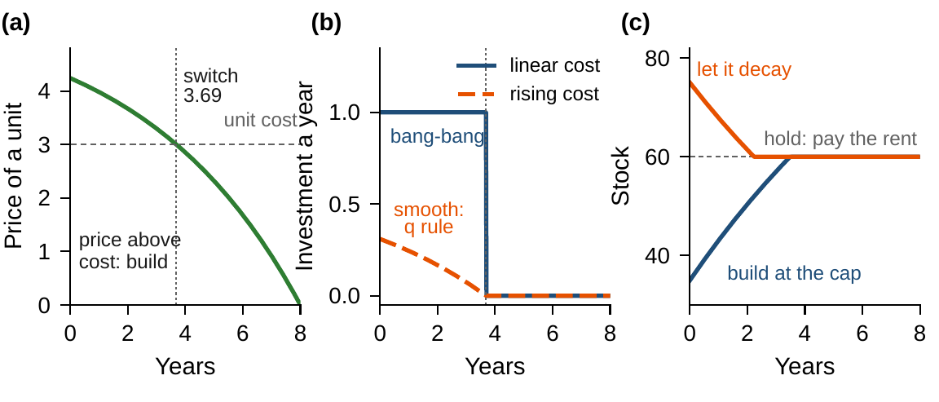
Costs set the shape: smooth, bang-bang, race
§6.4 · PROPOSITION 6.2
Smooth. Costs that rise with the pace make H strictly concave: the decision moves smoothly (q rule)
Bang-bang. H linear: the decision sits at a limit set by the sign of the switching function
The race. A maintained stock is raced to where its marginal earnings equal its user cost, then held
The modified golden rule is no fixed number: it moves with the hurdle rate, decay and price
Metered spending gives all-or-nothing plans; spending that strains the organization, smooth ones
Figure 6.2 (generic; Online Appendix 6.B.2). (a) The price of a unit falls through its cost at 3.69 years. (b) Bang-bang with a linear cost; smooth with a rising one. (c) Race to the level and hold it.
Notes:
Proposition 6.2; formal statement and proof in Online Appendix 6.B. Each shape is a declaration, not an accident: hiring at a known cost per point and automation at $120 million a round give linear Hamiltonians; overtime, agency fees and the capacity to onboard give rising costs. The race is Volume I's time to build read as an optimum.

Slide 12
A floor has a price: the user cost
§6.5 · PROPOSITION 6.3
$4m
5.57
$0.79m
the price of a point on the floor once the build runs: its cost
points a year of rent hold capability at 55: $22.3m a year
the floor's price, a point a year: $0.38m of interest plus $0.41m of attrition
(i) End conditions. If the end state must meet a floor, the price at the end exceeds the terminal value's gradient by a nonnegative multiplier
(ii) Floors on the path. Where a floor binds and the rent is within the limits, the price stays at the unit cost; the floor's price is the user cost less the marginal earnings
(iii) Infinite horizon. Prices need not vanish at infinity: certify with Theorem 6.3's limit condition
Notes:
Proposition 6.3; formal statement and proof in Online Appendix 6.B. Worked Example 6.1, Step 3: holding capability exactly at 55 costs the rent, and the floor's price is the user cost of a point.

Slide 13
Concavity turns the conditions into a proof
§6.5 · THEOREM 6.3
For Meridian
THEOREM 6.3
Sufficiency Theorem
Once the build runs the problem is linear: paying exactly the rent is certified best
Without concavity several candidates can pass; doing nothing can be one (Example 6.B.1)
The race to the floor is lumpy, the delay ending at 55: Worked Example 6.1 certifies it directly
A plan that meets the maximum condition, with a costate that solves the costate equation and the end condition, is best if
(i) the Hamiltonian is concave in state and decision, the decision set convex, the terminal value concave; or
(ii) the maximized Hamiltonian is concave in the state, and the terminal value concave
(iii) Floors and other convex state commitments are allowed, with their multipliers
(iv) An infinite horizon adds a limit condition on the gap to any feasible path
Notes:
Theorem 6.3; formal statement and proof in Appendix 6.A. Concavity is the certificate Chapter 3 promised, now on paths. Part (ii) is Arrow's refinement of Mangasarian's condition.

Slide 14
Direct methods find plans; indirect ones audit
§6.6 · TABLE 6.2
Method | Solves | Strength | Watch for
Single shooting | the maximum principle, by guessing the starting prices | accurate prices and switching times | the starting guess; sensitivity grows with the horizon
Multiple shooting | the same, with the horizon split into segments | robust; standard boundary-value solvers | the arc structure must be guessed
Collocation (indirect) | state and costate equations on a grid | high accuracy | the number of switches is fixed in advance
Direct transcription | a finite program (Chapter 5) | floors and limits native; Part I's certificates | prices approximate the costates only on fine calendars
Direct collocation | states and decisions on polynomial elements | large sparse instances | decisions that switch
Meridian's transcription costs $0.38m more than the closed form weekly, $0.02m daily, and never less.
Notes:
Table 6.2 and Section 6.6. In enterprise practice the direct method finds the plan and the indirect conditions audit it. Solved as a linear program with HiGHS, the transcription's floor multipliers reproduce the floor's price to four decimals.

Slide 15
What is Meridian's engineering team worth?
WORKED EXAMPLE 6.1 · THE SITUATION
Chief human resources officer
Chief financial officer
The board
How fast to rebuild if the team goes?
Take the buyer's extra $20m?
What would it pay to keep the team?
Without the team capability falls from 58 to 53, below the floor of 55 the digital build needs.
The buyer pays $112m net with the team, $92m if Meridian keeps it.
If the buyer asked $30m. A quarter of delay is worth $8m; the hurdle rate is 10 percent.
Volume I, Worked Example 10.1 counted the two options in cash over five quarters and found a wash.
Notes:
Worked Example 6.1, the situation. The transformation office values a quarter of delay at $8 million (Volume I, Chapter 15) and the board discounts at 10 percent a year (Chapter 5).

Slide 16
Write the problem in time, then the Hamiltonian
WORKED EXAMPLE 6.1 · STEPS 1–3
capability c decays at δ = 0.101 a year; hiring at $4m a point, at most ū = 10.13 a year; delay $32m a year; ρ = ln 1.1
Step 2: hire at the cap if m > 4, nothing if m < 4, any rate if m = 4; off the floor the price grows at ρ + δ, 19.7 percent a year
Step 3: on the floor pay the rent, δ × 55 = 5.57 points ($22.3m) a year; the price stays at $4m and the floor's price is the user cost, $0.79m a point a year
Paying the rent forever is worth −$233.8m
Notes:
Worked Example 6.1, Steps 1-3. The automation program needs 55 only at its annual round decisions, and the race restores 55 within half a year, so the value found is, if anything, low.

Slide 17
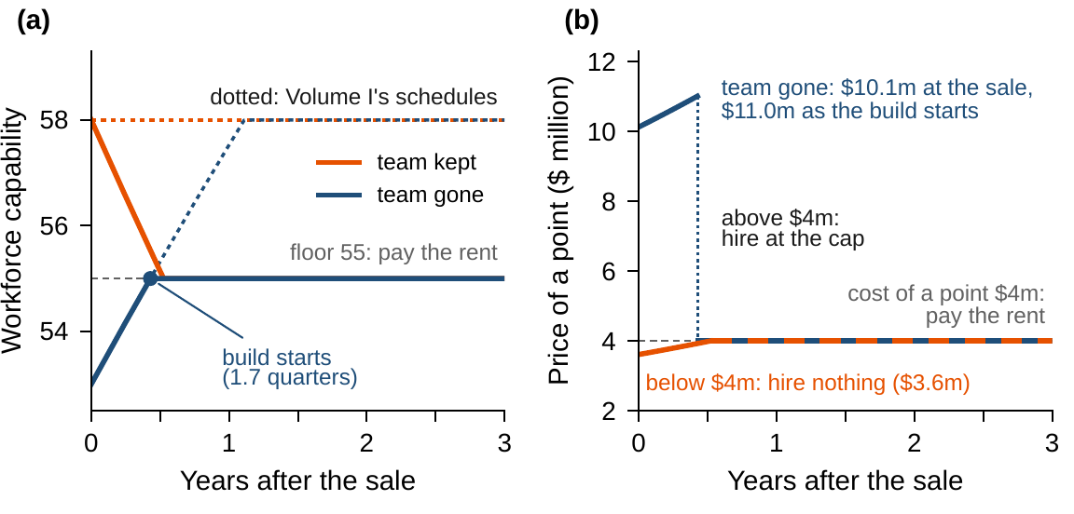
Race to the floor or drift to it; then the rent
WORKED EXAMPLE 6.1 · STEP 4
Team kept: a point is worth $3.6m, below cost: hire nothing, drift to 55 in 2.1 quarters, pay the rent
Volume I's rent on 58 buys three points of margin the floor does not require, for $24.1m
Team gone: a point is worth $10.1m: race at the cap and reach 55 in 1.7 quarters
On arrival a point is worth $11.0m: its $4m cost plus $7.0m of delay saved, 0.22 years of it
Rebuilding to 58 first costs $23.0m more
Figure 6.3. (a) Capability under the best plans; dotted, Volume I's schedules, which hold 58. (b) The price of a point: above $4m hire at the cap, below it nothing, at it the rent.
Notes:
Worked Example 6.1, Step 4. The moment the build starts, the price falls to the cost of a point.

Slide 18
The best plans against Volume I's schedules
WORKED EXAMPLE 6.1 · TABLE 6.3
Plan | Build starts (quarters) | Hiring | Delay | Proceeds less costs
Team kept: drift to 55, pay the rent | 0 | 222.4 | 0.0 | −130.4
Team gone: race to 55, pay the rent | 1.7 | 241.4 | 13.5 | −142.9
Volume I: team kept, hold 58 | 0 | 246.5 | 0.0 | −154.5
Volume I: team gone, rebuild to 58, hold it | 1.7 | 264.4 | 13.5 | −165.9
Present values at 10 percent over an open horizon, $ million. Proceeds: $92m with the team kept, $112m with it gone.
The team is worth $32.5m: $17.0m of hiring, $13.5m of delay and $2.0m because the rent starts later.
Notes:
Table 6.3 and Step 5. The team-kept plan is certified by Theorem 6.3; the race by its closed form, which satisfies the dynamic-programming condition at every level above 43.4. A transcription solved as a linear program starts the build in week 23 and costs $0.38 million more, the price of deciding by the week.

Slide 19
Price the stock, not the cash
WORKED EXAMPLE 6.1 · WHAT THE BOARD SHOULD TAKE AWAY
$10.1m
$32.5m
$24m
a point of capability on the day the team leaves; the buyer charges $4m a point
the team's value: keep it at a $20m discount, and still at $30m
the cost of holding 58 when the floor is 55: stop defending capability above it
Step 6: attrition of 6 to 11 percent a year, $28.4–35.2m; a cap of 2.0 a quarter, $42.3m; a quarter of delay at $4m or $16m, $25.8m or $46.0m
Five points of margin, a floor at 60: $48.5m, and $3.9m a year to hold. A $20m ask is below every figure; a $30m ask, below all but two
If the floor needs a margin because the survey is coarse, declare it and price it, at $0.79m a point a year, or tighten the survey
Notes:
Worked Example 6.1, Step 6 and what the board should take away. For discussion: if the digital build could run at a reduced pace below 55, how would the shape of the rebuild change? Who should own the margin over the floor?

Slide 20

Steering a stock, in AXIOM
AXIOM LAB 2.6 · MODULE AXIOM-06
The sale of part of Industrial Systems is on the board's agenda: the chief financial officer wants the buyer's extra $20 million, and the chief human resources officer must plan the rebuild if the team goes. Open AXIOM, choose Lab 2.6 and load the Meridian capability instance.
1
2
3
4
5
Simulate
Read the Hamiltonian
Price capability
Solve
Compare
Run Volume I's schedules and the race-and-rent plan; compare capability paths and the build's start date.
Plot it against the hiring rate, and the switching function m − 4 along each plan.
Compute the price of a point along each plan; check it by finite differences.
By shooting, and by direct transcription on the AXIOM-04 solvers; cross-audit the two.
Vary attrition, the hiring cap, the value of a quarter of delay and the floor's margin; record the team's value.
Deliverable: a one-page note to the board on the sale: the value of the team, the rebuild plan if it goes, the price of the floor and of a margin over it, and the declarations the answer depends on. About 75 minutes.
Notes:
AXIOM Lab 2.6. What to look for: prices that grow at the hurdle rate plus the attrition rate off the floor and sit at the cost of a point on it (Theorem 6.1); decisions at the cap or at zero according to the sign of the switching function (Theorem 6.2, Proposition 6.2); a floor priced at the user cost (Proposition 6.3); and a certificate that holds where the problem is concave and must be argued directly where it is not (Theorem 6.3).

Slide 21
What to carry forward
KEY TAKEAWAYS
1
In continuous time the prices of Chapter 5 become costates, and the Hamiltonian—value earned now plus value banked in the stocks—is the one quantity a decision must maximize.
2
A stock's price is its marginal value: the present value of what one more unit earns, net of decay, a binding floor's price counted as earnings, and along a best plan the slope of the best value; its ratio to the replacement cost says whether to build.
3
Every best plan maximizes the Hamiltonian at almost every moment, which repairs myopia; with a free end date and data that do not change with time, it stops when the value rate of continuing falls to the hurdle return on the terminal value.
4
Rising costs give smooth plans, linear costs give bang-bang plans with switches, and over an open horizon maintained stocks are raced to the level where marginal earnings equal the user cost and held there; ends and floors carry prices.
5
The maximum principle is necessary; concavity makes it sufficient, and without concavity candidates must be compared or certified directly. Direct methods find plans, indirect conditions audit them.
Notes:
Key Takeaways, Chapter 6.

Slide 22
Notebook and workbook reproduce the book
THIS WEEK'S LABORATORY
44
49
26206
AXIOM-06, AXIOM-04
notebook checkpoints, every one PASS
workbook checks against the engine, ALL PASS
the lab's seed
AXIOM Lab 2.6
Notebook DCT_V2_Ch06_Lab.ipynb: Worked Example 6.1 and the lab's five steps in nine panels, with Figure 6.2's capital problems, ready for Colab
Workbook DCT_V2_Ch06_Lab.xlsx: values and prices, shooting by bisection, the transcription's plan, the certificate and the declarations tested, in formulas
Every number on these slides is the book's, and both companions check it
Notes:
The notebook and workbook are on the course website, www.dynamiccorporatetransformation.com.

Slide 23

Chapter 7 values every position
NEXT · CHAPTER 7
Theorem 6.1(iii) is the bridge: the costate is the slope of the best value along one plan
Dynamic programming computes the best value at every state, so its slope prices every position at once, and the maximum condition becomes a rule
Chapter 7 does it on a calendar, when capability does not move as planned; Chapter 8 in continuous time, the Hamilton–Jacobi–Bellman equation
Notes:
Section 6.6's bridge to Chapters 7 and 8.

