Slide 1
Stochastic Enterprise Dynamics
VOLUME I · CHAPTER 8 · WEEK 4
Every transformation plan is a wager: the honest forecast is a distribution, and every risk is reported as odds with an error bar
Graduate course companion · Lab seed 26108 · AXIOM Lab 1.8 (AXIOM-08)
Notes:
Volume I, Chapter 8. Chapter 7 completed the deterministic theory and named its own fiction: every environment input a known function of time. This chapter gives the environment channel a probability distribution and turns plans into odds (Section 8.1).

Slide 2
“Wall Street indexes predicted nine out of the last five recessions!”
Paul A. Samuelson
Nobel Memorial Prize in Economic Sciences 1970; Newsweek (1966)
Notes:
Paul Samuelson in Newsweek (1966). A single forecast line hides the odds: the honest forecast is a distribution, and a transformation plan is a wager (the chapter's abstract; Proposition 8.1).

Slide 3
After this chapter, you can
LEARNING OUTCOME STATEMENTS
8.1
Explain why a transformation plan needs probability: where uncertainty enters a company model, and why the honest forecast is a distribution of outcomes rather than a single path.
8.2
Describe how the distribution of a company's state evolves—the fan chart as the forecast—and test whether multi-year risk views are consistent with one another.
8.3
Distinguish the steady accumulation of small shocks from discrete events, and use each to size a company's volatility budget and the plan and risk lines of an event exposure.
8.4
Explain when a deterministic plan is the correct average and when curvature biases it (the flaw of averages), and how programs amplify or damp the uncertainty they inherit.
8.5
Estimate risks such as a liquidity breach by Monte Carlo simulation, and report each estimate with an honest error bar.
Notes:
The five learning outcome statements; LOS Guidance at the end of the chapter.

Slide 4
Nine sections, a worked example and a lab
ROADMAP
§8.1
§8.2
§8.3
§8.4
§8.5
Why Transformation Needs Probability
Sources of Enterprise Uncertainty
Probability Foundations for Enterprise Analysis
Stochastic Enterprise Systems in Discrete Time
The Evolution of Enterprise State Distributions
§8.6
§8.7
§8.8
§8.9
Worked Example 8.1
Enterprise Diffusion
Enterprise Jump Processes and Jump-Diffusion
Expected Evolution and the Flaw of Averages
Monte Carlo Simulation of Enterprise Dynamics
Will the Digital Program Breach the Floor?
AXIOM Lab 1.8
Putting Odds on Meridian's Plan
Notes:
Section 8.2: Definition 8.1, Table 8.1 and Proposition 8.1. Section 8.3: Lemma 8.1, Definitions 8.2-8.4 and Tables 8.2-8.3. Section 8.4: Definition 8.5, Theorem 8.1 and Propositions 8.2-8.3. Section 8.5: Definitions 8.6-8.8, Theorem 8.2, Proposition 8.4 and Figure 8.1. Section 8.6: Definition 8.9, Theorem 8.3 and Figure 8.2. Section 8.7: Definition 8.10, Theorem 8.4 and Figure 8.3. Section 8.8: Theorem 8.5 and Proposition 8.5. Section 8.9: Table 8.4. Worked Example 8.1: Table 8.5 and Figure 8.4. AXIOM Lab 1.8: module AXIOM-08, five steps. Proofs of Theorems 8.2-8.5 are in Appendix 8.A; Lemma 8.1, Theorem 8.1 and Propositions 8.1-8.5 in Online Appendix 8.B.

Slide 5
Transformation decisions are wagers
§8.1 · WHY TRANSFORMATION NEEDS PROBABILITY
Chapter 7's fiction
What arrives at random
Not wasted
Every environment input a known function of time
Demand varies; funding markets open and shut
For linear companies, exactly the theory of the average
No operating executive recognizes that world.
Technologies leap, regulators intervene, key people resign on Tuesdays.
Theorem 8.5: the deterministic plan, read as a mean.
One idea
Proved here
Left for Volume II
The distribution of futures is the object of prediction
Discrete time, Gaussian propagation, events, Jensen
Stochastic control and filtering
Determinism relocated one level up: from the path to the fan chart.
Brownian motion and SDEs stated with precise hypotheses.
Chapter 12's risk architecture is built on this chapter.
A theory of transformation that cannot say “with what probability” has not yet met its subject.
Notes:
Section 8.1. The Stochastic Enterprise Dynamics Framework (SEDF) keeps the states, operators and dynamics of Chapters 5-7 and gives the environment channel a probability distribution. Sample paths scatter, but the distribution of the state moves by an exact, deterministic rule of its own (Theorem 8.2).

Slide 6
Uncertainty enters through declared channels
§8.2 · DEFINITION 8.1 · TABLE 8.1
Source | Channel into the model | Typical shape
Market and demand | revenue and market-share dynamics | mean-reverting fluctuation; seasonal noise
Capital markets | cost and availability of funding | fluctuation with occasional regime jumps
Technology | capability and platform shifts | jumps (breakthroughs) on top of drift
Regulation and law | resets of constraints and costs | interventions at random dates, with random size
Behavior | attrition, adoption, execution | noise on rates
Operations | throughput, quality, outages | high-frequency noise; rare large events
Table 8.1. Declaring which quantities are random, and with what distributions, is part of the modeling contract (Definition 8.1).
Proposition 8.1. Futures that agree with every record can still diverge: the honest forecast is a distribution.
Notes:
Definition 8.1, Table 8.1 and Proposition 8.1 (formal statement and proof in Online Appendix 8.B). Uncertainty is the condition; noise its per-period increment (Definition 8.3); risk, reserved for Chapter 12, the exposure of declared objectives to that distribution. Enriching the state can turn some noise into explained dynamics, but the argument survives every finite enrichment.

Slide 7
Every deterministic object has a stochastic twin
§8.3 · LEMMA 8.1 · TABLE 8.2
Object | Deterministic (Chapter 7) | Stochastic (this chapter)
Environment | a scenario w(t) | a random input with a declared law
Trajectory | one state path | sample paths and their laws μₖ
Law of motion | transition map f | transition probabilities P (Theorem 8.2)
Equilibrium | fixed point x* | stationary distribution
Stability | spectral radius below one | a variance that settles (Theorem 8.3)
Forecast | a point, good for a horizon | a fan chart that widens and may settle
Board question | where will we be? | with what probability?
Table 8.2, the translation dictionary the chapter fills in entry by entry.
Lemma 8.1. Tomorrow's noise is averaged out at the known current state.
Notes:
Section 8.3: probability spaces, random vectors and their laws, expectation and covariance, filtrations and conditional expectation with its tower property. Definitions 8.2-8.4: an adapted, Markov process; noise independent of today's information; the law of the state replaces “the state”. Lemma 8.1 (formal statement and proof in Online Appendix 8.B). Table 8.3 previews the processes the chapter uses.

Slide 8

One random path for each starting state
§8.4 · EQUATION 8.1 · THEOREM 8.1
Chapter 2's enterprise system with its environment input made random; decisions declared in advance or set by a policy
Theorem 8.1. The recursion defines exactly one random path for each starting state, and it is Markov: given today's state, the history adds nothing to the odds
In continuous time the stochastic differential equation has one continuous solution when drift and volatility respond with bounded sensitivity and grow at most linearly (cited)
Proposition 8.2. Every path statistic, its trough, the date it first crosses a threshold, its horizon value, has a distribution
Proposition 8.3. With no spread in the noise, every result reduces to Chapter 7's
Notes:
Definition 8.5, Theorem 8.1 (formal statement and proof in Online Appendix 8.B) and Propositions 8.2-8.3. The Markov property is a declaration about the chosen state: if shocks have memory, enlarging the state to carry it restores the property (an information state).

Slide 9
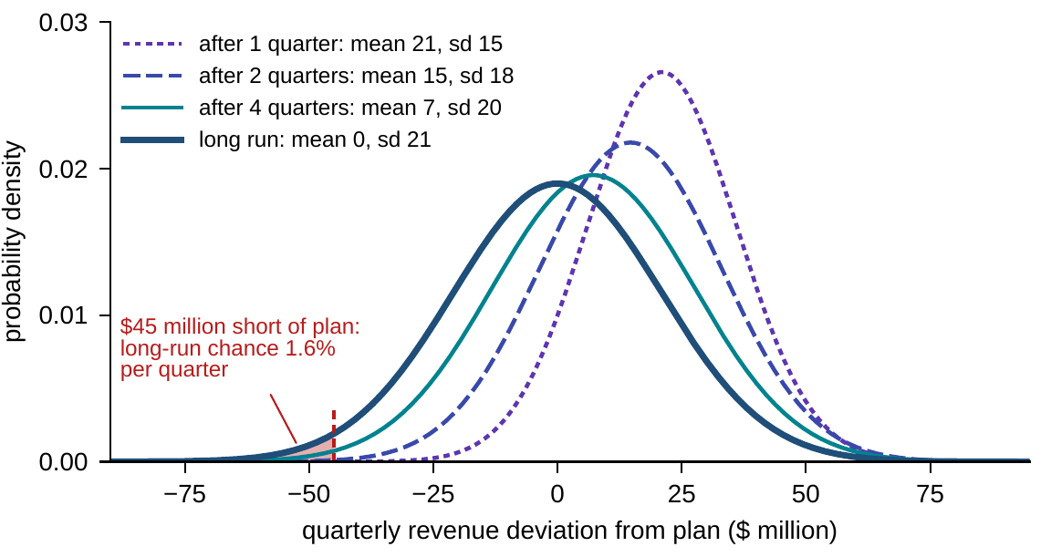
The fan chart is the forecast
§8.5 · THEOREM 8.2 · FIGURE 8.1
Theorem 8.2(i). Paths are random; their distribution moves by an exact rule
(ii) Multi-period odds compose: a three-year fan must match its one-year fans
After a strong quarter, Meridian's revenue fan drifts back toward plan and widens
It settles at a standard deviation of $21m: the fan, not its center, is the forecast
Figure 8.1. Industrial Systems' revenue deviation, R′ = 0.7R + w with shocks of sd $15m, after a strong quarter; the shaded tail is the long-run chance of falling $45m or more short of plan.
Notes:
Theorem 8.2 (proof in Appendix 8.A); Definitions 8.6-8.8 and Proposition 8.4. A planning process that tracks only the center line discards most of the object: the questions boards ask, a covenant breach, a funding gap, program failure, are properties of the whole distribution. A three-year fan inconsistent with its one-year fans compounded is an arithmetic error: from on plan, a quarterly chain of 0.9 and 0.3 implies 19.6 percent off plan after three quarters, not 30 (Online Appendix 8.B.2).

Slide 10
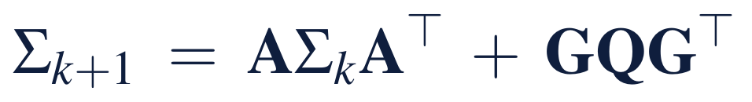
Stable companies have a volatility budget
§8.6 · THEOREM 8.3
For Meridian
THEOREM 8.3
Diffusion Representation Theorem
Revenue: R′ = 0.7R + w, with shocks of sd $15m
Long-run variance 15²/(1 − 0.7²) ≈ 441: a budget of $21m, not $15m
A covenant test $45m below plan fails in 1.6% of quarters, not 0.13%
Halving the persistence cuts the budget to $16.0m and the chance sixfold
Excess measured variance flags undeclared noise or unmodeled dynamics
(i) In the linear company the state stays normal; its mean and covariance follow exact recursions
(ii) Stable: the covariance settles at the Lyapunov solution. With no restoring force it grows without bound
(iii) Small, frequent shocks give the Ornstein–Uhlenbeck process; the scaled random walk, Brownian motion
Notes:
Theorem 8.3 (proof in Appendix 8.A) and Definition 8.9. Stable companies have a volatility budget, not zero volatility: persistence inflates the naive figure by 1/√(1 − 0.49) = 1.40. Managing the persistence, a faster commercial response, shrinks the budget where managing the shocks cannot (Online Appendix 8.B.4). Online Appendix 8.B.3 solves a two-reading budget.

Slide 11
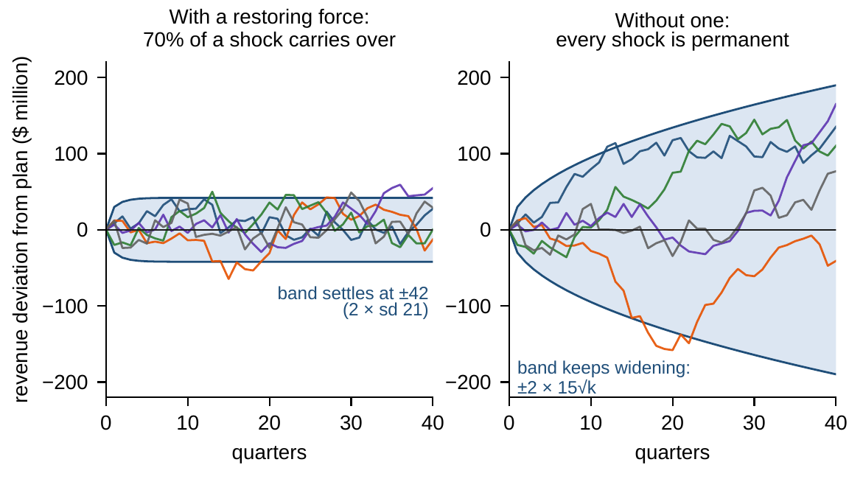
Without a restoring force, the band never settles
§8.6 · FIGURE 8.2
With 70% of a shock carried over, the band stops widening at ±2 × $21m
With every shock permanent, R′ = R + w, it widens like the square root of time
Eigenvalue-one accumulators turn steady small shocks into unbounded drift
“Death by a thousand cuts” has a formula; stability buys a budget, not silence
Figure 8.2. Left: Industrial Systems' revenue deviation stays inside a band that stops widening at ±2 × $21m. Right: the same shocks with no restoring force spread like the square root of time.
Notes:
Figure 8.2 and Theorem 8.3(ii). The unbounded branch is the mirror warning: a reading with no restoring force, such as the eigenvalue-one accumulators of Theorem 7.3(ii), turns steady small shocks into unbounded drift. AXIOM Lab 1.8, step 1 sweeps the persistence through one and watches the band stop settling.

Slide 12
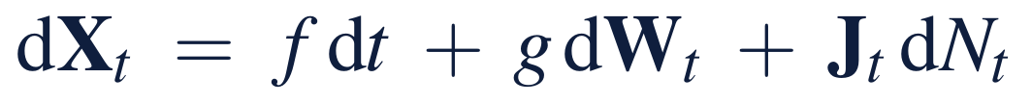
Event risk has two ledger lines
§8.7 · THEOREM 8.4
For Meridian
THEOREM 8.4
Jump-Diffusion Enterprise Dynamics Theorem
Interventions arrive at λ = 0.15 a year and cost $40m on average (sd $30m)
Plan line: 0.15 × 40 = $6m a year, quiet years included
Risk line: 0.15 × 2,500 = 375 a year: an sd of about $19m over one year, $43m over five
Half the frequency at twice the size: same plan line, twice the variance
Five quiet years leave next year's chance at 1 − e^{−0.15} ≈ 14%
(i) Memorylessness. The wait for a Poisson event does not depend on how long one has waited: an event is never “due”
(ii) Two ledger lines. Events of frequency λ and size J add λE[J] to the expected outcome and λE[J²] to its variance
(iii) Expected path. Events correct the drift of the expected path to μ + λE[J]
Notes:
Theorem 8.4 (proof in Appendix 8.A), Definition 8.10 and Equation 8.6. The plan line belongs in the expected plan; the risk line is weighted by squared size, so it is dominated by large, rare events. Boards that manage event risk by expected cost alone manage half the object. Provisioning that relaxes after a shock and tenses after a quiet spell has the sign exactly wrong for memoryless risks.

Slide 13
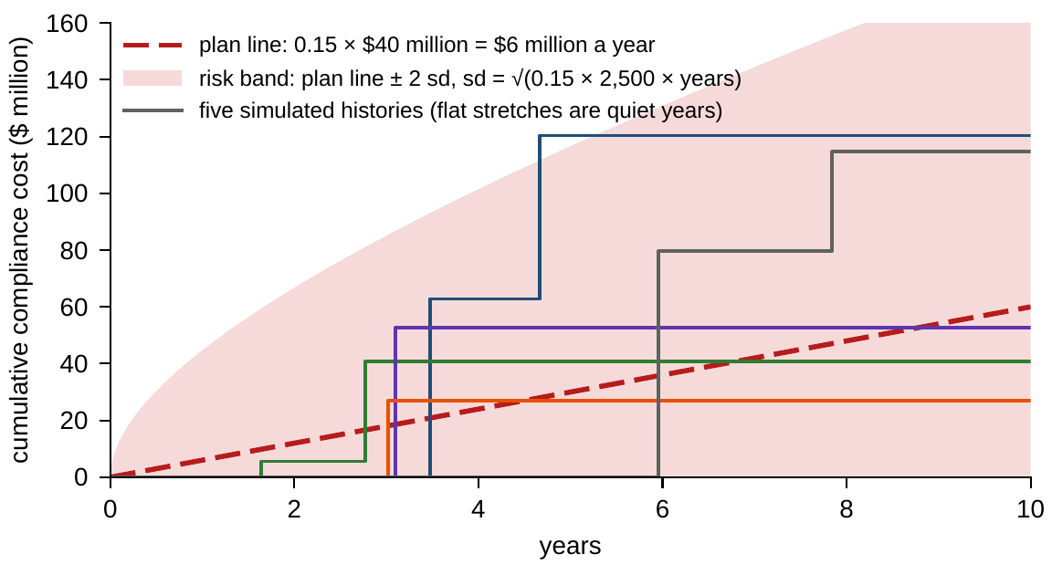
The plan line accrues through quiet years
§8.7 · FIGURE 8.3
The cumulative compliance cost of Meridian's regulatory interventions
The plan line accrues $6m a year, in quiet years and eventful ones alike
The risk band, the plan line ± 2 sd, widens with the square root of time
Flat stretches are quiet years; a plan without the plan line understates every year
Figure 8.3. Interventions arrive at 0.15 a year and cost on average $40m (sd $30m): the plan line, the risk band, and simulated histories.
Notes:
Figure 8.3 and Theorem 8.4. AXIOM Lab 1.8, step 3 generates interventions at 0.15 a year, reads the plan line and the risk line, then conditions on five quiet years: next year's chance stays at about 14 percent. Risks whose hazard genuinely rises, such as wear, fatigue or mounting political pressure, deserve a different clock; choosing it is a declaration, not a default.

Slide 14
The plan is the average only when linear
§8.8 · THEOREM 8.5 · PROPOSITION 8.5
What it means
THEOREM 8.5
Expected Enterprise Evolution Theorem
Capacity costs, which are convex, run over plan on average
A path's low point is concave: Meridian's average trough is $384m against a planned $482m
Quote a single path as the mean or a percentile, never as “the case”
Three expansive steps at 1.2 can triple the inherited variance; at 0.8 they cut it to 0.26 of its size
(i) Linear. The average path obeys Chapter 7's deterministic law exactly
(ii) Curvature. Convex: the average outcome lies above the plan at average inputs; concave: below (Jensen)
(iii) Total variance splits into the average variance within scenarios plus the variance between them
Proposition 8.5. A step with sensitivity L multiplies the mean-square spread it inherits by up to L²
Notes:
Theorem 8.5 (proof in Appendix 8.A) and Proposition 8.5 (Online Appendix 8.B: 1.2^6 is about 3, 0.8^6 about 0.26). The mean workforce of Worked Example 4.1, with random attrition restored, follows that chapter's roll-up exactly. A start-up whose average path clears its cash constraint can still fail on most paths (Online Appendix 8.B.7). A step with sensitivity above one, placed late in a program, multiplies the whole fan of uncertainty the program has accumulated by then.

Slide 15
Report the error bar with the number
§8.9 · MONTE CARLO SIMULATION · TABLE 8.4
±4.3
±1.4
±0.4
±0.14
100 paths: 25.0 percent
1,000 paths: 25.2 percent
10,000 paths: 24.5 percent
100,000 paths: 24.6 percent (Worked Example 8.1)
A probability is estimated by the share of paths in which the event occurs, with standard error √(p(1 − p)/N); errors here are in percentage points
Precision improves only with the square root of the paths: one more decimal digit costs a hundredfold more
Pinning a probability to ±0.1 point takes 47,500 paths near 5 percent and 187,500 near 25 percent
Paths are exact for discrete models; Euler–Maruyama errs by order √Δ for paths and Δ for distributions
Notes:
Section 8.9, Table 8.4 and Online Appendix 8.B.5. The law of large numbers guarantees convergence and the central limit theorem supplies the error bar. Section 8.9 asks the model of Worked Example 8.1 the same question with 100, 1,000 and 10,000 paths (one standard error, in percentage points). A common mistake is to report a simulated probability without its error bar, or to trust a few hundred paths for a rare event (LOS Guidance 8.5).

Slide 16
Will the digital program breach the floor?
WORKED EXAMPLE 8.1 · THE SITUATION
$482m
$132m
5%
the planned trough, in quarter 7, from $620m today; $510m by the end of year 3
of headroom above the board's floor of $350m (Table 5.4)
the board's appetite: the largest tolerated chance of breaching the floor
Chapters 1 and 5 drew the digital program's liquidity path as a single line (Figure 5.2)
The board asks what a single line cannot answer: with what probability does liquidity fall below the floor in some quarter of the three years?
Notes:
Worked Example 8.1, the situation. The plan is Chapter 1's digital liquidity path read quarterly over the program's three years; the floor is Table 5.4's, and the board's risk appetite statement tolerates at most a 5 percent chance of breaching it during the program.

Slide 17
Declare two channels, size each, simulate
WORKED EXAMPLE 8.1 · STEPS 1–3
quarterly liquidity, $ million: the plan, a persistent deviation, less closures that are not recovered
Step 1: surprises of sd $50m a quarter, 60% carried over; closures about once a decade, removing $120m on average (sd $50m)
Step 2: the deviation's budget is 50/√(1 − 0.6²) = $62.5m, so the trough's headroom is only 2.1 sd
The closures' plan line is 0.10 × 120 = $12m a year, with a 26% chance of at least one in three years
Step 3: in 100,000 simulated paths liquidity falls below $350m in 24.6%, standard error 0.14 points
Notes:
Worked Example 8.1, Steps 1-3; Theorems 8.3(ii) and 8.4; Section 8.9. The standard error is √(0.246 × 0.754/100,000) = 0.14 percentage points. The 100,000 paths are drawn with random seed 8 (Volume II, Online Appendix 1.B.4); the notebook reproduces them exactly.

Slide 18
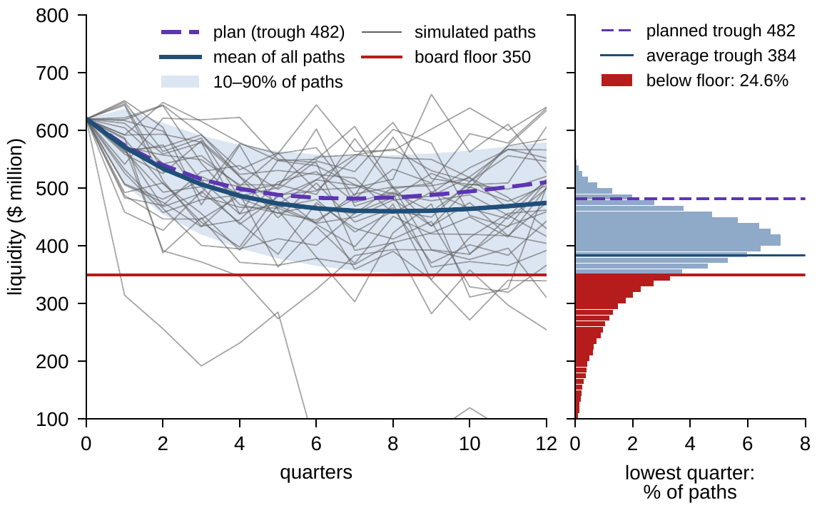
The average trough is not the planned trough
WORKED EXAMPLE 8.1 · STEP 4 · FIGURE 8.4
Each path's lowest quarter averages $384m, almost $100m below the plan's $482m
The low point is concave in the path: Jensen's inequality works against the plan
Even the mean path bottoms out at $460m: closures accrue $12m a year
Deviation alone breaches in 8.4%, events alone in 10.6%, together in 24.6%
A path with a closure breaches 71% of the time; three in four breaches occur on such paths
Figure 8.4. Left: simulated quarterly liquidity paths (30 shown), the band holding 80 percent, the mean path, the plan and the floor. Right: each path's lowest quarter; the red share is the breach probability.
Notes:
Worked Example 8.1, Step 4; Theorem 8.5(ii); Online Appendix 8.B.6. By total probability, 0.259 × 0.709 + 0.741 × 0.084 = 0.246; by the law of total variance, 40 percent of the uncertainty about whether the floor is breached is uncertainty about whether a window closes, which is why the standby line, which acts on that channel, is the first lever to price.

Slide 19
Only both levers bring the odds within appetite
WORKED EXAMPLE 8.1 · STEP 5 · TABLE 8.5
Scenario | Plan trough ($ million) | Breach probability
Plan as drawn, both channels | 482 | 24.6%
Execution and market deviation only | 482 | 8.4%
Funding-window events only | 482 | 10.6%
Standby line (up to $100 million per closure) | 482 | 12.4%
Phased build | 531 | 13.1%
Standby line and phased build | 531 | 3.0%
Probability that liquidity falls below the $350 million floor during the three-year program; 100,000 simulated paths each; standard errors 0.05–0.14 percentage points.
Either lever alone halves the risk; only the two together bring it within the board's 5 percent appetite.
Notes:
Table 8.5 and Step 5. A committed standby line replaces up to $100 million of any closed funding window; phasing the build makes its deepest cash draw $49 million smaller and lifts the trough to $531 million.

Slide 20
A comfortable trough is not a small risk
WORKED EXAMPLE 8.1 · WHAT THE BOARD SHOULD TAKE AWAY
24.6%
3 in 4
3.0%
chance of breaching the floor, ±0.14 points: report the odds, not the trough
breaches come with a funding event: manage the risk where it originates
with the standby line and the phased build together: within the appetite
Report the plan with its breach probability and its error bar, not with its trough alone
Either lever alone halves the risk; only the two together bring it within the board's appetite
For discussion: phasing delays the digital option's technology gains. How would you value that delay, to compare it with the cost of the standby line?
Notes:
Worked Example 8.1, what the board should take away, and the discussion question.

Slide 21

Putting odds on Meridian's plan, in AXIOM
AXIOM LAB 1.8 · MODULE AXIOM-08
Meridian's board has asked for a risk view of the digital program it can trust: the probability of breaching the liquidity floor, what drives it, and what each mitigation buys; the chief risk officer wants the planning pack's fans and event provisions checked. Open AXIOM, choose Lab 1.8 and load the Meridian stochastic model.
1
2
3
4
5
Watch the fan form
Check the multi-year view
Price an event risk
Feel the flaw of averages
Put odds on the program
Start the revenue deviation after a strong quarter; sweep persistence through one and watch the band stop settling.
Enter a one-year and a three-year fan from the planning pack and test whether they compose.
Generate interventions at 0.15 a year, read the plan and risk lines, and condition on five quiet years.
Bend a cost function and watch the gap between the average cost and the cost at average volume.
Reproduce Worked Example 8.1: vary the paths, switch each channel off, test both levers.
Deliverable: a one-page risk memo to the board stating the breach probability with its error bar, the share due to each channel, the effect of each lever, and a recommendation against the 5 percent appetite. About 60 minutes.
Notes:
AXIOM Lab 1.8. What to look for: a stable company's fan stops widening while an accumulator's never does (Theorem 8.3); quiet years do not make an event “due” (Theorem 8.4); the average trough lies well below the planned trough (Theorem 8.5). Discussion: which plan numbers would you restate as probabilities, and with what error bars? How would you explain to the board that the plan's trough and the average trough differ by almost $100 million? Which lever would you fund first, and why?

Slide 22
What to carry forward
KEY TAKEAWAYS
1
Uncertainty is a declared channel of the model and cannot be modeled away; the honest forecast at decision time is a distribution.
2
The fan chart is the forecast: distributions evolve by an exact rule, and multi-year risk views must compose.
3
Stability buys a volatility budget, not silence; event risk has a plan line and a risk line, and memoryless events are never “due”.
4
The deterministic plan is the exact average only for linear companies; with curvature the base case is biased, and expansive steps amplify inherited uncertainty.
5
Monte Carlo answers any question about paths, with an error bar that shrinks like 1/√N; report the bar with the number.
Notes:
Key Takeaways, Chapter 8.

Slide 23
Notebook and workbook reproduce the book
THIS WEEK'S LABORATORY
79
81
26108
AXIOM-08
notebook checkpoints, every one PASS
workbook checks against the engine, ALL PASS
the lab's seed
AXIOM Lab 1.8
Notebook DCT_V1_Ch08_Lab.ipynb: Worked Example 8.1 and the lab's five steps in nine panels, ready for Colab; its 100,000 paths are the book's
Workbook DCT_V1_Ch08_Lab.xlsx: the plan, the volatility budget, the two ledger lines, Table 8.5, and 2,000 of the book's paths rebuilt by formula
Every number on these slides is the book's, and both companions check it
Notes:
The notebook and workbook are on the course website, www.dynamiccorporatetransformation.com. The worked example's simulation is drawn, as in the book, with random seed 8 (Volume II, Online Appendix 1.B.4); the lab's seed 26108 is used only for fresh draws, labelled as such.

Slide 24

Chapter 9 turns the model into an architecture
NEXT · CHAPTER 9
Part II built the mathematics of the company in general; Part III builds it around what companies are made of
Components with their own states, wired by flows of demand, cash, capability and policy, and bound by constraints that reach across the wiring
Shocks travel only along the arrows, never faster than the steps they must cross
For Meridian, a demand shock cannot reach the loan covenant before the second quarter-end
The risk architecture of Chapter 12 attaches this chapter's distributions to that wiring
Notes:
Chapter 9's opening (Section 9.1 and the abstract) and the bridge from Section 8.1: within this volume, the risk architecture of Chapter 12 is built directly on this chapter.

