Slide 1
Enterprise Capital Architecture
VOLUME I · CHAPTER 10 · WEEK 5
Give every form of capital the same accounting: holding a stock is a rental, rebuilding it has a speed limit, and money spent off the bottleneck buys nothing
Graduate course companion · Lab seed 26110 · AXIOM Lab 1.10 (AXIOM-10)
Notes:
Volume I, Chapter 10. Chapter 9 built the company's skeleton: components, wiring and constraints. This chapter adds the stocks: the durable quantities that make action possible and are consumed, converted and rebuilt by it (Section 10.1).

Slide 2
“You can see the computer age everywhere but in the productivity statistics.”
Robert M. Solow
Nobel Memorial Prize in Economic Sciences 1987; New York Times Book Review (1987)
Notes:
Solow's remark (1987). Technological capital is productive only when integrated, hence its complementarity with human and organizational capital (Definition 10.6); those complements are stocks that build at the rate their decay allows, and the balance sheet does not record them.

Slide 3
After this chapter, you can
LEARNING OUTCOME STATEMENTS
10.1
Explain why a company's capacity depends on more than its financial capital, and describe the forms of enterprise capital by how they behave: how fast they decay, how long they take to build, and whether they can be bought or separated from the people who carry them.
10.2
Account for any capital stock as investment, use, decay, and conversion, recognize the loss in converting one form into another, and use the unexplained residual to detect channels the ledger has missed.
10.3
Use the accumulation law to price the rent on a capital stock and the minimum time to build it, and explain why capital is fast to destroy and slow to rebuild.
10.4
Distinguish the bottleneck and complementarity regimes of capital interaction, and explain what each implies for where the next dollar should go.
10.5
Allocate a capital budget across forms by equalizing marginal returns, recognize when zero funding is optimal, and audit a capital architecture for consistency.
Notes:
The five learning outcome statements; LOS Guidance at the end of the chapter.

Slide 4
Eight sections, a worked example and a lab
ROADMAP
§10.1
§10.2
§10.3
§10.4
§10.5
Why Capital Is More Than Money
Capital Beyond Finance
The Enterprise Capital Architecture
The Forms of Enterprise Capital
Capital Dependencies
§10.6
§10.7
§10.8
Worked Example 10.1
AXIOM Lab 1.10
Capital Accumulation and Depletion
Capital Allocation and Productivity
Architecture Consistency and Capital Dynamics
Keep the Engineers or Rebuild Them?
Meridian's Capital Ledger
Notes:
Section 10.2: Proposition 10.1. Section 10.3: Definitions 10.1-10.2 and Theorem 10.1. Section 10.4: Definitions 10.3-10.9 and Tables 10.1-10.3. Section 10.5: Definition 10.10, Proposition 10.2 and Theorem 10.2. Section 10.6: Definitions 10.11-10.12, Theorem 10.3, Propositions 10.3-10.4 and Figure 10.1. Section 10.7: Theorem 10.4 and Figure 10.2. Section 10.8: Proposition 10.5, Theorem 10.5 and Table 10.4. Worked Example 10.1: Table 10.5 and Figure 10.3. AXIOM Lab 1.10: module AXIOM-10, five steps. Proofs of Theorems 10.2-10.4 are in Appendix 10.A; Theorems 10.1 and 10.5 and Propositions 10.1-10.5 in Online Appendix 10.B.

Slide 5
Folklore becomes results with numbers
§10.1 · WHY CAPITAL IS MORE THAN MONEY
“It takes time to build”
“It needs maintenance”
“The weakest capital binds”
A floor of about (1/δ) ln(1/ε) periods
I = δC: capital is rented, not bought
Marginal value sits on the bottleneck
Theorem 10.3(iii)
Theorem 10.3(ii)
Theorem 10.2(i)
“Equalize marginal returns”
“The accountant's plug”
“Capital is optionality”
An optimality condition, with its exceptions
A detector of model error
More capital never removes a move
Theorem 10.4(i)
Theorem 10.5(iii)
Proposition 10.3
Stocks live at components, flow and convert along the wiring, and are governed by scoped constraints.
Notes:
Section 10.1. Of everything a state architecture carries, the stocks do disproportionate work in transformation: cash and debt capacity, but equally the trained workforce, codified know-how, installed technology, routines, relationships and strategic positions. Formalizing turns folklore into results with numbers attached.

Slide 6
Money alone does not set what a company can do
§10.2 · PROPOSITION 10.1
What it means
PROPOSITION 10.1
Enterprise Value Depends on Multidimensional Capital
Identical balance sheets can differ by the whole value of unmeasured stocks
Acquirers learn this as goodwill, boards as key-person risk
Running down routines can flatter the financials while capacity falls
A money-only plan misprices capability building and platform migration
If capacity rises with at least one non-financial form of capital, the others held fixed, financial capital alone does not determine capacity
Two companies with identical financial capital can differ in what they can do
Any plan or valuation built on financial capital alone lacks information it needs
The benchmark: under Modigliani and Miller, value is set by the productive capacity of the assets; DCT asks what that capacity is made of
Notes:
Proposition 10.1; formal statement and proof in Online Appendix 10.B. The hypothesis does the work: which non-financial stocks move capacity, and over what range, is what a capital architecture declares.

Slide 7

Every form of capital obeys double-entry
§10.3 · THEOREM 10.1
decay, investment, use, and conversion in and out at efficiency η: the balance of Equation 10.2
(i) Stock and flow. When every channel is measured, each change in a stock splits uniquely into its channels; when not, only their net is known
(ii) Conversion leaks. Conversion never creates capital: the conversion bill Σ(1 − η)T is a cost separate from execution drift
(iii) Capital dynamics are company dynamics. The balance is a Part II state equation, so its results apply unchanged
A chain leaks more than any link: a platform built at 80 percent and turned into capability at 70 percent delivers 56 percent
Notes:
Definitions 10.1-10.2 and Theorem 10.1; formal statement and proof in Online Appendix 10.B, with the chain of conversions (10.B.1). The architecture is the triple (C, D, G): capital components with their carriers, the dependency structure, and capital governance.

Slide 8
Ten forms of capital, one accounting
§10.4 · TABLE 10.1
Form | Content | Typical carrier
Financial | money and funding capacity | treasury
Human | skills embodied in the workforce | people, functions
Intellectual | codified knowledge and IP | IP estate; data
Technological | installed systems and platforms | operations; IT
Organizational | routines and coordination capacity | the wiring itself
Relational | external trust and commitments | boundary components
Strategic | positional advantage and options | corporate center
Governance | decision quality and legitimacy | board; governance
Innovation | pipeline of unrealized options | R&D; ventures
Informational | decision-relevant data and models | platforms; functions
The ten representative forms of the capital vector (Equation 10.1). The list is a modeling choice, not an ontology: shorter vectors are legitimate wherever the questions asked allow.
Notes:
Table 10.1 and Definitions 10.1 and 10.3-10.9. The capital vector is C = [C_F, C_H, C_I, C_T, C_O, C_R, C_S, C_G, C_N, C_Info]: ten forms. Definitions 10.3-10.9 define the first of them one by one; the other three, governance, innovation and informational capital, are treated with the same machinery, and no result depends on the length of the list.

Slide 9
The forms differ in how fast they decay
§10.4 · TABLE 10.2
Form | Depreciation a year | Build time | Tradable | Separable
Financial | about 0 | immediate | fully | fully
Human | 0.10–0.25 | years | at the margin | no
Intellectual | 0.05–0.20 | years | partly | yes
Technological | 0.15–0.30 | quarters to years | in parts | partly
Organizational | 0.03–0.10 | years | no | no
Relational | 0.05–0.15, plus breach | years | no | no
Strategic | tied to the regime | years | rarely | partly
Typical ranges and modeling defaults, to be declared for each company. Each form needs declared indicators, error bars and a validity range (Table 10.3).
Technology decays fast but can be bought in parts; organizational capital decays slowly, cannot be bought, and cannot be separated from its carriers.
Notes:
Table 10.2: the forms of Definitions 10.3-10.9 on the four properties that drive their dynamics. The softer forms, organizational, relational and strategic, have the widest error bars exactly where they matter most (Section 10.4); LOS Guidance 10.1.

Slide 10
Know the coupling regime before allocating
§10.5 · THEOREM 10.2
What it means
THEOREM 10.2
Capital Dependency Theorem
Investment that provably does nothing: technology without trained operators, data without models
The bottleneck ledger: publish the ratios C/r beside the budget; fund the smallest
Where forms are smooth complements, fund technology with training with process redesign
Proposition 10.2: independence is the strong claim; a missing dependency is a testable claim
(i) Bottleneck concentration. In fixed proportions only the scarcest form adds capacity at the margin
(ii) Complementary accumulation. Building one complement raises the return to the other: joint programs win
(iii) Propagation discipline. A shock reaches another form only along dependency paths, at their distance
Notes:
Definition 10.10, Proposition 10.2 and Theorem 10.2; proof in Appendix 10.A. Complementarity is Milgrom and Roberts's. Part (iii) imports Chapter 9's arithmetic: capital contagion has computable arrival floors.

Slide 11
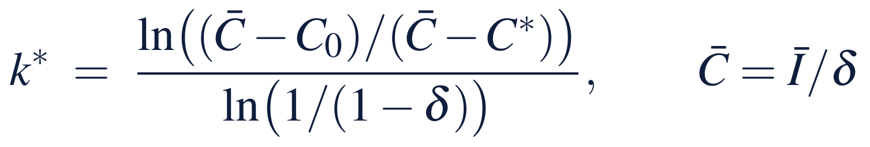
Capital is a rental with a speed limit
§10.6 · THEOREM 10.3
What it means
THEOREM 10.3
Capital Accumulation Theorem
The first period the rent goes unpaid, decline is not a risk but a certainty
No budget inside the cap shortens the time to build; only a higher cap, or buying a tradable stock
Proposition 10.3: more capital never removes an option
Proposition 10.4: a stock can fall below a floor in one period; climbing back takes the time to build
(i) Geometric memory. The inherited stock decays by the factor 1 − δ a period
(ii) Capital is a rental. Holding C* needs the perpetual flow I = δC*; any lower flow guarantees decline
(iii) Time to build. Under a cap Ī on investment, nothing beats full throttle, which takes at least k* periods
Notes:
Definitions 10.11-10.12, Theorem 10.3 (proof in Appendix 10.A) and Propositions 10.3-10.4 (Online Appendix 10.B). Closing all but a fraction ε of the gap to the ceiling takes about (1/δ) ln(1/ε) periods when δ is small. Burning capital is fast; rebuilding it is limited by δ.

Slide 12
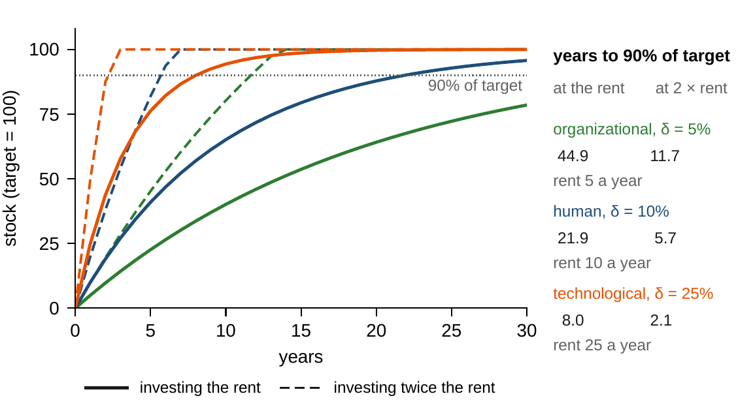
Slow stocks are cheap to hold, slow to build
§10.6 · FIGURE 10.1
Target 100; decay of 5, 10 and 25 percent a year: rents of 5, 10 and 25 a year
To 90 percent at the rent: 44.9, 21.9 and 8.0 years; at twice the rent, 11.7, 5.7, 2.1
Slow stocks take decades at the rent and more than a decade at twice it
Protect slow stocks: running them down creates a repurchase liability
Figure 10.1. Three stocks with the same target and different depreciation rates, built from zero. Solid: investing the rent; dashed: twice the rent until the target is reached.
Notes:
Figure 10.1 and Section 10.6's enterprise box. The time to build is the planning constant that settles Chapter 1's tension between ambition and the calendar.

Slide 13
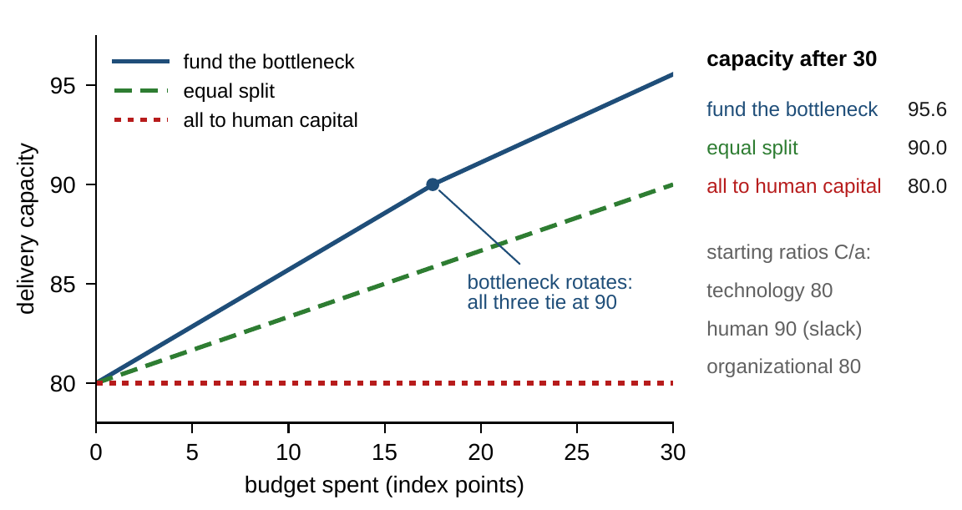
Fund the bottleneck, then rotate
§10.7 · THEOREM 10.4
Theorem 10.4. Funded forms earn the same marginal capacity λ; unfunded forms earn less
Stocks 80, 45, 60, requirements 1.0, 0.5, 0.75: technology and routines bind
Funding the bottleneck adds 0.57 a point until all tie at 90 (17.5 points), then 0.44
After 30 points: 95.6; an equal split 90.0, the “talent war” 80.0
Figure 10.2. Capacity against budget spent under three policies; the kink marks the point where all three forms tie and the bottleneck rotates.
Notes:
Theorems 10.2(i) and 10.4(ii); proofs in Appendix 10.A. The shadow value λ is the company's internal price of capacity, its hurdle rate for capability. Part (iii): fund strict complements together; one-sided programs are self-undermining.

Slide 14
The plug is a detector, not an embarrassment
§10.8 · THEOREM 10.5
What it means
THEOREM 10.5
Enterprise Capital Architecture Consistency Theorem
A persistent negative plug on routines: coordination costs billed off the books
A positive plug on human capital: learning by doing that no budget paid for
Proposition 10.5: transformations rewrite the architecture; audit it before and after
(i) Capital and state. Capital dynamics close only if companies alike in measured capital evolve alike in it
(ii) Governance. Budget identities and group ratios are wide couplings that need joint review
(iii) The plug. Each form's residual π vanishes exactly when the declared channels are complete; its sign and timing locate a missing one
Meridian: booked without the team, the sale leaves a plug of −5 capability points at closing and $20m of unexplained cash
Notes:
Theorem 10.5 and Proposition 10.5; formal statements and proofs in Online Appendix 10.B, with what the plug reveals (10.B.5). Run the balance for every declared form of capital.

Slide 15
Companies differ in which regime binds
§10.8 · TABLE 10.4
Company | Capital signature | What it means for management
Technology company | delivery needs technology, people and routines in fixed proportions; the scarcest binds (Figure 10.2) | publish the ratios beside the budget; spending off the bottleneck buys nothing
Commercial bank | regulated financial capital; depositor and regulator trust built slowly and destroyed by breach | consolidated joint checks are mandatory; franchises are priced on trust, failures told in cash
Hospital network | the platform comes at purchase speed; trained clinicians and redesigned workflows build at the rate δ allows | the dip after go-live is a time-to-build floor; schedule go-live to the complements
Start-up | everything but cash and the idea starts near zero and must be built within the runway | viability: time to build no longer than the runway; funding buys runway
Table 10.4, abridged. Each kind of company differs less in how much capital it holds than in which regime binds and which stocks are slow.
Notes:
Table 10.4. The capital architecture hands the chapters that follow their subject in audited form: performance (Chapter 11), risk (Chapter 12) and optimization (Chapter 15).

Slide 16
Keep the engineers or rebuild them?
WORKED EXAMPLE 10.1 · THE SITUATION
The buyer
Chief financial officer
The board
$112m if the engineering team goes, $92m if Meridian keeps it
Take the extra $20m and rebuild capability
What does the extra $20m really cost?
The sale of part of Industrial Systems, Meridian's restructuring option.
Without the team, capability falls from 58 to 53, below the floor of 55.
The digital build and the automation program both require capability of 55.
Capability is a stock the balance sheet never shows; the buyer has just put a price on it.
Notes:
Worked Example 10.1, the situation. The terms are Worked Example 3.1's; the floor of 55 is the one both the digital build and the automation program require (Figure 6.3).

Slide 17

Price the stock, pay the rent, run the clock
WORKED EXAMPLE 10.1 · STEPS 1–3
from 53 back to 58 at the cap of 2.5 points a quarter, with the ceiling C̄ = 2.5/0.025 = 100
Step 1: the sale converts technological, human and relational capital into cash: liquidity rises from $620m to $732m, or to $712m with the team
The buyer's discount is a price, $20m for 5 points: $4m a point for a stock that never appears on the balance sheet
Step 2: capability loses 2.5 percent a quarter; holding 58 costs 1.45 points a quarter, about $23m a year
Step 3: at full throttle, at least 1.7 quarters to clear 55 and 4.4 to regain 58: two and five; at the old budget, 21
Notes:
Worked Example 10.1, Steps 1-3. Technology falls from 41 to 36.9 either way; capability falls by 5 points unless the team stays. The rent is already in the operating budget. Annual depreciation is 1 - 0.975^4 = 9.6 percent, inside the 6-11 percent attrition range of Table 4.3.

Slide 18
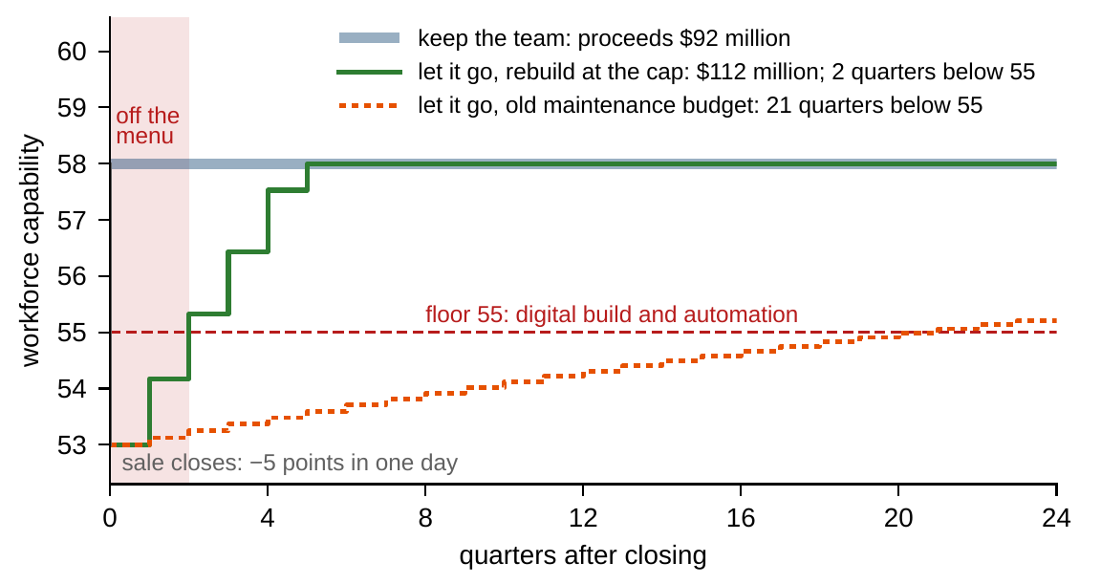
Money rebuilds the stock, not the quarters
WORKED EXAMPLE 10.1 · STEPS 3–4
At the cap: 53.00, 54.18, 55.32, 56.44, 57.53, 58.00
The floor is cleared at quarter 2 and 58 regained at quarter 5
At the old budget, 58 − 5 × 0.975^{k}: past 55 only after 21 quarters
Step 4: below 55 the digital build and the automation program are off the menu
The sale removes them the day it closes; buying them back takes two quarters
Figure 10.3. Meridian's workforce-capability index after the sale, quarter by quarter.
Notes:
Worked Example 10.1, Steps 3-4, Figure 10.3 and Online Appendix 10.B.6; Propositions 10.3 and 10.4.

Slide 19
In cash, the two options are a wash
WORKED EXAMPLE 10.1 · TABLE 10.5
 | Keep the team | Let it go, rebuild
Proceeds at closing ($ million) | 92 | 112
Capability at closing | 58 | 53
Quarters below the floor of 55 | 0 | 2
Quarters below 58 | 0 | 5
Capability investment, five quarters (points) | 7.25 | 11.9
Capability investment, five quarters ($ million) | 29.0 | 47.6
Proceeds net of that investment ($ million) | 63.0 | 64.4
Over the five-quarter rebuild window, capability points valued at $4 million.
Rebuilding invests $18.6m more than holding 58, and comes out $1.4m ahead net of the extra $20m.
Notes:
Table 10.5 and Step 5. Online Appendix 10.B.6: with the cap at 2.0 points a quarter, quarters 4 and 9 and $17.8m more; attrition of 6 percent a year, 2 and 4 and $19.4m; 11 percent, 3 and 6 and $18.2m.

Slide 20
The $20m is the price of time
WORKED EXAMPLE 10.1 · WHAT THE BOARD SHOULD TAKE AWAY
2 quarters
5 quarters
$1.4m
in which the digital program cannot start
of reduced capability, with hiring and training run at their limit
rebuilding's lead in cash: the buyer prices the team at roughly its rebuild cost
The $20m is not a premium for capability: money can rebuild the stock; it cannot buy back the quarters
For discussion: at a $30m ask, keeping the team costs about $11m more in cash than rebuilding
What would you need to know about the value of two quarters of digital-program time?
Notes:
Worked Example 10.1, what the board should take away, and the discussion question; Online Appendix 10.B.6 prices the $30m ask.

Slide 21

Meridian's capital ledger, in AXIOM
AXIOM LAB 1.10 · MODULE AXIOM-10
The chief financial officer wants a capital view of the transformation: which stocks each option builds or consumes, what each costs to hold, how fast each can be rebuilt. The transformation office must defend its training and platform budgets against a cut for a year. Open AXIOM, choose Lab 1.10 and load the Meridian capital model.
1
2
3
4
5
Build the capital vector
Price the rent
Test the asymmetry
Allocate a budget
Audit the ledger
Declare financial, human, technological and organizational capital with carriers, units, indicators and error bars.
Hold each stock with its sustaining flow; cut investment for four quarters and recover at the old budget and at the cap.
Destroy 30 percent of human capital in one quarter and count the quarters needed to recover.
Balanced, finance-heavy, bottleneck first: compare the capacity each buys and read the shadow value λ.
Run the plug auditor on a record with one undeclared conversion and locate it by sign and timing.
Deliverable: a one-page capital memo to the chief financial officer: the capital vector with error bars, the rent on each stock, the time to rebuild what each option consumes, the bottleneck, and one reallocation you would propose. About 75 minutes.
Notes:
AXIOM Lab 1.10. What to look for: holding a stock costs its rent for as long as it is wanted; after a cut the stock recovers only slowly at the old budget and, at the cap, no faster than the time to build (Theorem 10.3); spending off the bottleneck buys nothing (Theorem 10.2(i)).

Slide 22
What to carry forward
KEY TAKEAWAYS
1
Capital is the family of stocks a company builds, uses, and loses; most of it is off the balance sheet, and financial capital alone does not determine what a company can do.
2
Every form of capital obeys double-entry: a change in a stock splits into investment, use, decay, and conversion, conversion leaks, and the unexplained residual is a detector, not an embarrassment.
3
Capital is a rental and capability has a speed limit: holding C* costs δ C* every period, no budget inside the cap builds faster than the time to build allows, and one decision can destroy in a day what takes quarters to rebuild.
4
Know the coupling regime before allocating: under fixed proportions, value sits on the bottleneck; under complementarity, returns compound and joint programs win.
5
Equalize marginal returns across funded forms at the budget's shadow value; zero funding can be optimal; and audit the architecture before trusting its dynamics.
Notes:
Key Takeaways, Chapter 10.

Slide 23
Both companions reproduce the book's numbers
THIS WEEK'S LABORATORY
53
59
26110
AXIOM-10
notebook checkpoints, every one PASS
workbook checks against the engine, ALL PASS
the lab's seed
AXIOM Lab 1.10
Notebook DCT_V1_Ch10_Lab.ipynb: Worked Example 10.1 and the lab's five steps in eight panels, ready for Colab
Workbook DCT_V1_Ch10_Lab.xlsx: the capital vector, the rent, the rebuild clock, Table 10.5, the bottleneck and the plug auditor, in formulas
Every number on these slides is the book's, and both companions check it
Notes:
The notebook and workbook are on the course website, www.dynamiccorporatetransformation.com.

Slide 24

Chapter 11 measures what the stocks produce
NEXT · CHAPTER 11
Performance is a flow, consumed by the period that produces it; capital is the stock behind it (Definition 11.1)
The stock-and-flow balance becomes the basis for attribution: results earned by deploying stocks against results earned by consuming them
The rent δC* becomes a required line in any honest performance statement: skipping Meridian's $23m a year flatters EBITDA while capability falls below 55 within three quarters
Notes:
Section 10.8's bridge to Chapter 11, and Section 11.8 on Meridian's capability rent.

