Slide 1
Enterprise Risk, Resilience, and Robustness Architecture
VOLUME I · CHAPTER 12 · WEEK 6
Boards use one word, risk, for four different questions: keep them apart, and each becomes a number the board can act on
Graduate course companion · Lab seed 26112 · AXIOM Lab 1.12 (AXIOM-12)
Notes:
Volume I, Chapter 12. Part III has built what the company is, has and delivers; this chapter builds what it can lose, and what decides whether a loss is a bruise, a change of regime, or the end (Section 12.1). The Enterprise Risk, Resilience, and Robustness Architecture is the quadruple of risk, vulnerability, resilience and robustness on the state architecture (Definition 12.3).

Slide 2
“Nothing in life is so exhilarating as to be shot at without result.”
Winston S. Churchill
Nobel Prize in Literature 1953; The Story of the Malakand Field Force (1898)
Notes:
Churchill on the Malakand Field Force (1898). To be shot at without result is robustness: every shock smaller than the armor is absorbed in place (Theorem 12.2). The chapter keeps that guarantee apart from risk, vulnerability and resilience, the other three words for what a company can lose.

Slide 3
After this chapter, you can
LEARNING OUTCOME STATEMENTS
12.1
Explain risk, vulnerability, robustness, and resilience as four different answers to four different board questions, and use the distinctions to diagnose a risk report or register that blurs them.
12.2
Explain how a risk measure turns a distribution of losses into a number; compare expected loss, value at risk, and expected shortfall; and explain why the choice decides whether a risk dashboard rewards or punishes diversification.
12.3
Compute a company's armor against its declared limits—the robustness radius, read as a reverse stress test—and explain what protection against the worst case costs in expected performance.
12.4
Read resilience as two numbers, margin and rate; compute a recovery clock; treat recovery as re-entry into a band rather than a return to plan; and estimate the odds that the next shock arrives before recovery from the last.
12.5
Trace a shock through a company's feedback core, explain why containment depends on an eigenvalue of the gain-weighted wiring, and explain why common causes make joint failures far likelier than a register of separate risks suggests.
Notes:
The five learning outcome statements; LOS Guidance at the end of the chapter.

Slide 4
Eight sections, a worked example and a lab
ROADMAP
§12.1
§12.2
§12.3
§12.4
§12.5
Why Risk Needs Four Words
Risk, Uncertainty, and the Architecture
Shocks, Stress, and Vulnerability
Enterprise Robustness
Enterprise Resilience and Recoverability
Table 12.1
Theorem 12.1 · Tables 12.2–12.3
Definitions 12.4–12.6
Theorem 12.2
Theorem 12.3 · Figure 12.1
§12.6
§12.7
§12.8
Worked Example 12.1
AXIOM Lab 1.12
Enterprise Survivability
Risk Propagation and Systemic Risk
The Risk Architecture Assembled
What Would Break Meridian?
Stress-Testing Meridian
Theorem 12.4
Theorem 12.5 · Figure 12.2
Tables 12.4–12.5
Table 12.6 · Figure 12.3
AXIOM-12 · five steps
Notes:
Section 12.2: Definitions 12.1-12.3, Propositions 12.1-12.2, Theorem 12.1 and Tables 12.2-12.3. Section 12.3: Definitions 12.4-12.6. Section 12.4: Definition 12.7 and Theorem 12.2. Section 12.5: Definitions 12.8-12.9, Theorem 12.3 and Figure 12.1. Section 12.6: Definition 12.10 and Theorem 12.4. Section 12.7: Definitions 12.11-12.12, Theorem 12.5 and Figure 12.2. Section 12.8: Tables 12.4-12.5. Worked Example 12.1: Table 12.6 and Figure 12.3. AXIOM Lab 1.12: module AXIOM-12, five steps. Proofs of Theorems 12.1, 12.3 and 12.5 are in Appendix 12.A; those of Theorems 12.2 and 12.4 and Propositions 12.1-12.2 in Online Appendix 12.B.

Slide 5
Four words for four board questions
§12.1 · TABLE 12.1
Concept | Question it answers | What it is | Meridian reading
Risk | How likely, and how bad? | a number computed from the distribution of losses | a 24.6% chance that the digital program breaches the liquidity floor
Vulnerability | Where does a given shock hurt, and when? | a damage map on the state and the wiring | a demand shock reaches the divisions in one quarter, treasury in two
Robustness | What is guaranteed, whatever happens in a declared set? | armor: the smallest shock that breaks a limit | $270 million of cash above the floor today, $132 million at the program's low point
Resilience | How far can it be pushed, and how fast does it return? | two numbers: margin and rate | Industrial Systems back inside its normal band three quarters after a $90 million shock
Table 12.1. Conflating the four is the standard failure of risk conversations.
A risk report that answers a different question from the one asked is among the commonest failures of risk governance.
Notes:
Table 12.1 and Section 12.1. Risk is computed from a distribution of losses; vulnerability is a damage map; robustness is a guarantee, the largest shock the company is certain to absorb, with no probabilities required; resilience is dynamic. A board that asks 'are we exposed?' may mean any of the four.

Slide 6
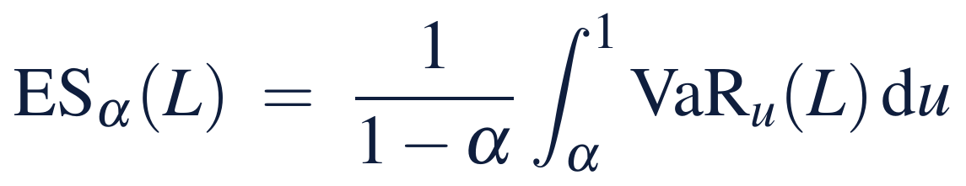
Value at risk can punish diversification
§12.2 · THEOREM 12.1
Two independent loans
THEOREM 12.1
Enterprise Risk Representation Theorem
Each loses 100 with probability 4 percent
95% value at risk: 0 for each loan, 100 for the pair
Expected shortfall: 80 for each, 103.2 for the pair, well below the 160 of the parts
The trap opens for tail probabilities just below 1 − α: from 0.025 to 0.05 at 95 percent
Report two numbers for any channel: how often, and how deep
(i) Risk is well defined. Every loss channel, and every path quantity such as a program's lowest liquidity, has a distribution derived from the state's
(ii) Coherence, and who has it. Expected loss and expected shortfall are coherent; value at risk is not subadditive
(iii) The diversification verdict. Under a subadditive measure the whole never looks riskier than its parts; under value at risk it can
Notes:
Theorem 12.1; formal statement and proof in Appendix 12.A. Online Appendix 12.B.1 locates the trap at 1 - sqrt(alpha) < p <= 1 - alpha. Value at risk answers a real question but sees nothing beyond its quantile, and the blindness has a direction: it can rank a concentrated book above a diversified one. Expected shortfall restores subadditivity at the price of estimating deeper into the tail, which is why the banking standard moved to it at the 97.5 percent level.

Slide 7
Declare the measure, and whether it is coherent
§12.2 · TABLES 12.2–12.3
Measure | Coherent? | What it sees | Honest use
Expected loss | yes | the average only | pricing, budgets, plan lines
Standard deviation | no | gains and losses alike | volatility budgets (Theorem 8.3)
Value at risk | no: not subadditive | one quantile; blind beyond it | threshold reporting, never netting
Expected shortfall | yes | the average of the tail | netting, consolidation, appetite
Breach probability | no | how often, not how deep | survival odds (Theorem 12.4)
Table 12.3. Table 12.2 declares a support and a measure for each of the risk vector's ten channels: financial, operational, strategic, technological, cyber, governance, legal and regulatory, environmental, reputational, and ESG (Equation 12.1).
Declare the measure for each channel, state whether it is coherent, and never net risks with one that is not.
Notes:
Tables 12.2-12.3, Definitions 12.1-12.3 and Propositions 12.1-12.2 (Online Appendix 12.B). No single risk number answers every risk question: channels have different supports (Proposition 12.1). A robustness guarantee is a risk guarantee under every distribution the declared set allows, but not conversely (Proposition 12.2, the Knightian bridge).

Slide 8

Vulnerability depends on the state and wiring
§12.3 · DEFINITIONS 12.4–12.6
the damage map: the declared performance lost at impact when a shock s displaces the state x
A shock is a sudden displacement of the state; a stress a sustained adverse path: the impulse and the step of the same dynamics
The same $150 million cash loss is absorbed today, with $270 million above the floor, and breaks the floor at the program's low point, with $132 million
A demand shock reaches Meridian's divisions in one quarter, but treasury, where the covenant lives, only in two
Arrival floors are the first layer of a damage map; Theorem 12.5 adds the magnitudes
Notes:
Definitions 12.4-12.6 and Section 12.3. Vulnerability is a property of state and wiring, not of the shock alone (Worked Examples 9.1 and 12.1). Chapter 7 prices both the shock, through the free response, and the stress, through the forced response and the shift of the equilibrium.

Slide 9
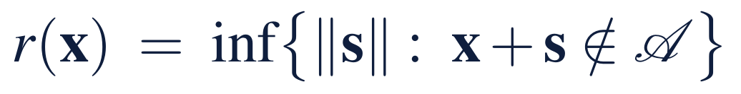
Armor is the distance to the nearest wall
§12.4 · THEOREM 12.2
For Meridian today
THEOREM 12.2
Enterprise Robustness Theorem
A cash loss of $270m breaks the floor; it would lift leverage only to 3.9 times
EBITDA would have to fall $121m, 24 percent, to break the covenant
Strategic risk can rise 11 points before it meets the ceiling
On the declared scale, 0.44, 0.32 and 0.11: the nearest wall is not a financial one
(i) The armor bound. Every shock smaller than the radius is absorbed in place; with one sensitivity, the radius becomes a guaranteed performance floor
(ii) The price of the worst case. Protection against every shock in a declared set costs expected performance: a computable premium
(iii) The reverse stress test. When each limit bounds one reading, the radius is the smallest slack on the declared scale
Notes:
Definition 12.7 and Theorem 12.2; formal statement and proof in Online Appendix 12.B. Buffers are strategy, not slack: the governance question is never 'robust or not' but 'how much premium for how much armor'. Online Appendix 12.B.2 prices the worst case in a two-by-two table: the robust choice raises the guaranteed outcome from 2 to 4 and costs 4.0 in expectation. Armor certifies nothing outside the declared walls and shocks (Proposition 12.2).

Slide 10
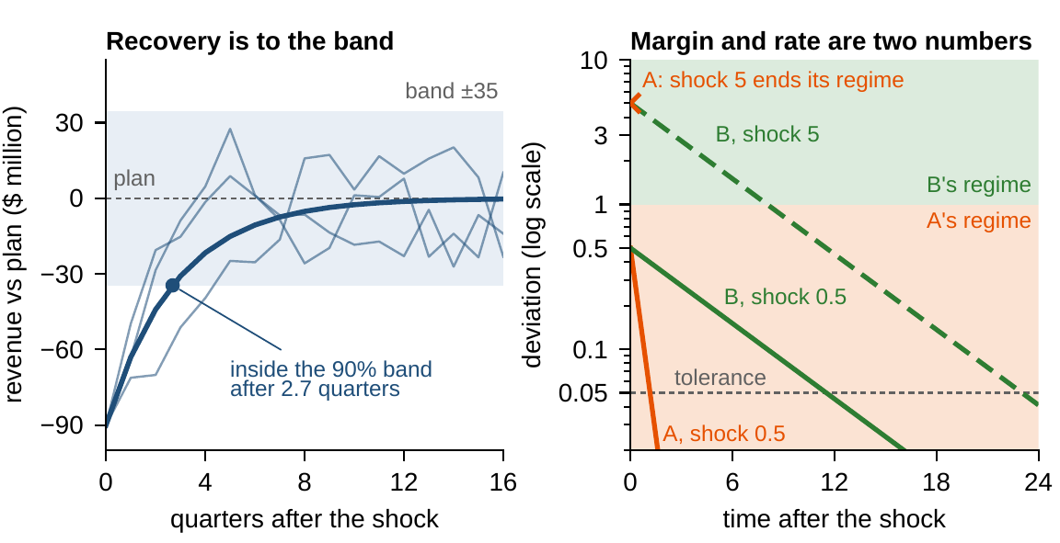
Recovery is to the band, not to the plan
§12.5 · THEOREM 12.3 · FIGURE 12.1
The clock: a $90m shock falls to a tenth in 7 quarters (Equation 12.2)
But it re-enters the 90% band, ±$34.5m, after 2.7 quarters: the honest target
Revenue is within $1m of plan only 3.8% of the time: plan is never reached for good
A sustained $15m shortfall moves the equilibrium to $50m below plan
Margin and rate cannot substitute: no single resilience score can rank A and B
Figure 12.1. Left: Industrial Systems' revenue after a $90 million shock re-enters the 90 percent band after 2.7 quarters. Right: A (rate 2, margin 1) heals a shock of 0.5 in 1.2 against B's 11.5; a shock of 5 ends A's regime, while B heals it in 23.
Notes:
Theorem 12.3 (formal statement and proof in Appendix 12.A) and Definitions 12.8-12.9. Recovery time grows only with the logarithm of the shock, but without bound as the rate approaches one. A stress test is first an equilibrium computation: can the company live at the stressed point? Fast-and-brittle against slow-and-wide is a strategic choice, and no single number can make it.

Slide 11
The next shock may arrive before recovery
§12.6 · THEOREM 12.4
23%
19%
12%
chance that the next regulatory intervention lands while Industrial Systems is still recovering: 1 − exp(−0.15 × 7/4)
at most: Boole's floor on a quarter $45m below plan within three years
by simulation, with its error bar: persistent deviations make bad quarters come together
(i) Survival is a product of period-by-period hazards; with a constant hazard h, failure comes after 1/h periods
(ii) Single-period breach probabilities add up to a conservative floor; simulation tightens it
(iii) The race: the next shock beats recovery with probability 1 − e^{−λT_rec}; survivable shocks ratchet
Levers: shorten the recovery, lower the effective λ, or widen the armor so that wounded is not fragile
Notes:
Definition 12.10 and Theorem 12.4; formal statement and proof in Online Appendix 12.B, with Boole's floor against simulation (12.B.5). Interventions arrive about once in 6.7 years; Industrial Systems needs 7 quarters to work a $90 million shock down to a tenth. The Poisson clock is the optimistic case: when shocks cluster, the next one is most likely precisely when the company is weakest.

Slide 12
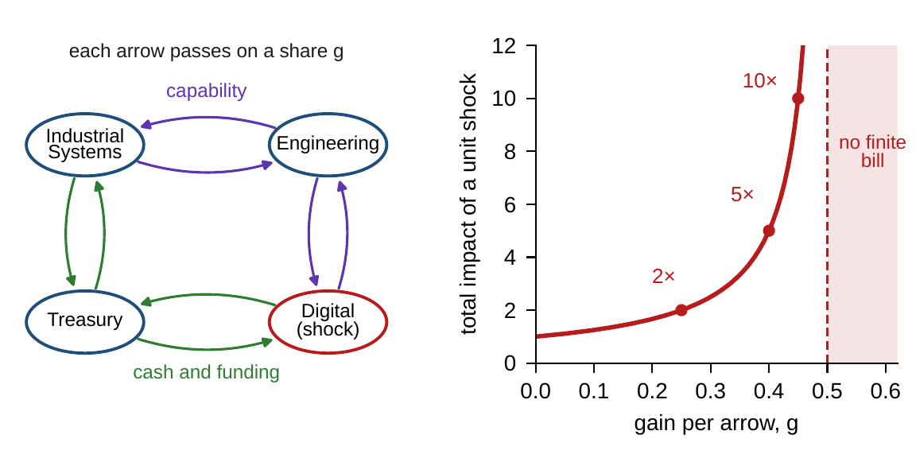
Containment is an eigenvalue
§12.7 · THEOREM 12.5 · FIGURE 12.2
Gain matrix G: each arrow passes on a share g of the loss arriving at its source
Threshold: the core's spectral radius is 2g; cascades die out only below g = 0.5
Multiplier 1/(1 − 2g): 2 at g = 0.25, 5 at 0.40, 10 at 0.45, none from 0.5
At g = 0.40 a unit shock to Digital costs Digital itself 1.9
Engineering and treasury 1.1 each, and Industrial Systems 0.9
A register of direct exposures books 1.8 of the 5.0
Figure 12.2. Left: Meridian's feedback core, a four-cycle whose every link runs both ways. Right: the total impact of a unit shock, 1/(1 − 2g): 2, 5 and 10, and unbounded from g = 0.5 on.
Notes:
Definitions 12.11-12.12 and Theorem 12.5; formal statement and proof in Appendix 12.A; Online Appendix 12.B.4 computes the multiplier component by component. A shock at Digital reaches engineering and treasury in one quarter and Industrial Systems in two. The same wiring with gains a quarter higher than 0.40, and containment is gone.

Slide 13
Common causes make joint failures likelier
§12.7 · THEOREM 12.5(IV)
14.5%
2.1%
10.2%
each of two units fails: a common cause of 10 percent, plus 5 percent on its own
both fail, if the register multiplies the separate probabilities
both fail, truly: nearly five times as likely
A register that multiplies separate probabilities has assumed an independence it must defend
A common cause of probability z can make a joint failure up to 1/z times likelier
Three levers: cut gains (dampen arrows), cut cycles (restructure the core), cut common causes
Notes:
Theorem 12.5(iv) and Online Appendix 12.B.3: with z = 10 percent the ratio is 4.9 when the separate failures have probability 5 percent, 8.4 at 1 percent, and approaches 10 as they vanish. Portfolios diversified across names can be crowded in common factors, and hedges that diversify in calm conditions fail in the liquidity stress in which they are needed (Section 12.7).

Slide 14
The stress test as an audit, item by item
§12.8 · TABLE 12.4
Element | Content and grounding
Scenario declaration | shocks and stresses; distributions for measurable channels, sets for Knightian ones (Definition 12.2)
Stressed equilibrium | the shift of the equilibrium under the stress: can the company live at the stressed point? (Theorem 12.3(iii))
Propagation account | walk bounds and the multiplier on G; the threshold check ρ(G) < 1 (Theorem 12.5)
Recovery clocks | a clock for each mode; re-entry into the band, never return to the point (Theorem 12.3(i), (iv))
Survivability account | hazards, the summed floor, simulation with error bars; the race number (Theorem 12.4)
Dependence audit | common causes named; no multiplying of separate probabilities without a defense (Theorem 12.5(iv))
Reverse stress test | the smallest breaking shock, wall by wall and jointly: the robustness radius (Theorem 12.2(iii))
Table 12.4. Table 12.5 reads the same architecture in a commercial bank, a technology company, a manufacturer and a hospital network.
Every risk statement names its object: distribution or set, dent or spring-back, separate or systemic.
Notes:
Section 12.8 and Tables 12.4-12.5. Part III's four structures now stand: what the company is, has, delivers, and can lose. Chapter 15's optimization treats this chapter's objects as constraints and objectives at last: radii as constraint margins, risk measures as terms in the objective, recovery clocks and the race as design variables.

Slide 15
What would break Meridian?
WORKED EXAMPLE 12.1 · THE SITUATION
Robustness
Risk
Resilience
The levers
How much armor does the plan leave, and where is it thinnest?
How deep does the tail go?
Could Meridian recover from one shock before the next?
What would it cost to make the program safe?
Steps 1–2: the walls, today and along the plan
Step 3: the program's low point
Step 4: the race
Step 5: Chapter 8's levers, in the four words
The board has the odds from Worked Example 8.1: a 24.6 percent chance of breaching the $350 million floor, against an appetite of 5 percent.
Notes:
Worked Example 12.1, the situation. The chair of the risk committee asks for the stress test in the four words of Table 12.1: how much armor the plan leaves and where it is thinnest, how deep the tail goes, whether Meridian could recover from one shock before the next, and what it would cost to make the program safe.

Slide 16
Armor today, and where the program thins it
WORKED EXAMPLE 12.1 · STEPS 1–2
Wall (Table 5.4) | Armor today | Declared scale | At the program's thinnest
Liquidity floor, $350m | $270m of cash | 0.44 | $132m at quarter 7 (0.21)
Covenant, 4.5× net leverage | $121m of EBITDA, 24% | 0.32 | for cash shocks the floor binds first
Strategic-risk ceiling, 75 | 11 points | 0.11 | 1.4 points around month 11 (0.014)
Armor is the slack to each declared wall, read on Meridian's declared scale (Chapter 3). A cash loss big enough to break the floor lifts leverage only to 3.9 times. The risk committee measures strategic risk with an error of ±6 points (Table 5.2).
The reverse stress test points first at the risk ceiling: at the digital peak its armor is less than a quarter of the measurement error.
Notes:
Worked Example 12.1, Steps 1-2; Theorem 12.2(iii); Online Appendix 12.B. Along the plan the cash armor falls from $270 million to $132 million at quarter 7 and recovers only to $160 million when the program ends: the build spends $138 million of armor and rebuilds $28 million. Robustness at the risk peak is not a number the board can know; it is a number the board must decide how to treat.

Slide 17
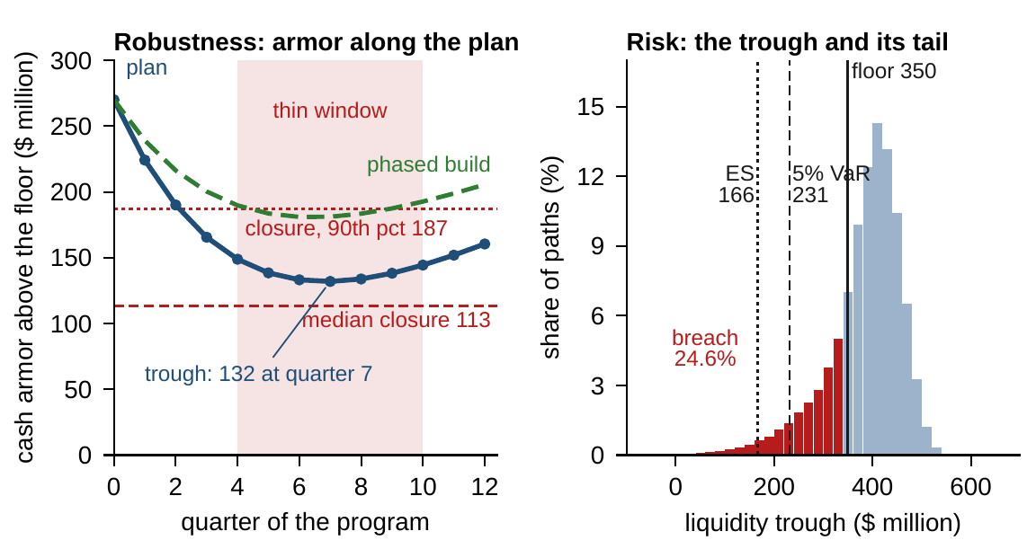
Thin armor meets a deep tail
WORKED EXAMPLE 12.1 · STEPS 2–4 · FIGURE 12.3
Cash armor sits below $150m for seven quarters, quarters 4 to 10
24.6% of paths breach the floor, by $72m on average
95% value at risk of the low point $231m; expected shortfall $166m
A closure lands in the thin window with probability 16%
At the low point a closure exceeds the armor with probability 36%
Recovery cannot win this race: it must be won with armor, not speed
Figure 12.3. Left: cash armor along the program, as planned and phased, against the median and 90th-percentile closure. Right: the program's lowest liquidity over 100,000 simulated paths.
Notes:
Worked Example 12.1, Steps 2-4; Theorem 12.4(iii). The paths are Worked Example 8.1's (100,000 paths, seed 8). The worst one path in twenty averages a low point $184 million below the floor. Closures arrive about once a decade and remove $120 million on average (median $113 million, 90th percentile $187 million) that does not come back within the program; one lands in the seven thin quarters with probability 1 - exp(-0.10 x 7/4) = 16 percent. After the low point the plan rebuilds its armor only slowly.

Slide 18
Two levers buy armor; only both meet appetite
WORKED EXAMPLE 12.1 · STEP 5 · TABLE 12.6
Configuration | Armor ($m) | Closure exceeds it | Breach | VaR | ES
Plan as designed | 132 | 36% | 24.6% | 231 | 166
Standby line | 132 + 100 | 2.8% | 12.4% | 320 | 286
Phased build | 181 | 12% | 13.1% | 278 | 213
Both levers | 181 + 100 | 0.6% | 3.0% | 367 | 332
100,000 simulated paths each (seed 8). Armor is liquidity above the $350 million floor at the low point; VaR and ES are the 95 percent value at risk and expected shortfall of the program's lowest liquidity, in $ million.
With both levers the odds fall to 3.0 percent, within appetite, yet the expected shortfall sits $18m below the floor.
Notes:
Table 12.6 and Step 5. The standby line leaves the plan's armor at $132 million but covers $100 million of any closure, so only a closure above $232 million breaks the floor at the low point; the breach odds halve to 12.4 percent. Phasing the build raises the armor itself, to $181 million. With both, a closure must exceed $281 million, a 0.6 percent chance.

Slide 19
Within appetite is not out of the tail
WORKED EXAMPLE 12.1 · WHAT THE BOARD SHOULD TAKE AWAY
3.0%
+$17m
−$18m
breach odds with both levers: within the board's 5 percent appetite
the low point's 95 percent value at risk, above the floor
its expected shortfall: the worst one path in twenty averages that far below
An appetite stated only as a probability is a value-at-risk statement, blind beyond its threshold
Meridian's appetite should say both how often and how deep (Theorem 12.1)
The most important finding: at the digital peak, the risk armor is smaller than its measurement error
For discussion: treat the ceiling as breached, measure better, or redesign the program? At what cost?
Notes:
Worked Example 12.1, what the board should take away, and the discussion question: at the digital peak strategic risk sits 1.4 points below a ceiling measured with an error of ±6 points. Should the board treat the ceiling as breached, commission a better measurement, or redesign the program so that the peak stays further away? What would each choice cost, and which of the four words does each answer?

Slide 20

Stress-testing Meridian, in AXIOM
AXIOM LAB 1.12 · MODULE AXIOM-12
Meridian's risk committee must sign off the digital program's stress test before the board's next meeting: what would break the company, how badly, how fast it would recover, and whether a shock in one division would spread. Open AXIOM, choose Lab 1.12 and load the Meridian risk model.
1
2
3
4
5
Build the register
Map the armor
Shock and recover
Race the next shock
Cross the threshold
Declare six or more channels with supports and measures, flag the coherent ones, and run the two-loan demonstration.
Read the distance to each wall today and at the low point, on the declared scale; run the reverse stress test.
Hit Industrial Systems with a $90 million shock; compare recovery to plan with re-entry into the band; hold a stress.
Set the closure rate and the recovery time; simulate with the error bar, with and without the levers.
Raise the core's gain until the multiplier explodes; dampen or cut one arrow and record the threshold.
Deliverable: a two-page stress-test report for the risk committee: the register and its measures, the armor table with the reverse stress test, recovery clocks and bands, the race number, the core's multiplier and threshold, and the levers with the armor each buys. About 75 to 90 minutes.
Notes:
AXIOM Lab 1.12. What to look for: value at risk can rank the concentrated book as safer (Theorem 12.1); armor is set by the nearest wall on the declared scale (Theorem 12.2(iii)); recovery is to the band (Theorem 12.3(iv)); the race is lost when armor is thin and recovery slow (Theorem 12.4(iii)); and the multiplier explodes as the spectral radius of G approaches one (Theorem 12.5(iii)). Discussion: which channels would you treat with a distribution and which with a set of scenarios? Rewrite the appetite so that it also limits how deep a breach may go. Which arrow of the feedback core would you dampen first, and what would it cost the business?

Slide 21
What to carry forward
KEY TAKEAWAYS
1
Four words, four objects: risk is a number computed from a distribution, vulnerability a damage map, robustness armor against a declared set, resilience a margin and a rate. Name the object, or the conversation is already lost.
2
The risk measure is a governance choice. Subadditivity decides whether consolidation can look worse than its parts, and value at risk fails it by arithmetic; report how often and how deep.
3
Armor is distance to the nearest wall: every shock below the radius is absorbed, the reverse stress test is a computation, and the worst case has a computable premium.
4
Resilience is two numbers. Recovery clocks grow with the logarithm of the shock and explode as the rate slows; stress moves the equilibrium; recovery is to the band, never the point; and the next shock may arrive first, with odds 1 - e^(-λ T_rec).
5
Containment is an eigenvalue: cascades die out when ρ(G) < 1, the total bill is the multiplier (I - G)⁻¹, and registers of separate risks omit both the cascade terms and the common causes.
Notes:
Key Takeaways, Chapter 12.

Slide 22
Notebook and workbook reproduce the book
THIS WEEK'S LABORATORY
133
127
26112
AXIOM-12
notebook checkpoints, every one PASS
workbook checks against the engine, ALL PASS
the lab's seed
AXIOM Lab 1.12
Notebook DCT_V1_Ch12_Lab.ipynb: Worked Example 12.1 and the lab's five steps in eight panels, ready for Colab; its 100,000 paths are the book's
Workbook DCT_V1_Ch12_Lab.xlsx: the register, the armor table, the recovery clock, the race, the core's multiplier and Table 12.6 in formulas, with 2,000 of the book's paths rebuilt by formula
Every number on these slides is the book's, and both companions check it
Notes:
The notebook and workbook are on the course website, www.dynamiccorporatetransformation.com. The worked example's paths are Worked Example 8.1's, drawn as in the book with random seed 8 (Online Appendix 12.B.6); Online Appendix 12.B.5's revenue paths use the book's seed 12; the lab's seed 26112 is used only for fresh draws, labelled as such.

Slide 23

Chapter 13 assembles the five architectures
NEXT · CHAPTER 13
Part III's four structures now stand: what the company is, has, delivers, and can lose
Chapter 13 assembles them, with the transformation layer as the element they share: one state, five layers, and a declared register of the couplings between them
Every layer can pass its own stress test while the whole is unstable
On the same digital program, the joint check finds $325 million of claims on $270 million of cash
Notes:
Section 12.8's bridge and Chapter 13's abstract; Definition 13.1 of the Unified Enterprise Transformation Architecture.

