Slide 1
Mathematical Analysis of the Unified Enterprise Transformation Architecture
VOLUME I · CHAPTER 14 · WEEK 7
Certify the model before optimizing it: the register is a stability budget, one gap sets recovery and amplification, and only the viability kernel certifies the horizon
Graduate course companion · Lab seed 26114 · AXIOM Lab 1.14 (AXIOM-14)
Notes:
Volume I, Chapter 14. Chapter 13 built the unified object; this chapter asks what it does, and puts to it the questions an investment committee puts to any forecast (the chapter's abstract and Section 14.1).

Slide 2
“It is not even wrong.”
Wolfgang Pauli
Nobel Prize in Physics 1945; on a young physicist's paper, as recalled by Rudolf Peierls (1960)
Notes:
Pauli's remark on a young physicist's paper, as recalled by Rudolf Peierls (1960). A model that is not well posed is not even wrong: before a company optimizes its transformation, it should know whether the model it optimizes can bear the weight (the chapter's abstract).

Slide 3
After this chapter, you can
LEARNING OUTCOME STATEMENTS
14.1
Explain what makes a transformation model fit for analysis—a future that exists, is unique, and depends boundedly on its inputs—and who in the company owns each assumption behind it.
14.2
Test whether a company settles after shocks, read the coupling register as a stability budget, and explain why stable units can compose an unstable company.
14.3
Size how strongly a company responds to a change, direct and knock-on, and explain why the spectral gap governs both recovery speed and amplification.
14.4
Distinguish feasible this quarter from viable over the horizon, using the runway trap and the viability kernel, and explain why margin is the price of robust feasibility.
14.5
Explain how gain audits, invariants, and convergence certificates turn analysis into governance, and what the optimization problem of Chapter 15 inherits from this chapter.
Notes:
The five learning outcome statements; LOS Guidance at the end of the chapter.

Slide 4
Nine sections, a worked example and a lab
ROADMAP
§14.1
§14.2
§14.3
§14.4
§14.5
Why Analyze Before Optimizing
The Analytical Setting
Existence and Uniqueness
Enterprise Stability
Sensitivity and Perturbation
§14.6
§14.7
§14.8
§14.9
Worked Example 14.1
Feasibility and Viability
Structural Consistency and Invariants
Convergence
From Analysis to Optimization
Can Meridian Afford the New Link?
AXIOM Lab 1.14
How Close to the Edge Is Meridian?
Notes:
Section 14.2: Definitions 14.1-14.3, Table 14.1 and Proposition 14.1. Section 14.3: Definition 14.4, Proposition 14.2 and Theorems 14.1-14.2. Section 14.4: Definition 14.5, Theorem 14.3 and Table 14.2. Section 14.5: Definitions 14.6-14.7, Propositions 14.3-14.4, Theorem 14.4 and Figure 14.1. Section 14.6: Definition 14.8, Theorem 14.5 and Figure 14.2. Section 14.7: Definitions 14.9-14.10, Theorem 14.6, Proposition 14.5 and Theorem 14.7. Section 14.8: Theorem 14.8. Section 14.9: Definitions 14.11-14.12 and Table 14.3. Worked Example 14.1: Table 14.4 and Figure 14.3. AXIOM Lab 1.14: module AXIOM-14, five steps. Proofs of Theorems 14.3-14.5 are in Appendix 14.A; the others in Online Appendix 14.B.

Slide 5
Eight questions, eight theorems
§14.1 · WHY ANALYZE BEFORE OPTIMIZING
Existence
Uniqueness
Stability
Sensitivity
Does the plan have a future in the model?
Only one?
Does the company settle after a shock, and how fast?
How strongly does a change in one place move the whole?
Theorem 14.1
Theorem 14.2
Theorem 14.3
Theorem 14.4
Feasibility and viability
Structural consistency
Invariants
Convergence
Can it stay within its limits for the whole horizon?
Are the guarantees backed by audits?
What can never change?
Where does the company settle?
Theorem 14.5
Theorem 14.6
Theorem 14.7
Theorem 14.8
Every analytical property can fail while the declarations are perfectly consistent.
Notes:
Section 14.1. A declared dynamics can trap itself against its own constraints, a stable-looking company can be one coupling away from divergence, and a plan feasible in every period can be infeasible as a trajectory. The method is inheritance under declared assumptions; no result presupposes an objective function, which lets Chapter 15 and Volume II rest on one common base.

Slide 6
Every assumption has an owner
§14.2 · TABLE 14.1 · PROPOSITION 14.1
Tag | Requires | Owner | Buys
A1 | the feasible region nonempty, closed and bounded | consistency audit (Chapter 13) | trajectories and operating points exist
A2 | f Lipschitz on the region with constant L: no infinitely violent response | layer owners | one plan, one forecast; bounded drift
A3 | capital, performance and risk readouts Lipschitz on the region | ledger owners | ledgers inherit every state result
A4 | each constraint continuous; convex where declared | constraint owners (Chapter 9) | feasibility analysis; Chapter 15's optimality
A5 | f differentiable, true gains within the ceilings (Equation 14.3) | risk office's coupling register | stability certificates; sensitivities
A6 | standing dynamics keep the region in itself, or contract (L < 1) | viability audit | equilibria exist; global convergence
Table 14.1, the analytical assumption panel. A6 is invoked only where stated.
Proposition 14.1. The constructions of Parts II–III deliver A1–A5; A6 is audited separately.
Notes:
Definitions 14.1-14.3, Table 14.1 and Proposition 14.1 (Online Appendix 14.B). The register's ceilings read as a bound on the true linearized dynamics, |A| <= M: the declared-gain certificate (Equation 14.3). A6 is withheld from the default panel because it is the assumption companies most often make and least often have: that operating admissibly keeps them admissible.

Slide 7
One policy, one future
§14.3 · THEOREMS 14.1–14.2
What it means
THEOREMS 14.1 AND 14.2
Existence and Uniqueness
The license for scenario planning: one start and one policy give one forecast
The license for declaration management: a recalibration moves forecasts by a stated ceiling
A response declared with infinite marginal sensitivity forfeits predictability
The state does not determine its history: provenance lives in the records
Trajectories exist from every admissible start under every admissible policy, while each step's preconditions hold
One policy, one future: two trajectories under the same decisions drift apart at most by the factor L^{k} after k periods
Recalibration is bounded: under contraction, forecasts move at most 1/(1 − L) times a recalibration's one-period effect
Non-uniqueness needs infinite sensitivity: ẋ = √|x| from zero has two solutions
Existence is not admissibility: staying in the region is viability (Theorem 14.5)
Notes:
Theorems 14.1 and 14.2; formal statements and proofs in Online Appendix 14.B. The ceiling degrades as L approaches 1, a first sighting of the conditioning theme of Section 14.5. Part (iv) is why Chapter 4's audit trail cannot be replaced by a snapshot, however complete.

Slide 8
The coupling register is a stability budget
§14.4 · THEOREM 14.3
For Meridian
THEOREM 14.3
Architectural Stability Theorem
Every core link is capped at 0.40: each unit passes on at most 0.80 of a deviation
The register's radius is 0.80: certified, a half-life of 3.1 quarters
Five stable functions, each certified by its owner, can compose an unstable company
Stability monitoring needs state-level telemetry, not stationary indicators
(i) Spectral test. Deviations die out geometrically when ρ < 1; above 1, the equilibrium is unstable
(ii) Certified budget. A register audited to ρ(M) < 1 certifies every equilibrium in the region
(iii) Coupling destabilization. Stable, even inert, layers can compose an unstable company
(iv) One-number monitor. A Lyapunov health index falls every period exactly when ρ < 1
(v) Ledgers can settle while the state drifts
Notes:
Theorem 14.3; formal statement and proof in Appendix 14.A. Part (ii) closes a loop: the coupling register began as a governance document, became a propagation calculator in Chapter 13, and is now a stability guarantee, provided the ceilings are audited against the measured dynamics (Theorem 14.6(ii)). All parts but (ii) are local.

Slide 9
Five tests, from local to global
§14.4 · TABLE 14.2
Test | Requires | Delivers | Reading
Spectral, ρ(A) < 1 | the Jacobian at the equilibrium | decay at about rate ρ | the company's return spring
Certified budget, ρ(M) < 1 | the audited register | stability of every equilibrium in the region | a governance ceiling as a guarantee
Block small gain, ρ(M̂) < 1 | layer and coupling block sizes | stability from layer-level data | the only legitimate layer-wise sign-off
Lyapunov, P positive definite | a solved Lyapunov equation | a health index that falls | one number, provably decreasing
Contraction, L < 1 | A2 with L < 1 on an invariant region | global convergence | strongest, rarest, checkable
Table 14.2. All but the last are local to a declared operating point.
Layer-by-layer attestations do not certify a company; the block small gain, which includes the couplings, does.
Notes:
Table 14.2 and Theorem 14.3(iii)-(iv). The notebook and workbook run all five tests on the five registers of Table 14.4: contraction fails for the trimmed register although its radius meets the board's rule.

Slide 10

Every change lands direct plus knock-on
§14.5 · THEOREM 14.4
the direct effect the parameter's owner sees, plus knock-on effects along layered walks
(i) The sensitivity S obeys a linear recursion of its own, S′ = AS + B from S = 0 (Equation 14.4)
(iii) With nonnegative couplings the multiplier is at least 1/(1 − ρ): the spectral gap is the conditioning number
Meridian: 1/(1 − 0.80) = 5: $10m a quarter at Digital settles at $50m, $40m of it knock-on
Compare unit-free elasticities; a structural change has no derivative and needs re-analysis
Notes:
Theorem 14.4 (proof in Appendix 14.A), Definitions 14.6-14.7 and Propositions 14.3-14.4. The multiplier of Theorems 12.5 and 13.3 returns as a derivative. Definition 14.7 classifies perturbations: state, parametric and structural propagate by different mathematics (dynamics, sensitivity, re-analysis).

Slide 11
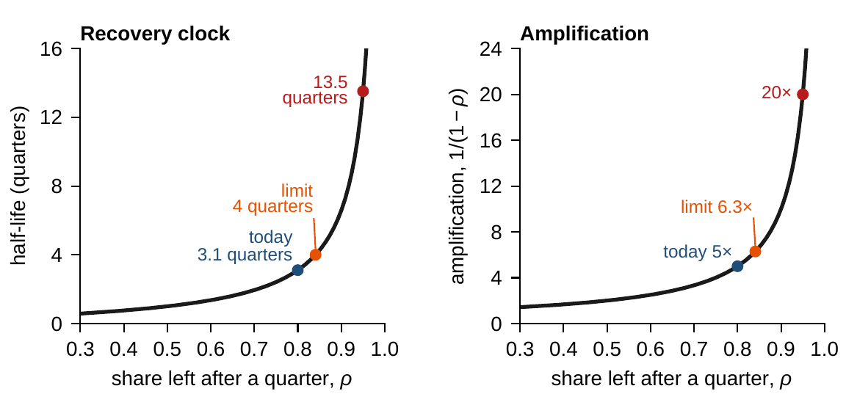
Near the edge, slow and nervous at once
§14.5 · FIGURE 14.1
Keep a share ρ of every deviation each quarter, and the half-life is ln 2 / ln(1/ρ) quarters
A permanent change is amplified 1/(1 − ρ) times: one gap sets both clocks
Meridian today: ρ = 0.80, 3.1 quarters and 5×
The board's limit: ρ = 0.84, 4 quarters and 6.3×
Near the edge: ρ = 0.95, 13.5 quarters and 20×
Figure 14.1. One gap, two clocks: the recovery clock (left) and the amplification (right) against the share of a deviation left after a quarter.
Notes:
Figure 14.1, Theorems 14.3(i) and 14.4(iii), and LOS Guidance 14.3. The gap that slows recovery amplifies every recalibration; treating the recovery clock and the amplification as two problems is the common mistake.

Slide 12
Feasible now is not viable over the horizon
§14.6 · THEOREM 14.5
What it means
THEOREM 14.5
Enterprise Feasibility Theorem
Rolling plans: each plan feasible and approved, the company walking a corridor that ends
The kernel is the analytical content of “strategic room”
A Slater point is what holding buffers above floors means
Chapter 15 consumes the kernel as the honest planning set
(i) Structure. The region is compact, convex when every constraint is; slack stays slack nearby
(ii) A Slater point, every constraint met strictly, gives the region an interior
(iii) The viability kernel, what the shrinking leaves, is the largest part that sustains itself
(iv) Per-period feasibility is not viability: feasible this quarter and next can be doomed
(v) Margin. The region survives small tightenings exactly when a Slater point exists
Notes:
Theorem 14.5; formal statement and proof in Appendix 14.A. V_j is the set of states that can stay admissible for j periods; a trajectory can stay admissible forever if and only if it starts in the kernel.

Slide 13
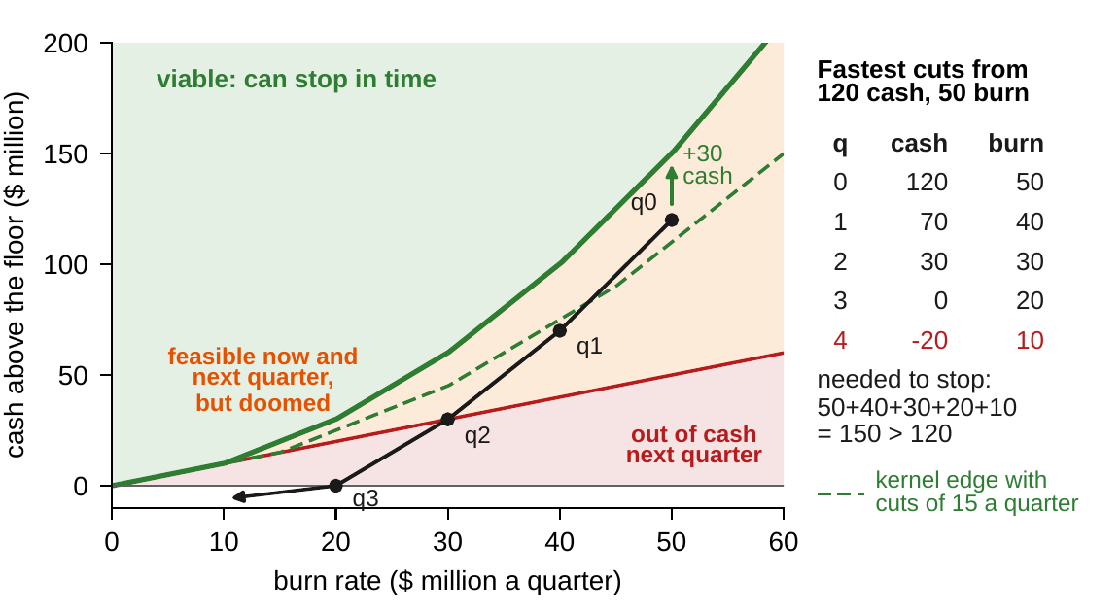
The runway trap: feasible, and doomed
§14.6 · FIGURE 14.2
$120m of cash above the floor, a $50m burn, cuts of at most $10m a quarter
Next quarter is feasible whatever the unit does: cash will be $70m
Stopping takes 50 + 40 + 30 + 20 + 10 = $150m: with the fastest cuts, cash runs out in quarter 4
Repairs: $30m more cash, or exit clauses that allow $15m cuts, which make $110m enough
The kernel's edge grows with the square of the burn
Figure 14.2. Below the red line the unit is out of cash next quarter; between it and the solid green curve it is feasible now and next quarter but doomed; above the curve lies the viability kernel.
Notes:
Section 14.6, Figure 14.2 and Online Appendix 14.B.2. The kernel's edge with cuts of b is r(r + b)/(2b) where the burn r is a multiple of b; cuts of $12.5m would need $125m. The digital program of Chapters 12-13 has the same shape: the cash above the floor must cover the spending still to come.

Slide 14
The gain audit makes the register falsifiable
§14.7 · THEOREMS 14.6–14.7
What it means
THEOREMS 14.6 AND 14.7
Structural Consistency and Invariance
The gain audit, a recurring meeting, renews or suspends the stability and sensitivity guarantees
Warranties compose like a chain: signed per layer, audited centrally
A jump flags an implementation error, a drift a mis-declared map, a breach an inadmissible state
Proposition 14.5: p independent identities leave at most n − p directions of movement
Closure. The panel survives integration, assembly and projection
The certificate is checkable: estimate the Jacobian blocks, compare entry by entry, attribute each violation to its channel
The weakest link: one layer that is not Lipschitz voids every bound for the whole system
Invariance: sets that trap and identities that hold restrict every reachable future
Tripwires: along any admissible computed trajectory, declared identities hold exactly; a violation proves a fault
Notes:
Theorems 14.6 and 14.7, Definitions 14.9-14.10 and Proposition 14.5; formal statements and proofs in Online Appendix 14.B. Time scales: analyzing slow stocks against equilibrated fast flows is a cited license (singular perturbations), not a theorem of the book.

Slide 15
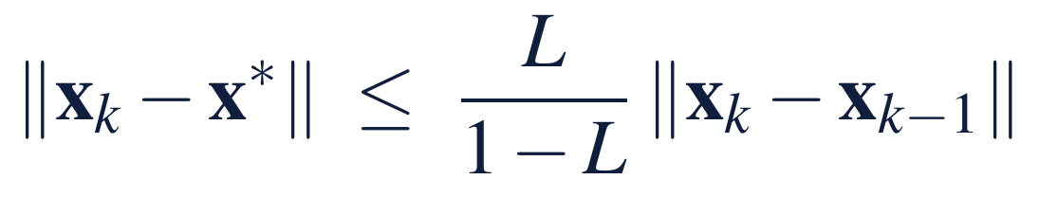
Convergence is certified, or not claimed
§14.8 · THEOREM 14.8
What it means
THEOREM 14.8
Unified Enterprise Convergence Theorem
This quarter's movement and the audited L bound the distance to the settling point now
Twin books are licensed when the Jacobian's signs preserve order, checked in the gain audit
Nothing here says where the company should settle: that is Chapter 15's question
(i) Contraction: geometric convergence, with a priori and a posteriori bounds
(ii) Lyapunov and invariance: a health index that never rises (LaSalle)
(iii) Monotone brackets: two books bracket every intermediate reality
(iv) Stochastic: the company settles to a band, never to a point
(v) No certificate, no promise: an eigenvalue on or outside the unit circle, and deviations persist, oscillate or diverge
Notes:
Theorem 14.8; formal statement and proof in Online Appendix 14.B. Mixed-sign couplings, such as competitive channels and risk feedbacks, break the bracketing license, so it is checked per declaration.

Slide 16
What optimization inherits from analysis
§14.9 · TABLE 14.3
Result | Delivers | The optimization uses it as
Theorem 14.1 (existence) | trajectories; operating points | a decision-to-outcome map that exists
Theorem 14.2 (uniqueness) | one outcome per policy | well-defined objective values
Theorem 14.3 (stability) | spectral, budget and Lyapunov tests | holdability constraints on optima
Theorem 14.4 (sensitivity) | multipliers; conditioning | gradients for first-order theory
Theorem 14.5 (feasibility) | compact region; margin; kernel | existence of optima; the honest planning set
Theorem 14.6 (consistency) | panel closure; gain audit | model-risk governance
Theorem 14.7 (invariance) | trapped sets; identities; tripwires | dimension reduction; conservation constraints
Theorem 14.8 (convergence) | rates; brackets; bands | implementable optima; certified horizons
Table 14.3. Definition 14.11 measures analytical complexity; Definition 14.12 states the preliminary optimality condition, whose gradients are the layered sensitivities.
Complexity is partly chosen: sparsity, the gap and the invariants are governance decisions.
Notes:
Section 14.9, Definitions 14.11-14.12 and Table 14.3. A small, dense system near its edge resists every instrument at once; the analytically kind company chose its architecture with the analyst, and Chapter 15's optimizer, in the room.

Slide 17
Can Meridian afford the new link?
WORKED EXAMPLE 14.1 · THE SITUATION
The strategy office
The risk committee
The board
The digital program's largest synergy
What does it do to Meridian's stability?
Any deviation must halve within a year
Phase two links Digital and Industrial Systems directly: the platform into the installed base, the software through the service teams.
Its register caps every link of the feedback core at 0.40 of a quarter's deviation.
A half-life of at most four quarters: a spectral radius of at most 0.84.
Industrial Systems and Digital are each wired both ways to engineering and treasury (Worked Example 9.1).
Notes:
Worked Example 14.1, the situation. The register is Chapter 12's (Section 12.7): no unit passes on more than 40 percent of a quarter's deviation to a linked unit in the next quarter.

Slide 18
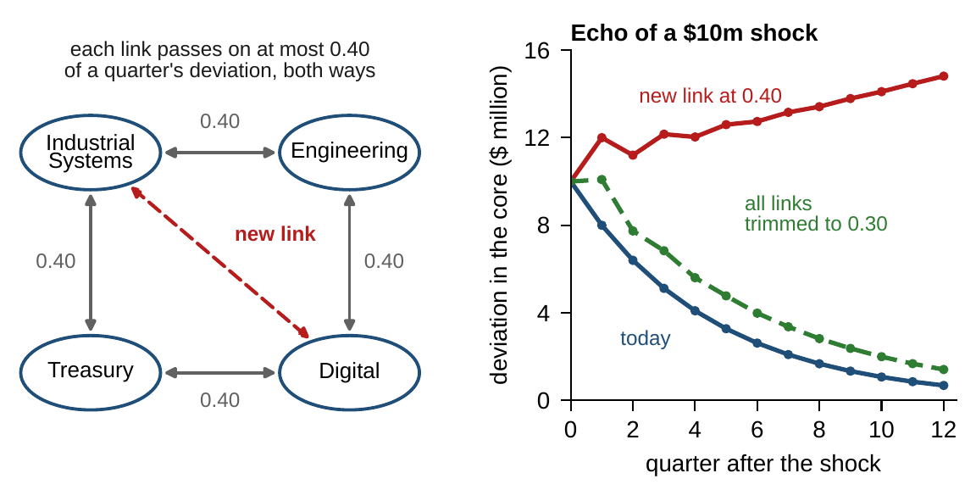
One well-meant link breaks the certificate
WORKED EXAMPLE 14.1 · STEPS 1–2 · FIGURE 14.3
Step 1: two links a unit, 0.80 passed on: radius 0.80, a half-life of 3.1 quarters
Amplification 5: $10m a quarter at Digital settles at $50m, $40m of it knock-on
Step 2: with the new link at 0.40, Industrial Systems and Digital pass on 1.20: radius 1.02
A $10m shock echoes as $12m next quarter and $15m after three years
Every link passes its own review; the failure belongs to the two new loops
Figure 14.3. Left: the core, every link capped at 0.40, and the new link. Right: the echo of a $10m shock at Digital, summed over the core, with every link at its ceiling.
Notes:
Worked Example 14.1, Steps 1-2, and Online Appendix 14.B.3. Step 1's split: $19m at Digital, $11m each at engineering and treasury, $9m at Industrial Systems. Step 2 is Theorem 14.3(iii) at Meridian, the moving version of Chapter 13's cascade gap: the new loops run through engineering and through treasury.

Slide 19

Re-budget the core under the board's rule
WORKED EXAMPLE 14.1 · STEPS 3–5
engineering links e, treasury links t, the new link h: the register's radius in closed form
Step 3: the new link at most at 0.08; or treasury's links at 0.16; or every existing link trimmed from 0.40 to 0.30
Step 4: each repair sits on its edge: amplification from 5 to 6.3; the same shortfall settles at $64–70m a quarter
Step 5: the link is a structural change, priced by re-analysis; the integration plan becomes a gain-reduction schedule, checked in the gain audit
Notes:
Worked Example 14.1, Steps 3-5, and Online Appendix 14.B.1: rho <= r* exactly when h r* + 2(e^2 + t^2) <= r*^2. Exactly: 0.080, 0.159 and 0.304, a trim of 24 percent. Ring-fencing lets treasury absorb funding shocks with the standby line and the phased build of Chapter 8 rather than pass them on.

Slide 20
The synergy costs a quarter of every coupling
WORKED EXAMPLE 14.1 · TABLE 14.4 · WHAT THE BOARD SHOULD TAKE AWAY
Register | Eng. links | Treas. links | New link | ρ | Half-life (quarters) | Settled ($m)
Today | 0.40 | 0.40 | – | 0.80 | 3.1 | 50
New link at the ceiling | 0.40 | 0.40 | 0.40 | 1.02 | none | no limit
Run the new link light | 0.40 | 0.40 | 0.08 | 0.84 | 4.0 | 64
Ring-fence treasury | 0.40 | 0.16 | 0.40 | 0.84 | 4.0 | 68
Trim every existing link | 0.30 | 0.30 | 0.40 | 0.84 | 4.0 | 70
Table 14.4. Gains: the share of a quarter's deviation passed on per link. Settled: the deviation across the core per quarter for a permanent $10 million a quarter shortfall at Digital.
Real and affordable, but not free: no office's review would find the bill, because no single link is to blame.
Notes:
Table 14.4 and what the board should take away: at full strength the synergy costs a quarter of every existing coupling, or most of treasury's. For discussion: which repair would you choose, and who should own it? Ring-fencing concentrates the cost in treasury and damps Digital's funding in good quarters; trimming spreads it. What would you monitor to know that the trims have actually happened?

Slide 21

How close to the edge is Meridian, in AXIOM
AXIOM LAB 1.14 · MODULE AXIOM-14
Before Chapter 15's optimization is run on Meridian, the board wants an analysis certificate: is the model well posed, how stable is the company, how strongly does it respond to change, and can it stay within its limits for the whole horizon? Open AXIOM, choose Lab 1.14 and load the Meridian model.
1
2
3
4
5
Stability bench
Sensitivity explorer
Perturbation simulator
Feasible-region visualizer
Diagnostics dashboard
Edit couplings; watch the radius, margin, half-life and Lyapunov bowl; add the new link and find trims that meet the rule.
Multipliers with the walk decomposition and the elasticity table; turn the blow-up dial toward 1.
A state shock, a recalibration and an acquisition: why only the first two have derivatives.
Run the viability iteration on the restructuring corridor and apply its two repairs.
Read the complexity panel, run the gain audit, trip an invariant and classify the violation.
Deliverable: a one-page analysis certificate for the board: the register's spectral radius and its margin; the half-life and the amplification; the re-budget for the new link, with its cost; the viability check and its repairs; and the audit plan. About 75–90 minutes.
Notes:
AXIOM Lab 1.14. What to look for: a register with spectral radius below 1 certifies the core, and one new link can undo it (Theorem 14.3(ii)-(iii)); the multipliers grow like 1/(1 - rho) (Theorem 14.4(iii)); the corridor is feasible every quarter until it is not, and only the kernel sees it in advance (Theorem 14.5(iii)-(iv)); the guarantees stand or fall with the audit (Theorem 14.6(ii)). Discussion: which couplings would you audit first? A divisional head says her unit is stable, so the group is: what do you reply? How much runway does the digital program's committed spending need, and who should hold it?

Slide 22
What to carry forward
KEY TAKEAWAYS
1
Analysis runs on a declared panel—a bounded region, regular responses, and an audited coupling register—and every guarantee has an owner.
2
One policy, one future, boundedly sensitive to recalibration; and no route back from the state to its history.
3
The coupling register is a stability budget: true dynamics within the ceilings settle whenever the register's spectral radius is below 1, and stable units do not certify a stable company.
4
The spectral gap is the company's temperament: near the edge, recovery is slow and every change is amplified.
5
Feasible this quarter and next can still be doomed: only the viability kernel certifies the horizon, and margin is what makes feasibility robust.
Notes:
Key Takeaways, Chapter 14.

Slide 23
Notebook and workbook reproduce the book
THIS WEEK'S LABORATORY
47
71
26114
AXIOM-14
notebook checkpoints, every one PASS
workbook checks against the engine, ALL PASS
the lab's seed
AXIOM Lab 1.14
Notebook DCT_V1_Ch14_Lab.ipynb: Worked Example 14.1 and the lab's five steps in nine panels, ending with the analysis certificate, ready for Colab
Workbook DCT_V1_Ch14_Lab.xlsx: a live stability bench, Table 14.4 and its frontier, the clocks, the sensitivity explorer, the runway's viability sets and the dashboard, in formulas
Every number on these slides is the book's, and both companions check it
Notes:
The notebook and workbook are on the course website, www.dynamiccorporatetransformation.com. The chapter's numbers are computed exactly; the lab's seed 26114 is used only for fresh draws, labelled as such.

Slide 24

Chapter 15 chooses among admissible futures
NEXT · CHAPTER 15
Of the futures the company can reach, which should it choose? One problem, the General Enterprise Optimization Problem, posed on this certified object
Its feasible set is the audited region with the viability kernel as its honest core; its gradients are this chapter's sensitivities
Under the board's half-life rule the stability budget binds and has a price: 0.01 trimmed from both engineering links frees 0.019 of the new link
Notes:
Section 14.9's bridge, Chapter 15's opening and Proposition 15.9; the GEOP is Equation 15.1.

