Slide 1
Introduction to Enterprise Optimization
VOLUME II · CHAPTER 1 · WEEK 8
Optimization runs backward, from what the company wants and must respect to a plan, and an answer is worth the certificates that come with it
Graduate course companion · Lab seed 26201 · AXIOM Lab 2.1 (AXIOM-01)
Notes:
Volume II, Chapter 1. Volume I ended with a question stated so precisely that it can be solved: of the futures a company can reach, which should it choose, and at what price? This chapter turns that question into a problem that methods can take apart (chapter abstract).

Slide 2
“I will economize on words. […] Many things that are desirable are not feasible.”
Thomas J. Sargent
Nobel Memorial Prize in Economic Sciences 2011; commencement address, UC Berkeley (2007)
Notes:
Sargent's point is the chapter's first discipline: commitments carve the region of decisions a company can take, and many desirable decisions lie outside it (Section 1.3, Proposition 1.2).

Slide 3
After this chapter, you can
LEARNING OUTCOME STATEMENTS
1.1
Explain what optimization adds to the analysis of Volume I, and why an optimizer's answer is only as good as the declaration it was given and the certificates it returns.
1.2
Write a transformation decision in the canonical form—its decisions, objective, commitments, and dynamics—and say what each element must declare and who owns it.
1.3
Describe the structure of a decision space—continuous, lumpy, or a rule—and explain how that structure decides whether a guaranteed best decision can be found and at what cost.
1.4
Distinguish changes to an objective that leave the best decision unchanged from changes that alter it, and explain why “the optimal strategy” is incomplete until its objective is named.
1.5
Place a decision problem on the map of Volume II, and use the readiness gates and the optimization lifecycle to decide what must happen before any solver is run.
Notes:
The five learning outcome statements; LOS Guidance at the end of the chapter.

Slide 4
Eight sections, a worked example and a lab
ROADMAP
§1.1
§1.2
§1.3
§1.4
§1.5
Why Optimize?
Optimization and the Company: A Short History
The Canonical Form
Decision Spaces: Where the Difficulty Lives
What the Objective Decides
§1.6
§1.7
§1.8
Worked Example 1.1
AXIOM Lab 2.1
A Map of Volume II
Ready to Optimize: The Gates and the Lifecycle
Learning with This Book
Can Meridian Sign Volume I's Answer?
From Question to Solvable Problem
Notes:
Section 1.1: Definition 1.1, Proposition 1.1, Figure 1.1. Section 1.3: Theorem 1.1, Proposition 1.2, Table 1.1. Section 1.4: Theorems 1.2 and 1.3, Table 1.2. Section 1.5: Theorem 1.4, Proposition 1.3, Definition 1.7. Section 1.6: Proposition 1.4, Figure 1.2. Section 1.7: Theorem 1.5. Section 1.8: Figure 1.3. Worked Example 1.1: Table 1.3, Figure 1.4. Proofs of Theorems 1.1 and 1.3 to 1.5 are in Appendix 1.A; Propositions 1.1 to 1.4 and Theorem 1.2 in Online Appendix 1.B.

Slide 5
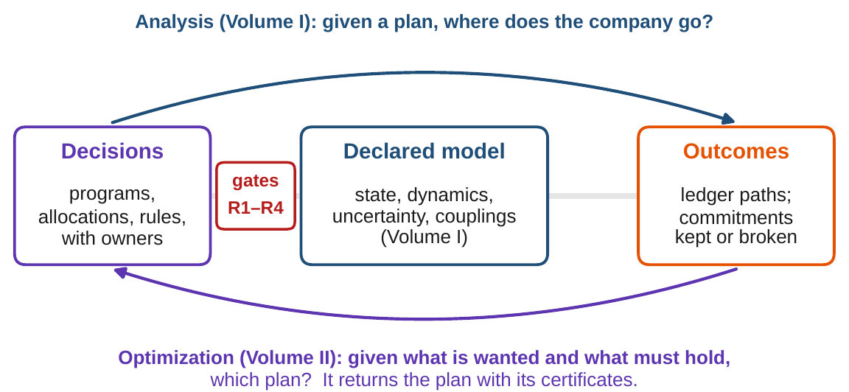
Analysis runs forward; optimization runs backward
§1.1 · DEFINITION 1.1 · PROPOSITION 1.1
DEFINITION 1.1
Enterprise Optimization
The selection, by methods with stated guarantees, of a company's decisions: its programs, allocations and rules
that maximize a declared objective of the company's path
subject to the commitments of all its architectures and the declared description of its uncertainty
The backward search is large, partly lumpy and coupled: strong analysis does not by itself make strong optimization
Proposition 1.1. No declared state, no optimization: a solver that answers an undeclared problem has solved one of its own
Figure 1.1. Both directions use the same declared model of the company; the readiness gates of Volume I stand in front of it.
Meridian arrives with Volume I's answers: eight readings, a core certified at 0.80, an appetite priced at $10.4m
The first step on any problem is a declaration audit, not a model build
Notes:
Definition 1.1 and Proposition 1.1. Analysis computes where a given plan takes the company; optimization searches the plans for the best one that keeps every commitment. Meridian's state, five architectures on seven components, a feedback core with spectral radius 0.80, and the board's appetite priced at a $170 million line and two months of delay (Section 1.1).

Slide 6
Old mathematics that became young computation
§1.2 · OPTIMIZATION AND THE COMPANY
1
1940s: linear programs
2
1950s: structure, time
3
1980s–90s: convexity
Kantorovich's production planning, Dantzig's simplex method and Koopmans's activity analysis made allocation under linear limits a solved industrial problem.
Karush, Kuhn and Tucker extended the multipliers to inequalities; Markowitz made portfolio choice a quadratic program; Bellman and Pontryagin optimized over time.
Linear programming proved solvable in polynomial time; the convex synthesis moved the line between easy and hard to convex versus nonconvex.
4
Business at a distance
5
The company itself
6
This volume joins them
Management science optimized production, blending, scheduling and logistics; finance optimized portfolios and capital structures.
Transformation stayed unoptimized: no shared state, no declared objective, no audited commitments. Decision makers satisficed (Simon).
The last two decades supplied stochastic and robust programming at scale and learned policies; Volume I supplied the representation.
Notes:
Section 1.2. The obstacles to optimizing the company itself were never algorithmic but representational. Part I of this volume is organized along the line between convex and nonconvex.

Slide 7

One canonical form for every well-posed decision
§1.3 · THEOREM 1.1 · EQUATION 1.1
the decisions the company can take, its declared objective, the path they induce, and every declared commitment
Decisions carry a domain, a type, a unit and an address: the owner who sets them (Definition 1.2); rules set them from what the company knows (Definition 1.3)
Objectives are measurements promoted to criteria, so weights are policy (Definition 1.4); constraints are commitments with an owner (Definition 1.5)
Theorem 1.1. Nothing is lost, and nothing is left to taste: two modelers obtain the same instance up to the order and sign of the constraints
Notes:
Theorem 1.1 and Equation 1.1; proof in Appendix 1.A. One form, many methods: a strategy review can ask for the canonical form as a deliverable, objective named, commitments listed with owners, decisions typed, before anyone discusses a method.

Slide 8
Where Volume I's architectures enter a problem
§1.3 · TABLE 1.1 · PROPOSITION 1.2
Architecture | What it supplies | How it enters the problem
State (ESA) | the readings, their components and the dependency graph | the state x; bounds on readings; which decisions can reach which readings
Transformation (ETA) | programs, operators, rules and their domains | the decisions u and the policy class; execution limits
Capital (ECA) | stocks, conversions, rents | budgets and balances; capital floors; costs in the objective
Performance (EPA) | ledgers with declared weights | objective terms; targets and service floors
Risk (ERRA) | risk measures, stress sets, appetite | risk ceilings; probability and worst-case constraints
Unified (UETA) | one state and the coupling register | the only object on which problems that mix ledgers are well posed
Proposition 1.2. Feasibility is conjunction: objectives compensate; constraints do not.
Notes:
Table 1.1 and Proposition 1.2. A decision that breaks one commitment is infeasible however well it meets the others. Whether a requirement belongs in the objective, where it trades at a price, or among the commitments, where it holds absolutely, is among the most consequential declarations a company makes.

Slide 9
Kinds of decision, and what each does
§1.4 · TABLE 1.2
Kind | Form | Meridian instance | Effect on the problem
Continuous | an interval [a, b] | size of the standby line; months of delay; capability spending | benign: convex boxes, smooth search
Integer | {0, 1, 2, …} | line written in $50 million tranches; whole quarters of delay; plants converted | the region breaks into separate pieces
Binary | {0, 1} | sell part of Industrial Systems or not; keep the engineering team or not | every choice doubles the number of pieces
Sequencing | orders, start dates | digital build before or after the sale (Volume I, Worked Example 3.1) | feasibility can depend on the order
Rule | a policy in a declared class | draw the line only after a funding window closes; slow the build when cash falls | the search is over functions, not numbers
Theorem 1.2. Feasibility, boundedness and continuity are the whole existence bill.
Notes:
Table 1.2 and Theorem 1.2 (formal statement and proof in Online Appendix 1.B). No property of the objective can create feasibility; a closed, bounded decision space and a continuous objective guarantee a best decision.

Slide 10
Where the difficulty of a problem lives
§1.4 · THEOREM 1.3
The routing switch
THEOREM 1.3
Decision Space Characterization
Continuous allocations go to Chapter 3: local answers are global, certificates cheap
Lumpy choices go to Chapter 4: forty yes-or-no choices make 2⁴⁰ ≈ 1.1 × 10¹² combinations
Rules go to the dynamic methods of Part II and the learned policies of Part IV
Fixed plans are not neutral: they forgo the value of responding to events
(i) Structure. Closed and bounded when rules have finitely many parameters in closed ranges
(ii) Convexity lives and dies with the lumpy choices: one piece of the region per combination
(iii) Scale. q free yes-or-no choices make at least 2^{q} pieces
(iv) Rules. The search is over functions; a larger class of rules can only raise the best value
(v) A relaxation bounds every lumpy decision; rounding its optimum can be infeasible or dearer
Notes:
Theorem 1.3; proof in Appendix 1.A. Part (iii) says the difficulty of lumpy strategic choices is arithmetic, not software. Part (v) is the practical compromise: solve the continuous problem first, because its answer bounds every lumpy package, then search rather than round (Worked Example 1.1).

Slide 11
Rescaling changes no decision; reweighting can
§1.5 · THEOREM 1.4
Rescale: after tax
Delay at $4m a quarter
Delay at $16m a quarter
(150, 1)
$140m
$195m
the signed package: unchanged
continuous line, 0.83 quarters: $7.52m
continuous line, 0.60 quarters: $15.51m
(170, 0.67)
(150, 1)
(150, 1)
the continuous best: unchanged
the lumpy answer stays: $8.50m
the lumpy answer stays: $20.50m
Theorem 1.4. A strictly increasing transformation (a change of currency, an after-tax view, a monotone utility) leaves the best decisions unchanged; new weights make a new objective
Argue about weights first and in the open: the board's value of delay moves the continuous line by $55m
Notes:
Theorem 1.4, parts (iii) and (iv); proof in Appendix 1.A. Packages are (line in $ million, delay in quarters), from Worked Example 1.1, Step 5. An optimizer does not launder the weights; it turns them into actions.

Slide 12
An answer is worth its certificates
§1.5 · DEFINITION 1.7 · PROPOSITION 1.3
Scope and limits
DEFINITION 1.7
Optimal Enterprise Policy and Certificate
Proposition 1.3. Unless one option wins on every reading, the best depends on the weights
A certificate is about the instance; that the instance is the company's problem is the declaration's job
A certificate computed on a sample carries the sample's error, reported with it
An uncertified optimum is, for governance purposes, an opinion with a decimal point
Optimal relative to the declared class, objective, commitments and uncertainty: change any of them and the title must be earned again
A certificate is evidence computed from the declared instance, checkable by someone who did not compute it
Feasible: the residual of every commitment
Within ε of the best: a bound from a relaxation, a dual problem, or optimality conditions with their multipliers
Robust: the size of the declared perturbations the claim survives
Notes:
Definition 1.7 and Proposition 1.3 (proof in Online Appendix 1.B); the scope-and-limits box of Section 1.5. 'The optimal transformation', spoken without its objective, is an incomplete phrase. An uncertified optimum is, for governance purposes, an opinion with a decimal point (Section 1.6).

Slide 13
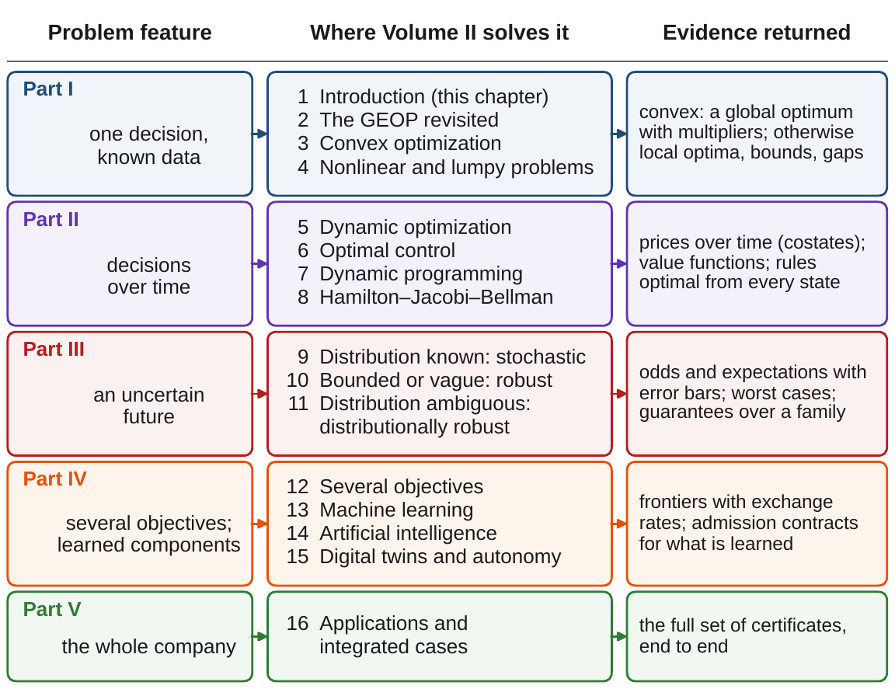
Four questions route a problem to its methods
§1.6 · FIGURE 1.2 · PROPOSITION 1.4
Once or over time? One act, or a sequence that reshapes later options
Known or uncertain? Data taken as known, or commitments on distributions or sets
One objective or several? A best point, or a frontier
Benign or hard? Local answers global, or lumps and couplings
Proposition 1.4. Optimizing one ledger alone never beats the unified problem
Figure 1.2. The features of a problem decide where it is solved and what evidence the solution can carry.
Notes:
Section 1.6, Figure 1.2 and Proposition 1.4 (proof in Online Appendix 1.B). Volume I owns what the problem is and whether it is well posed; Volume II owns how it is solved. The same cash promised twice, to the program and to the closure buffer, showed the cost of separated procedures for Meridian (Volume I, Worked Example 13.1).

Slide 14
Four gates before any solver runs
§1.7 · THEOREM 1.5
Readiness, not tooling, is the adoption milestone: once the gates pass, a solver's certificate is a certificate about the company.
R1
Declaration completeness
R2
Unified consistency
Every term of the instance is a declared quantity with an owner. Without it the instance is not defined, and a solver optimizes a substituted problem.
The commitments can hold together. Without it no decision is feasible: the right output is a certificate naming the commitments that cannot hold.
R3
The analytical panel
R4
Feasibility with horizon honesty
The regularity the guarantees need: compact decision sets, continuous data. Without it feasible decisions can exist with no best one among them.
Some admissible decision keeps every commitment over the whole horizon. Without it no decision is feasible. The gates are ordered, and none implies the next.
Notes:
Theorem 1.5; proof in Appendix 1.A. Meridian passed the gates in Volume I, Worked Example 16.1, after two repairs: declaring its levers' prices and the scale of its scorecard. The optimization lifecycle: represent, analyze, certify, optimize, execute, monitor, adapt (Volume I, Figure 16.1).

Slide 15
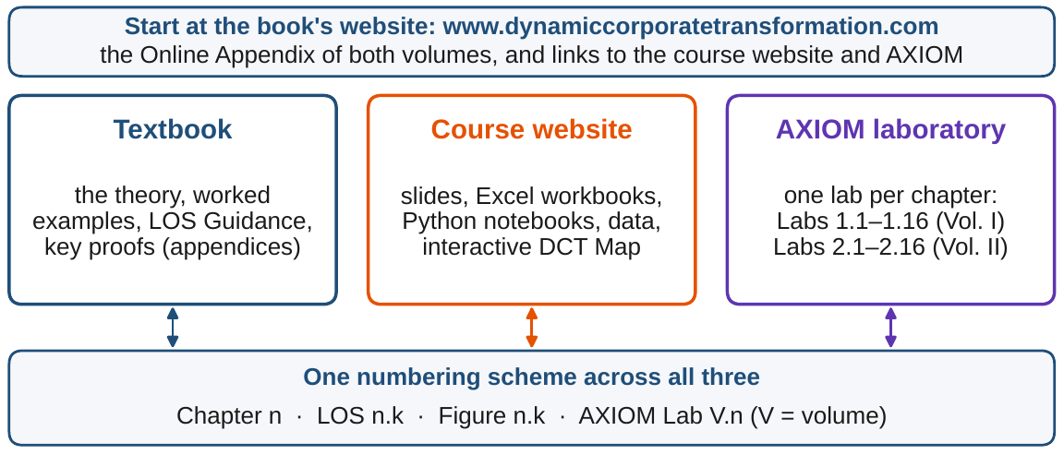
The book, the website and AXIOM work together
§1.8 · FIGURE 1.3
The textbook: five LOS, one Worked Example on Meridian and one AXIOM Lab in every chapter
Two layers of rigor: key proofs in Appendix 1.A, the rest in the Online Appendix
The course website: slides, an Excel workbook and a Python notebook for every chapter
AXIOM: formulation assistants, solvers and certificate checkers; Lab 2.n runs AXIOM-n
The book's website is the entry point, with the Online Appendix of both volumes
Figure 1.3. One numbering scheme across all three: a chapter, a learning outcome, a figure or a lab carries the same number everywhere.
Notes:
Section 1.8 and Figure 1.3. The book's website, www.dynamiccorporatetransformation.com, hosts the Online Appendix of both volumes and leads to the course website and the AXIOM laboratory.

Slide 16
Can Meridian sign Volume I's answer?
WORKED EXAMPLE 1.1 · THE SITUATION
Volume I's answer
The bank
The program office
The board
A $170m line and two months' delay
Lines come in $50m tranches
The build moves in whole quarters
What should it sign?
The cheapest way to hold the chance of breaching the $350m floor at 5 percent: $10.4m.
Committed standby lines are written in tranches of $50 million; treasury owns the line.
The delay is planned in whole quarters, each worth $8m of Digital Solutions' contribution.
What do the lumps cost, and which number in the problem moves the answer most?
The chief financial officer takes Volume I's answer to the bank and the program office, and comes back with two facts.
Notes:
Worked Example 1.1, the situation. The board's appetite: at most a 5 percent chance that liquidity falls below the $350 million floor during the three-year digital program (Volume I, Worked Example 15.1).

Slide 17

Write the problem, check the gates, solve
WORKED EXAMPLE 1.1 · STEPS 1–3
the line l ($ million, treasury) and the delay φ (quarters, transformation office), on Volume I's Chapter 8 model
Step 2: the gates pass after Volume I's repairs; with the package, the deepest draw and the closure buffer use $138.5m of the $270m above the floor
Step 3: with continuous levers the box is closed, bounded and convex, so a best package exists: $170m and 0.67 quarters, $10.44m, with the appetite met exactly
Neither lever works alone: the best line on its own leaves the odds at 8.4 percent, and delay on its own needs more than five quarters
Notes:
Worked Example 1.1, Steps 1 to 3. Fees of about 1 percent a year for three years give 0.03 l; a quarter of delay costs $8 million of Digital Solutions' contribution. By Theorem 1.5(ii), what a solver certifies about this instance it certifies about Meridian.

Slide 18
Packages for the board's 5 percent appetite
WORKED EXAMPLE 1.1 · TABLE 1.3
Package | Line ($m) | Delay (q) | Breach odds | Cost ($m)
Continuous levers (Volume I) | 170 | 0.67 | 5.0% | 10.44
Whole quarters, line to the $1 million | 121 | 1 | 5.0% | 11.63
Whole quarters, $10 million tranches | 130 | 1 | 4.6% | 11.90
Whole quarters, $50 million tranches | 150 | 1 | 4.0% | 12.50
Rounded down (fails the appetite) | 150 | 0 | 9.6% | 4.50
Rounded up | 200 | 1 | 3.4% | 14.00
Volume I's Chapter 8 model, 100,000 paths. Cost is line fees plus $8 million per quarter of delay.
The lumps cost $2.06m, about 20 percent: $1.19m for whole quarters and $0.87m more for $50m tranches.
Notes:
Table 1.3. The continuous answer is a floor that no lumpy package can beat (Theorem 1.3(v)). The best package for every number of quarters is in Online Appendix 1.B.4.

Slide 19
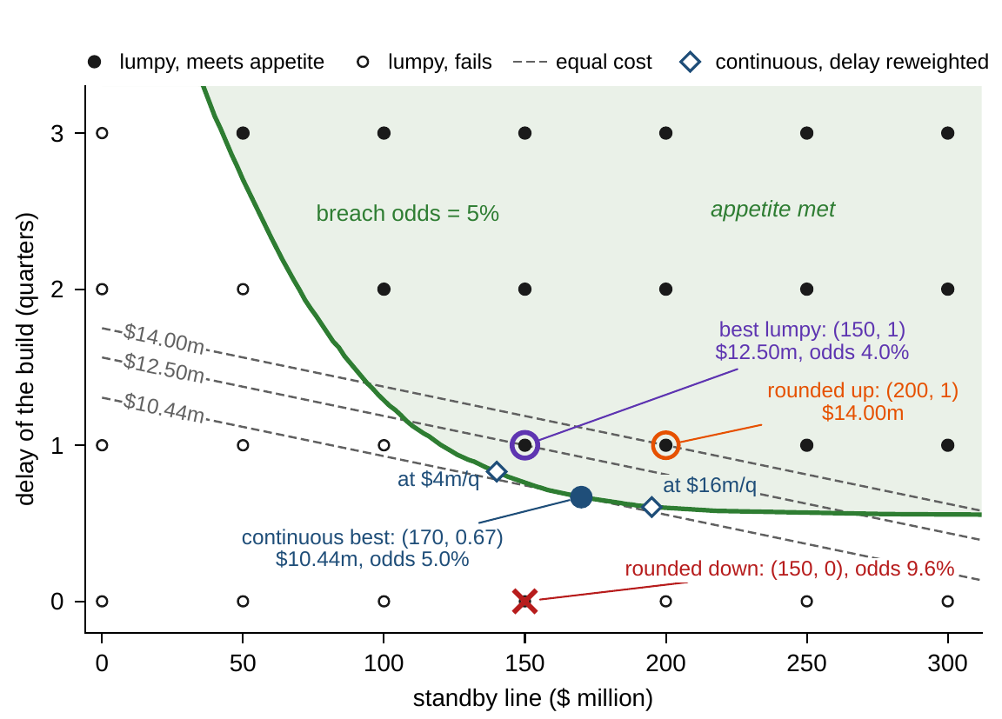
The lumps cost $2.06m; rounding is no method
WORKED EXAMPLE 1.1 · STEPS 4–5 · FIGURE 1.4
63 packages, 46 meet the appetite; the cheapest: $150m and one quarter, $12.50m
Rounded down, (150, 0) breaches at 9.6%; rounded up, (200, 1) costs $14.00m
The continuous answer is a floor no lumpy package beats (Theorem 1.3(v))
Rescaling (after tax, in thousands) moves no package (Theorem 1.4(iii))
Reweighting: at $4m or $16m a quarter, the continuous line moves from $140m to $195m
The lumpy answer stays (150, 1) for any value above $1.5m a quarter
Figure 1.4. Above the 5 percent curve the appetite is met; dashed lines are packages of equal cost; open diamonds: the continuous answer at $4m or $16m a quarter.
Notes:
Worked Example 1.1, Steps 4 and 5, and Figure 1.4. No lumpy package meets the appetite without a quarter of delay, and none with one quarter needs less than $150 million.

Slide 20
Sign $150m with one quarter of delay
WORKED EXAMPLE 1.1 · WHAT THE BOARD SHOULD TAKE AWAY
$12.50m
$2.06m
$55m
a $150m line and one quarter of delay: breach odds 4.0 percent
what the lumps cost; a bank writing $10m pieces would save $0.60m of it
of line moved by the board's value of delay; the signed package stays
The joint check of Volume I still passes, with $120m of cash above the floor unclaimed
The number that moves the answer most is not the solver's but the board's: the value of a quarter of delay
Step 6: set once and under uncertainty, with lumpy levers: Chapter 9's chance constraints with Chapter 4's integer methods
For discussion: the package overshoots the appetite, 4.0 rather than 5 percent. Is the extra safety worth $2.06m, and would you pay the bank for smaller pieces?
Notes:
Worked Example 1.1, what the board should take away, and the question for discussion. Step 6 routes the problem: static, under uncertainty and lumpy, so Chapter 9's chance constraints with Chapter 4's integer methods; a rule would make it a problem of policies (Part II).

Slide 21

From question to solvable problem, in AXIOM
AXIOM LAB 2.1 · MODULE AXIOM-01
Meridian's board wants to know what an optimizer adds to the analysis it already has, and the chief financial officer must turn Volume I's answer into a package the bank and the program office can sign. Open AXIOM, choose Lab 2.1 and load the Meridian digital program.
1
2
3
4
5
Formulate
Run the gates
Explore the decision space
Rescale, then reweight
Add a commitment
Enter the levers with owners and prices; delete the delay's declaration and watch the assistant refuse.
Run (R1)–(R4); remove the standby line and rerun (R2): which commitments does the minimal infeasible set name?
Switch to $50m tranches and whole quarters; count the packages and compare the cheapest with the roundings.
State the costs after tax; value a quarter of delay at $4m and $16m.
Add the capability floor and the covenant with the line fully drawn: the feasible packages can only shrink.
Deliverable: a one-page note to the board: the package to sign, its odds and cost, what the lumps cost, which declaration moves the answer most, and the certificates that support each number. About 60 minutes.
Notes:
AXIOM Lab 2.1. What to look for: the refusal when a term is not declared (Proposition 1.1; gate R1); feasible packages that can only shrink as commitments are added (Proposition 1.2); the continuous answer as a floor no lumpy package beats (Theorem 1.3(v)); a rescaling that moves no decision and a reweighting that can (Theorem 1.4).

Slide 22
What to carry forward
KEY TAKEAWAYS
1
Analysis runs forward from a plan to its consequences; optimization runs backward from what the company wants and must respect to a plan. Both use the same declared model, and optimization needs every term of its problem declared.
2
Every well-posed transformation decision fits one canonical form: decisions, an objective, commitments, and the company's dynamics, with nothing lost and nothing left to taste.
3
The decision space says how hard the problem is: continuous choices are benign, every lumpy choice doubles the pieces to search, and rules make the search one over functions. A relaxed answer bounds every lumpy one, but rounding it is not a method.
4
Rescaling an objective changes no decision; reweighting it can change every decision, so the weights are the board's to declare.
5
An answer is worth its certificates, and certificates are about the company only when the readiness gates have passed.
Notes:
Key Takeaways, Chapter 1.

Slide 23
Notebook and workbook reproduce the book
THIS WEEK'S LABORATORY
45
53
26201
AXIOM-01
notebook checkpoints, every one PASS
workbook checks against the engine, ALL PASS
the lab's seed
AXIOM Lab 2.1
Notebook DCT_V2_Ch01_Lab.ipynb: Worked Example 1.1 and the lab's five steps in eight panels, on the book's 100,000 paths, ready for Colab
Workbook DCT_V2_Ch01_Lab.xlsx: the formulation assistant, the gates, the 63 packages, Table 1.3, reweighting and the two-channel budget, in formulas
Every number on these slides is the book's, and both companions check it
Notes:
The notebook and workbook are on the course website, reached from the book's website, www.dynamiccorporatetransformation.com.

Slide 24

Chapter 2 turns the form into an instance
NEXT · CHAPTER 2
Every instance is written in five blocks: dynamics, admissible decisions, path commitments, start and end conditions, and uncertainty, with empty blocks declared empty
One sentence, liquidity above $350m, costs nothing on the average path (odds 24.6%), $1.65m in Volume I's stress set (17.4%), $10.44m at 95 percent, and cannot be bought on every path
How a commitment holds under uncertainty is a declaration with a price, and the board owns it
Its Worked Example asks whether two pledges on Meridian's automation program can both be kept
Notes:
Chapter 2, The General Enterprise Optimization Problem Revisited: the quantifier of a commitment (Chapter 2, Table 2.4, on the same two levers).

