Slide 1
The General Enterprise Optimization Problem Revisited
VOLUME II · CHAPTER 2 · WEEK 8
Write every decision as an instance in five blocks, check each claim by simulation, and when commitments clash, name the clash and price the repairs
Graduate course companion · Lab seed 26202 · AXIOM Lab 2.2 (AXIOM-02)
Notes:
Volume II, Chapter 2. Volume I posed the General Enterprise Optimization Problem and proved what its answers mean; this chapter turns the problem into an instance, something a solver can take and an auditor can check (chapter abstract).

Slide 2
“We have not got any money, so we have got to think.”
Ernest Rutherford
Nobel Prize in Chemistry 1908; as recalled by Henry Tizard, The Chemical Age (1952)
Notes:
Rutherford's line is the chapter's situation: Meridian's two pledges compete for the same cash, and the answer is not more money but a better-posed problem. Worked Example 2.1 thinks it through: write the instance, check the plan, name the clash, price the way out.

Slide 3
After this chapter, you can
LEARNING OUTCOME STATEMENTS
2.1
Write a transformation decision as a GEOP instance in five blocks—dynamics, admissible decisions, path commitments, start and end conditions, and uncertainty—with every empty block declared empty.
2.2
Separate what the company chooses from what its dynamics induce, and explain why any claim about a plan's value or feasibility can be checked by simulating the plan forward.
2.3
Distinguish choices that only change how an objective is written from choices that change the answer, and explain why the way a commitment holds under uncertainty is a declaration with a price.
2.4
Read an instance's convexity block by block, certify feasibility before optimizing, and, when an instance is infeasible, name the commitments that clash and the period in which the plan dies, and price the repairs.
2.5
Classify an instance, route it to the methods of this volume, prepare it for a solver, and state what a certified instance is owed whatever method solves it.
Notes:
The five learning outcome statements; LOS Guidance at the end of the chapter.

Slide 4
Seven sections, a worked example and a lab
ROADMAP
§2.1
§2.2
§2.3
§2.4
§2.5
From Problem to Instance
What Is Chosen and What Is Induced
Objectives: Form Is Free, Content Is Governance
Commitments and How They Hold
Feasibility, Computed
Definition 2.1 · Table 2.1
Proposition 2.2 · Table 2.2
Theorem 2.1 · Table 2.3
Proposition 2.3 · Table 2.4
Theorems 2.2–2.3
§2.6
§2.7
Worked Example 2.1
AXIOM Lab 2.2
Classes, Architecture, and the Warranty
Preparing an Instance for a Solver
Can Meridian Automate and Pay Out at Once?
Building and Diagnosing an Instance
Theorem 2.4 · Table 2.5
Standard form · scaling
Tables 2.6–2.7 · Figure 2.3
AXIOM-02 · five steps
Notes:
Formal statements and proofs of Theorems 2.1-2.3 are in Appendix 2.A; Propositions 2.1-2.5 and Theorem 2.4 in Online Appendix 2.B, with the numbers behind Worked Example 2.1 (Example 2.B.4).

Slide 5

A solver takes an instance, not a problem
§2.1 · DEFINITION 2.1 · PROPOSITION 2.1
dynamics, admissible decisions, path commitments, start and end, uncertainty: each commitment declared with its quantifier
Definition 2.1. Volume I's GEOP with every declared object filled in, its commitments sorted by form, not owner
Proposition 2.1. Every problem this volume solves is an instance with some blocks declared empty
Empty blocks are declarations: no uncertainty says the future is known; no end condition, that nothing after the horizon matters
Notes:
Definition 2.1 (equations 2.1-2.6) and Proposition 2.1, formal statement and proof in Online Appendix 2.B. Volume I's capital floors, performance targets, risk ceilings and governance identities become path commitments; the admissible decisions and the end set are named blocks because solvers treat them differently. Writing 'none' in a block is how a formulation review sees the choice.

Slide 6
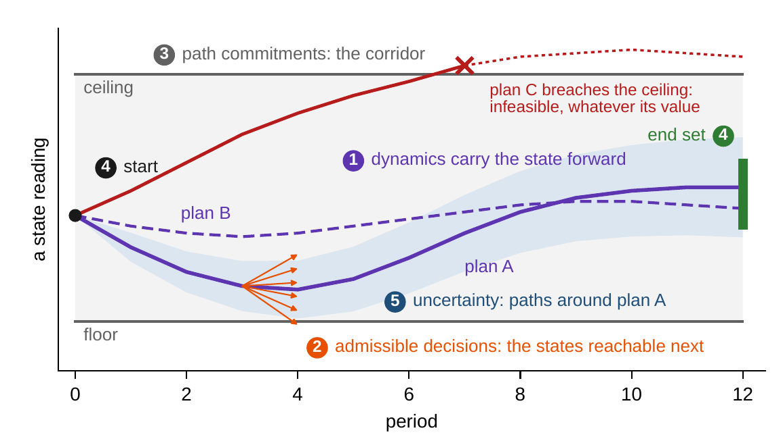
Five blocks, each supplied by Volume I
§2.1 · TABLE 2.1 · FIGURE 2.1
Dynamics: how the state moves, given decisions and shocks
Admissible decisions: the levers, their domains and the class of rules
Path commitments: floors, ceilings and identities, each with an owner
Start and end: today's audited state; where the horizon must leave the company
Uncertainty: the law or the set of environments, and each commitment's quantifier
Objective: running and terminal terms built from the ledgers
Figure 2.1. Anatomy of a GEOP instance on one state reading. Plans A and B are feasible; plan C breaches the ceiling in period 7 and is infeasible, whatever its value.
Notes:
Table 2.1 and Figure 2.1. Volume I supplies each block: dynamics from Chapters 7, 8 and 13; admissible decisions from Chapter 6 and Definitions 15.2-15.3; path commitments from Chapters 9-13 and Table 15.2; start and end from Chapter 5 and the viability of Chapter 14; uncertainty from Chapters 8 and 12; the objective from Chapters 10-12 and Definition 15.4.

Slide 7
Decisions are chosen; states are induced
§2.2 · DEFINITIONS 2.2–2.3 · PROPOSITION 2.2
The anti-advocacy clause
PROPOSITION 2.2
Objectives Depend on Decisions Through Paths
Budgets are chosen; capability is induced. Hiring is chosen; culture is induced
An induced quantity listed as a decision is a phantom lever, and the optimum leans on it
Meridian: six-round savings, $702m, carried into a three-round plan that saves $647.5m
A dispute about a proposal's value becomes a dispute about a declared object
A policy's value and feasibility depend on it only through the path it induces and the decisions taken along it
Two policies that induce the same paths and decisions have the same value and the same feasibility
Every claim that a plan reaches a value or keeps a commitment can be checked by simulating the declared dynamics forward
One pass when the instance is certain; a sample of paths with its error bar when it is not
Notes:
Definitions 2.2 and 2.3, Table 2.2 (levels of decision: strategic, tactical, operational, policy) and Proposition 2.2, proof in Online Appendix 2.B. The boundary between chosen and induced is the formulation error a review most often catches. Worked Example 2.1, Step 1, and LOS Guidance 2.2: the spreadsheet overstates the three-round plan's savings by $55 million.

Slide 8
Form is free; content is governance
§2.3 · THEOREM 2.1
What it retires, what it promotes
THEOREM 2.1
Objective Equivalence Theorem
“Optimize the journey or the destination?” is not a modeling question: the forms interconvert
What the board puts into the terminal term states what the horizon's edge is worth
Risk is content: a curve inside the expectation can change the answer; one outside cannot
Meridian: the credit for year-6 savings decides how many automation rounds run
(i) Running into terminal. An accumulator makes any running objective terminal, with the same value for every policy
(ii) Terminal into running. A terminal objective is its value at the start plus its changes, period by period
(iii) Harmless changes. Rescaling, adding a constant, any strictly increasing transformation of the whole objective
(iv) Consequential changes. The weights, the horizon, what the terminal term credits, a curve inside the expectation
Notes:
Theorem 2.1; formal statement and proof in Appendix 2.A. An objective is a measure promoted to the criterion the optimizer pushes against every commitment; promotion amplifies its virtues and its defects alike, which is why Volume I paired every objective with tripwires (Volume I, Theorem 11.1(iii)). Worked Example 2.1, Step 5, shows the terminal credit deciding the program's size.

Slide 9
Which changes move the best decision
§2.3 · TABLE 2.3
Change | Example | Best decision
running form ↔ terminal form | six-year payout as a sum or as a year-6 balance | unchanged (Thm. 2.1(i)–(ii))
rescale; change units; add a constant | report in thousands; a flat tax | unchanged (Thm. 2.1(iii))
increasing transformation of the whole objective | the logarithm of expected value | unchanged (Thm. 2.1(iii))
weights between readouts | more weight on resilience | can change (Thm. 1.4(iv))
what the terminal term credits | years of savings credited beyond the horizon | can change (Worked Example 2.1)
the horizon | six years instead of ten | can change (Vol. I, Thm. 15.4(iv))
a curve inside the expectation | a utility or a risk measure | can change
a commitment's quantifier | average path instead of 95 percent | can change (Table 2.4)
Appendix 2.A: a sure 1, or an even chance of 0 or 2.2? Value picks the gamble (1.1); ln(1 + t) picks the sure 1
Notes:
Table 2.3. Form is free, content is governance. The witness for a curve inside the expectation is the proof of Theorem 2.1(iv) in Appendix 2.A: E[u] is ln 2, about 0.693, for the sure 1 and half of ln 3.2, about 0.582, for the gamble, so the utility reverses the choice.

Slide 10
One commitment, four quantifiers, four prices
§2.4 · PROPOSITION 2.3 · TABLE 2.4
Declared as | What it requires | Cheapest package | Cost ($m) | True odds
on the average path | the mean path stays above the floor | no lever | 0 | 24.6%
in every scenario of a stress set | the program's draw and a closure buffer fit in the $270m above the floor | a $55m standby line | 1.65 | 17.4%
with probability at least 95% | breach odds of at most 5 percent | a $170m line and two months' delay | 10.44 | 5.0%
on every path | no path breaches | none: the odds never fall below 0.001% | – | –
Volume I's Chapter 8 model with 100,000 simulated paths and Worked Example 15.1's levers. True odds: the share of paths that breach the $350m floor in some quarter of the digital program.
“Liquidity stays above $350m” costs nothing, $1.65m or $10.44m, or cannot be bought at all.
Notes:
Table 2.4 and Proposition 2.3 (proof in Online Appendix 2.B). On every path implies 95 percent; the average path, or a stress set narrower than the uncertainty, implies neither. The cheap versions are not conservative: the average path never breaches while a quarter of the paths do. Chapters 9-11 solve each version.

Slide 11
Where convexity comes from, and where it dies
§2.5 · THEOREM 2.2
The ledger, block by block
THEOREM 2.2
Enterprise Feasible Region Theorem
Feasible regions are born as intersections, and every piece is a named declaration
“Reinvest a share of what we hold” under a ceiling: (1, 0) and (0, 1) keep x₂ ≤ 2; their midpoint gives 2.25
Written as amounts, the same commitment is convex
Meridian: the lumpy rounds break convexity; with the rounds fixed, every commitment is linear
(i) Closed. Limits of feasible policies are feasible
(ii) The convexity ledger. Linear dynamics, convex inequalities, linear equalities, convex decision and end sets, nothing lumpy: a convex set of plans
(iii) Where convexity dies. A lumpy decision, dynamics nonlinear in the decisions, a nonconvex commitment, a feedback rule
(iv) Existence. Some policy feasible and the objective continuous in the parameters: a best policy exists
Notes:
Theorem 2.2; formal statement and proof in Appendix 2.A, whose witness for part (iii)(d) is the reinvestment rule x₂ = (1 + θ₀)(1 + θ₁). Part (iv) is the volume's standing reassurance: a bounded class of rules, a certified feasible instance, and continuity. AXIOM's formulation assistant keeps the ledger.

Slide 12
Name the clash and the year the plan dies
§2.5 · THEOREM 2.3
Meridian's joint plan
THEOREM 2.3
Infeasibility Diagnosis Theorem
It dies in year 3: round 3 would leave $347.5m, below the $350m floor
Board's conditions first, the filter names {floor, six rounds, half payout}
Pledges first, it names {six rounds, half payout, end condition}
Dropping the floor alone repairs nothing: give up a pledge, or both board conditions
(i) A minimal clash in one pass. Drop each commitment whose removal leaves the rest infeasible: one check per commitment
(ii) Repairs must break every clash. Dropping a group restores feasibility exactly when it meets every minimal clash
(iii) Plans die on a date. Carry forward the states some plan reaches keeping every commitment; the first empty set is the date
Notes:
Theorem 2.3; formal statement and proof in Appendix 2.A. The proofs are algorithms: part (i) is the deletion filter that solvers use to report an irreducible infeasible set, part (ii) turns the choice of repair into a covering problem, part (iii) is the forward reachability pass of AXIOM's feasibility bench. Worked Example 2.1, Steps 2 and 3.

Slide 13
Classes route an instance to its methods
§2.6 · TABLE 2.5 · PROPOSITION 2.5
Class | What the instance has | Chapters
linear and quadratic programs | one period; linear or quadratic blocks; continuous decisions | 3
convex programs | convex blocks (Theorem 2.2(ii)) | 3
nonlinear programs | smooth nonconvex blocks | 4
mixed-integer programs | lumpy decisions | 4
dynamic optimization, optimal control | dynamics and path commitments | 5–8
stochastic programs, Markov decision processes | a declared law; expectations and chance commitments | 7, 9
robust and distributionally robust programs | a declared set of environments or of laws | 10–11
multi-objective programs | several objectives; a frontier as the deliverable | 12
learned-policy programs | rich classes of rules under admission contracts | 13–15
Proposition 2.5. Classical problems are instances with blocks frozen: ask which blocks a solver drops.
Notes:
Table 2.5 and Proposition 2.5 (proof in Online Appendix 2.B). Classifying an instance is a checklist, not a judgment call. Downward, everything known about each class applies; upward, every packaged optimization solution solves some row of the table, and the dropped blocks are where silo optima hide their losses (Volume I, Proposition 13.5).

Slide 14
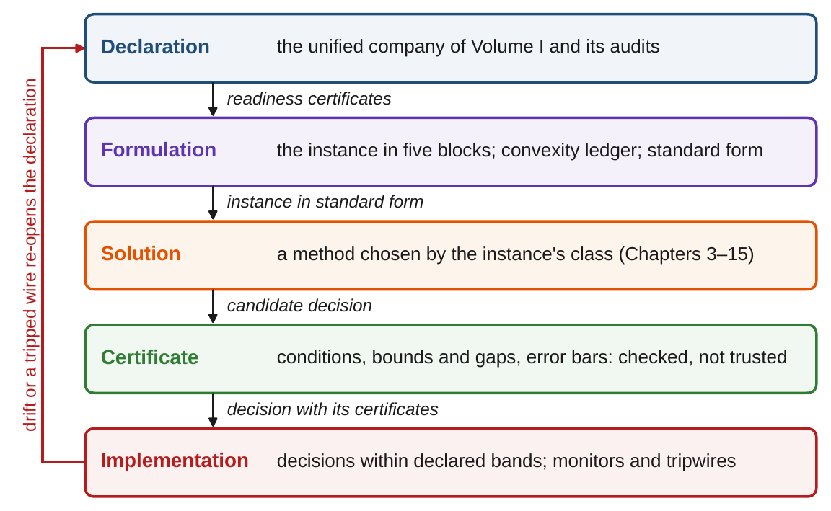
A certified instance carries a warranty
§2.6 · DEFINITION 2.7 · THEOREM 2.4
Definition 2.7. Five layers, each with owners, exchange only declared artifacts
Theorem 2.4. Whatever the method, a certified instance has a best policy with checkable conditions
Under convexity each binding commitment has a price that bounds what relaxing it can gain
Values move continuously with the data; decisions can move sharply near the stability edge
Meridian's appetite: $1.8m per percentage point of breach odds, a breach implicitly at about $180m
Figure 2.2. Five layers pass declared artifacts down the stack; drift or a tripped wire in the implementation layer re-opens the declaration.
Notes:
Definition 2.7, Figure 2.2 and Theorem 2.4 (proof in Online Appendix 2.B). Before any vendor is owed anything by contract, a certified instance is owed by mathematics an optimum that exists, conditions that recognize it, prices for what binds, and stability under small drifts. The price of the appetite is Volume I, Worked Example 15.1: stable values, twitchy decisions (Volume I, Proposition 15.5).

Slide 15
Prepare the instance before the solver runs
§2.7 · PREPARING AN INSTANCE
Standard form
Scaling
Sparsity
Warm starts
Emit the form its class expects
Bring magnitudes together
Declare the zero pattern
Export the last optimum
Maximize or minimize, inequalities one way, Mayer or Lagrange form, and record which.
No decision changes, but a commitment scaled by γ has its price divided by γ.
Solvers then scale with the architecture's links rather than their square.
The lifecycle re-solves instances that drift slowly.
The route into Part I is the convexity ledger: convex blocks go to Chapter 3; the breaks organize Chapter 4.
Notes:
Section 2.7 and Online Appendix Example 2.B.1: the price of a liquidity floor written in billions of dollars is 1,000 times its price written in millions, so a price must be read in the units of the commitment as written. Enterprise instances mix basis points with billions and are badly conditioned from birth.

Slide 16
Can Meridian automate and pay out at once?
WORKED EXAMPLE 2.1 · THE SITUATION
Volume I, Worked Example 6.1
Chief operating officer
Chief financial officer
The board
The automation program
A round every year for six years
Pay out half of each year's savings
Can both pledges be kept?
$120m a round closes half the gap to an efficiency of 85; each point above 71 saves $10m a year.
A round needs $470m on hand, so the $350m floor holds after paying for it.
Investors want a share of the savings the rounds produce.
And end year 6 with the $470m another round would need. If not, what does each way out cost?
Today Meridian has $620m of liquidity, efficiency 71 and capability 58. All amounts are undiscounted.
Notes:
Worked Example 2.1, the situation. A round also raises workforce capability by one point and needs capability of at least 55. Five commitments, each with an owner: the floor (the board), capability (HR), six rounds (the COO), half payout (the CFO), the end condition (the board).

Slide 17
Write the instance, then run it forward
WORKED EXAMPLE 2.1 · STEPS 1–2 · TABLE 2.6
Block | Meridian's declaration | Owner
Decisions | a round in year k, z(k) ∈ {0, 1}; a payout p(k) ≥ 0 | COO; CFO
Dynamics | each round closes half the efficiency gap to 85 and adds a point of capability; savings $10m per point above 71; liquidity falls by 120 a round, rises by the savings, falls by the payout | COO; treasury
Admissible decisions | a round needs capability of at least 55 | HR
Path commitments | liquidity of at least $350m after paying for a round and at year end; a round every year; half of each year's savings paid out | board; COO; CFO
Start and end | $620m, efficiency 71, capability 58; at least $470m at the end of year 6 | treasury; board
Uncertainty | none declared (Volume I's point estimates) | –
Step 1: savings are induced by the rounds. The CFO's spreadsheet carries six-round savings, $702m, into every plan; a plan with three rounds saves $647.5m.
Step 2: one forward pass: $535m, then $467.5m; round 3 would leave $347.5m. The plan dies in year 3.
Notes:
Table 2.6, the instance card, and Steps 1 and 2. Liquidity is q(k) = q(k-1) - 120 z(k) + S(k) - p(k) with savings S(k) = 10(e(k) - 71). Year 1: 620 - 120 + 70 - 35 = 535; year 2: 535 - 120 + 105 - 52.5 = 467.5 (Figure 2.3(a)). The objective waits for Step 5; feasibility comes first.

Slide 18
Two clashes, three repairs, one optimizer
WORKED EXAMPLE 2.1 · STEPS 3–5 · TABLE 2.7
Plan | Rounds | Paid out ($m) | Efficiency, year 6 | Liquidity, year 6 ($m) | Gives up
joint plan | two, then blocked | – | – | – | dies in year 3
(a) pay out less | six | 132.2 | 84.78 | 470.0 | half payout
(b) fewer rounds | years 1, 2, 4 | 323.8 | 83.25 | 583.8 | six rounds
(c) both pledges | six | 351.1 | 84.78 | 251.1 | floor and end
optimizer, no credit | years 1–2 | 505.0 | 81.50 | 470.0 | both pledges
optimizer, ten years' credit | years 1–3 | 455.0 | 83.25 | 470.0 | both pledges
Six-year totals, undiscounted. Step 3: the only minimal clashes are {floor, six rounds, half payout} and {six rounds, half payout, end condition}.
A repair must break both clashes: give up one pledge, or both of the board's conditions.
Notes:
Table 2.7. Theorem 2.3(ii): dropping the floor alone repairs nothing. Repair (c) rewrites the board's appetite rather than repairing the plan. The optimizer's rows drop both pledges and keep the floor, the capability condition and the end condition.

Slide 19
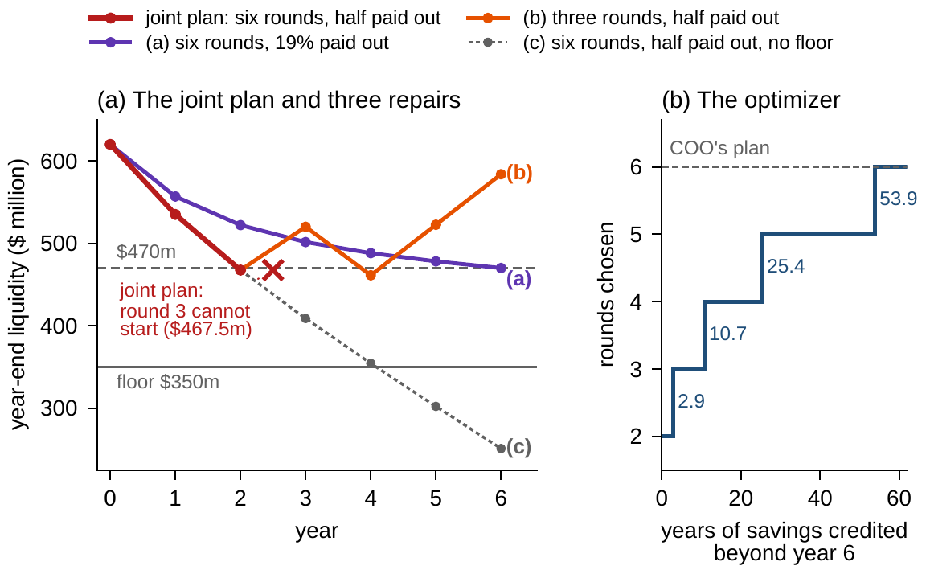
The credit beyond year 6 sizes the program
WORKED EXAMPLE 2.1 · STEPS 4–6 · FIGURE 2.3
(a) Six rounds: pay out at most 18.8% of savings, $132m; the end condition binds
(b) Half payout: three rounds, in years 1, 2 and 4; $324m paid out, $584m at the end
(c) Both pledges: $182m after the sixth round; it rewrites the board's appetite
Optimizer: no credit buys two rounds and $505m of payouts; rounds switch at 2.9, 10.7, 25.4 and 53.9 years
Step 6: lumpy outside, linear inside: 64 small linear programs; Mayer form changes no plan
Figure 2.3. (a) Year-end liquidity under the joint plan and the three repairs. (b) Rounds the optimizer chooses as the credit for year-6 savings grows.
Notes:
Worked Example 2.1, Steps 4 to 6, and Figure 2.3. Rounds 3 to 6 would cost $480 million and return only $107 million of savings inside the window. Theorem 2.1(iv): the content of the terminal term decides; writing the payout as a year-6 accumulator, in Mayer form, changes none of these plans. Online Appendix Example 2.B.4 gives the paths year by year and the arithmetic of the thresholds.

Slide 20
The pledges clash; the credit is the decision
WORKED EXAMPLE 2.1 · WHAT THE BOARD SHOULD TAKE AWAY
Year 3
18.8%
53.9 years
the joint plan dies: round 3 would leave $347.5m, below the floor
the most of each year's savings six rounds allow to be paid out
the credit for year-6 savings beyond which the COO's six rounds win
Choose a pledge: under a fifth of the savings with six rounds, or the half payout with three rounds
No credit beyond year 6 buys two rounds and $505m of payouts: the decision is a declaration
For discussion: what should Meridian credit for efficiency in place after year 6, and who should own that number?
Would your answer change if savings were discounted at 10 percent a year?
Notes:
Worked Example 2.1, what the board should take away, and its two discussion questions. On discounting, Online Appendix Example 2.B.3: it lowers the value of each round's later savings relative to its cost, and so tends to move the optimizer toward fewer rounds.

Slide 21

Building and diagnosing an instance, in AXIOM
AXIOM LAB 2.2 · MODULE AXIOM-02
Meridian's board has two executive pledges on its automation program and a standing rule that every proposal arrives as an instance, not a spreadsheet. You support the chief financial officer. Open AXIOM, choose Lab 2.2 and load the Meridian automation program.
1
2
3
4
5
Build
Check
Diagnose
Price
Reweight
Declare the five blocks; enter savings as a decision and watch the editor refuse.
Run the joint plan forward and find the year it dies; compare the COO's plan with all savings kept.
Run the deletion filter twice and record both clashes; drop the floor alone.
Find the largest payout share or the most rounds each repair allows; rebuild Table 2.7.
Move the terminal credit from 0 to 60 years; switch to Mayer form; export in standard form.
Deliverable: a one-page note to the board: the instance card, the year the joint plan dies, the two clashes, the three repairs with their prices, and a recommendation on the terminal credit, with its owner. About 75 minutes.
Notes:
AXIOM Lab 2.2. What to look for: the refusal of an induced quantity as a decision (Proposition 2.2); two clashes and a repair that must break both, and the year the joint plan dies (Theorem 2.3); a terminal credit that changes the program's size while the Mayer rewrite changes nothing (Theorem 2.1).

Slide 22
What to carry forward
KEY TAKEAWAYS
1
A solver takes an instance, not a problem: the GEOP with every declared object filled in, in five blocks—dynamics, admissible decisions, path commitments, start and end conditions, and uncertainty—with empty blocks declared empty.
2
Decisions are chosen and states are induced; every claim about a plan's value or feasibility is a simulation anyone can rerun.
3
How an objective is written is free; what it counts is governance. Running and terminal forms interconvert and units change nothing, but the terminal credit, the weights, the horizon, and a commitment's quantifier can each change the answer.
4
Convexity is read block by block and dies at lumpy decisions, nonlinear dynamics, nonconvex commitments, and feedback rules; infeasibility is diagnosed as named clashes and a date, and a repair must break every clash.
5
Classes route instances to methods, preparation makes them solvable, and a certified instance is owed an optimum, checkable conditions, prices, and stable values, whatever method solves it.
Notes:
Key Takeaways, Chapter 2.

Slide 23
Notebook and workbook reproduce the book
THIS WEEK'S LABORATORY
55
66
26202
AXIOM-02
notebook checkpoints, every one PASS
workbook checks against the engine, ALL PASS
the lab's seed
AXIOM Lab 2.2
Notebook DCT_V2_Ch02_Lab.ipynb: Worked Example 2.1 and the lab's five steps in seven panels, with Table 2.4 on the book's 100,000 paths, ready for Colab
Workbook DCT_V2_Ch02_Lab.xlsx: the instance card, the 64 schedules, the deletion filter, the repairs, the optimizer and the standard form, in formulas
Every number on these slides is the book's, and both companions check it
Notes:
The notebook and workbook are on the course website, reached from the book's website, www.dynamiccorporatetransformation.com.

Slide 24
Chapter 3 turns convexity into a certificate
NEXT · CHAPTER 3
When every block is convex, a locally best plan is the best plan, and the answer arrives with a certificate
Lagrangian duality turns commitments into prices, and any price list into a ceiling on value
Tiers, worst cases, ratio targets and probability statements can be rewritten exactly as convex commitments
Its Worked Example relaxes this automation program and proves the three-round plan within $7.1m of anything achievable, without enumerating a single schedule
Notes:
Chapter 3, Convex Enterprise Optimization (chapter abstract). The inequality is weak duality: for any nonnegative prices on the commitments, the Lagrangian's maximum bounds the best value.

