Slide 1
Convex Enterprise Optimization
VOLUME II · CHAPTER 3 · WEEK 9
Convexity turns optimization from a search into a proof: a locally best plan is the best plan, and the answer arrives with a price list anyone can check
Graduate course companion · Lab seed 26203 · AXIOM Lab 2.3 (AXIOM-03)
Notes:
Volume II, Chapter 3. Convexity is the property that turns optimization from a search into a proof. When every block of an instance is convex, a locally best plan is the best plan, and the answer arrives with a certificate (chapter abstract).

Slide 2
“The point of philosophy is to start with something so simple as not to seem worth stating, and to end with something so paradoxical that no one will believe it.”
Bertrand Russell
Nobel Prize in Literature 1950; The Philosophy of Logical Atomism, Lecture II (1918)
Notes:
The chapter starts with something simple, the chord test (Definitions 3.1 and 3.2), and ends with a proof that no automation plan is worth more than $1,687.1 million, obtained without enumerating a single schedule (Worked Example 3.1).

Slide 3
After this chapter, you can
LEARNING OUTCOME STATEMENTS
3.1
Recognize convexity in an enterprise instance: test sets and functions with the chord test, certify each block from a catalog of shapes and rules, and name the block where convexity breaks.
3.2
Explain what convexity guarantees—local answers are global, best plans form a menu, curvature makes the best plan unique and near-best plans near—and why a flat sensitivity report then proves completion.
3.3
Form the Lagrangian dual of a convex instance, explain why any price list gives a ceiling on value, and use the duality gap to certify a plan as best or to bound its distance from best.
3.4
Check the Karush–Kuhn–Tucker conditions of a claimed solution, read its multipliers as prices that bound the value of relaxing a commitment, and explain the equal-marginal-value principle.
3.5
Rewrite business commitments exactly in convex form, choose a solver class, and use a convex relaxation to bound a lumpy instance without enumerating its plans.
Notes:
The five learning outcome statements; LOS Guidance at the end of the chapter.

Slide 4
Six sections, a worked example and a lab
ROADMAP
§3.1
§3.2
§3.3
§3.4
What Convexity Buys
Recognizing Convexity
Convex Instances and Global Answers
Duality: Prices You Can Check
Table 3.1 · four promises
Definitions 3.1–3.2 · Table 3.2 · Figure 3.1
Definition 3.3 · Proposition 3.1 · Theorems 3.1–3.2
Theorems 3.3–3.5 · Figure 3.2
§3.5
§3.6
Worked Example 3.1
AXIOM Lab 2.3
Rewriting Commitments in Convex Form
Solving, Certifying, and Bounding
How Good Is the Three-Round Plan?
Convex Models, Prices, and Certificates
Definition 3.5 · Theorem 3.6 · Table 3.3
Table 3.4 · Definition 3.6 · Proposition 3.2
Table 3.5 · Figure 3.3
AXIOM-03 · five steps
Notes:
Proofs of Theorems 3.1, 3.4 and 3.5 are in Appendix 3.A; Theorems 3.2, 3.3 and 3.6 and Propositions 3.1 and 3.2 in Online Appendix 3.B, with the numbers behind Worked Example 3.1 (Example 3.B.4).

Slide 5
A convex instance makes four promises
§3.1 · WHAT CONVEXITY BUYS
(i)
(ii)
(iii)
(iv)
Local answers are global
A certificate
Prices for commitments
Predictable computing
Every locally best plan is the best plan, so a search that stalls has finished.
A list of prices under which no feasible plan can be worth more, checkable without trusting the software.
Every binding commitment acquires a price, computed with the answer.
Computing time grows predictably with the size of the instance, so the planning cycle can budget for it.
The second and third promises need one mild condition: some room to spare in the commitments (Section 3.4).
Notes:
Section 3.1. Volume I proved that under declared convexity any plan with multipliers is best (Volume I, Theorem 15.3). Outside convexity each promise can fail: lumpy choices split the feasible region into pieces (Theorem 1.3(ii)), so a search can stall in the wrong one, and Chapter 4 renegotiates the other promises.

Slide 6
The same question on both sides of the line
§3.1 · TABLE 3.1
Question | Convex version | Nonconvex version
allocating a budget | diminishing returns in each program | a set-up charge for each funded program
rebalancing a workforce | adjustment costs that rise with the size of the move | whole-team moves; hiring in minimum batches
building a portfolio | a variance limit and position limits | at most a fixed number of positions
routing supply | congestion costs on declared routes | choosing which routes to open
penalizing overruns | rates that rise tier by tier | discounts that grow with volume
paying out savings | at most half of each year's savings | at least half of each year's savings (Worked Example 3.1)
Convexity is a property of the shapes a company declares, not an accident of its data.
Notes:
Table 3.1. Diminishing returns, rising adjustment costs, proportional limits and capacity ceilings are convex; set-up charges, all-or-nothing choices and economies of scale are not. The right-hand column usually holds a convex instance with one nonconvex block, and Section 3.6 shows how to exploit the convex part.

Slide 7
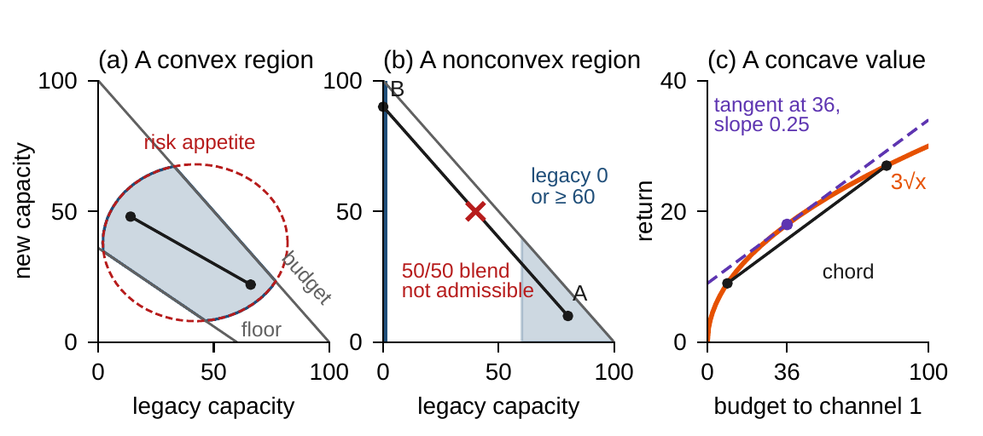
The chord test, and where convexity breaks
§3.2 · DEFINITIONS 3.1–3.2 · FIGURE 3.1
Convex set: every blend of two admissible plans is admissible
Concave value: a blend is worth at least the blend of the values
Strictly concave: a unique best plan; strongly concave: near-best plans are near
A concave value's sensitivity report at any plan is a ceiling on value everywhere
Legacy run at 60 or more, or shut down, is not convex: the 50/50 blend runs it at 40
A pledge to pay out at most half of the savings is convex; at least half is not
Figure 3.1. (a) A region built from convex blocks is convex. (b) Volume I's minimum efficient scale splits the region in two. (c) A concave value, 3√x: chords lie below it, the tangent at 36 above.
Notes:
Definitions 3.1 and 3.2 and Figure 3.1. The test is a business question: if two plans are admissible, is every blend of them admissible? Identities (sources equal uses, flows balance) are affine, the strongest convexity a block can have. A commitment that holds a concave quantity below a ceiling is not convex.

Slide 8
A catalog of shapes and rules certifies convexity
§3.2 · TABLE 3.2
 | Shape or rule | Business reading
Convex sets | halfspace; affine set | budgets, floors, ceilings; balances and identities
 | ellipsoid; second-order cone | risk appetites; variance and service-level limits
Convex functions | quadratic, Q positive semidefinite | adjustment costs, variance, tracking error
 | norms; the maximum of affine pieces | deviation budgets; tiered tariffs
 | exp(au), −ln u, u ln u (concave: √u, ln u) | growth and decay; barriers; diminishing returns
Rules | intersection of convex sets | a region built from convex blocks
 | pointwise maximum (minimum, for concave) | the worst of several scenarios
 | h(g(u)), h convex nondecreasing, g convex | an exponential of a convex cost
 | {f ≤ c}, f convex; {J ≥ c}, J concave | a cost under a ceiling; a value over a floor
Recognition fails at compositions, (u² − 1)² has two minima, and at products of decisions.
Notes:
Table 3.2, selected rows: the same catalog a modeling system uses to check a model automatically (Section 3.6). Two calculus tests settle most remaining cases: a differentiable concave function lies below every tangent, and a twice-differentiable function is convex when its matrix of second derivatives is positive semidefinite. Worked Example 3.1 meets a product of decisions and removes it by rewriting.

Slide 9
In a convex instance, local answers are global
§3.3 · DEFINITION 3.3 · THEOREM 3.1
What each part retires
THEOREM 3.1
Global Optimality Theorem
“Did the search stall in a side valley?” A convex instance has none
Inside the region, a flat sensitivity report is a proof of completion
Theorem 3.2: certify the region block by block; one nonconvex block voids the guarantee
Proposition 3.1: any blend of feasible plans is feasible: compromise needs no new review
(i) Local is global. A plan best among nearby feasible plans is best among all
(ii) Best plans form a menu. Any blend of best plans is best
(iii) Recognition. No feasible direction improves the objective at first order; inside the region, a zero gradient
(iv) Uniqueness. With strict concavity there is at most one best plan
(v) Near-best is near. Within ε of the best value, under curvature m, means within √(2ε/m) of the best plan
Notes:
Definition 3.3, Proposition 3.1, Theorems 3.1 and 3.2; proof of Theorem 3.1 in Appendix 3.A, of Proposition 3.1 and Theorem 3.2 in Online Appendix 3.B. A formulation review hunts for the nonconvex block and keeps it quarantined: without it the instance is convex, and that convex remainder bounds the whole (Section 3.6).

Slide 10
Price the commitments instead of enforcing them
§3.4 · EQUATIONS 3.2–3.3 · DEFINITION 3.4
each commitment becomes a tariff: exceeding it costs its price λ a unit, and a unit of slack earns λ
The dual problem chooses prices λ ≥ 0 and ν to minimize q; the duality gap is d* − p* (Definition 3.4)
For each plan the Lagrangian is affine in the prices, so q is convex: the dual is a convex problem, whatever the instance
Theorem 3.3. At every point on the edge of a convex set some price list makes that point the best in the set
The two-channel budget: q(λ) = 25/(4λ) + 100λ. Every price gives a ceiling, and the best price, 0.25, gives exactly the best return, 50 (Figure 3.2(b))
Notes:
Equations 3.2 and 3.3, Definition 3.4 and Theorem 3.3 (proof in Online Appendix 3.B). Read as an economist would, the supporting hyperplane theorem says that at every point on the edge of a convex set of achievable outcomes there is a linear valuation, a price list, under which that point is the best in the set.

Slide 11
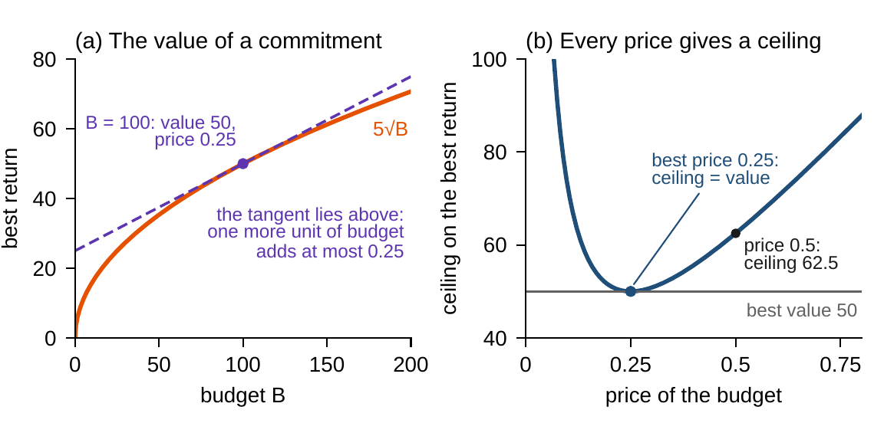
Plans and prices certify each other
§3.4 · THEOREM 3.4 · FIGURE 3.2
THEOREM 3.4
Duality Theorem
(i) Any price list is a ceiling. Every feasible plan is worth at most q(λ, ν); this part needs no convexity
(ii) The best prices close the gap, given a Slater plan: one that keeps every inequality strictly
(iii) Plans and prices certify each other: a feasible plan worth q(λ, ν) is best, and so are the prices
Optimization becomes auditable: “nothing better exists” turns into a claim about one price list
Figure 3.2. The two-channel budget. (a) The best return 5√B is concave; its tangent at B = 100 has slope 0.25, the budget's multiplier. (b) Every price gives a ceiling; the best, 0.25, gives exactly 50.
A plan and a price bracket the best: the plan (50, 50), worth 49.50, and the price 0.5, a ceiling of 62.5
Solvers stop when primal and dual values agree: the gap is the tolerance
Notes:
Theorem 3.4; proof in Appendix 3.A. Slater's condition has a plain meaning: the commitments leave room to spare. Interior-point solvers report a primal value, a dual value and the residuals at every iteration; the reported gap is the optimality tolerance. The two-channel budget: Example 3.B.1, Online Appendix 3.B.

Slide 12
Only binding commitments carry prices
§3.4 · THEOREM 3.5 · EQUATION 3.4
The anatomy of a defensible decision
THEOREM 3.5
KKT Certificate Theorem
Feasibility: the plan keeps every commitment
Signs: relaxing a ceiling can never hurt
Complementary slackness: management attention, quantified, flows to what binds
Stationarity: the objective's pull balances the priced resistance of the binding commitments
The conditions are the audit protocol: four residuals, checked without the solver
(i) Sufficiency: the conditions prove plan and prices best, with a zero gap
(ii) Necessity, given a Slater plan
(iii) Prices bound what commitments are worth: relaxing one by s gains at most λ*s; at a kink, the prices form a range
(iv) Equal margins: at the best allocation the last unit earns the same in every use
Notes:
Theorem 3.5 and Equation 3.4; proof in Appendix 3.A. AXIOM-03's KKT verification module computes the four residuals of any vendor's claimed plan and prices. Part (iv): 0.25 in each channel of the two-channel budget. Part (iii) warns that at a kink cutting a commitment can cost more per unit than enlarging it gains (Worked Example 3.1, Step 6).

Slide 13
Rewriting a commitment is not cheating
§3.5 · THEOREM 3.6 · TABLE 3.3
Commitment as declared | Convex form | Solver class
tiered overrun penalty | an extra variable above each tier's line | linear (LP)
the worst of a list of scenarios | an extra variable below each scenario's value | LP or quadratic (QP)
return on capital of at least r | profit minus r times capital, at least zero | LP when both are linear
portfolio variance at most σ² | ‖Σ^(1/2) u‖ ≤ σ | second-order cone (SOCP)
95 percent service level under Gaussian demand | Equation 3.5 with z = 1.645 | SOCP
logarithmic utility; exponential growth or decay | exponential-cone atoms | exponential cone
a covariance or stability declaration | a linear matrix inequality | semidefinite (SDP)
Theorem 3.6. The same best decisions, the same value, and prices that land on the commitments as declared.
Notes:
Theorem 3.6 (proof in Online Appendix 3.B) and Table 3.3. Device (v) is the first bridge from a board's language of confidence to a convex commitment: it charges the plan 1.645 standard deviations of its exposure against the headroom. Set-up charges, all-or-nothing choices and payout floors on concave quantities cannot be rewritten. Online Appendix 3.B.2 prices a tiered penalty at its kink: 0.25 and 0.75.

Slide 14
Methods for convex instances, and when to use each
§3.6 · TABLE 3.4
Method | Each iteration | How fast | When to use
gradient, projected gradient | a gradient (and a projection) | error ∝ 1/k; geometric, by 1 − 1/κ, if strongly convex | large smooth instances; simple regions
accelerated gradient | a gradient and momentum | error ∝ 1/k²; geometric, by 1 − 1/√κ | large instances, poor conditioning
subgradient | a subgradient | error ∝ 1/√k | kinks that cannot be rewritten
Newton | a gradient and a linear solve | digits double near the answer | moderate size, high accuracy
interior point | a Newton step on the KKT system | gap ε in O(√m ln(1/ε)) steps | LP, QP, SOCP, exponential cone, SDP: the default
splitting (ADMM) | a solve per block, then a price update | error ∝ 1/k, typically | divisions with their own data
simplex | an exchange of binding constraints | finite; fast in practice | linear programs; warm starts
In production the stopping rule is the duality gap, never the size of the last step.
Notes:
Table 3.4. Disciplined convex programming (CVXPY in this volume's laboratories) checks a model by the rules of Table 3.2, compiles it into a cone program and returns the plan with its prices. Interior-point methods follow the central path and exhibit feasible prices with a duality gap of m/t at every point; an independent KKT audit follows every solve.

Slide 15
A convex relaxation bounds every lumpy plan
§3.6 · DEFINITION 3.6 · PROPOSITION 3.2
The convex spine
PROPOSITION 3.2
Convex Relaxations Bound Lumpy Instances
Rewrite the largest part of the instance that Theorem 3.6 can make exactly convex
Quarantine what it cannot (lumpy choices, set-up charges) and relax it
Branch-and-bound and cutting planes build on relaxations (Chapter 4)
Rounding is not a method: the rounded plan can be infeasible, or not best
(i) The relaxation's best value is a ceiling on every plan of the instance
(ii) If the relaxation's best plan is feasible for the instance, with the same value, it is best there
(iii) A feasible plan within ε of the ceiling is within ε of the best: a certificate without enumeration
(iv) For a linear objective, the gap measures how far the relaxation's region exceeds the convex hull
Notes:
Definition 3.6 and Proposition 3.2 (proof in Online Appendix 3.B). This is the bound Chapter 1 said every lumpy package must respect (Theorem 1.3(v)). The relaxation's value is a ceiling; any lumpy plan close to it is certified close to best; and when the relaxation's own answer is lumpy, it is the answer.

Slide 16
How good is the three-round plan?
WORKED EXAMPLE 3.1 · THE SITUATION
Worked Example 2.1
The chief risk officer
What she asks for
Three rounds, in years 1 to 3
Accepts the arithmetic, not the method
A ceiling, a price list, a distance
$455m paid out plus ten years of the $122.5m year-6 savings: $1,680m, by enumerating all 64 schedules.
With a dozen plants decided quarterly, the schedules outnumber anything a computer can visit.
A ceiling on any plan, without enumeration; the price of each commitment and round; the plan's distance from the ceiling.
The board keeps its $350m liquidity floor and its $470m end condition; all amounts are undiscounted.
Notes:
Worked Example 3.1, the situation. In Worked Example 2.1 the board dropped both executive pledges and let an optimizer choose the automation rounds and the payouts. Theorem 1.3(iii): the schedules outnumber anything a computer can visit.

Slide 17
Relax the rounds in a form that shows convexity
WORKED EXAMPLE 3.1 · STEPS 1–2
rounds as fractions, payouts as chosen: the savings are concave, liquidity is concave, every floor is convex
Step 1: Volume I's form multiplies rounds: two half rounds save $61.25m in year 2, less than the $70m of either whole round. The chord test fails
Written as 14 × 2^{−(z₁ + z₂)}, identical at every lumpy plan, the gap is an exponential of a sum: convex
Step 2: CVXPY accepts the model; Clarabel returns after 15 iterations: rounds 1, 1, 1, 0.39, 0, 0, worth $1,687.1m
Notes:
Worked Example 3.1, Steps 1 and 2. The CFO's pledge to pay out at least half of each year's savings holds a concave quantity below the payout and could not have joined; the board had dropped it. The plan is not one the chief operating officer can run; its value is a ceiling on every plan that can be run, and no search could have stalled short of it (Theorem 3.1(i)).

Slide 18
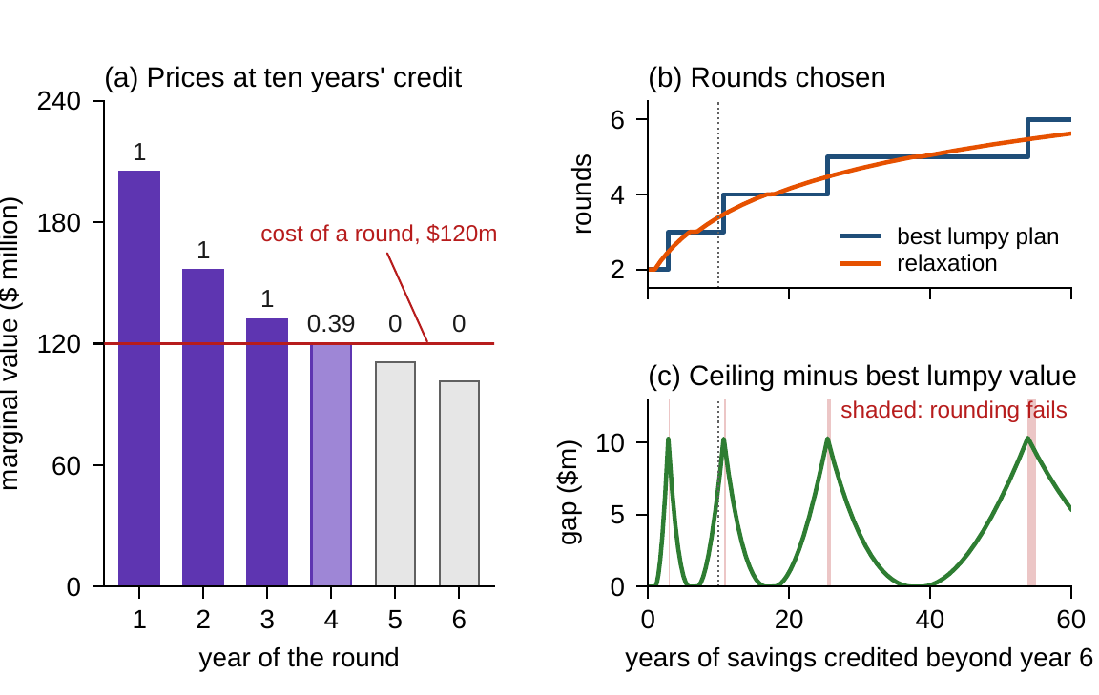
Rounds are whole where the margin beats the cost
WORKED EXAMPLE 3.1 · STEPS 3–4 · FIGURE 3.3
Margins by year: $204.9m, $156.4m, $132.1m, $120.0m, $110.8m, $101.5m; cost $120m
Each year's limit is priced at the excess: $84.9m, $36.4m, $12.1m
Forcing a round into year 5 or 6 would cost $9.2m or $18.5m at the margin
Floors carry no price, because payouts can wait; the end condition costs a dollar per dollar
Step 4: the three-round plan, $1,680.0m, is within $7.1m, 0.42 percent, of the ceiling
Figure 3.3. (a) Marginal values at ten years' credit against the $120m cost. (b) Rounds chosen as the credit grows. (c) The ceiling minus the best lumpy value, at most $10.3m; shaded, rounding fails.
Notes:
Worked Example 3.1, Steps 3 and 4. Rounds are whole where the margin exceeds the cost, partial where it equals it, absent where it falls short: complementary slackness and stationarity (Theorem 3.5(i)). Charged at these prices no schedule of rounds is worth more than $1,687.1 million (Theorem 3.4(i)), a certificate a reviewer can check on a spreadsheet. Rounding down gives the three-round plan; four rounds are worth $1,673.75 million.

Slide 19
A ceiling is reliable; a rounded answer is not
WORKED EXAMPLE 3.1 · STEP 5 · TABLE 3.5
Credit (years) | Relaxation's rounds | Ceiling | Best lumpy plan | Its value | Gap
0 | 2.00 | 505.00 | years 1–2 | 505.00 | 0.00
5 | 2.86 | 1,068.25 | years 1–3 | 1,067.50 | 0.75
10 | 3.39 | 1,687.09 | years 1–3 | 1,680.00 | 7.09
20 | 4.15 | 2,987.26 | years 1–4 | 2,986.25 | 1.01
40 | 5.05 | 5,675.11 | years 1–5 | 5,675.00 | 0.11
60 | 5.62 | 8,406.33 | years 1–6 | 8,400.94 | 5.39
$ million, undiscounted. The relaxation's answer is lumpy, so it proves the lumpy plan best, for credits up to 0.95 years and from 5.9 to 6.9, 16.8 to 17.8 and 37.6 to 38.6.
The gap never exceeds $10.3m; just past 2.9, 10.7, 25.4 and 53.9 years, rounding picks the wrong number.
Notes:
Table 3.5 and Worked Example 3.1, Step 5. The ceiling comes closest to $10.3 million only where the best number of rounds changes, at the credits found in Chapter 2. At 54 years the relaxation runs 5.47 rounds, which round to five, while the best plan has six. With no credit the relaxation proves Worked Example 2.1's two-round plan best (Proposition 3.2(ii)).

Slide 20
One convex solve replaces enumeration
WORKED EXAMPLE 3.1 · STEP 6 · WHAT THE BOARD SHOULD TAKE AWAY
$1,687.1m
$7.1m
$0.31–0.42
the ceiling: no automation plan is worth more
the three-round plan's distance from the ceiling, 0.42 percent
a dollar of capital under a $360m cap: a range of prices at the kink
Step 6: with capital capped at $360m the relaxation picks exactly the three rounds and proves them best; a dollar more gains $0.31, a dollar cut loses $0.42
The year-1 round earns $84.9m more than it costs at the margin, the year-3 round only $12.1m: pressure for more rounds is pressure to raise the credit for savings after year 6
The board should take ceilings and prices from a relaxation, never a rounded plan
Notes:
Worked Example 3.1, Step 6, and what the board should take away. Clarabel prices the cap at $0.37 a dollar, one point of the range. For discussion: if the chief operating officer could automate part of a plant line, would you trust the 0.39 round as a plan? Which price in Step 3 would move most if savings were discounted at 10 percent a year?

Slide 21

Ceilings and price lists, in AXIOM
AXIOM LAB 2.3 · MODULE AXIOM-03
Meridian's chief risk officer wants a ceiling on the value of any automation plan, computed without enumeration, and a price list the board can audit. Open AXIOM, choose Lab 2.3 and load the Meridian automation relaxation.
1
2
3
4
5
Recognize
Solve
Audit
Bound
Stress the prices
Enter the program in both forms; check they agree at the 64 lumpy plans; find the violating chord.
Declare the relaxation in disciplined convex form, solve it, and watch the duality gap close.
Run the KKT verification module; rebuild the marginal values and prices of Figure 3.3(a).
Compare the ceiling with the 64 lumpy plans; value the plan rounded down and rounded up.
Move the credit from 0 to 60 years, add a capital cap, and find the kink at $360m.
Deliverable: a one-page note to the board: the ceiling and the solver's certificate, the three-round plan's distance from it, the price list, the credits at which the relaxation proves the lumpy plan best, and whether further search is worth its cost. About 75 minutes.
Notes:
AXIOM Lab 2.3. What to look for: a model that fails the convexity check in one form and passes in another (Table 3.2); a gap that closes to zero (Theorem 3.4); margins equal to the cost exactly where a round is partial (Theorem 3.5); and a ceiling that bounds every lumpy plan while rounding sometimes fails (Proposition 3.2).

Slide 22
What to carry forward
KEY TAKEAWAYS
1
Convexity turns optimization into proof: in a convex instance local answers are global, best plans form a menu, and curvature makes the best plan unique and near-best plans near.
2
Convexity is recognized block by block from a catalog of shapes and rules; it breaks at set-up charges, all-or-nothing choices, products of decisions, and commitments that hold a concave quantity below a ceiling.
3
Duality turns commitments into prices: any price list gives a ceiling on value, and under Slater's condition the best price list closes the gap, so a plan and its prices certify each other.
4
The KKT conditions are both the audit protocol and the economics of the answer: only binding commitments carry prices, margins are equal at the best allocation, and a price bounds what relaxing its commitment can gain, with a range at a kink.
5
Tiers, worst cases, ratio targets, and Gaussian chance commitments rewrite exactly into convex form; what cannot be rewritten is quarantined and relaxed, and the relaxation bounds every lumpy plan—Meridian's three-round plan lies within $7.1 million of anything achievable.
Notes:
Key Takeaways, Chapter 3.

Slide 23
Notebook and workbook reproduce the book
THIS WEEK'S LABORATORY
91
101
26203
AXIOM-03
notebook checkpoints, every one PASS
workbook checks against the engine, ALL PASS
the lab's seed
AXIOM Lab 2.3
Notebook DCT_V2_Ch03_Lab.ipynb: Worked Example 3.1 and the lab's five steps in seven panels, with an interior-point method written out in numpy, ready for Colab
Workbook DCT_V2_Ch03_Lab.xlsx: the 64 lumpy plans, the closed form with its prices and KKT residuals, Table 3.5 and the capital cap, in formulas
Every number on these slides is the book's, and both companions check it
Notes:
The notebook and workbook are on the course website, www.dynamiccorporatetransformation.com.

Slide 24
Chapter 4 goes beyond convexity
NEXT · CHAPTER 4
Beyond convexity optimization keeps its questions and loses its guarantees: local peaks, candidates rather than answers, prices that hold only nearby
Branch-and-bound carries a certified gap at every stage; cutting planes and decomposition handle instances lumpy outside and convex inside
Its Worked Example lets Meridian automate part of a plant line: this chapter's relaxation puts the best plan within $1.01m of anything achievable
Notes:
Chapter 4, Nonlinear and Mixed-Integer Enterprise Optimization (chapter abstract and Equation 4.1): three plans pass every local test, Chapter 3's relaxation puts the best within $1.01 million of anything achievable, and five convex solves prove it best.

