Slide 1
Mathematical Foundations
VOLUME I · CHAPTER 3 · WEEK 2
Declare the units before comparing, the norm before measuring and the order before signing: a program is feasible only if each step delivers the company where the next can start
Graduate course companion · Lab seed 26103 · AXIOM Lab 1.3 (AXIOM-03)
Notes:
Volume I, Chapter 3. Chapters 1 and 2 used mathematical vocabulary on credit; this chapter pays the debt at the level of use: mappings and operators, vectors and units, matrices, distances, state spaces, and the difference between deterministic and stochastic models (Section 3.1).

Slide 2
“Mathematics may be defined as the subject in which we never know what we are talking about, nor whether what we are saying is true.”
Bertrand Russell
Nobel Prize in Literature 1950; “Recent Work on the Principles of Mathematics” (1901)
Notes:
Russell's quip (1901) is about pure mathematics, which reasons from axioms whatever its objects. Applied to a company the burden reverses: a number says something only with its unit, its scaling and its domain declared, which is the discipline of this chapter (Section 3.1; Proposition 3.2).

Slide 3
After this chapter, you can
LEARNING OUTCOME STATEMENTS
3.1
Read a company's state as a vector of readings with units, and explain why comparisons or totals across different units mean nothing without declared weights.
3.2
Explain what it means to measure the distance between two company states, and why the choice of measure changes the numbers but not the qualitative conclusions.
3.3
Describe transformations as operators that work only from certain starting states, and explain why a program is feasible only if each step delivers the company into the domain of the next.
3.4
Explain why the order of initiatives matters, why most transformations cannot be undone, and how sensitivities compound along a program.
3.5
Describe a company's state space—including ratings and categories—and distinguish deterministic from stochastic models, saying when each is adequate.
Notes:
The five learning outcome statements; LOS Guidance at the end of the chapter.

Slide 4
Seven sections, a worked example and a lab
ROADMAP
§3.1
§3.2
§3.3
§3.4
§3.5
Mathematical Language
Mappings and Transformation Operators
Vectors, Units, and Meridian's Declared State
Matrices and Linear Operators
Distances Between Company States
Figure 3.1
Proposition 3.1 · Figure 3.2
Proposition 3.2 · Table 3.1
Equation 3.2 · Table 3.2
Theorems 3.1–3.2 · Proposition 3.3
§3.6
§3.7
Worked Example 3.1
AXIOM Lab 1.3
Enterprise State Spaces
Deterministic and Stochastic Models
Does the Order of Initiatives Matter?
Measuring Meridian
Theorem 3.3 · Figure 3.5
Table 3.3
Table 3.4 · six steps
AXIOM-03 · five steps
Notes:
Section 3.2: Definitions 3.1-3.2 and Proposition 3.1. Section 3.3: Definition 3.3, Proposition 3.2 and Table 3.1. Section 3.4: Equation 3.2 and Table 3.2. Section 3.5: Definitions 3.4-3.5, Proposition 3.3 and Theorems 3.1-3.2. Section 3.6: Definition 3.6 and Theorem 3.3. Section 3.7: Table 3.3. Proofs of Propositions 3.1-3.2 and Theorem 3.2 are in Appendix 3.A; those of Proposition 3.3 and Theorems 3.1 and 3.3 in Online Appendix 3.B.

Slide 5
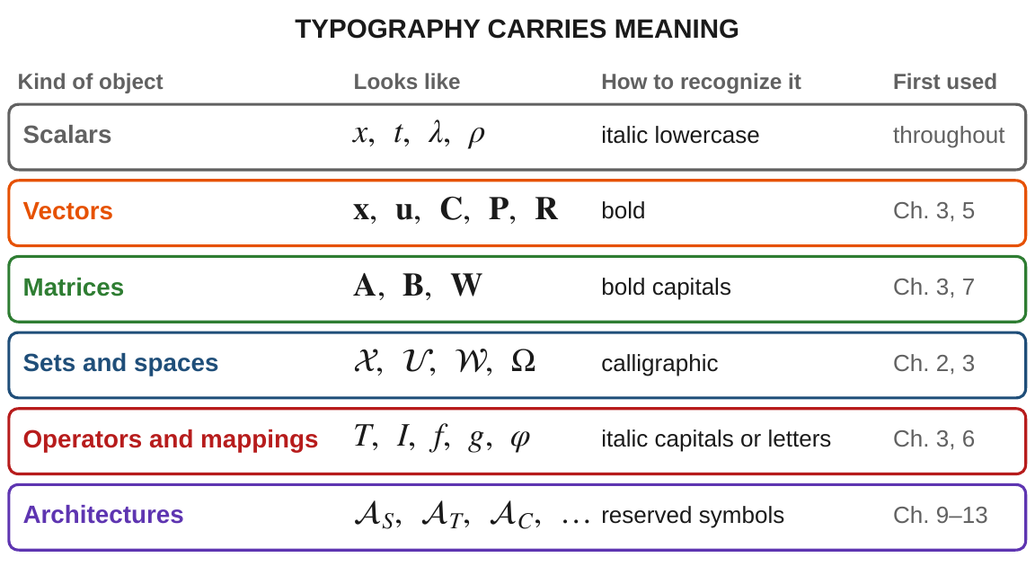
Typography carries meaning
§3.1 · FIGURE 3.1
The kind of object a symbol stands for can be read from its face
Vectors bold, matrices bold capitals, sets calligraphic, operators italic capitals
It catches errors, such as adding a vector to a matrix, before they spread
One hierarchy across both volumes, the course website and AXIOM
Read for the ideas, stated in words throughout; the proofs are in the appendices
Figure 3.1. The DCT notation hierarchy: the kind of object a symbol stands for can be read from its typeface.
Notes:
Section 3.1 and Figure 3.1. The convention is a working tool, not decoration; the full notation appears at the front of the book. Readers with strong preparation can skim for the conventions particular to the book.

Slide 6
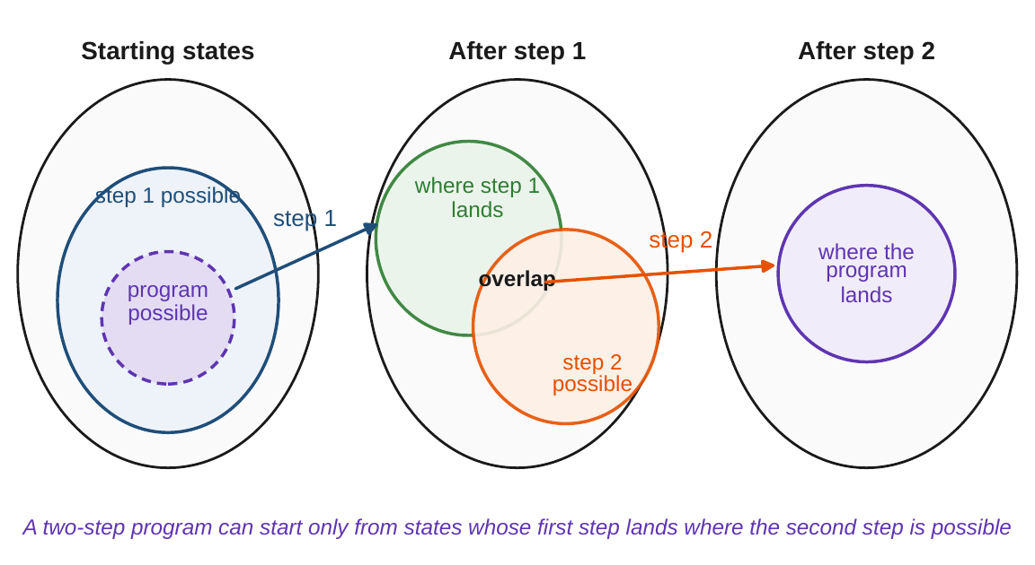
A program is feasible only step by step
§3.2 · PROPOSITION 3.1
Definition 3.2. Operators act only from a domain: a divestiture needs the asset
Proposition 3.1. Step 1, then step 2, starts only where step 1 lands in step 2's domain
Such starts exist only if what step 1 produces overlaps what step 2 requires
Meridian: restructure-then-digital needs the restructured company to keep its engineers
Composition is associative, and “do nothing” changes nothing
Figure 3.2. Feasibility chaining: the program can start only from the purple region, the starting states whose first step lands in the overlap.
Notes:
Definitions 3.1-3.2 and Proposition 3.1; proof in Appendix 3.A. Injectivity is distinguishability, surjectivity attainability, preimages diagnosis. The coupling flagged in Table 1.2 becomes a membership condition an analyst can check; Chapter 6 builds the full operator theory.

Slide 7
Meridian's state, declared with units
§3.3 · TABLE 3.1
 | Reading | Unit | Today | Scaled
x₁ | liquidity | US$ billion | 0.62 | 1.00
x₂ | net leverage | net debt / EBITDA | 3.4 | 1.00
x₃ | workforce capability | index, 0–100 | 58 | 0.58
x₄ | technology platform | index, 0–100 | 41 | 0.41
x₅ | operational efficiency | index, 0–100 | 71 | 0.71
x₆ | return on invested capital | ratio | 0.083 | 1.00
x₇ | strategic risk (lower is better) | index, 0–100 | 64 | 0.64
x₈ | market share | ratio | 0.19 | 1.00
Table 3.1; scaled as in Figure 3.3: unbounded readings divided by today's value, bounded indices by their range, the declared scaling used whenever the book computes a distance for Meridian.
The canonical starting state for both volumes: three families of unit, so raw distances are dominated by the indices.
Notes:
Table 3.1 and Section 3.3. The readings mix currency, ratios and bounded indices, so the raw straight-line distance between two Meridian states would be dominated by the index readings purely because their numbers are largest. The declared remedy is W_M = diag(1/0.62, 1/3.4, 1/100, 1/100, 1/100, 1/0.083, 1/100, 1/0.19).

Slide 8
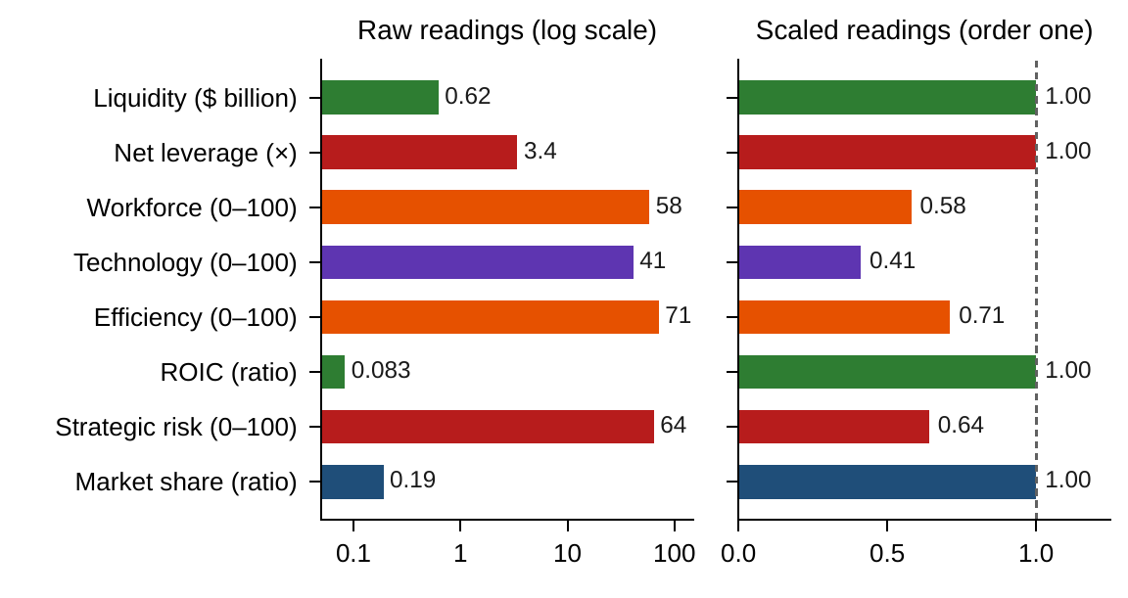
Units can reverse any raw comparison
§3.3 · PROPOSITION 3.2
Proposition 3.2. Changing units loses no information
Raw cross-reading comparisons and undeclared totals can be reversed by a change of units
“Strategic risk, at 64, exceeds leverage, at 3.4” says nothing: a rescaling reverses it
Weighted totals are legitimate when their weights are declared and carry units
The declared scaling divides unbounded readings by today's value, indices by their range
Figure 3.3. Meridian's declared state: raw readings in their own units (log scale), and the same state after the declared scaling.
Notes:
Proposition 3.2; proof in Appendix 3.A; LOS Guidance 3.1. Comparisons within one attribute are unaffected; nonlinear changes of description, such as logarithms of currency, are a modeling question for Chapter 4. A common mistake is to think the rule forbids composite scores: it requires them to be declared.

Slide 9

Without investment, a company runs down
§3.4 · EQUATION 3.2
workforce capability, technology platform and operational efficiency, all indices; u is annual capability investment
Entry (i, j) is the response of reading i to reading j: capability builds the platform (0.10); efficiency feeds neither of the others
From (50, 40, 60) with u = 10, one year later (53.0, 42.0, 54.5): capability and technology rise, unaided efficiency decays
Eigenvalues 0.95, 0.80 and 0.80, all below one: without investment the company decays steadily toward zero
Open systems run down without throughput (Table 2.2); Chapter 7 develops the stability theory
Notes:
Section 3.4, Equation 3.2 and Table 3.2, which makes the spectral radius the stability quantity of Chapter 7. Near a reference state smooth company dynamics are approximately linear, and x_(k+1) = A x_k + B u_k is where analysis begins even when it does not end. V56 corrects the eigenvalues of this illustration.

Slide 10
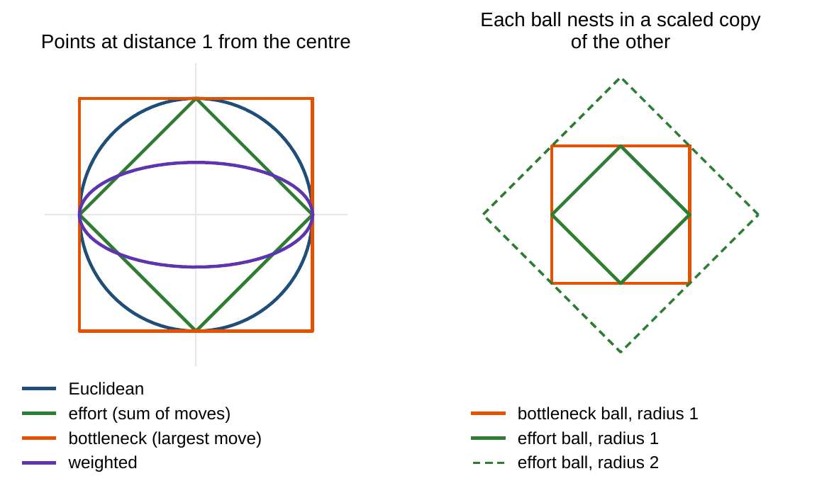
Norms change the numbers, not the conclusions
§3.5 · THEOREM 3.1
The effort view totals the moves; the bottleneck view reports the largest
Theorem 3.1. All norms agree on convergence, open sets, continuity and stability
Proposition 3.3. Unit-proof distances need weights that move against the units
For Meridian's eight readings, effort and bottleneck views can differ eightfold
Declare the norm whenever a distance is reported
Figure 3.4. Left: the points at distance one under four norms. Right: each ball nests inside a scaled copy of the other.
Notes:
Definitions 3.4-3.5, Proposition 3.3 and Theorem 3.1; proofs in Online Appendix 3.B with the sharp constants (Remark 3.B.1): the effort and bottleneck norms on R^n are linked by the constants 1 and n, so 'equivalent' never means 'interchangeable in a calculation'. LOS Guidance 3.2.

Slide 11
How far each option moves Meridian
§3.5 · MERIDIAN, MEASURED WITH THE DECLARED SCALING
0.11
0.26
0.36
the turnaround's Year-5 state, from today
restructuring's Year-5 state
digital's Year-5 state: more than three times the turnaround's
Section 5.8 measures the Chapter 1 options with this chapter's scaling: indices divided by 100, liquidity by today's value
Profile proximity is not state proximity: rankings of similar states are computed with the declared distance, never read off the page
Every quantitative object, from shock sizes to resilience radii, depends on the chosen norm and unit convention
The norm and the units change these numbers; convergence and stability do not depend on them (LOS Guidance 3.2)
Notes:
Section 5.8 (Figure 5.5) and the scope limits after Theorem 3.1. Euclidean distances on the declared scale; in the Chapter 1 model only liquidity, technology, efficiency and strategic risk move (Table 1.9).

Slide 12
Order matters, and sensitivities multiply
§3.5 · THEOREM 3.2
What it means
THEOREM 3.2
Transformation Composition Theorem
Irreversibility is the default: an integrated acquisition cannot be unwound
Five mild steps (factor 1.2) can amplify a starting error by up to 1.2⁵ ≈ 2.5
Two consolidating steps (0.7) bring the bound to 1.2³ × 0.7² ≈ 0.85
Programs are ordered sequences, not bags of initiatives: the order is a decision
(i) Programs compose. “Do nothing” is the neutral program; only reversible transformations can be undone
(ii) Sensitivities multiply. A sequence's sensitivity factor is at most the product of its steps' factors
(iii) Order matters. The same two transformations in different orders generally produce different companies
Appendix 3.A. From (2, 40), the two orders of a two-reading example end at (2.5, 40.0) and (4.0, 37.44)
Notes:
Theorem 3.2; formal statement and proof in Appendix 3.A. An operator with sensitivity factor (Lipschitz constant) L never stretches the distance between two starting states by more than L; L < 1 is a contraction. Appendix 3.A's example: from (2, 40), T_D(T_R x0) = (2.5, 40.0) but T_R(T_D x0) = (4.0, 37.44); Online Appendix 3.B splits the gap (-1.5, 2.56) into a commutator and a constant term.

Slide 13
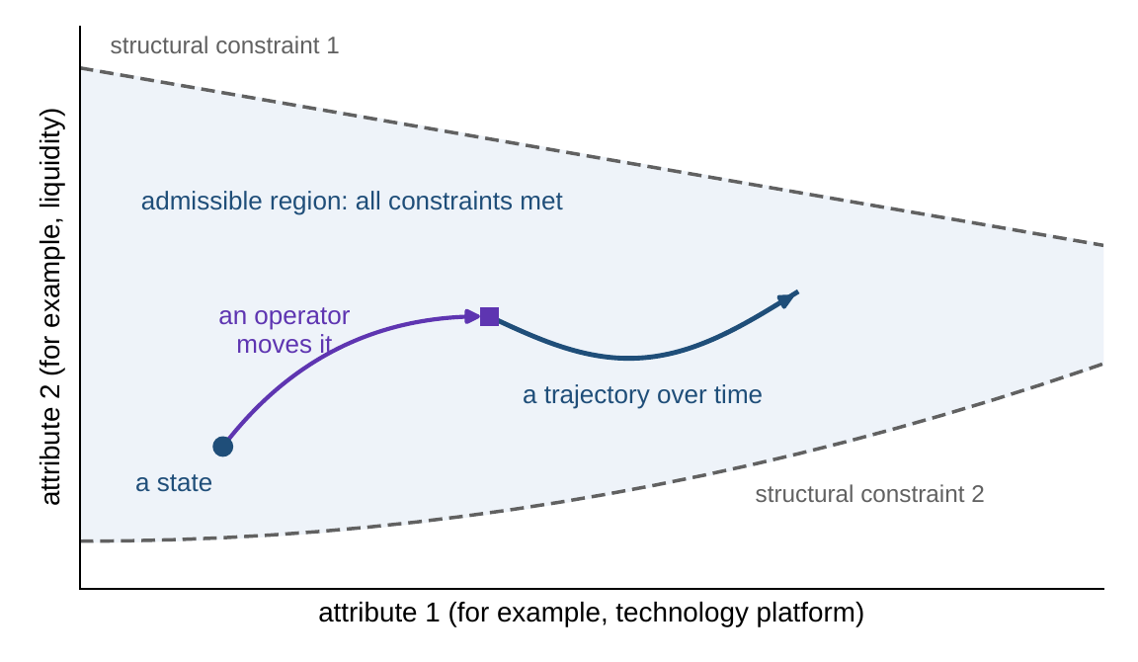
Ratings and categories fit one state space
§3.6 · THEOREM 3.3
Definition 3.6. Products of attribute spaces, cut by structural constraints
Liquidity is an interval, a credit rating a ranked scale, a legal form a set of categories
Theorem 3.3. Any mix of readings maps into numbers without losing distinguishability
Ranks impose an unearned spacing; indicators put all categories equally far apart
Legitimate when declared, dangerous when unnoticed
Figure 3.5. Structural constraints carve the admissible region; a state is a point, an operator moves it, and a trajectory traces its path.
Notes:
Definition 3.6 and Theorem 3.3; proof in Online Appendix 3.B. States that also meet decision-dependent constraints form the feasible region, treated from Chapter 5. The theorem secures distinguishability, deliberately nothing more; Chapter 4 treats the choice of spacing as it treats the choice of units.

Slide 14
Determinism is a regime, not a belief
§3.7 · TABLE 3.3
 | Deterministic model | Stochastic model
Transition | one next state, f(x, u, w) | a distribution of the next state, given (x, u)
Trajectory | a single path | a fan of paths with probabilities
Prediction | a point | a distribution: mean, variance, quantiles
Appropriate when | disturbances small against the signal; short horizons; design-stage reasoning | uncertainty material to the decision; risk is itself the subject
DCT usage | Chapters 5–7; linear analysis | Chapter 8 onward; ERRA (Chapter 12); Volume II
Table 3.3. The deterministic model is the special case of the stochastic one in which every distribution is a point mass (Proposition 8.3).
When dispersion is the subject (risk, resilience, robustness), the deterministic regime is not simplified but wrong.
Notes:
Section 3.7 and Table 3.3. Every deterministic conclusion carries an implicit clause about the smallness of what was suppressed. The stochastic regime is also unavoidable when readings are uncertain or observed only occasionally, as with private assets valued by model rather than by market price.

Slide 15
Does the order of initiatives matter?
WORKED EXAMPLE 3.1 · THE SITUATION
The sale (restructuring)
The platform build (digital program)
The board
$112m net; the unit takes 10% of the technology position
Commits half the liquidity; 0.05 points per $1m
Which order, and on what terms?
Unless the contract keeps the shared engineering team, workforce capability falls by 5 points.
It can run only if workforce capability is at least 55: its domain.
Today: liquidity $620m, technology platform 41, workforce capability 58.
Both initiatives are approved in principle; the strategy team must recommend an order.
Notes:
Worked Example 3.1, the situation. In the language of Section 3.2, the digital program's domain is 'workforce capability of at least 55': below that, Meridian lacks the engineers to execute it.

Slide 16
Check feasibility step by step
WORKED EXAMPLE 3.1 · STEPS 1–4
1
Appraise each initiative alone
2
Restructure, then digital
The sale alone brings in $112m and costs 4.1 technology and 5 workforce points; the build alone spends $310m and adds 15.5. Added up, a “bag of initiatives” predicts $422m, 52.4, 53.
After the sale: $732m, 36.9, workforce 53. Below 55 the digital program cannot start: the sequence is infeasible as designed (Proposition 3.1).
3
Digital, then restructure
4
Redesign the deal
The build invests $310m, leaving $310m and a platform of 41 + 0.05 × 310 = 56.5. The sale then takes 10% of the new platform: $422m, 50.9, 53.
Keep the engineers for $20m of proceeds: $712m, 36.9, 58. The build then invests $356m: $356m, 54.7, 58.
Notes:
Worked Example 3.1, Steps 1-4. In restructure-then-digital the first step delivers the company outside the domain of the second; checking each initiative from today's state only is the common mistake (LOS Guidance 3.3).

Slide 17
Two feasible orders, two companies
WORKED EXAMPLE 3.1 · TABLE 3.4
 | Liquidity | Technology | Workforce
Today | 620 | 41.0 | 58
Bag of initiatives (each appraised alone, then added) | 422 | 52.4 | 53
Restructure, then digital (as designed) | – | infeasible | –
Digital, then restructure | 422 | 50.9 | 53
Restructure (engineers kept), then digital | 356 | 54.7 | 58
Table 3.4. Meridian after the two initiatives, depending on the order (liquidity in $ million; indices 0–100).
Digital-first ends with $66m more cash; restructure-first, engineers kept, with a stronger platform and workforce.
Notes:
Table 3.4 and Step 5. The bag-of-initiatives estimate matches neither feasible order, because it misses two interactions: the sale takes a share of a platform that grows if the digital program runs first, and the digital program's size depends on the cash the sale provides.

Slide 18
Fix the order and the terms before signing
WORKED EXAMPLE 3.1 · WHAT THE BOARD SHOULD TAKE AWAY
$66m
54.7 vs 50.9
58 vs 53
more cash if the digital program goes first
platform strength if the sale goes first, with the engineers kept
workforce capability: the retention clause decides whether the build can follow the sale
Feasibility is checked step by step, not initiative by initiative; the same initiatives in a different order deliver a different company
Step 6. The sale cannot be undone (Theorem 3.2(i)): fix the order and the retention clause before signing
For discussion: what would have to be true about the value of cash against platform strength for your recommendation to change?
Notes:
Worked Example 3.1, Step 6, what the board should take away, and the discussion question. Chapter 6 revisits the order under the board's $350 million floor (Table 5.4): the digital build alone would leave $310 million, below it, and selling with the engineers kept, then building, ends $6 million above the floor (Sections 6.5-6.6).

Slide 19

Measuring Meridian, in AXIOM
AXIOM LAB 1.3 · MODULE AXIOM-03
The board asks which of two peer companies Meridian is most like, and whether the order of the restructuring and the digital program matters. The answers depend on choices of units, distance measure and sequence that nobody has made explicitly. Open AXIOM, choose Lab 1.3 and load the Meridian state.
1
2
3
4
5
Read the vector
Declare the scaling
Compare distance measures
Sequence the initiatives
Watch a company run down
Read the eight readings and units; switch liquidity from billions to millions. Does the closer peer change?
Switch on the declared scaling and compare again. Which comparison would you defend?
Effort, bottleneck and Euclidean views of one change of state, and the constants that link them.
Apply the restructuring and the digital investment in both orders; record both end states.
Run the three-reading company without and with investment; read the eigenvalues.
Deliverable: a one-slide recommendation to the board on the order of the two initiatives, with the end states that support it and one sentence on the units and scaling used. About 45–60 minutes.
Notes:
AXIOM Lab 1.3, module AXIOM-03. What to look for: a change of units can reorder raw comparisons until the scaling is declared (Proposition 3.2); the distance measures disagree on numbers but not on conclusions (Theorem 3.1); the two orders end in different places (Theorem 3.2). Discussion: which reading dominates an unscaled comparison; what two analysts with different distance measures can agree on; which two initiatives in your own organization give different results in different orders.

Slide 20
What to carry forward
KEY TAKEAWAYS
1
A company's state is a vector of readings with declared units; comparisons and totals across units are meaningful only with declared weights.
2
Distances between company states depend on the chosen norm and unit convention; all norms agree on qualitative conclusions, so declare the norm whenever a number is reported.
3
Transformations are operators with domains; a program is feasible only if each step delivers the company into the domain of the next.
4
Most transformations cannot be undone, sensitivities multiply along a program, and the order of initiatives is a decision.
5
Mixed readings—numbers, ratings, categories—fit one state space under declared conventions, and deterministic models are a regime chosen for clarity, replaced by stochastic ones when dispersion is the subject.
Notes:
Key Takeaways, Chapter 3.

Slide 21
Notebook and workbook reproduce the book
THIS WEEK'S LABORATORY
55
93
26103
AXIOM-03
notebook checkpoints, every one PASS
workbook checks against the engine, ALL PASS
the lab's seed
AXIOM Lab 1.3
Notebook DCT_V1_Ch03_Lab.ipynb: Worked Example 3.1 and the lab's five steps in seven panels, ready for Colab
Workbook DCT_V1_Ch03_Lab.xlsx: the declared state and scaling, three norms, both orders and the run-down, in formulas
Every number on these slides is the book's; the lab's two peer companies, which the book does not declare, are drawn in the notebook with seed 26103
Notes:
The notebook and workbook are on the course website, www.dynamiccorporatetransformation.com.

Slide 22

Chapter 4 asks what a model can answer
NEXT · CHAPTER 4
Preimages are diagnosis: the states consistent with an observed output, and how large that set is, anticipate the measurement problem of Chapter 4
No analysis extracts what a model's readings leave out (Theorem 4.1); validation certifies a model only where history has been
The declarations of this chapter, units, scaling and the spacing of ratings, become part of Chapter 4's modeling contract
Notes:
Section 3.2 (preimages as diagnosis) and the bridges to Chapter 4 in Sections 3.3 and 3.6; Chapter 4's abstract and Theorem 4.1, the Enterprise Model Representation Theorem.

