Slide 1
Dynamic Enterprise Systems
VOLUME I · CHAPTER 7 · WEEK 4
A company is a process in time: its path is momentum plus program, held policies choose its steady states, and steering harder can cause the swings it means to damp
Graduate course companion · Lab seed 26107 · AXIOM Lab 1.7 (AXIOM-07)
Notes:
Volume I, Chapter 7. Chapters 5 and 6 built the two halves of a machine, the states in which a company lives and the actions by which it moves; this chapter assembles them into behavior, the Dynamic Enterprise Systems Framework (Section 7.1).

Slide 2
“I never think of the future. It comes soon enough.”
Albert Einstein
Nobel Prize in Physics 1921; to reporters in New York (1930)
Notes:
Einstein's remark to reporters in New York (1930). The future arrives one period at a time; this chapter supplies the mathematics of how it unfolds, and how far ahead any model can see (Section 7.3).

Slide 3
After this chapter, you can
LEARNING OUTCOME STATEMENTS
7.1
Describe a company as a dynamic system—states, decisions, environment, and reported outputs under a declared law—and relate its continuous-time and quarterly descriptions.
7.2
Split a company's path into inherited momentum and program effect, and explain when that attribution is valid.
7.3
Determine what outsiders can learn about a company's internal state from what it reports, and explain why some conditions remain invisible.
7.4
Explain steady states under a held policy, and use the spectral tests to decide whether a company settles, drifts, or spirals.
7.5
Analyze management rules as feedback: calibrate a rule's strength, recognize overcorrection, and explain how delays shrink the safe range.
Notes:
The five learning outcome statements; LOS Guidance at the end of the chapter.

Slide 4
Seven sections, a worked example and a lab
ROADMAP
§7.1
§7.2
§7.3
§7.4
§7.5
From Acts to Behavior
Dynamic Enterprise Systems and Their Equations
Continuous and Discrete Time
The State Transition Structure
Enterprise Equilibria
The board's questions
Definitions 7.1–7.6 · Tables 7.1–7.2
Proposition 7.2 · Theorem 7.1
Theorem 7.2 · Figure 7.1
Theorem 7.3 · Proposition 7.4
§7.6
§7.7
Worked Example 7.1
AXIOM Lab 1.7
Enterprise Stability
Feedback in Enterprise Dynamics
How Hard Should Meridian Steer Its Hiring?
Steering Meridian Through Time
Theorem 7.4 · Table 7.3 · Figure 7.2
Theorem 7.5 · Table 7.4
Table 7.5 · Figure 7.3
AXIOM-07 · five steps
Notes:
Proofs of Theorems 7.2, 7.4 and 7.5 are in Appendix 7.A; the formal statements and proofs of Propositions 7.1–7.5 and Theorems 7.1 and 7.3 are in Online Appendix 7.B, with the worked examples the chapter cites.

Slide 5
Five questions a board asks of a process
§7.1 · FROM ACTS TO BEHAVIOR
If we do nothing
If we run the program
If we hold this policy
Where does momentum carry us, and how fast?
What does it add, year by year?
Does the company settle, and where?
The free response (Section 7.4).
The forced response (Section 7.4).
The policy map and the spectral tests (Sections 7.5–7.6).
If we steer
If we report
Chapter 8
How hard, and when does harder make things worse?
What can lenders, analysts and regulators infer?
The last chapter in which the future is a point
Feedback gains and delays (Section 7.7).
Observability: a matter of rank (Section 7.4).
Everything here is deterministic by declaration.
The Dynamic Enterprise Systems Framework: state equations, their solutions, steady states, stability, feedback.
Notes:
Section 7.1. The chapter also settles debts: it proves the spectral test previewed with Equation 3.2 and Table 5.3 (Theorem 7.4), answers which internal conditions an outsider can reconstruct (Theorem 7.2(iii)), and turns the promise that a model keeps the company inside its bounds into a checkable condition (Theorem 7.1(iii)).

Slide 6
A dynamic model declares its law
§7.2 · DEFINITIONS 7.1–7.6 · TABLE 7.2
Meridian's standing model (Table 7.2)
DEFINITIONS 7.1–7.6
Dynamic Enterprise System
Decisions: the capital-spending mix, the hiring rate, divestiture timing
Environment: demand, interest-rate paths, competitor entry; probabilities come in Chapter 8
Reported: financial statements, covenant certificates, KPI packs
Choosing the reported outputs is a governance decision with analytical consequences
An enterprise system with a time scale and a declared law that generates its evolution
Inputs: the decisions u, management's instrument, and the environment w; outputs: the reported readings y = Cx
Classes: autonomous or driven, time-invariant or varying, linear or nonlinear, continuous or discrete
The record of inputs and outputs is what boards, markets and regulators actually see
Notes:
Definitions 7.1–7.6, Proposition 7.1 (Online Appendix 7.B) and Table 7.2. Delivered outputs, the flows crossing the boundary, are shipments and service levels; Theorem 7.2(iii) determines what the reported ones can reveal.

Slide 7
Every model declares its class on four axes
§7.2 · TABLE 7.1
Class axis | Meaning | Meridian instances
Autonomous or driven | no outside influence, or driven by decisions and environment | closed simulation runs; the operating company
Time-invariant or varying | law fixed, or drifting over time | stable-regime model; secular migration of demand
Linear or nonlinear | effects add up, or not | analysis near today's operating point; saturation, thresholds, network effects
Continuous or discrete | flows, or period-to-period maps | intraday treasury; quarterly planning
The declarations are testable, and they expire: a time-invariant model of a transforming company contradicts itself once the transformation is under way.
A sale of part of Industrial Systems is hybrid: one law until closing, a jump, and a different law after it.
Notes:
Table 7.1 and Section 7.2. For hybrid dynamics the discipline is to check that the jump lands in the feasible region (Definition 6.8), to rediagnose stability after the jump, since it is not inherited across a perimeter change (Theorem 2.2), and to revalidate the model, since the jump leaves its validated domain (Theorem 4.3).

Slide 8
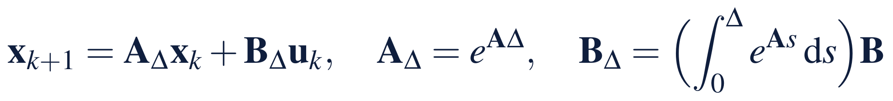
Exact clocks, and how far a model can see
§7.3 · PROPOSITION 7.2 · THEOREM 7.1
Meridian's forecastable horizon
PROPOSITION 7.2
Exact Discretization
Capability is measured to within 5 points; decisions need it within 15; its dynamics have sensitivity 0.5 a year
The horizon (1/L) ln(15/5) = 2 ln 3 is about 2.2 years
Halving the measurement error adds 1.4 years; faster dynamics buy shorter sight
A model that violates the wall condition fails verification
Inputs held within each period: a continuous linear company's quarterly readings follow the discrete law exactly
For nonlinear dynamics the correspondence is only approximate, and the approximation must be declared
Theorem 7.1. One trajectory from each start; two trajectories drift apart at most like e^{Lt}; dynamics that respect the walls keep the company within its bounds
Notes:
Proposition 7.2 and Theorem 7.1; formal statements and proofs in Online Appendix 7.B, with the horizon worked in 7.B.1. The start-up's quarterly map of Chapter 5 is the Euler approximation of its logistic law: it compounds at 22.5 percent a quarter while small against about 25 percent for the law, and stands at 58.1 at year 5; with a monthly step the gap is 2.1, with a weekly one 0.5 (Online Appendix 7.B.4).

Slide 9
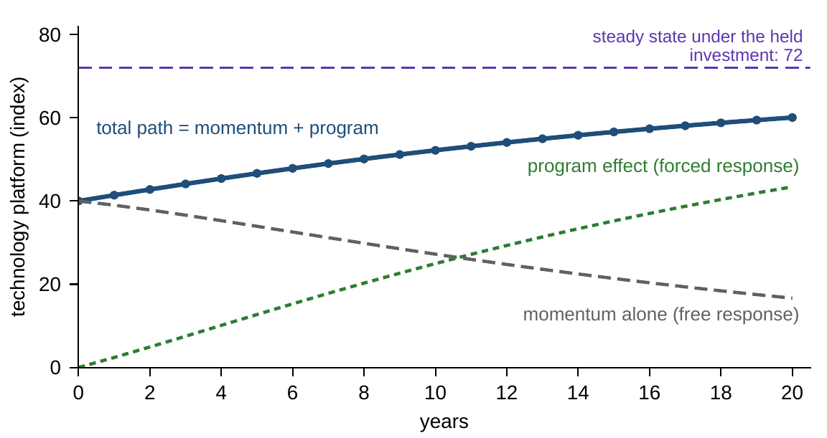
The path is momentum plus program
§7.4 · THEOREM 7.2(I) · FIGURE 7.1
Theorem 7.2(i). In the linear regime the path is exactly the free response plus the forced response
Three-reading company, held investment of 8 a year: momentum alone lets technology erode from 40 to 27 over ten years
The program adds 25, and the company ends at 52, on its way to the steady state of 72
Outside the linear regime the split fails: attribution disputes are structural, not accounting, problems
Figure 7.1. The technology reading of the three-reading company of Equation 3.2 under a held investment of 8 a year: free response, forced response, and their sum.
Notes:
Theorem 7.2(i), Equation 7.4 and Figure 7.1; proof in Appendix 7.A. Where momentum takes us and what the program adds are the two exact terms of Equation 7.4: computable, attributable, and additive. With saturation, thresholds or network effects the split fails.

Slide 10
What lenders can see is a matter of rank
§7.4 · THEOREM 7.2(III) · ONLINE APPENDIX 7.B.2
rank 4
±480
rank 3
the covenant package, liquidity and leverage, when technology feeds capability and capability feeds liquidity
uncertainty on technology after four quarters of certificates; still ±6 after forty
if technology feeds nothing: no record of certificates, however long, reveals the platform
Theorem 7.2(iii). Knowing the inputs, an outsider reconstructs the state from n periods of outputs exactly when the observability matrix has rank n
Technology reaches reported liquidity after two quarters, with weight 0.002: visible in principle, invisible in practice for years
Disclosure design is the choice of C: one reading of technology, or a KPI that loads on it, restores full rank
Notes:
Theorem 7.2(iii), Equation 7.5 and Online Appendix 7.B.2, with one unit of error on each reported number (one standard error: about 480 after four quarters, 37 after twelve, 14 after twenty, 6 after forty). A lender who needs to see the technology platform should ask for a reading of it rather than wait for it to surface in cash.

Slide 11

Held policies choose steady states
§7.5 · THEOREM 7.3 · EQUATION 7.6
exactly one steady state for every held input when 1 is not an eigenvalue of A
Steady states are chosen, not found: the policy map is management's long-run instrument panel
Each unit of yearly investment held forever adds 10.5 points of capability, 9 of technology and 7.1 of efficiency
A held investment of 8 settles the company at (84, 72, 57) against (50, 40, 60) today: efficiency, with no investment of its own, ends lower
Proposition 7.4. A logistic company has two equilibria, 0 unstable and κ stable: a plan that extends the early exponential past κ/2 contradicts its own model
Notes:
Theorem 7.3 and Proposition 7.4; proofs in Online Appendix 7.B, with the policy map worked in 7.B.3. An eigenvalue at 1 marks a direction with no restoring force, along which a held policy pins nothing. The start-up's exponential plan forecasts 443 at year 6, more than four times the entire market (Online Appendix 7.B.4).

Slide 12
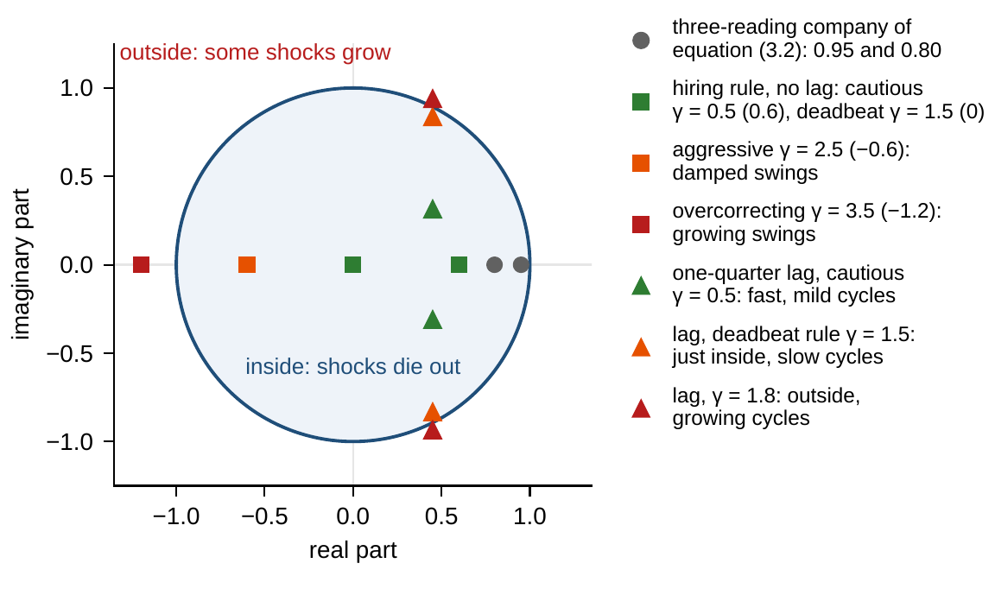
Inside the unit circle, shocks die out
§7.6 · THEOREM 7.4 · FIGURE 7.2
Theorem 7.4. Shocks die out when every eigenvalue lies inside the unit circle (discrete time) or has negative real part (continuous time)
The rate is a budget: the slowest eigenvalue, 0.95, leaves half of any shock after 13.5 years
Lyapunov's method: an index that is positive off target and falls every period certifies stability, with no eigenvalues
Remark 7.1: a stable linear company always has a quadratic health index x^{T}Px
Figure 7.2. The three-reading company and Meridian's hiring loop under different rules, with hires acting at once or a quarter late, against the unit circle.
Notes:
Theorem 7.4 and Remark 7.1; proof in Appendix 7.A. In such a company programs show their full effect only over a decade. Boards run informal Lyapunov arguments whenever they track a recovery scorecard and ask only that it improve every quarter; the theorem says what that practice, done exactly, proves.

Slide 13
Name the regime, then budget the recovery
§7.6 · TABLE 7.3
Class | Test (linear; general) | Business reading
Exponentially stable | all eigenvalues inside the unit circle (discrete) or with negative real part (continuous); a strictly decreasing health index | shocks die out at a computable rate; convergence budgets exist
Stable only | eigenvalues on the boundary, without repeated blocks; a non-increasing health index | shocks neither die out nor grow; drift without restoration
Unstable | some eigenvalue outside the circle or with positive real part | some deviations feed on themselves; a reinforcing loop dominates
Saddle | eigenvalues on both sides | knife-edge: stable in some directions, fleeing in others
Table 7.3 completes Table 5.3 with the tests of Theorem 7.4.
A leadership team that claims resilience is claiming eigenvalues inside the circle with a stated margin.
Notes:
Table 7.3 and Section 7.6. The spectral tests are the diagnosis, the rate is the budget, and Lyapunov's method is the argument without eigenvalues.

Slide 14
Management is a gain: read the chart
§7.7 · THEOREM 7.5 · TABLE 7.4
Gain range | Coefficient a − bγ | Behavior | Managerial reading
γ ≤ (a − 1)/b | 1 or more | divergence persists | undercorrection
(a − 1)/b < γ < a/b | between 0 and 1 | steady convergence | calibrated steering
γ = a/b | 0 | one step (deadbeat) | fastest; brittle to model error and delays
a/b < γ < (a + 1)/b | between −1 and 0 | damped swings | aggressive but stable
γ ≥ (a + 1)/b | −1 or less | growing swings | overcorrection: steering causes the swings
One reading, x′ = ax + bu, under the rule u = −γx, with a > 0 and b > 0 (Theorem 7.5(ii)).
Feedback changes the law: the closed loop is a different system, stable exactly when |a − bγ| < 1.
Notes:
Definition 7.10, Proposition 7.5 and Theorem 7.5; proof in Appendix 7.A. Two management teams identical in the record can differ precisely where the record never went, in the crisis states. The deadbeat gain sits on a knife-edge: its virtue evaporates under model error and delays. Committees that retune a rule at every meeting run a second loop with its own overcorrection threshold (Online Appendix 7.B.8).

Slide 15
How hard should Meridian steer its hiring?
WORKED EXAMPLE 7.1 · THE SITUATION
The digital program
Human resources
Chief operating officer
The engineering bench is 100 short of target
Approve hires equal to γ times the gap
How large should γ be?
Retraining and internal moves close 10 percent of any gap each quarter.
60 percent of approved external hires are productive within the quarter.
Close the gap fast, without a hiring boom and bust.
The whole design question is one coefficient: how much of the gap survives each quarter under the rule.
Notes:
Worked Example 7.1, the situation. The gap is the bench minus the target, so Meridian starts at −100.

Slide 16
Write the loop, then read the chart
WORKED EXAMPLE 7.1 · STEPS 1–2
90 percent of the gap carries over; approvals arrive at 60 percent within the quarter
Step 2: stable for gains below 1.9/0.6 ≈ 3.17; the deadbeat gain 0.9/0.6 = 1.5 closes the gap in a single quarter
Gains between 1.5 and 3.17 overshoot and swing back with shrinking swings
Above 3.17 the rule overcorrects: at 3.5 a shortfall of 100 becomes a surplus of 120, then a shortfall of 144
A hiring spree, a freeze, a bigger spree: the controller causes the oscillation
Notes:
Worked Example 7.1, Steps 1–2, and Table 7.4 with a = 0.9 and b = 0.6 (Theorem 7.5(ii)).

Slide 17
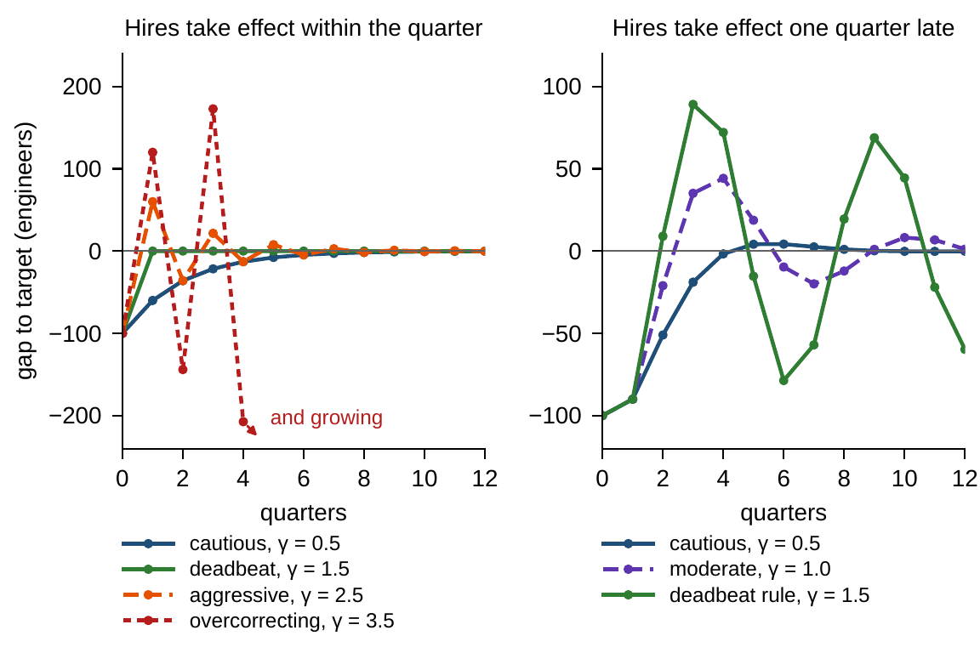
A quarter's delay makes the deadbeat rule cycle
WORKED EXAMPLE 7.1 · STEPS 3–4 · FIGURE 7.3
Step 3: approvals take a quarter to arrive; the closed loop has two eigenvalues, and the safe range shrinks from γ < 3.17 to γ < 1.67
Step 4: the deadbeat rule is barely stable, modulus 0.95: 89 too many in quarter 3, 79 too few in quarter 6
The cycle repeats about every six quarters and is still more than 10 engineers off a decade later
The cautious rule, γ = 0.5, is now the fastest: within 10 engineers by quarter 4
Figure 7.3. Meridian's hiring gap under different rules. Left: hires take effect within the quarter. Right: hires take effect a quarter late.
Notes:
Worked Example 7.1, Steps 3–4, and Figure 7.3. With the delay the eigenvalues are the roots of z² − 0.9z + 0.6γ = 0, of modulus √(0.6γ) when complex; Online Appendix 7.B.6 derives the condition and 7.B.7 works the cycle: period 5.8 quarters, swings halving only every 13.

Slide 18
The gap by quarter under each rule
WORKED EXAMPLE 7.1 · TABLE 7.5
Rule (engineers, bench minus target) | 0 | 1 | 2 | 3 | 4 | 5 | 6 | 7 | 8
Cautious, γ = 0.5 | −100 | −60 | −36 | −22 | −13 | −8 | −5 | −3 | −2
Deadbeat, γ = 1.5 | −100 | 0 | 0 | 0 | 0 | 0 | 0 | 0 | 0
Overcorrecting, γ = 3.5 | −100 | 120 | −144 | 173 | −207 | 249 | −299 | 358 | −430
Cautious, γ = 0.5, late hires | −100 | −90 | −51 | −19 | −2 | 4 | 4 | 3 | 1
Deadbeat rule, γ = 1.5, late hires | −100 | −90 | 9 | 89 | 72 | −15 | −79 | −57 | 19
Quarters 0 to 8. Late hires: approvals take effect one quarter late.
Without the delay the fastest rule is γ = 1.5; with it, the same rule produces a boom and bust that lasts years.
Notes:
Table 7.5. The overcorrecting row alternates and grows by a factor of 1.2 a quarter; with the delay the deadbeat rule's gap swings from 89 too many to 79 too few within three quarters.

Slide 19
Calibrate the rule to the delays you have
WORKED EXAMPLE 7.1 · WHAT THE BOARD SHOULD TAKE AWAY
1.67
0.95
0.5
the largest safe gain once hires arrive a quarter late, against 3.17 without: the safe range halves
the deadbeat rule's modulus with the delay: a hiring boom and bust that lasts years
a gain near the cautious rule: slowest without the delay, it settles fastest with it
Steering harder is not monotonically better: compute the critical gain before setting policy rather than discovering it in the headcount
A committee that retunes the gain at every review runs a second loop: retuned too hard, the rule itself swings ever wider (Online Appendix 7.B.8)
For discussion: where else does Meridian steer with a delay (pricing, inventory, capital spending), and what would a one-quarter delay do to the rules it uses there?
Notes:
Worked Example 7.1, what the board should take away, and the discussion question. The gain with the smallest modulus, about 0.34, is slower from Meridian's starting gap: within 5 engineers by quarter 7, against quarter 4 for 0.5 (Online Appendix 7.B.7).

Slide 20

Steering Meridian through time, in AXIOM
AXIOM LAB 1.7 · MODULE AXIOM-07
Meridian's executive committee is setting three standing policies for the next two years: capability investment, how aggressively to hire against the engineering gap, and what to report to lenders beyond the covenant package. Open AXIOM, choose Lab 1.7 and load the Meridian dynamics.
1
2
3
4
5
Check the clock
Split the path
Probe the disclosure
Tune the hiring rule
Certify with a health index
Sample a continuous model quarterly; compare exact discretization with a step-by-step approximation.
Separate free and forced responses; move the held investment along the policy map.
Choose the lender package row by row; watch the rank and the invisible directions.
Sweep the gain through every regime of Table 7.4, then add a one-quarter delay.
Test whether a scorecard of your choosing falls every quarter along simulated paths.
Deliverable: a one-page memo to the executive committee recommending the investment level and its steady state, the hiring gain and its margin from instability with and without the delay, and one disclosure change with what it reveals. About 45–60 minutes.
Notes:
AXIOM Lab 1.7. What to look for: the program's contribution grows while momentum fades (Theorem 7.2(i)); readings that feed nothing reported stay invisible however long the record (Theorem 7.2(iii)); and the delay halves the safe range of hiring gains (Theorem 7.5).

Slide 21
What to carry forward
KEY TAKEAWAYS
1
A dynamic model declares its law, its time scale, and its class; continuous and quarterly descriptions of a linear company are exact translations of each other, and measurement error limits how far any model can see.
2
In the linear regime a company's path is exactly momentum plus program; outside it, attribution disputes are structural, not accounting, problems.
3
What outsiders can learn is a rank: readings that feed nothing reported stay invisible forever, and disclosure design is the choice of what to report.
4
Held policies choose steady states through the policy map; eigenvalues inside the unit circle mean that shocks die out, at a rate that budgets recovery.
5
Management is a feedback rule: undercorrection persists, calibration converges, overcorrection manufactures swings, and delays shrink the safe range.
Notes:
Key Takeaways, Chapter 7.

Slide 22
Notebook and workbook reproduce the book
THIS WEEK'S LABORATORY
75
94
26107
AXIOM-07
notebook checkpoints, every one PASS
workbook checks against the engine, ALL PASS
the lab's seed
AXIOM Lab 1.7
Notebook DCT_V1_Ch07_Lab.ipynb: Worked Example 7.1 and the lab's five steps in eight panels, ready for Colab
Workbook DCT_V1_Ch07_Lab.xlsx: the clock, the split, the policy map, the covenant rank, the hiring loop with and without the delay, and Lyapunov certificates, in formulas
Every number on these slides is the book's, and both companions check it
Notes:
The notebook and workbook are on the course website, www.dynamiccorporatetransformation.com. The lab's seed 26107 is used only for the new draws of the health-index step, labelled as such.

Slide 23
Chapter 8 gives the future a distribution
NEXT · CHAPTER 8
The environment inputs get probabilities: the honest forecast is a distribution, and the fan chart evolves by exact rules (Equation 8.5)
A stable company is not still: under continual shocks it carries a volatility budget, the solution of a Lyapunov equation
Industrial Systems' revenue: shocks of $15m become a $21m volatility budget once their persistence is counted
Worked Example 8.1: a liquidity trough that looks comfortable breaches the board's floor in about one future in four
Notes:
Chapter 8, Stochastic Enterprise Dynamics: Theorem 8.3 (Diffusion Representation) carries this chapter's linear company into uncertainty, and its Lyapunov equation is Remark 7.1's with the noise as Q.

