Slide 1
Nonlinear and Mixed-Integer Enterprise Optimization
VOLUME II · CHAPTER 4 · WEEK 9
Beyond convexity, optimization keeps its questions and loses its guarantees: what survives, and how to manage the rest
Graduate course companion · Lab seed 26204 · AXIOM Lab 2.4 (AXIOM-04)
Notes:
Volume II, Chapter 4. Chapter 3 gave convex instances four promises; most enterprise instances break convexity somewhere. This chapter renegotiates the promises for smooth nonconvex and lumpy instances.

Slide 2
“One thing a person cannot do, no matter how rigorous his analysis or heroic his imagination, is to draw up a list of the things that would never occur to him!”
Thomas C. Schelling
Nobel Memorial Prize in Economic Sciences 2005; in Managing Nuclear Operations (1987)
Notes:
No number of starts can list the basins a search missed: the impossibility theorem of the epigraph. A bound can (Section 4.4).

Slide 3
After this chapter, you can
LEARNING OUTCOME STATEMENTS
4.1
Explain what is lost beyond convexity—local optima that are not global, optimality conditions that mark candidates, prices that hold only nearby, gaps that no price list closes—and trace each loss to products of decisions, economies of scale, or lumpy choices.
4.2
Test whether a plan is locally best with first- and second-order conditions, and tell a local maximum from a saddle point.
4.3
State when the KKT conditions are necessary, read multipliers as local prices and their sensitivities, and explain what happens to prices when a constraint qualification fails.
4.4
Search a nonconvex landscape with local methods and many starting plans, report the inventory of local optima, and bound the best of them with a convex relaxation.
4.5
Formulate lumpy decisions as a mixed-integer instance, solve it by branch-and-bound with a stated optimality gap, and use cutting planes and Lagrangian or Benders decomposition when it is large.
Notes:
The five learning outcome statements; LOS Guidance at the end of the chapter.

Slide 4
Six sections, a worked example and a lab
ROADMAP
§4.1
§4.2
§4.3
§4.4
What Is Lost Beyond Convexity
Local Answers
Multipliers and Local Prices
Searching Smooth Landscapes
Proposition 4.1 · Table 4.1
Theorem 4.1 · Proposition 4.2
Theorems 4.2–4.3
Table 4.2 · multistart
§4.5
§4.6
Worked Example 4.1
AXIOM Lab 2.4
Lumpy Decisions and Branch-and-Bound
Decomposition, and the Road to Policies
Can Meridian Automate Part of a Line?
Local Search, Bounds, and Branch-and-Bound
Theorem 4.4 · Table 4.3
Theorem 4.5
Table 4.4 · Figures 4.1, 4.3
AXIOM-04 · five steps
Notes:
Formal statements and proofs of Theorems 4.1, 4.2 and 4.4 are in Appendix 4.A; Propositions 4.1-4.3 and Theorems 4.3 and 4.5 in Online Appendix 4.B, with the numbers behind Worked Example 4.1 (Example 4.B.3).

Slide 5
Beyond convexity, the guarantees go
§4.1 · PROPOSITION 4.1
Three doors, and Meridian's witnesses
PROPOSITION 4.1
What Is Lost Beyond Convexity
Products of decisions: each automation round closes a share of the remaining gap, so rounds multiply
Economies of scale and thresholds: costs that rise less than in proportion; minimum scales
Lumpy choices: tranches, whole quarters and yes-or-no programs split the region into pieces
Part (iii): with a $60m cap, half a round, the program is worth $150m; the best price list says $650m
Every convex instance with differentiable data is a NEO problem (Definition 4.1). Beyond convexity:
(i) a smooth instance can have strict local maxima of different values, and KKT points that are not maxima
(ii) when every decision is lumpy, every feasible plan is a local maximum
(iii) the best ceiling a price list gives can exceed the best value, with room to spare in every commitment
(iv) a blend of two feasible plans can be infeasible, even when every function is smooth
Notes:
Proposition 4.1; formal statement and proof in Online Appendix 4.B. Part (i)'s witness is Worked Example 4.1's three locally best plans and its saddle; part (iv) is Volume I's minimum efficient scale: blends of admissible configurations need not be admissible, so negotiated compromises need a new review.

Slide 6
Chapter 3's promises, beyond convexity
§4.1 · TABLE 4.1
Promise of a convex instance | Smooth, nonconvex | Lumpy
a local answer is global | several local maxima; bracket the best with a ceiling (Section 4.4) | every lumpy plan is locally best; search with bounds (Section 4.5)
the KKT conditions certify | they mark a candidate; add the second-order test (Theorem 4.1) | they say nothing about the lumpy choices
multipliers exist | under a constraint qualification (Theorem 4.2) | only for the continuous part
prices are global ceilings | local slopes (Theorem 4.3) | none: values move in steps
the best price list closes the gap | a gap can remain; relaxations and price lists still bound | the gap is the search's stopping rule (Theorem 4.4)
computing time is predictable | fast to a local answer; slow to a proved global one | can grow exponentially; stop at a declared gap
Notes:
Table 4.1: Chapter 3's promises beyond convexity, and what this chapter puts in their place. Read it row by row: global answers, certificates, multipliers, prices, gaps and computing time.

Slide 7
Audit a local answer at two orders
§4.2 · THEOREM 4.1
For Meridian
THEOREM 4.1
Local Optimality Theorem
Three plans pass every local test, worth $2,986.25m, $2,977.50m and $2,968.75m
A fourth passes first order: years 1–3 whole, 0.75 of a round in year 4, 0.84 in year 5
Moving t of a round from year 5 to year 4 adds 96.25t²: a saddle, about $1m for a tenth
The audit proves a plan best among its neighbors, never best overall
(i) First order. At a local maximum no feasible direction improves the objective at first order
(ii) Second order. Along a feasible line, slope zero and curvature not upward
(iii) Certificate. A KKT point whose Lagrangian curves strictly down along every critical direction is a strict local maximum
Notes:
Theorem 4.1; formal statement and proof in Appendix 4.A. Solvers check part (iii) by projecting the Hessian of the Lagrangian onto the critical directions: all eigenvalues negative certifies; a positive one is a saddle, and its eigenvector a direction of escape. At a corner where every binding bound carries a positive price there are no critical directions: the case of every local maximum in the Worked Example.

Slide 8
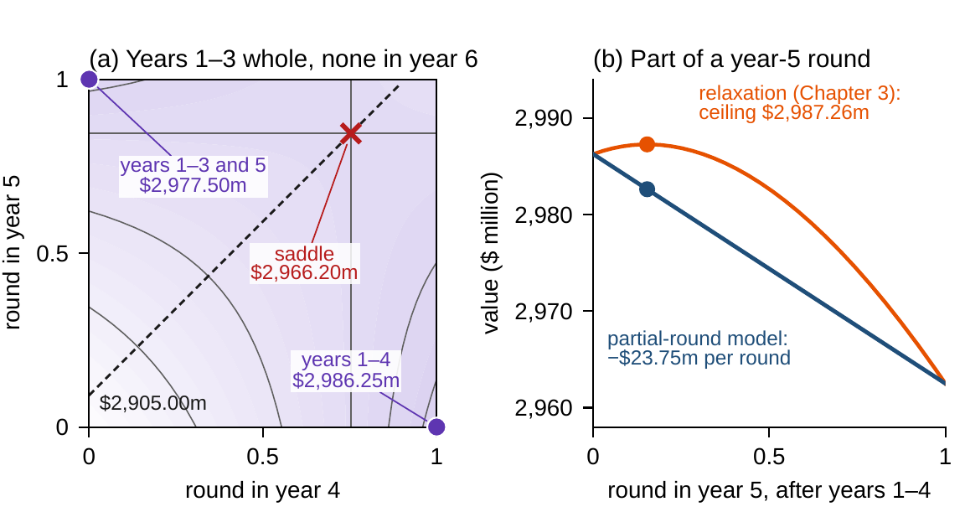
When decisions multiply, look at corners
§4.2 · PROPOSITION 4.2
(i) Part measures are blends. Part of a decision is worth the same blend of its two limits
(ii) Corners suffice. A best plan exists at a corner of the box
(iii) Every strict local maximum is a corner; a corner is one when each marginal value points out
(iv) A stationary plan inside the box is a saddle
A pilot at half scale earns half the difference between none and all: the funding threshold
Chapter 3's 0.15 of a year-5 round, read for partial rounds, loses $3.64m
Figure 4.1. (a) Years 4 and 5 vary: V = 2,905 + 81.25x + 72.5y − 96.25xy, two corner peaks and the saddle (0.75, 0.84). (b) Part of a year-5 round: a straight line under the relaxation's $2,987.26m.
Notes:
Proposition 4.2; formal statement and proof in Online Appendix 4.B. Part (i) is the arithmetic of half-measures: it defeats a governance process that funds a little, observes, and funds in proportion. The dashed line in panel (a) separates the plans from which an ascent reaches each corner.

Slide 9
Prices exist under a qualification
§4.3 · DEFINITION 4.3 · THEOREM 4.2
Reading the prices
THEOREM 4.2
KKT Theorem under Constraint Qualifications
LICQ: binding gradients independent; each commitment can be relaxed alone
MFCQ: the binding commitments can be relaxed together
Budgets, balances, ranges and box limits are affine: no further check
Write either-or rules with a binary: hires × layoffs = 0 has no determined price
(i) Unique prices. Under LICQ a local maximum is a KKT point with unique multipliers
(ii) Bounded prices. Under MFCQ its multipliers form a bounded set
(iii) Linear commitments need no qualification
(iv) Without a qualification multipliers can fail to exist, or be unbounded
Notes:
Definition 4.3 and Theorem 4.2; formal statement and proof in Appendix 4.A. LICQ implies MFCQ, and in a convex instance a Slater plan gives MFCQ at every feasible plan (Online Appendix 4.B.1). A commitment squared to hold exactly, u² ≤ 0, has no price at all.

Slide 10
Prices are slopes, valid near the plan
§4.3 · THEOREM 4.3
$122.5m
10.71
$131.25m
a year of credit with three rounds: their year-6 savings, best from 2.86 to 10.71 years
years of credit where four rounds overtake three: the best plan jumps
a year of credit with four rounds, best from 10.71 to 25.43 years
(i) Under LICQ, the certificate and positive prices, plan and prices move smoothly with the data
(ii) The local value moves at the rate the parameter moves the Lagrangian: multipliers are local prices
(iii) A zero price allows a kink; (iv) where local values cross, the best plan jumps
A price read at nine years understates the value of credit at twelve: say which plan a report describes
Notes:
Theorem 4.3; formal statement and proof in Online Appendix 4.B. With whole rounds, Meridian's best automation plan runs three rounds at credits from 2.86 to 10.71 years and four from 10.71 to 25.43 (Worked Example 2.1). A sensitivity report must say which plan it describes and where that plan stops being best.

Slide 11
Local methods return a KKT point
§4.4 · TABLE 4.2
Method | Each iteration | Returns | When to use
SQP | solves a quadratic model of the Lagrangian with linearized commitments | a KKT point; fast near a certified one | moderate size; good starting plans
interior point (IPOPT) | a Newton step on barrier-perturbed KKT conditions | a KKT point | large, sparse, smooth instances
augmented Lagrangian | maximizes a penalized Lagrangian, then raises prices of violated commitments | a KKT point and its prices | hard equalities; divisions
multistart | a local method from many starting plans | an inventory of local maxima, with no proof | always, with a bound
spatial branch-and-bound | convex relaxations on shrinking boxes | a best plan, with a gap | few nonconvex terms
branch-and-cut | relaxations, branching, and valid inequalities | a best lumpy plan, with a gap | lumpy decisions
Lagrangian relaxation | prices shared commitments; solves divisions apart | a ceiling | many divisions sharing resources
Benders decomposition | a lumpy master; convex subproblems return price cuts | a best plan, with converging bounds | lumpy outside, convex inside
Notes:
Table 4.2: methods beyond convexity. Each local method returns a KKT point, and which one depends on where it starts. The augmented Lagrangian is the logic of a treasury that raises an internal price until divisions comply.

Slide 12
Search, audit, bound, then close the gap
§4.4 · THE PRODUCTION DISCIPLINE
Five steps for a nonconvex answer, with Worked Example 4.1's numbers.
1
Declare the source
2
Run a multistart
3
Audit each answer
Products of decisions, economies of scale or lumpy choices (Proposition 4.1).
With a recorded seed, and report the inventory: three basins, reached by 87, 11 and 2 of 100 runs.
First and second order (Theorems 4.1 and 4.2): three strict local maxima and a saddle.
4
Bound the inventory
5
Close the gap
With a relaxation or a price list: a ceiling of $2,987.26m, a gap of $1.01m.
By branch-and-bound, only if the gap exceeds the decision's materiality: five convex solves.
Notes:
Section 4.4's computational box. If a basin attracts a share v of random starts, N starts all miss it with probability (1 − v)^N: a basin that attracts 5 percent needs about 59 starts for 95 percent confidence. No number of starts can list the basins it missed; a convex relaxation or a price list bounds every plan, found or not.

Slide 13
Write lumpy choices with true ranges
§4.5 · TABLE 4.3 · PROPOSITION 4.3
Declaration | Formulation | Example
yes-or-no program | value v·y, cost c·y | an automation round (Worked Example 2.1)
tranches; whole quarters | x = 50n, n integer, 0 ≤ n ≤ 8 | the standby line; the build's delay (Worked Example 1.1)
set-up charge | cost F·y + c·x, with x ≤ U·y | opening a route; starting a line
minimum scale | L·y ≤ x ≤ U·y | the legacy platform: shut, or 60 to 100
at most k of n programs | the sum of the n binaries ≤ k | a transformation portfolio
if A, then B | y(A) ≤ y(B) | a round only past the capability gate
either-or commitments | g₁(x) ≤ M·y, g₂(x) ≤ M(1 − y) | hire or lay off in a quarter, not both
piecewise-linear cost | one binary per segment, segments filled in order | volume discounts
Proposition 4.3: each row is exact; true ranges give set-up charges and minimum scales their convex hull.
Notes:
Definition 4.4, Table 4.3 and Proposition 4.3; proof in Online Appendix 4.B. Binary y, lever x with range [0, U], minimum scale L, set-up charge F. Declare the true range of every lever: a loose big M lets the relaxation run a lever at full scale for a sliver of its set-up charge, so the bound is loose and the search long.

Slide 14
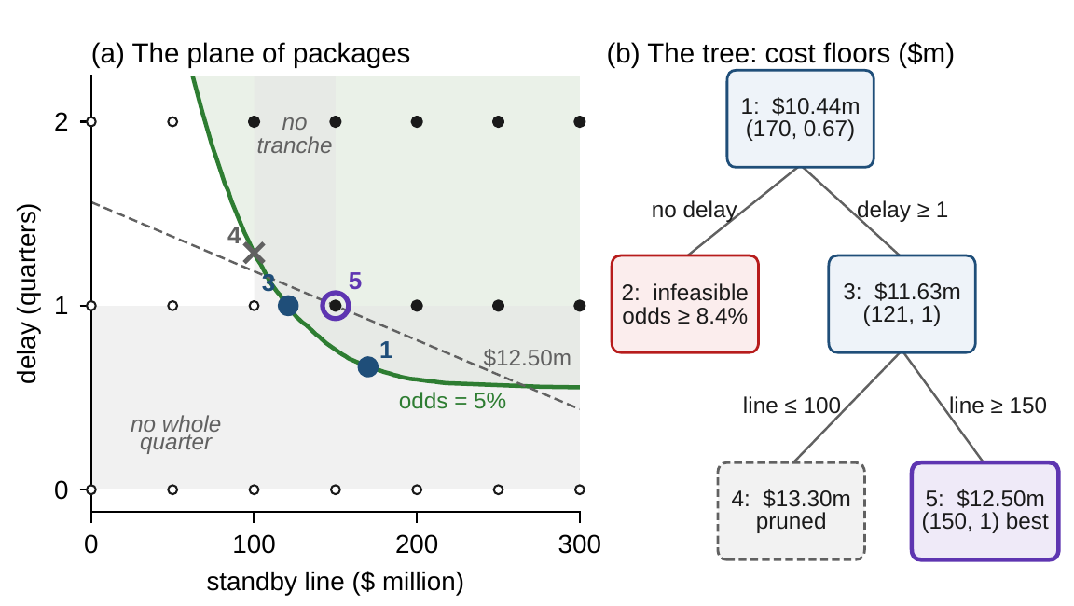
Branch-and-bound certifies at every stage
§4.5 · THEOREM 4.4
(i) The best value lies between the incumbent and the largest open bound: a valid gap
(ii) A node whose bound cannot beat the incumbent is pruned safely; (iii) a lumpy answer settles it
(iv) The search ends with a best plan, or stops within a declared gap; (v) tighter bounds prune more
Worked Example 1.1's package: five nodes, not 63 packages; the lumps cost $2.06m
The cut 'delay at least one quarter' closes $1.19m of that gap before any branching
Figure 4.2. Line fees and delay at breach odds of at most 5 percent, the line in $50m tranches, the delay in whole quarters. Node 2 is infeasible; node 5 settles at $12.50m; node 4 is pruned.
Notes:
Theorem 4.4; formal statement and proof in Appendix 4.A. For costs, bounds are floors and the inequalities reverse. Node 1 is Volume I's continuous answer, $10.44 million at a $170 million line and 0.67 quarters; the node with no delay is infeasible, the line alone leaving the odds at 8.4 percent at best. Declare the stopping gap in money: 0.01 percent is $1,250 on the package, about $0.3 million on Meridian's automation value. Lumps have no prices.

Slide 15
Lumpy outside, convex inside: decompose
§4.6 · THEOREM 4.5
For Meridian
THEOREM 4.5
Decomposition Theorem
A dozen plants deciding every quarter for six years: 288 choices, 2²⁸⁸ schedules
The $60m cap: the best price list's $650m is tighter than Chapter 3's $746m, yet far above $150m
Benders keeps the liquidity plan out of the search over schedules and returns its prices as cuts
Rules with parameters turn policy design into a NEO problem; Part II exploits time
(i) Lagrangian bounds separate. Priced coupling commitments give a ceiling, division by division
(ii) Their strength. The best such ceiling is never weaker than the continuous relaxation, often stronger
(iii) Benders. A lumpy master with price cuts from convex subproblems ends with a best plan
Notes:
Theorem 4.5; formal statement and proof in Online Appendix 4.B. Lagrangian decomposition is the center pricing a shared resource and letting each division choose; Benders decomposition is the board choosing lumpy strategic options while operations solve the convex remainder and report what each option is worth at the margin.

Slide 16
Can Meridian automate part of a line?
WORKED EXAMPLE 4.1 · THE SITUATION
Part rounds
Many answers
A proof
Is part of a round worth running?
Which of the optimizer's answers should the board trust?
Can the best plan be proved without enumerating every plan?
A fraction z of a round costs $120m × z and closes z/2 of the remaining gap.
Her planners' optimizer, started from different plans, returns different answers.
At twenty years' credit the relaxation runs 0.15 of a year-5 round.
The chief operating officer's three questions, now that the board credits twenty years of year-6 savings.
Notes:
Worked Example 4.1, the situation. At twenty years' credit the relaxation's ceiling is $2,987.26 million and the best whole-round plan, years 1 to 4, is worth $2,986.25 million (Table 3.5). All amounts are undiscounted.

Slide 17

Rounds multiply: affine in each round
WORKED EXAMPLE 4.1 · STEPS 1–2
the cash freed above $470m plus twenty years of the year-6 savings; payouts wait, so the floors keep $85m
Step 1: part of a round is a blend of none and a whole one: Chapter 3's 0.15 of a year-5 round is worth $2,982.61m, $3.64m less than none
Chapter 3's exponential form overstates part rounds, 2^{−z} ≤ 1 − z/2: its relaxation is a ceiling, not a plan
Step 2: SLSQP from 100 random starts ends at three plans, each passing the KKT audit with zero residuals
A fourth candidate is a saddle: moving t of a round from year 5 to year 4 adds 96.25t²
Notes:
Worked Example 4.1, Steps 1-2. The gap after year k is 14 times the product of (1 − z_j/2): Volume I's recursion read for fractions, identical at whole rounds. V is not concave (Chapter 3's chord test fails) but affine in each round, the case of Proposition 4.2. Only box limits bind, so LICQ holds and each plan's multipliers are unique.

Slide 18
Three answers pass every local test
WORKED EXAMPLE 4.1 · TABLE 4.4
Plan | Runs | Value | First order | Second order | Below ceiling
years 1–4 | 87 | 2,986.25 | passes | strict local maximum | 1.01
years 1–3 and 5 | 11 | 2,977.50 | passes | strict local maximum | 9.76
years 1–3 and 6 | 2 | 2,968.75 | passes | strict local maximum | 18.51
years 1–3; 0.75 in year 4; 0.84 in year 5 | 0 | 2,966.20 | passes | saddle | 21.06
ceiling (Chapter 3's relaxation) |  | 2,987.26
Where 100 local searches end at twenty years' credit, $ million, undiscounted. SciPy's SLSQP from 100 random starts (seed 2026, Online Appendix 4.B.3). Ceiling: Chapter 3's relaxation.
The best local answer lies within $1.01m, or 0.03 percent, of the ceiling; no run stops at the saddle.
Notes:
Table 4.4 and Step 4. No number of runs proves that a fourth basin does not exist; Chapter 3's relaxation does: its ceiling bounds every plan of whole or partial rounds, found or not. The other two answers lie $9.76 and $18.51 million below it.

Slide 19
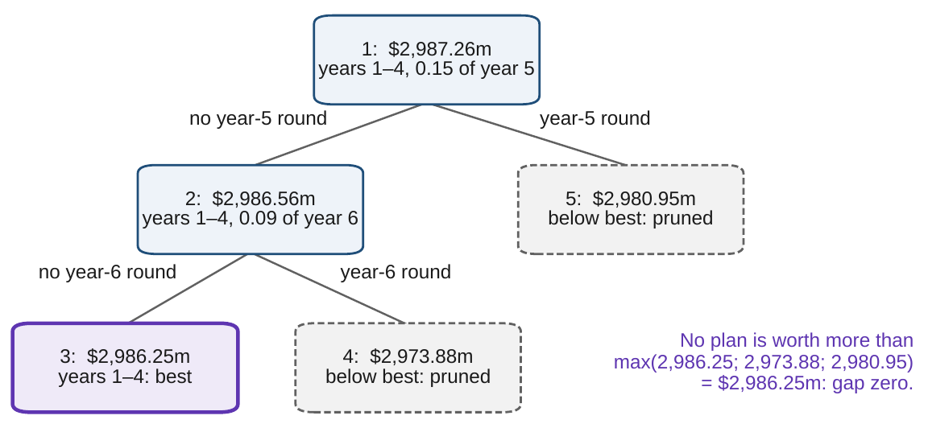
Prices differ by basin; a bound decides
WORKED EXAMPLE 4.1 · STEPS 3–5
Step 3: at years 1–4 the year-4 round earns $81.25m over its cost
Forcing a round into year 5 or 6 there loses $23.75m or $28.13m
At years 1–3 and 5 a year-4 round loses $15.00m, yet the swap gains $8.75m: an interaction of $96.25m
Step 5: without a year-5 round, 0.09 of a year-6 round ($2,986.56m); without either, years 1–4
Ceilings of $2,973.88m and $2,980.95m are pruned: five convex solves, gap zero
Figure 4.3. Branch-and-bound over whole rounds at twenty years' credit, Chapter 3's relaxation as each node's ceiling: years 1–4 at node 3 is the incumbent; nodes 4 and 5 are pruned.
Notes:
Worked Example 4.1, Steps 3-5. Local prices answer what a small change from here costs, not whether a better basin exists (Theorem 4.3(ii)). The incumbent is settled by Theorem 4.4(iii), the pruning by part (ii). At ten years' credit the same search proves Chapter 3's three-round plan best in seven solves.

Slide 20
Four whole rounds, and ask for the gap
WORKED EXAMPLE 4.1 · WHAT THE BOARD SHOULD TAKE AWAY
$2,986.25m
5
10.71–25.43
four whole rounds in years 1–4: proved best of whole or partial rounds
convex solves prove it: no enumeration, gap zero
years of credit for which the answer holds (Step 6)
Part rounds are not worth running: when rounds multiply, a fraction of a round earns the same fraction of the difference between none and a whole one
An optimizer's answer depends on where it starts; only a bound settles which is best. Ask for the ceiling and the gap with every optimizer's answer
For discussion: if a line's first stations were the most valuable to automate, would part rounds pay?
Notes:
Worked Example 4.1, Step 6 and what the board should take away. The three local maxima all run four rounds by year 6, so their values rise together, by $131.25 million per year of credit. Discussion: which chapter's methods would you use, and why might a planning team that starts its optimizer from last year's plan keep finding the same basin?

Slide 21

Search, bound and branch, in AXIOM
AXIOM LAB 2.4 · MODULE AXIOM-04
Meridian's chief operating officer can automate plant lines in part, and her planners' optimizer returns different plans from different starts. The chief financial officer wants the inventory, an audit of each plan and a proof of the best before the board meets. Open AXIOM, choose Lab 2.4 and load the Meridian partial-round instance.
1
2
3
4
5
Explore
Search
Audit
Bound
Branch
Draw the value where only years 4 and 5 vary: two corner peaks, the saddle, the Hessian.
Run SLSQP and the interior-point solver from 100 seeded starts; compare inventories and iterations.
Verify the KKT conditions at each answer and the saddle: residuals, LICQ, the reduced Hessian.
Solve Lab 2.3's relaxation and compute each answer's distance from the ceiling.
Fix the year-5 round at none and at whole, re-solve, and continue until every node settles.
Deliverable: a one-page note to the board: the inventory of local answers with their audits, the ceiling and each answer's distance from it, the branch-and-bound certificate, and a recommendation on partial automation. About 75 minutes.
Notes:
AXIOM Lab 2.4. What to look for: different answers from different starts, each passing the first-order audit (Theorem 4.2); a saddle that only the second-order test rejects (Theorem 4.1); local prices that change by basin (Theorem 4.3); and a ceiling that bounds what no run reached, with a tree that closes the gap (Theorem 4.4).

Slide 22
What to carry forward
KEY TAKEAWAYS
1
Beyond convexity the questions stay and the guarantees go: several local maxima, KKT points that are saddles, prices that hold only nearby, and gaps that no price list closes.
2
A local answer is audited in two steps, first order and second order; the audit proves a plan best among its neighbors, never overall.
3
Multipliers exist under a constraint qualification and are local prices: under the second-order certificate and strict complementarity plans and prices move smoothly, and where local values cross the best plan jumps.
4
Search from many starts, report the inventory, and bound it: a convex relaxation or a price list bounds what no start reached, and when decisions multiply, part measures never pay.
5
Lumpy decisions are formulated with binaries and true ranges and solved by branch-and-bound, which certifies a gap at every stage; cutting planes and decomposition scale it, and five convex solves prove Meridian's four-round plan best.
Notes:
Key Takeaways, Chapter 4.

Slide 23
Notebook and workbook reproduce the book
THIS WEEK'S LABORATORY
69
61
26204
AXIOM-04
notebook checkpoints, every one PASS
workbook checks against the engine, ALL PASS
the lab's seed
AXIOM Lab 2.4
Notebook DCT_V2_Ch04_Lab.ipynb: Worked Example 4.1 and the lab's five steps in ten panels, with the $60m cap and the package, ready for Colab
Workbook DCT_V2_Ch04_Lab.xlsx: the partial-round model, the 64 plans, the saddle, the audit, the relaxation and every node of both trees, in formulas
Every number on these slides is the book's, and both companions check it
Notes:
The notebook and workbook are on the course website, www.dynamiccorporatetransformation.com.

Slide 24

Chapter 5 puts time into the instance
NEXT · CHAPTER 5
Today's decisions build stocks that later years inherit, payoffs arrive after their costs, and commitments must hold on every date
Transcription turns the path into one large program: every method of Part I applies, and the multipliers of the dynamics become prices over time
Its Worked Example asks when Meridian should pay its shareholders while it automates
Notes:
Section 4.6's bridge: when decisions become rules, a family of rules with parameters turns policy design into a NEO problem, rarely convex; Part II builds the methods that exploit the structure of time instead. Chapter 5, Dynamic Enterprise Optimization.

