Slide 1
Dynamic Enterprise Optimization
VOLUME II · CHAPTER 5 · WEEK 10
Decide over time with prices that carry each stock's value backward, and a terminal value that stands for continuing
Graduate course companion · Lab seed 26205 · AXIOM Lab 2.5 (AXIOM-05, AXIOM-04)
Notes:
Volume II, Chapter 5, opens Part II. Part I chose Meridian's plans as single decisions; time changes the problem in three ways: decisions build stocks that later years inherit, payoffs arrive later than costs, and commitments must hold on every date.

Slide 2
“Each morning for over eight months I woke up and decided that the next morning would be the day to send the Stiglitz box.”
George A. Akerlof
Nobel Memorial Prize in Economic Sciences 2001; “Procrastination and Obedience” (1991)
Notes:
Akerlof's procrastination, at board level: a board that weighs this year above all later years means to act next year, every year (Section 5.6, Theorem 5.3(iv)).

Slide 3
After this chapter, you can
LEARNING OUTCOME STATEMENTS
5.1
Explain what time adds to an enterprise optimization problem—stocks carried between periods, payoffs that arrive after their costs, commitments on whole paths—and why deciding period by period loses value or breaks commitments.
5.2
Formulate a dynamic instance in discrete or continuous time, with its state, decisions, dynamics, discounting, running and terminal value, and commitments, and say when a best plan exists.
5.3
Transcribe a dynamic instance into a finite program, read the multipliers of its dynamics as prices of stocks over time, and audit intertemporal trade-offs with the rule of equal discounted marginal values.
5.4
Choose a horizon and a terminal value, bound what truncation costs, and recognize the end effects of a missing or inconsistent terminal value.
5.5
Distinguish plans from rules, explain when re-planning confirms a plan and when it reverses it, and judge when a rule is worth more than a plan.
Notes:
The five learning outcome statements; LOS Guidance at the end of the chapter.

Slide 4
Six sections, a worked example and a lab
ROADMAP
§5.1
§5.2
§5.3
§5.4
What Time Adds
Dynamic Instances
Transcription: From Paths to Programs
Prices over Time
Proposition 5.1 · Table 5.1
Definition 5.1 · Proposition 5.2
Theorem 5.1 · Figure 5.1
Proposition 5.3
§5.5
§5.6
Worked Example 5.1
AXIOM Lab 2.5
Horizons and Terminal Values
Plans, Rules, and Re-planning
When Should Meridian Pay Its Shareholders?
Planning over Time: Plans, Rules, and Horizons
Theorem 5.2 · Figure 5.2
Definition 5.2 · Theorem 5.3
Table 5.3 · Figure 5.3
AXIOM-05 · five steps
Notes:
Formal statements and proofs of Theorems 5.1-5.3 are in Appendix 5.A; Propositions 5.1-5.3 in Online Appendix 5.B, with Worked Example 5.1 in numbers (Example 5.B.3).

Slide 5
What changes when an instance unfolds over time
§5.1 · TABLE 5.1
 | Part I instance | Dynamic instance
Decision | a vector, chosen once | a plan (a path of decisions) or a rule (decisions as functions of the state)
Commitments | one check each | one check per period, plus conditions before decisions and at the end
Value | one number | running values discounted period by period, plus a terminal value
Prices | one per binding commitment | one per commitment per period, and one for each stock at each date
Typical failure | a local or lumpy answer reported as best | a myopic decision; a plan that runs the company down at its horizon; a plan reversed when re-made
Time adds stocks, delays, and commitments on whole paths, and takes away the right to decide everything at once.
Notes:
Table 5.1. Stocks: decisions move quantities that persist, so a decision is worth what it leaves to later periods. Delays: an automation round costs $120 million in its year and saves for every year after. Commitments: a floor every year, cash before a round, an end condition.

Slide 6
Deciding year by year breaks commitments
§5.1 · PROPOSITION 5.1
For Meridian
PROPOSITION 5.1
Myopia Fails
The CFO's rule pays out all cash above the $350m floor: $220m in year 1
A round needs $470m on hand, so the program stops after one round
Year 6 ends $120m short of the board's end condition
Judged year by year, no round is ever run: at most $70m of savings in its year against $120m
The repair: charge each year for the stocks it changes, at their prices
(i) Deciding each period for that period alone can break a later commitment, even when plans that keep every commitment exist
(ii) It can lose any share of the best value, even when it keeps every commitment
(iii) It is optimal when no decision moves the stocks on which later periods depend
Notes:
Proposition 5.1; formal statement and proof in Online Appendix 5.B. The CFO's rule is Worked Example 5.1, Step 2. Part (iii) names the repair, Theorem 5.1(iii).

Slide 7
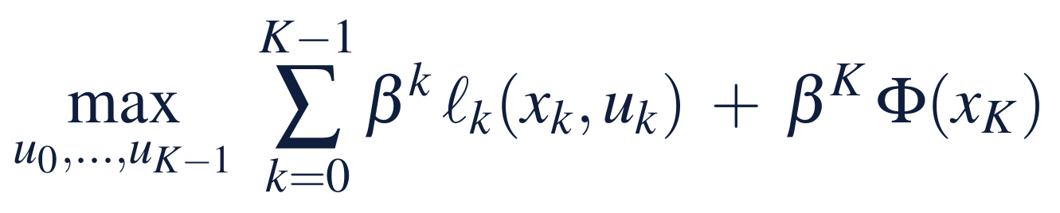
Declare the period, the discount and the end
§5.2 · DEFINITION 5.1
For Meridian
DEFINITION 5.1
Dynamic Enterprise Optimization
State: year-end cash and efficiency; decisions: a round and a payout
A round costs $120m and closes half the gap to 85; a point saves $10m a year
The board declares a 10 percent hurdle rate and savings that continue forever
A best plan exists on any calendar; in continuous time it needs convexity (Proposition 5.2)
Dynamics carry the state from each date to the next
Commitments hold on every date: limits, floors, preconditions, and an end set
Discount β = 1/(1 + r) at the hurdle rate r; in continuous time ρ = ln(1 + r)
Terminal value Φ: what the position the plan leaves is worth to the board
Notes:
Definition 5.1 and Proposition 5.2. Three declarations are new relative to Part I: the period, the discount, and the terminal value. Leaving the terminal value implicit declares it zero.

Slide 8
Commitments take six forms over time
§5.2 · TABLE 5.2
Kind | Meridian | In the program
Path | liquidity of at least $350 million at every year end | one constraint per period
Precondition | a round needs $470 million on hand when it starts | links a decision to the state before it
End | $470 million at the end of year 6, cash for another round | a constraint on the last state
Cumulative | total automation spending under a capital cap (Worked Example 3.1) | a sum over periods
Rate | capability rebuilt by at most 2.5 points a quarter (Volume I, Chapter 10) | a bound on the change between periods
Sequence | the digital build needs capability of at least 55 first (Volume I, Chapter 3) | a logical, often lumpy, constraint
Proposition 5.2: a best plan exists on any calendar of review dates; in continuous time only with convexity.
Notes:
Table 5.2. Commitments take more forms over time than at one date. Proposition 5.2(iii): a lever that can only run flat out or stand idle can approach half speed by alternating ever faster, a value no plan attains.

Slide 9
Transcribe the path into one program
§5.3 · THEOREM 5.1
What it means
THEOREM 5.1
Transcription Theorem
A plan on a quarterly calendar is one the company can carry out; monthly reviews can only help
With prices, judge each year on its own: its value plus the priced change in the stocks
That is myopia repaired, the idea Chapter 6 develops as the maximum principle
Meridian: six lumpy rounds with a linear payout program inside, 64 schedules in all
(i) Floors. A calendar's best value is a floor on the true one, and a finer calendar never lowers it
(ii) Convergence. The floors approach the true value when near-best plans keep the commitments with room to spare
(iii) Prices. The multipliers of the dynamics price every stock at every date, computed backward from the end
(iv) Methods. Linear dynamics give a convex program; nonlinear dynamics a nonlinear one; lumpy decisions a mixed-integer one
Notes:
Theorem 5.1; formal statement and proof in Appendix 5.A. The multipliers are Volume I's costates (Volume I, Theorem 15.4(ii)). The simultaneous form is large but sparse: each equation touches only two consecutive dates.

Slide 10
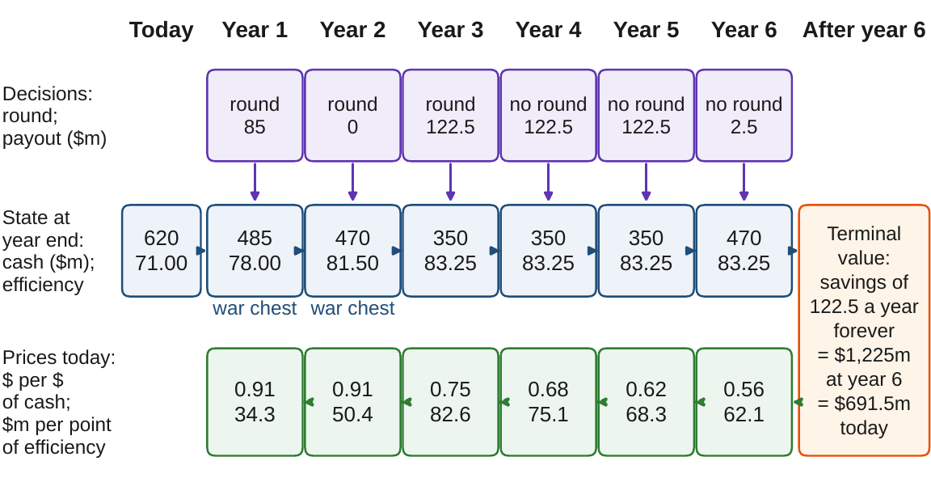
States forward, prices backward
§5.3 · FIGURE 5.1
Each year a round and a payout carry the state, cash and efficiency, forward
Transcription stacks the six years into one program
Its multipliers carry prices backward: one more dollar, one more point, valued today
The terminal value credits the year-6 savings forever: $1,225m at year 6, $691.5m today
Figure 5.1. Meridian's automation program at a 10 percent hurdle rate: states carried forward by the decisions, prices carried backward by the multipliers.
Notes:
Figure 5.1, the transcribed program (Theorem 5.1(iii)). Under the year-1 and year-2 states, the war chest: the cash held for the rounds still to come.

Slide 11
A dollar in year 2 is worth one in year 1
§5.4 · PRICES OVER TIME
Paid out at once, a dollar at the end of year k is worth β^{k} today: $0.75 in year 3, $0.56 in year 6
A dollar arriving in year 2 is worth $0.91, as much as one in year 1: it shrinks the year-1 war chest
Commitments cost what idle cash costs: round 3's war chest $0.16 a dollar, the end condition $0.56
A point of efficiency is worth $82.6m in year 3, ten a year forever, but $34.3m in year 1
Notes:
Section 5.4 and Figure 5.1's price row. Each binding floor in years 3 to 5 costs about $0.06 a dollar, one year of discounting. A point in year 1 is worth less because the two later rounds would have closed half of it each. Online Appendix 5.B.3 lists every price.

Slide 12

Discounted marginal values are equal
§5.4 · PROPOSITION 5.3
wherever a resource can move freely between two periods; g is the growth of what is carried over
(i) With the same concave value, use is smoothed when r = g, tilted toward the present when r > g
(ii) With linear value and r > g, the resource is used as early as the commitments allow
(iii) A commitment that binds between two periods breaks the equality by exactly its price
Meridian's cash earns nothing: pay out early and keep only the war chest; the same $455m paid at the end of year 6 is worth $73.6m less
Notes:
Proposition 5.3, equation (5.3); proof in Online Appendix 5.B. Ramsey's rule for saving, Hotelling's for exhaustible resources, the economist's Euler equation. Smoothing payouts is worth something only if shareholders value steady payouts above early ones.

Slide 13
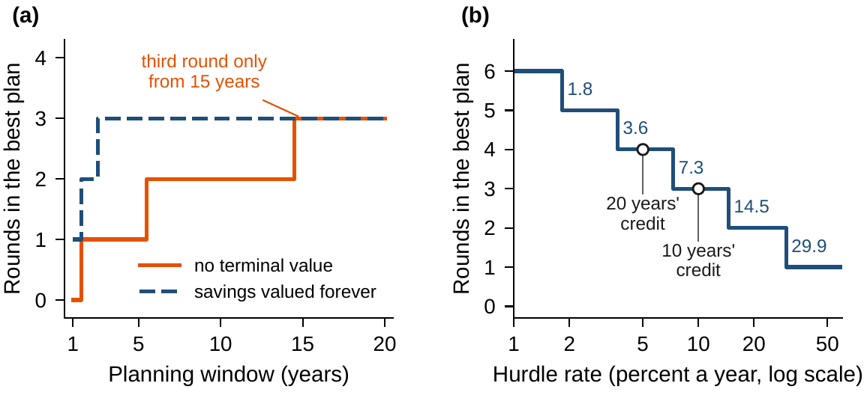
The terminal value must stand for continuing
§5.5 · THEOREM 5.2
(i) Exact. With the true value of continuing, any horizon makes the long-run plan's decisions
(ii) Bounded. Off by ε, it costs at most 2β^{T}ε
(iii) Zero. Only payoffs inside the window count: the six-year plan drops round 3, $45.1m less
The window must reach fifteen years before the third round appears
Part I's credits were perpetuities: ten years at 10 percent, twenty at 5
The end condition costs $67.7m for a round the 10 percent rate rejects
Figure 5.2. (a) Rounds against the planning window at 10 percent. (b) Rounds against the hurdle rate: each further round pays only below about half the rate for the round before.
Notes:
Theorem 5.2; formal statement and proof in Appendix 5.A. A lower hurdle rate buys more rounds: four at 5 percent, matching Chapter 4's twenty years of credit; the third round pays only below about 14.5 percent, the fourth below 7.3, the fifth below 3.6.

Slide 14
When re-planning confirms the plan
§5.6 · THEOREM 5.3
Plans and rules (Definition 5.2)
THEOREM 5.3
Plans and Rules Theorem
A plan fixes decisions as functions of time; a rule as functions of the state
A best plan is time consistent if its rest stays best when the problem is posed afresh
With no news, re-planning confirms Meridian's three rounds in years 1 to 3
Rolling six-year windows without a terminal value never run the third round
(i) Every rule induces a plan with the same path and value, so the best plan is as good as the best rule
(ii) Every best plan is time consistent
(iii) Re-planning every period from where the company stands follows a best plan
(iv) Re-planning can depart from every best plan when weights are not exponential, or a window ignores what follows it
Notes:
Definition 5.2 and Theorem 5.3; formal statement and proof in Appendix 5.A. The theorem is deterministic: when the future is uncertain, a rule can use information that a plan cannot, and the difference is the value of information (Volume I, Theorem 15.4(iii)).

Slide 15
A present-biased board postpones every year
§5.6 · AKERLOF'S BOX AT BOARD LEVEL
$14.4m
$102.4m
94.3%
lost by a board that weighs later years at 90 percent: the third round slips to year 6
lost by a board at 60 percent: it completes only two rounds
the weight above which the board carries out the plan it approved
A round's war chest is withheld from this year's payout while its savings come later, so a round always looks better a year on
The 90 percent board approves rounds in years 1 to 3, then moves the third to year 4, 5 and finally 6, where the end condition makes it hold the cash anyway
The repair is a commitment: approve the program as a whole, ring-fence its war chest, or contract the rounds in advance
Notes:
Section 5.6 and Theorem 5.3(iv). Shareholders discount at 10 percent throughout. The plans the 90 percent board makes at each date are in Online Appendix 5.B.3; the plan it carries out is Table 5.3's present-biased board.

Slide 16
When should Meridian pay its shareholders?
WORKED EXAMPLE 5.1 · THE SITUATION
Chief financial officer
The board's declarations
The board's commitments
Pay out everything above the floor?
Discount the payouts; value the savings forever
Keep the floor and the end condition
Every year, whatever cash exceeds the $350m floor.
A 10 percent hurdle rate; the lines are maintained after year 6.
$350m at every year end; $470m to start a round and at the end of year 6.
Is the CFO's rule right? When, and how much, to pay? What do the commitments cost? Would it survive a shortfall?
Notes:
Worked Example 5.1, the situation. Worked Examples 2.1 and 3.1 settled the program: three rounds, in years 1 to 3, with ten years of the year-6 savings credited and every amount undiscounted.

Slide 17

Write the instance in time, then solve it
WORKED EXAMPLE 5.1 · STEPS 1–3
β = 1/1.1; a round costs $120m and closes half the gap to 85; savings are $10m a year a point
Step 1: state, cash and efficiency; floor $350m; $470m to start a round and to end year 6
Step 2: the CFO's rule stops the program after one round and misses the end condition; even waived, it is worth $185.6m less
Step 3: 64 schedules of rounds, each with a linear payout program: rounds in years 1 to 3, worth $1,021.9m
The plan: pay out, every year, whatever exceeds a war chest: $485m, then $470m, the floor, and $470m at the end
Notes:
Worked Example 5.1, Steps 1-3. At 10 percent the perpetuity is ten years of the year-6 savings, the credit Part I used, so Part I's answer is this instance with the discounting removed. The value is $330.5m of payouts and $691.5m of savings after year 6.

Slide 18
Pay above a war chest; keep every commitment
WORKED EXAMPLE 5.1 · TABLE 5.3
Plan | Rounds (years) | Payouts, years 1–6 | Value | Commitments
CFO's rule | 1 | 220, 70, 70, 70, 70, 70 | 836.36* | end missed
Best plan | 1–3 | 85, 0, 122.5, 122.5, 122.5, 2.5 | 1,021.93 | kept
No terminal value | 1–2 | 100, 105, 105, 105, 90, 0 | 976.87 | kept
Present-biased board | 1, 2, 6 | 85, 105, 105, 105, 0, 2.5 | 1,007.55 | kept
A point short: Step 3's schedule | 1–2 | 85, 0, 122.5, 122.5, 122.5, 2.5 | – | floor, end breached
A point short: war-chest rule | 1–3 | 60, 0, 105, 105, 90, 0 | 853.73 | kept
Value at 10 percent: payouts plus the year-6 savings forever, $ million, to the cent as in Online Appendix 5.B.3. *If the board waived its end condition. The present-biased board weighs later years at 90 percent.
When each round falls a point short, the war-chest rule runs all three rounds; the schedule blocks the third.
Notes:
Table 5.3. The CFO's rule pays out the program's future; a plan without a terminal value runs the company down; a present-biased board postpones the third round; and when the rounds fall short the schedule breaches the floor and the end condition.

Slide 19
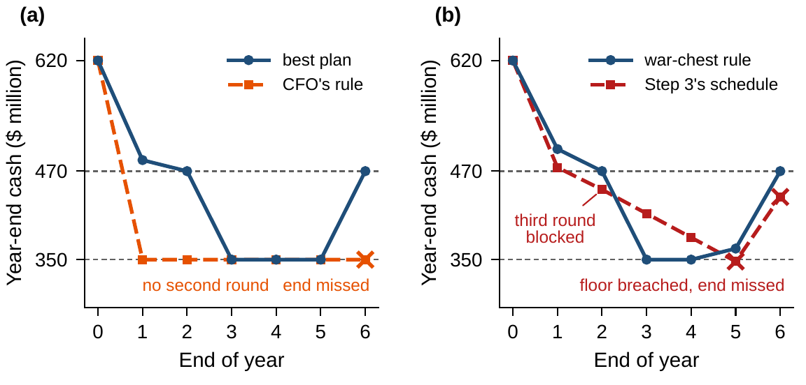
The rule keeps commitments the schedule breaks
WORKED EXAMPLE 5.1 · STEP 6
Each round may close a point less of the gap than planned (Volume I, Worked Example 6.1)
Paid regardless, Step 3's schedule leaves $445m at the end of year 2: the third round cannot start
The floor is then breached in year 5, and the end condition is missed
The war-chest rule recomputes the war chest every year end and pays out the rest
It runs all three rounds, worth $853.7m: the best plan had the shortfall been known
Figure 5.3. Year-end cash, $ million. (a) The CFO's rule against the best plan. (b) Each round a point short: Step 3's schedule against the war-chest rule; crosses mark breaches.
Notes:
Worked Example 5.1, Step 6, and Theorem 5.3 with its scope note. The war-chest rule pays $60m, 0, 105, 105, 90 and 0 million. A schedule is only as good as its forecast.

Slide 20
Pay out early, but only above the war chest
WORKED EXAMPLE 5.1 · WHAT THE BOARD SHOULD TAKE AWAY
$1,021.9m
$73.6m
$67.7m
pay out everything above a war chest recomputed every year
what paying early adds, against paying the same $455m at the end of year 6
the end condition's cost, for a round the board's own hurdle rate rejects
Discounting makes the timing of payouts a decision; the CFO's rule pays out the program's future
Lower the end condition to the floor, or justify it by something the terminal value misses
For discussion: if the hurdle rate rose with financial conditions, how would the war chest and the number of rounds move?
Notes:
Worked Example 5.1, what the board should take away, and the discussion questions. What would have to be true of Meridian's shareholders for the CFO's old pledge to pay out half of each year's savings to be worth keeping?

Slide 21

Planning over time, in AXIOM
AXIOM LAB 2.5 · MODULE AXIOM-05
Meridian's board has asked when the automation program's cash should go to shareholders. The CFO favors paying out everything above the floor; the program office wants cash held for the rounds. Open AXIOM, choose Lab 2.5 and load the Meridian automation instance.
1
2
3
4
5
Simulate
Transcribe
Price
Move the horizon and the rate
Stress
Run the CFO's rule and the war-chest rule; watch cash against the floor and the $470m line.
Transcribe the six years and hand the program to the AXIOM-04 solvers; record the best plan.
Read the prices of cash and efficiency by year; check two by perturbing the instance.
Vary the hurdle rate from 3 to 30 percent, switch the terminal value, lengthen the window.
Make each round a point short; run Step 3's schedule and the war-chest rule side by side.
Deliverable: a one-page note to the board recommending a payout rule, with its value, the war chest by year, the price of the end condition, and the plan's behavior when the rounds fall short. About 75 minutes.
Notes:
AXIOM Lab 2.5. What to look for: a myopic rule that stops the program; a transcription whose multipliers are the prices of cash and efficiency; a war chest that front-loads payouts; rounds that appear and disappear with the horizon and the rate; a rule that survives the shortfall that breaks the schedule.

Slide 22
What to carry forward
KEY TAKEAWAYS
1
Time adds stocks, delays, and commitments on whole paths; deciding period by period ignores them and can break commitments or lose any share of the value.
2
A dynamic instance declares its period, its discount, and its terminal value as well as its dynamics and commitments (Definition 5.1); a best plan exists under compactness, and in continuous time under convexity in the decisions.
3
Transcription turns the path into one program: a calendar's value is a floor that rises as the calendar is refined, and the multipliers of the dynamics are the prices of stocks over time (Theorem 5.1); at a best plan discounted marginal values are equal wherever a resource can move.
4
The terminal value must stand for the value of continuing: without it a plan runs the company down, and an end condition must agree with it.
5
With exponential discounting re-planning confirms the best plan; present bias and windows without terminal values reverse it (Theorem 5.3); and when the forecast fails, a rule keeps commitments that a schedule breaks.
Notes:
Key Takeaways, Chapter 5.

Slide 23
Notebook and workbook reproduce the book
THIS WEEK'S LABORATORY
36
46
26205
AXIOM-05, AXIOM-04
notebook checkpoints, every one PASS
workbook checks against the engine, ALL PASS
the lab's seed
AXIOM Lab 2.5
Notebook DCT_V2_Ch05_Lab.ipynb: Worked Example 5.1 and the lab's five steps in six panels, ready for Colab
Workbook DCT_V2_Ch05_Lab.xlsx: all 64 schedules with their war chests, the prices, horizons and rates, re-planning and the shortfall, in formulas
Every number on these slides is the book's, and both companions check it
Notes:
The notebook and workbook are on the course website, www.dynamiccorporatetransformation.com.

Slide 24
Chapter 6 lets the reviews come continuously
NEXT · CHAPTER 6
Let the review dates come together and this chapter's prices become the costates of optimal control
One rule replaces the whole program: at every moment, maximize the Hamiltonian, the value earned now plus the value banked in the stocks at their prices
Chapter 6 proves Pontryagin's maximum principle and asks what Meridian's engineering team is worth
Notes:
Chapter 6, Optimal Control of Enterprise Systems, develops the repair of myopia that Theorem 5.1(iii) names: the maximum principle.

