Slide 1
Dynamic Programming for Enterprise Systems
VOLUME II · CHAPTER 7 · WEEK 11
Value every position the company could reach, and let the best decisions form a rule that responds to what happens
Graduate course companion · Lab seed 26207 · AXIOM Lab 2.7 (AXIOM-07)
Notes:
Volume II, Chapter 7. Chapters 5 and 6 priced every stock along a plan; this chapter values every position and turns a plan into a rule.

Slide 2
“The Commanding General is well aware that the forecasts are no good. However, he needs them for planning purposes.”
Kenneth J. Arrow
Nobel Memorial Prize in Economic Sciences 1972; recalling his wartime weather service, “I Know a Hawk from a Handsaw” (1992)
Notes:
Arrow needed forecasts for planning although they were no good. A rule needs no forecast of the path, only the position the company is in and a declared law of what may happen next (Section 7.1).

Slide 3
After this chapter, you can
LEARNING OUTCOME STATEMENTS
7.1
Explain how dynamic programming extends the prices of Chapters 5 and 6 to the value of every position, and why a rule can beat a plan when the future is uncertain.
7.2
Formulate a dynamic program—states, decisions and their limits, a declared law of outside events, dynamics, the value of each period, discounting, and the horizon—and write its Bellman equation.
7.3
Read a value function: its differences value lumps, its slopes price stocks, and a concave value prices a stock lower the more of it there is.
7.4
Recognize the shapes of best rules—monotone, threshold, and target rules with a critical-ratio margin—and compare plans, re-plans, and rules, pricing the value of information.
7.5
Compute values and rules by backward induction, value and policy iteration, linear programming, and approximation, and certify them with their error bounds.
Notes:
The five learning outcome statements; LOS Guidance at the end of the chapter.

Slide 4
Five sections, a worked example, a case and a lab
ROADMAP
§7.1
§7.2
§7.3
§7.4
From Prices along a Plan to Values at Every Position
The Bellman Equation
Thresholds and Targets
Plans, Re-plans, and Rules
Definition 7.1 · Table 7.1
Theorem 7.1 · Proposition 7.1
Theorem 7.2
Proposition 7.2
§7.5
Worked Example 7.1
In Practice
AXIOM Lab 2.7
Computing Values and Rules
How Much Margin Should Meridian Hold Above the Capability Floor?
American Airlines Prices Its Last Seat
Valuing Every Position: Rules for Meridian's Capability
Theorem 7.3 · Proposition 7.3
Table 7.3 · Figure 7.3
At a Glance · board questions
AXIOM-07 · five steps
Notes:
Formal statements and proofs of Theorems 7.1-7.3 are in Appendix 7.A; Propositions 7.1-7.3 in Online Appendix 7.B.

Slide 5
Value every position; act by a rule
§7.1 · FROM PRICES ALONG A PLAN TO VALUES
What dynamic programming adds
DEFINITION 7.1
Dynamic Program
Chapters 5 and 6 priced stocks along one plan; dynamic programming computes the best value from every position
The value function's slope prices every position at once, and its differences value lumps
The best decisions form a rule, not a schedule: a rule responds to what happens
A rule needs the current position and a declared law of what may happen next, not a forecast of the path
States x, and at each a set of decisions U(x) that carries the limits of authority and the commitments
A law of outside events: finitely many outcomes w with probabilities p(w | x, u)
Dynamics x′ = f(x, u, w), a period's value ℓ(x, u), and a discount factor β for periods of Δ years at the hurdle rate r: β = (1 + r)^{−Δ}
A horizon: K periods with a terminal value, or open with β < 1
A rule assigns a decision to every period and state; the value function V* is the best value from each state
Notes:
Definition 7.1. With a single event of probability one, a dynamic program is Chapter 5's instance in recursive form. The state must carry everything a rule needs to know.

Slide 6
What changes when every position is valued
§7.1 · TABLE 7.1
 | Along a plan (Chapters 5–6) | At every position (this chapter)
What is computed | a best plan from one start | the value of every position and a best rule
Prices of stocks | multipliers or costates along the plan | slopes of the value function, wherever the company stands
Lumps | priced only at the margin | differences of the value function
Outside events | a plan cannot respond; re-planning is a rule | a rule responds to what happens
Optimality condition | the maximum principle (Theorem 6.2) | the Bellman equation (Theorem 7.1)
Certificate | concavity (Theorem 6.3) or a direct argument | the Bellman equation, with computable error bounds
What limits it | the shape of the answer must be guessed | the number of positions: the curse of dimensionality
Notes:
Table 7.1. Read it row by row: what is computed, how stocks and lumps are priced, how outside events are handled, the optimality condition, the certificate, and what limits each approach.

Slide 7
Capability does not move as planned
§7.1 · MERIDIAN
Chapter 6 let capability drift to the floor of 55 and held it there, as if it moved exactly as planned
The record: half of all quarters end where planned, four in ten 0.75 points off, one in ten 1.5 points off
Holding exactly 55 then leaves capability short of the floor in 27.5 percent of quarters
A rule asks a different question each quarter: given where capability stands now, how much should Meridian hire?
Notes:
Section 7.1's Meridian box and Worked Example 7.1, Step 1. The departures are beyond normal attrition: hires who start late or early.

Slide 8

The value of a position solves Bellman's equation
§7.2 · DEFINITION 7.2
the best a decision can earn now, plus the discounted expected value of the position it leads to
The value of a decision Q_V(x, u): what it earns now plus the discounted expected value of where it leads
The Bellman operator T maps V to the best value of a decision at every state; a rule is greedy for V if it attains it
Over K periods it is a recursion, solved from the terminal value back to the first period
Notes:
Definition 7.2. Look one period ahead: if the value of every position were known, the best decision now would earn the most now plus the discounted expected value of where it leads. Bellman's insight is that the value of a position is exactly that best.

Slide 9
The principle of optimality, as a board can use it
§7.2 · THEOREM 7.1
What it means
THEOREM 7.1
Bellman Equation Theorem
A decision needs the current position and the values of the positions it can lead to, not the history or a forecast
The value function is the durable asset: a ledger of what every position is worth
Each pass shrinks the largest error by at least β; at Meridian's quarterly β = 0.976, fewer than a hundred passes cut it tenfold
The board approves a rule, best from every position, including the ones no one planned for
(i) Finite horizon. The recursion gives the best value from every state; the rest of a best rule is best from wherever the company stands. Rules that use the past do no better
(ii) Open horizon. The Bellman operator is a contraction by β: the value function is its only bounded fixed point
(iii) Rules. A stationary rule is best from every state exactly when it is greedy for the value function
Notes:
Theorem 7.1; formal statement and proof in Appendix 7.A. Chapter 5's war-chest rule, which recomputed each year what the rest of the program needed, was a rule of this kind.

Slide 10
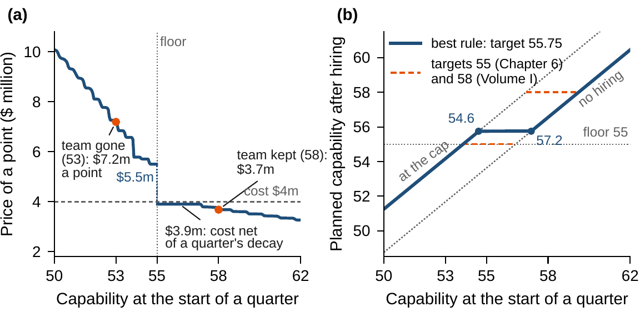
Slopes price stocks; differences value lumps
§7.2 · PROPOSITION 7.1
Lumps. Moving the company from x to x′ is worth V*(x′) − V*(x), each position with its own best continuation
Prices. The slope prices each stock and satisfies the price recursion, Chapter 6's costate equation on a calendar, averaged over events
Concavity. A stock's price falls as the stock grows
Meridian: a point is worth $3.9m between 55 and 57.2, the cost of a point net of a quarter's decay; $3.7m at 58; $7.2m at 53
The engineering team is worth $23.8m, between $18.4m and $36.0m at the prices at either end
Figure 7.1. (a) The price of a capability point, the slope of the value function. (b) The best rule as planned capability after hiring: at the cap below 54.6, the target 55.75, no hiring above 57.2.
Notes:
Proposition 7.1; proof in Online Appendix 7.B. Pricing the team at the price at 53 would overstate it by half.

Slide 11
The best rule tops capability up to a target
§7.3 · THEOREM 7.2
12.3%
0.75
55.75
critical ratio: holding a planned point, $0.19m a quarter, against a point short next quarter, $1.56m today
margin: 5% of quarters lose more than 0.75 points, 25% lose 0.75 or more
target for planned capability: hire at the cap below 54.6, nothing above 57.2
Theorem 7.2. Monotone rules rise with the state; yes-or-no decisions become thresholds; a maintained stock gets a target rule
The margin is the smallest m at which the chance of losing more than m in a period does not exceed k(1 − αβ)/(βq)
The newsvendor's critical fractile, except that a unit not needed is carried over, net of decay
Notes:
Theorem 7.2; formal statement and proof in Appendix 7.A. A fixed cost of acting gives an (s, S) rule instead (Scarf). Part (iii)'s condition fails in Meridian's extreme quarters; the recursion certifies the target.

Slide 12
A rule beats a plan when the future is uncertain
§7.4 · PROPOSITION 7.2
Best plan fixed today
Re-plan each period
Best rule
$254.7m
$230.8m
$230.8m
Meridian: cost of hiring and delay from 58
recovers the best rule for Meridian
top up to 55.75 each quarter
$5.0m
$5.0m
$22.7m
the project: build now, expected value
builds now too: no plan can use the news
wait a year; build only on good news
Proposition 7.2. The best rule is at least as good as re-planning, which is at least as good as the best plan fixed today; the gap between rule and plan is the value of information
Meridian's value of responding is $23.9m. The project ($100m, worth $150m or $60m next year) shows where re-planning fails: it values the future as if nothing will be learned
Notes:
Proposition 7.2; proof and the real-option example in Online Appendix 7.B. The difference for the project is the value of waiting to learn, the heart of real-options analysis.

Slide 13
Six ways to compute values and rules
§7.5 · TABLE 7.2
Exact
Open horizon
Open horizon
Backward induction
Value iteration
Policy iteration
A finite horizon, period by period from the end.
Repeated sweeps; the error shrinks by β a sweep, with a stopping bound.
Evaluate a rule exactly, then improve it; never worse, finite with finite sets.
Part I's solvers
Scale
Chapter 14
Linear programming
Approximation
Learning from experience
The value function is the least V with V ≥ TV.
Grids and fitted values for many stocks; errors amplified by 1/(1 − β).
A rule without a declared law, from data and exploration.
With n stocks on a grid of G levels each there are G^{n} positions: the curse of dimensionality (Proposition 7.3).
Notes:
Table 7.2 and Proposition 7.3. All methods rest on Theorem 7.1; they differ in what they compute and in what they promise.

Slide 14
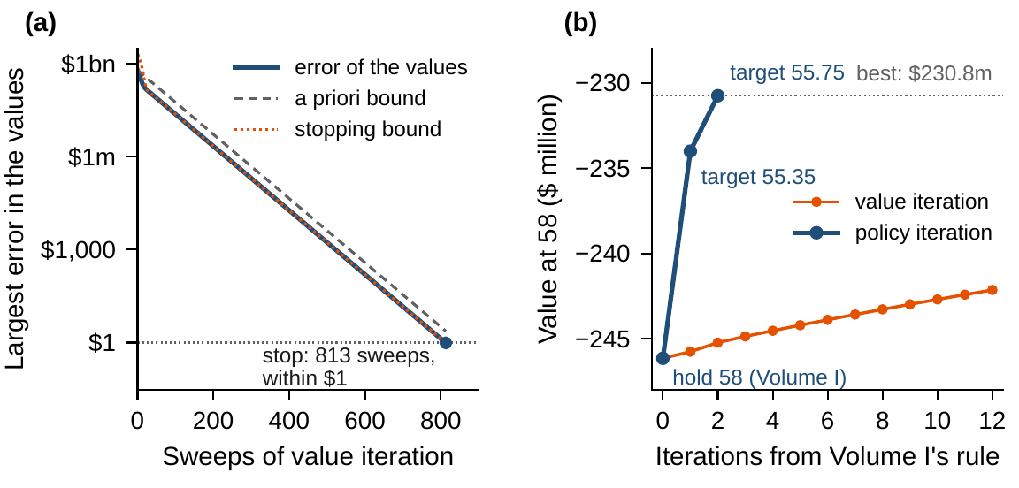
Error bounds certify the computation
§7.5 · THEOREM 7.3
Value iteration: once two sweeps differ by at most d, the values are within βd/(1 − β). Meridian's run stops after 813 sweeps
Policy iteration from Volume I's rule, hold 58: three evaluations
Any values lie within their Bellman residual over 1 − β: Meridian's residual, 0.0044, puts them within $0.19m
Approximation amplifies errors by the effective horizon: a coarse grid loses $2.1m (guaranteed under $22m); a quadratic that cannot bend at the floor loses $82m
Figure 7.2. (a) Value iteration from zero with its a priori and stopping bounds. (b) Policy iteration from Volume I's rule; value iteration from the same start creeps.
Notes:
Theorem 7.3; formal statement and proof in Appendix 7.A. An approximation must be able to take the shape of the value, here the kink the declaration puts at the floor.

Slide 15
How much margin above the capability floor?
WORKED EXAMPLE 7.1 · THE SITUATION
Chief human resources officer
Chief financial officer
The board
How much margin, and how to hold it?
What does it cost?
Can Volume I's budget be retired?
Capability ends 0.75 points off plan in four quarters in ten, 1.5 points off in one in ten.
Below 55 the build slows by a fifth per point short: $1.6m for a point short for a quarter.
It pays the rent on 58 every quarter, whatever happens.
Chapter 6 told the board to stop defending 58 and hold the floor of 55. Two facts it left out have arrived.
Notes:
Worked Example 7.1, the situation. The engineering office's record and the transformation office's declaration of the reduced-pace delay.

Slide 16
Write the program, then solve it
WORKED EXAMPLE 7.1 · STEPS 1–3
capability c, points hired h at $4m each, unplanned loss w by the record, β = 1.1^{−1/4} = 0.976 a quarter
Step 2: in planned capability y = 0.975c + h, Theorem 7.2(ii) applies: the value is concave and the best rule a target
Step 3: value iteration certifies every value within a dollar in 813 sweeps; policy iteration needs three evaluations
The rule: bring planned capability to 55.75 each quarter; hire at the cap below 54.6, nothing above 57.2
The recursion, not the formula, certifies the target: the formula's condition fails in the extreme quarters
Notes:
Worked Example 7.1, Steps 1-3. Capability is modeled between 30 and 80; the rules come near neither end.

Slide 17
Rules against plans, from capability 58
WORKED EXAMPLE 7.1 · TABLE 7.3
Rule or plan | Margin | Short (%) | Hiring | Delay | Total | Extra
Best rule: top up to 55.75 | 0.75 | 6.0 | 228.0 | 2.7 | 230.8 | –
Re-plan each quarter | 0.75 | 6.0 | 228.0 | 2.7 | 230.8 | 0.0
Chapter 6's 55, as a rule | 0 | 27.5 | 222.1 | 15.2 | 237.4 | 6.6
Cover the worst quarter: 56.5 | 1.5 | 0.3 | 234.0 | 0.1 | 234.0 | 3.3
Volume I's 58, as a rule | 3 | 0.0 | 246.2 | 0.0 | 246.2 | 15.4
Best committed plan | 3.5* | 12.3 | 244.9 | 9.7 | 254.7 | 23.9
Volume I's budget: rent on 58 | 3 | 16.0 | 246.3 | 10.0 | 256.3 | 25.6
Present values at 10 percent over an open horizon, $ million; components may not add because of rounding. Margin: planned capability above 55. Short: long-run share of quarters that start below 55. *In the long run; the schedule starts lower.
Replace the budget with a rule: $25.6m less than Volume I's budget, $6.6m less than holding the floor exactly.
Notes:
Table 7.3. Chapter 6's answer run as a rule leaves capability short in 27.5 percent of quarters; the margin adds $5.9m of hiring and saves $12.5m of delay.

Slide 18
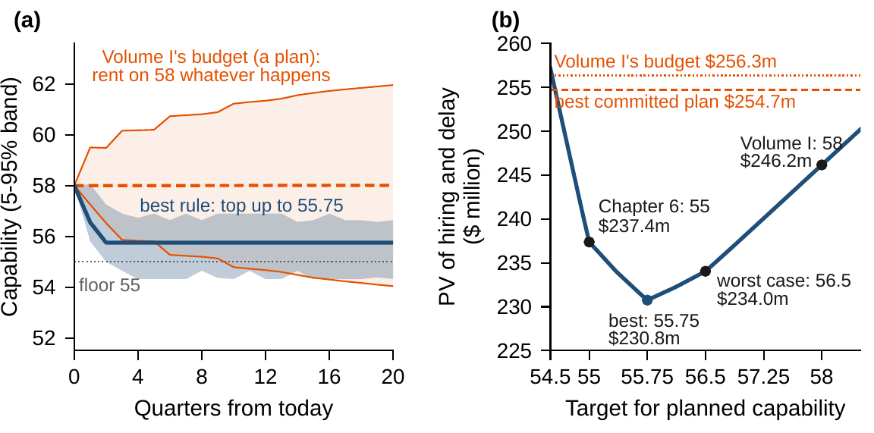
The margin rests on declarations the board owns
WORKED EXAMPLE 7.1 · STEPS 5–6
If every quarter short stopped the build, the margin would be 1.5 points
Delay worth $4m or $16m a quarter: 0.70 or 0.75; the record's shape sets the margin, not the price of delay
Swings twice as wide: 1.85, more than double; half as wide: 0.375, the formula's
A hiring cap of 2.0 points a quarter: 0.85
Under this declaration the team is worth $23.8m, not Chapter 6's $32.5m
Figure 7.3. (a) Capability over five years from 58: the rule's narrow band against the budget's widening one. (b) Every target rule's cost from 58, least at 55.75.
Notes:
Worked Example 7.1, Steps 5 and 6. A margin that guards against the survey's whole error costs five more planned points, $3.8m a year: a sharper survey is worth up to that.

Slide 19
Replace the budget with a rule
WORKED EXAMPLE 7.1 · WHAT THE BOARD SHOULD TAKE AWAY
55.75
$25.6m
$6.6m
top planned capability up to 55.75 each quarter; hire nothing above 57.2
less than Volume I's budget, which still falls short one quarter in six
less than holding the floor exactly
The margin of 0.75 points is the insurance that capability which does not move as planned requires, sized by the critical ratio of 12.3 percent
Three owners: the engineering office keeps the record of swings, the transformation office declares what a shortfall costs, the chief human resources officer runs the rule
For discussion: halving the swings saves $4.4m in present value. What should Meridian pay a year for a retention program that does it?
Notes:
Worked Example 7.1, what the board should take away, and the discussion questions.

Slide 20
American Airlines prices its last seat
IN PRACTICE · AMERICAN AIRLINES
The decision
The method
The result
Which booking, at which fare
Value a seat by position
$1.4bn over three years
On every flight, with no-shows to allow for and full-fare passengers still to come.
Accept a fare only if it covers the seat's value; protection levels; Littlewood's rule.
American's quantifiable benefit, with over $500m a year expected; the 1991 Franz Edelman Award.
Making it work
What Meridian takes
For the board
Systems and a champion
A margin by a critical ratio
Do customers understand our rules?
SABRE put bookings in one place; the group grew from 13 people to about 700, with Crandall as its champion.
Worked Example 7.1's capability margin is the airline's protection level.
By 1992, 94 percent of travelers bought discount tickets with cumbersome rules.
Notes:
In Practice, Chapter 7: American Airlines Prices Its Last Seat. A real organization's decision of this chapter's kind, told from its published record; every figure is cited in the book. The lesson for Meridian: A margin above a floor is sized like a protection level: by a critical ratio. Sources: Smith, Leimkuhler and Darrow (1992), Interfaces; McGill and van Ryzin (1999); Talluri et al. (2008); INFORMS; Cross (1997).

Slide 21

Valuing every position, in AXIOM
AXIOM LAB 2.7 · MODULE AXIOM-07
The board has accepted Chapter 6's advice to stop defending 58. Capability does not move as planned, and the chief human resources officer must propose a hiring rule with a margin over the floor. Open AXIOM, choose Lab 2.7 and load the Meridian capability instance with the engineering office's record.
1
2
3
4
5
Look one quarter ahead
Solve backward
Iterate
Read values and prices
Approximate and shrink the period
Plot the value of each hiring decision at a capability level and find the best.
Solve a twelve-quarter horizon by backward induction and read the rule table.
Value iteration with its stopping bound, then policy iteration from Volume I's rule.
Plot the value and its slope; value the engineering team as a lump.
Test a coarse grid and a smooth fit against their bounds; shorten the period and compare with Chapter 6.
Deliverable: a one-page note to the board with the rule, its margin and its cost, the comparison with Volume I's budget and with Chapter 6's answer, and the declarations the rule depends on. About 75 minutes.
Notes:
AXIOM Lab 2.7. What to look for: values that converge from any start; prices that fall as capability grows; a target rule with a margin; error bounds that hold; a recursion that approaches Chapter 6's solution as the period shrinks.

Slide 22
What to carry forward
KEY TAKEAWAYS
1
Dynamic programming values every position, and its best decisions form a rule; when the future is uncertain, a rule can respond to what happens and a plan cannot.
2
The value function solves the Bellman equation: the value of a position is the best a decision can earn now plus the discounted expected value of where it leads. Over an open horizon the Bellman operator is a contraction, and a rule is best exactly when it is greedy for the value function.
3
Differences of the value function value lumps; its slopes price stocks and satisfy the price recursion, Chapter 6's costate equation on a calendar, averaged over events.
4
Best rules take simple shapes: thresholds for yes-or-no decisions, and targets for maintained stocks, with a margin set by the critical ratio. The best rule is at least as good as re-planning, which is at least as good as the best plan; the gap between rule and plan is the value of information.
5
Backward induction, value and policy iteration, and linear programming compute values and rules with error bounds that certify them; approximations scale to many stocks, with errors amplified by the effective horizon.
Notes:
Key Takeaways, Chapter 7.

Slide 23
Notebook and workbook reproduce the book
THIS WEEK'S LABORATORY
25
26
26207
AXIOM-07
notebook checkpoints, every one PASS
workbook checks against the engine, ALL PASS
the lab's seed
AXIOM Lab 2.7
Notebook DCT_V2_Ch07_Lab.ipynb: Worked Example 7.1 and the lab's five steps in eight panels, ready for Colab
Workbook DCT_V2_Ch07_Lab.xlsx: the critical ratio, a twelve-quarter backward induction, the Bellman certificate, prices and the upper bound, in formulas
Every number on these slides is the book's, and both companions check it
Notes:
The notebook and workbook are on the course website, www.dynamiccorporatetransformation.com.

Slide 24

Chapter 8 lets the periods shrink
NEXT · CHAPTER 8
As the period shrinks, Bellman's recursion becomes the Hamilton–Jacobi–Bellman equation (Equation 7.4)
The hurdle return on a position equals the best the next moment can earn: Chapter 6's maximized Hamiltonian, with the costate replaced by the slope of the value function
Chapter 8 makes it precise, with verification theorems and the linear–quadratic problems
Notes:
Section 7.5's bridge to Chapter 8.

