Slide 1
Enterprise Applications and Integrated Transformation Case Studies
VOLUME II · CHAPTER 16 · WEEK 14
Put the pieces certified one chapter at a time into one program on one account: check them jointly, compute the order and timing, allocate by internal prices, and certify a region with its triggers
Graduate course companion · Lab seed 26216 · AXIOM Lab 2.16 (AXIOM-16)
Notes:
Volume II, Chapter 16, the last chapter of Volume II and of the series. Volume II certified Meridian's decisions one piece at a time: the build's financing, the sale, the automation rounds, the capability rule, and the twin that runs it. This chapter puts the pieces into one program and delivers what the framework promised: a roadmap, internal prices, and a certified decision. The Worked Example signs Meridian's program: the sale first, rounds in years 1 to 3, payouts held for two years, and a $21.4 million package, worth $1,039.4 million; Chapter 5's plan and Volume I's package, signed together, would breach the floor on 74 percent of paths (abstract).

Slide 2
“You can see the computer age everywhere but in the productivity statistics.”
Robert M. Solow
Nobel Prize in Economic Sciences 1987; “We'd Better Watch Out,” New York Times Book Review (1987)
Notes:
Robert Solow's remark named the productivity paradox (Further Reading). Pieces that each work need not show up in the whole; this chapter certifies the whole (Section 16.1).

Slide 3
After this chapter, you can
LEARNING OUTCOME STATEMENTS
16.1
Assemble one program from pieces certified separately: declare its shared stocks and their room, and run the joint check.
16.2
Compute a roadmap: the order of moves, the timing of lumpy moves, and when a choice is worth keeping open.
16.3
Allocate capital by internal prices: price the shared stocks and the appetite, and judge every use of them against the price.
16.4
Certify a program: its certificate chain, the region over which it holds, and the triggers that call for re-certification.
16.5
Apply the method to other enterprises: find the program's shared stocks and choose methods by the problem's shape.
Notes:
The five learning outcome statements; LOS Guidance at the end of the chapter.

Slide 4
Five sections, a worked example, a case and a lab
ROADMAP
§16.1
§16.2
§16.3
§16.4
One Program from Many Pieces
Roadmaps: Order and Timing Are Computed
Capital Allocation by Internal Prices
Certified Decisions and Triggers
Definition 16.1 · Theorem 16.1 · Table 16.1
Definition 16.2 · Theorem 16.2 · Propositions 16.1–16.2
Proposition 16.3 · Figure 16.2
Definition 16.3 · Theorem 16.3 · Figure 16.3
§16.5
Worked Example 16.1
In Practice
AXIOM Lab 2.16
Seven Enterprises, One Method
Can Meridian Run Its Whole Program?
Banks Put a Price on Their Liquidity
One Program: Check, Order, Price, Certify
Table 16.2 · three lessons
Table 16.3 · Figures 16.1–16.3
At a Glance · board questions
AXIOM-16 · five steps
Notes:
Formal statements and proofs of Theorems 16.1-16.3 are in Appendix 16.A; Propositions 16.1-16.3, how the program is computed on one account (Remark 16.B.1) and every number of the Worked Example and the figures (Example 16.B.2) are in Online Appendix 16.B. The four outputs Volume I's map promised: roadmaps, capital allocation, execution on a twin, and certified decisions.

Slide 5
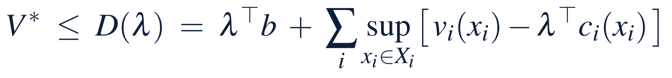
Certify the sum of the claims, not the parts
§16.1 · DEFINITION 16.1 · THEOREM 16.1
Meridian's pieces, signed together
THEOREM 16.1
One Program from Many Pieces
Chapter 5's plan and Volume I's package, with the sale, breach on 74% of paths; 99.6% without it
With no deviations and no closures the plan keeps $7m above the floor at quarter 9
With Volume I's closure buffer the claims there exceed the room by $9.6m
Keeping the pieces as certified would need 5.6 quarters of delay, $50.0m of levers
The program's appetite is worth $1.83m a point, near Volume I's $1.81m for the build alone
(i) Certify the sum, not the parts. Feasible exactly when the claims' sum fits the room at every date; a piece certified on the whole room certifies nothing about the program
(ii) Appetites add when the room is split. Shares kept with chances 1 − αᵢ keep the program with 1 − Σαᵢ; certifying jointly never needs more room
(iii) Internal prices. Prices on the shared stocks give a ceiling each owner computes alone; at a best program every lever in use buys chance at the appetite's price
Notes:
Definition 16.1: a program is a set of pieces, each with its decisions, value, commitments and owner, acting on shared stocks such as liquidity or capability; a piece's claim is what it uses of a stock's room; the joint check asks whether all the claims fit the room together, at every date, with the declared chance. Theorem 16.1; formal statement and proof in Appendix 16.A. The claims at quarter 9 are the build's draw, the rounds less their savings, the payouts made, and the closure buffer the line leaves uncovered (Figure 16.1(b)); with no deviations and no closures the plan itself keeps $7 million (Step 2).

Slide 6
Five pieces, two shared stocks
§16.1 · TABLE 16.1
Piece | Owner | Certified in | Claims on
Build and its package | transformation office; CFO | Volume I, WE 15.1; Chapters 1, 4, 9–11, 13 | liquidity (the draw); capability of 55 to start
Sale, engineers kept | board | Volume I, WE 3.1; Chapters 6–7 | adds $92 million of liquidity
Automation rounds and payouts | COO; CFO | Volume I, WE 6.1; Chapters 2–5, 12 | liquidity ($120 million a round); capability of 55 at a round
Capability rule and twin | human resources; audit committee | Chapters 6–8, 14–15 | capability (floor 55)
Appetite | board | Volume I, Chapter 8; Chapter 9 | the joint check
Pieces that share a stock are one program, and a program is certified only as a whole.
Notes:
Table 16.1: Meridian's program, the pieces, where each was certified, and the stocks they share. The rounds and the build draw on the same cash, the sale changes the cash both use, and the rounds and the build both need capability. A program whose pieces disagree about what they share fails Volume I's consistency gate before any joint check (Scope and limits; Volume I, Theorem 16.4).

Slide 7
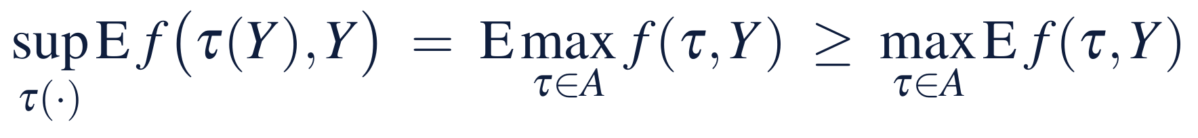
Order and timing are computed, not negotiated
§16.2 · DEFINITION 16.2 · THEOREM 16.2
Meridian's roadmap
THEOREM 16.2
Order and Timing
Kept with its engineers, the sale only adds cash, so it goes first: worth $100.5m, $37.6m more than after the build
Rounds in years 1–3: round 3 in year 4 costs $2.6m, starting in year 2 $85.8m
Round 3 run in year 3 only if cash after the year-2 payout is at least $490m: $1.35m more than committing it to year 3
(i) Order is a decision. The best order solves a dynamic program over the moves taken and the stocks they left
(ii) What only adds goes first. A move always available, that keeps the others in their domains and commutes with them, can go first without loss
(iii) Keeping a choice open. Timing an irreversible move on a reading is worth at least the best committed timing; more when the best timing depends on the reading
A roadmap is the moves in their computed order; a milestone records why decisions change there
Notes:
Definition 16.2 and Theorem 16.2; formal statement and proof in Appendix 16.A. Held and Karp solved sequencing by dynamic programming over subsets; Arrow and Fisher and Henry found the irreversibility effect. Sold with its engineers the sale would take capability to 53, below the 55 the build and the rounds need, and its order would matter (Volume I, Worked Example 3.1). The sale first is worth $100.5 million: $69.1 million paid out at the end of year 3 and $31.3 million of levers it makes unnecessary (Worked Example 16.1, Step 3).

Slide 8
Phase the core so every phase is stable
§16.2 · PROPOSITIONS 16.1–16.2
Phase of the build | Engineering and treasury links | New link | Spectral radius | Half-life
Today | 0.40 | none | 0.800 | 3.1 quarters
Phase two, the link added first | 0.40 | 0.40 | 1.025 | none: deviations grow
Phase two, every link trimmed | 0.304 | 0.40 | 0.841 | 4.00 quarters
Trim first, the link later | 0.304 | none | 0.609 | 1.40 quarters
Phase two, the link run light | 0.40 | 0.080 | 0.841 | 4.00 quarters
Volume I's register (Worked Example 14.1): radius (h + √(h² + 8(e² + t²)))/2; the board's rule 0.841, deviations halving within a year.
Waiting (Proposition 16.2): Chapter 7's project is worth 5.00 started now and 22.73 if it waits a year.
Notes:
Proposition 16.1 and Proposition 16.2; formal statements and proofs in Online Appendix 16.B. Stable start and end do not make the phases between them stable: add the link first and the core passes through 1.025; trim first and it passes through 0.61. The milestone is 'link and trim together, or trim first', and it traces to a viability condition. Waiting: the project costs 100 and will be worth 150 or 60 with equal odds; the expected loss waiting avoids, 20, exceeds what waiting costs, 2.27 (Online Appendix 16.B).

Slide 9
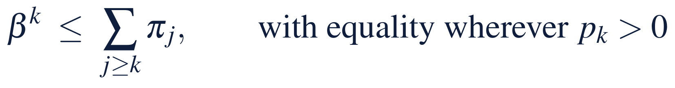
Every use of a stock is judged by its price
§16.3 · PROPOSITION 16.3
Meridian's prices
PROPOSITION 16.3
What Internal Prices Say
A dollar of room at the start is worth $1.09: $0.75 paid out in year 3, $0.34 of levers
The line buys a point of chance for $1.76m, the delay for $2.29m: near the appetite's $1.83m
Paying a dollar in year 1 earns $0.77m a point, in year 2 $0.67m: below the price, so payouts wait
A round adds a point of capability, $3.90m at Chapter 7's price: $10.7m for rounds in years 1–3
(i) Room. One more unit of a shared stock's room adds at most its price to the best value; exactly its price for small changes when prices are unique
(ii) Use. A lumpy move is worth taking when its value exceeds its claims at the program's prices; its date moves only when a price crosses that line
(iii) Payouts. Cash earning nothing, a best program pays out as early as its commitments allow; a payout waits while the cash is priced above what paying earns
Notes:
Proposition 16.3; formal statement and proof in Online Appendix 16.B. Each price is the value of one more unit of a stock where it binds: a dollar of room at the build's trough, a point of the appetite, a point of capability on its floor. Part (iii) is Chapter 5's war chest worked out (Proposition 5.3): a dollar paid in year 1 rather than at the end of year 3 earns β − β³ = 0.158 and spends 0.204 points of chance (Online Appendix 16.B). Everett, Dantzig and Wolfe, and Arrow and Hurwicz read prices as decentralization.

Slide 10
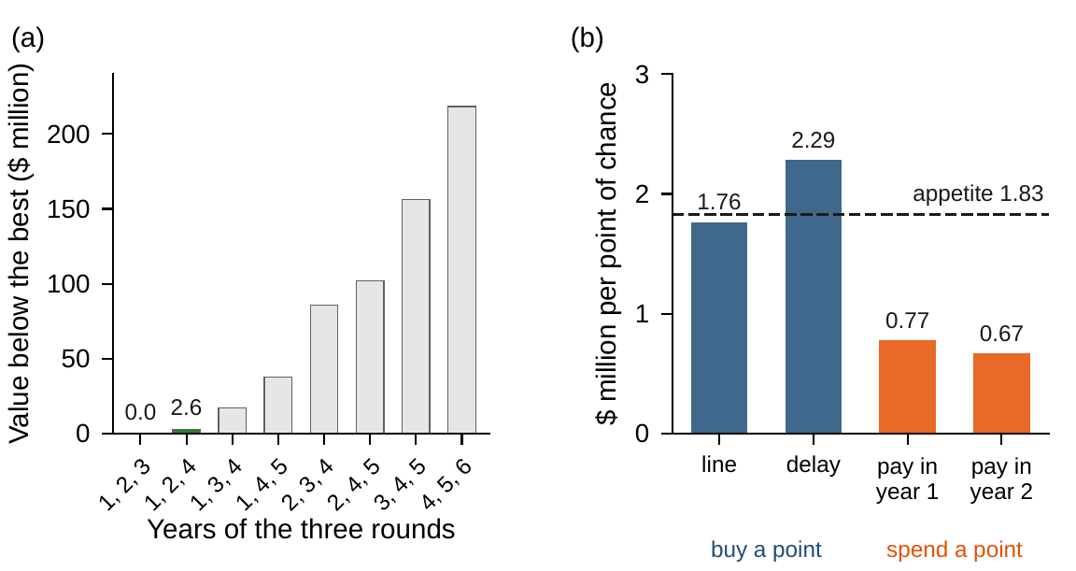
Rounds in years 1–3, and the payouts wait
§16.3 · FIGURE 16.2
(a) Each timing of the three rounds, its payouts and package re-optimized: years 1–3 are best, years 1, 2, 4 $2.6m below
(b) The line and the delay buy a point of chance near the appetite's $1.83m
Paying early earns $0.77m or $0.67m a point: below the price, so the payouts are held
The prices separate the search: checking a signed program takes a second
Figure 16.2. (a) The best program for each timing of the three rounds, below the best. (b) At the best program: what the line and the delay cost per point of chance, and what paying in year 1 or 2 instead of year 3 would earn; the appetite's price between them.
Notes:
Figure 16.2 and Worked Example 16.1, Steps 3-4. The rounds in years 4-6 and the payouts after the build touch only the planned path, so a war chest prices them exactly; only the rounds in years 1-3 and the payouts in years 1-2 meet the build's paths, and for each the cheapest package is a quantile of the paths' critical depths, on 100,000 paths (Section 16.3, Computational note).

Slide 11
An optimized program has no slack
§16.4 · DEFINITION 16.3 · THEOREM 16.3
Meridian's region
THEOREM 16.3
Certified Decisions and Triggers
At 5% the program meets the appetite exactly: a closure rate or spread any higher breaks it
Designed for 4%: $2.07m more; it keeps 5% for closure rates to 0.30 and spreads to $52.2m
Designed for 3%: $4.65m, and spreads to $55.0m
Triggers: the treasury's or the engineering office's estimate leaving the region, or the twin's monitor
(i) No slack. A best program uses its whole appetite: at the declared law its chance equals the appetite, so if the chance rises strictly with an adverse parameter, any adverse change breaks it
(ii) A margin buys a region. Designed for a smaller appetite, it keeps the board's on a region with computable edges; the margin costs the difference in value
(iii) Triggers come from the region. Keep the program while the estimates stay inside; re-certify at the first exit or alarm
A certified decision is a program, its certificate chain, and its certified region
Notes:
Definition 16.3 and Theorem 16.3; formal statement and proof in Appendix 16.A. The region is computed along the doubts Chapter 11 declared, the closure rate and the spread; a doubt the board has not declared has no region and no trigger. How fast an estimate notices a change is the monitor's business (Theorem 15.3). Fiacco, Bonnans and Shapiro, and Ben-Tal, El Ghaoui and Nemirovski develop sensitivity and regions.

Slide 12
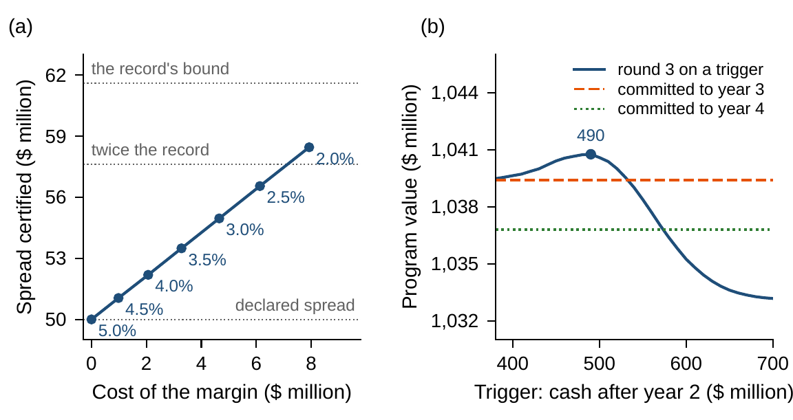
A margin buys a region; a trigger buys value
§16.4 · FIGURE 16.3
(a) Re-designed for 4.5% to 2%, the program keeps 5% for spreads from $51.0m to $58.4m; the record's bound is $61.6m
At the records' corner, rate 0.315 and spread $61.6m, it breaches on 13.9% of paths; $33.52m of levers keep it there
(b) Round 3 on a $490m trigger: $1,040.76m, against $1,039.41m committed to year 3
Figure 16.3. (a) What a margin of appetite certifies: the spread up to which the re-designed program keeps 5 percent, against the margin's cost. (b) Round 3 on a trigger: the program's value by trigger, against the two committed timings.
Notes:
Figure 16.3 and Worked Example 16.1, Steps 5-6. The records' family is Chapter 11's: the treasury's two closures in twenty years and the engineering office's forty quarters of deviations, at their one-sided 95 percent bounds. At the corner the best program keeps the rounds in years 1-3 with a $200 million line and 3.44 quarters, $33.52 million, against $21.37 million at the declared law; Chapter 11's price of ambiguity for the build alone was $13.56 million (Step 6).

Slide 13
Seven enterprises, one method
§16.5 · TABLE 16.2
Enterprise | Pieces and shared stocks | Method by shape | Certificate
Manufacturer | capacity, emissions, financing; cash and an emissions budget | lumpy capacity (Ch. 4); demand as a law (Ch. 9) | gap of the lumpy plan; chance on fresh paths
Commercial bank | business lines; capital and a risk budget | convex allocation with prices (Ch. 3); a set of shocks (Ch. 10) | prices of capital; split or pooled appetite (Thm. 16.1)
Hospital system | units and shifts; staff by skill | rules on queues and staff (Chs. 7–8); a twin (Ch. 15) | residual of the rule; the twin's monitor
Energy utility | retirements and builds; capital and a carbon budget | law, set, or family for carbon prices (Chs. 9–11) | price of ambiguity; certified region (Thm. 16.3)
Technology firm | projects; budget and engineers | lumpy portfolio (Ch. 4); options to wait (Prop. 16.2) | gap of the portfolio; value of keeping choices open
Government | programs; one budget, several objectives | frontier first, choice second (Ch. 12) | the frontier's prices; the weights declared
Private equity fund | exits and follow-ons; the fund's cash | stopping rules (Ch. 7); learned values held to their records (Chs. 13–14) | the exit rule's residual; joint check of the calls
Find the shared stocks first; let the commitments choose the method; admit learned parts under the same certificates.
Notes:
Table 16.2 holds no numbers on purpose: each enterprise must declare its own. The three lessons that travel (Section 16.5): the shared stocks decide the program's shape; the commitments decide the method, since a probability, a bounded set, or a family of laws are different problems and several owners' objectives are a frontier before they are a choice; and learned parts and twins enter under the same terms as everything else. The author's work applies the same discipline to private capital, where a fund's cash, its investors' calls and its holdings' illiquid values are shared stocks of one program.

Slide 14
Can Meridian run its whole program?
WORKED EXAMPLE 16.1 · THE SITUATION
Volume I's three options
The board
The CFO
The build, the sale, the automation rounds
Sign one program
Do the pieces fit, in what order, at what cost?
Volume II certified each one on its own account.
The sale, the build with its financing, the rounds with their payouts.
And on what terms does the program stay certified?
New declarations: one account, the timing of rounds and payouts, the sale at the start, the appetite over the build.
Notes:
Worked Example 16.1, the situation and Step 1. The treasury puts everything on one account: liquidity is Volume I's plan for the build plus the automation program's cash and the sale's proceeds; Volume I's Worked Example 6.1 had assumed the rest of Meridian's cash flows left liquidity unchanged. The sale closes at the start with the engineers kept, for $92 million. The program's value is Chapter 5's, payouts at 10 percent plus the year-6 savings forever at the board's $5.645 a dollar a year, less the levers' cost.

Slide 15
Six steps from the pieces to a signed program
WORKED EXAMPLE 16.1 · STEPS 1–6
1
Declare one program
2
Check jointly
3
Order the moves
One account: Volume I's plan, the automation program's cash and the sale's $92m. Value: payouts at 10% and savings, less levers.
Signed together, Chapter 5's plan and Volume I's package breach on 74.3% of paths; keeping them needs $50.0m.
The sale goes first, worth $100.5m. Rounds in years 1–3; round 3 in year 4 costs $2.6m.
4
Price and allocate
5
Keep a choice open
6
Certify
A $160m line and 2.07 quarters, $21.37m: worth $1,039.41m. The appetite $1.83m a point; payouts wait.
Round 3 in year 3 only if cash after year 2 is at least $490m: $1,040.76m, $1.35m more.
No slack at 5%. Designed for 4%, $2.07m buys rates to 0.30 and spreads to $52.2m. At the corner, $33.52m.
Notes:
Worked Example 16.1, Steps 1-6; Online Appendix Example 16.B.2. Step 4: the payouts then run $189.9, $160.4, $158.8 and $32.7 million in years 3-6, and the program meets the appetite at 5.00 percent (fresh paths 4.99 percent). Step 6: the certificate chain is each chapter's certificate plus the joint check; the triggers are the region's edges, the twin's monitor, and Volume I's feedback core, whose new link lands with its trim.

Slide 16
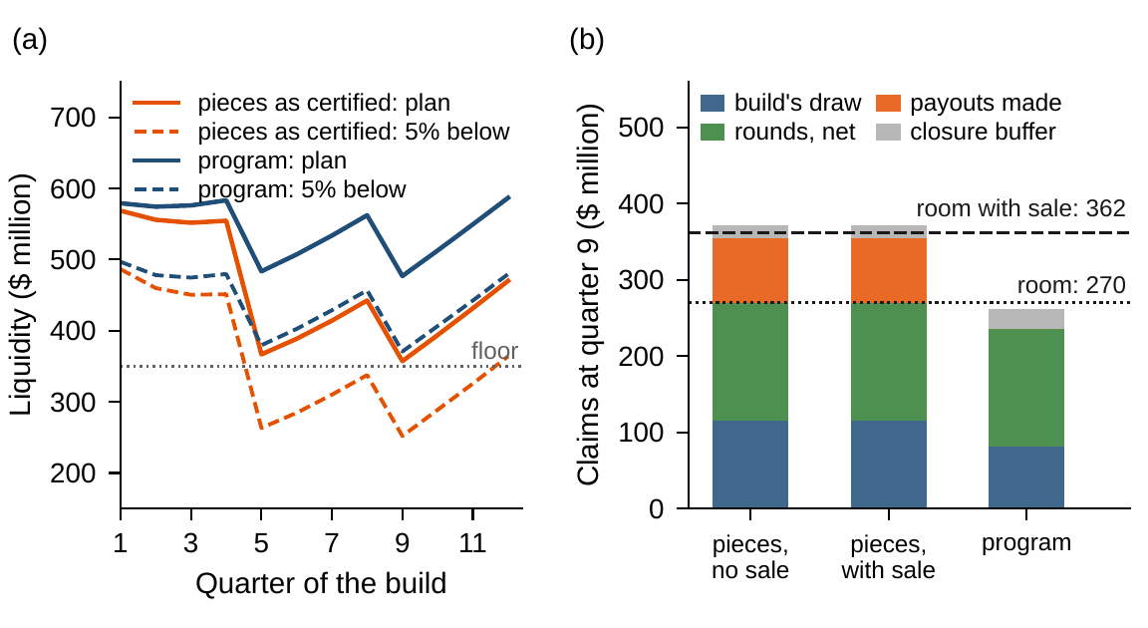
Signed side by side, the pieces fail
WORKED EXAMPLE 16.1 · FIGURE 16.1
(a) On one account the pieces' plan comes within $7m of the floor at quarter 9, when the third round is paid; 5% of paths fall far below
(b) At quarter 9 the claims exceed the room by $9.6m; the program's leave $100.0m
Without the sale the pieces breach on 99.6% of paths, and no package keeps them
Figure 16.1. (a) Liquidity by quarter on one account, with the sale: the pieces as certified and the best program, as planned and as the level 5 percent of paths fall below. (b) Claims on the room at quarter 9.
Notes:
Figure 16.1 and Worked Example 16.1, Step 2. The claims at quarter 9 are the build's draw, the rounds less their savings, the payouts made, and the closure buffer the line leaves uncovered, against the room above the floor: $270 million, or $362 million with the sale (Online Appendix Example 16.B.2).

Slide 17
Programs on one account, priced exactly
WORKED EXAMPLE 16.1 · TABLE 16.3
Program | Rounds (years) | Line | Delay (q) | Levers | Value | Breach (%)
Pieces as certified | 1–3 | 170 | 0.67 | 10.44 | – | 74.3
levers to keep them | 1–3 | 165 | 5.63 | 50.02 | – | 5.0
Best program | 1–3 | 160 | 2.07 | 21.37 | 1,039.41 | 5.0
Round 3 in year 4 | 1, 2, 4 | 160 | 1.48 | 16.62 | 1,036.80 | 5.0
Round 3 on a trigger | 1, 2, 3 or 4 | 155 | 1.64 | 17.79 | 1,040.76 | 5.0
Sale after the build | 1–3 | 165 | 5.97 | 52.71 | 1,001.79 | 5.0
No sale | 1–3 | 165 | 5.97 | 52.71 | 938.95 | 5.0
Designed for 4% | 1–3 | 165 | 2.31 | 23.44 | 1,037.34 | 4.0
At the records' corner | 1–3 | 200 | 3.44 | 33.52 | 1,027.26 | 5.0
Levers: the line's fees and the delay's cost; value: payouts at 10 percent plus the year-6 savings forever, less the levers; breach: chance of liquidity below $350 million in some quarter of the build, on the book's 100,000 paths ($ million).
Notes:
Table 16.3. Every answer is checked on 100,000 fresh paths: the best program breaches on 4.99 percent of them, round 3 on its trigger on 5.00 percent (Online Appendix Example 16.B.2).

Slide 18
Sell first, hold the payouts, keep a trigger
WORKED EXAMPLE 16.1 · WHAT THE BOARD SHOULD TAKE AWAY
74%
$1,039.4m
$2.1m
of paths breach the floor if the pieces are signed side by side, as certified
the program as one: sale first, rounds in years 1–3, payouts held, a $21.4m package
a point of margin of appetite, and the region it certifies
Sell first, keeping the engineers; run the rounds in years 1–3, the third on a trigger; hold the payouts until the trough has passed
Buy a line and a delay at $1.8m a point of appetite; decide how much doubt to certify, and state the triggers now
For discussion: who should decide to delay the platform two quarters to keep round 3 in year 3, and at what price?
Notes:
Worked Example 16.1, what the board should take away, and the discussion questions: the best program delays the platform by two quarters to keep round 3 in year 3; which owner should decide that trade, and at what price? What would change if the board split its appetite between the build and the rounds?

Slide 19
Banks put a price on their liquidity
IN PRACTICE · FUNDS TRANSFER PRICING
The decision
The method
The result
What each line pays for liquidity
Marginal, maturity-matched prices
A supervisory expectation
Business lines draw on shared funding and on a shared buffer of liquid assets.
Funds transfer pricing, with the buffer's cost charged to the activities that create the need.
Basel Principle 4 (2008), European guidelines (2010), and U.S. interagency guidance (2016).
Making it work
What Meridian takes
For the board
Owners, and limits
One program, priced
What does each unit pay?
A central function owns the prices; desks with their own funding sources needed limits as well.
Worked Example 16.1: pieces certified alone breached the floor three times in four together.
Is the price the marginal value of the stock to the whole firm, or a convenient average?
Notes:
In Practice, Chapter 16: Banks Put a Price on Their Liquidity. A real organization's decision of this chapter's kind, told from its published record; every figure is cited in the book. The lesson for Meridian: UBS funded every line at one favorable rate: certify the sum, not the parts, and price the shared stock. Sources: Grant (2011), BIS FSI; Basel Committee (2008); Senior Supervisors Group (2008, 2009); Swiss Federal Banking Commission (2008); CEBS (2010); SR 16-3 (2016).

Slide 20

Check, order, price, certify, in AXIOM
AXIOM LAB 2.16 · MODULE AXIOM-16
Meridian's board wants to sign one program: the sale, the build with its financing, and the automation rounds with their payouts. The CFO asks whether the pieces fit together, in what order, at what cost, and on what terms. Open AXIOM, choose Lab 2.16 and load Meridian's program.
1
2
3
4
5
Check jointly
Order
Price
Keep a choice open
Certify
Sign Chapter 5's plan and Volume I's package together; read the breach chance and the claims.
Move the sale before and after the build, and the rounds across years; price each order.
Read the appetite's price and each lever's cost per point of chance; hold or release the payouts.
Put round 3 on a trigger and find the best trigger.
Buy margins of appetite, read the region along the closure rate and the spread, set the triggers.
Deliverable: a one-page note to the board: the program, its roadmap with each milestone's reason, its prices, and its certificate chain with the region and the triggers. About 75 minutes.
Notes:
AXIOM Lab 2.16. What to look for: pieces that fail together (Theorem 16.1(i)); a sale that must come first (Theorem 16.2(ii)); levers bought at the appetite's price and payouts held below it (Theorem 16.1(iii)); a trigger worth more than any commitment (Theorem 16.2(iii)); and a program with no slack until a margin buys a region (Theorem 16.3).

Slide 21
What to carry forward
KEY TAKEAWAYS
1
Pieces that share a stock are one program: certify the sum of their claims, not each piece on the whole room.
2
Prices on the shared stocks split the program among its owners, and every use of a stock is judged against its price; levers are bought at about the appetite's price and uses that earn less wait.
3
Order and timing are computed: what only adds goes first, a feedback core is phased so every phase is stable, and an irreversible move is worth keeping open when its best timing depends on what will be read.
4
A certified decision is a program, its certificate chain, and its certified region; an optimized program has no slack, a margin buys a region, and the region's edges are the triggers.
5
Meridian's program—sale first, rounds in years 1–3, payouts held, a $21.37 million package—is worth $1,039.41 million; its pieces as certified would breach the floor on 74 percent of paths.
Notes:
Key Takeaways, Chapter 16.

Slide 22
Notebook and workbook reproduce the book
THIS WEEK'S LABORATORY
203
120
26216
AXIOM-16
notebook checkpoints, every one PASS
workbook checks against the engine, ALL PASS
the lab's seed
AXIOM Lab 2.16
Notebook DCT_V2_Ch16_Lab.ipynb: Worked Example 16.1 and the lab's five steps in seven panels, with the book's seeds, ready for Colab
Workbook DCT_V2_Ch16_Lab.xlsx: Chapter 5's war chest, the one account and its joint check, every program's value, the prices, the trigger and the core, in formulas
Notes:
The notebook and workbook are on the course website, www.dynamiccorporatetransformation.com. The paths are Chapter 9's, drawn from Volume I's stream with seed 8 and checked on fresh paths drawn with seed 26209; the lab's seed is used only for new draws.

Slide 23
The loop runs again: re-certify each cycle
CLOSE · THE SERIES
Volume I drew the map: seven moves, from Represent to Adapt, run as a loop, with gates that say when a board is ready to optimize
Volume II supplied the methods: each piece optimized and certified on its own terms, then signed as one program on one account
The program carries its prices, its region and its triggers: when an estimate leaves the region or a monitor alarms, the loop runs again
The method travels: every enterprise's program has pieces with owners, shared stocks with room, and commitments with a declared chance
Notes:
The last slide of the series. Volume I's last chapter ran the seven moves of the DCT Map as a loop, the transformation lifecycle, with readiness gates before optimizing. Volume II's last chapter closes the loop for Meridian: a roadmap whose order and milestones are computed (Execute), a twin that watches the certificates (Monitor), and triggers stated in advance (Adapt): keep the program while the estimates stay inside the certified region of Theorem 16.3, and re-certify at the first exit or alarm.

