Slide 1
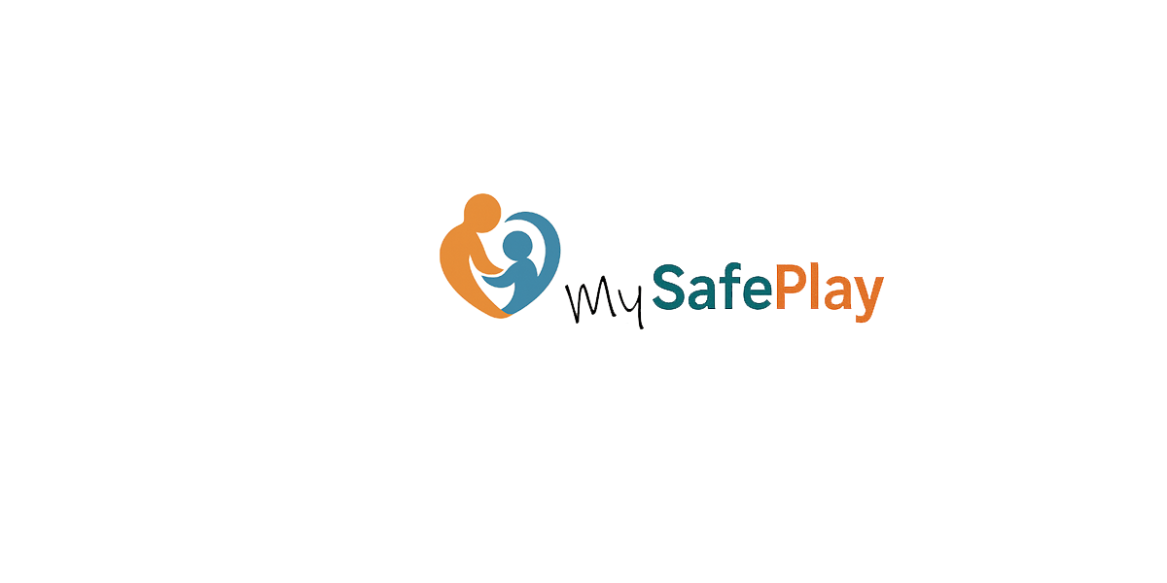
Never Miss a Moment, Always Know They're Safe
Notes:
This presentation was automatically generated by PowerPoint Copilot based on content found in this document: https://1drv.ms/w/c/0f4bd263333d365c/EQjBHVwl-QlIvv1evTDNHsEBFMzkvfaaUnQ0DmHAUCwAwg?e=AAmYlO AI-generated content may be incorrect.

Slide 2
Agenda
Introduction
Market Need and Opportunity
Memory Capture
Complete Solution
Technology Details
Next-Generation Solution
Revenue Opportunities
Redefining the Family Experience
Conclusion
Notes:
Agenda * Introduction * Platform Overview * Advanced Safety Features * Market Need and Opportunity * Parent Concerns * Security Features * Memory Capture * Precious Moments * System Setup and Maintenance * Complete Solution * Peace of Mind * Technology Overview * Technology Details * Privacy Protection * Industry-Leading Accuracy * Market Comparison * Revenue Opportunities * Digital Memories Pricing * Subscription Plans * Family Experience Overview * Core Promise

Slide 3

Platform Overview
Child Safety Platform
Ensures the safety of children at your venue
Capturing Precious Memories
Allows families to capture and cherish moments
Enhances Venue Experiences
Elevates the experiences provided by your venue
Notes:
mySafePlay™ is a platform that ensures child safety while allowing families to capture precious memories, enhancing the experiences your venue already provides. Original Content: mySafePlay™ - Never Miss a Moment, Always Know They're Safe A Platform That Ensures Child Safety While Capturing Precious Memories mySafePlay™ is designed to enhance and elevate the outstanding experiences your venue already provides for families.

Slide 4

Advanced Safety Features
Advanced Safety Features
Streamline operations
Reduce liability
Strengthen reputation as a secure destination
Unique Memory Preservation
Adds value for guests
Creates shareable memory montages
Encourages families to return
Promotes premium pricing
Facilitates word-of-mouth marketing
Operational Tool and Growth Engine
Enhances operational efficiency
Notes:
Our platform’s advanced safety features streamline operations, reduce liability, and strengthen your reputation. mySafePlay™ adds value with memory montages, encouraging families to return, pay premium prices, and spread the word. It serves as both an operational tool and a growth engine. Original Content: Our platform’s advanced safety features help streamline operations, reduce liability, and further strengthen your reputation as a trusted secure destination. In addition, mySafePlay™ introduces a unique memorypreservation element that adds a fresh layer of value for your guests. These shareable memory montages create meaningful connections with your brand—encouraging families to return more often, happily pay premium pricing, and naturally spread the word about their experiences. In this way, mySafePlay™ becomes both a powerful operational tool and an engine for organic growth.

Slide 5

Parent Concerns
Common Parental Concerns in Play Zones
Children disappearing into play structures
Extended search times beyond the initial 5 minutes
Fears and Anxieties of Parents
Worry about children being hurt and unheard
Fear of abduction or children leaving the facility
Concerns about bullying and children hiding
Challenges of Supervising in Dynamic Environments
Difficulty in monitoring children in busy play areas
Need for effective supervision solutions
Notes:
Parents often face anxiety when their children play in busy zones. They worry about injuries, abduction, or bullying. These concerns highlight the need for better supervision solutions in dynamic environments. Original Content: The Market Need and Opportunity Every parent knows this moment: You tell your child "5 more minutes" at the play zone, and they vanish into the maze of tunnels and slides. Five minutes becomes ten. You're searching everywhere, checking slides, climbing walls, play structures—while your mind races with every parent's worst fears: What if they're hurt and crying somewhere I can't hear them? What if someone led them away? What if they somehow left the facility? What if they're being bullied and hiding? Every parent can relate to these anxieties—they reflect the real challenges of supervising children in busy, dynamic environments.

Slide 6
Security Features
Instant Safety Alerts
Immediate notifications for potential safety issues
Child Injury or Distress Detection
Recognizes signs of injury or distress in children
Bullying Incident Identification
Detects and alerts on bullying incidents
Unauthorized Area Access Warnings
Alerts when children enter restricted areas
Exit Monitoring with Unknown Individuals
Tracks and alerts if a child exits with an unknown person
Notes:
mySafePlay™ offers advanced security features including instant safety alerts, child injury detection, bullying identification, unauthorized area access warnings, and exit monitoring with unknown individuals. Original Content: Instant Safety Alerts Child injury or distress detection Bullying incident identification Unauthorized area access warnings Exit monitoring with unknown individuals mySafePlay™: Offers venues unprecedent security features, with enterprise-grade secure biometric technology that lets parents visually check on their children anytime, anywhere. Using advanced facial and body gesture recognition, our system provides:

Slide 7

Precious Moments
Genuine Breakthrough Achievements
AI identifies significant milestones
Heartwarming Social Interactions
Captures moments of bonding and friendship
Moments of Pure Joy and Discovery
Preserves instances of wonder and learning
Authentic Smiles and Laughter
Records genuine expressions of happiness
Notes:
mySafePlay™ uses AI to capture your child's precious moments, including achievements, social interactions, joy, and laughter. Original Content: Precious Memory Capture While keeping your child safe, mySafePlay™ automatically captures the magical moments you'd otherwise miss. Our AI intelligently identifies and preserves: Genuine breakthrough achievements Heartwarming social interactions Moments of pure joy and discovery Authentic smiles and laughter

Slide 8
System Setup and Maintenance
System Setup and Maintenance
Ensuring smooth integration with existing operations
Minimizing disruptions to ongoing activities
Notes:
We handle system setup and maintenance to ensure smooth integration with your ongoing operations, minimizing disruptions. Original Content: And we take care of system setup and maintenance, so our solution doesn’t get in the way of your ongoing operations.

Slide 9
Peace of Mind
Enterprise-Grade Security Features
Provides top-level security for venues
Ensures genuine privacy protection
Peace of Mind for Parents
Combines pinpoint accuracy with security
Gives parents confidence in safety and data protection
Intelligent Solution
Integrates security and memory creation
Notes:
mySafePlay™ offers enterprise-grade security features and beautiful memories, ensuring peace of mind for parents with top-level security and genuine privacy protection. Original Content: mySafePlay™ delivers what every venue can use, and what every parent wants: complete peace of mind with enterprise-grade security features, and beautiful memories, all in one intelligent solution. It combines pinpoint accuracy, top-level security, and genuine privacy protection - giving parents complete confidence in both safety and data protection.

Slide 10

Technology Overview
Our Technology Fills the Gap
Notes:
Our technology effectively bridges the gap in the market. Original Content: Our Technology Fills the Gap

Slide 11
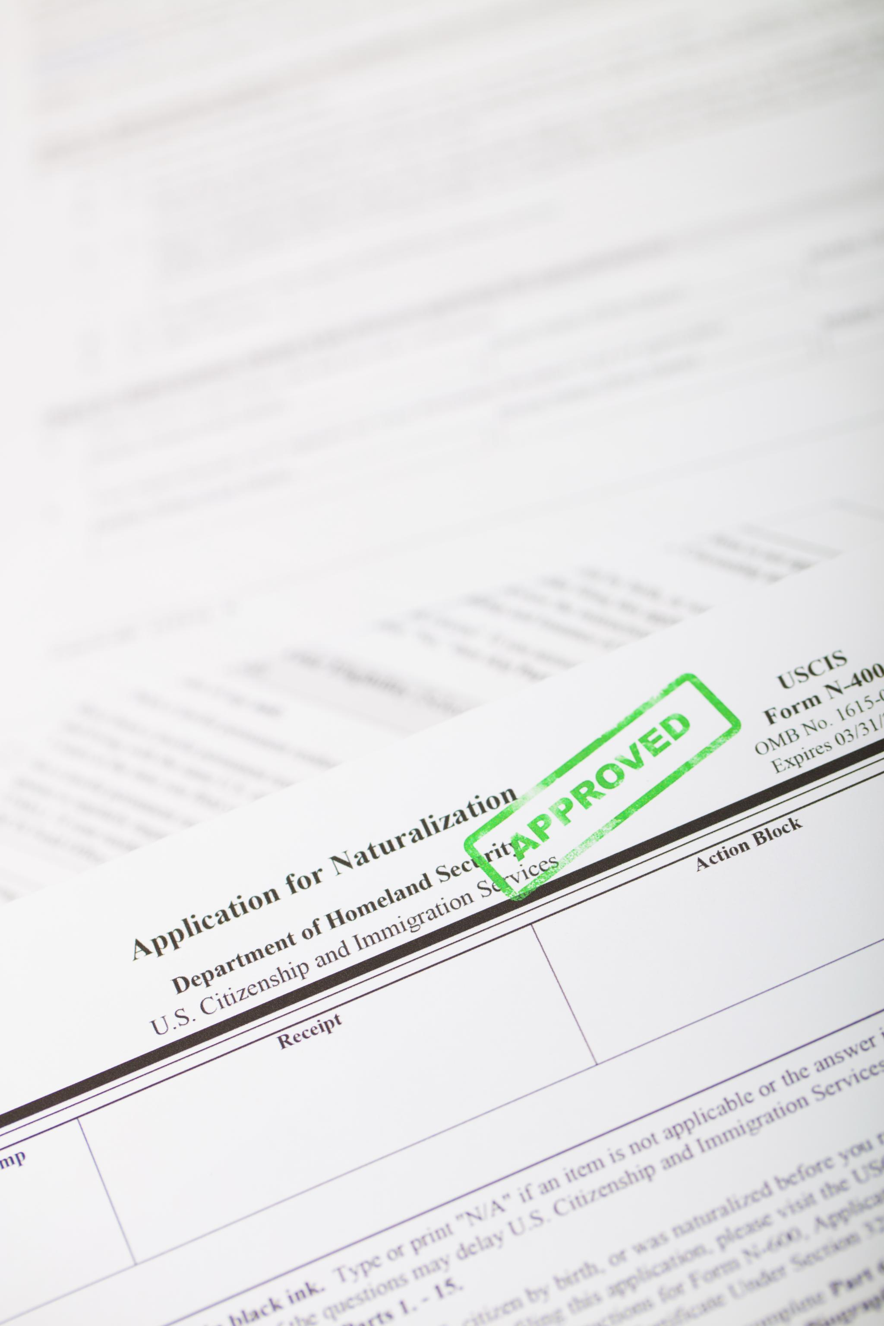
Privacy Protection
Parental Consent
Required for all data collection and processing
Transparent Data Usage
Clear opt-out options provided
Minimal Data Retention
Data retained only while in venue
No Third-Party Data Sharing
Data not shared under any circumstances
COPPA Compliance
Protects venues against legal recourse
Notes:
mySafePlay™ ensures privacy protection with parental consent, transparent data usage, minimal data retention, no third-party sharing, and COPPA compliance. Original Content: Privacy Protection Beyond Compliance The mySafePlay™' privacy-first approach includes: Parental consent for all data collection and processing Transparent data usage with clear opt-out options Minimal data retention policies (only while in venue) No third-party data sharing under any circumstances COPPA-compliancy protects venues against legal recourse (see https://www.coppa.org/coppa/)

Slide 12
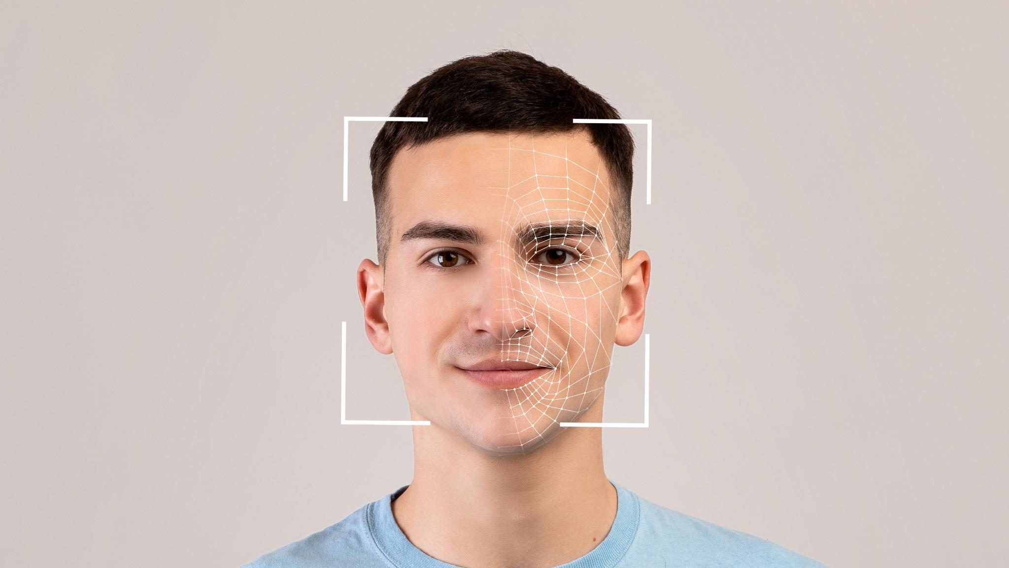
Industry-Leading Accuracy
Industry-Leading Accuracy
High level of precision
Dependable performance
Enterprise-Grade Security
Military-grade encryption
Zero-trust architecture
Protection of children's biometric data
Notes:
Our facial recognition technology offers industry-leading accuracy and dependable performance in dynamic play environments. With enterprise-grade security, mySafePlay™ ensures the protection of children's biometric data using military-grade encryption and zero-trust architecture. Original Content: Industry-Leading Accuracy Engineered with unmatched security, our facial recognition technology offers a high level of precision and dependable performance in dynamic play environments. Enterprise-Grade Security mySafePlay™ employs military-grade encryption and zero-trust architecture to protect children’s biometric data.

Slide 13

Next-Generation Solution
Unique Market Offering
mySafePlay™ utilizes venue-optimized algorithms
Maximizes visibility and responsiveness
Limitations of Consumer Tracking Devices
Apple AirTag® offers a relatively inexpensive alternative
Designed for item tracking, not person tracking
Relies on nearby devices for approximate positioning
Issues with stalking, signal jamming, and spoofing
Unsuitable for child safety applications
Notes:
mySafePlay™ is a unique solution that uses venue-optimized algorithms for better visibility and responsiveness. Unlike consumer tracking devices like Apple AirTag®, which have security vulnerabilities and are not designed for child safety, mySafePlay™ offers a more secure and reliable option. Original Content: Next-Generation Solution There’s nothing on the market like mySafePlay™, which also utilizes venue-optimized algorithms to maximize visibility and responsiveness. Some parents today rely on consumer tracking devices like Apple AirTag® which offer a relatively inexpensive alternative, but have significant security vulnerabilities and limitations, including: Designed for item (vs. person) tracking with probabilistic, consumer-grade functionality that relies on nearby devices for approximate positioning Documented issues with stalking, signal jamming, and spoofing, making them unsuitable for child safety applications

Slide 14

Digital Memories Pricing
Digital Memories
$0.99 per candid photo
$2.99 per AI video montage
Packages
Digital Pack 1: $9.99 for 5 photos and 3 video montages
Digital Pack 2: $19.99 for 10 photos and 5 video montages
Digital Pack 3: $29.95 for 20 photos and 10 video montages
Notes:
We offer revenue sharing with ongoing recurrent income opportunities through digital memories and packages. Digital memories include candid photos at $0.99 each and AI video montages at $2.99 each. Our packages range from $9.99 to $29.95, offering various combinations of photos and video montages. Original Content: Revenue Sharing with Ongoing Recurrent Income Opportunities: Digital Memories: $0.99 candid photo, $2.99 AI video montage Packages: Digital Pack 1: $9.99 – 5 photos + 3 Video montages Digital Pack 2: $19.99 – 10 photos +5 Video montages Digital Pack 3: $29.95 – 20 photos + 10 video montages

Slide 15
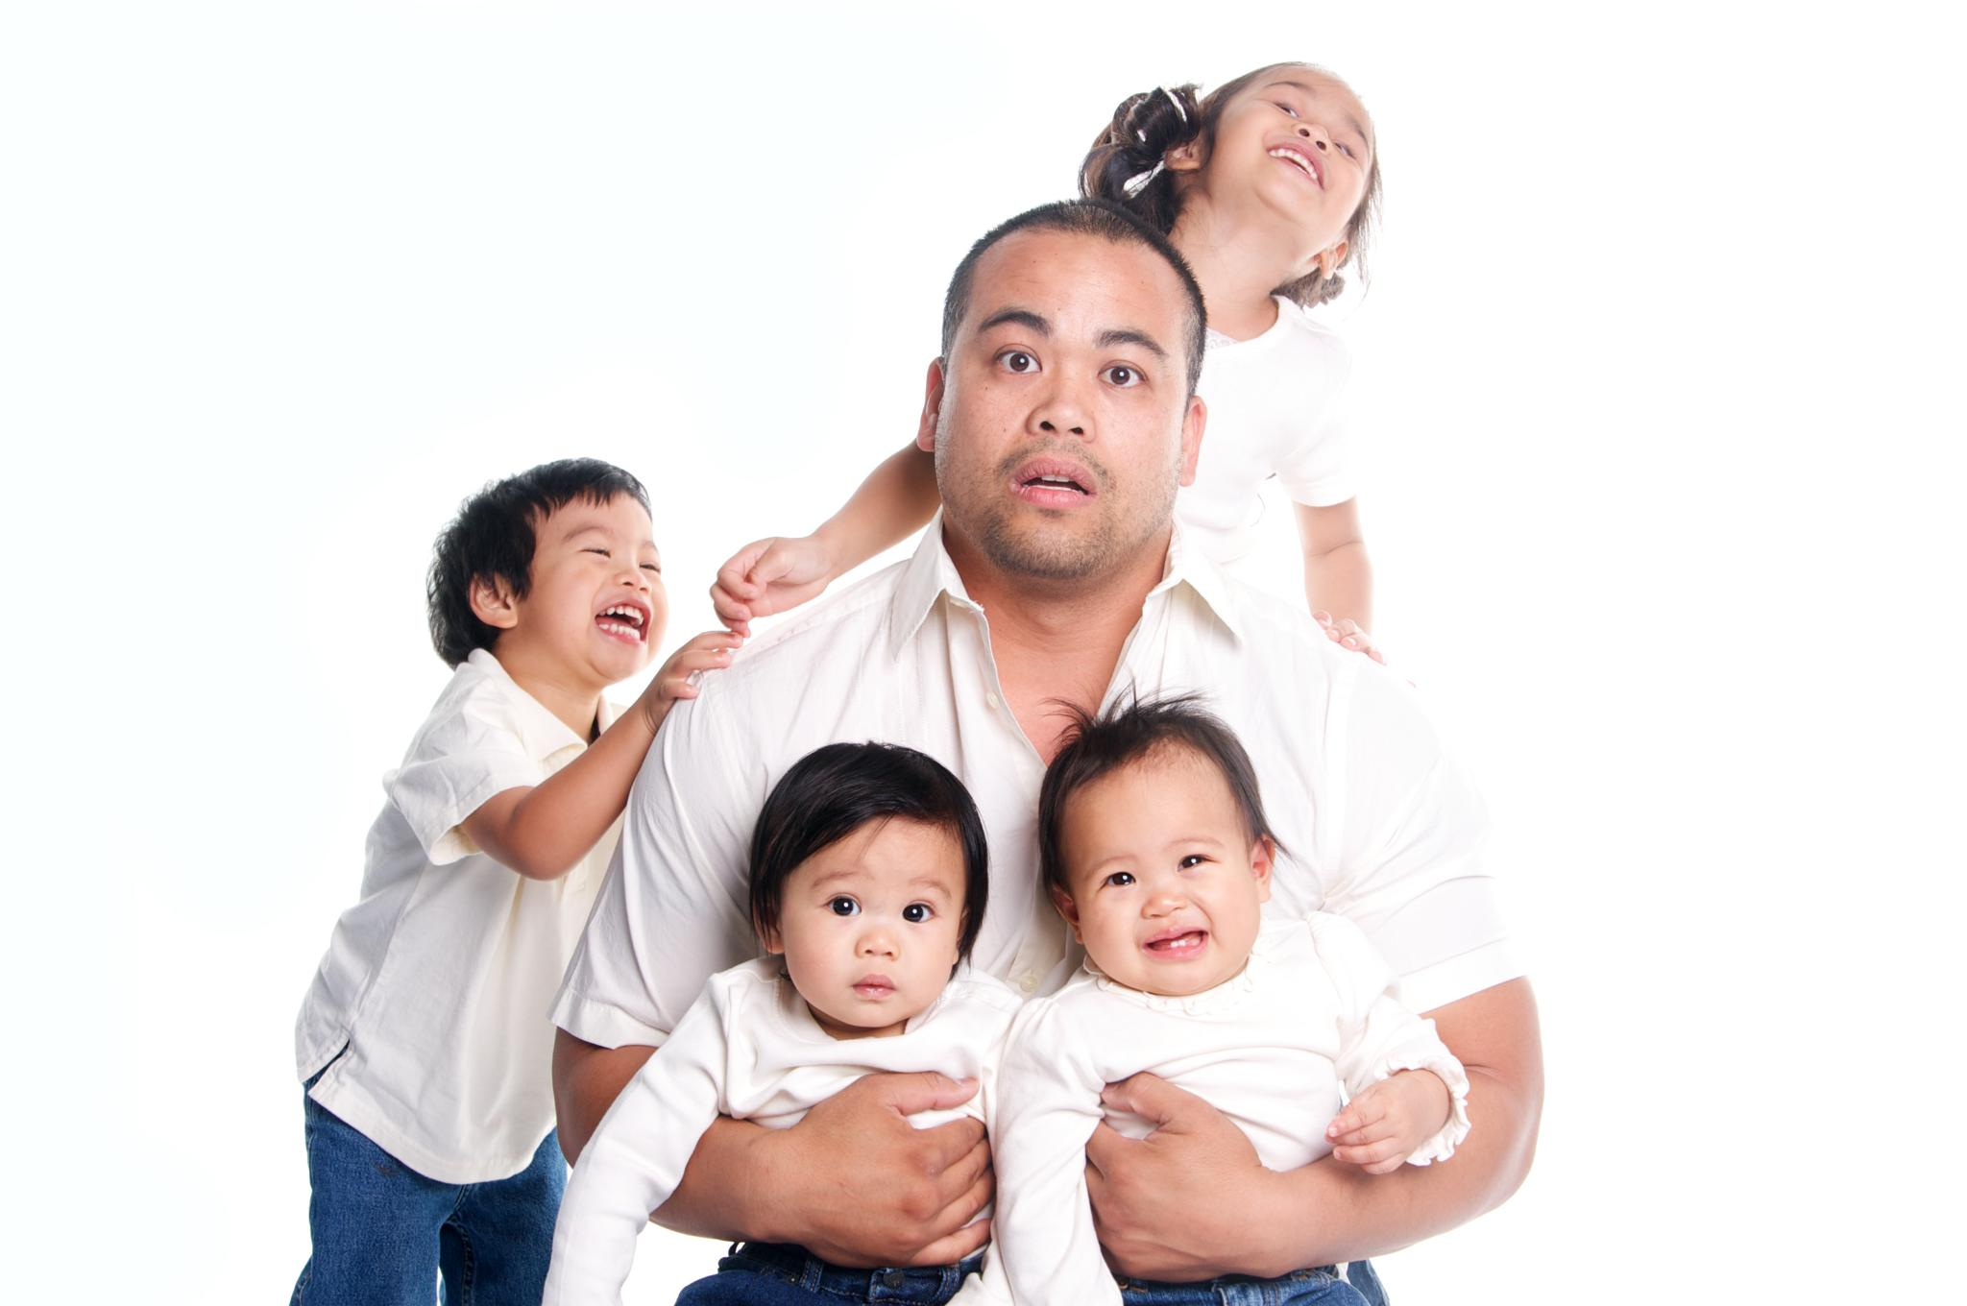
Subscription Plans
Free Plan
1 Child
One location
Basic Plan
$9.99/month
2 children
Unlimited locations
Premium Plan
$19.99/month
3 children
Unlimited locations
Family Plan
Notes:
Our Peace of Mind subscriptions offer various plans. The Free Plan covers 1 child and one location. The Basic Plan costs $9.99/month for 2 children and unlimited locations. The Premium Plan is $19.99/month for 3 children and unlimited locations. The Family Plan is $29.99/month for unlimited children and locations. Original Content: Peace of Mind Subscriptions: Free Plan: 1 Child, one location. Basic Plan: $9.99/month (2 children, unlimited locations) Premium Plan $19.99/month (3 children, unlimited locations) Family plan: $29.99/month (unlimited children, unlimited locations)

Slide 16
Redefining the Family Experience
Technology and Family Experience
Fundamental reimagining of child and family experience
Enterprise-grade safety and AI-powered memory preservation
Balancing Independence and Connection
Eliminates conflict between child's independence and parent's connection
Tools and assurance for confident family decisions
Fostering Healthy Development
Promotes healthy development for children
Strengthens family bonds
Success Measures
Never Miss a Moment
Always Know They're Safe
Notes:
mySafePlay™ redefines the child and family experience by combining enterprise-grade safety and AI-powered memory preservation. It balances a child's need for independence with a parent's desire for connection, fostering healthy development and strengthening family bonds. Our success is measured by preserving precious moments and providing peace of mind. Original Content: Redefining the Family Experience mySafePlay™ is more than a technology; it is a fundamental reimagining of the child and family experience. Utilizing enterprise-grade safety and AI-powered memory preservation, we eliminate the conflict between a child's need for independence and a parent's desire for connection. We provide the tools and assurance necessary for families to make confident decisions, foster healthy development for children and strengthen bonds within families. The ultimate measure of our success lies in Never Miss a Moment, Always Know They're Safe, the countless precious moments we preserve and the peace of mind we provide, ensuring that families can fully embrace our core promise.

Slide 17
Conclusion
Enterprise-Grade Safety
Ensures high-level security for children
Provides peace of mind for parents
AI-Powered Memory Preservation
Captures and preserves precious moments
Balances child's independence with parental connection
Tools for Confident Decision-Making
Helps families make informed choices
Supports healthy child development
Strengthening Family Bonds
Enhances connections within families
Core Promise
Notes:
mySafePlay™ revolutionizes the child and family experience with enterprise-grade safety and AI-powered memory preservation. It ensures security, captures moments, supports decision-making, and strengthens family bonds. Our core promise is to never miss a moment and always know they're safe. Original Content: mySafePlay™ is more than a technology; it is a fundamental reimagining of the child and family experience. Utilizing enterprise-grade safety and AI-powered memory preservation, we eliminate the conflict between a child's need for independence and a parent's desire for connection. We provide the tools and assurance necessary for families to make confident decisions, foster healthy development for children and strengthen bonds within families. The ultimate measure of our success lies in Never Miss a Moment, Always Know They're Safe, the countless precious moments we preserve and the peace of mind we provide, ensuring that families can fully embrace our core promise.

