Slide 1
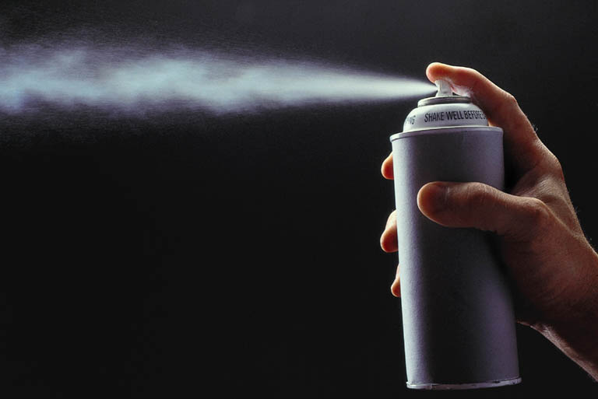


Slide 2
INTRODUCTION
Aerosol or Pressurized package is defined as “A system that depends on the power of a compressed gas or liquefied gas to expel the contents from the container.”
Pharmaceutical Aerosol is defined as aerosol product containing active ingredients dissolved ,suspended or emulsified in a propellant or a mixture of solvent and propellant and intended for oral or topical administration or for administration into the eye, nose ,ear, rectum and vagina.
In 1942 - First aerosol was developed. (insecticide)
In1950 - Pharmaceutical aerosol for topical administration was developed.
In 1955 - Aerosol for the local activity in the respiratory tract was developed (Epinephrine).

Slide 3

ADVANTAGES OF AEROSOLS
A dose can be removed with out contamination of materials.
Stability is enhanced for these substances adversely affected by oxygen and or moisture.
When sterility is an important factor, it can be maintained while a dose is being dispensed.
The medication can be delivered directly to the affected area in a desired form. (localized action)
Irritation produced by the mechanical application of topical medication is reduced or eliminated.
Ease and convenience of application.
Application of medication in thin layer .
Rapid response to the medicament .
Bypasses First pass effect.

Slide 4
DISADVANTAGES OF AEROSOLS
Expensive.
Chlorofluorocarbon propellants cause Ozone layer depletion.
Inflammability
Toxicity
Explosivity

Slide 5

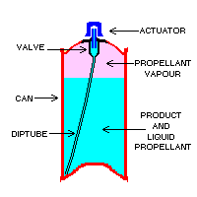
COMPONENTS OF AEROSOLS
Propellant
Container
Valve and actuator
Product concentrate

Slide 6
PROPELLANTS
Responsible for developing proper pressure within the container.
Provide driving force to expel the product from the container.
TYPES OF PROPELLANTS
Liquefied gases Propellants
Compressed gases Propellants

Slide 7

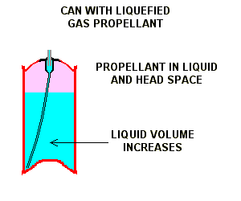
LIQUEFIED GAS PROPELLANTS
Liquefied propellants are gases that exist as liquids under pressure.
Because the aerosol is under pressure propellant exists mainly as a liquid, but it will also be in the head space as a gas.
The product is used up as the valve is opened, some of the liquid propellant turns to gas and keeps the head space full of gas.
In this way the pressure in the can remains essentially constant and the spray performance is maintained throughout the life of the aerosol.

Slide 8
CHLORO FLUORO CARBONS
Propellant of choice for oral and inhalation .
Advantages
Chemical inertness
Lack of toxicity
Non flammability.
Lack of explosiveness.
Disadvantages
High cost
It depletes the ozone layer
Examples: Trichloromonofluoromethane - Propellant 11
Dichlorodifluoromethane - Propellant 12
Dichlorotetrafluoroethane - Propellant 114

Slide 9
HYDROCARBONS
Can be used for water based aerosols and topical use.
Advantages
Inexpensive
Excellent solvents
It does not cause ozone depletion
Disadvantages
Inflammable
Unknown toxicity produced
Ex: Propane - Propellant A-108
Isobutane - Propellant A-31
Butane - Propellant A-17

Slide 10
HYDROFLUORO CARBONS AND
HYDRO CHLORO FLUORO CARBONS
These compounds break down in the atmosphere at faster rate than CFCs.
Lower ozone destroying effect.
Advantages
Low inhalation toxicity
High chemical stability
High purity
Not ozone depleting
Disadvantages
Poor solvent
High cost
Examples: Heptafluoro propane (HFA-227)
Tetrafluoroethane (HFA-134a) Difluoroethane - Propellant 152a Chlorodifluoromethane - Propellant 22
Chlorodifluoroethane - Propellant 142 b

Slide 11
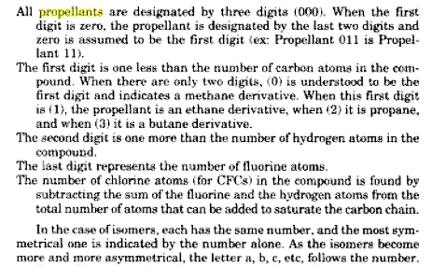
NOMENCLATURE OF PROPELLANTS

Slide 12
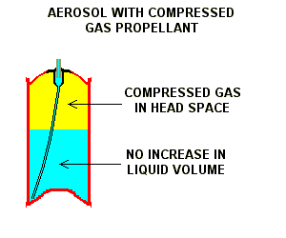
COMPRESSED GAS PROPELLANTS
Compressed gas propellants occupy the head space above the liquid in the can.
When the aerosol valve is opened the gas 'pushes' the liquid out of the can.
The amount of gas in the headspace remains the same but it has more space, and as a result the pressure will drop during the life of the can.
Spray performance is maintained however by careful choice of the aerosol valve and actuator.
Examples: Carbon dioxide, Nitrous oxide and Nitrogen

Slide 13
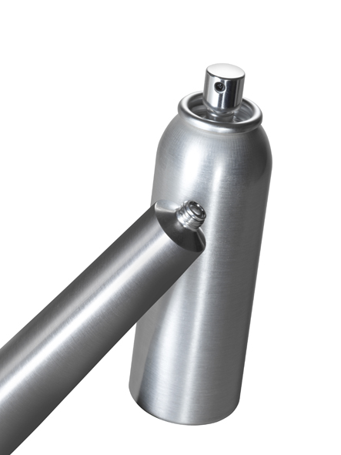
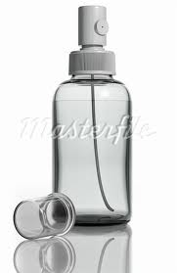
CONTAINERS
They must be able to withstand pressures as high as 140 to 180 psig (pounds per sq. inch gauge) at 130 ° F.
AEROSOL CONTAINERS
A . Metals
Tinplated steel
Aluminum
Stainless steel
B. Glass
1. Uncoated glass
2. Plastic coated glass

Slide 14
TIN PLATED STEEL CONTAINERS
It consist of a sheet of steel plate, this sheet is coated with tin by electrolytic process .
The coated sheet is cut into three pieces ( top , bottom and body) .
The top, bottom are attached to body by soldering .
When required it is coated with organic material usually oleoresin, phenolic , vinyl or epoxy coating .
Welding eliminates soldering process, Saves considerable manufacturing time and decreases the product/container interaction.
Recent developments in welding include Soudronic system and Conoweld system.

Slide 15

ALUMINIUM CONTAINERS
Used for inhalation and topical aerosols .
Manufactured by impact extrusion process.
Light in weight, less fragile, Less incompatibility due to its seamless nature.
Greater resistance to corrosion .
Pure water and pure ethanol cause corrosion to Al containers.
Added resistance can be obtained by coating inside of the container with organic coating like phenolic , vinyl or epoxy and polyamide resins.

Slide 16
STAINLESS STEEL CONTAINERS
Used for inhalation aerosols
Advantage :
Extremely Strong.
Resistant to many materials.
No need for internal coating.
Disadvantage :
Costly

Slide 17
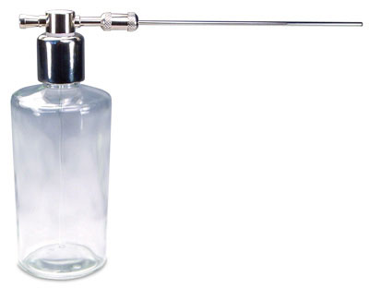
GLASS CONTAINERS
These containers are preferred because of its Aesthetic value and absence of incompatibilities.
These containers are limited to the products having a lower pressure (33 psig) and lower percentage of the propellant.
Used for topical and MDI aerosols.
Two types of glass aerosol containers
i) Uncoated glass container:
Less cost and high clarity and contents can be viewed at all times.
ii) Plastic coated glass containers:
These are protected by plastic coating that prevents the glass from shattering in the event of breakage.

Slide 18
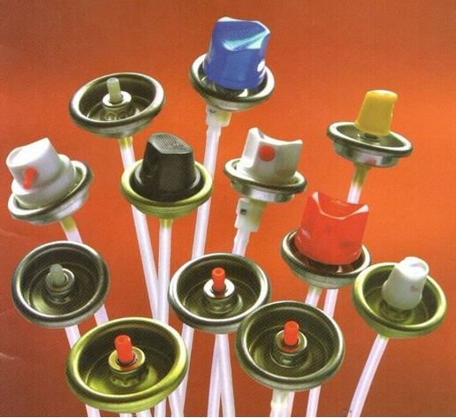
VALVES
Easy to open and close .
Capable of delivering the content in the desired form such as spray, foam, solid stream etc.
It can deliver a given amount of medicament .
TYPES OF VALVES :
Continuous spray valve
Metering valves

Slide 19
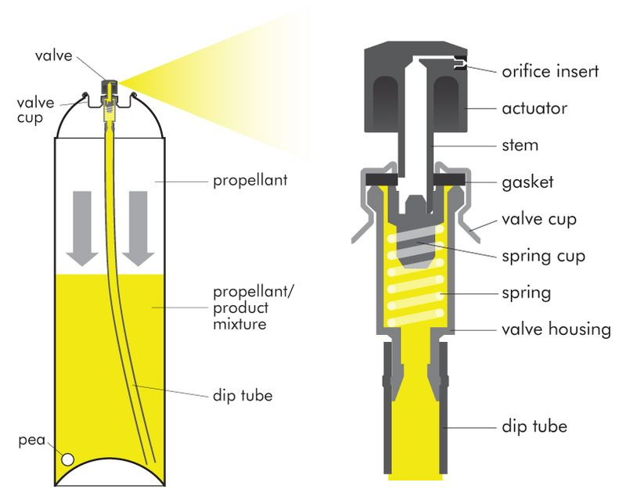
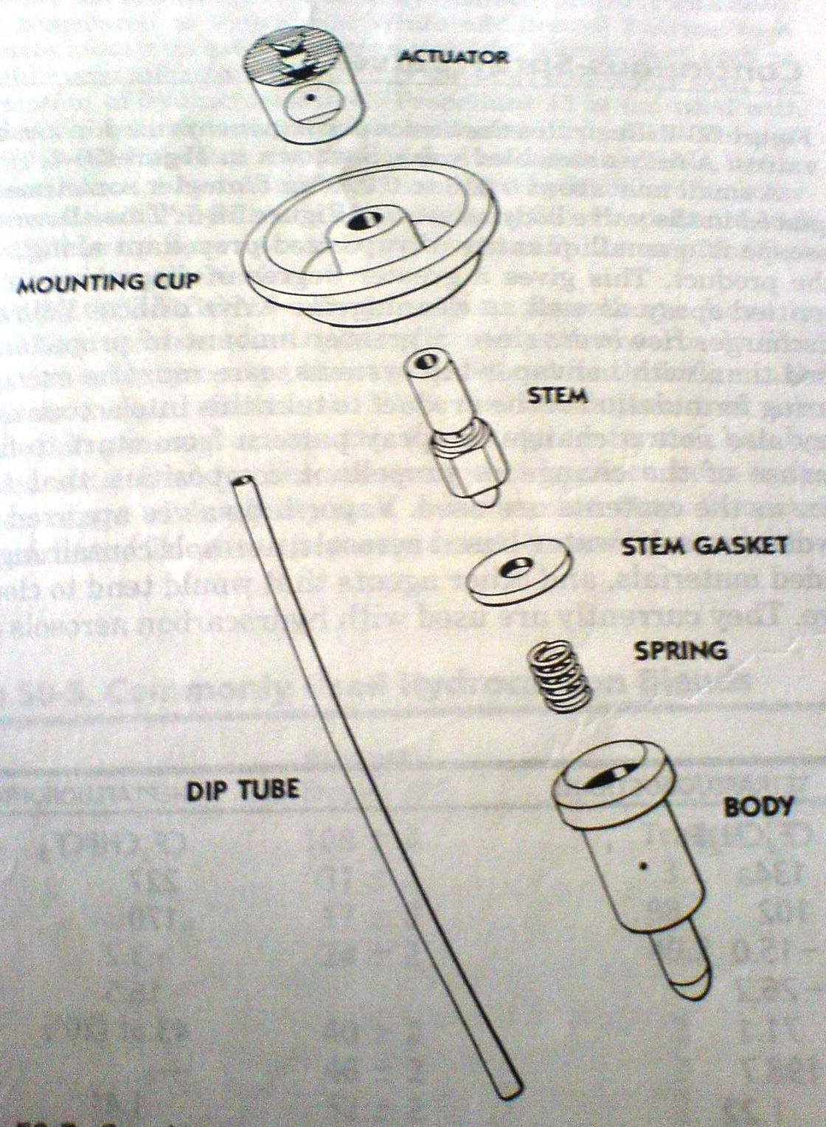
VALVE ASSEMBLY

Slide 20
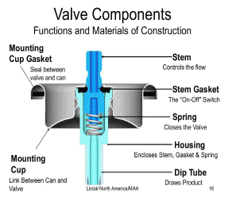
CONTINUOUS SPRAY VALVE
Used for topical aerosols .
Valves assembly consists :
Ferrule or mounting cup
Valve body or housing
Stem
Dip tube
Gasket
Spring

Slide 21
FERRULE OR MOUNTING CUP :
Used to attach valve to container.
Made from Tin plated steel, Al , Brass .
Under side of the valve cup is coated with single or double epoxy or vinyl resins.
VALVE BODY OR HOUSING :
Made up of Nylon or Derlin and contains a opening at the point of attachment of dip tube. (0.013 to 0.080 inch)
STEM :
Made from Nylon or Derlin , brass and stainless steel can also be used. (orifice - 0.013 to 0.030 inch).

Slide 22
GASKET :
Made from Buna-N and neoprene rubber.
SPRING :
Made from Stainless steel .
Used to hold gasket in place.
DIP TUBE :
Made from Poly ethylene or poly propylene.
Inner diameter 0.120 – 0.125 inch.
However for Capillary dip tube inner diameter is 0.050 inch and for highly viscous products it is 0.195 inch.

Slide 23
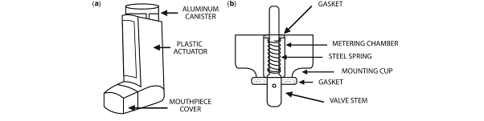
METERING VALVES
Used for dispensing of potent medication.
Operates on the principle of a chamber whose size determines the amount of medication dispensed.
Approximately 50 to 150 mg ±10 % of liquid materials can be dispensed at one time with the use of such valve.
MDI
Metering valve

Slide 24

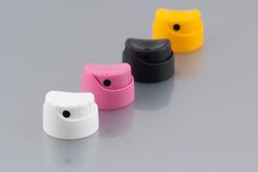
ACTUATORS
These are specially designed buttons which helps in delivering the drug in desired form i.e., spray, wet stream, foam or solid stream .
TYPES OF ACTUATORS :
Spray actuators
Foam actuators
Solid steam actuators
Special actuators

Slide 25
SPRAY ACTUATORS:
It can be used for topical preparation, such as antiseptics, local anesthetics and spray on bandages etc.
It allows the stream of product concentrate and propellant to pass through various openings and dispense as spray.
FOAM ACTUATORS :
It consist of large orifice which ranges from 0.070—0.125 inch .
SOLID STREAM ACTUATORS :
These actuators are required for dispensing semi solid products such as ointments .
SPECIAL ACTUATORS :
These are used for a specific purpose.
It delivers the medicament to the appropriate site of action such as throat, nose, dental and eyes etc.

Slide 26
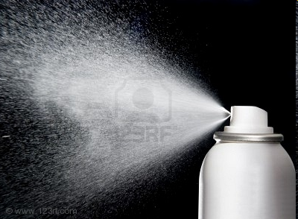
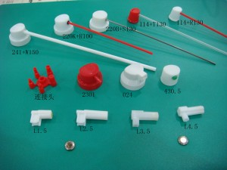
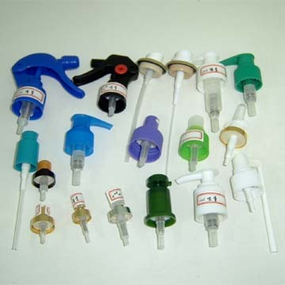
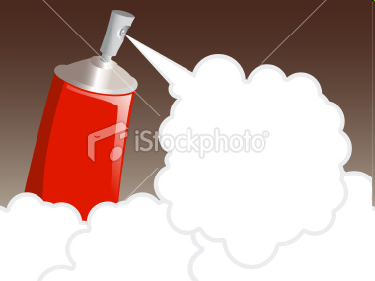
SPRAY
ACTUATORS
ACTUATORS
FOAM

Slide 27

METERED DOSE INHALERS
Used to minimize the number of administration errors.
To improve the drug delivery of aerosolized particles into the nasal passageways and respiratory tract.
Advantages of MDI:
It delivers specified amount of dose .
Portable and compact.
Quick to use , no contamination of product.
Dose-dose reproducibility is high.
Disadvantages of MDI :
Low lung deposition ; high pharyngeal deposition .
Coordination of MDI actuation and patient inhalation is needed.

Slide 28

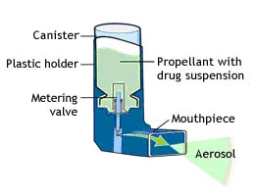
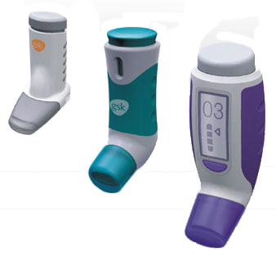
Metered Dose Inhalers (MDIs)

Slide 29
MARKETED PHARMACEUTICAL AEROSOL PRODUCTS
Metered Dose inhalers :
BRAND NAME | DRUG | USE
Flovent Diskus | Fluticasone | Asthma
Advair | Fluticasone and Salmeterol | Asthma
Aerobid | Flunisolide | Asthma
Qvar | Beclomethasone | Asthma
Proventil | Albuterol | Bronchospasm

Slide 30
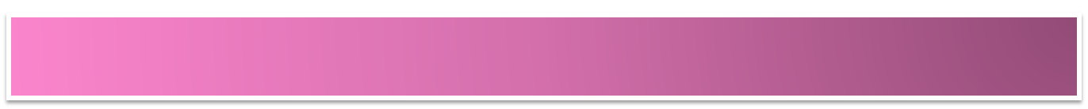
FORMULATION OF AEROSOLS
It consist of two essential components :
Product concentrate and
Propellant
Product concentrate :
Active ingredient or mixture of active ingredients and other necessary agents such as solvents, anti oxidants and surfactants.
Propellant :
Single or blend of various propellants is used.
Blend of solvents is used to achieve desired solubility characteristics.

Slide 31
Various surfactants are mixed to give the proper HLB value for emulsion system.
The propellants are selected to give the desired vapor pressure, solubility and particle size.
Pharmaceutical aerosol may be dispensed as fine mist, wet spray, quick breaking foam, stable foam, semi solid etc.
Type of system selected depends on
Physical, chemical and pharmacological properties of drug.
Site of application .

Slide 32
TYPES OF SYSTEMS
TYPES OF AEROSOL SYSTEMS :
Solution system
Water based system
Suspension or Dispersion systems
Foam systems
1. Aqueous stable foams
2. Non aqueous stable foams
3. Quick-breaking foams
4. Thermal foams
Intranasal aerosols

Slide 33

SOLUTION SYSTEM
This system is also referred to as Two phase system consists of vapor and liquid phase.
If active ingredient is soluble in propellant ,no other solvent is required.
The vapor pressure of system is reduced by the addition of less volatile solvents such as ethanol, acetone , propylene glycol, glycerin, ethyl acetate. This results in production of larger particles upon spraying.
Amount of Propellant may vary from 5% (for foams) to 95% (for inhalations).
General formula weight %
Active drug - to 10-15
Propellant 12/11 (50:50) - to 100

Slide 34
INHALATION AEROSOL :
Formulation Weight %
Isoproterenol Hcl – 0.25
Ascorbic acid – 0.1
Ethanol – 35.75
Propellant 12 – 63.9
Packed in 15 -30 ml Stainless Steel, Aluminum or glass container.
HYDROCARBONS IN TOPICAL AEROSOL PHARMACEUTICAL PREPARATIONS :
Formulation Weight %
Active ingredient -up to 10-15
Ethanol - up to 10-15
Water - 10-15
Hydro Carbon propellant (A-46) - 55-70

Slide 35
Depending on water content the final product may be solution or three phase system.
Solution aerosols produce a fine to coarse spray.
Hydrocarbon propellant A-70 produces drier particles while propellants A-17 and A-31 tend to produce a wetter spray.
These are useful for topical preparations.
Packaged in Plastic coated glass containers.

Slide 36
WATER BASED SYSTEM
Large amounts of water can be used to replace all or part of the non aqueous solvents used in aerosols.
Produce spray or foam.
To produce spray, formulation must consist of dispersion of active ingredients and other solvents in emulsion system in which the propellant is in the external phase.
Since propellant and water are not miscible, a three phase aerosol forms (propellant, water and vapor phases).
Ethanol can be used as cosolvent to solubilize propellant in water. It also reduces surface tension aiding in the production of smaller particles .
0.5 to 2% of surfactant is used to produce a homogenous dispersion.

Slide 37
Surfactants with low water solubility and high solubility in non polar solvents will be most useful eg: Long chain fatty acid esters of polyhydric compounds including glycol, glycerol and sorbitan esters of oleic, stearic, palmitic and lauric acids .
Propellant concentration varies from about 25 to 60%.
Aquasol system (Aquasol valve) – dispensing fine mist or spray of active ingredient dissolved in water .
No chilling effect, since only active ingredient and water are dispensed, propellant is in vapor state.
Difference between aquasol system and three phase system is aquasol dispenses fairly dry spray with very small particles, non flammability of the product .

Slide 38
SUSPENSION SYSTEM
It involves dispersion of active ingredient in the propellant or mixture of propellants.
To decrease the rate of settling of dispersed particles, surfactants or suspending agents can be added.
Primarily used for inhalation aerosols.
Example:
Formulation Weight%
Epinephrine bitartrate (1-5 Microns) 0.50
Sorbitan trioleate 0.50
Propellant -114 49.50
Propellant -12 49.50
Epinephrine bitartrate has minimum solubility in propellant system but soluble in fluids in the lungs.

Slide 39
Physical stability of aerosol dispersion can be increased by:
Control of moisture content. (< 300 ppm)
Reduction of initial particle size to less than 5 µm.
Adjustment of density of propellant and suspensoid so that they are equalized.
Use of dispersing agents.
Use of derivatives of active ingredients with minimum solubility in propellant system.

Slide 40
Physical stability of a dispersed system depends on rate of agglomeration of the suspensoid.
Agglomeration is accelerated at elevated temperatures and it is also affected by particle size of drug (1-5µ , never > 50 µ).
Agglomeration results in valve clogging , inaccuracy of dosage and depending on the nature of active ingredients, it may cause damage to the liner and metal container.
Isopropyl myristate and mineral oil are used to reduce agglomeration.
Surfactants of HLB value less than 10 are utilized for aerosol dispersions (sorbitan monooleate, monolaurate, trioleate, sesquioleate).
Surfactants are effective in a concentration of 0.01 to1 %.

Slide 41

FOAM SYSTEMS
Emulsion and foam aerosols consist of active ingredients, aqueous or non aqueous vehicle, surfactant, Propellant and are dispensed as a stable or quick breaking foam depending on the nature of the ingredients and the formulation.
AQUEOUS STABLE FOAM :
Formulation %w/w
Active ingredient
Oil waxes
o/w surfactant 95-96.5
Water
Hydrocarbon Propellant (3 -5%) 3.5-5

Slide 42
Total propellant content is usually (3 or 5% w/w or 8-10% v/v) .
As the amount of propellant increases a stiffer and dryer foam is produced.
Lower propellant concentrations yield wetter foams.
Hydrocarbon and compressed gas propellants are used.
NON-AQUEOUS STABLE FOAM :
Formulation %w/w
Glycol 91-92.5
Emulsifying agent 4
Hydrocarbon propellant 3.5-5
Glycols such as poly ethylene glycols are used.
Emulsifying agent is propylene glycol monostearate.

Slide 43
QUICK BREAKING FOAM :
Propellant is in the external phase .
When dispensed the product is emitted as a foam, which then collapses into a liquid.
Especially applicable to topical medications .
Formulation %w/w
Ethyl alcohol 46-66
Surfactant 0.5-5
Water 28-42
Hydrocarbon Propellant 3-15
Surfactant should be soluble in both alcohol and water and can be of non ionic or cationic or anionic type.

Slide 44
THERMAL FOAM :
Used to produce warm foam for shaving .
Used to dispense hair colors and dyes but were unsuccessful due to the corrosion problems and are expensive , inconvenient to use and lack of effectiveness.
INTRANASAL AEROSOLS :
Intended to deposit medication into nasal passages for local or systemic effect.
ADVANTAGES
Deliver measured dose of drug.
Require lower doses compared to other systemic products.
Excellent depth of penetration into the nasal passage way.
Decreased mucosal irritability .
Maintenance of sterility from dose to dose.
Greater flexibility in the product formulation.

Slide 45
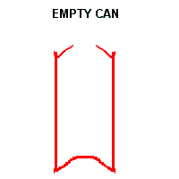
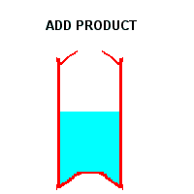
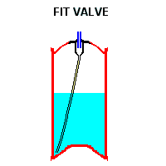
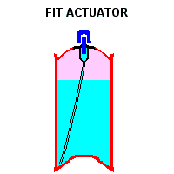
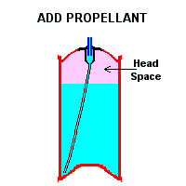
Manufacture of aerosols

Slide 46
MANUFACTURE OF PHARMACEUTICAL AEROSOLS
Pressure filling apparatus
Cold filling apparatus
Compressed gas filling apparatus
PRESSURE FILLING APPARATUS
It consists of a pressure burette capable of metering small volumes of liquefied gas into the aerosol container under pressure.
Propellant is added through an inlet valve located at the bottom or top of the pressure burette.
The propellant is allowed to flow with its own vapor pressure in the container through aerosol valve.
The trapped air escapes out from the upper valve.

Slide 47
The propellant stops flowing when the pressure of burette and container becomes equal.
If further propellant is to be added, a hose (rubber pipe) leading to a cylinder of nitrogen is attached to the upper valve, the pressure exerted by nitrogen helps in the flow of the propellant into the container.
Another pressure filling device makes use of piston arrangement and is capable of maintaining positive pressure .
This type of device cannot be used for filling inhalation aerosols which have metered valves.

Slide 48
PROCEDURE:
This method involves filling of the concentrate into the container at the room temperature.
Then the valve is placed in the container and crimped.
Through the opening of the valve the propellant are added or it can be added “under the cap”.
Since the opening of the valve are smaller in size ranging from 0.018-0.030 inches, it limits the production and the process becomes slow.
But with the use of rotary filling machines and newer filling heads where the propellants are filled through valve stem, the production rate is increased.
The trapped air in the container and air present in head space is removed before filling the propellant to protect the products from getting adversely affected.

Slide 49
Various units used in pressure filling line are arranged in the following order :
Unscrambler , Air cleaner , Concentrate filler , Valve placer , Purger ,Valve crimper , Propellant filler ,Water bath , Labeler , Coder and Packing table .
Purger ,vacuum crimper and pressure filler are replaced with a single unit if filling is carried by ‘under the cap’ method.

Slide 50
ADVANTAGES OF PRESSURE FILLING:
Solutions, emulsions, suspensions can be filled by this method as chilling does not occur.
Contamination due to moisture is less.
High production speed can be achieved.
Loss of propellant is less.
DISADVANTAGES :
Certain types of metering valves can be handled only by the cold filling process or through use of an under the cap filler and valve crimper.
Process is slower than Cold filling method.

Slide 51
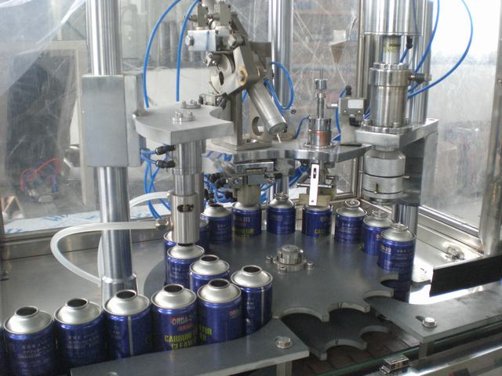
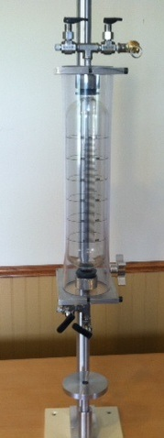
Pressure filling Equipment
Pressure burette

Slide 52
COLD FILLING APPARATUS
It consist of an insulated box fitted with copper tubings and
the tubings are coiled to increase the area exposed to cooling.
The insulated box should be filled with dry ice or acetone prior to use.
The apparatus can be operated with or without metered valves.
Hydrocarbon propellant cannot be filled into aerosol containers using this apparatus because large amount of propellant escapes out and vaporizes.
This may lead to formation of an explosive mixture .
Fluorocarbon vapors do not form any explosive or flammable mixture though their vapors are heavier than air.

Slide 53
PROCEDURE:
Non aqueous products and products which can withstand low temperatures of - 40°F are used in this method.
The product concentrate is chilled to a temperature of - 40°F and filled into already chilled container.
Then the chilled propellant is added completely in 1 or 2 stages, depending on the amount.
Another method is to chill both the product concentrate and propellant in a separate pressure vessel to - 40 °F and then filling them into the container.
The valve is placed and crimped on to the container.
Then test for leakage and strength of container is carried out by passing container into a heated water bath, where the contents of the container are heated to 130°F. After this, the containers are air dried , capped and labeled.

Slide 54
Various units used in cold filling methods are :
Unscrambler, Air cleaner ,Concentrate filler ,Propellant filler ,Valve placer ,Valve crimper ,Water bath ,Labeler, Coder and Packing table .
The cold filling method is no longer being used, as it has been replaced by pressure filling method.
Advantage:
Easy process .
Disadvantages :
Aqueous products, emulsions and those products adversely affected by cold temperature cannot be filled by this method.

Slide 55
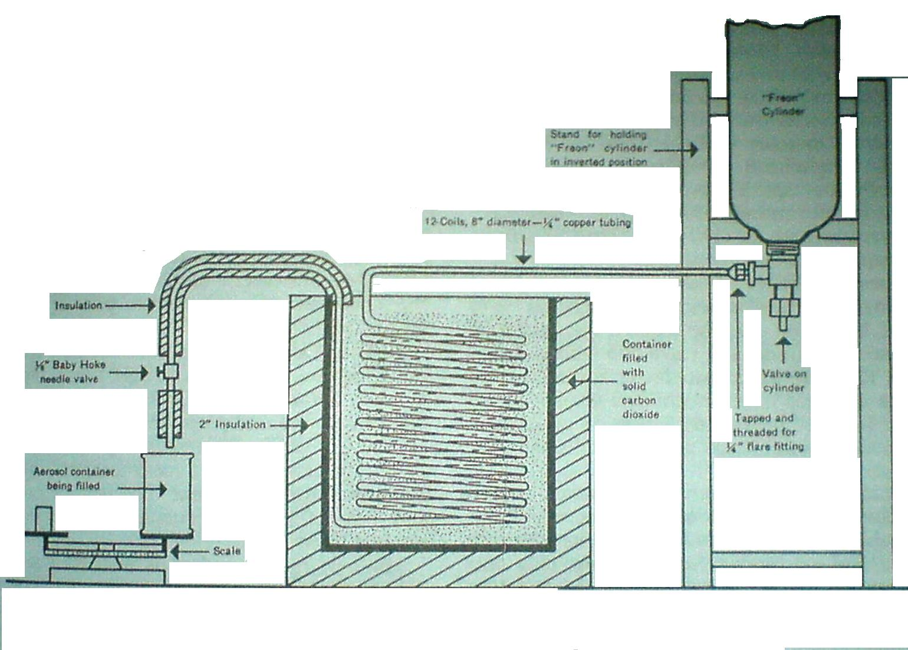
COLD FILLING APPARATUS

Slide 56
COMPRESSED GAS FILLING APPARATUS
Compressed gases have high pressure hence a pressure reducing valve is required.
The apparatus consists of delivery gauge.
A flexible hose pipe which can withstand 150 pounds per square inch gauge pressure is attached to the delivery gauge along with the filling head.
A flow indicator is also present in specialized equipments.
PROCEDURE :
The product concentrate is filled into the container.
Valve is placed and crimped on the container.
With the help of vacuum pump the air is removed from the container.

Slide 57
Filling head is put in the opening of the valve and the valve is depressed and the gas is allowed to flow in to container.
The gas stops flowing if the delivery pressure and the pressure within the container become equal.
Carbon dioxide and nitrous oxide is used if more amount of gas is required.
High solubility of the gas in the product can be achieved by shaking the container manually or with the help of mechanical shakers.

Slide 58

QUALITY CONTROL TESTS
It includes the testing of
1. Propellants
2. Valves, Actuators and Dip Tubes
3. Containers
4. Weight Checking
5. Leak Testing
6. Spray Testing

Slide 59
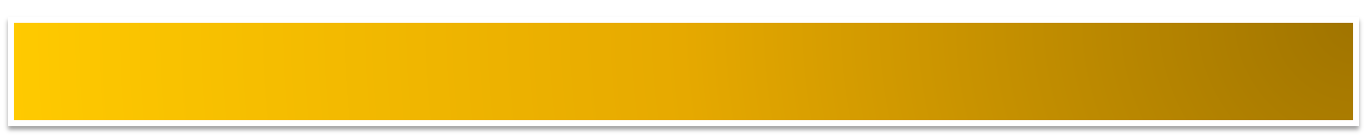

1. PROPELLANTS :
Vapor pressure and density of the propellant are determined and compared with specification sheet.
Parameter | Tested By
Identification Purity and acceptability | Gas Chromatography IR Spectroscopy Moisture, Halogen, Non-Volatile Residue determinations

Slide 60
2. VALVES , ACTUATORS AND DIP TUBES :
Sampling is done according to standard procedures as found in Military Standards “MIL-STD-105D”.
For metered dose aerosol valves ,test methods were developed by
‘Aerosol Specifications Committee’
‘Industrial Pharmaceutical Technology Section
‘Academy Of Pharmaceutical Sciences.
The objective of this test is to determine magnitude of valve delivery & degree of uniformity between individual valves.
Standard test solutions were proposed to rule out variation in valve delivery.

Slide 61
TEST SOLUTIONS
Ingredients % w/w | Test Solutions ‘A’ | Test Solutions ‘B’ | Test Solutions ‘C’
Iso Propyl Myristate | 0.10% | 0.10% | 0.10%
Dichloro Difluoro methane | 49.95% | 25.0% | 50.25%
Dichloro tetrafluoro ethane | 49.95% | 25.0% | 24.75%
Trichloro monofluoro methane | - | - | 24.9%
Alcohol USP | - | 49.9% | -
Specific Gravity @ 25^{°c} | 1.384 | 1.092 | 1.388

Slide 62
Testing Procedure:
Take 25 valves and placed on containers filled with specific test solution.
Actuator with 0.020 inch orifice is attached.
Temperature -25±1°C.
Valve is actuated to fullest extent for 2 sec and weighed.
Again the valve is actuated for 2 sec and weighed.
Difference between them represents delivery in mg.
Repeat this for a total of 2 individual deliveries from each of 25 test units.
Individual delivery wt in mg.
Valve delivery per actuation in µL =
Specific gravity of test solution
Valve Acceptance: Deliveries Limit’s
54µL or less ± 15%
55 to 200 µL ± 10%

Slide 63
Of the 50 individual deliveries,
If 4 or more are outside the limits : valves are rejected
If 3 deliveries are outside limits : another 25 valves are tested.
Lot is rejected if more than 1 delivery is outside the specifications.
If 2 deliveries from 1 valve are beyond limits : another 25 valves are tested.
Lot is rejected if more than1 delivery is outside specification.

Slide 64
3. CONTAINERS :
Containers are examined for defects in lining.
Quality control aspects includes degree of conductivity of electric current as measure of exposed metals.
Glass containers examined for Flaws.
4. WEIGHT CHECKING :
Is done by periodically adding to the filling line tared empty aerosol containers, which after filling with concentrate are removed & weighed.
Same procedure is used for checking weight of Propellants being added.

Slide 65
5. LEAK TESTING :
It is a means of checking crimping of the valve and detect the defective containers due to leakage.
Is done by measuring the Crimp’s dimension & comparing.
Final testing of valve closure is done by passing the filled containers through water bath.
6. SPRAY TESTING :
Most pharmaceutical aerosols are 100% spray tested.
This serves to clear the dip tube of pure propellant and pure concentrate.
To check for defects in valves and spray pattern.

Slide 66
EVALUATION TESTS
A. Flammability and combustibility :
        1. Flash point
        2. Flame Projection
B. Physicochemical characteristics :
        1. Vapor pressure
        2. Density
        3. Moisture content
        4. Identification of Propellants

Slide 67
C. Performance:
        1. Aerosol valve discharge rate
        2. Spray pattern
        3. Dosage with metered valves
        4. Net contents
        5. Foam stability
        6. Particle size determination
D. Biological testing :
        1. Therapeutic activity
        2. Toxicity studies

Slide 68
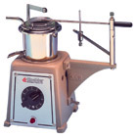
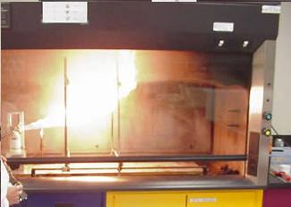
A. Flammability and combustibility
1. Flash point:
Apparatus : Tag Open Cup Apparatus
Product is chilled to – 25°F and test liquid
temperature is allowed to increase slowly and the temperature at which vapors ignite is called as Flash Point .
2. Flame Projection:
Product is sprayed for 4 sec
into a flame and the flame is
extended ,exact length is
measured with a ruler.

Slide 69
B. Physicochemical characteristics:
Property | Method
1. Vapor Pressure | » Pressure gauge » Can Puncturing Device.
2. Density | » Hydrometer, » Pycnometer.
3. Moisture | » Karl Fisher Method, » Gas Chromatography.
4. Identification of propellants | » Gas Chromatography, » IR Spectroscopy.

Slide 70
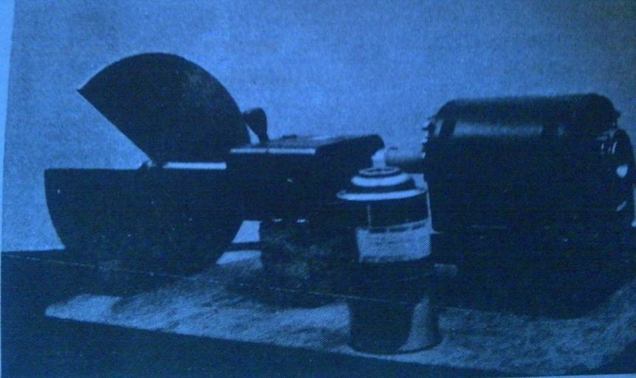
C. Performance:
1. Aerosol valve discharge rate :
Contents of the aerosol product of known weight is discharged for specific period of time.
By reweighing the container after the time limit, the change in the weight per time dispensed gives the discharge rate ( g/sec).
2. Spray pattern :
The method is based on the
impingement of spray on piece of
paper that has been treated with
Dye-Talc mixture.
The particles that strike the paper
cause the dye to go into solution and to be adsorbed onto paper giving a record of spray for comparison purpose.

Slide 71
3. Dosage with metered valves :
Reproducibility of dosage can be determined by:
»Assay techniques
»Accurate weighing of filled container followed by dispensing of
several doses . Containers are then reweighed and difference in
weight divided by number of doses dispensed gives average dose.
4. Net Contents :
Tared cans that have been placed onto the filling lines are reweighed and the difference in weight is equal to the net contents.
In Destructive method : weighing a full container and then dispensing as much of the content as possible . The contents are then weighed . This gives the net content.

Slide 72
5. Foam stability :
Methods : » Visual Evaluation,
» Time for given mass to penetrate the foam,
» Time for given rod that is inserted into the foam to fall ,
» Rotational Viscometer.
6. Particle Size Determination :
Methods : » Cascade Impactor,
» Light Scattering Decay.

Slide 73
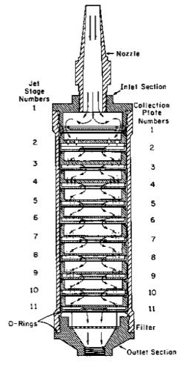
a). Cascade Impactor :
Principle :
Stream of particles projected
through a series of nozzles and
glass slides at high velocity,
larger particle are impacted first
on lower velocity stage and
smaller particles are collected
at higher velocity stage.
b). Light Scattering Decay :
Principle :
As aerosol settles under turbulent
conditions, the change in the light
intensity of a Tyndall beam is
measured.

Slide 74
D. Biological testing:
1.Therapeutic Activity :
» For Inhalation Aerosols : dosage of the product is determined and is related to the particle size distribution.
» For Topical Aerosols : is applied to test areas and adsorption of therapeutic ingredient is determined.
2.Toxicity :
» For Inhalation Aerosols : exposing test animals to vapors sprayed from aerosol container.
» For Topical Aerosols : Irritation and Chilling effects are determined.

Slide 75
CONCLUSION
At present there is much interest in developing MDIs for conditions including asthma, COPD, Chronic bronchitis ,emphysema and other respiratory diseases etc.
Many of compounds have been developed using biotechnology process and their delivery to the respiratory system via MDI in an extremely challenging undertaking.
As Chlorofluorocarbon (CFC) propellants cause ozone depletion , they are being replaced with acceptable
Hydro fluoro carbons (HFC) propellants.

Slide 76

References:
“The Theory & Practice Of Industrial Pharmacy” by Leon Lachman , H.A.Lieberman.
Remington’s “The Science & Practice Of Pharmacy” 21st Edition, Volume-I.

Slide 77


