Slide 1
Applying Machine Learning
Modules on a DNA strand i.e., on a
Prompter Genes
Project Progress Update
By: Saroj Shah

Slide 2
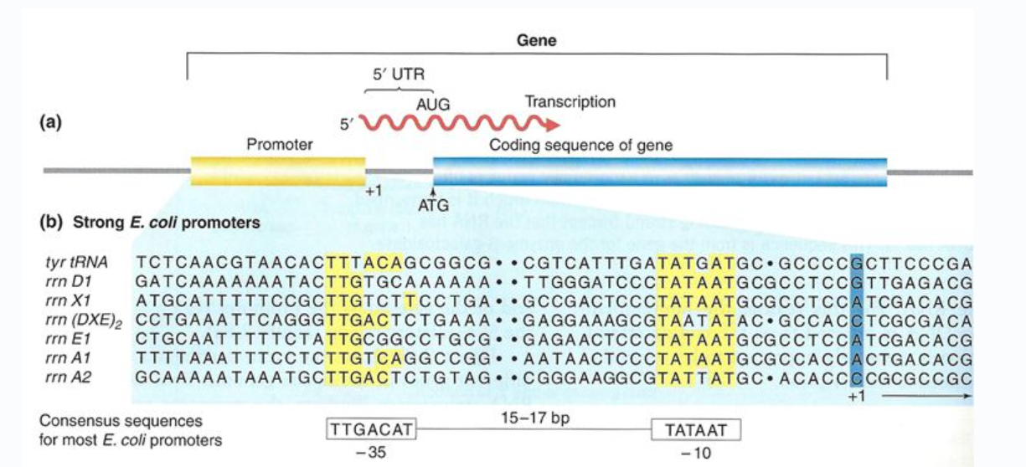
Introduction:
The project focuses on applying various machine learning (ML) techniques to DNA strands of E. coli (especially the promoter gene).
DNA classification is the process of categorizing DNA sequences into specific groups based on their characteristics.

Slide 3
Purpose and goals:
The primary goal of this project is to apply appropriate ML techniques such as preprocessing, training and testing, and evaluation to the imported dataset to develop the most suitable ML algorithm for DNA/RNA strand classification.
This classification can serve as a foundation for future research, particularly in identifying various disease-causing bacteria and viruses.

Slide 4
Approach and methodology:
MATLAB will be used to write and simulate ML code
The methodology consists of three phases –
  The First phase includes Data Collection, encoding, and fixing missing or misaligned nucleosides and other necessary data transformations.
  The Second phase focuses on training, testing, and evaluating performance (scores) by using various methods like K-Nearest Neighbors, Neural Net, and others.
  The third phase involves comparing scores to determine the most effective methods for the DNA/RNA classification.

Slide 5
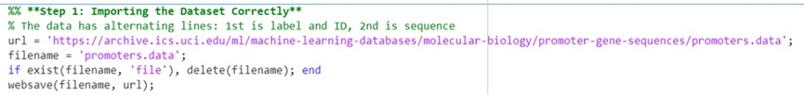
Data Collection:
For the project, the dataset can either be used directly from the UC Irvine Machine Learning Repository: https://archive.ics.uci.edu/ml/.../promoters.data
Or it can be downloaded and stored locally for safer and more reliable access during the project.
For this project, the second method is used.

Slide 6
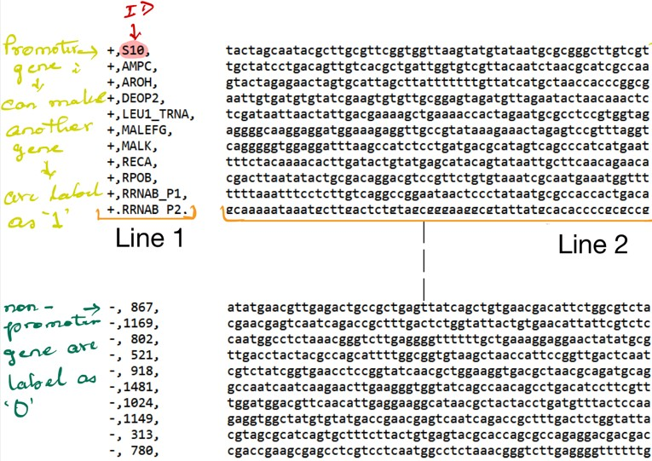
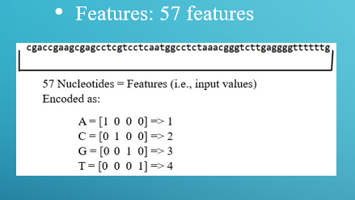
About Data:
The dataset contains 105 rows (DNA sequence) and 2 columns. Each row includes:
Column 1 (Line 1): the label (either 1 or 0)
Column 2 (Line 2): a sequence of 57 nucleotides (DNA base pairs), i.e., 57 features.
There are two types of labels:
Label 1: Promoter gene — involved in initiating DNA replication
Label 0: Non-promoter gene — performs other functions such as protein synthesis.

Slide 7
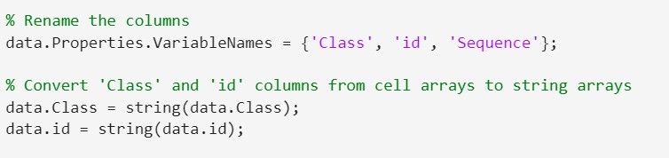
Data Set-Up:
Data Import & Setup: After importing the dataset, the columns were renamed as Class, ID, and Sequence.
The Class and ID columns were then converted to string data types for easier manipulation.

Slide 8
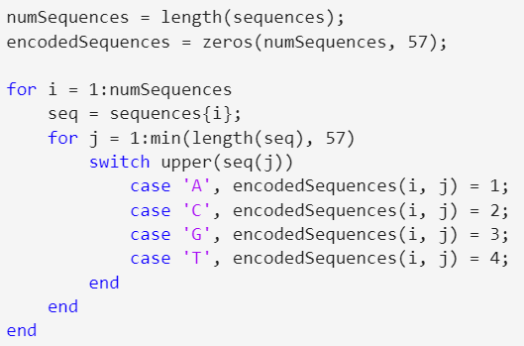
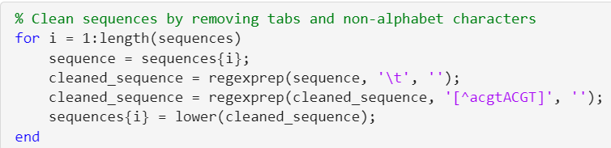
Pre-processing:
Cleaning: Removed whitespace, tabs, and prefix characters from raw data
Sequence Filtering: Retained only valid nucleotides: A, C, G, T, using regex
  Encoding: Mapped nucleotides to numbers: A = 1, C = 2, G = 3, T = 4

Slide 9
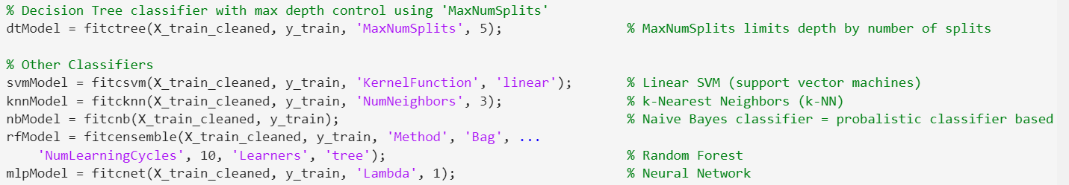
Training and Testing:
  Data Splitting: Split into 70% training and 30% testing datasets
  Multiple models used, such as KNN, SVM (Support Vector Machine), Decision Tree, Naive Bayes, Neural Networks, and others.

Slide 10
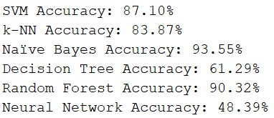
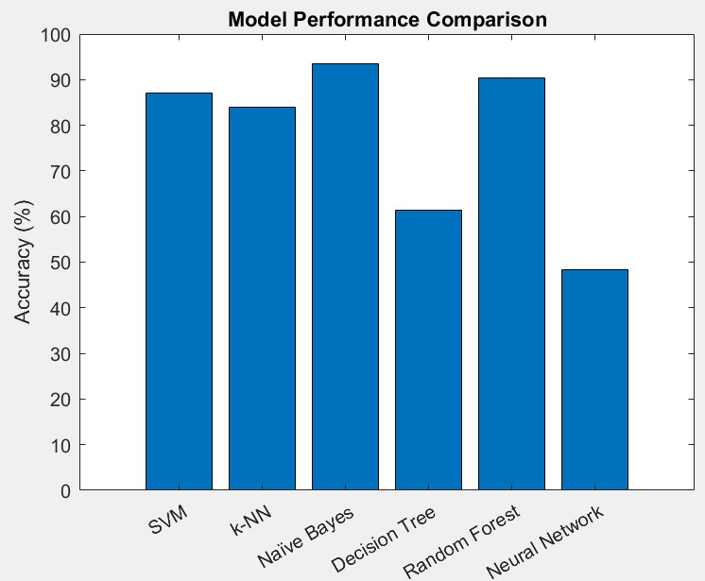
Results:
Accuracy Result:
Visualization:
Bar Chart

Slide 11
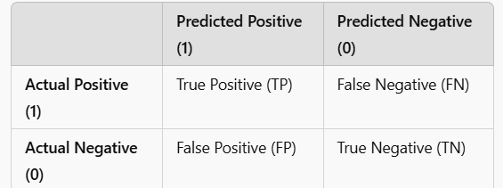
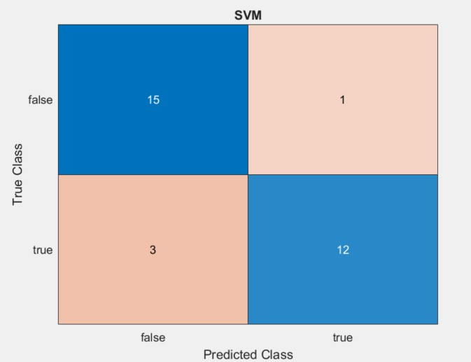
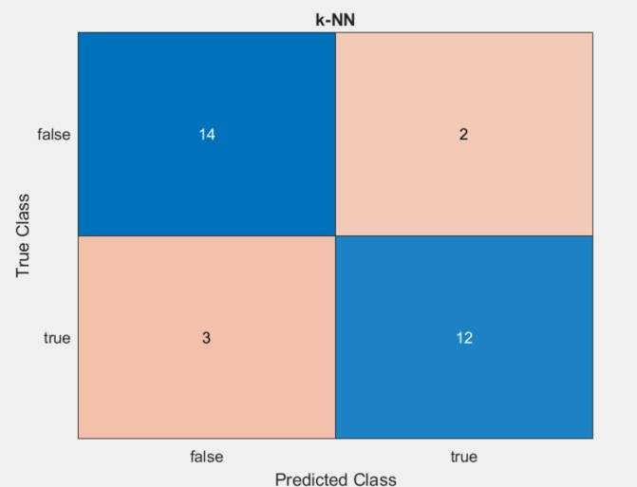
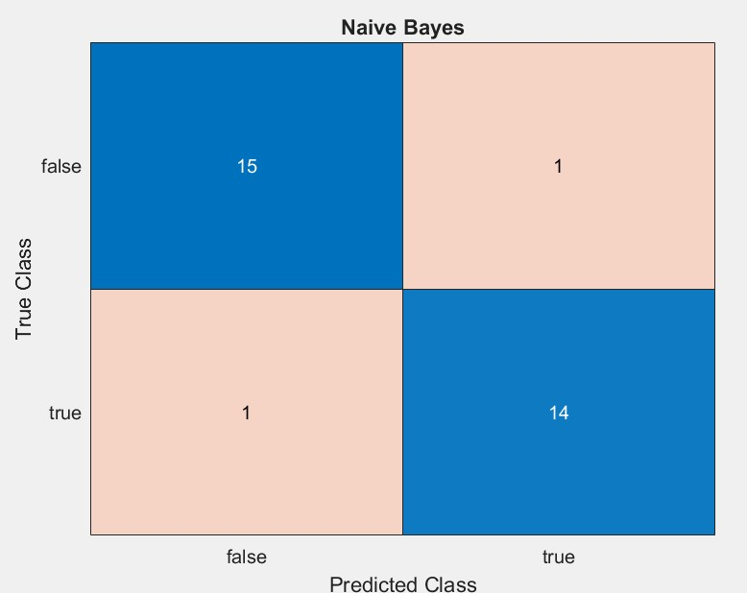
Confusion Matrices:

Slide 12
Conclusion:
Comparing the accuracy scores and classification enables the identification of the most effective method for DNA/RNA classification. Here in this project, since my data is small, Naïve Bayes scored outperformed others. But in reality, if you have a bigger data, the SVM is better for DNA Classification.
As this project involves exploring and applying various machine learning techniques, it provides valuable insights into the underlying processes involved in building ML/AI models.

Slide 13
Thank you!

Slide 14
Works Cited
Elgala, Hany. Class Notes, “Introduction to Machine Learning for Engineers- IECE 565.”
Harley, C., R. Reynolds, and M. Noordewier. "Molecular Biology (Promoter Gene Sequences)." UCI Machine Learning Repository, 1987, https://doi.org/10.24432/C5S01D. Accessed 4 Feb. 2025.
ajitsingh98. “GitHub - Ajitsingh98/DNA-Classification-Machine-Learning-Project: Classify DNA Sequence into Binary Class Using Different Classification Algorithms.” GitHub, 2019, github.com/ajitsingh98/DNA-Classification-Machine-Learning-Project. Accessed 4 Feb. 2025.
Chat GPT

