Slide 1

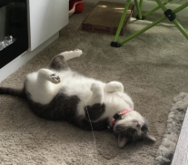
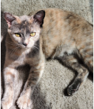

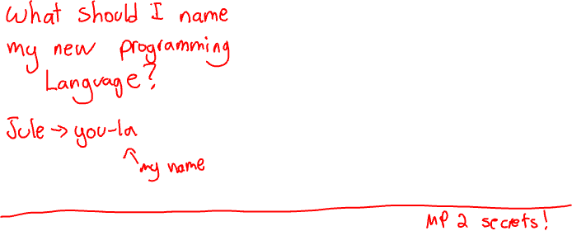
CS 340
clicker.cs.illinois.edu
Q1
~Code~ 340
A Program’s Memory | Virtual Memory
Justin P.
Sage Y.
“Arr me see green turtle”
Notes:
MP 2 secrets!
What would be the best name for a new programming language I invent?
Jule (so I can constantly be correcting people on the pronunciation)
Oolong (a more chill version of java)
oop (the midwestern slang for excuse me not to be confused with object oriented programming)
Sea (not to be confused with C)

Slide 2
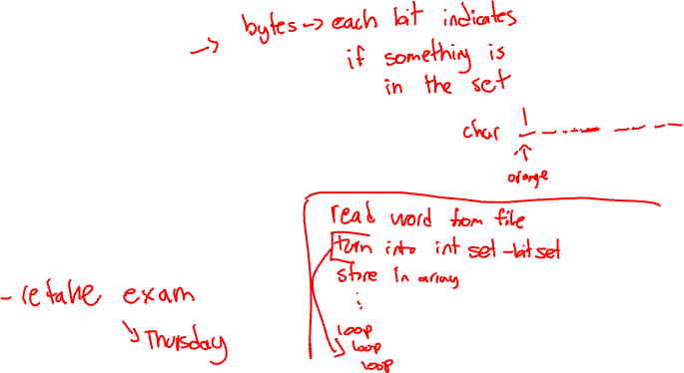
Updates
MP3 - Due Today
MP4 - Out today, due next week
  No MPP this week
HW5 - due Wednesday

Slide 3

Program’s Memory | Virtual Memory
Today’s LGs - Deepen your understanding of how memory works in a C program and on your computer.
Be able to differentiate between globals/static, the stack, and the heap
Be able to identify common issues with the stack and the heap use
Be able to implement a simplified, efficient version of the C allocator
Be able to articulate why we use virtual memory in a computer
Be able to put together system concepts with virtual memory.

Slide 4
Agenda
A Program’s Memory
  Description
  Examples
  Clickers
MP4 intro
Virtual Memory
  Description
  Examples
  Clickers

Slide 5
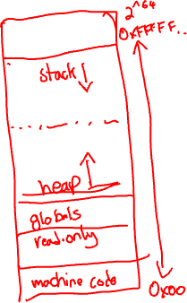
The C Program’s View of its Memory Space
Notes:
The heap grows by asking the OS to map more pages.
The stack grows automatically until its fixed limit.
High address
Stack
Unmapped address space
Heap
globals, read-only, static
Machine code
Low addresses

Slide 6
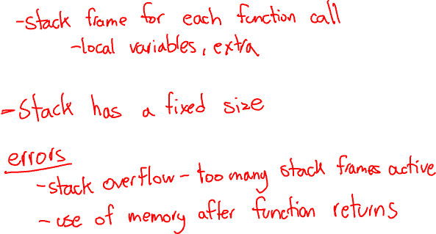
The Stack
Notes:
-stack frames get added as they are needed to store local variables and function information
-Has a fixed size limit (to avoid infinite recursion being an issue for example)
Error - Stack overflow - too much data or deep recursion
Error - use of memory after function returns

Slide 7
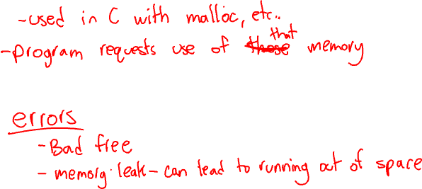
The Heap
Notes:
Grows upwards
Program requests use of those addresses on a as needed basis
Errors
Bad free
Memory leak - can lead to running out of space

Slide 8
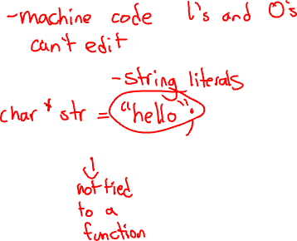
Code/Globals/Static Memory
Code
Read only globals
Static and global variables
Notes:
Code -> assembly->machine code (1s and 0s) stored in the program’s memory (cannot be edited)
char* str = “hello”
Static - can still be tied to a function but it’s value is stored here not in a stack frame on the stack
Global - not tied to a function ← cannot live on the stack

Slide 9
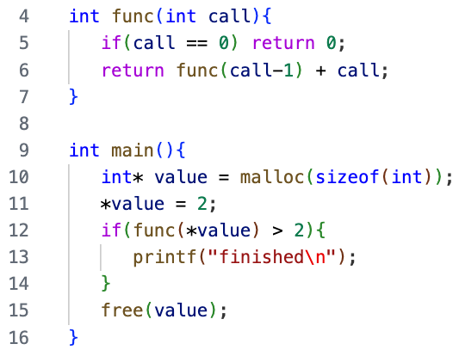

Example

Slide 10
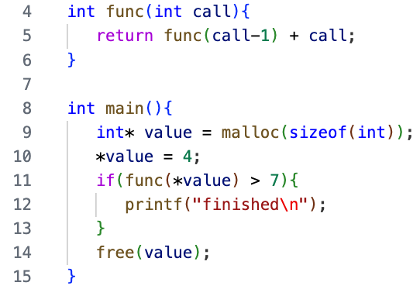

Is there an error?
clicker.cs.illinois.edu
Q2
~Code~ 340
No
Compiler error
Runtime - memory leak
Runtime - stack overflow

Slide 11
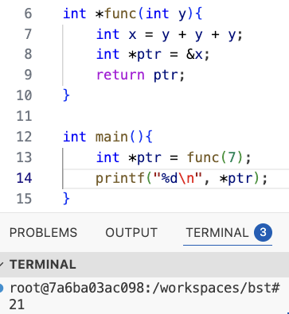

Is there an error?
clicker.cs.illinois.edu
Q3
~Code~ 340
Yes - undefined behavior
No - looks good
Yes - memory leak
Yes - stack overflow

Slide 12
Explanation

Slide 13
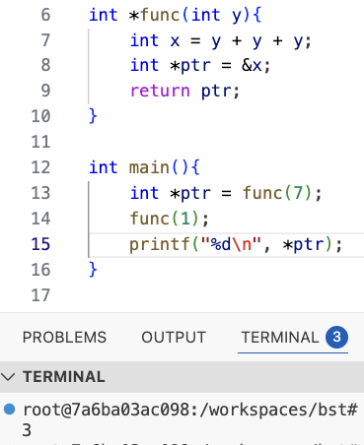

Notes:
Prints 3, not 21

Slide 14
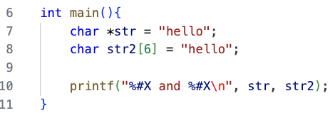

What is true about this code?
clicker.cs.illinois.edu
Q4
~Code~ 340
str and str2 will always hold different addresses
str will always hold a smaller address than str2
str lives on the heap but holds the address to read only memory
Notes:
Prints - 0X4006B8 and 0XE5554520

Slide 15

How many bytes do str + str2 need on the stack? Assuming 8 byte addresses.
clicker.cs.illinois.edu
Q5
~Code~ 340
12 bytes
14 bytes
16 bytes
18 bytes

Slide 16
Agenda
A Program’s Memory
  Description
  Examples
  Clickers
MP4 intro
Virtual Memory
  Description
  Examples
  Clickers

Slide 17
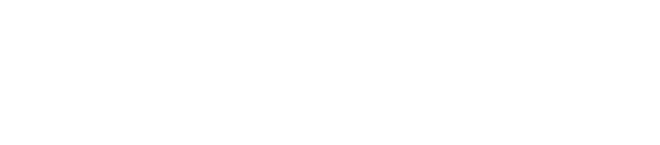
MP4 - Allocator
Notes:
Premise - you are in charge of managing a giant block of memory
Other programs will ask your program for X bytes of this space. You return a pointer to the start of X bytes they can use.
You are in charge of maintaining this giant block of memory.

Slide 18

MP4 - Allocator
malloc(size) - allocates size bytes and returns a pointer to the allocated memory.
free(p) - frees the memory space pointed to by p which must have been allocated previously with a call to malloc.
realloc(p, size) - changes the size of allocated memory pointed to by p to size bytes. Contents of memory will be unchanged if within new range. If size is 0, this is the same as free(p). The function returns a pointer to the new block of allocated memory or NULL if size is 0.
Notes:
Specifically, your code will provide these functions to other programs
Goal - keep this functionality the whole time, improve space and time

Slide 19
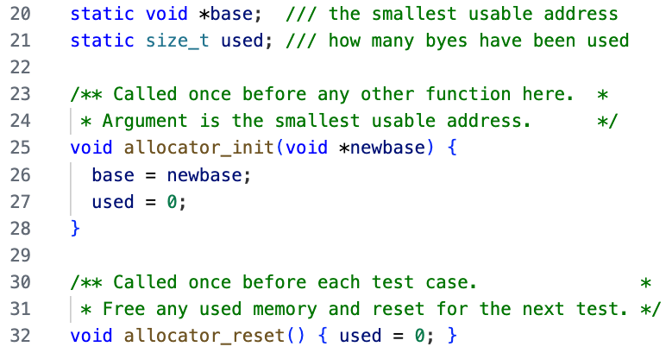

MP4 - Starter Code
Notes:
Given - working slow implementation
Void * base = starting address
Size_t = used

Slide 20
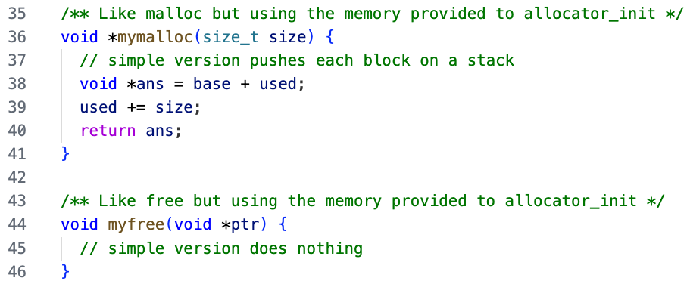

MP4 - Starter Code
Notes:
Draw out example.

Slide 21
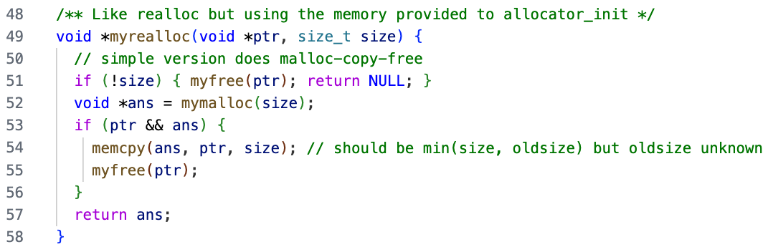

MP4 - Starter Code
Notes:
If size is 0, free and return null

Slide 22
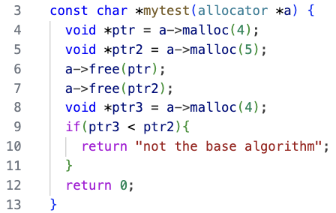


MP4 - Example
Notes:
Example with test case (you could write!)
YOU: Improve efficiency!
Think - pair - share “How would you improve the efficiency (time and or space)?”
We give you the instructions 1-6 Required for 100% 7&8 for extra credit

Slide 23
Agenda
A Program’s Memory
  Description
  Examples
  Clickers
MP4 intro
Virtual Memory
  Description
  Examples
  Clickers

Slide 24

Program Memory - Takeaways
A C program sees its addresses as starting at 0 and going until 2^64.
C code ->
Heap
Stack
Notes:
C code → assembly → machine code (1’s and 0’s a CPU can understand)
The machine code is stored in the programs available memory (but cannot edit)
Heap grows from smaller to higher addresses as needed
The stack grows down (stack frames get added as needed)

Slide 25
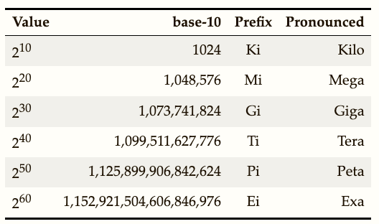

What is the following translated to?
2^(64) Bytes
clicker.cs.illinois.edu
Q6
~Code~ 340
16 TB
32 GB
16 PB
32 EB
16 EB
Notes:
3

Slide 26
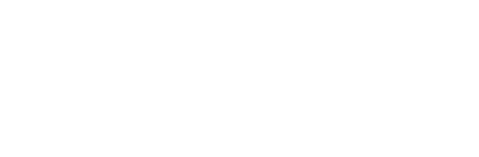
Potential Issues
Notes:
Q: How does every program have address 0 - 2^64
Space - How can we have that much space for every running program? 2^40 is 1 TB for reference
Security - can I accidentally or purposely access the memory holding the data in my notes app from a C program?
When you were learning pointers, why was this never a consideration to accidentally mess something up on your computer?

Slide 27

The Solution
Notes:
Virtual Memory
The memory model is an abstraction given to programs so they think they have access to and reign over all memory. In reality the address space is fake. If you print out the address of an int, that’s not physically where those 1’s and 0’s live.
Memory is given to programs as it is needed and in varying locations.

Slide 28

Virtual Memory
Notes:
Every program is told it has all addresses (laid out like this) Draw picture
As needed, physical memory is given and then mapped to a virtual address for the program to access.
Each running program gets its own page table
The MMU in the CPU uses the page table to find the physical address of the virtual one.
Then it searches the cache for that physical address.
In chunks (pages) ex) 4 KB
Page Table (holds mapping) stored in memory with its own cache TLB (translation lookaside buffer)
MMU - translates virtual to physical address by looking in the page table

Slide 29
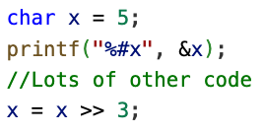

Virtual Memory Example #1
Notes:
char x = 5;
printf(“%#x”, &x); ← prints 0xFE5
… lots of code
x = x >> 3;
Assembly Pseudocode
Load from memory address 0xFE5 into register1
Shift 3 to register1 and store in register1
CPU decodes the instruction to load X from virtual address 0xFE5
MMU uses the page table to find entry for the page that contains that virtual address, see what physical page it corresponds to
Search through cache (fast small memory to slow big memory) — memory to find that physical address and it’s content, retrieves the whole cache line into the highest cache
Return the 8 bits at that location to the cpu (0000 0101)(store in register)
Cpu decodes the instruction to put x into ALU with 3 and picks the >> shifted answer
Puts the answer in a register and eventually back at the physical address of where x lives

Slide 30
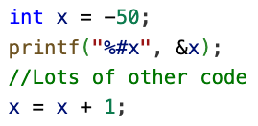

Virtual Memory Example #2
Notes:
int x = -50;
…. Lots of other code
printf(“%#x”, &x); ← prints 0xB50
x = x + 1;
Assembly Pseudocode
Load x from memory 0xB50 into register1
Add 1 to register1 and store in register1
50 = 0000 0000 0000 0000 0000 0000 0011 0010
-50 = 1111 1111 1111 1111 1111 1111 1100 1110
Little endian = 0xCE, FF, FF, FF
CPU fetches and decodes the instruction to load x from virtual address 0xB50
CPU employs the MMU which uses the page table for this running program to find entry for the page that contains that virtual address, see what physical page it corresponds to
Search through cache (fast small memory to slow big memory) — memory to find that physical address and it’s content
Return the 4 bytes at that location to the program 1111 1111 1111 1111 1111 1111 1100 1110 (store in register)
CPU puts x through the ALU with a 1 and store as X again
**if i were to print x as a signed char, it would convert the binary to 2’s complement to see what negative number to print to the screen

Slide 31

Takeaways
Virtual memory - isolates programs for security and the illusion of space.
You (the programmer) cannot see or know what physical address your code is using. You can only access the virtual addresses for your specific program.
Each running program gets its own page table. Virtual addresses may overlap between programs but physical addresses cannot.
Physical memory for a program can vary in size and location.
Virtual memory has a fixed size and a consistent location.

Slide 32
Am I guaranteed that ptr and ptr2 hold values 6,000 bytes apart in physical memory?
clicker.cs.illinois.edu
Q7
~Code~ 340
char x = 7;
char *ptr = &x;
char *ptr2 = ptr + 6000;

Slide 33
Am I guaranteed that ptr and ptr2 hold values 6,000 bytes apart in virtual memory?
clicker.cs.illinois.edu
Q8
~Code~ 340
char x = 7;
char *ptr = &x;
char *ptr2 = ptr + 6000;

Slide 34
If program 1 stores my password in a c-string at virtual address 0xB50632 will this code in program 2 get me that password?
clicker.cs.illinois.edu
Q9
~Code~ 340
char *ptr = (char*)0xB50632;
printf(“%s”, ptr);

Slide 35
Is it possible for these two programs to print out the same value while running at the same time?
clicker.cs.illinois.edu
Q10
~Code~ 340
int x = 5;
printf(“%#x”, &x);
int x = 2;
printf(“%#x”, &x);

Slide 36
Permissions
Notes:
Draw memory diagram
Pages has access bits (read, write)
Read only globales → are in a read only page
At run time the computer attempts to write and then causes an error

Slide 37
Takeaways II
The MMU reads the page table to translate addresses from virtual to physical.
Physical memory with physical addresses use the cache for speed.
Each page has permission bits that are checked at runtime.
Notes:
More on OS Thursday

Slide 38
Program’s Memory | Virtual Memory
Today’s LGs - Deepen your understanding of how memory works in a C program and on your computer.
Be able to differentiate between globals/static, the stack, and the heap
Be able to identify common issues with the stack and the heap use
Be able to implement a simplified, efficient version of the C allocator
Be able to articulate why we use virtual memory in a computer
Be able to put together system concepts with virtual memory.

