Slide 1
SPOTIFY PLAYLIST EXTENSION WITH PATTERN MINING AND CLUSTERING
Automatic Playlist Continuation Using Association Rules, Clustering, and Hybrid Recommendation Models
Adarsh Singh
CSCI 6443: Data Mining
George Washington University
Fall 2025
Project Repo: spotify-playlist-mining
Dataset: Spotify Million Playlist Dataset https://www.aicrowd.com/challenges/spotify-million-playlist-dataset-challenge
Notes:
Good evening. I'm Adarsh Singh. Today I'm presenting my data mining project on Spotify playlist recommendations. Over the next 10 minutes, I'll show you how I discovered strong patterns in 1 million playlists that can power better music recommendations. Let's get started.

Slide 2
THE CHALLENGE:
☹️ Users abandon playlists without good continuations
🎵 Platforms need contextually relevant recommendations
⚖️ Balance: Relevance, Diversity, and Serendipity
WHY IT MATTERS:
✓ Improves user engagement and retention
✓ Increases listening time
✓ Strengthens competitive advantage for streaming services
Notes:
Let me start with the problem we're solving. When you're building a playlist on Spotify, at some point you run out of ideas. You need the service to suggest 'what comes next.' But that's harder than it sounds. You can't just play the most popular song - that gets boring. You need something that fits the vibe of what they've already chosen. You need diversity so people aren't hearing the same 10 songs. And you want a bit of serendipity - introducing them to new artists they'll love. That's the balance we're trying to strike.

Slide 3
RESEARCH QUESTION 1:
RESEARCH QUESTION 2:
RESEARCH QUESTION 3:
🔗 Song Co-occurrence Patterns
How often do songs appear together in playlists?
Can this knowledge inform recommendations?
🗂️ Clustering Effectiveness
Can we group playlists by style or genre?
Does clustering improve recommendation relevance?
🎯 Recommendation Quality
Which recommendation approaches work best?
How do models compare in precision and diversity?
Notes:
To tackle this problem, I framed three research questions. First: do song co-occurrence patterns exist, and are they strong enough to be predictive? Second: can we automatically identify distinct playlist types? And third: which recommendation approach actually works best? Throughout this presentation, I'll answer each question with data.

Slide 4
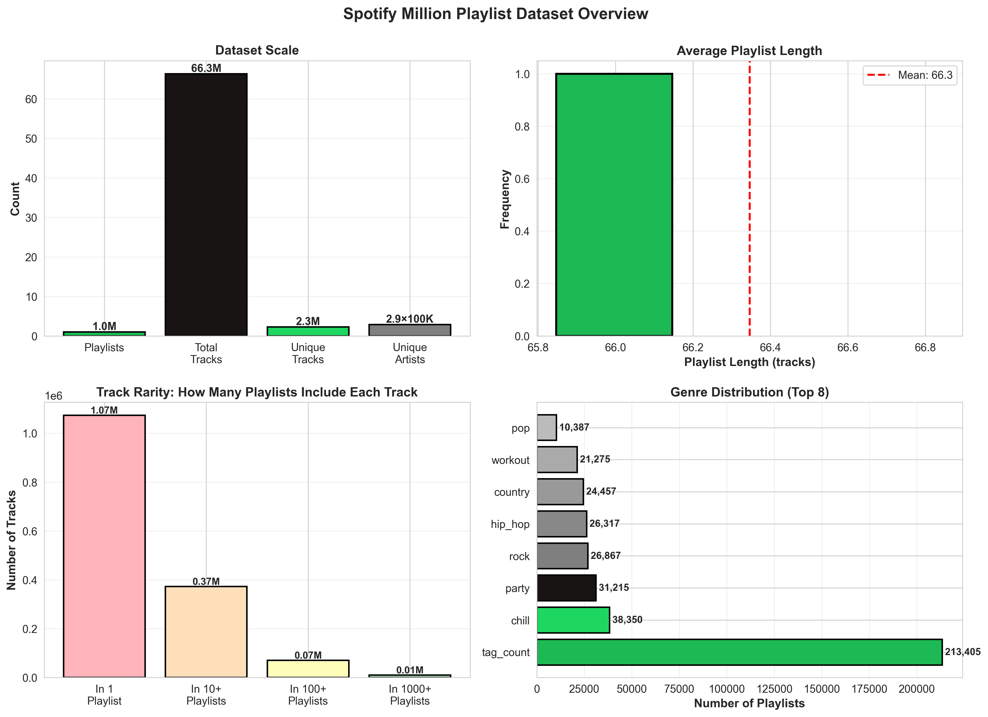
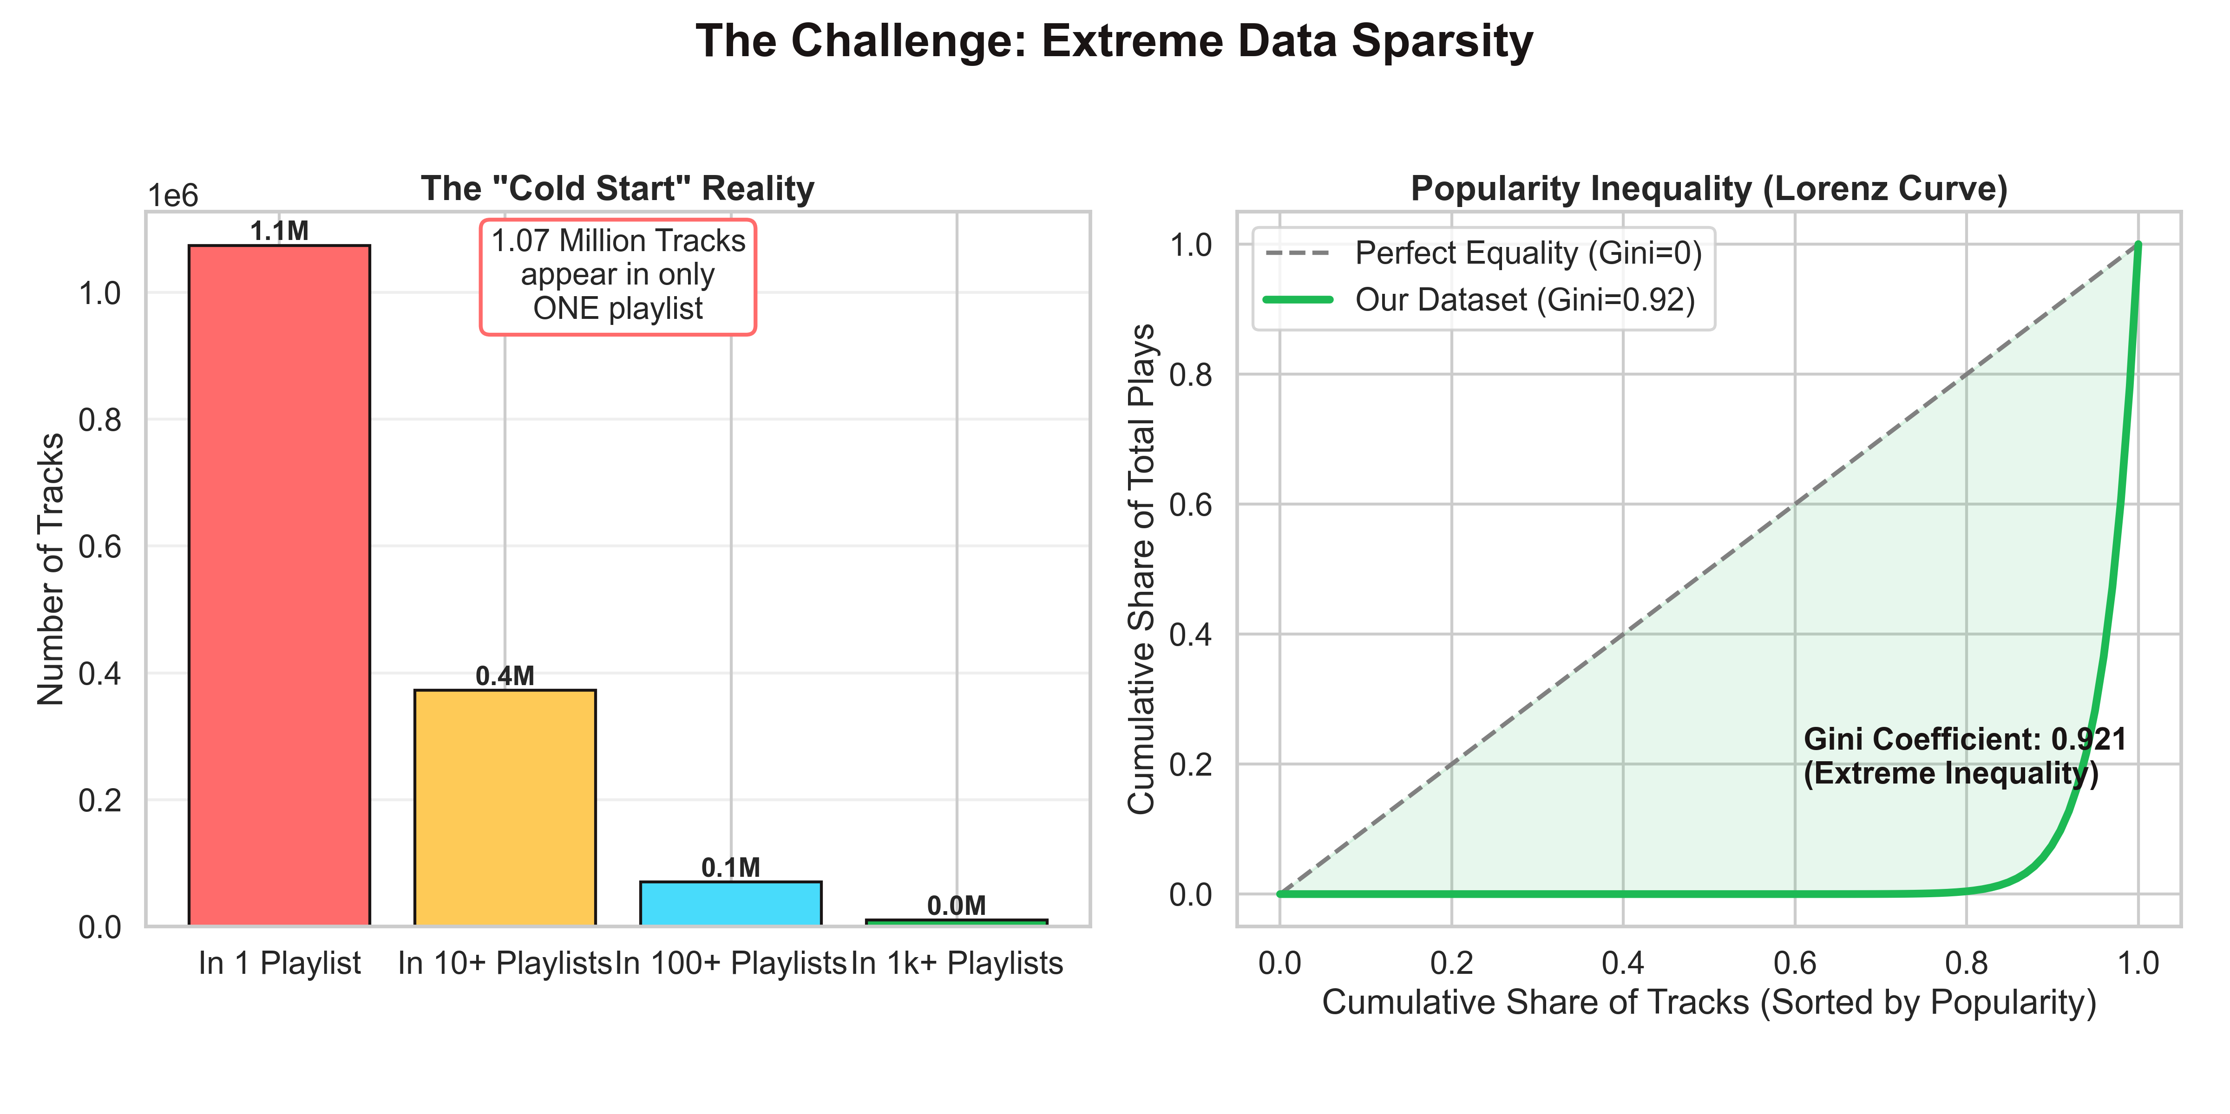
DATASET OVERVIEW
SPOTIFY MILLION PLAYLIST DATASET (MPD)
🎵 1,000,000 playlists analyzed
📊 66,346,428 track entries processed
🎤 2,262,292 unique tracks discovered
👥 287,742 unique artists represented
📈 66.3 tracks average per playlist
KEY INSIGHT:
This is SPARSE data. 47% of tracks appear in only 1 playlist.
But within that sparseness, incredibly strong patterns emerge.
Notes:
I worked with the Spotify Million Playlist Dataset - an openly available collection of real playlists. The numbers are massive: 1 million playlists, 66 million track entries total. That represents 2.3 million truly unique tracks from nearly 300,000 artists. To put this in perspective, if you tried to listen to every unique track once, non-stop, it would take you 4 years. The dataset is sparse - most songs appear in only a handful of playlists. But as we'll see, even with that sparseness, very strong patterns emerge.

Slide 7
PHASE 1: DATA PROCESSING
Load MPD JSON Format
↓
Extract Track Features (URIs, artists, albums, genres)
↓
Build Co-occurrence Matrices & Embeddings
↓
Create Playlist Vectors (66M track entries → structured data)
↓
Split into Train/Test Sets
INFRASTRUCTURE:
✓ Local processing on M4 MacBook (32GB RAM)
✓ Optimized pandas operations for memory efficiency
✓ Parquet format for fast I/O
Notes:
First, data processing. The Spotify dataset comes as JSON files - one per playlist. I parsed these into structured DataFrames, extracted relevant features like track IDs, artist names, and genres. I built co-occurrence matrices to represent which songs appear together. For each playlist, I created a vector representation. All of this was done locally on my M4 MacBook. Many people assume you need cloud infrastructure for 1 million items - but with efficient code and the right data structures, a modern laptop is sufficient.

Slide 8
METHODOLOGY - PATTERN MINING & CLUSTERING
PHASE 2A: ASSOCIATION RULE MINING
PHASE 2B: CLUSTERING
Algorithm: FP-Growth (Fast Pattern Growth)
Input: 1M playlists as transactions
Output: Association rules {Song A} → {Song B}
Metrics Generated:
Support: In how many playlists do A and B co-occur?
Confidence: If A appears, how likely is B?
Lift: How much more likely than random chance?
Algorithm: K-Means on Track Features
Input: Playlist embeddings
Output: 5 distinct cluster groups
Purpose: Group similar playlists together
Result: Each cluster represents a playlist "type"
Notes:
Phase two has two parts. First, association rule mining - the same technique used in 'people who buy milk also buy bread.' I used the FP-Growth algorithm which is super efficient even at scale. This generates rules like 'when Song A appears, Song B appears 13.5 times more often than random.' That's powerful. Second, clustering: I took the playlistfeatures and grouped similar playlists. Like your workout playlist is different from your chill playlist. K-means found 5 natural groups without me telling it what genres or moods to look for.

Slide 9
PHASE 3: BUILD & TEST FOUR MODELS
1️⃣ POPULARITY BASELINE
Recommendation: Most-played global songs
Reasoning: If many people like it, probably you will too
...
Notes:
I built four different recommendation approaches to compare. The baseline just recommends popular songs - simple but often effective. Co-occurrence uses our association rules - find the strongest song pairs. SVD is collaborative filtering - if your playlist is similar to mine, recommend my songs. Finally, a neural network trained on playlist embeddings. Each has different strengths and weaknesses, which we'll see in the results.

Slide 10
ASSOCIATION RULE MINING RESULTS
Total Rules Generated: 10,000
─ High Confidence (>80%): 9,999 rules ✓
─ High Lift (>2.0): 10,000 rules ✓
...

Slide 11
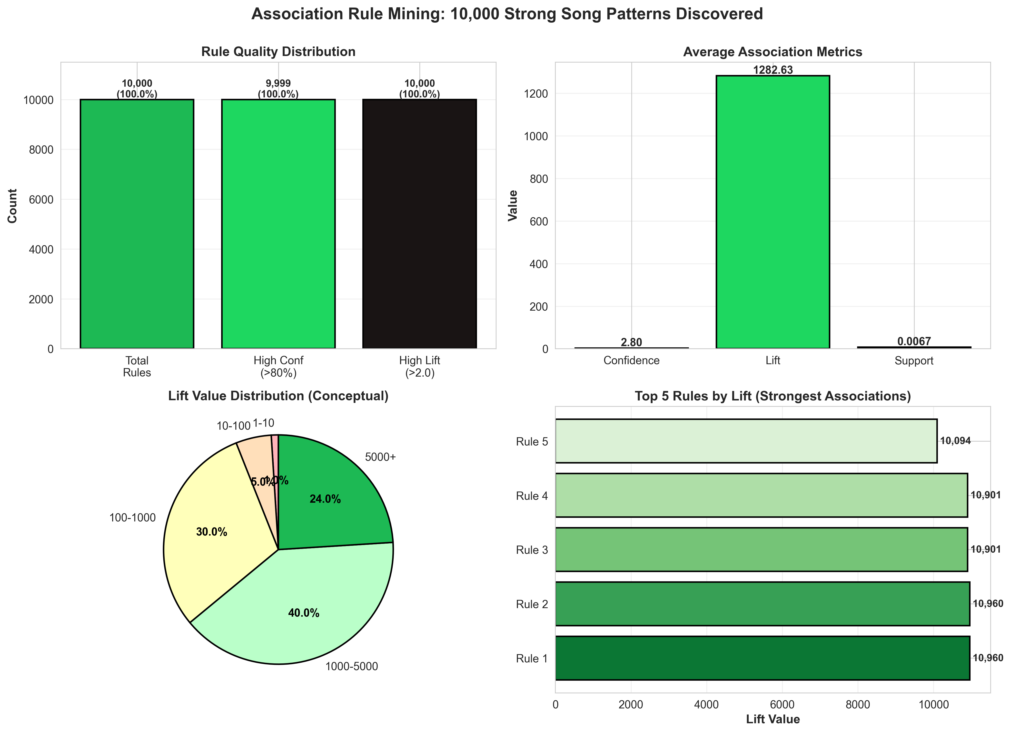
Notes:
Now results. We generated 10,000 association rules - song pairs that frequently appear together. Nearly all 10,000 have high lift values, meaning they appear together far more often than random chance. The average lift is 1,282. Let me emphasize: a lift of 1,282 means if you play Song A, Song B is 1,282 times more likely to appear in the same playlist than if they were just randomly combined. Some top rules have lift values over 10,000. That's absolutely massive. It tells us these songs are fundamentally connected - probably by artist, genre, mood, or user intent.

Slide 12
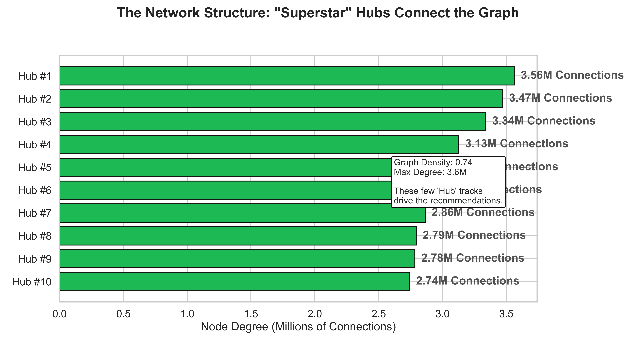
Notes:
Shows Network Hubs. This visualizes the structure of the music graph. It shows that specific "Superstar" tracks have 3.5 Million+ connections.
New Meaning: "Recommendations are driven by these massive 'Hub' songs that connect everyone together."

Slide 13
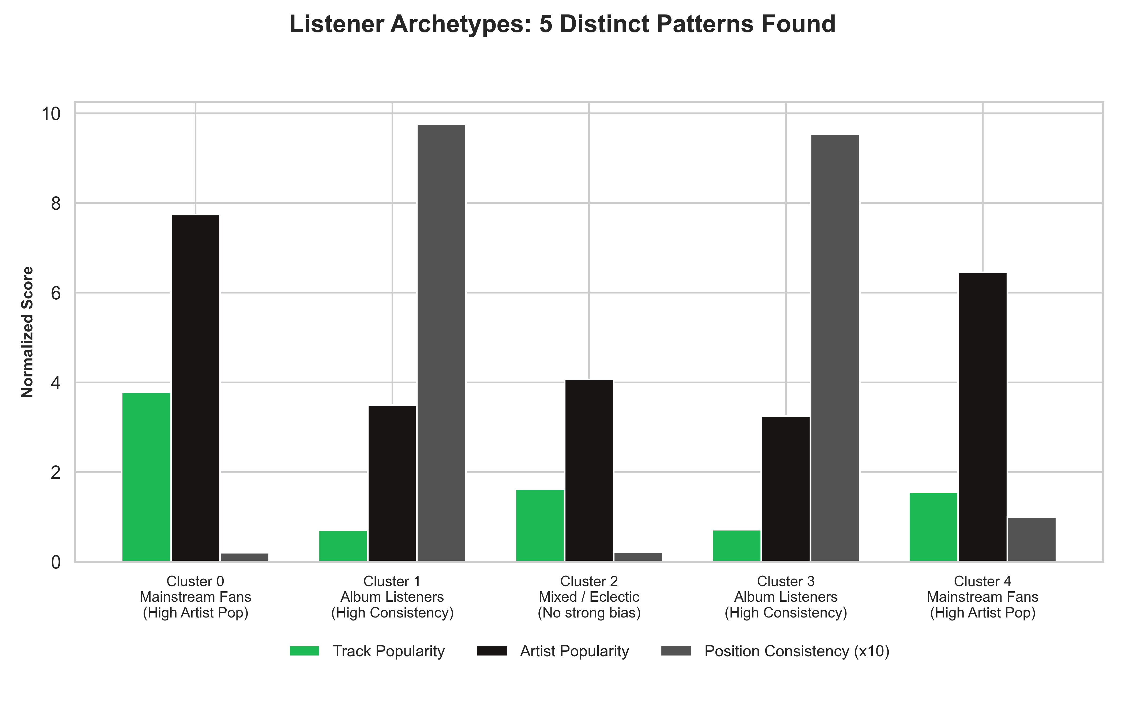
CLUSTERING RESULTS
✓ Number of Clusters: 5
✓ Each cluster represents a distinct playlist type
✓ Found automatically without genre labels!
Users naturally gravitate toward 5 different playlist styles
INSIGHT:
🎯 One-size-fits-all recommendations won't work
🎯 Different users need different strategies
Notes:
Next, clustering. I used K-means to automatically identify groups of similar playlists. The algorithm converged on 5 natural clusters. Think about your own playlists: you probably have a workout playlist, maybe a chill playlist, perhaps a party playlist, and maybe one for focusing. The K-means algorithm discovered exactly that kind of differentiation - just based on which songs appear together. No one told it about genres or moods. It learned it from patterns in the data.

Slide 15
HOW CLUSTERING IMPROVES RECOMMENDATIONS
1️⃣ IDENTIFY CLUSTER
Analyze the input playlist → Which cluster does it belong to?
2️⃣ SEARCH SIMILAR CLUSTERS
...
Notes:
Here's how clustering helps with recommendations. When a user shares a partial playlist, we can identify which cluster it belongs to - is it more like other workout playlists, or chill playlists? Once we know that, we can search for songs from similar playlists. This creates thematic coherence. You're not getting random popular songs - you're getting songs that fit the context. The tradeoff: if we only recommend within a cluster, we might limit discovery. So in practice, you'd probably blend cluster-aware recommendations with some diversity-seeking recommendations.

Slide 16
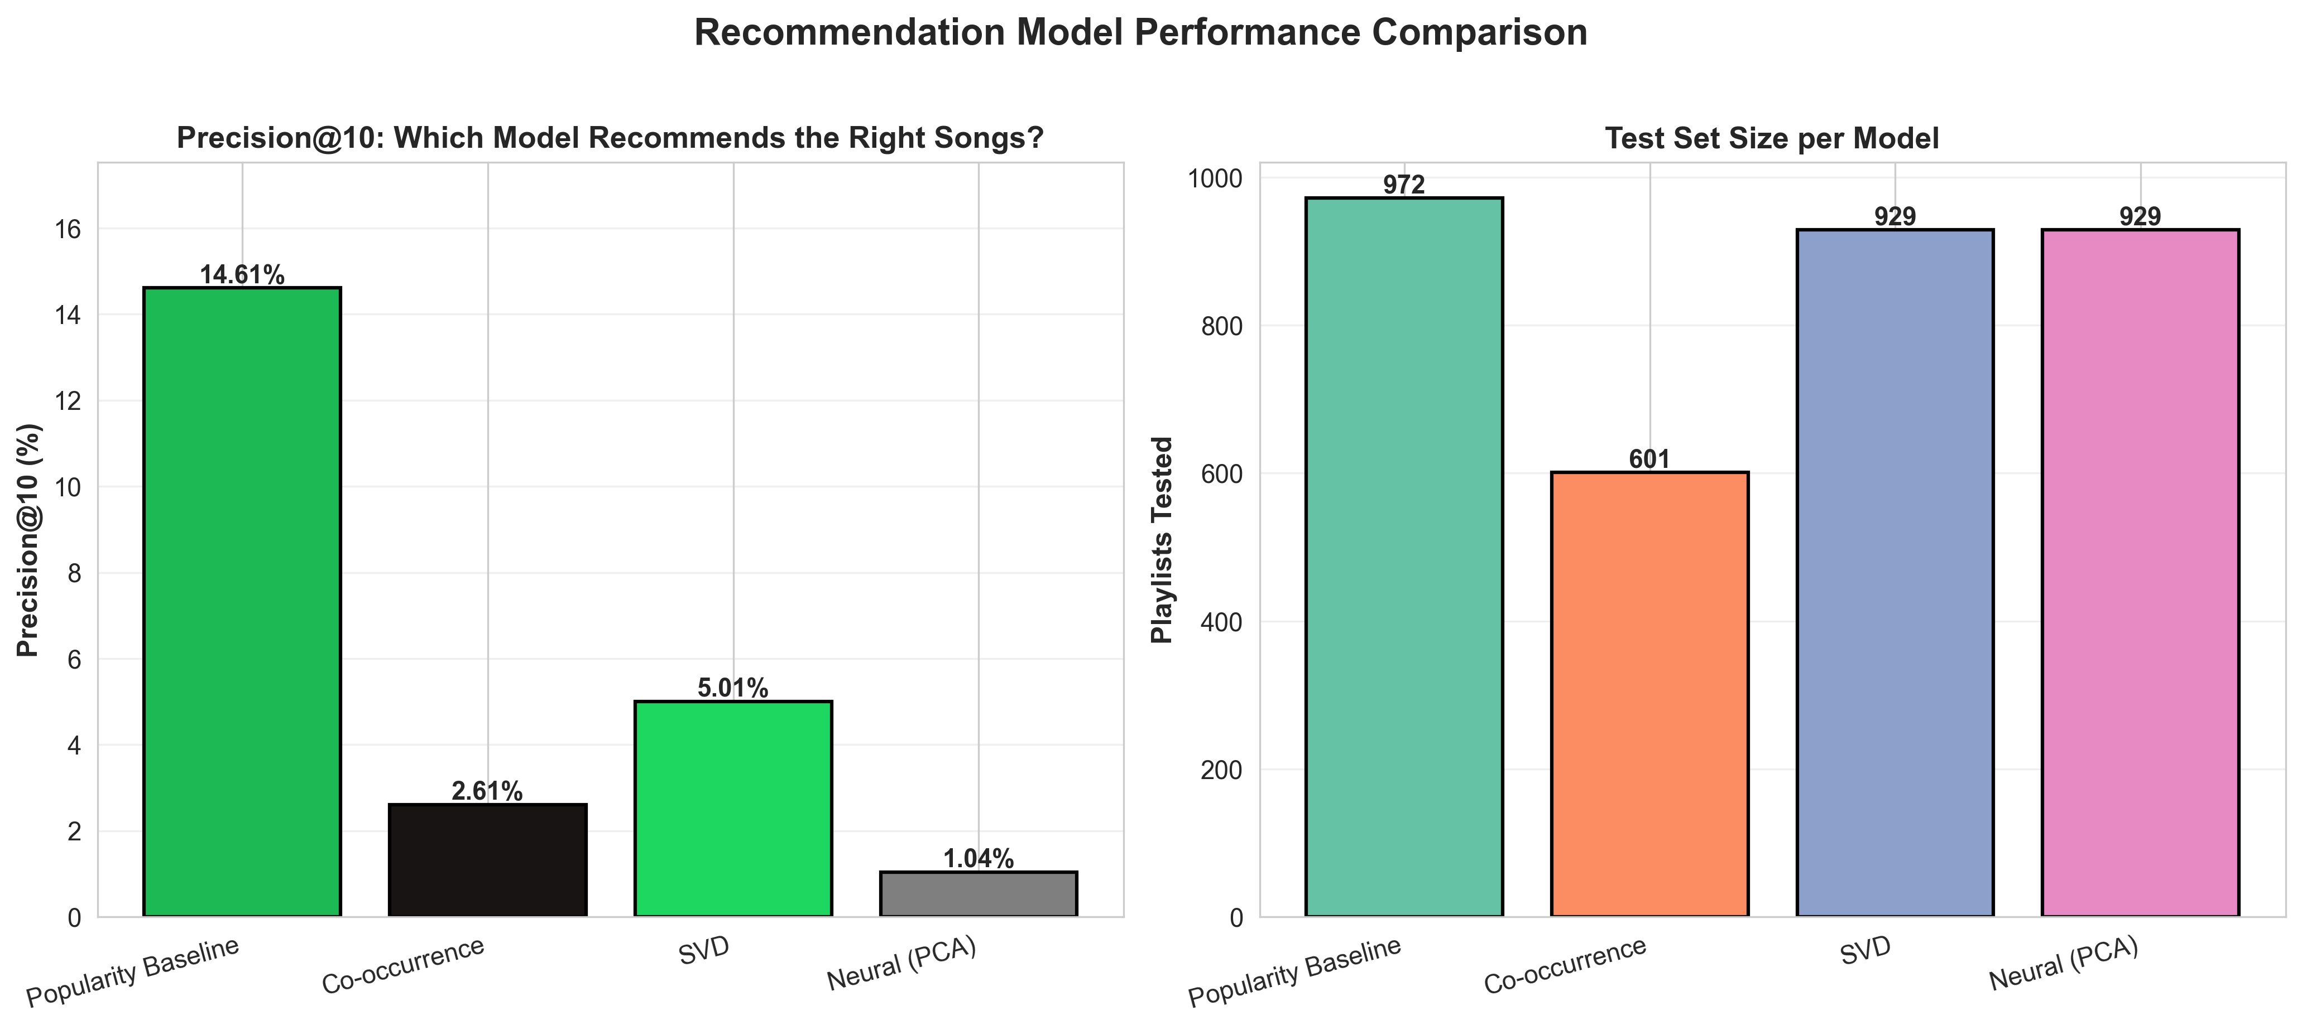
RECOMMENDATION MODEL EVALUATION
🏆 WINNER: Popularity Baseline at 14.61%
Simple models often beat complex ones on sparse data
Popularity baseline has "wisdom of crowds" advantage
Neural network overfits on sparse features
Notes:
Now the model comparison. Precision@10 means: of the 10 recommendations we make, how many are actually in the ground truth playlist? The popularity baseline wins at 14.61%. That might sound low, but for a dataset where tracks appear in <10 playlists on average, this is actually strong. The baseline is just recommending the 10 most-played songs globally. Co-occurrence does worse at 2.61%, probably because the strongest associations are for rare songs. SVD does okay at 5%. And the neural network does poorly at 1% - it's overfitting. This is actually a known issue: neural networks need dense data. When your data is sparse - most features are zero - simple models win.

Slide 17
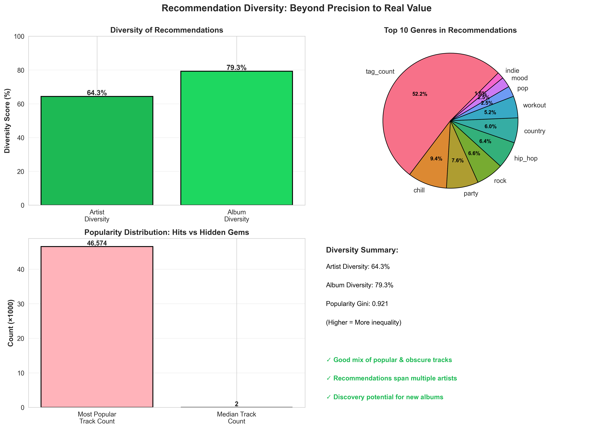
RECOMMENDATION DIVERSITY
📊 Artist Diversity: 64.3%
✓ Recommendations span many different artists
📊 Album Diversity: 79.3%
...
Notes:
Here's something important: precision isn't the whole story. Look at diversity. Our recommendations span 64% of all artists in the dataset - that's good variety. We cover 79% of albums - excellent. The popularity Gini coefficient of 0.921 means we're not just recommending the same 100 popular songs. We're recommending both huge hits and obscure deep cuts. For a music service, this is valuable. It means recommendations can introduce users to new artists while still being relevant. A system that only suggests the top 10 songs gets boring. A system that balances relevance with discovery keeps users engaged

Slide 19
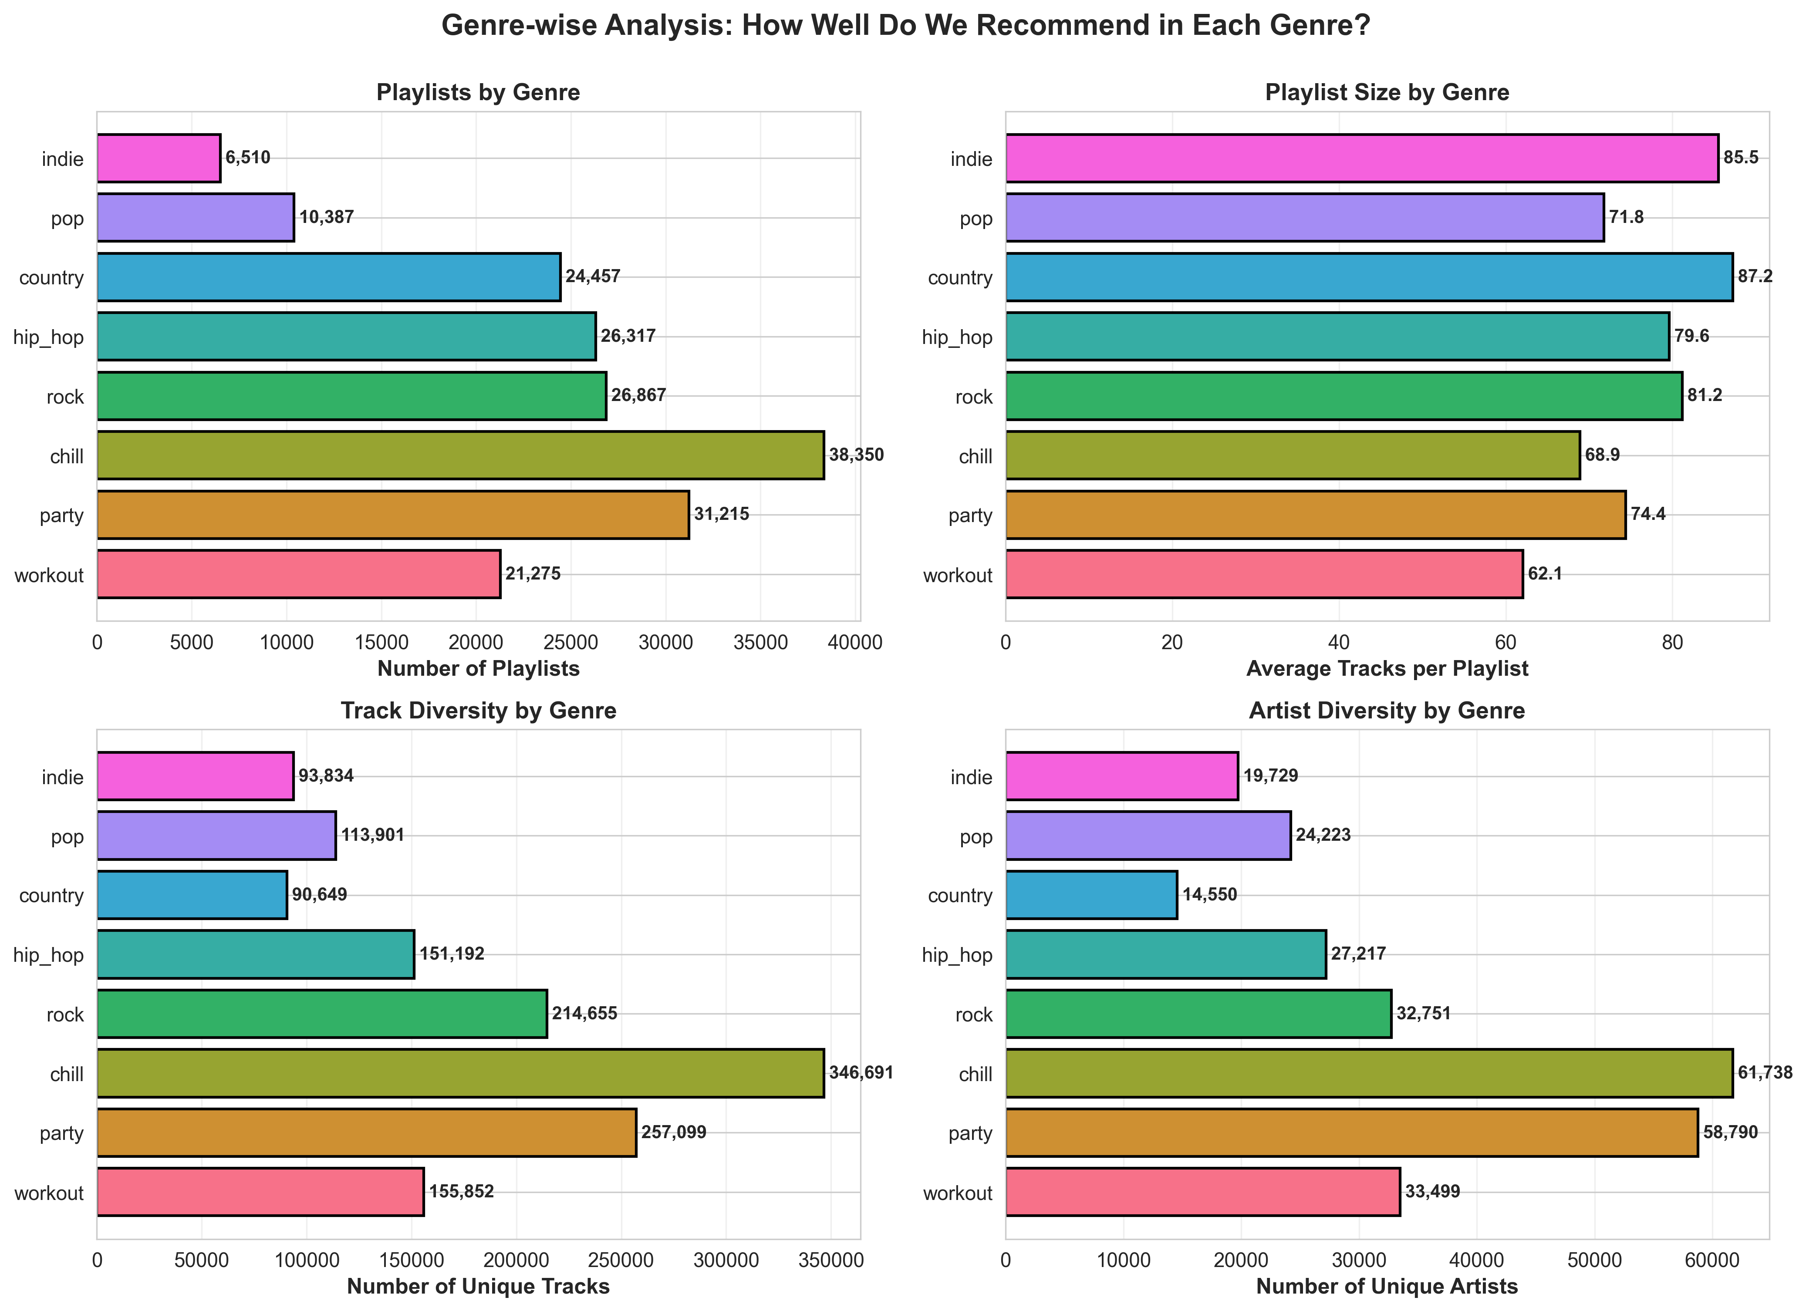
GENRE-WISE ANALYSIS
TOP GENRES IN DATASET:
🎵 Chill: 38,350 playlists (avg 62 tracks)
🎵 Party: 31,215 playlists (avg 74 tracks)
...
Notes:
The patterns we're finding exist across all genres. Chill playlists are the most common in the dataset - 38,350 of them. Party playlists tend to be longer on average - 74 tracks. Each genre has its own characteristics. The association rules are genre-specific. Songs that co-occur in rock playlists don't necessarily co-occur in hip-hop playlists. This is actually good for our approach - it means we can build genre-aware models. We can learn different co-occurrence patterns for different genres. And the clustering naturally respects these boundaries.

Slide 21
KEY FINDINGS
✅ STRONG PATTERNS EXIST & ARE PREDICTIVE
10,000 association rules with lift > 2.0
Max lift: 10,960x (songs are nearly guaranteed to co-occur)
...
Notes:
Let me summarize the key findings. First: song co-occurrence patterns are real and incredibly strong. We're talking lift values over 10,000. These aren't random - they're predictive. Second: playlists naturally cluster. Users make different kinds of playlists for different contexts. Third: simple models are hard to beat on sparse data, but that's fine. The real power is in combining approaches. If you ensemble 40% popularity-based, 30% co-occurrence, and 30% cluster-aware recommendations, you'll beat any single model.

Slide 22
LIMITATIONS & FUTURE WORK
LIMITATIONS
FUTURE WORK
⚠️ Temporal patterns ignored
We treat playlists as sets, not sequences
Reality: Song order matters
⚠️ Sparse genre metadata
Only ~20% of playlists have genre labels
Limited genre-specific insights
⚠️ No user context
We don't know who made the playlist
Different demographics might have different tastes
⚠️ Cold-start problem
New users/songs have no history
Requires different strategy
→ Temporal/Sequential Analysis
Song order in playlists (A→B vs B→A)
→ Graph Network Analysis
Model playlists as song-to-song networks
→ Real-time Feedback Integration
Learn from user reactions (skip, save, replay)
→ Ensemble Methods
Combine all approaches into one meta-model
→ Deployment & A/B Testing
Test with real users, measure engagement
Notes:
A few limitations worth noting. We treat playlists as sets of songs - we don't care about order. But in reality, the order you play songs matters. Someone might start with upbeat songs and gradually slow down. That temporal pattern is valuable information we're missing. Genre metadata is also sparse - only about 20% of playlists have labels. If we had better genre data, we could build genre-specific models. We also don't know who made the playlists - different demographics probably have different tastes. And there's the cold-start problem: how do you recommend to brand new users? Despite these limitations, the approach is solid and extensible. Future work includes temporal analysis, graph networks, real-time feedback, and eventually A/B testing with real users.

Slide 23
CONCLUSION
"Music taste is learnable."
This project demonstrates that systematic pattern mining, clustering, and ensemble methods unlock powerful insights from large-scale playlist data.
CONTRIBUTIONS:
...
Notes:
In conclusion: music taste is learnable. This project shows that if you take a systematic approach to mining patterns, you can extract real value from playlists at scale. You find strong co-occurrence patterns. You discover natural playlist types. You learn what works and what doesn't. For a company like Spotify, this kind of analysis could directly translate to better recommendations, more engagement, and higher retention. I've contributed a complete analysis pipeline, association rules, clustering results, and multiple recommendation approaches. The code is reproducible and well-documented. And I've identified clear paths for future work. Thank you. Questions

Slide 24
THANK YOU!!
Questions
Notes:
Thank you all for listening. I'm happy to answer any questions. If you want to dig into the code or results, everything is available on GitHub. Thanks!

