Slide 1

Module 1 Project Report
ALY 6010 ProbTheory and Intro Stats
SEC 03 CRN 20698
Dr. Dee Chiluiza, PhD
Dhruvin Rakesh Shah
NUID: 001087062

Slide 2
Introduction
The project aims at analyzing various components of 2017 US County Migration and Population Dataset. Using various statistical method, the data needs to be process, analyze and represented visually using Pareto Chart, Histogram, Box plot, Scatter plot and Line Graph.

Slide 3
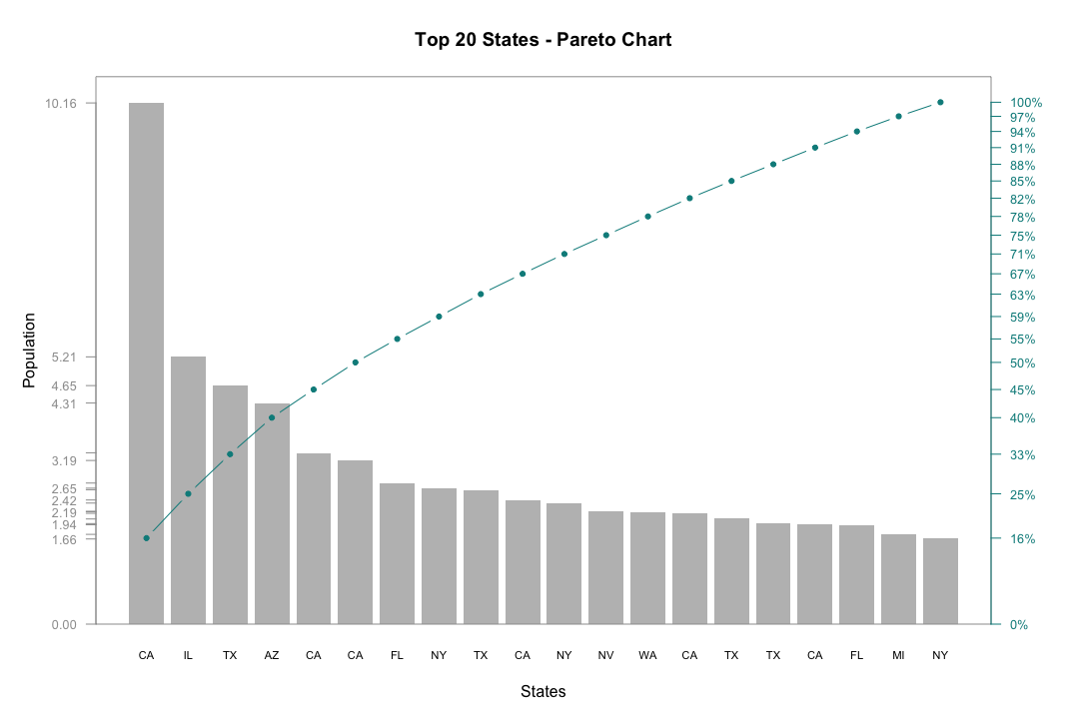
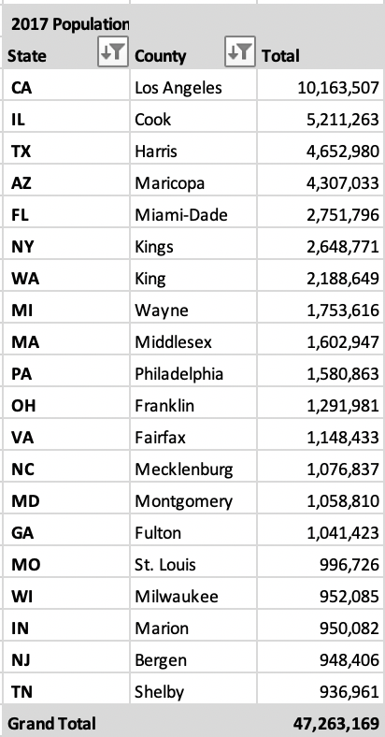
Pareto Chart for 20 Most Populated States in United States
Pareto chart is combination of bar and line graph and helps to determine the value along with cumulative frequency.
Each bar here represents the population in the states.
Line represents the Cumulative Frequency of population.
The table shows the top 20 most populated county of the States of US.
Decreasing order of Population along with county easily convey the stats of population.

Slide 4
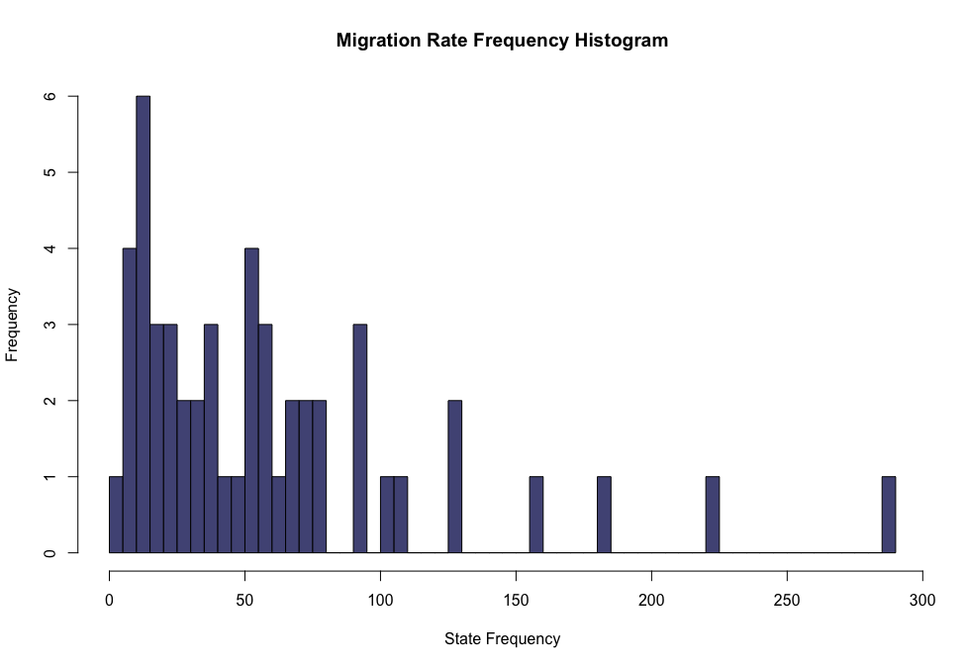
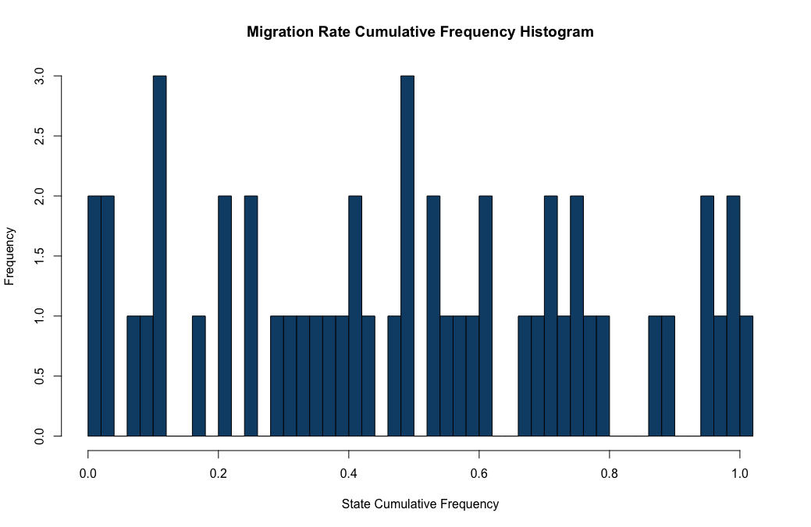
HISTOGRAM
The bars of the Histogram States the frequency or the repetition of a value (State).
It even determines the shape and spread of the continuous sample data.
The graph here shows the Migration Rate Frequency and Cumulative Frequency of US States

Slide 5
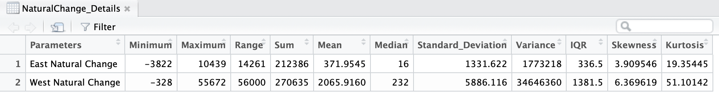
Descriptive Statistics for Natural Change in East and West Coast
Vast difference is observed in the mean and median (Central Tendency) of the data.
Moreover it is observed that West Coast Natural change is 4 to 5 times much deviated than East Coast.
Skewness determines the deformity in the symmetrical curve. So, it is observed that West Coast Natural Change curve is more distorted than East Natural Change curve.
From the kurtosis it is clear that West Coast Natural Change curve is far more sharper than East Coast.

Slide 6
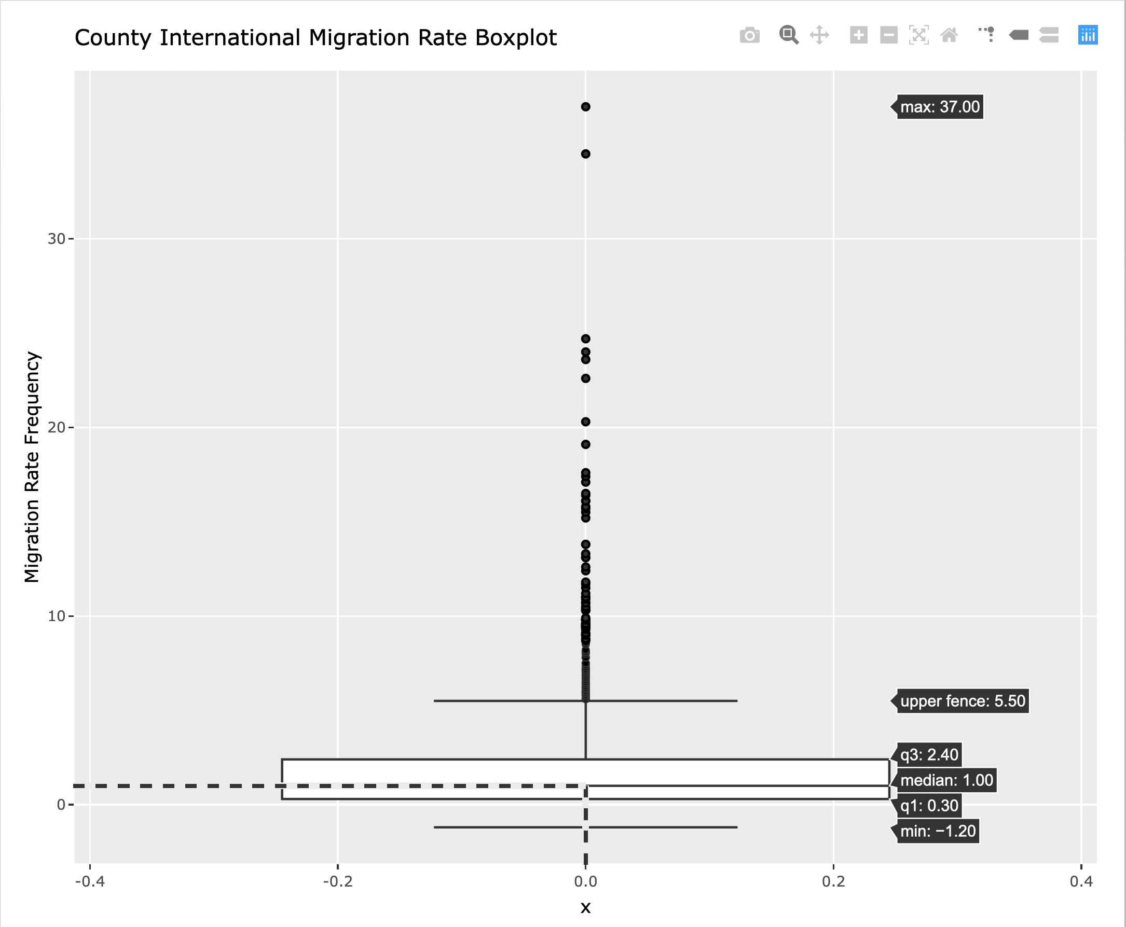
BOX PLOT
The boxplot here determines the density (distribution) of County International Migration Rate Data.
Consist of Five Point Summary (Minimum, Quartile 1, Median, Quartile 3, max)
It determines the density of the data.
Most efficient utility to predict outliers.
Results: Median 1.00 of the boxplot determines density of data is high In that region. The points above 30 that is 34.50 and 37.00 are outliers in this observation.

Slide 7
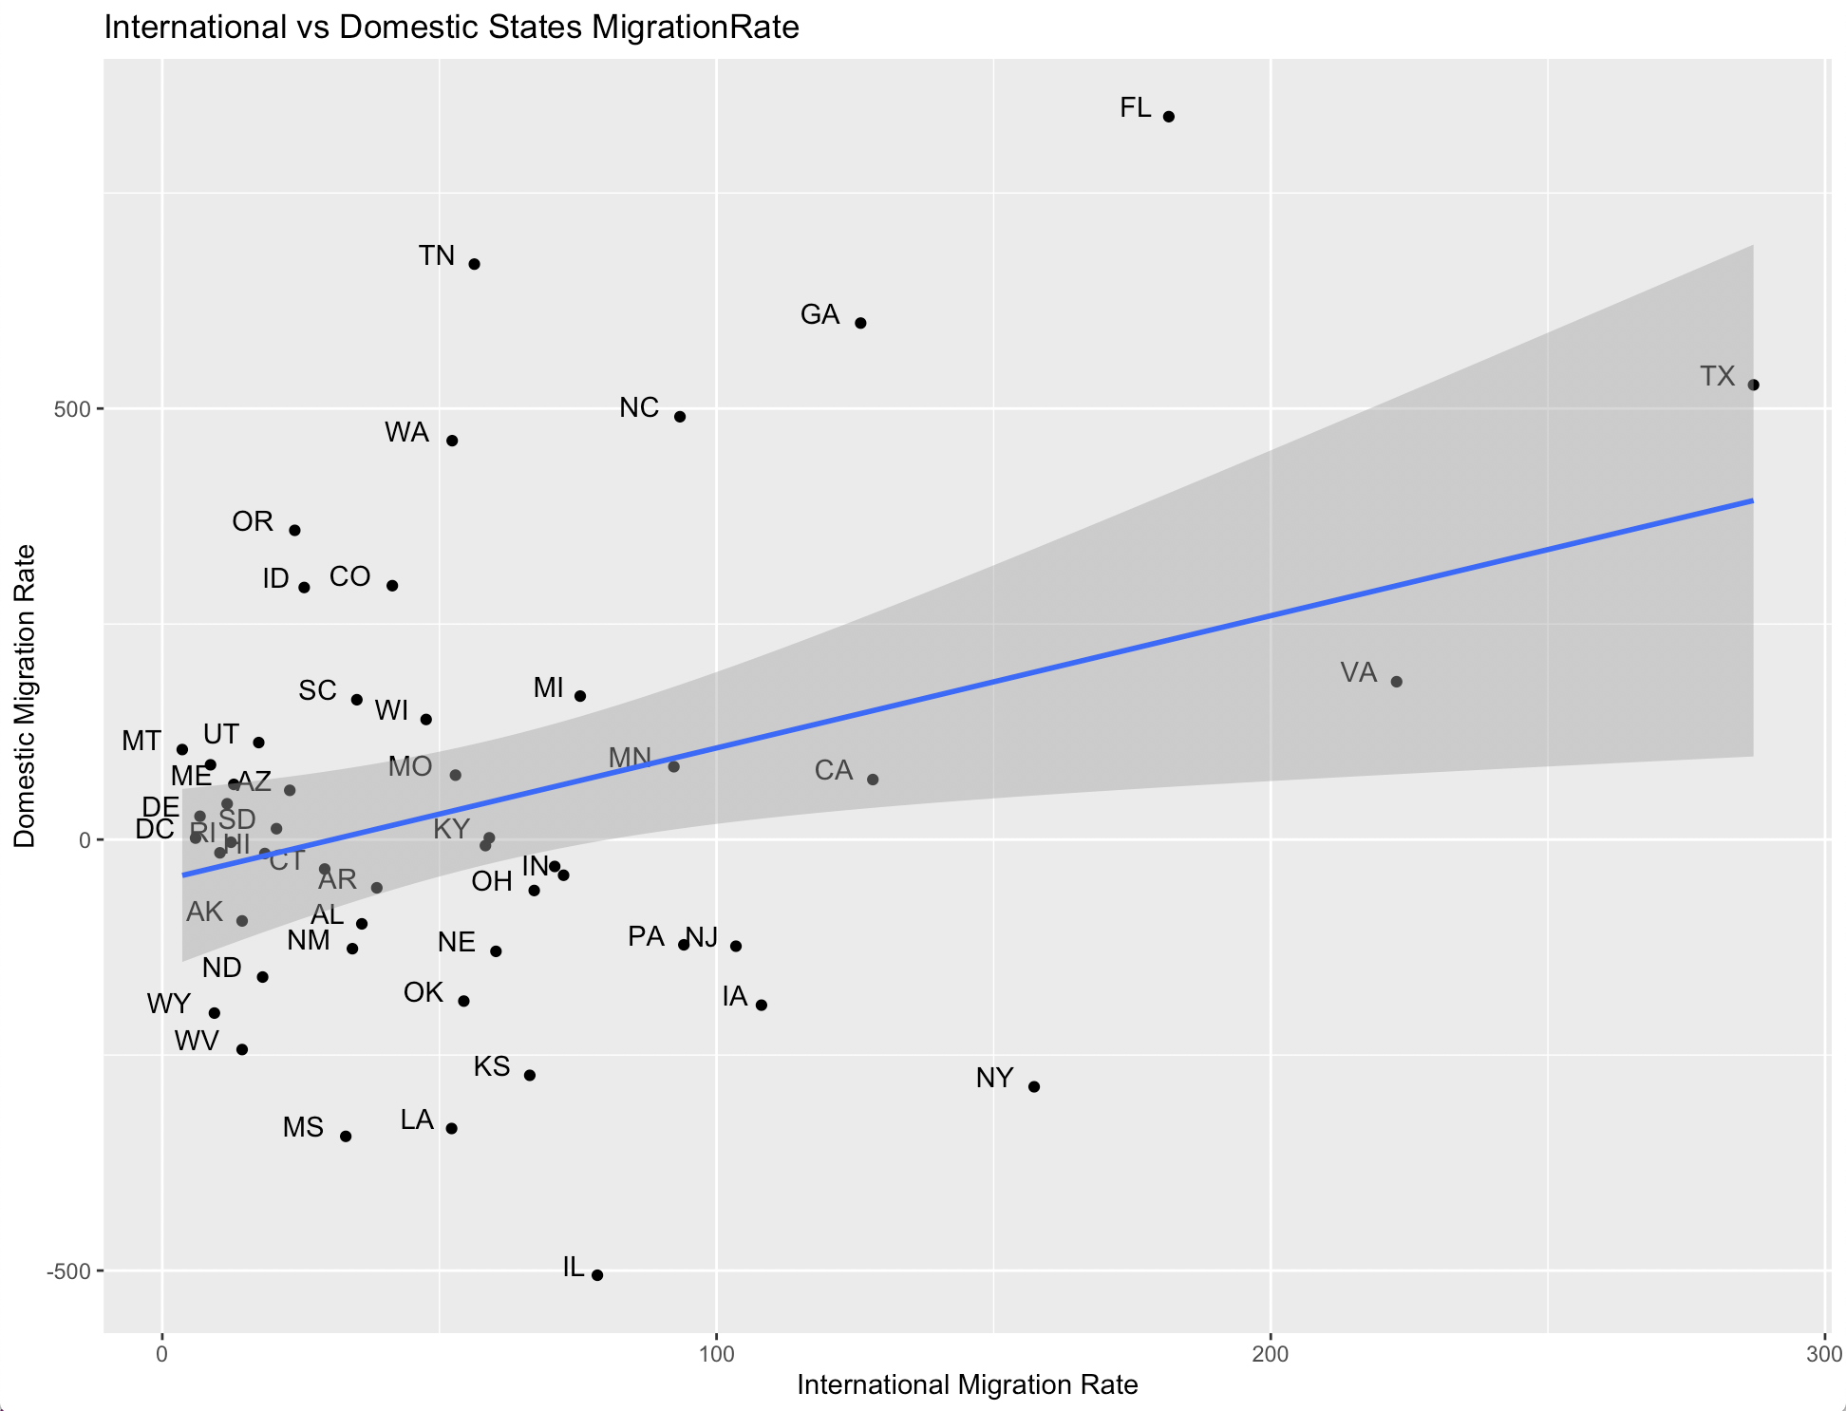
SCATTER PLOT
Correlation is a technique which determines whether the pairs are related or not.
The shaded region along the lm Regression Line shows the correlation between International and Domestic State Migration Rate
The evenly scattering of points is observed in the graph.
The graph represents the International versus Domestic Migration Rate for all States of US along with correlation between them.

Slide 8
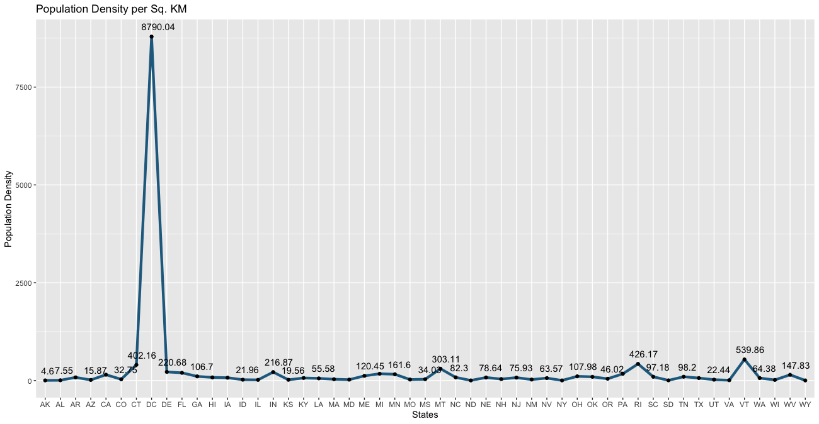
Population Density Line Graph
Line graphs are easy to interpret
Datapoints are plotted by connecting “Dot-to-Dot” function.
The graph here represents the density of population in each state.
From the graph it is observed that DC contains the highest population density that is 8790 Population per sq.km while Wyoming contains lowest population density that is 3.32 Population per sq.km.

Slide 9
Conclusion
It can be concluded that visualizing after analyzing the data makes the interpretation lucid. Moreover, graphs easily conveys the most vital information if the analysis. Using Statistical methods for processing data acts as problem-solving and also helps us to identify patterns in the dataset.

Slide 10
References
Natural Change region Dataset: https://www.factmonster.com/us/postal-information/state-abbreviations-and-state-postal-codes
Population Area Dataset: https://www.kaggle.com/giodev11/usstates-dataset#state-population.csv

