Slide 1









hpdp
Project 2
Presented by MasterData Group

Slide 2
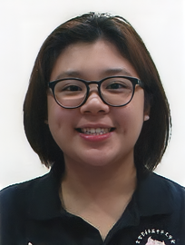


our team
BERNICE LIM JING XUAN
KEK JESSLYN
TAN JUN YUAN

Slide 3
1.1 Background
📈 Tourism in Malaysia is growing rapidly due to cultural diversity and natural beauty.
📺 YouTube is a popular platform for travelers to share and view experiences.
💬 YouTube comments offer valuable insights into public sentiment on travel.
🧠 We built a real-time sentiment analysis pipeline using Apache technologies.
📊 Analyzed ~2730 comments from 10 travel-related YouTube videos.
🤖 Used Hugging Face for initial labeling, then manually corrected.
🧪 Trained LSTM and Naive Bayes models and deployed for real-time inference.

Slide 4
1.2 Objective
Build a real-time sentiment analysis pipeline.
Use Apache Kafka for streaming YouTube comments.
Apply Apache Spark for real-time data processing.
Train and use ML models (LSTM, Naive Bayes, Hugging Face).
Store outputs in Elasticsearch.
Visualize sentiments with Kibana dashboards.

Slide 5
1.3 Scope
YouTube comment collection using YouTube API
NLP-based preprocessing and sentiment labeling
Model training: LSTM, Naive Bayes, Hugging Face
Real-time pipeline: Kafka + Spark + Docker
Data storage in Elasticsearch
Sentiment dashboard visualization using Kibana
Focused on Malaysian travel content

Slide 6
2.0 Data Acquisition & Preprocessing
🗂️ Sources
2730 comments from 20+ YouTube videos on Malaysian travel
Selected based on popularity and location diversity
⚙️ Tools Used
YouTube Data API, Python, Google Colab, Jupyter
NLP libraries: NLTK, spaCy, Hugging Face
🧹 Preprocessing Steps
Lowercased text, removed emojis/special characters
Tokenization, stopword removal
Stemming/Lemmatization
Sentiment labels generated using Hugging Face, then manually corrected

Slide 7
3.0 Sentiment Model Development
🧠 Models Used
Naive Bayes (TF-IDF, fast baseline)
LSTM (GloVe embeddings, deep learning)
Hugging Face (RoBERTa pretrained)
🏋️ Training Setup
2730 comments split into train/test sets
Naive Bayes trained with Scikit-learn
LSTM trained with TensorFlow in Google Colab
📊 Evaluation
LSTM: 85% accuracy
Naive Bayes: 79% accuracy
Hugging Face: Used for inference & comparison

Slide 8
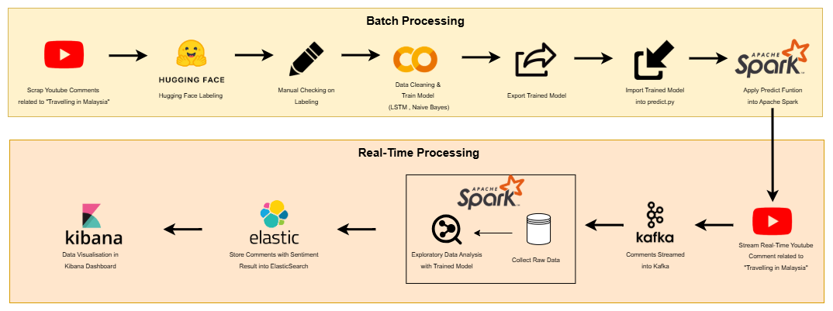
4.0 Apache System Architecture

Slide 9
5.0 Analysis & results
5.1 key findings
Total Comments Analyzed: 2,391
Model Confidence: Average confidence score of 0.812 (Hugging Face), indicating high prediction reliability
1.
2.
Naïve Bayes:
Positive: 75.53%
Neutral: 20.95%
Negative: 3.51%
4.
LSTM Model:
Positive: 43.37%
Neutral: 53.99%
Negative: 2.64%
3.
5.
Hugging Face Transformer:
Positive: 51.36%
Neutral: 40.80%
Negative: 7.83%
Most frequent keywords:
‘Malaysia’, ‘video’, ‘KL’, ‘love’, ‘thank’

Slide 10
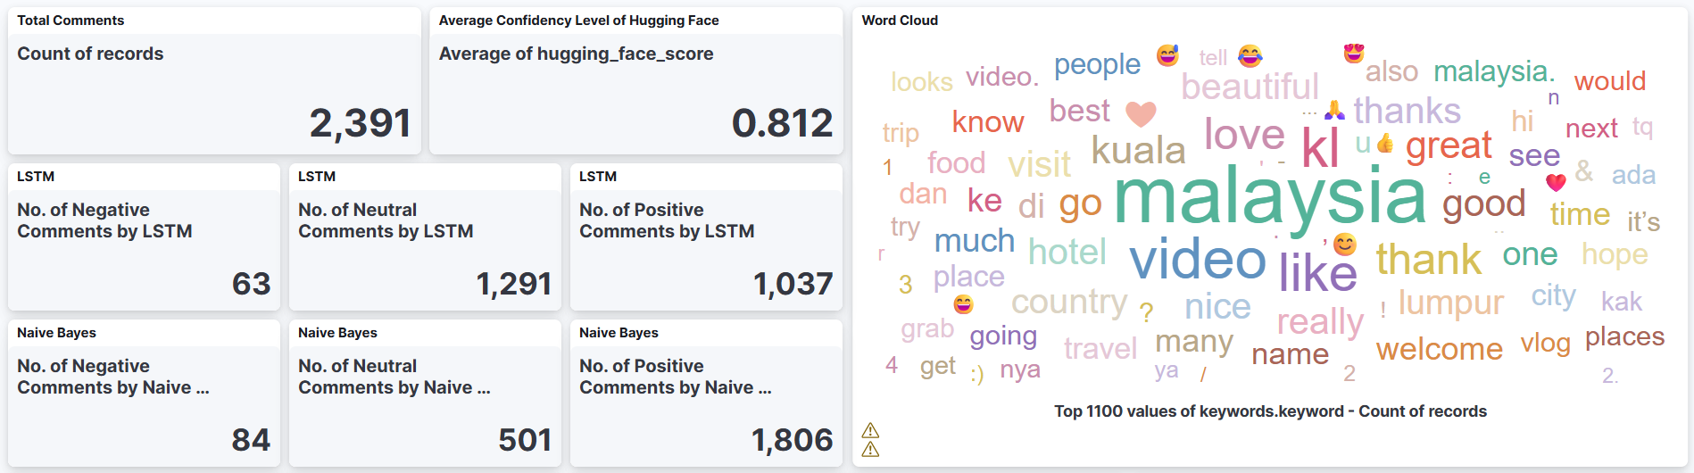
5.0 Analysis & results
5.2 visualizations

Slide 11
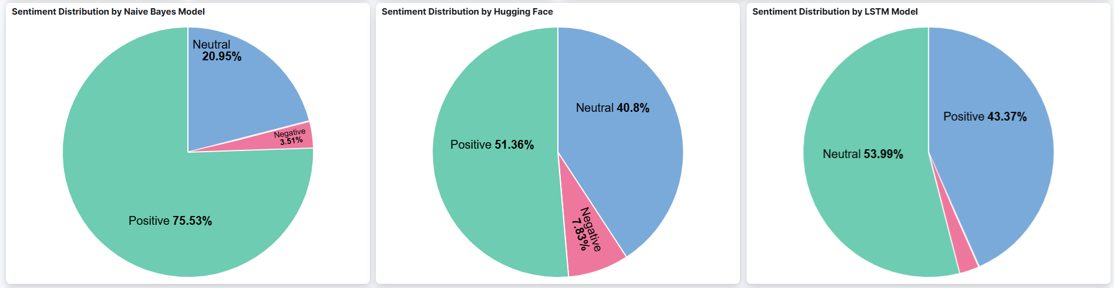
5.0 Analysis & results
5.2 visualizations

Slide 12
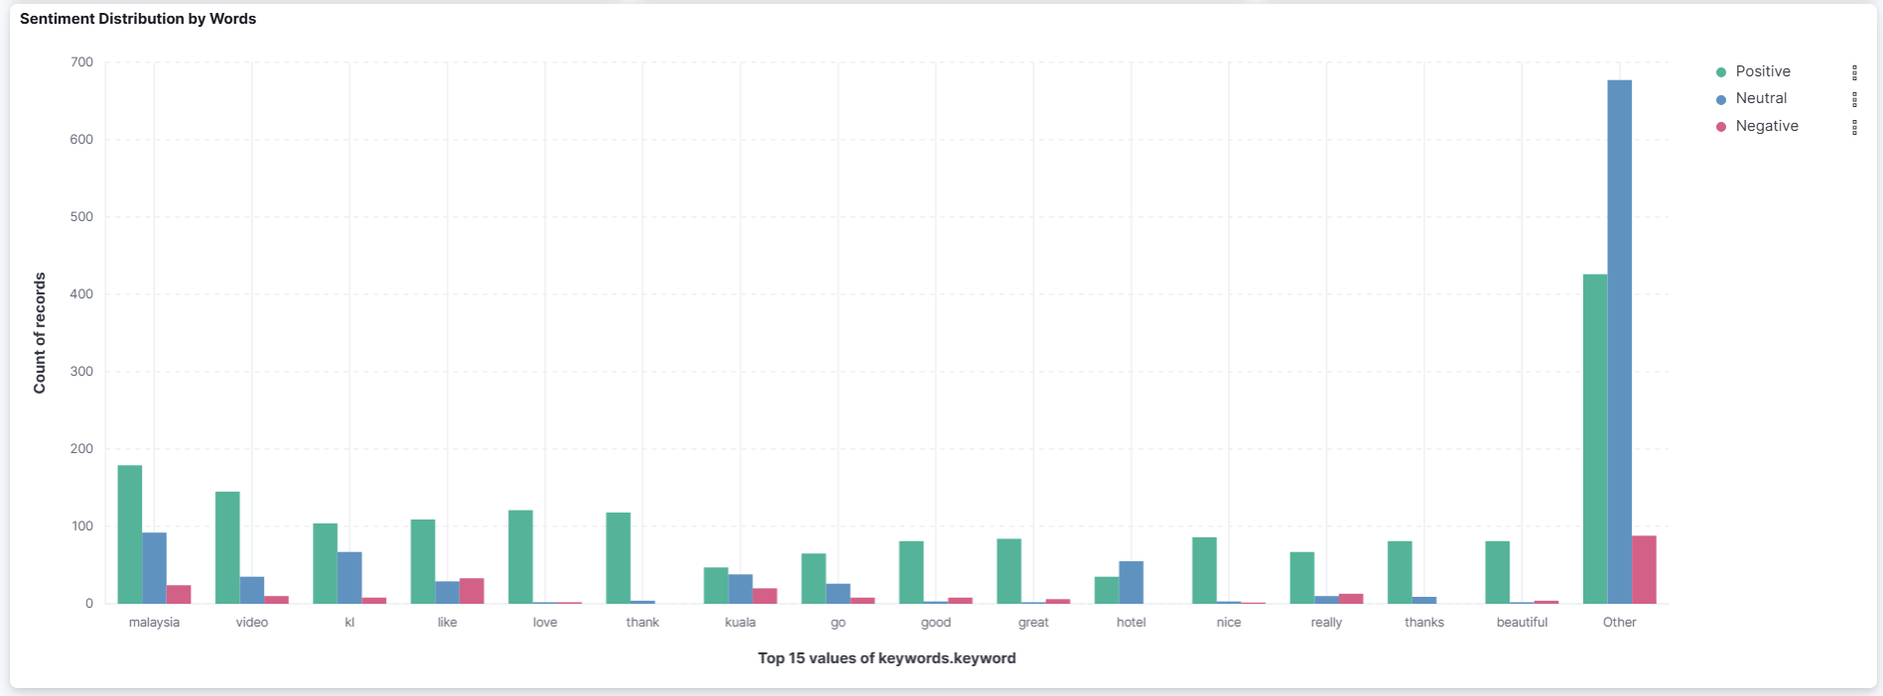
5.0 Analysis & results
5.2 visualizations

Slide 13
5.0 Analysis & results
5.3 insights
🌟 Overall Sentiment
The majority of comments are positive, especially as indicated by the Naive Bayes model (75.53%)
Suggests an appreciative, encouraging, and affirming audience tone
⚖️ Model Sentiment Variations
Naive Bayes: More optimistic, high positivity
Hugging Face & LSTM: Show higher neutrality, implying greater model sensitivity
Insight: Model selection influences sentiment interpretation, which is crucial for decision-making
🇲🇾 Keyword & Contextual Insight
Frequent positive keywords: Malaysia, KL, love, thank, beautiful
Reflects national pride, interest in local tourism, and positive audience engagement

Slide 14
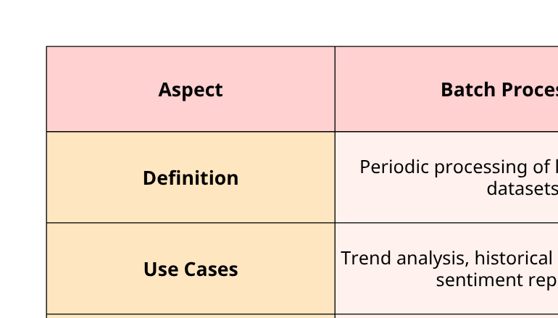
6.0 Optimisation & Comparison

Slide 15
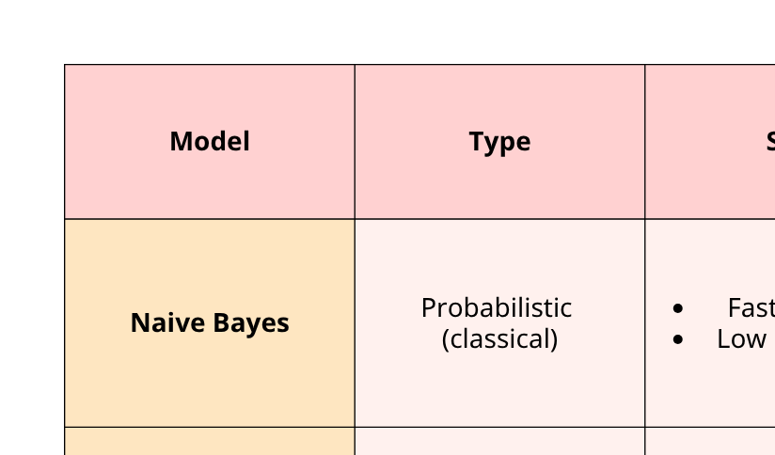

Slide 16
7.0 Conclusion & Future Work
Developed a real-time sentiment analysis pipeline for YouTube travel comments on Malaysia using Kafka, Spark, Elasticsearch, Kibana in a Dockerized setup.
Transformer model (Hugging Face) gave the most accurate and balanced sentiment results compared to Naive Bayes and LSTM.
Analysis showed a positive public perception of Malaysian tourism with frequent keywords like Malaysia, love, beautiful, thanks.
Real-time Kibana dashboard effectively visualized trends for actionable insights in tourism marketing.
Future improvements:
Extend to other platforms: Twitter, Instagram, TripAdvisor.
Include multilingual support (Malay, Mandarin).
Optimize real-time inference via TensorFlow Serving or TorchServe.
Explore Aspect-Based Sentiment Analysis (ABSA) for deeper insight into specific travel aspects.

Slide 17
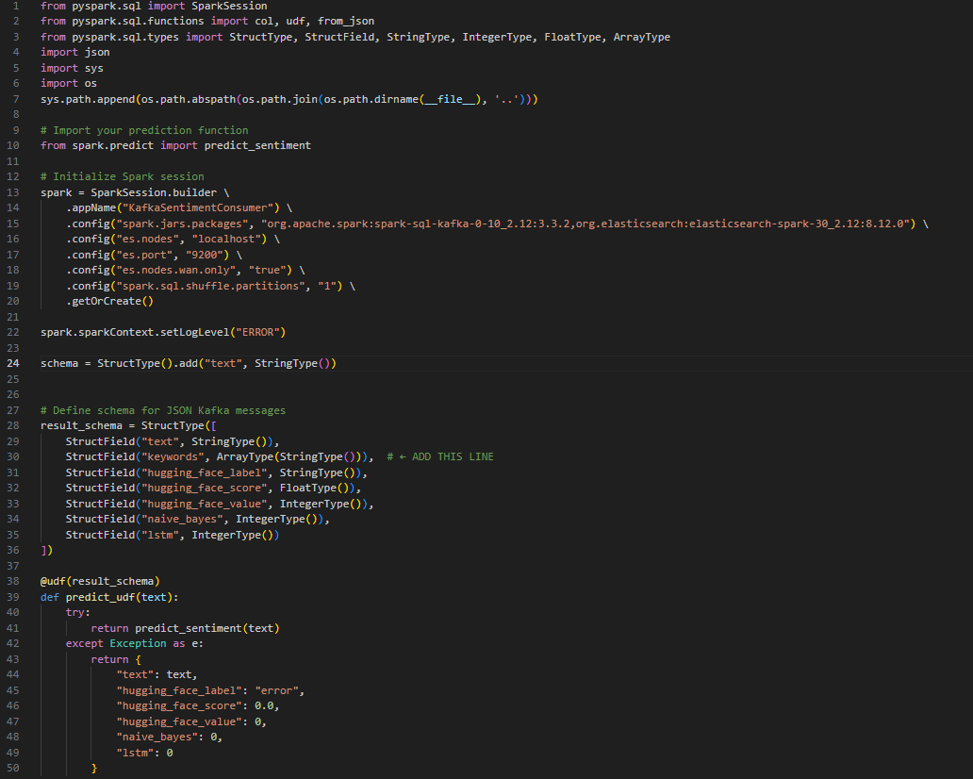
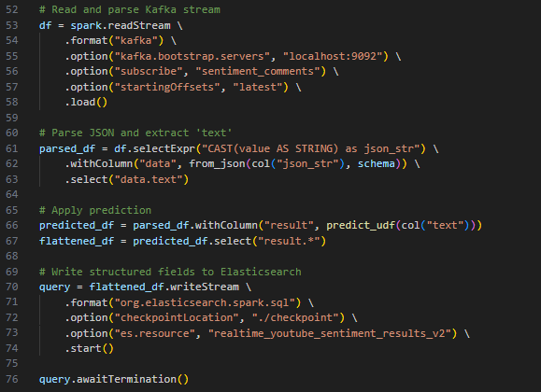
code snippets
spark_consumer.py

Slide 18
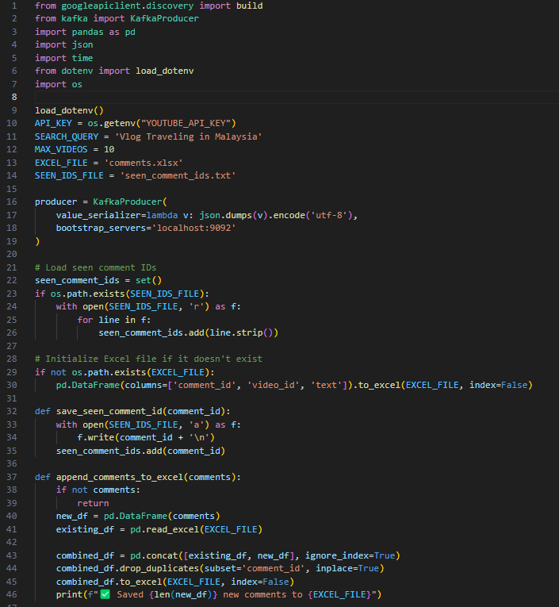
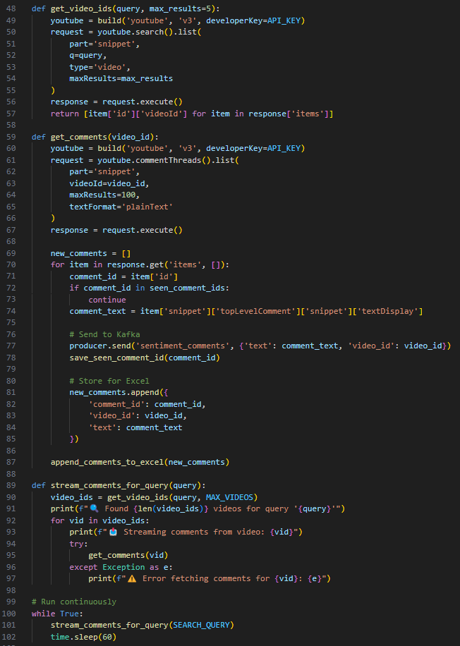
code snippets
youtube_producer.py

Slide 19
Thank
You

