Slide 1
HIGH PERFORMANCE DATA PROCESSING · SECP3133 · PROJECT 2
Real-Time Sentiment Analysis
using Apache Spark and Kafka
Touch 'n Go eWallet · Google Play Reviews
Ahmad Ziyaad bin Mohd Abbas · A23CS0206 | Universiti Teknologi Malaysia, Faculty of Computing

Slide 2
INTRODUCTION
Why Sentiment Analysis, Why Real-Time?
Organizations need to understand public opinion the moment it's posted and not after a weekly report.
1
Collect
Real Malaysian-relevant review data at scale
2
Classify
Positive / Negative / Neutral sentiment automatically
3
Stream
Process incoming reviews continuously, not in batches
4
Visualize
Surface trends through an interactive dashboard
Our system: scrape → clean → classify → stream → store → dashboard
2

Slide 3
DATA ACQUISITION
Data Source: Touch 'n Go eWallet Reviews
Why this app?
Collection Method
28M+ Malaysian users can easily reaches 10,000 reviews
Financial app → users write emotionally charged, opinionated reviews
Satisfies the brief's single primary data source requirement
Star rating doubles as a free initial sentiment label
Tool
google-play-scraper (Python)
Volume
10,000 reviews
Sort
Most Relevant → fallback to Newest
Why this sort
Surfaces longer, substantive reviews
Labeling
1-2★ neg · 3★ neutral · 4-5★ pos
3

Slide 4
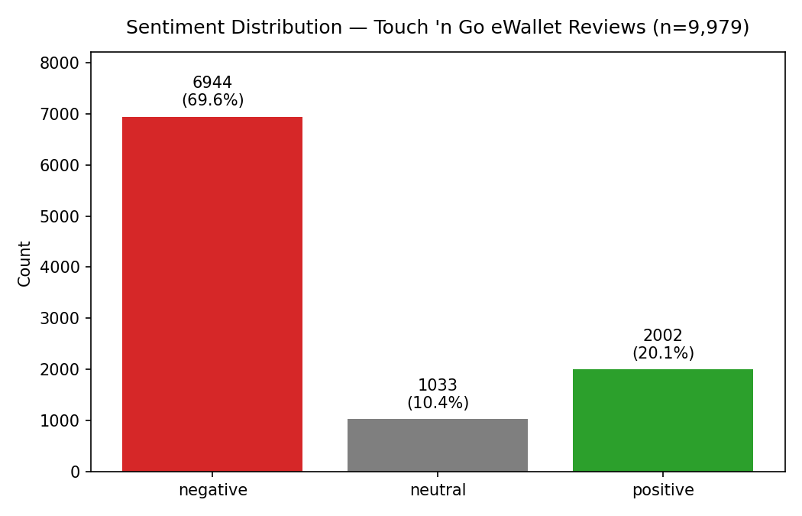
DATA ACQUISITION
A Real Finding: Star Ratings Skew Negative Here
What we found
69.6% negative, 10.4% neutral, 20.1% positive which is not the 'mostly 5-star' pattern typical of app stores
Most Relevant sort surfaces detailed complaints over quick praise
Neutral (3★) is structurally rare and the hardest class to classify, even for humans
We address this with class weighting in training, not data manipulation
4

Slide 5
SYSTEM DESIGN
End-to-End Pipeline Architecture
→
→
→
→
→
Scrape
Clean
Train
Stream
Store
Visualize
google-play-scraper
NLTK preprocessing
Naive Bayes vs LSTM
Kafka → Spark
Elasticsearch
Plotly dashboard
10,000
9,979
2
3
reviews collected
after cleaning
models compared
sentiment classes
5

Slide 6
DATA PREPARATION
Text Preprocessing Pipeline
1
Lowercase & strip URLs/mentions
Example transformation
RAW
2
Remove punctuation & numbers
"App keeps CRASHING!! Can't login, useless 😤"
3
Tokenize into words
CLEANED
"app keep crash cant login useless"
4
Remove English stopwords
5
Result: 9,979 / 10,000 reviews retained after cleaning + deduplication
Lemmatize (crashing → crash)
Star rating mapped to sentiment: 1-2★ negative · 3★ neutral · 4-5★ positive
6

Slide 7
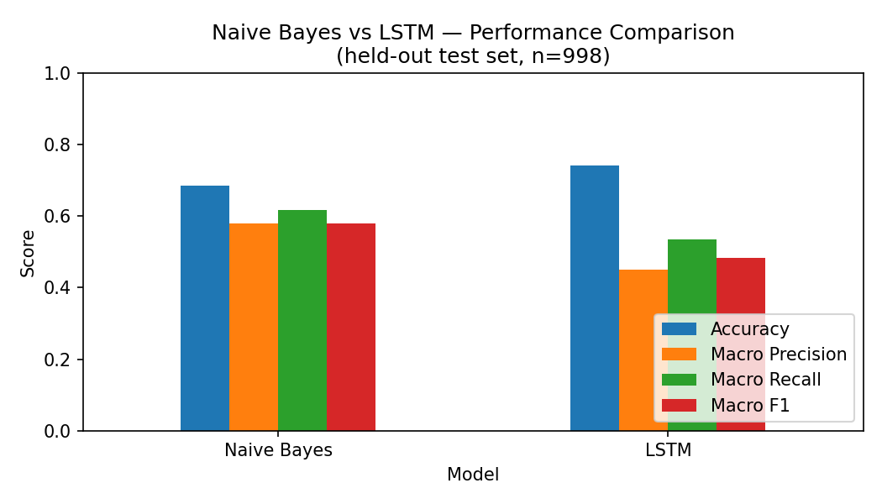
MODEL DEVELOPMENT
Naive Bayes vs LSTM — Held-Out Test Set
Metric
Naive Bayes
LSTM
Macro F1
0.580
0.484
Accuracy
0.684
0.742
Train time
~0.01s
~25s
Predict (998 rows)
0.001s
1.35s
Naive Bayes selected for deployment, better Macro F1, dramatically faster, and (critically) actually predicts the neutral class
7

Slide 8
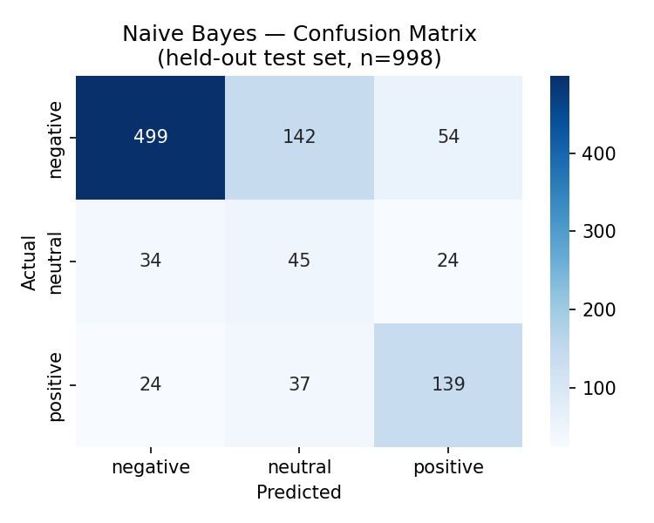
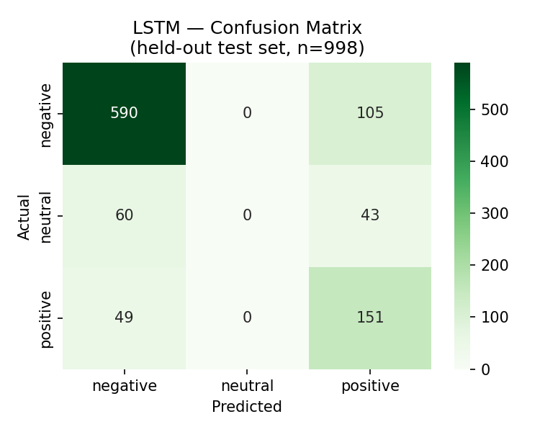
MODEL DEVELOPMENT
Why Naive Bayes Wins: The Neutral Class
Naive Bayes correctly identifies 45 of 103 neutral reviews (44%). LSTM identifies 0 but it never once predicts "neutral", regardless of class weighting.
8

Slide 9
MODEL DEVELOPMENT
A Genuine Methodological Finding
Class-weighting recipes don't transfer cleanly across model families
PROBLEM
Standard 'balanced' class_weight applied to LSTM caused it to collapse when predicting only the majority class (negative). Macro F1 fell to 0.27.
DIAGNOSIS
We trained the identical architecture with NO weighting at all. It trained normally proving the weighting mechanism itself, not the data or architecture, was destabilizing gradient descent.
FIX
Square-root-dampened sample weights + extended training patience let the optimizer escape the majority-class shortcut. Macro F1 rose to ~0.48.
9

Slide 10
STREAMING PIPELINE
Real-Time Classification with Kafka & Spark
→
→
→
Producer
Kafka Topic
Spark Structured
Streaming
Live Output
Sends reviews to Kafka topic
at a controlled rate
tng_reviews
buffers incoming messages
Consumes, parses JSON,
applies trained model
Classified sentiment
per review, in real time
Why a broadcast variable?
The trained Naive Bayes model is loaded once and broadcast to all Spark executors thus avoiding the cost of reloading it for every single incoming review.
Sample live classification
"used main ewallet suddenly dont allow quick payment..." → negative
"good app but please fix the slow update issue" → neutral
10

Slide 11
PERFORMANCE COMPARISON
Batch vs. Streaming: A Real Throughput Tradeoff
BATCH MODE
STREAMING (Kafka + Spark)
9,979
3,000
reviews classified
reviews classified
0.20s
4.98s
total time
total time
49,686
636
reviews / second
reviews / second
Batch wins on raw throughput (~78×) because it has no per-message network round-trip or micro-batch scheduling overhead. Streaming wins on latency where insights are available within seconds of a review being posted, not after the next scheduled job.
11

Slide 12
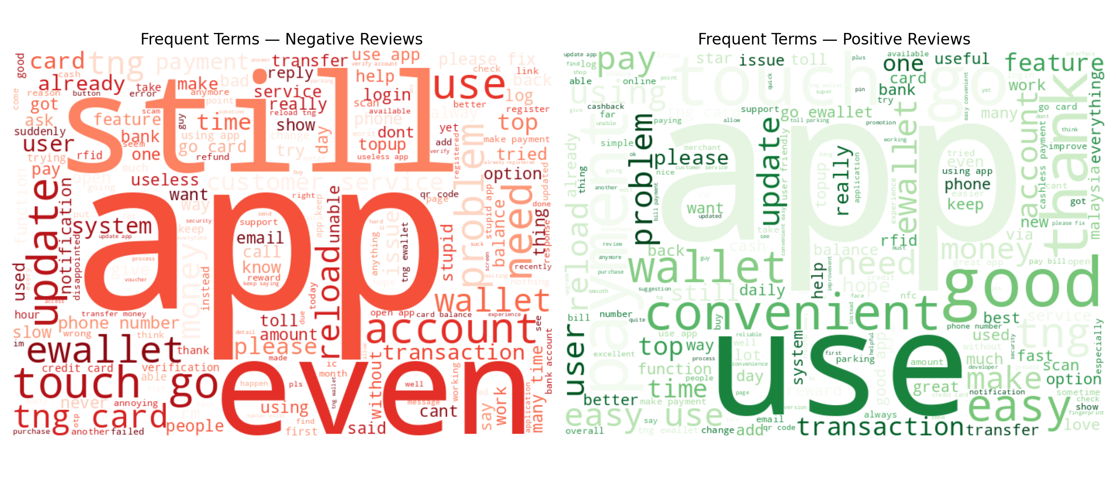
VISUALIZATION
Storage & Interactive Dashboard
Elasticsearch Index
Documents stored
9,979
Negative (predicted)
5,559
Neutral (predicted)
2,420
Positive (predicted)
2,000
Dashboard built with Plotly (interactive hover/zoom) — sentiment pie chart, time-series trend, and word clouds, satisfying the brief's visualization requirements without a Kibana/ngrok networking dependency.
Suggested by Section 10 alongside Kibana — Matplotlib, Seaborn, Plotly
12

Slide 13
CONCLUSION
What We Built, What We Learned
A complete, working real-time sentiment pipeline — scrape, clean, train, stream, store, visualize
Naive Bayes outperforms LSTM on this dataset — faster, and genuinely usable across all 3 classes
Class imbalance and model-family interactions are real engineering problems, not footnotes
Streaming trades raw throughput for low latency — a deliberate, measurable tradeoff
Thank you
Questions welcome

