Slide 1


Faculty of Computing | SECP3133
YouTube Sentiment Analysis:
Cost of Living in Malaysia
High Performance Data Processing Project
Afiq Danial
A23CS0117
Adib Zikri
A23CS0205
Dheshieghan
A23CS0072
LECTURER: PROF. MADYA. TS. DR MOHD SHAHIZAN BIN OTHMAN

Slide 2


Background & Context
Social media platforms generate vast amounts of unstructured public opinion daily. YouTube's comment section provides spontaneous, raw feedback on national issues.
This project focuses on identifying sentiments regarding the Cost of Living in Malaysia (2025-2026), capturing public concerns about inflation, migration, and quality of life at scale.

Slide 3
Primary Data Sources
Scraped from 6 High-Engagement YouTube Videos:
Video Title Reference | Context & Focus
Cost of Living in Malaysia per Month | Focuses on relocation expenses for expat families.
Singapore vs Malaysia: 2026 Comparison | Cost analysis between neighboring economies.
INFLASI: Singapura Gusar, Malaysia Henti Eksport | Economic friction and supply chain disruptions.
Pros & Cons of Living in KL (2025) | Affordability, tax-friendly policies, and drawbacks.
Pros & Cons of Living in Malaysia | Examines the broad lifestyle adjustments, visa considerations, and everyday pros and cons of making in Malaysia.
Cost of Living in Malaysia 2026: The Real Numbers | Focusing on budgeting for each lifestyles.
Total raw dataset: 5,388 records including metadata.

Slide 4
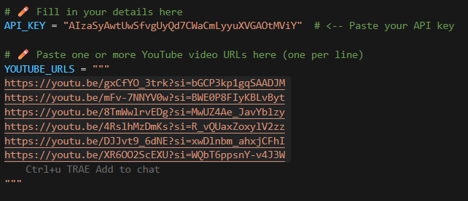
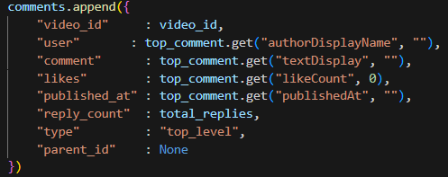
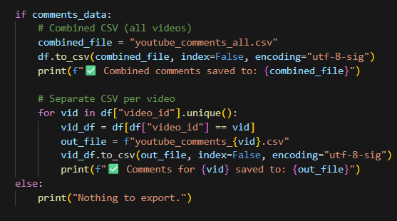
Primary Data Sources

Slide 5

Preprocessing Pipeline
Noise Removal: HTML entity decoding, URL stripping, @mention removal, and digit collapsing.
Tokenization: Splitting cleaned text into individual word tokens via NLTK word_tokenize().
Stop Word Removal: Combining 198 English and 1,057 Malay stop words using the Malaya library.
Lemmatization: Base dictionary form reduction (English only) via spaCy en_core_web_sm.

Slide 6
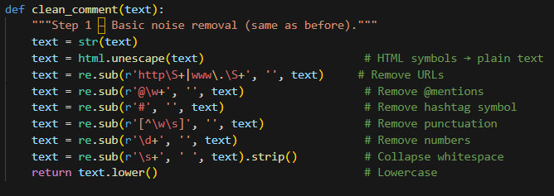
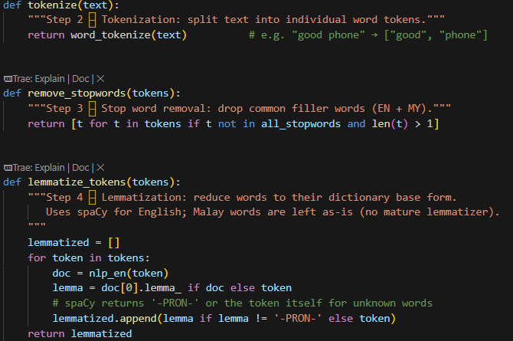
Preprocessing Pipeline

Slide 7



Sentiment Modeling Approach
SVM Classifier
LSTM Neural Network
Uses TF-IDF Vectorization with 5,000 features. Finds the optimal hyperplane in high-dimensional sparse space.
A type of RNN designed to learn long-range sequential dependencies. Processes text as ordered tokens to capture semantics.
•
10,000 word vocabulary.
•
Max sequence length: 100.
•
Dense 3-class categorical output.
Finding: Prone to overfitting on small datasets.
Efficient for short text data with distinct keywords.

Slide 8
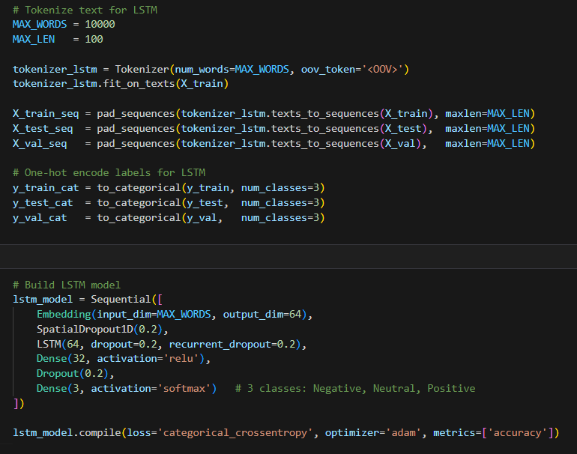
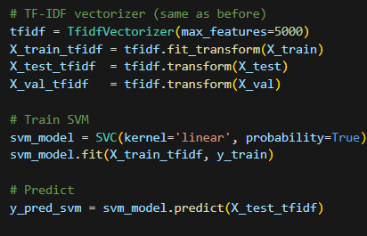
Sentiment Modeling Approach

Slide 9
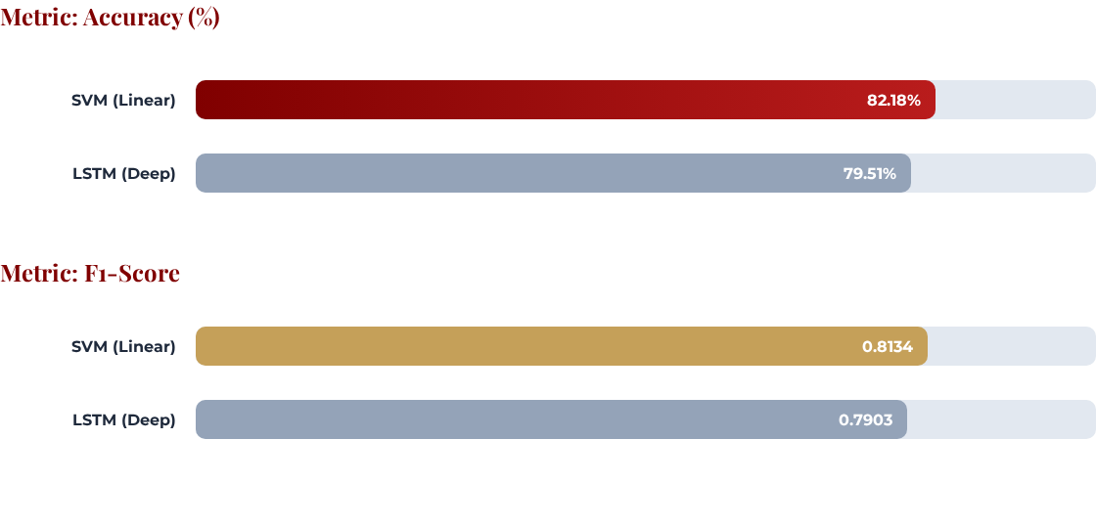
Model Comparison: SVM Wins
SVM shows superior generalization and lower computational overhead for real-time inference.

Slide 10
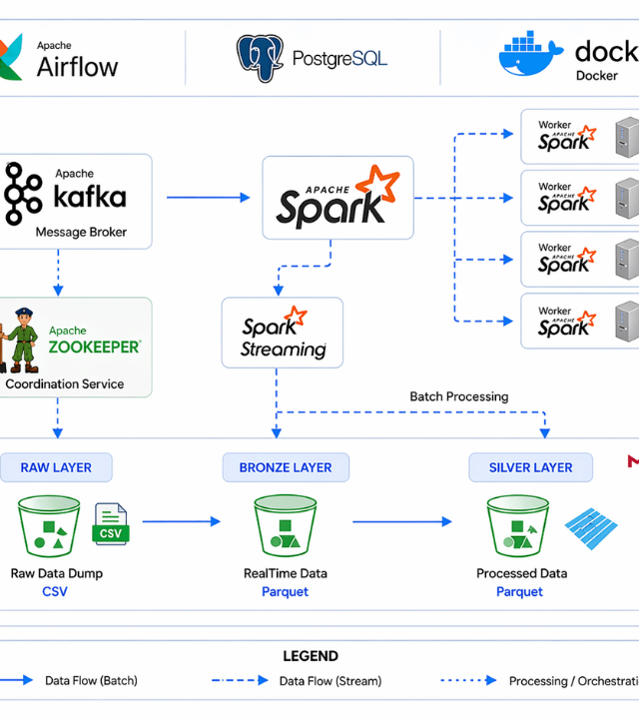
System Architecture
ELK + Kafka/Spark Pipeline
The system follows a classic Lambda-style streaming architecture composed of five distinct layers:
Ingestion: Apache Kafka decouples producers from consumers to handle data spikes.
Processing: Spark Structured Streaming performs real-time micro-batch classification.
Storage: Elasticsearch provides full-text indexing and near-instant aggregations.
Visualization: Kibana creates interactive dashboards and live sentiment feeds.

Slide 11
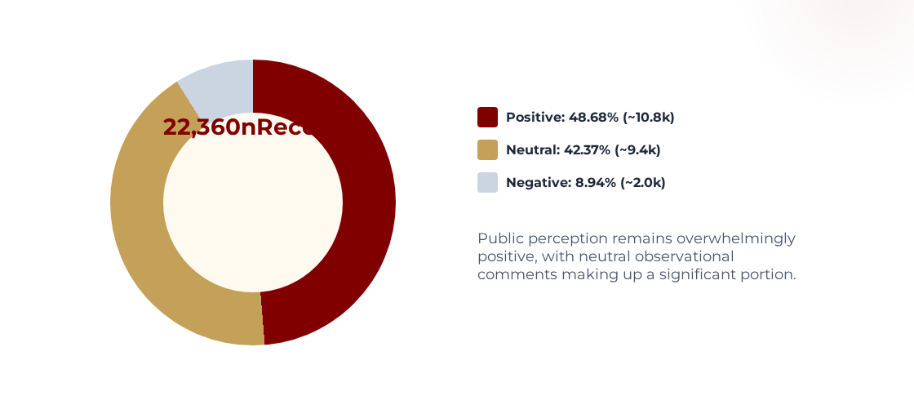
Sentiment Analysis Results

Slide 12
Performance Benchmarking
Optimization: Batch vs. Streaming Mode
Performance Metric | Batch Mode | Streaming Mode | Finding
Processing Time (s) | 1.452 s | 6.619 s | Batch is 4.6x Faster
Throughput (Rec/s) | 3,078.80 | 675.36 | Optimized Bulk Ops
CPU Usage (%) | 54.5 % | 2.0 % | Streaming is Less Intensive
Model Accuracy | 0.923 | 0.908 | Consistency Maintained
Micro-batching is essential for Spark to amortize TF-IDF transform overhead and reach higher throughput.

Slide 13
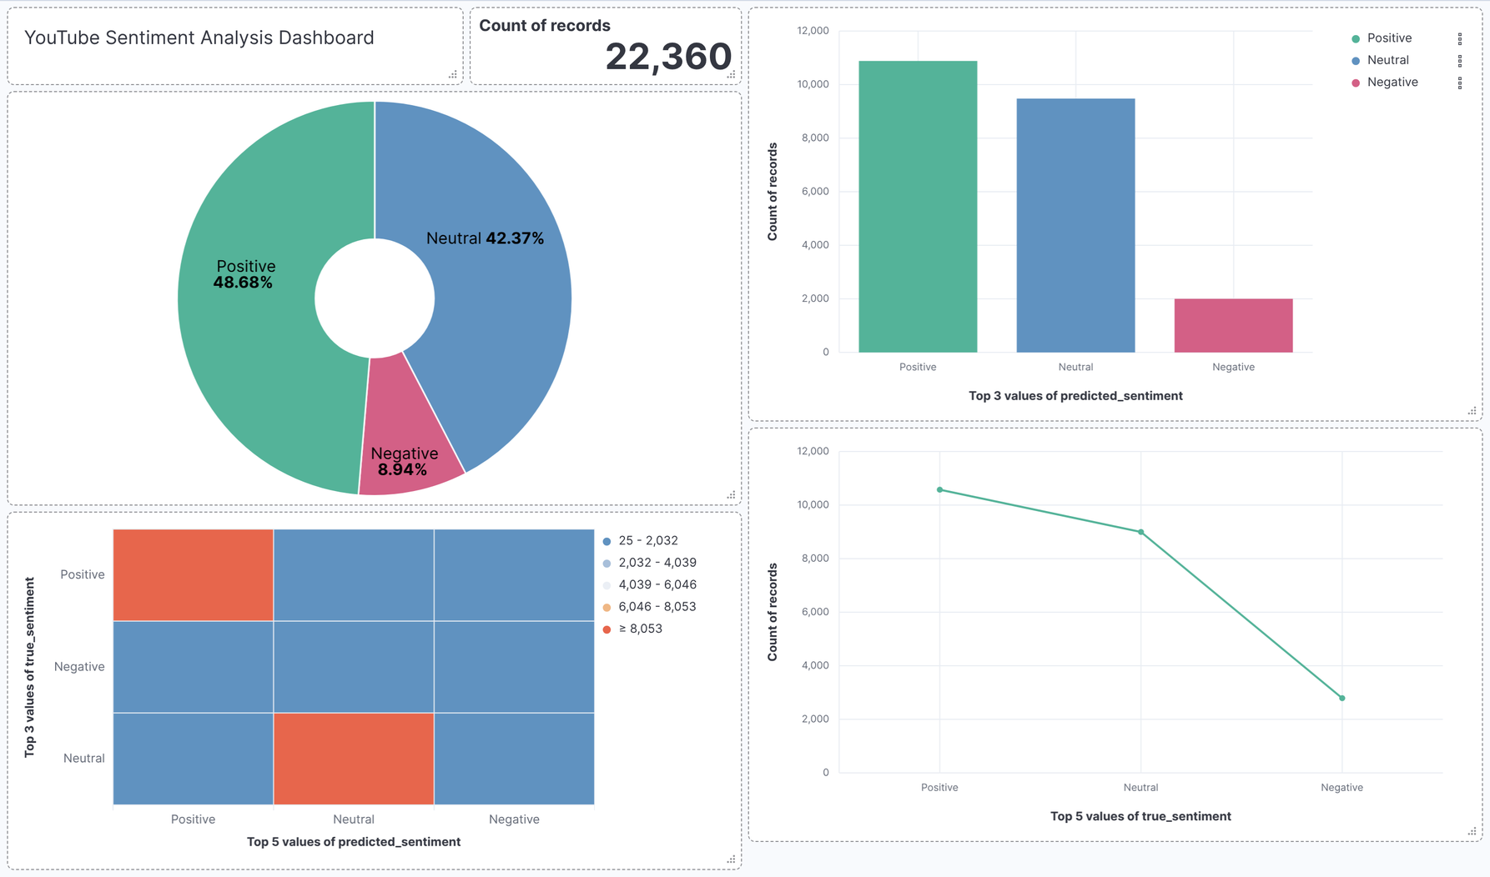
DASHBOARD

Slide 14

Thank You

Slide 15




Image Sources
https://chancellery.utm.my/wp-content/uploads/sites/23/2020/01/LOGO-UTM.png
Source: corporate.utm.my
https://img.magnific.com/premium-photo/kuala-lumpur-skyline-with-petronas-twin-towers-dusk_946209-18453.jpg?semt=ais_hybrid&w=740&q=80
Source: www.magnific.com
https://cdn.prod.website-files.com/68da32b2041c593b0511a582/68e51ad16872234577515bf4_nlp.png
Source: kili-technology.com
https://datavidhya.com/_next/image/?url=https%3A%2F%2Fdatavidhya-revamp.s3.amazonaws.com%2Fprojects%2Fimages%2F9.png&w=3840&q=100
Source: datavidhya.com

