Slide 1




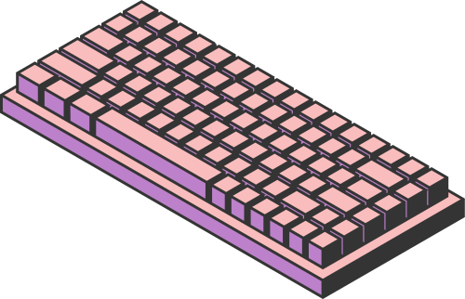
STUDIO SHODWE
HOME
SERVICE
ABOUT US
CONTACT US
PRESENTATION
OPTIMIZING HIGH-PERFORMANCE DATA PROCESSING FOR LARGE-SCALE WEB CRAWLERS
Presented By:
TIEW CHUAN RONG A22EC0112
DANIAL HARRIZ BIN MOHD ASINEH @MOHD ASNEH A22EC0152
CHAI YU TONG A22EC0145
KOH SU XUAN A22EC0060
Page 01

Slide 2

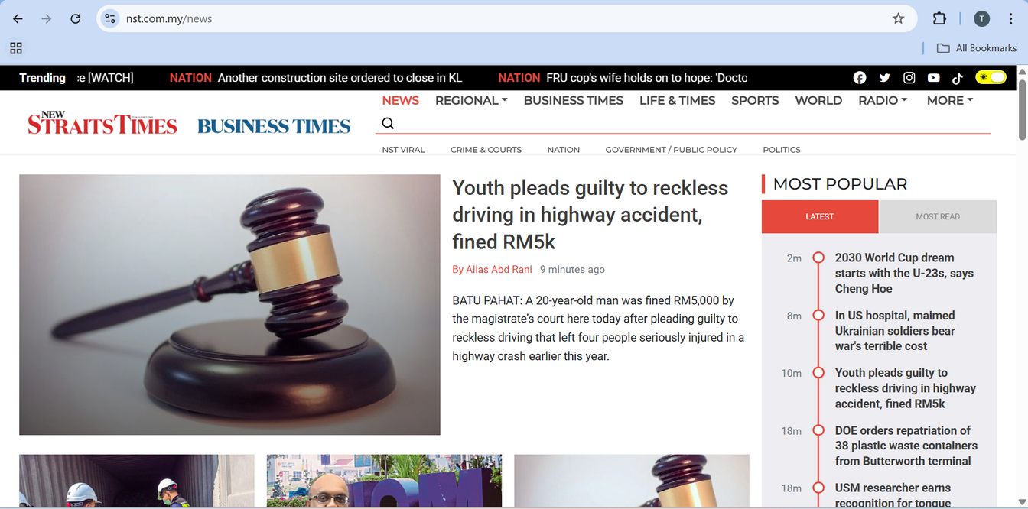


STUDIO SHODWE
HOME
SERVICE
ABOUT US
CONTACT US
INTRODUCTION
This project focuses on using web scraping techniques to extract news articles from an established Malaysian online news portal by leveraging a high-performance scraping pipeline. The end goal is to gather relevant news data for further processing and performance analysis.
The website that is targeted is the New Straits Times (NST) under the “News” section. I
Page 02

Slide 3
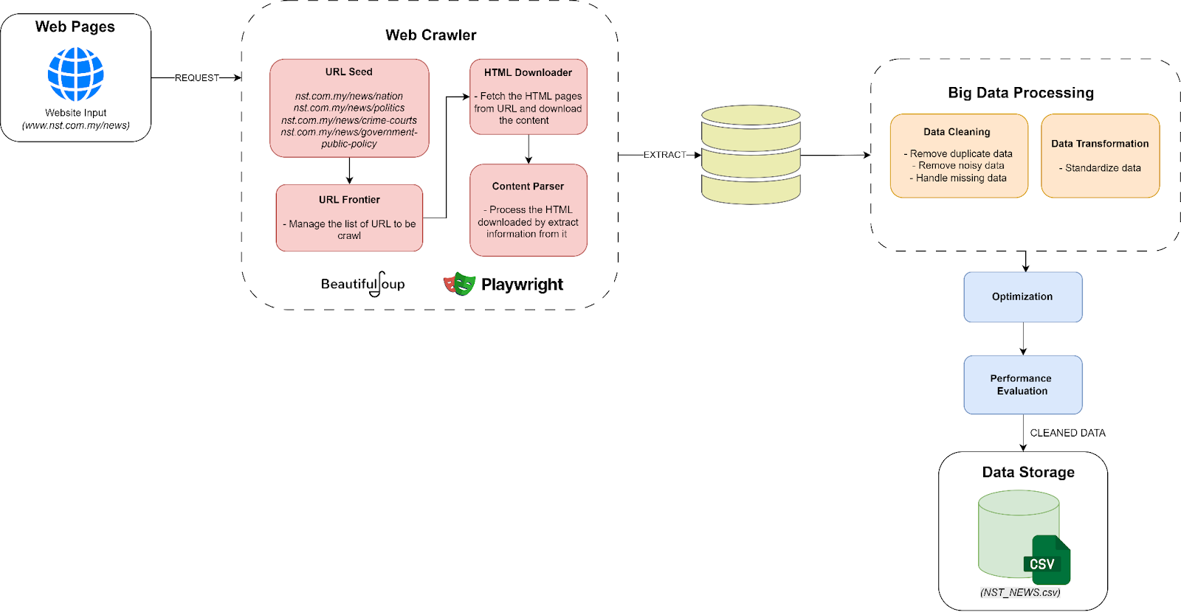

SYSTEM ARCHITECTURE
STUDIO SHODWE
HOME
SERVICE
ABOUT US
CONTACT US
Page 07

Slide 4
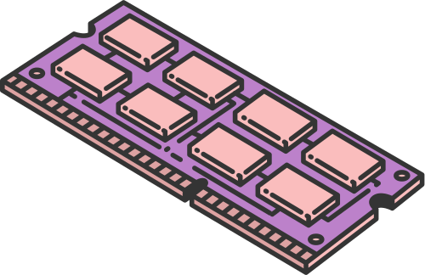
CENTRAL PROCESSING UNIT (CPU)
STUDIO SHODWE
WEB SCRAPPING
HOME
SERVICE
ABOUT US
CONTACT US
The data that will be scrape
Title: The headline/main title of the article.
URL: The full web link/URL of the article.
Teaser: A short description from the article content.
Category: The label that describes the main topic area of the article.
Strategy using:
Pagination
Asynchronous Processing
Rate Limiting and Random Delays
The category that we scrape are:
Crime & Courts
Nation
Government/Public Policy
Politic
The library used for web scraping are:
Beautiful Soup
Playwright
Asyncio
Page 03

Slide 5
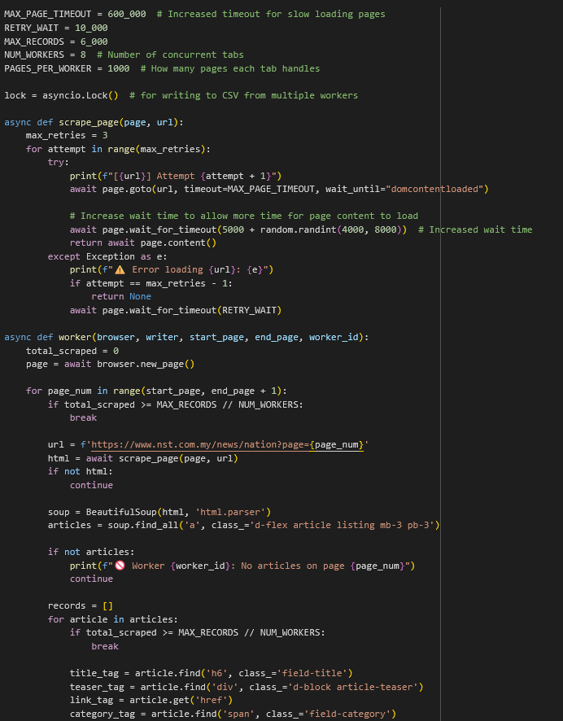
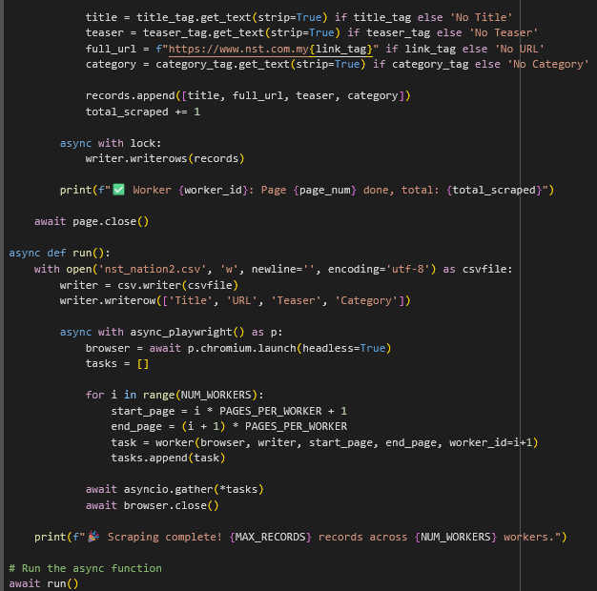
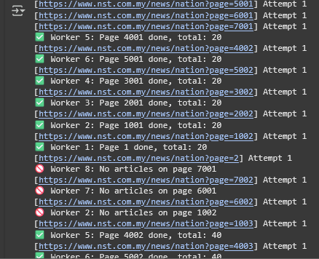
CENTRAL PROCESSING UNIT (CPU)
STUDIO SHODWE
WEB SCRAPPING
HOME
SERVICE
ABOUT US
CONTACT US
Page 03

Slide 6

STUDIO SHODWE
HOME
SERVICE
ABOUT US
CONTACT US
DATA PROCESSING
Pandas are selected as our tool for data processing. The process of data processing are:
Load data
Handle duplicate data
Handle missing data
Clean teaser column
Getting place from teaser column
Standardize place name
Extract date from URL
Save it in csv
Page 04

Slide 7




STUDIO SHODWE
HOME
SERVICE
ABOUT US
CONTACT US
OPTIMIZATION TECHNIQUE
Pandas
Modin
Polars
Pandas run in a single process and on a single thread only.
Polars use parallel processing, it uses all CPU cores in the computer to process a lot of data at same time.
Modin uses Ray or Dask, which break work into chunks and run them across the CPU core for multiprocessing.
Page 05

Slide 8

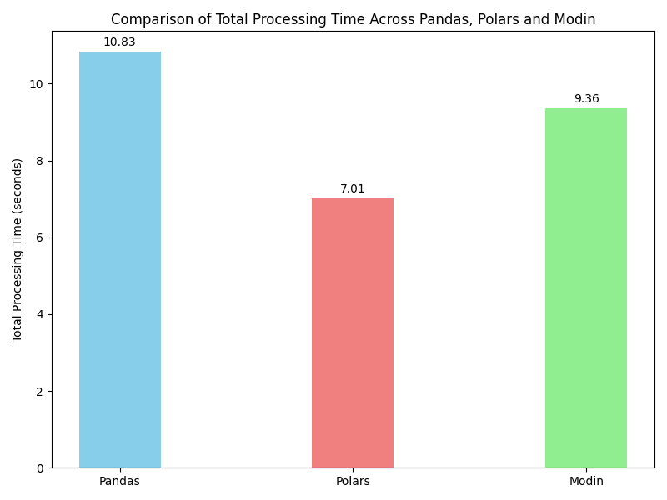
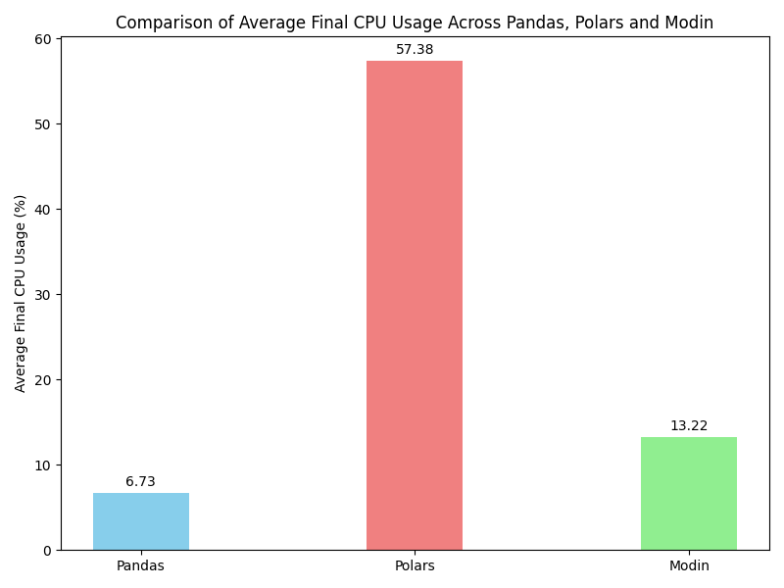

PERFORMANCE EVALUATION
STUDIO SHODWE
HOME
SERVICE
ABOUT US
CONTACT US
COMPARISON OF TOTAL PROCESSING TIME ACROSS PANDAS, POLARS AND MODIN
COMPARISON OF AVERAGE FINAL CPU USAGE ACROSS PANDAS, POLARS AND MODIN
Page 08

Slide 9

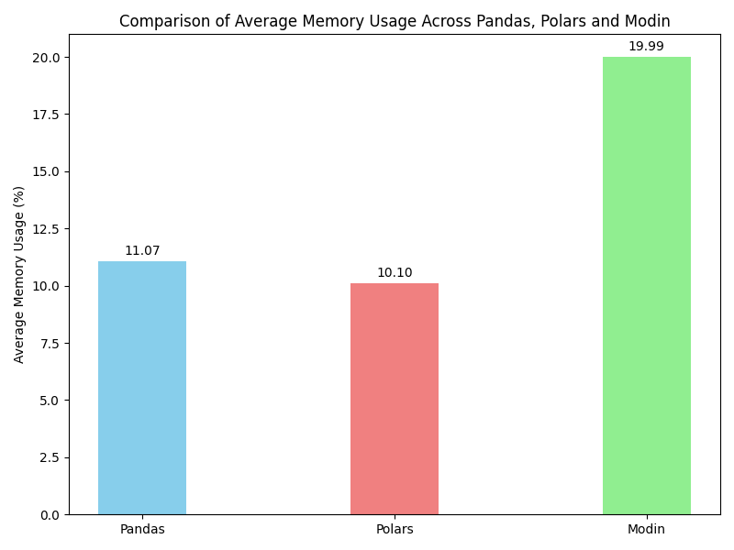
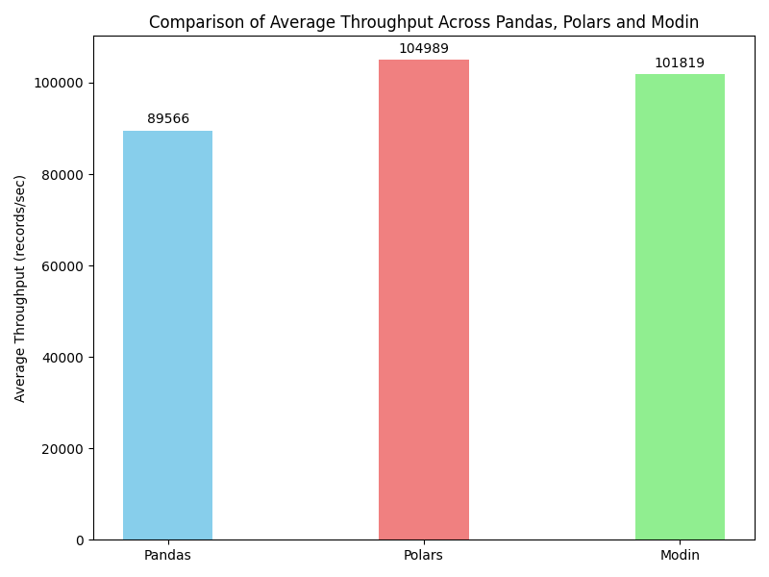


PERFORMANCE EVALUATION
STUDIO SHODWE
HOME
SERVICE
ABOUT US
CONTACT US
COMPARISON OF AVERAGE MEMORY USAGE ACROSS PANDAS, POLARS AND MODIN
COMPARISON OF AVERAGE THROUGHPUT ACROSS PANDAS, POLARS AND MODIN
Page 09

Slide 10



STUDIO SHODWE
HOME
SERVICE
ABOUT US
CONTACT US
CONCLUSION
This project had successfully design a high-performance web scraper using Playwright, Beautiful Soup, and Asyncio to collect over 110,000 news articles from the New Straits Times website. The raw data collected was cleaned and process using Pandas, Polars and Modin. While Polars and Modin shows the importance of optimize the performance of data processing for large dataset. Overall, the project highlights the importance of using optimized tools and parallel processing techniques for efficient large-scale data collection and analysis.
Page 06

Slide 11







STUDIO SHODWE
HOME
SERVICE
ABOUT US
CONTACT US
THANK YOU
+123-456-7890
WWW.REALLYGREATSITE.COM
123 ANYWHERE ST., ANY CITY
Page 10

